Slide 2
Molecular Dynamics simulations of sputtering and reflection for boron surfaces
Institute of Ion Physics and Applied Physics University of Innsbruck
Shokirbek Shermukhamedov
Michael Probst
WP PWI meeting March 2024, Prague

Slide 3
Background
One establishes a thin layer of B (“wall conditioning”) on W using B₂H₆ (diborane) and a glow discharge
This layer reacts with oxygen and removes it from the plasma region
It also incorporates deuterium etc. and is successively eroded
Eroded B is transported through the plasma and redeposited
This leads to the formation of layers of mixed compounds, (W-B-O-D ...)
… which are then themselves being eroded …
The concrete used in ITER contains boron as well
Boron absorbs neutrons (¹⁰B → ¹¹B)
Be would also catch O, albeit less strongly than B
https://www.iter.org/node/20687/coat-boron-capture-impurities

Slide 4
Investigating Sputtering, Reflection and Adsorption on Surfaces containing Boron by MD
Surfaces:
B
B₂O₃
B/W (B₂W, BW and BW₂ )
Sputtering with:
D, B, Ar (Kr, Xe ...)
(The seeding gases have not been started yet)
Last outlook November 2024:
Consolidating and publishing the B/D and B/B simulation data (with further dependencies)
B and O sputtering from B₂O₃ by D
B and W sputtering from B₂W, BW and BW₂ surfaces

Slide 5
Methods
Molecular dynamics simulations for sputtering (noncumulative, statistical) using
Neural network potential energy functions (NNP) trained by
Density functional theory calculations
Parametrical analysis (dependence on energies, angles, T ...)
of the Molecular Dynamics results: (trajectories):
Sputtering yields
Relative probabilities of sputtering/adsorption/retention
Rates,
Reaction mechanisms,
Surface energies

Slide 6
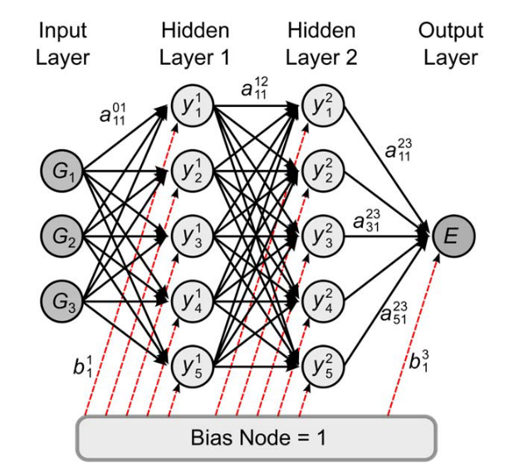
Neural Network Potential energy functions
Advantages:
Energies can be fitted to high accuracy with very small remaining errors compared to the underlying reference data.
The energies and forces NNPs can be calculated much faster than with electronic structure calculations.
No knowledge about the functional form of the PES is required.
Disadvantages:
Slower than using simple (BOP …) force fields.
Construction of NNPs requires substantial effort
Limited to systems containing only a few different chemical elements.
J. Behler Int. J. Quantum Chem., vol. 115, no. 16, pp. 1032–1050, 2015.

Slide 7
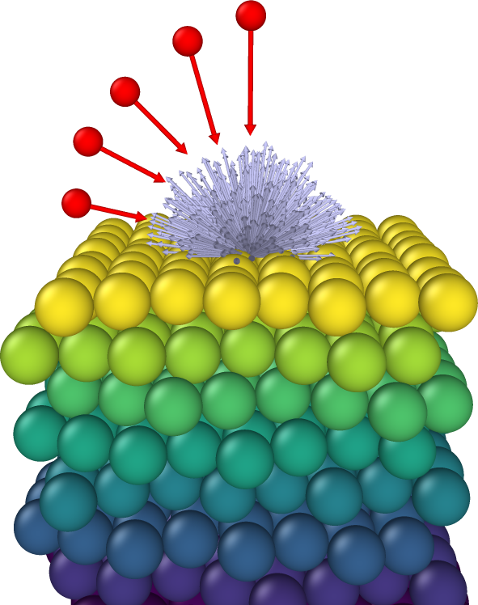
1) Boron surface sputtered by D
Always highest yields at 60°
For 30° there is a maximum at 120 eV
Reasonable agreement with experimental data from Hechtl92 and theoretical data from Yamamura95 (<100 eV)
Reasonable agreement with the Eckstein formula (theoretical)

Slide 8
Probabilities of Reflection Adsorption Retention
At lower energies, reflection and adsorption compete,
while at higher energies retention prevails.
For 60° impact angle most reflection and least retention

Slide 9
Distribution of the angles of sputtered B atoms
0°
30°
60°
No strong correlation with incoming angles.
For the 60° impact angle, the sputtering angle of B has a maximum at 40° for all energies.
For 0° and 30° higher energies cause a larger angle of the sputtered B atoms (in average)

Slide 10
Surface Binding Energy (SBE)
From the energy profile of sputtered boron atoms one can roughly estimate an effective SBE
The grey shaded area represents the normalized amount of sputtered boron atoms (yield) with a given energy.
The black line is a fit to the lognormal formula.
The estimated surface binding energy is 5.66 eV
$$E_{SB}=5.66 eV$$
$$Y\left(E\right) \sim A exp⁡\left[\frac{\ln\left(x\right)−E_{SB}}{σ}\right]$$

Slide 11
2) Sputtering of B and O from B₂O₃
B sputtering yields
D impact with energies of 25, 50, 75, 100, 150, and 200 eV with angles of 0, 30°, and 60°.
Highest yields at 60°.
At 30° the yield has a maximum at 150 eV.
All calculated values are less than those obtained when sputtering from a pure boron sample.
Different triangles represent different incident angles.
Eckstein curve is for sputtering from a pure boron surfaces.

Slide 12
2) Sputtering of B and O from B₂O₃
O sputtering
Yields increase ‘linearly’ for all energies and angles.
In contrast to B sputtering, perpendicular impact has greatest yields.

Slide 13
3) Sputtering by B (instead of D) on a B surface
$$E_{SB}=6.43 eV$$
Good agreement with existing sputtering data (which are limited in range)
Retention and adsorption compete with each other, almost no reflection.

Slide 14
Sputtering of B₂W, BW and BW₂ surfaces by D (preliminary results)

Slide 15
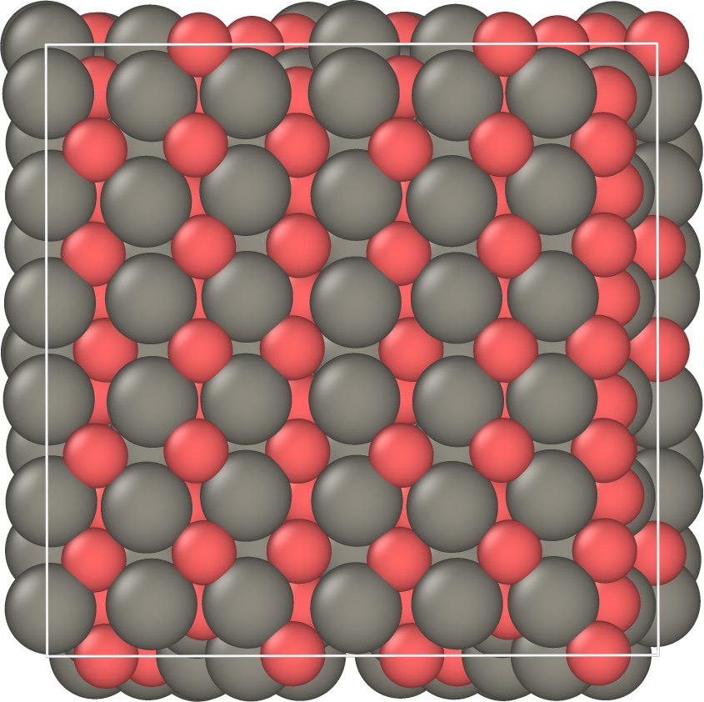
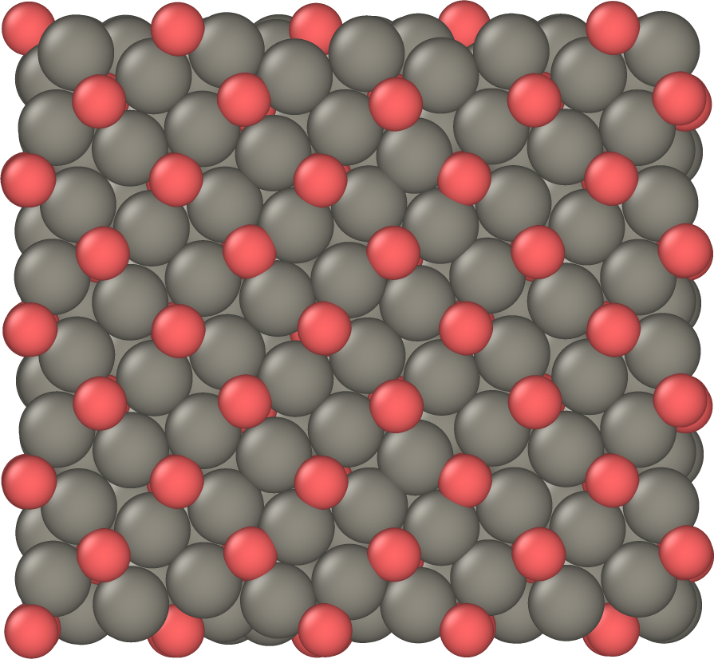
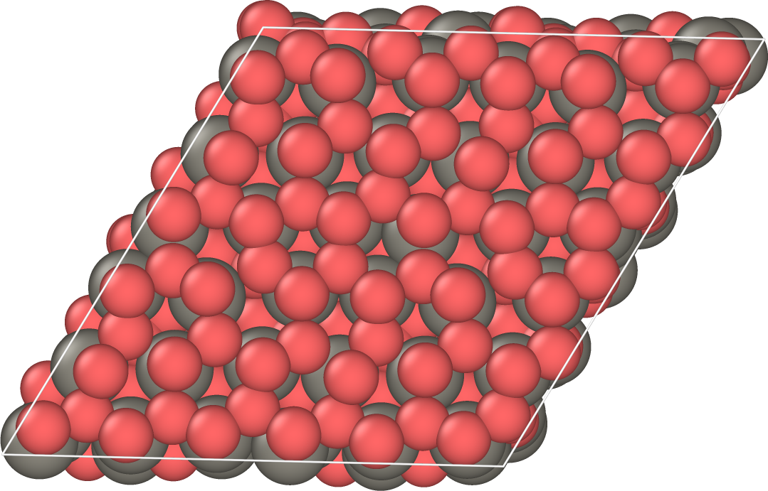
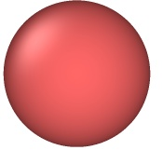
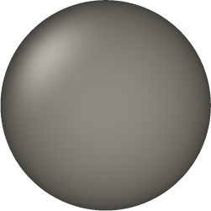
Surface structures
B₂W
BW
BW₂
B
W

Slide 16
Sputtering of B from the three surfaces by D
B sputtering
The sputtering yield of B is for all cases larger than in pure boron, likely due to the weaker bonds in boron-tungsten alloys.
The B₂W compound has the largest yield
The Eckstein curve is for sputtering from pure boron surfaces.

Slide 17
W sputtering
The sputtering yield of W is greater than in pure tungsten, again likely due to the relatively weaker bonds in boron-tungsten alloys.
The B₂W compound has the smallest yield

Slide 18
Reflection, Adsorption and Retention probabilities
A higher amount of boron atoms on the surface reduces retention probabilities while increasing adsorption probabilities.
At lower impact energies, reflection and adsorption are competing, while at higher energies retention prevails.

Slide 19
Conclusions / Outlook
We have developed potential energy functions and performed MD simulations in the same way as we did for surfaces with Be and W before.
The work on B and B₂O₃ (sputtering by D and B) is nearly complete
Simulations on the BW mixed surfaces and their analysis are still work in progress.

Slide 20
Conclusions / Outlook
We have developed potential energy functions and performed MD simulations in a similar way as we did for the Be/W systems.
Results for B and B₂O₃ work will be published soon
Simulations on the BW mixed surfaces and their analysis is in progress.
Thank you …

Slide 21
Estimated surface binding energy
ESB (eV):
B₂W = 4.26
BW = 2.68
BW₂ = 2.37

