Slide 1
AI-augmented SOL modelling for capturing impact of filaments on transport and PWI in mean field codes simulations
A. Glasser, D. Zarzoso (PI), E. Serre, F. Clairet, A. Jamann, G. Conway and SOLEDGE team

Slide 2
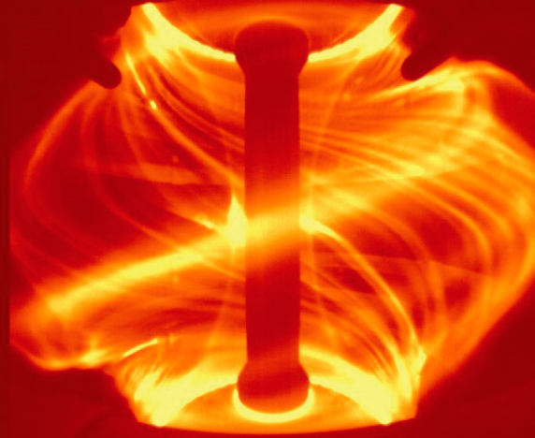
Challenges and motivation
Filamentary transport is crucial for understanding plasma-wall interactions and improving predictive modeling
Filaments and blobs are coherent density structures that influence cross-field transport and impact erosion and divertor heat loads
Standard transport models assume diffusive behavior
Γ_{n}​= −D​∂n/∂r,
but filaments contribute to convective transport
require new transport models
Garcia PPCF 2013
Naulin J. Plasma Phys. 2005
Manz, Physics of Plasmas 2020
https://www.iter.org/newsline/229/1229

Slide 3
Challenges and motivation
Filamentary transport is crucial for understanding plasma-wall interactions and improving predictive modeling
Filaments and blobs are coherent density structures that influence cross-field transport and impact erosion and divertor heat loads
Standard transport models assume diffusive behavior
Γ_{n}​= −D​∂n/∂r,
but filaments contribute to convective transport
require new transport models
Garcia PPCF 2013
Naulin J. Plasma Phys. 2005
Manz, Physics of Plasmas 2020
https://www.iter.org/newsline/229/1229
Filament measurements with reflectometry can provide statistics on their velocity, size and skewness introducing an effective diffusion coefficient
D_{eff​}=α⋅S⋅⟨v_{r}²​⟩^{1/2}⋅L_{c}​
Skewness measures asymmetry in fluctuation distribution, helping to identify filamentary transport. High positive skewness: presence of bursts in density, associated with outward-propagating blobs

Slide 4
Challenges and motivation
Filamentary transport is crucial for understanding plasma-wall interactions and improving predictive modeling
Filaments and blobs are coherent density structures that influence cross-field transport and impact erosion and divertor heat loads
Standard transport models assume diffusive behavior
Γ_{n}​= −D​∂n/∂r,
but filaments contribute to convective transport
require new transport models
Garcia PPCF 2013
Naulin J. Plasma Phys. 2005
Manz, Physics of Plasmas 2020
https://www.iter.org/newsline/229/1229
Objectives:
  Develop new AI tools for detecting and studying the dynamics of blobs and filaments
  in experimental databases supplemented by high-fidelity 2D turbulence simulations
  Introduce effective diffusion coefficients for 2D fluid modeling

Slide 5
Project timeline
Oct 2024
Mar 2025
May 2025
Oct 2025
Dec 2025
WP1 Optimizing data analysis and exploiting multi-machine database
WP2 AI detection of 3D and 2D turbulent structures
WP3 AI-augmented database for SOL ballistic transport model

Slide 6
Project timeline
Oct 2024
Mar 2025
May 2025
Oct 2025
Dec 2025
WP1 Optimizing data analysis and exploiting multi-machine database
WP2 AI detection of 3D and 2D turbulent structures
WP3 AI-augmented database for SOL ballistic transport model
Year | Deliverables
2024 | D1. Experimental database using data from WEST and AUG databases D2. 2D turbulent simulations varying the parallel connexion length and the aspect ratio D3. 3D turbulence simulations varying heating sources and gas puff in characteristic regimes Sheath-Limited, Inertial and detached D4. ML algorithm for filaments detection in 2D/3D simulations
2025 | D5. A physics informed unsupervised machine learning algorithm for filaments detection D6. An AI-augmented experimental database including effective diffusion coefficients for each discharge based on the characteristics of the blobs and/or filaments. D7. A supervised machine learning tool to predict the effective diffusion coefficient from experimental measurements
(cancelled due to the missing post-doc)

Slide 7
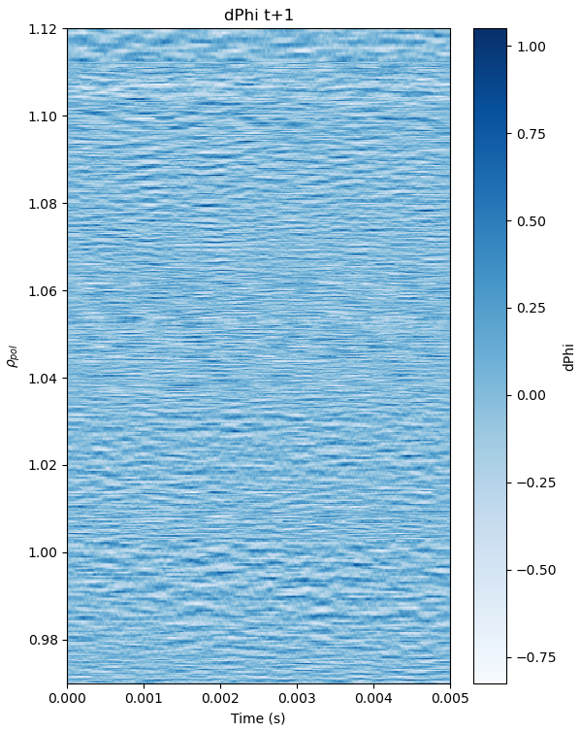
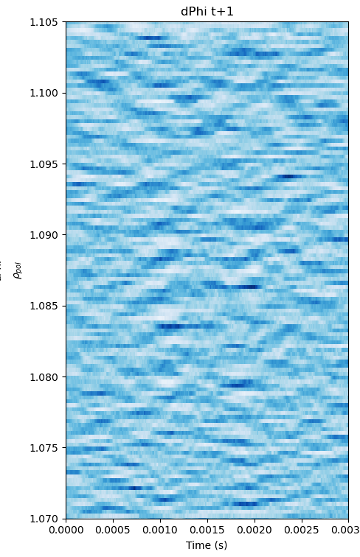
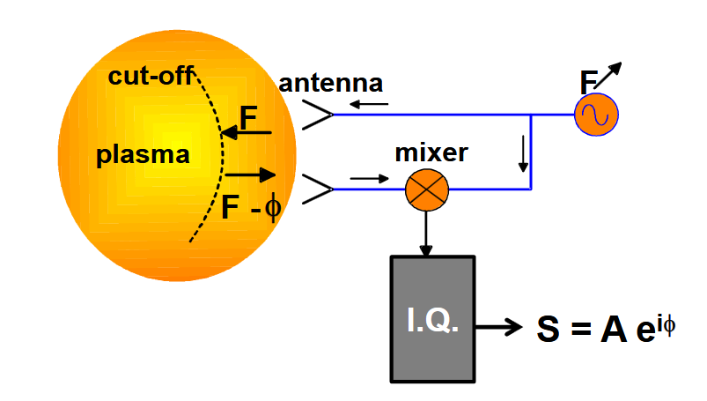
Experimental database
δΦ
v_{r}
L_{c}​
Clairet RSI 2017
Ultra-fast swept reflectometry measured density fluctuations on ASDEX Upgrade and WEST with high temporal resolution (1 μs)
δΦ phase fluctuation provides information on density fluctuation and filament characteristics (size, velocity, skewness) D_{eff​}=α⋅S⋅⟨v_{r}²​⟩^{1/2}⋅L_{c}​

Slide 8
Skewness analysis of reflectometer δΦ
Skewness S as quantitative characteristic of density fluctuation
  S>0 indicates intermittent positive bursts
  S≈0 corresponds to Gaussian fluctuations
  (diffusive-like transport)
Clairet PPCF 2025

Slide 9
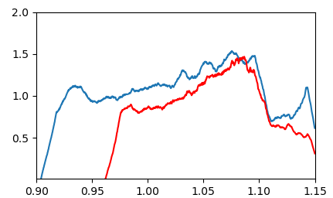
Skewness analysis of reflectometer δΦ
Skewness S as quantitative characteristic of density fluctuation
  S>0 indicates intermittent positive bursts
  S≈0 corresponds to Gaussian fluctuations
  (diffusive-like transport)
Ongoing work: Quantifying skewness across different regimes
Early observations:
  Higher skewness in turbulent regimes
  Correlation with D_{eff} under investigation
  Validation simulations + synthetic diagnostic FeDoT
Clairet PPCF 2025
L-mode → H-mode
S
ρ_{pol}
Glasser PPCF 2025

Slide 10
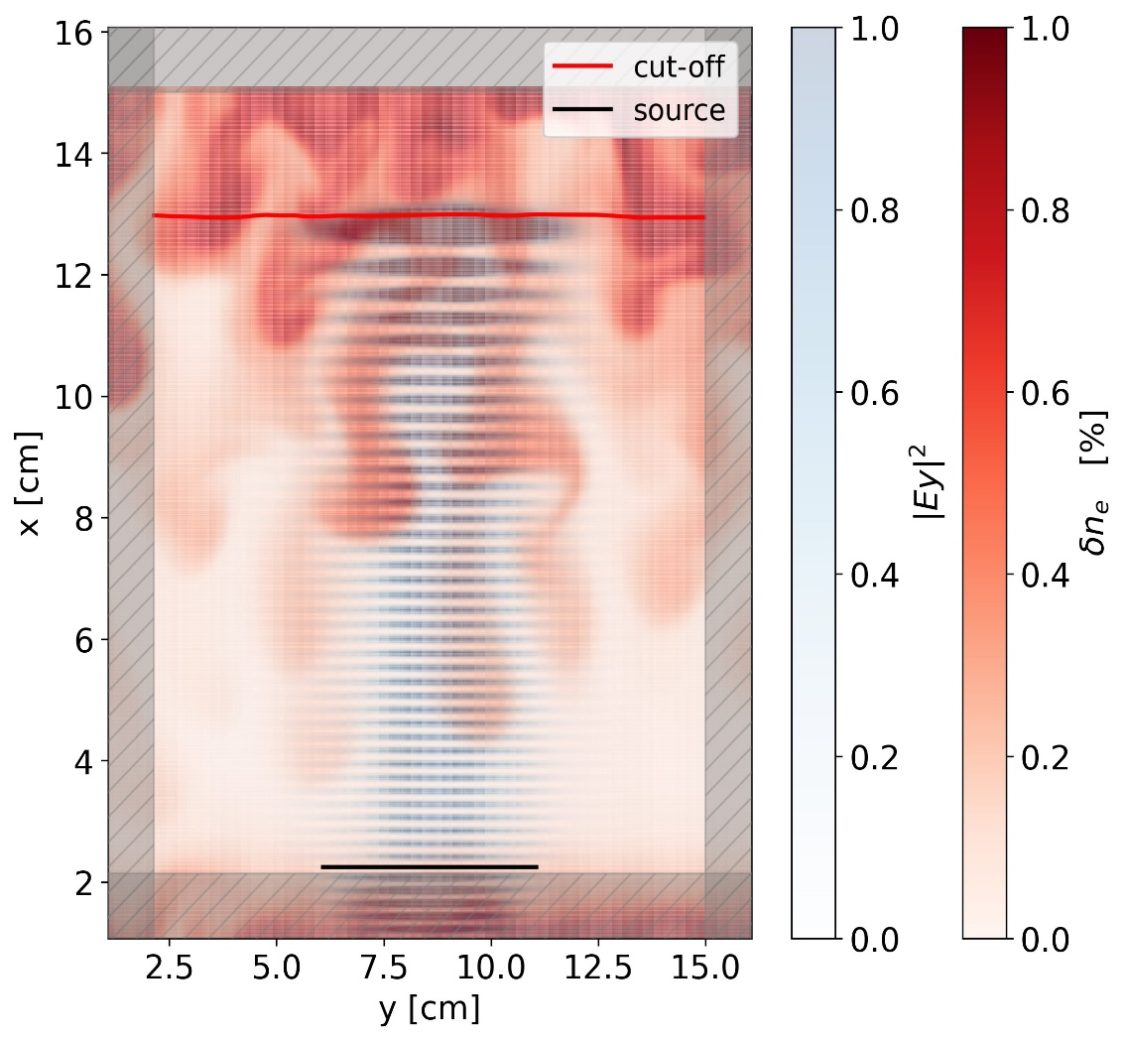
Synthetic diagnostic for ML database
TOKAM2D + FeDoT
Synthetic diagnostics bridge the gap between experimental data and simulations
FeDoT is a 2D full-wave propagation code producing reflectometer’s phase and amplitude
TOKAM2D and SOLEDGE3X simulations provide reference map for AI detection → D_{eff} compared to synthetic reflectometer data analysis D_{eff​}=α⋅S⋅⟨v_{r}²​⟩^{1/2}⋅L_{c}​
(validation)
Goal: generate synthetic reflectometry δΦ to create
a database of sets D_{eff} ─ δΦ(R,t)
A. Jamann PhD

Slide 11
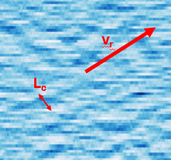
Upcoming AI work
Oct 2024
Mar 2025
May 2025
Oct 2025
Dec 2025
WP1 Optimizing data analysis and exploiting multi-machine database
Filaments detection in reflectometry data (radial velocity)
WP2 AI detection of 3D and 2D turbulent structures
Automatic detection of 2D/3D structures using graph spectral clustering, starting with TOKAM2D simulation with time-evolving density fluctuations, including time correlation/decorrelation
WP3 AI-augmented database for SOL ballistic transport model
Dimensionality reduction of reflectometer measurements using an auto-encoder, combined with other scalar quantities of the discharge → MLP → D_{eff}
Label experimental data with transport characteristics from AI-treated 2D fluid simulations and integrate transport coefficients into 2D fluid simulations

Slide 12
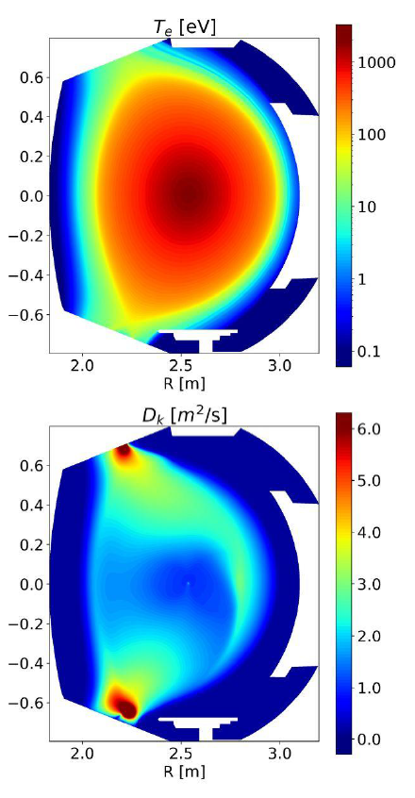
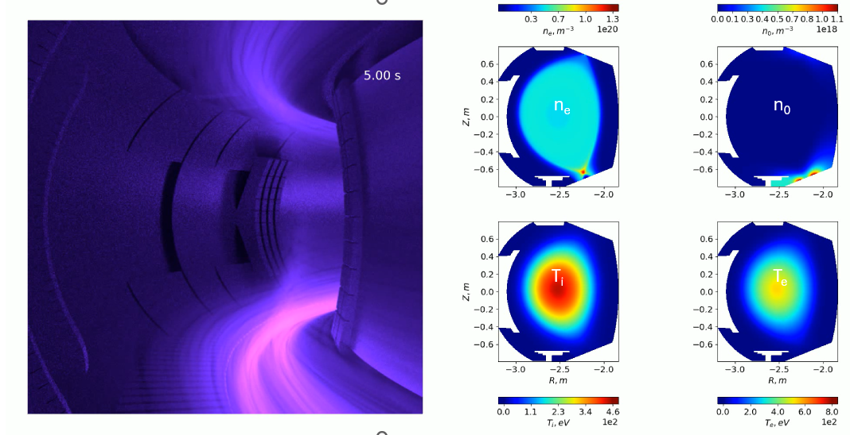
Application to 2D mean-field simulations
Enhancing SOLEDGE-HDG simulations
  Implement D_{eff} in a new variable diffusion model
  Strengthen predictive accuracy and simulation quality
  Benchmark results against WEST and ASDEX-U experiments
  Validate and refine the SOL transport model
Giorgiani Comp. Phys. Comm. 2020
Kudashev Frontiers in Phys. 2024

Slide 13
Concluding remarks
Filamentary transport plays a critical role in plasma-wall interactions and transport modeling
Traditional diffusive models are insufficient - convective transport mechanisms must be incorporated
AI-driven analysis enables automatic detection and characterization of filaments and blobs in experimental and simulation data
Effective diffusion coefficients provide a new pathway for improving 2D mean-field models
SOLEDGE-HDG will be enhanced using AI-informed transport coefficients, improving predictive accuracy and plasma modeling
Next Steps:
Validate AI-based filament detection against experiments & simulations
Refine transport models with AI-derived D_{eff}
Expand the AI-augmented database for SOL transport studies

