Slide 1
AIP: LIBS data processing and analysis by means of machine learning
P. Gąsior, D. Sokulski
IPPLM Institute of Plasma Physics and Laser Microfusion, Hery Street 23, 01-497, Warsaw, Poland
CU and FZJ contributors
WP PWIE Meeting 2025
JIPP.CR Prague, 26/03/2025

Slide 2
Outline
Machine learning concepts for LIBS for Fusion
Generalisation: bias vs overfitting
Finding an efficient representation with autoencoders
Results:
Application of evolutionary algorithms for hyperparameter tuning based on experimental data from FZJ
Application of chemical contents analysis for complex spectra after dimensionality reduction by autoencoders – CU contribution and PCA by IPPLM
Sumary and future work
Hyperparameter and their optimisation
Motivation
Machine learning – basic concepts
Deep learning
General ML scheme
WP PWIE Meeting 2025, P. Gasior et al.

Slide 3
Motivation
Although the materials for PFC change as well as plasma scenarios, the need for monitoring fuel retention and chemical composition of the wall is indisputable
To operate in harsh environments a contactless, EM resistant method which does not introduce interference is indispensable
Laser Induced Breakdown Spectroscopy (LIBS) fullfils these requirements
Nevertheless, regardless of numerous advantages it is still challenged by uncertainties – as not predictable environmental conditions, unknown morphology of deposits, uncertainties in plasma parameters estimation, and at last but not least: huge amoounts of data
On the other hand, these huge amounts of data may bring advantage if we employ artificial inteligence through machine learning
Such aproach has been confirmed as supreme in numerous application including (computer) science
WP PWIE Meeting 2025, P. Gasior et al.

Slide 4
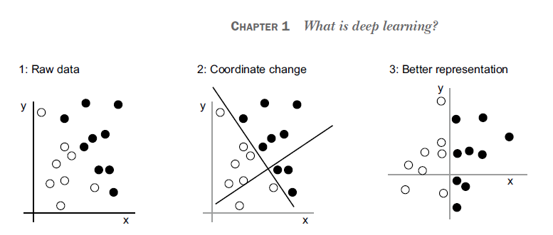
What is deep learning
The main goal is to extract the information so that it can be easier classified and quantified
F. Chollet, Deep Learning with Python (Manning Publications, New York, 582, 2017).
WP PWIE Meeting 2025, P. Gasior et al.

Slide 5
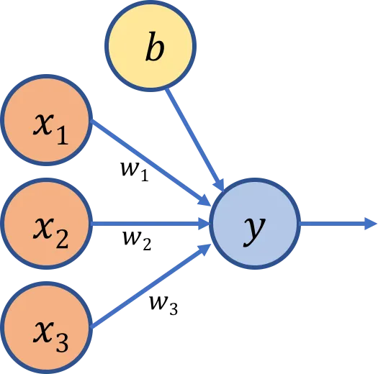
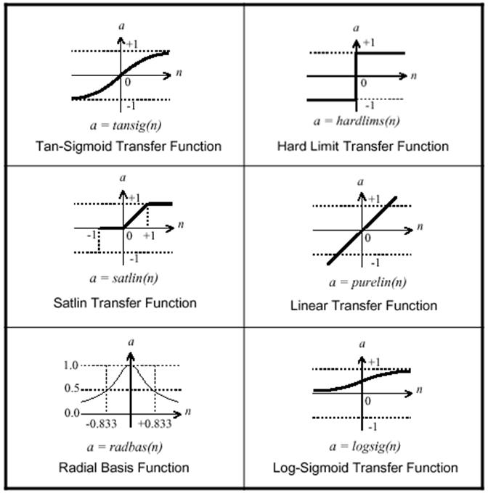
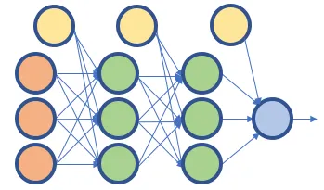
LR on steroids
https://medium.com/@melodious/understanding-deep-neural-networks-from-first-principles-logistic-regression-bd2f01c9e263
WP PWIE Meeting 2025, P. Gasior et al.

Slide 6
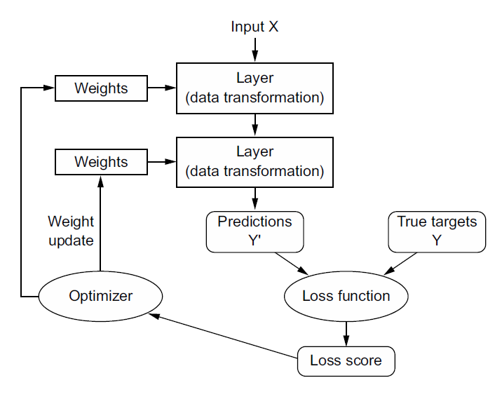
General ML scheme
F. Chollet, Deep Learning with Python (Manning Publications, New York, 582, 2017).
WP PWIE Meeting 2025, P. Gasior et al.

Slide 7
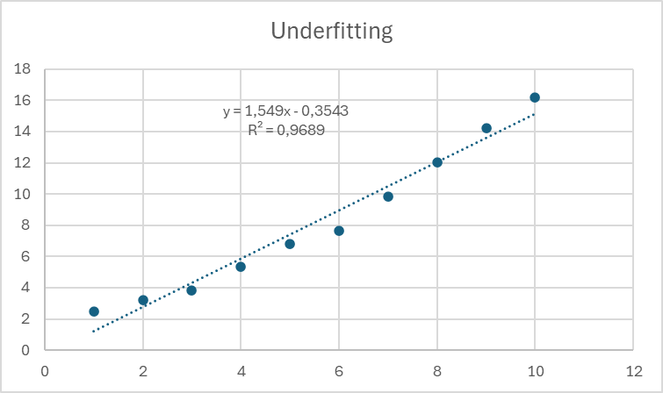
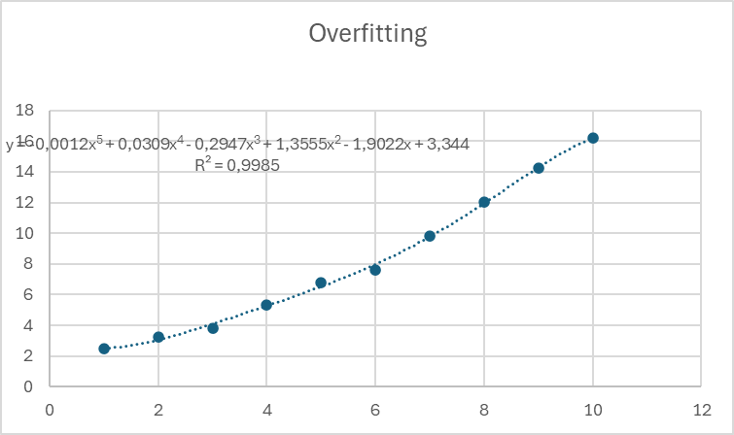
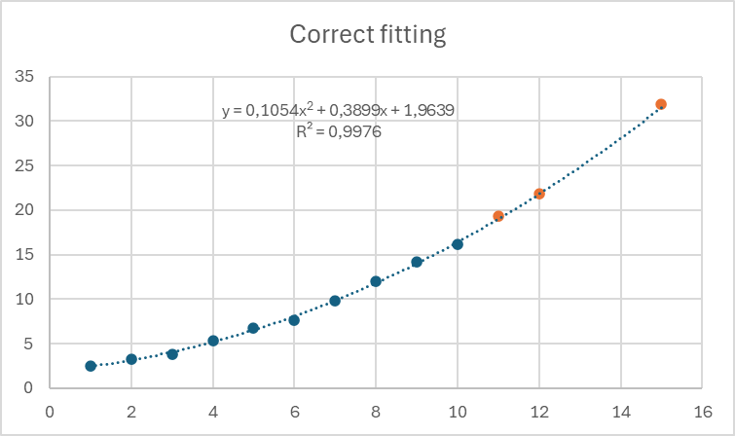
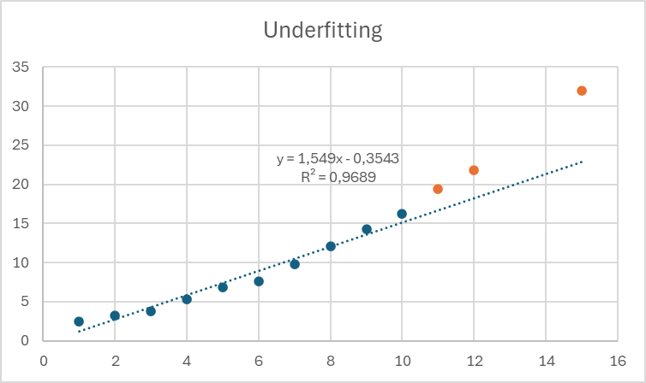
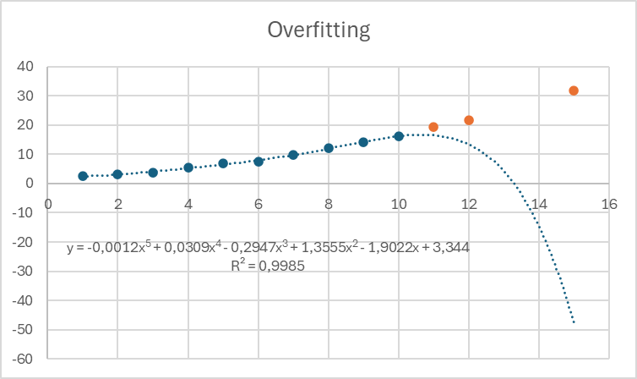
Memorisation vs generalisation
Real model:
x^{1.45}+1.9x+4 + noise
Regularisation aims at minimizing coefficients
WP PWIE Meeting 2025, P. Gasior et al.

Slide 8
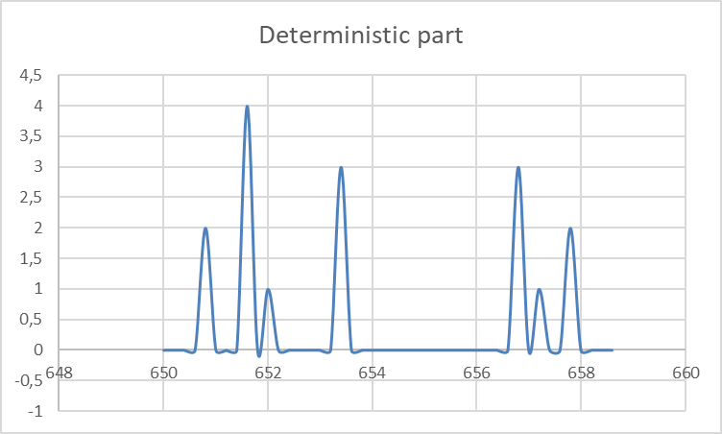
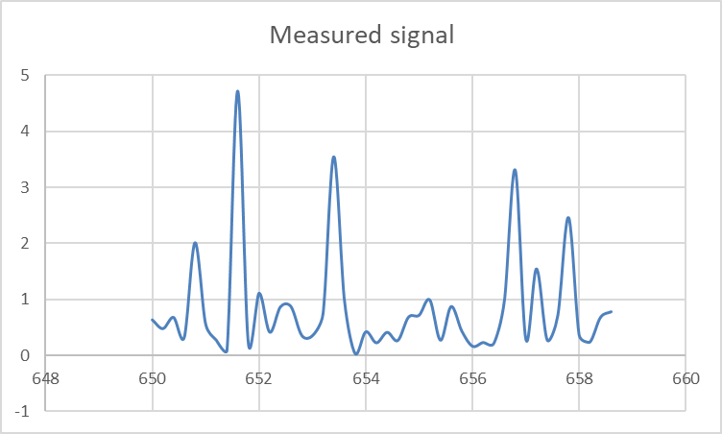
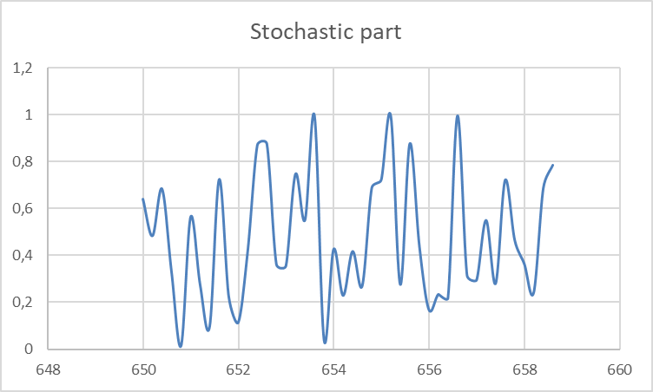
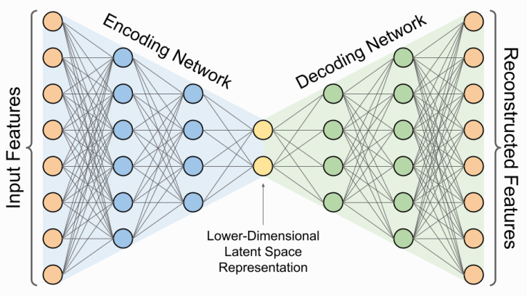
Finding efficient representation – autoencoder
Measurement
Autoencoder can solve two problems:
Data reduction
Noise removal
In generalisation mode, autoencoder can „learn” the signal, but fails to memorise the noise.
Input spectrum
Output spectrum
WP PWIE Meeting 2025, P. Gasior et al.

Slide 9
Human part of the machine learning
Parameters vs hyperparameters
The parameters of the model are learnt during the training. For the ANN based autoencoder, these are the weights of the neurons.
The hyperparameters are chosen by the model developer and are subject of optimisation. There are numerous hyperparameters, e.g.
Learning Rate: Controls how much to change the model in response to the estimated error each time the model weights are updated.
Batch Size: The number of training examples utilized in one iteration.
Number of Epochs: The number of complete passes through the training dataset.
Number of Layers: The number of hidden layers in the encoder and decoder parts of the autoencoder.
Number of Neurons per Layer: The number of neurons in each hidden layer.
Activation Functions: Functions like ReLU, Sigmoid, or Tanh used to introduce non-linearity into the model.
Optimizer: Algorithms like Adam, SGD, or RMSprop used to minimize the loss function.
Loss Function: Functions like Mean Squared Error (MSE) or Binary Cross-Entropy used to measure the difference between the predicted and actual outputs.
Dropout Rate: The fraction of neurons to drop during training to prevent overfitting.
Weight Initialization: Methods like Xavier or He initialization to set the initial weights of the network.
Regularization Parameters: Parameters like L1 or L2 regularization to prevent overfitting.
WP PWIE Meeting 2025, P. Gasior et al.

Slide 10
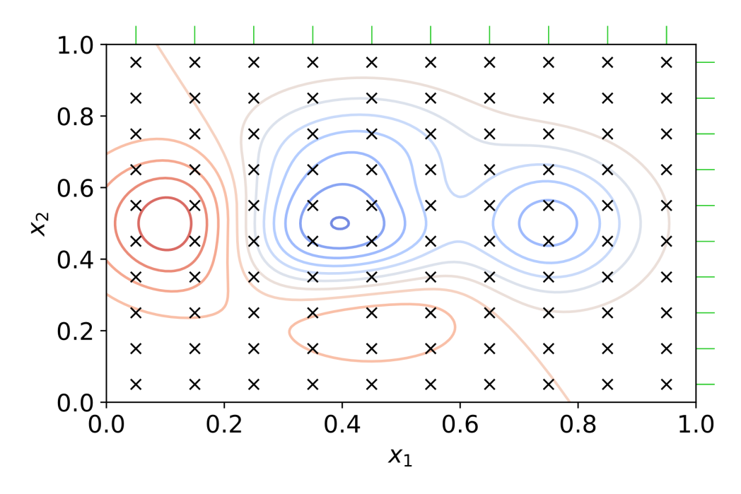
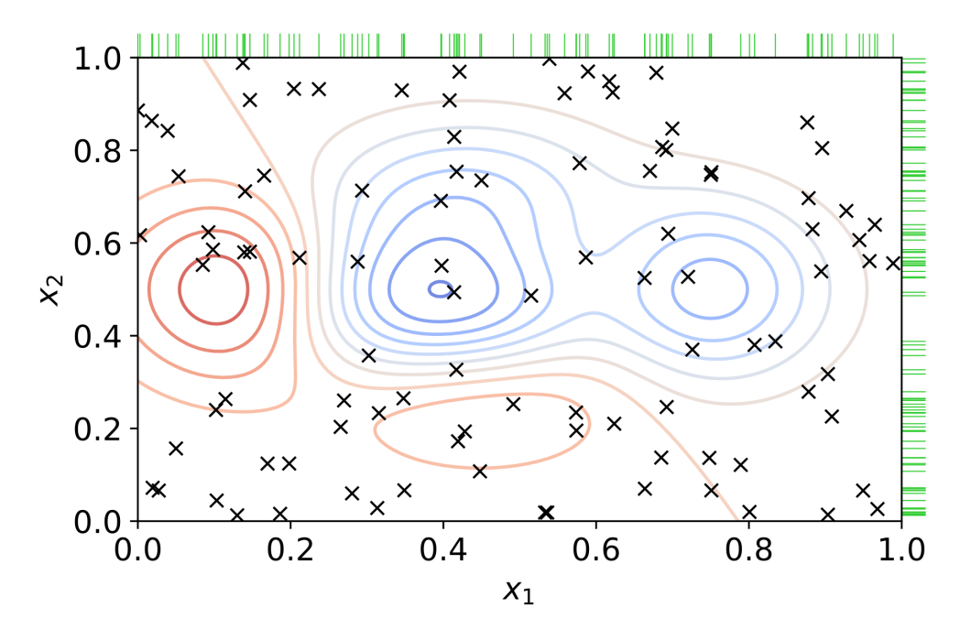
Hyperparameter tuning
Grid search:
High probability of finding global minimum
High computational cost
Random search:
High probability of finding local minima
Lower computational cost
WP PWIE Meeting 2025, P. Gasior et al.

Slide 11
Random initial population
Train and evaluate fitness of hyperparameter tuples
Generate new population based on best performers
Repeat until satisfactory performance is reached or is no longer improving
Output hyperparameters
Evolutionary hyperparameter optimization
Generating new population
Mutations
Random changes of hyperparameters
for example sampled from normal distribution centered on old hyperparameter value
Crossover
Select two parents, preferably of high fitness, and generate an offspring
Each offspring hyperparameter can be determined by either random choice or average
(x₁, y₁, z₁)
+
(x₂, y₂, z₂)
(x, y, z)
(x+Δ_{x}, y+Δ_{y}, z+Δ_{z})
((x₁+x₂)/2, (y₁+y₂)/2, (z₁+z₂)/2)
WP PWIE Meeting 2025, P. Gasior et al.

Slide 12
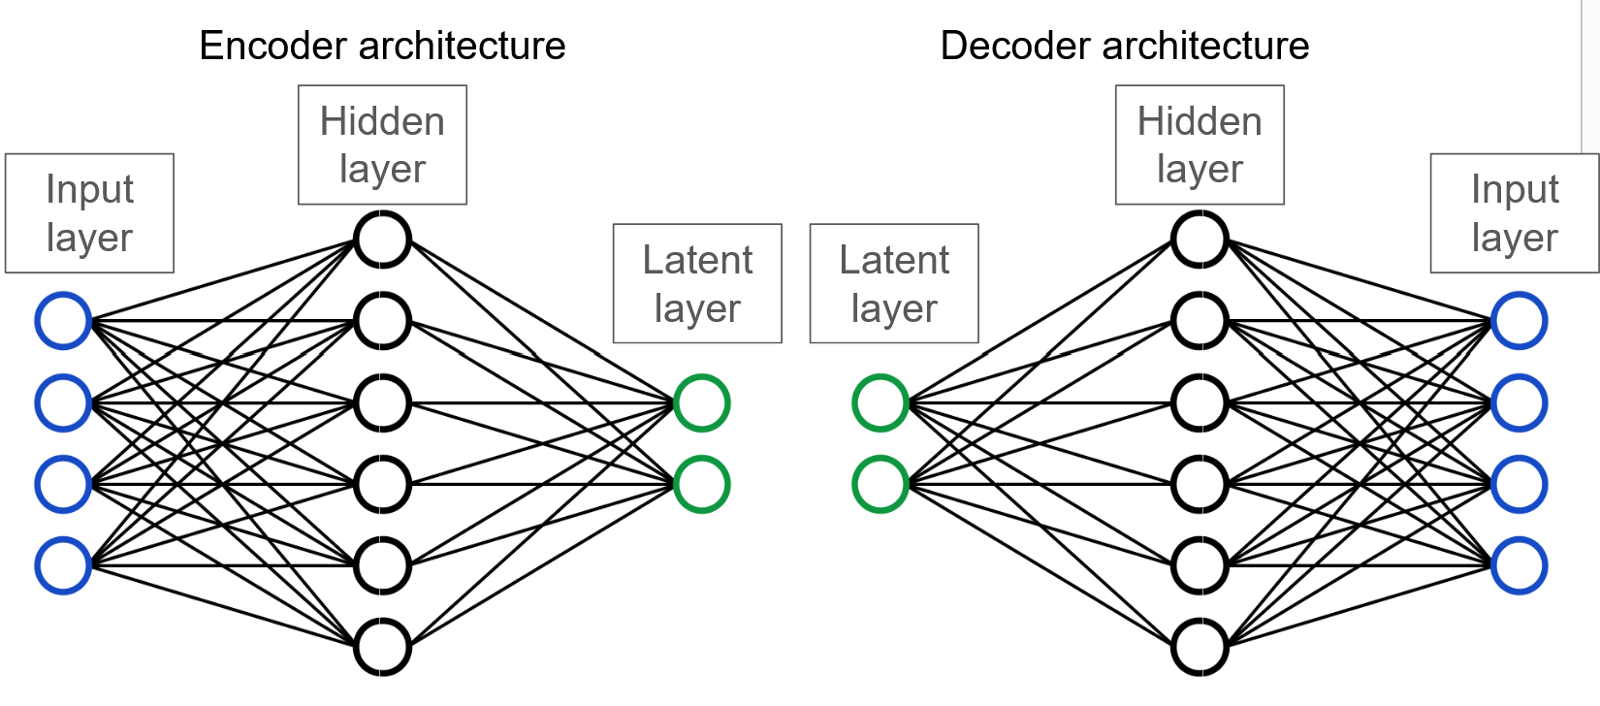
Why evolutionary algorithms?
Can be used for almost any optimization problem, including hyperparameter tuning in ML
Can produce high quality solutions compared to other methods
Simple, easy to implement algorithm, yet can solve very complex problems
Computationally expensive
True optimal solution may never be found, as with all metaheuristics
WP PWIE Meeting 2025, P. Gasior et al.

Slide 13
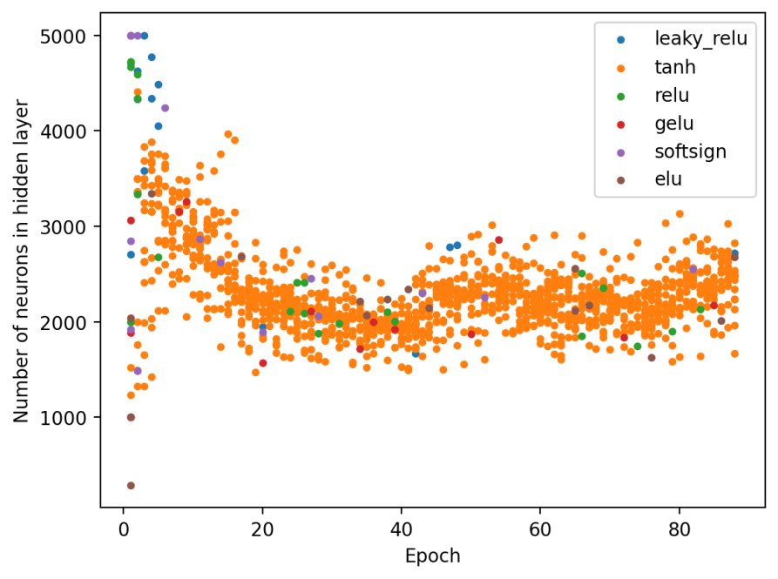
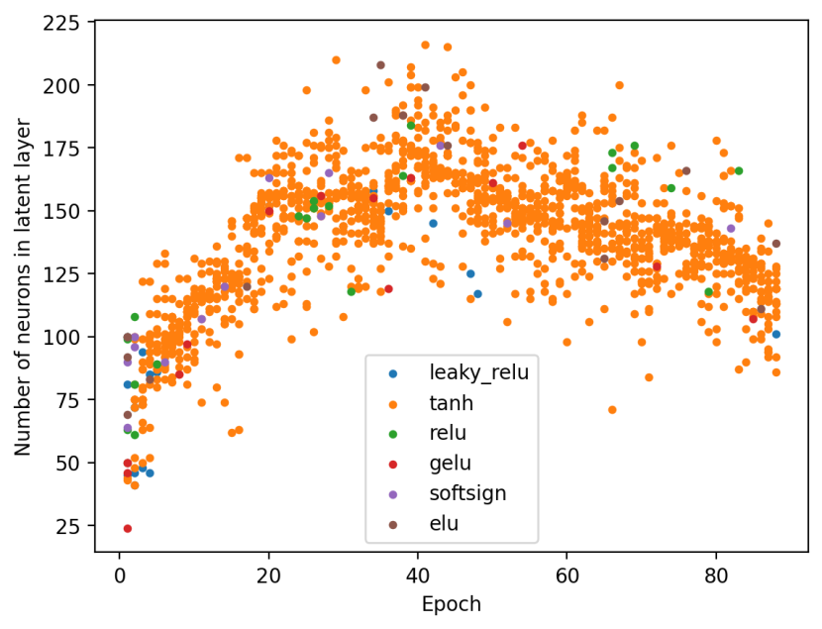
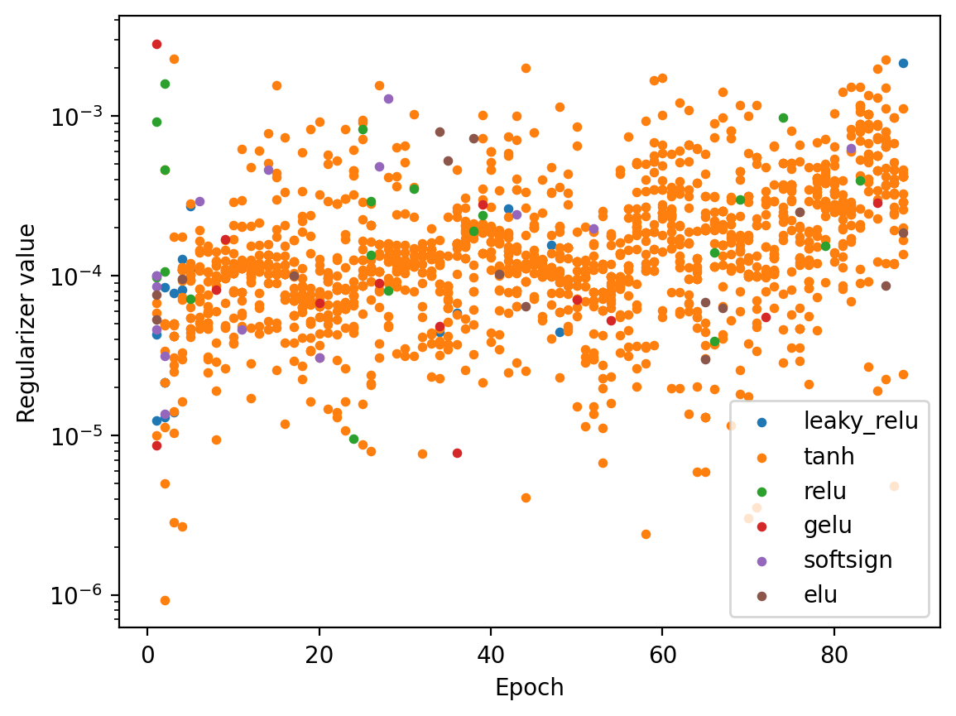
Optimizing autoencoder hyperparameters
Performed on the experimental data from ps-LIBS performer at FZJ
Optimal parameters found:
hidden: 2231
latent: 146
regularizer: 2.6x10⁻⁴
activation function: ‘tanh’
WP PWIE Meeting 2025, P. Gasior et al.

Slide 14
Updated approach
Dimensionality reduction/ autoencoder
Simulated data
Bootstrapping
CNN/
ANN/
KAN for chemical contents estimation
Averaging/
filtering
Anomaly detection
CNN/ANN for specral connversion
CNN/ANN for conversion
Metadata integration
Experimental data
WP PWIE Meeting 2025, P. Gasior et al.

Slide 15
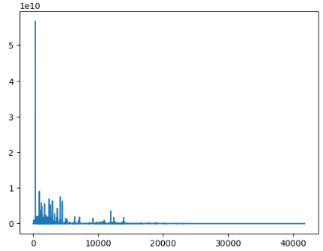
Determination of elemental composition using RNN and traditional DNN for fusion related samples. (CU+IPPLM)
S. J Shetty, P. Veis, P Gąsior et. al
Table: Considered elements and % composition for training the ML models.
Simulated Spectra
Elements | %Comp
W | 44-55
Be | 5.5-8.5
C | 4.5-7
B | 5.5-8.5
H | 8-11
Ar | 0-10
O | 0-10
N | 0-10
He | 0-10
Simulated spectra at a resolution of 4000 acquired from the NIST LIBS database.
The final dataset consists of 20000 samples with 41730 data points which comprises the spectra and the elemental composition.
The input features (spectra) is scaled with MinMax and the target features (composition and T_{e}) is scaled with Standard Scalar.
Dimension reduction with bottleneck
Dimension reduction with bottleneck
Dimension reduction with bottleneck
Dimension reduction with bottleneck
GRU
Bi-LSTM
DNN
PWIE meeting, Prague 2025
WP PWIE Meeting 2025, P. Gasior et al.

Slide 16
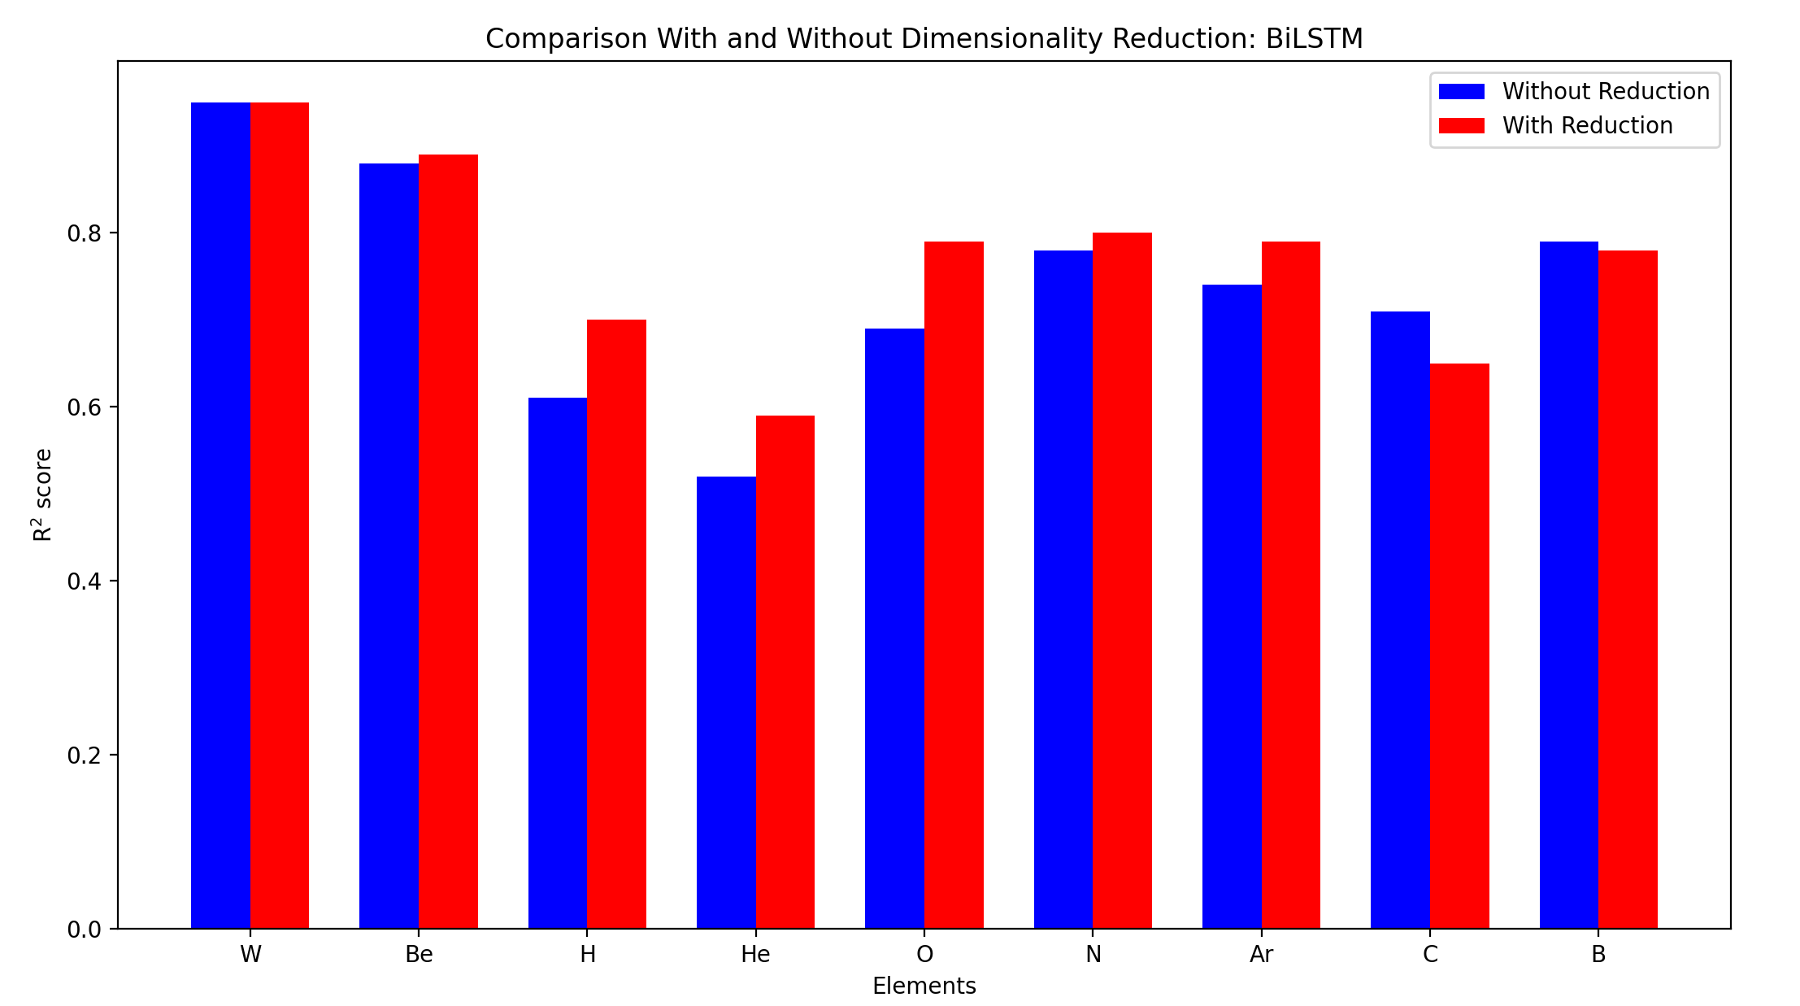
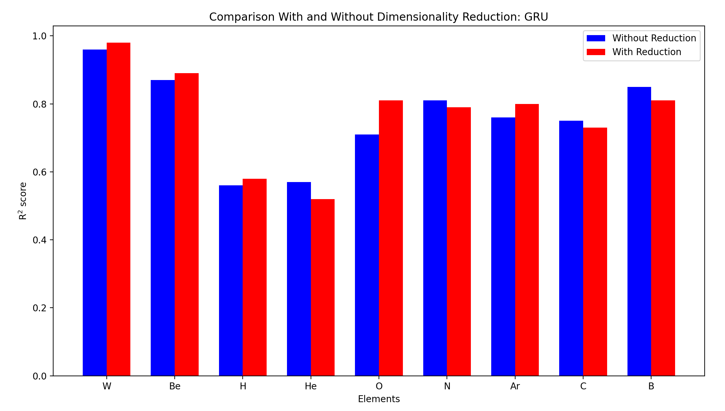
Determination of elemental composition using RNN and traditional DNN for fusion related samples. (CU+IPPLM)
S. J Shetty, P. Veis, P Gąsior et. al
Input layer
Hidden layer1
Hidden layer2
Bottleneck layer/
Latent layer
Table: Training loss (MSE) for considered models
41720
…..
Regression model. | Training Loss (MSE)
 | Without dimensionality reduction | With dimensionality reduction
Bi-LSTM | 0.3 | 0.18
GRU | 0.23 | 0.21
DNN | 0.76 | Not yet available
27764
…..
5346
…..
1024
Regression Models
Figure: Comparison of R² values for Bi-LSTM with and without bottleneck
PWIE meeting, Prague 2025
Figure: Comparison of R² values for GRU with and without bottleneck
WP PWIE Meeting 2025, P. Gasior et al.

Slide 17
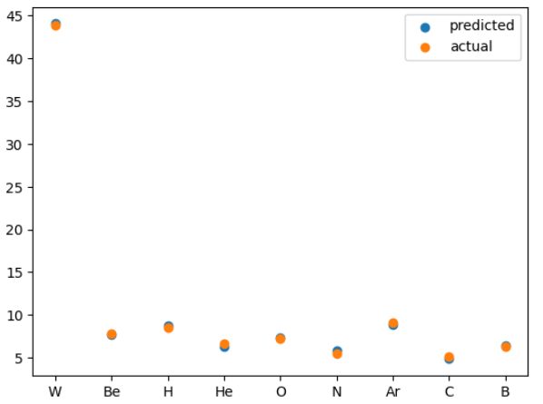
Determination of elemental composition using RNN and traditional DNN for fusion related samples. (CU+IPPLM)
S. J Shetty, P. Veis, P Gąsior et. al
Performance Metrics:
MSE - To determine training loss.
R² - To determine the corelation between the predicted and the evaluation targets.
Ongoing:
Training DNN with bottleneck.
Application of PSO to improve the architecture.
Parameter to tune:
Number of layer
Hidden Size
Batch Size
Learning rate.
Figure: Comparison of elemental composition predictions from the Bi-LSTM model with a bottleneck layer against the actual composition
PWIE meeting, Prague 2025
WP PWIE Meeting 2025, P. Gasior et al.

Slide 18
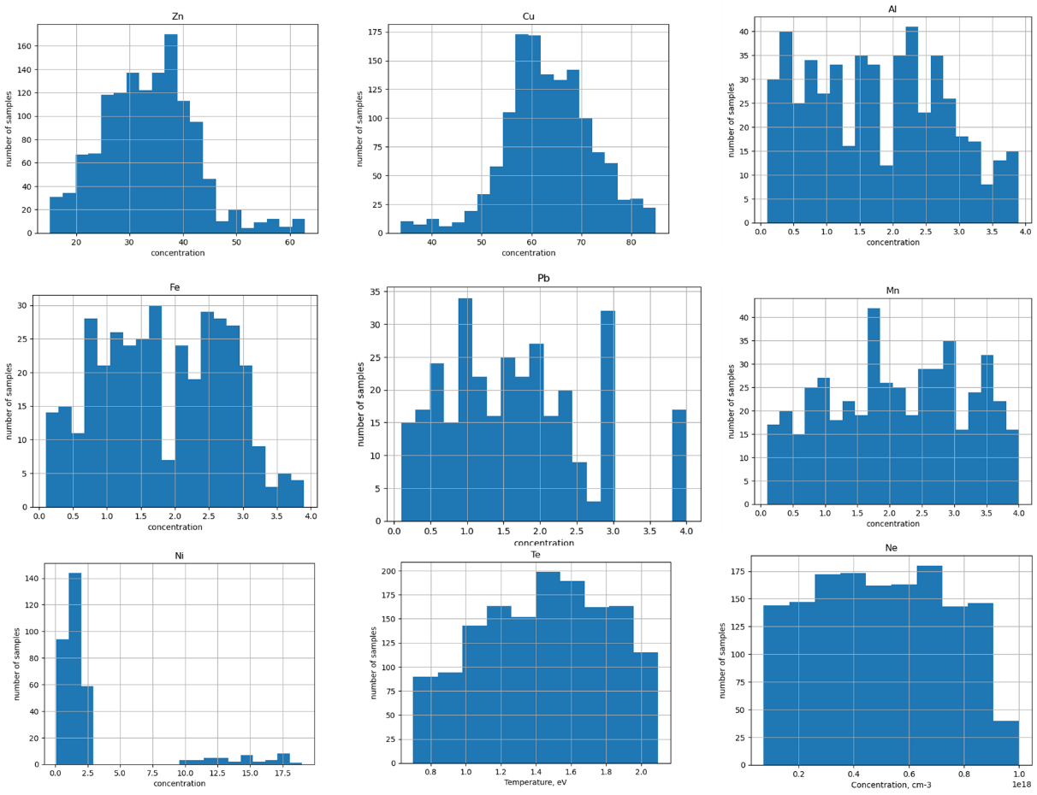
Models for synhetic brass brass alloys (I)
Alloy | number
CuZn | 300
ZnAlCu | 100
ZnNiCu | 300
ZnAlFeCu | 120
ZnMnPbCu | 250
ZnMnFeCu | 200
FeMnZnPbCu | 50
ZnPbCu | 50
ZnAlNiCu | 50
WP PWIE Meeting 2025, P. Gasior et al.

Slide 19
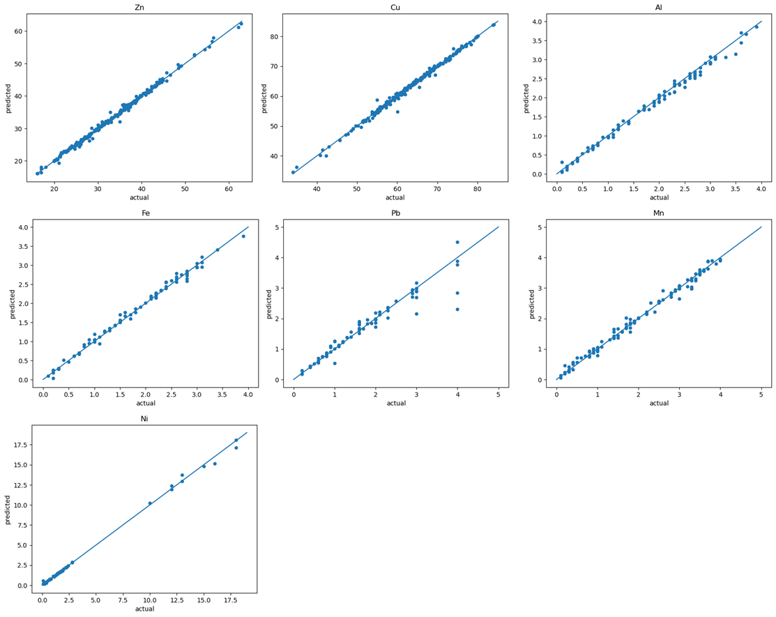
Models for synhetic brass brass alloys (II) results
Predictions for training
and validation
on synthetic data
Element | R2_score | RMSEP, conc. % | NRMSEP, % | Average Relative Error, %
Zn | 0.997 | 0.501 | 1.5 | 0.65
Cu | 0.998 | 0.438 | 0.7 | 0.35
Al | 0.994 | 0.081 | 4.6 | 3.40
Fe | 0.996 | 0.057 | 3.1 | 2.91
Pb | 0.968 | 0.175 | 10.7 | 7.31
Mn | 0.997 | 0.060 | 2.8 | 2.86
Ni | 0.997 | 0.218 | 7.5 | 4.41
WP PWIE Meeting 2025, P. Gasior et al.

Slide 20
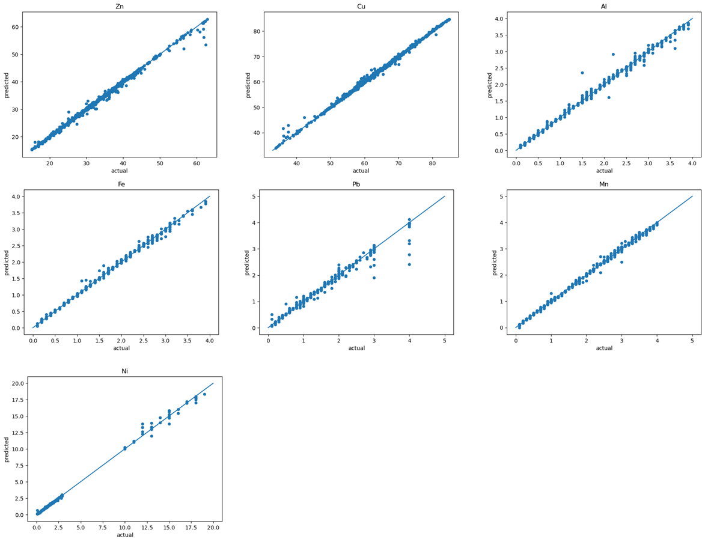
Models for synhetic brass brass alloys (II) results
Predictions for training
on synthetic data
and validation
on quasi-eperimental
data
Element | R2_score | RMSEP, conc. % | NRMSEP, % | Average Relative Error, %
Zn | 0.998 | 0.427 | 1.27 | 0.65
Cu | 0.998 | 0.396 | 0.63 | 0.36
Al | 0.980 | 0.130 | 7.62 | 4.60
Fe | 0.995 | 0.068 | 3.58 | 4.70
Pb | 0.928 | 0.279 | 16.59 | 13.7
Mn | 0.995 | 0.074 | 3.48 | 4.50
Ni | 0.998 | 0.193 | 6.40 | 10.9
WP PWIE Meeting 2025, P. Gasior et al.

Slide 21
Summary and plans for future
Application of autoencoders brings a decent progres in experimental spectra analysis.
There is a big role of pre-processing which was not fully addressed in this short presentation.
Tests on the spectra collected at the VTT bring interesting results which will be addressed in the PFMC contribution.
The models will be applied on data from LIBS@JET experiments
The spectra obtained from locations of determined composition may serve for training models for chemical contents estimation
WP PWIE Meeting 2025, P. Gasior et al.

Slide 22
