Slide 1
JET LIBS data analysis meeting #1
6.2.2025
Jari Likonen

Slide 2
Status and planning
VTT LIBS experiment (February-March 2024)
  Trustworthy lines identified for H (D), Be1, Ar1, W1, Mo1, Ni1, Cr1, Fe1 (Ristkok)
  Depth profiles calculated and compared with SIMS, layer thicknesses (CU, ENEA, UT)
  Signal fluctuation shot to shot, crater to crater
  J. Ristkok is preparing a paper
LIBS setup modified few times at JET (beam expander removed, new cone design)
  New experiment needed, June-August at VTT, also using Littrow spectrometer
We will now concentrate on data analysis of JET LIBS results
Access to JET data warehouse needs to be arranged
Where will be the analysed LIBS spectra stored?
Calibrations with different lamps and integrating sphere

Slide 3
Status and planning
What data analysis methods will be used (see e.g. Zhang, Frontiers in Physics, 10 (2022), 887171)?
  Methods: Boltzmann, Saha-Boltzmann, Columnar Density Saha–Boltzmann
  Corrections: Self-absorption, models?
  Validation of different methods?
Data analysis work in different RUs needs to be planned and coordinated
(A) Initial Boltzmann plot derived from the raw line intensity of the aluminum alloy sample. (B) Boltzmann plot corrected by the IRSAC for the aluminum alloy sample. Zhang, Frontiers in Phys.10, 887171, 2022

Slide 4
Analysis priorities
Traditionally highest fuel retention on the inner divertor tiles 0 and 1
  Analysis of these tiles have the highest priority
Widdowson PFMC 2021

Slide 5
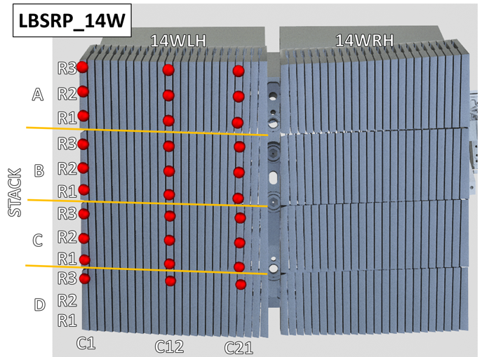
Analysis priorities
LBSRP_14W
Traditionally highest fuel retention on the inner divertor tiles 0 and 1
  Analysis of these tiles have the highest priority
Analysis of bulk W tile 5 also very important (2nd priority), right-hand side row
40
770
43
771
46
773
49

Slide 6
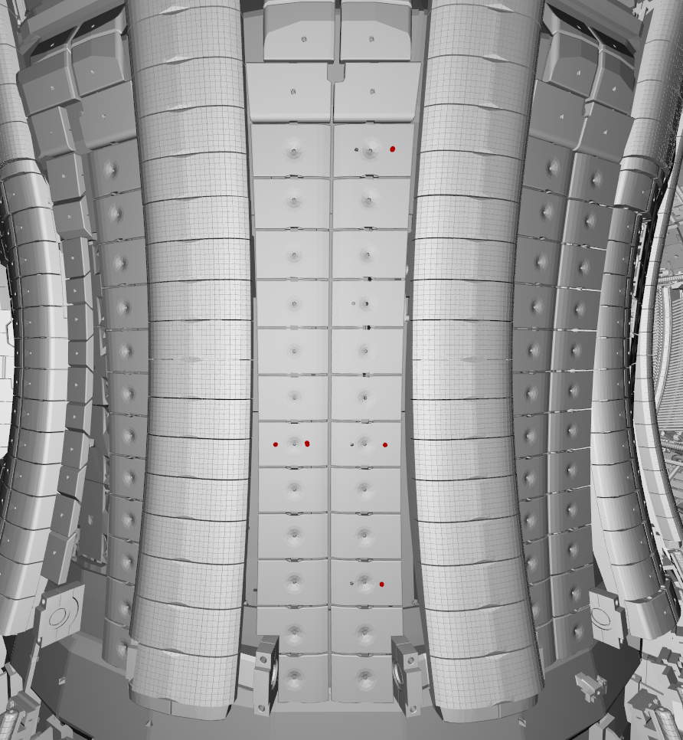
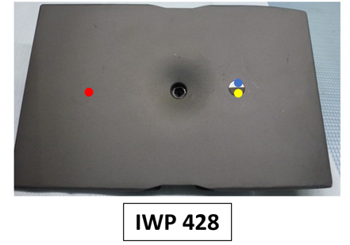
Analysis priorities
Traditionally highest fuel retention on the inner divertor tiles 0 and 1
  Analysis of these tiles have the highest priority
Analysis of bulk W tile 5 also very important (2nd priority)
Calibration pulses on IWC tiles (Sachet sample), ablation rate
402
428
408
411

Slide 7
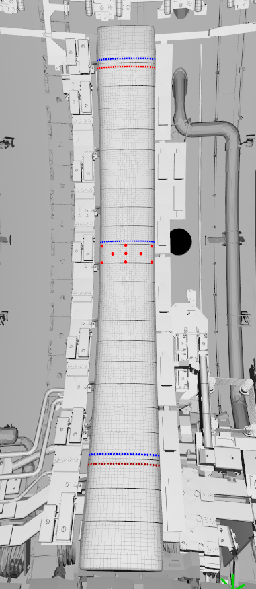
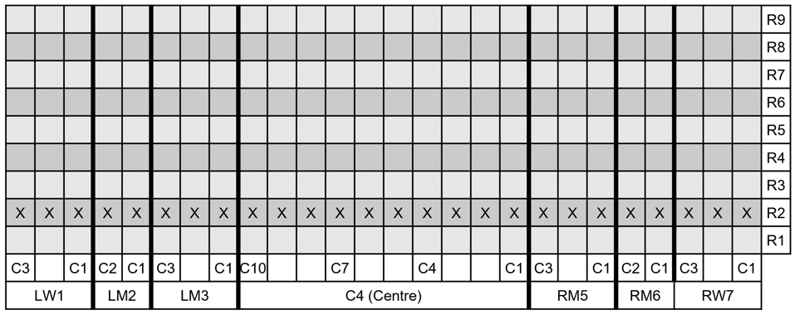
Analysis priorities
4D23
Traditionally highest fuel retention on the inner divertor tiles 0 and 1
  Analysis of these tiles have the highest priority
Analysis of bulk W tile 5 also very important (2nd priority)
Calibration pulses on IWC tiles, ablation rate
Limiter tiles 2XR9 and 4D14 from the centre of limiters
4D22
4D14
4D13
LIBS locations for 4D14
4D04
4D03

Slide 8
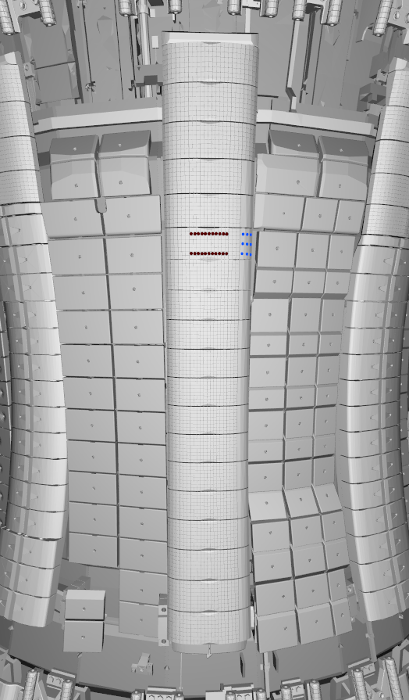
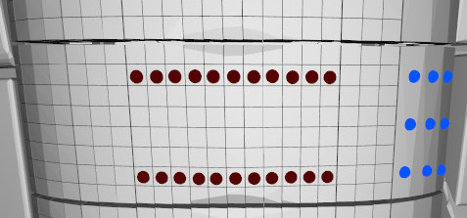
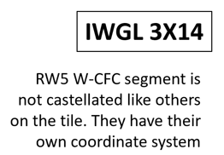
Analysis priorities
Traditionally highest fuel retention on the inner divertor tiles 0 and 1
  Analysis of these tiles have the highest priority
Analysis of bulk W tile 5 also very important (2nd priority)
Calibration pulses on IWC tiles, ablation rate
Limiter tiles 2XR9 and 4D14 from the centre of limiters
IWGL tile 3X14 with RE damage
  First analysis from the damaged area

Slide 9
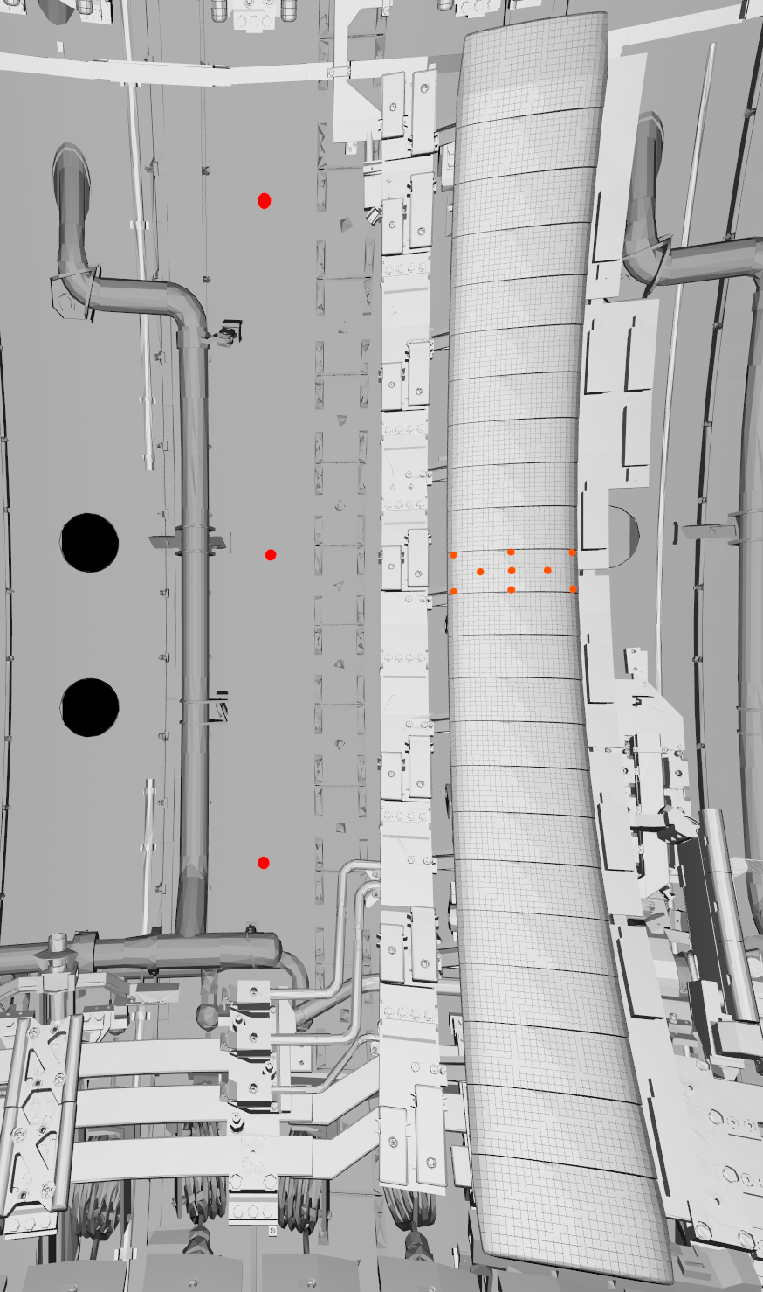
Analysis priorities
OCTANT 5 vessel wall
Traditionally highest fuel retention on the inner divertor tiles 0 and 1
  Analysis of these tiles have the highest priority
Analysis of bulk W tile 5 also very important (2nd priority)
Calibration pulses on IWC tiles, ablation rate
Limiter tiles 2XR9 and 4D14 from the centre of limiters
IWGL tile 3X14 with RE damage
  First analysis from the damaged area
Analysis of vessel wall
4D13
4D13 WPL
for reference

