Slide 1
LIBS campaign in JET
Ionuț Jepu

Slide 2
Outlook
LIBS “official” data access;
Overview of the LIBS analysis locations;
1st analysis plan (ongoing);
Future planning (priority based) - discussions

Slide 3
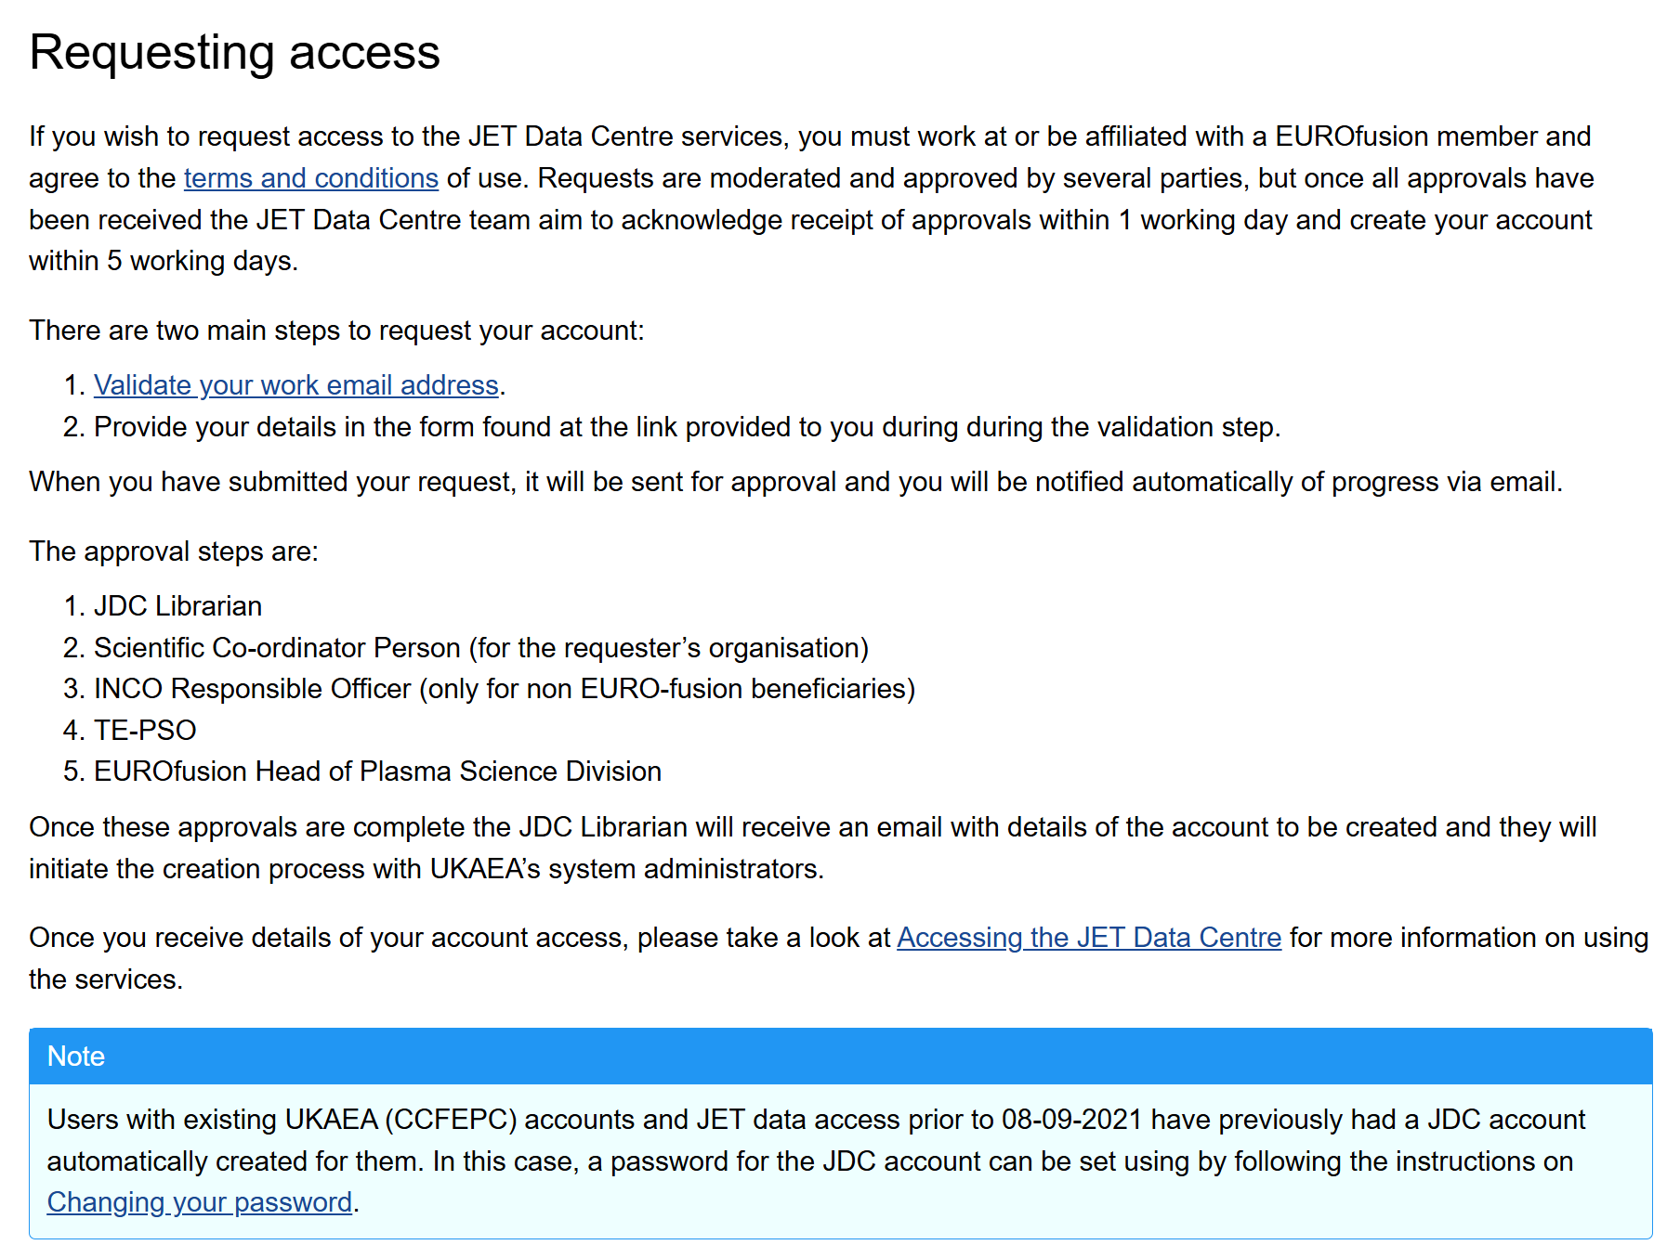
LIBS data access – STEP 1
Data access to be done via the JET Data Centre service (JDC account)
Each user needs to apply individually;
To apply for JDC account/credentials use the link below:
JET Data Centre — JET Data Centre Users Site 0.1.0 documentation

Slide 4
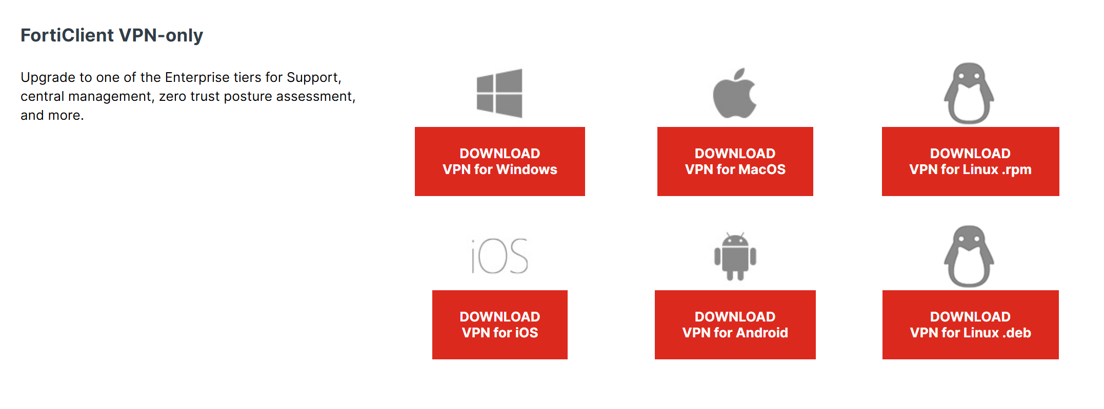
LIBS data access – STEP 2 (once JDC account created)
Access to the data warehouse is done via a VPN connection:
Install FrotiClient VPN-only:
Product Downloads | Fortinet Product Downloads | Support

Slide 5
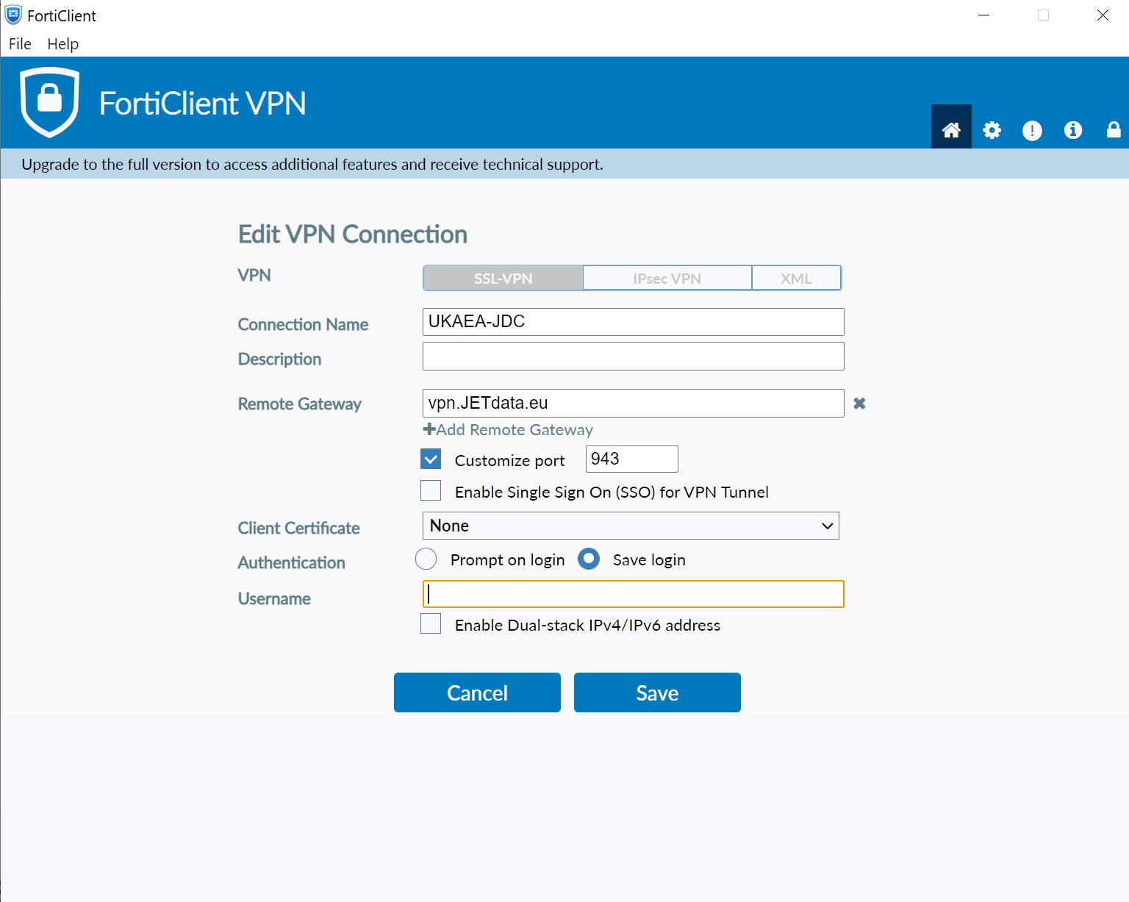
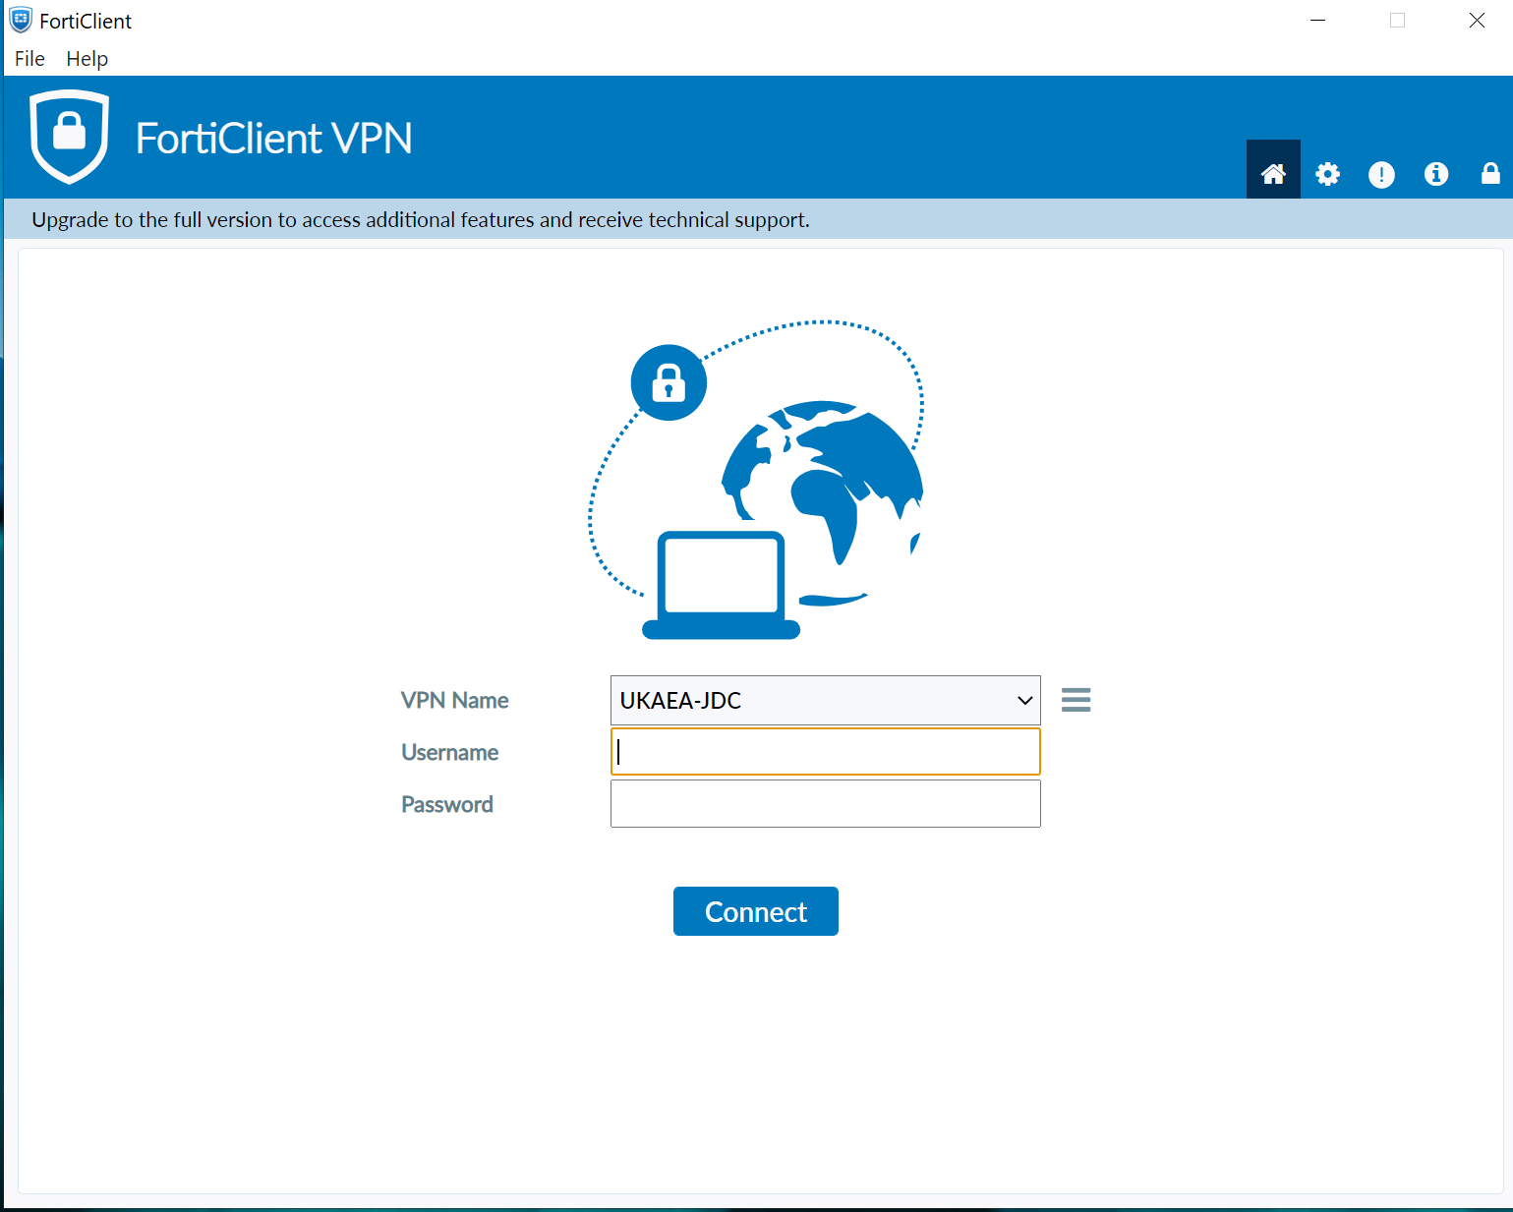
LIBS data access – STEP 3
Configure FortiClient VPN for UKAEA access:
Connect to UKAEA-JDC VPN:
Your username
JDC username
4-digit pin + 6-digit RSA token code
<- CLICK

Slide 6
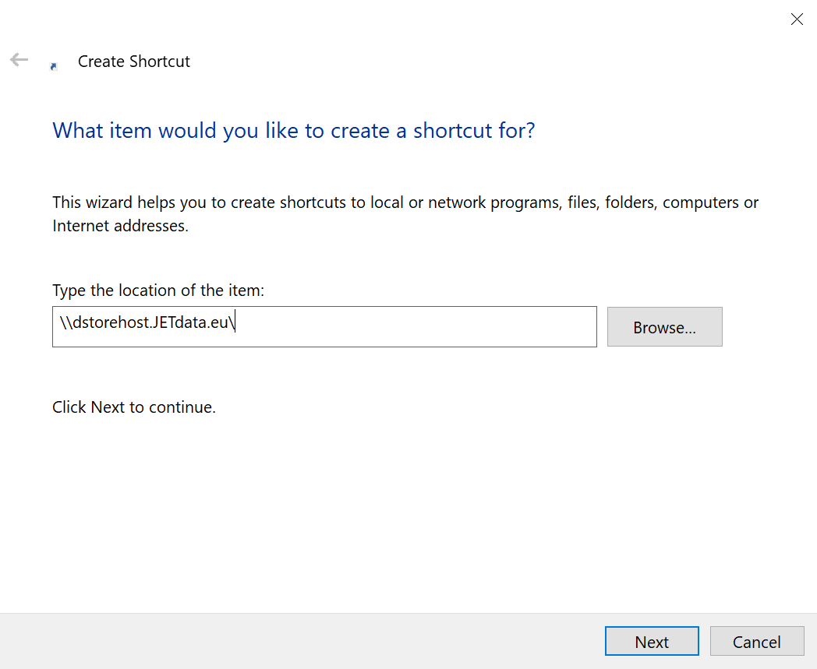
LIBS data access – STEP 4
On your PC/desktop create a shortcut folder:
For next prompt use:
Username: local\nobody
Password: <blank>(don't put any, leave empty)
\\dstorehost.JETdata.eu\rh-libs

Slide 7
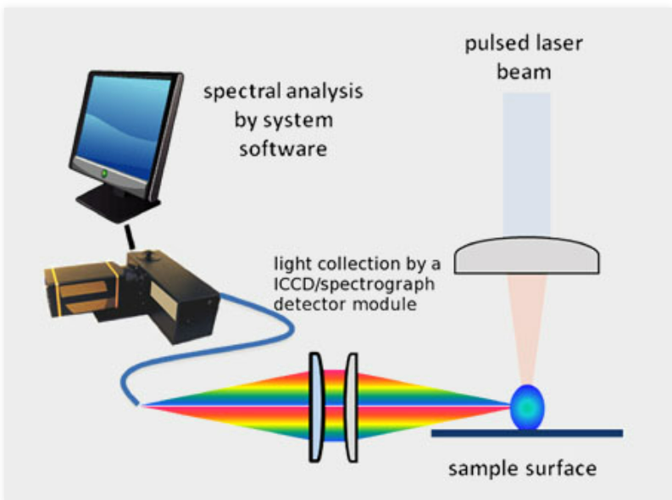
LIBS – Laser Induced Breakdown Spectroscopy
Concept of operation
Short intense laser pulse;
Ablation of surface material;
Evaporation and ionization of material;
Formation of high-temperature plasma plume;
Optical emission of the exited elements via a spectrometer;
Information about the contents of the evaporated material
[1] R.E. Russo, X.L. Mao, H.C. Liu, J.H. Yoo, S.S. Mao: Appl. Phys. A 69 [Suppl.], S887–S894 (1999)

Slide 8
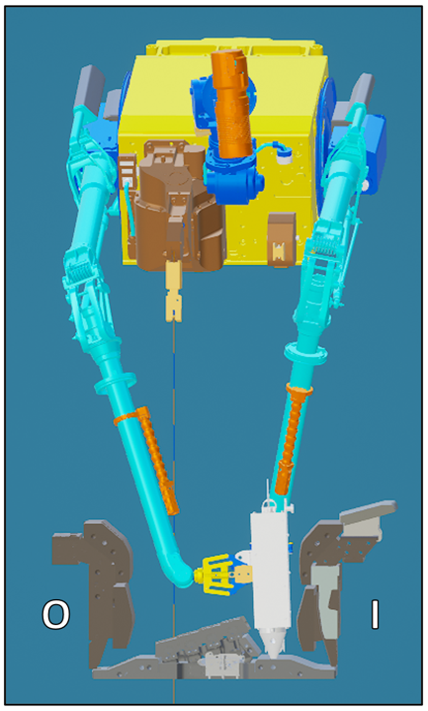
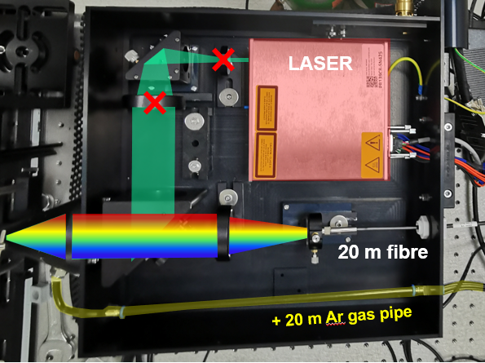
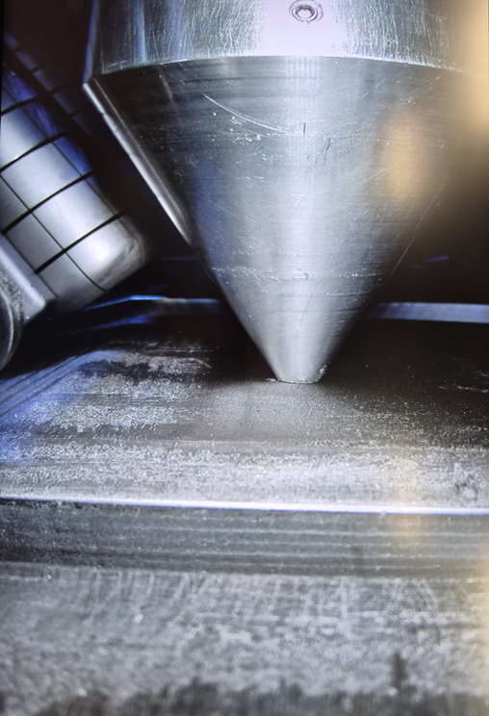
LIBS – Laser Induced Breakdown Spectroscopy
Application to JET
Target tile (HFGC)

Slide 9
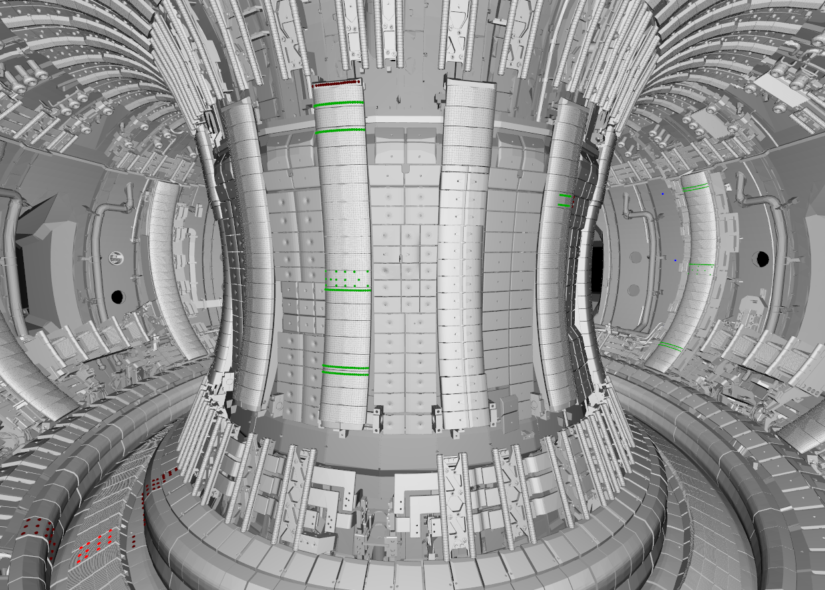
LIBS – Laser Induced Breakdown Spectroscopy
Application to JET – LIBS locations (examples)
Targeted materials:
Bulk Be
W – coated CFC
Be coated inconel
Bulk W
Inconel (vacuum vessel)

Slide 10
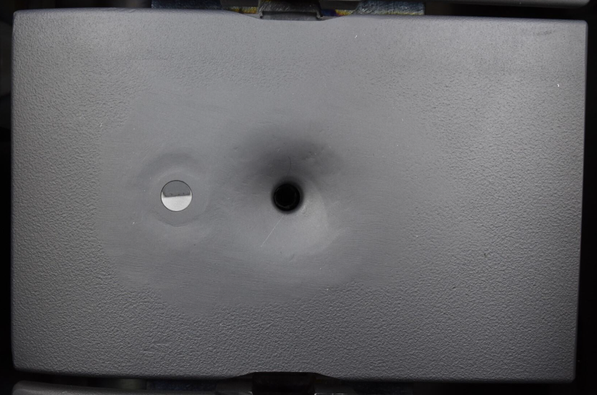
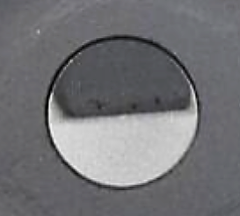
LIBS – Laser Induced Breakdown Spectroscopy
Application to JET – LIBS locations (examples)
10 mm

Slide 11
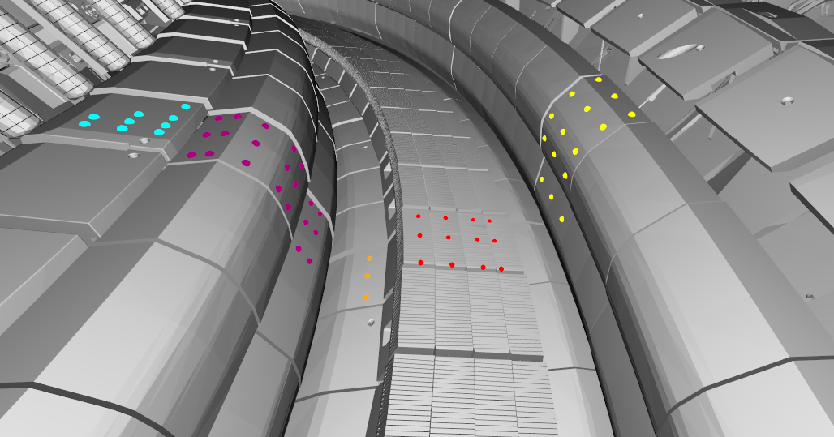
LIBS – Laser Induced Breakdown Spectroscopy
Application to JET – LIBS locations (examples)
HFGC_MOD2_RH2W
2IW G1B
LBSRP_2W_RH
2ON G8B
2ON G7A
2BW G4B
2IW G3A

Slide 12
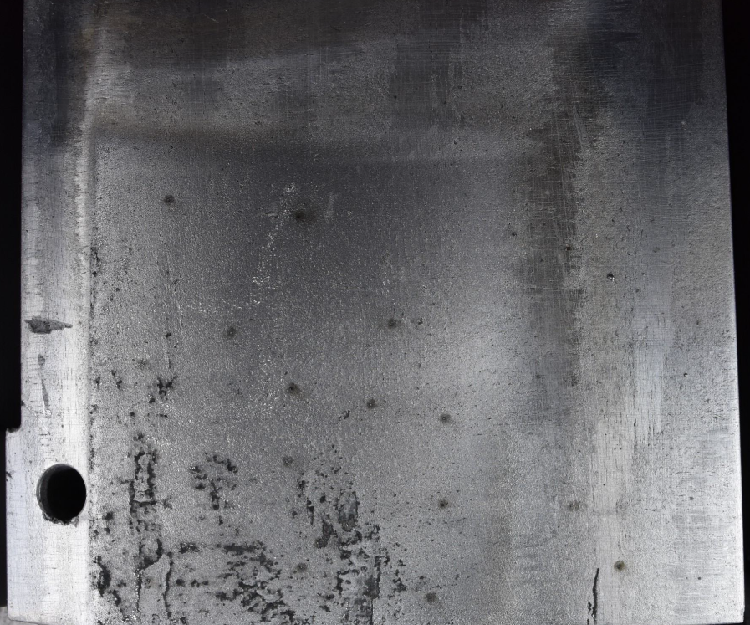
LIBS – Laser Induced Breakdown Spectroscopy
Application to JET – LIBS locations (examples)
10 mm
HFGC_MOD2_RH2W
2IW G1B
LBSRP_2W_RH
2ON G8B
2ON G7A
2BW G4B
2IW G3A

Slide 13
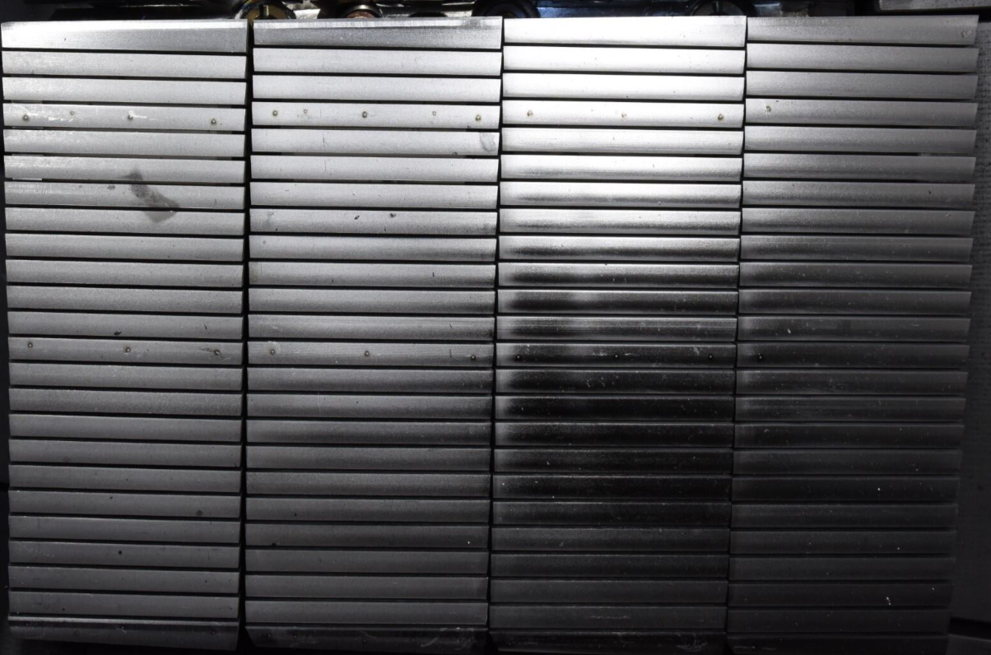
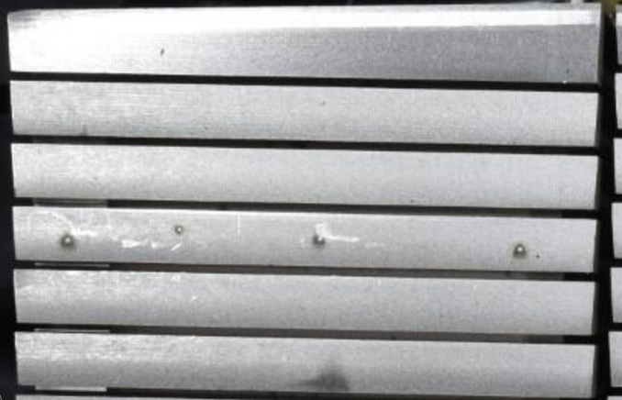
LIBS – Laser Induced Breakdown Spectroscopy
Application to JET – LIBS locations (examples)
10 mm
6 mm
HFGC_MOD2_RH2W
2IW G1B
LBSRP_2W_RH
2ON G8B
2ON G7A
2BW G4B
2IW G3A

Slide 14
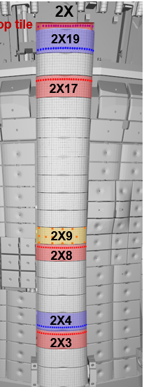
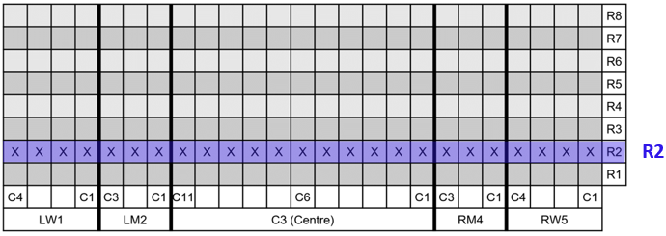
LIBS – Laser Induced Breakdown Spectroscopy
Application to JET – LIBS locations (examples)

Slide 15
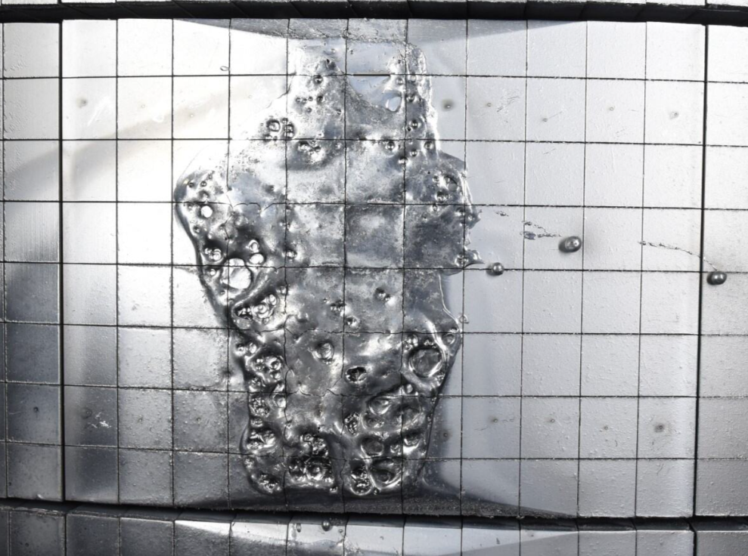
LIBS – Laser Induced Breakdown Spectroscopy
Application to JET – LIBS locations (examples)
12 ×12 mm

Slide 17
LIBS campaign @ JET completed
Last day of LIBS campaign: 18th of Oct 2024
Total shifts: 20 shifts (including one Sunday)
One shift = 9.25 working hours
Objective/Task | Pulses/Sessions goals | Status | Pulse # | Dates
All planned locations sampled | Be and W coating thickness Fuel retention and deposition | ☺ | 1-742 | 2-3, 7-8, 11-12, 14-15 October
Littrow delay settings optimisation | Improve H-D line resolution with laser pulses in high fuel retention areas (divertor HFGC & Tile 1) | ☺ | 744-758 | 16-17 October
Repeated locations with new Littrow settings | Divertor - W-CFC, Tile 5 - W, IWP – Be & W, OPL - Be | ☺ | 759-800 | 17 October
Divertor “risky pulses” (potential for damage to fibre due to space availability) | Fuel retention and deposition in divertor | ☺ | 801-829 | 17 October
Littrow 1st order settings | Wider spectral range for comparison with Aryelle spectrometer | ☺ |  | 18 October
Final D, D-H, Ne light calibration from J1T | Wavelength calibration check | ☺ |  | 18 October
Fuel retention and deposition with Littrow 1st order settings | Tile 5 – W & Tile 4 – W-CFC | ☺ | 830-840 | 18 October

Slide 18
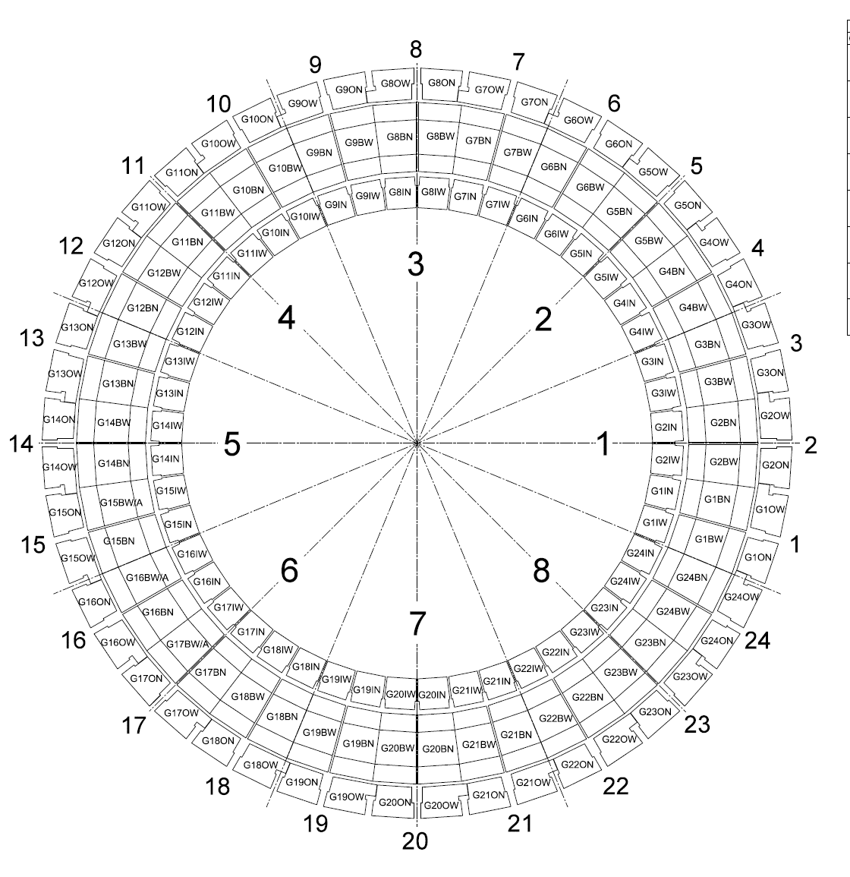
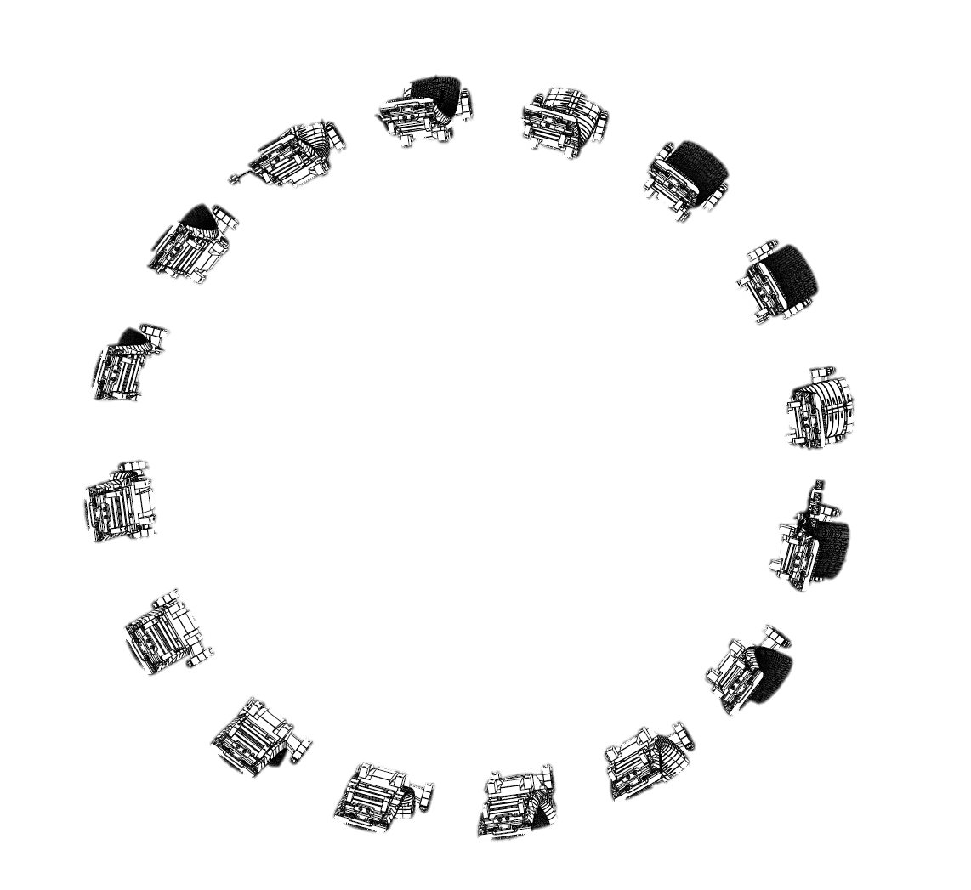
LIBS – Laser Induced Breakdown Spectroscopy – TOROIDAL MAP
4D
Z
X
VW
Oct5
X
Z
Z
X
X
Z
Z
X
X
Z
Z
X
VW
Oct1
X
Z
Bulk Be
W – coated CFC
Be coated inconel
Bulk W
Inconel (vacuum vessel)

Slide 19
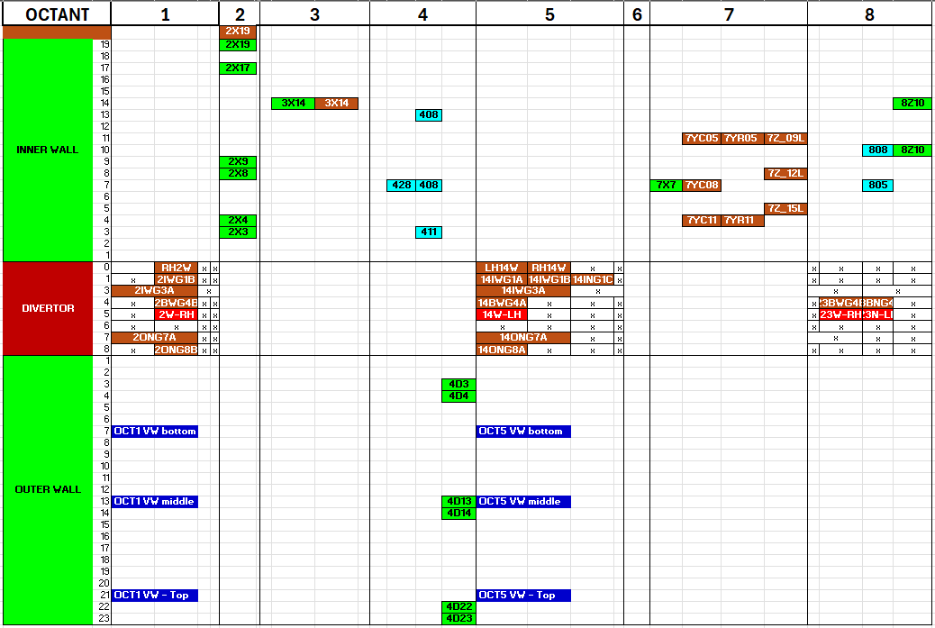
LIBS – Laser Induced Breakdown Spectroscopy – FULL DISTRIBUTION MAP
402
Poloidal direction
Bulk Be
W – coated CFC
Be coated inconel
Bulk W
Inconel (vacuum vessel)
Toroidal direction

Slide 20
LIBS – ANALYSIS PLANNING
402
Poloidal direction
Bulk Be
W – coated CFC
Be coated inconel
Bulk W
Inconel (vacuum vessel)
Toroidal direction

Slide 21
LIBS – ANALYSIS – Divertor poloidal cross section
Poloidal direction
W – coated CFC
Bulk W
Toroidal direction

Slide 22
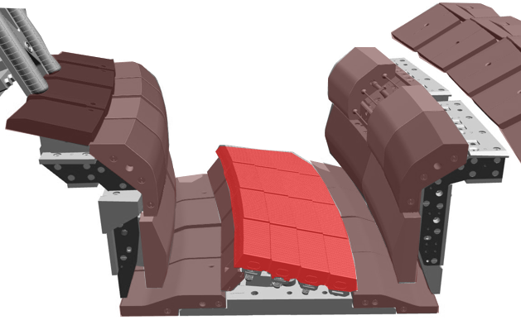
Full poloidal cross-section of divertor
LIBS – ANALYSIS – Divertor poloidal cross section
1st LIBS analysis plan
(ongoing)
Tile |  |  | Initial Pulse no. |  |  | Additional pulse no.(relatively same location)
HFGC (LH 14W) |  |  | 59 – 63 |  |  | 777 – 780
Tile 1 (14IW G1B) |  |  | 808; 12 – 15; 73 – 74 |  |  | 786 (a repeat of 74)
Tile 3 (14IW G3A) |  |  | 809 – 811 |  |  | Same as above
Tile 4 (14BW G4C)A |  |  | 75 – 77 |  |  | 787 – 788
Tile 5 LBSRP_14WLH | C1 | Stack A | 20 |  | 20 | 765
 |  | Stack B | 23 |  | 23 | 766
 |  | Stack C | 26 |  | 26 | 768
 |  | Stack D | 29 |  | 29 | 769
 | C21 | Stack A | 40 |  | 40 | 770
 |  | Stack B | 43 |  | 43 | 771
 |  | Stack B (C12) |  |  | 34
 |  | Stack C | 46 |  | 46 | 773
 |  | Stack D | 49 |  | 49 | -
Tile 6 |  |  | NO LIBS on T6 | NO LIBS on T6 |  | NO LIBS on T6 | NO LIBS on T6
Tile 7 (14ON G7A) |  |  | 805 | 805 |  | - | -
Tile 8 (14ON G8A) |  |  | 802; 54; 57 | 802; 54; 57 |  | 775 (between 54 and 57) | 775 (between 54 and 57)
Tile 8 (2ON G8B) |  |  | 360 & 368 | 360 & 368 |  | No repeated pulses | No repeated pulses
Top of tile 8 (14ON G8A) |  |  | 51 | 51 |  | - | -
14IWG1B
14ON G8A
0
HFGC_LH 14W
1
1
8
3
5
7
14IWG3A
4
6
14BWG4A
LBSRP_14W LH
C1 & C21
14ON G7A

Slide 23
LIBS – ANALYSIS PLANNING – discussions
402
Poloidal direction

Bulk Be
W – coated CFC
Be coated inconel
Bulk W
Inconel (vacuum vessel)
Toroidal direction

Slide 24
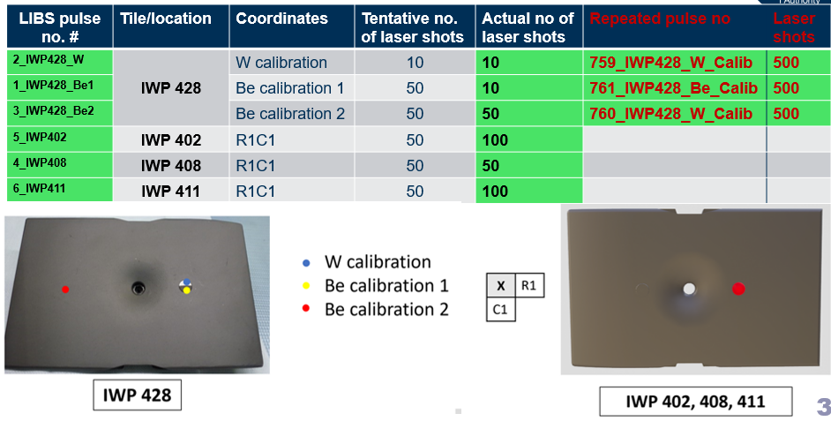
LIBS – FULL Detailed DISTRIBUTION MAP
402
Poloidal direction
Be coated inconel

Slide 25
LIBS – ANALYSIS PLANNING – discussions
JET LIBS CALIBRATION pulses (pure materials)
Be calibration: 2X8 pulse #492 (from C3 tile)
Inconel (vessel wall) OCT1 middle: pulse no. #357
Pure W (W-wedge – Lamellae): Stack A pulse #20 and repeated pulse (with setting changes) pulse #765
W-CFC Top of tile 8: pulse no. #51 (250 shots)

