Slide 1
JET-LIBS
RONGXING YI

Slide 2
Part 1: Experiment before the measurement in JET vessel
2

Slide 3
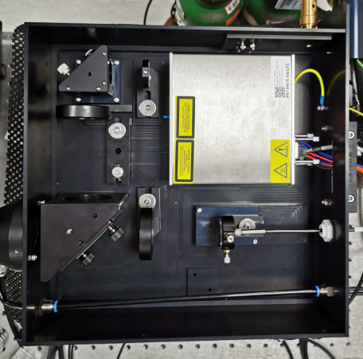
1.Setup and samples
Damaged W
Plansee W
CFC-W
W-Ta-D
3

Slide 4
2. Results-Ablation rate
Plansee W
Ablation rate varies from the initial 30 pulses to 1000 pulses
At first it is 300nm/ pulse, when it goes to 1000, averaged values is 179 nm/pulses
Crater bigger>larger surface>lower fluence>lower ablation rate
Ns laser melting also make the ablation rate smaller.
4

Slide 5
2. Results-Ablation rate
Ablation rate varies from sample to sample
Damaged recrystallization
Plansee W
Eurofusion W/Ta with Mo substrate
PURE Mo layer~ 280nm/pulse
55nm/pulse
Which means, we need do ablation rate test afterwards for all possible materials with the same laser system
5

Slide 6
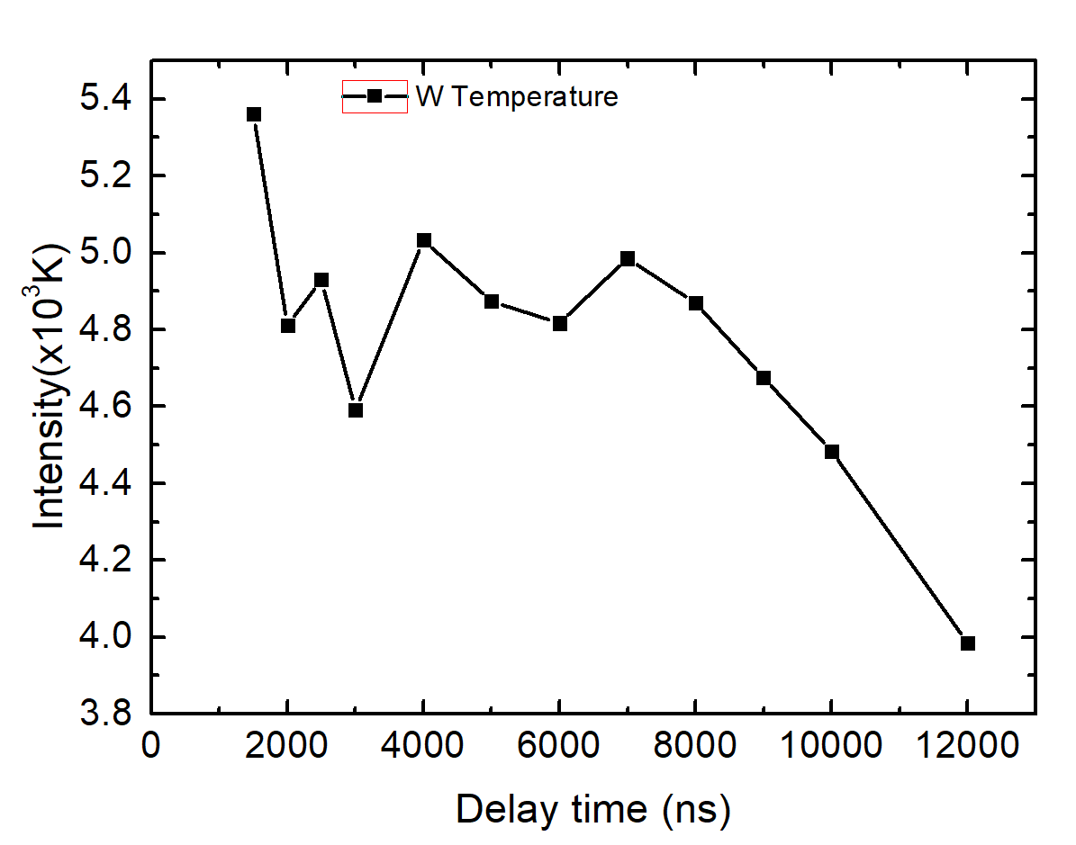
2. Results-Ha spectrum optimization
CFC sample- test with Littrow
Electron density was calculated through the width of H, LTE exist before 6us in W plasma
4 W lines can be used in this small range to calculate Te
9 us delay, linewidth is small enough to separate D+H visually, but we can still choose a shorter delay and use fitting method to separate D+H
6

Slide 7
Part 2: Measurement in JET vessel
7

Slide 8
We have the Littrow data, PMT data and avantes data.
Littrow: higher resolution, possibility for DT(also some layer info)
PMT: only for DH, not possible for T(considering the FWHM and multi peaks)
Avantes: overview, layer information
8

Slide 9
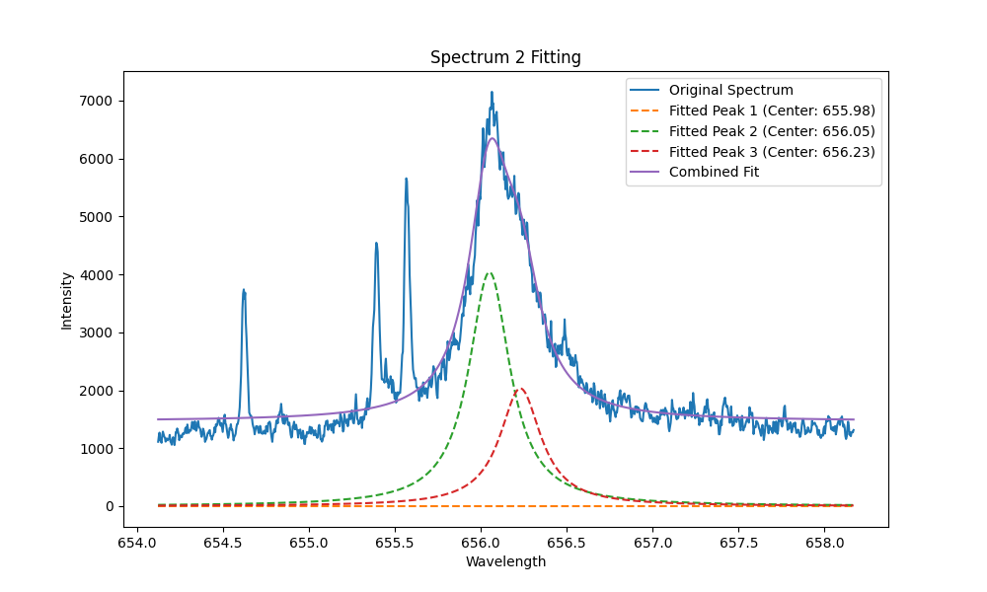
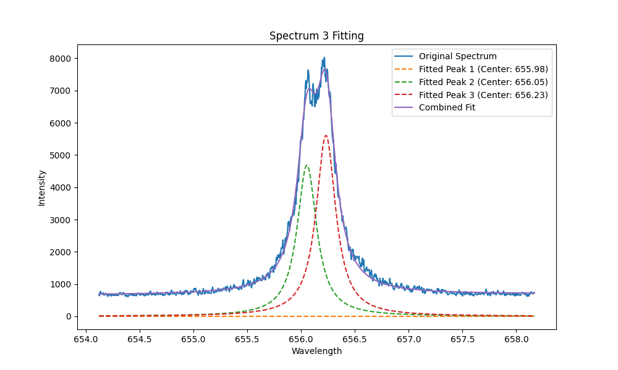
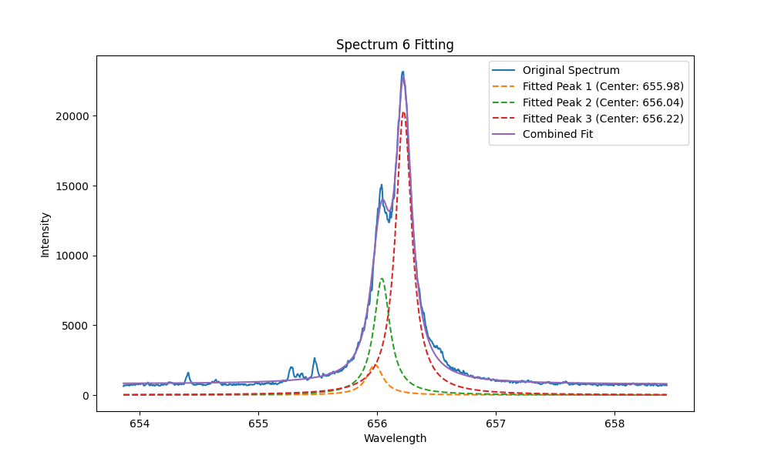
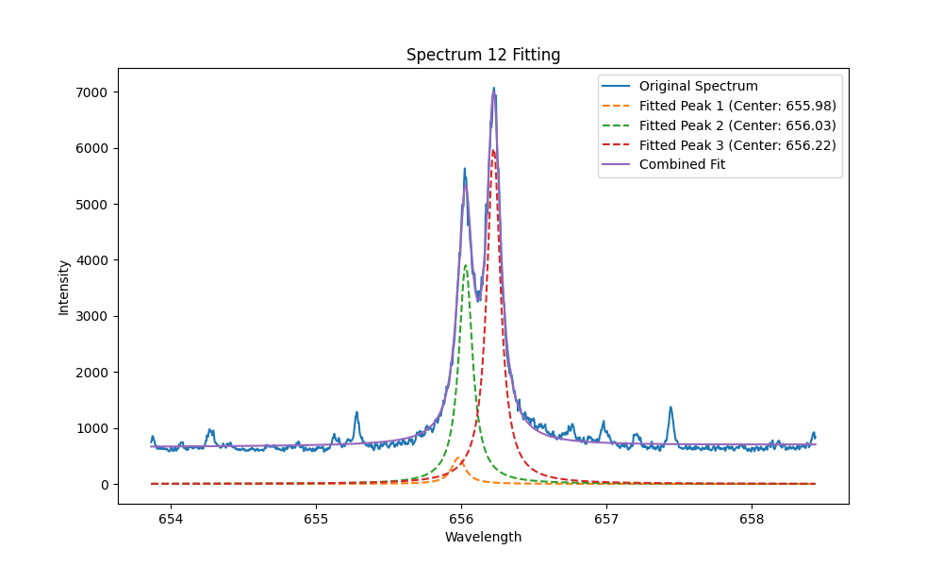
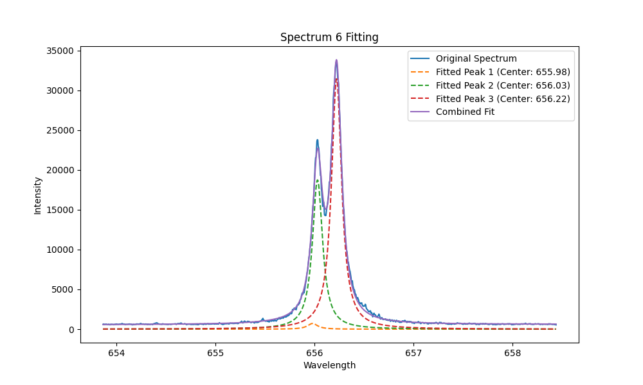
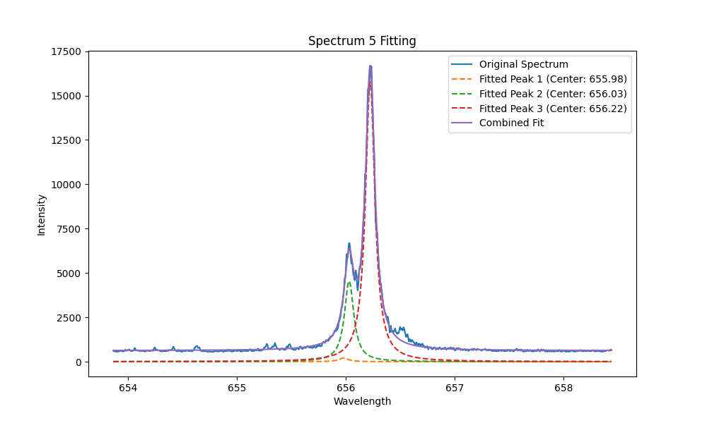
2. Results-Ha spectrum optimization
Different delay time in-vessel @JET
4us
8us
10us
12us
14us
18us
9

Slide 10
2. Results-Ha spectrum optimization
FWHM of Ha is narrow enough to separate H/D after 8 us. After 18us it reaches to 0.1 nm, which is still higher than the gap between T/D.
However, we can use voigt fitting to resolve them.
But there is still a trade off between delay and SNR.
Different delay time
H/D 0.18 nm
T/D 0.07 nm
FWHM
SNR
Fitting quality
10

Slide 11
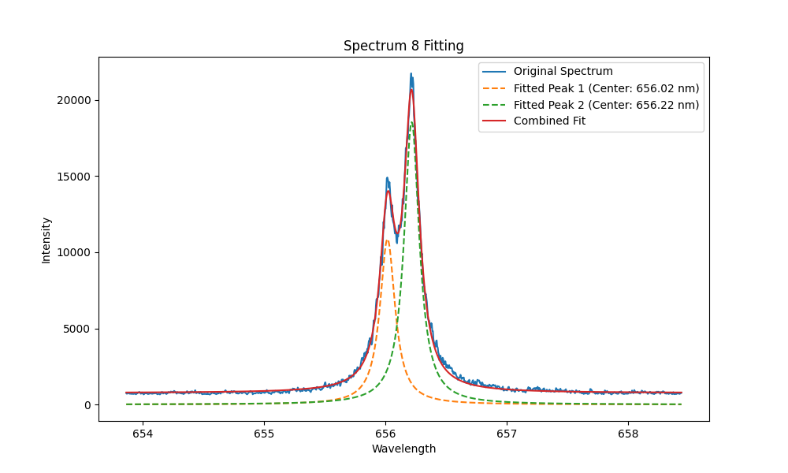
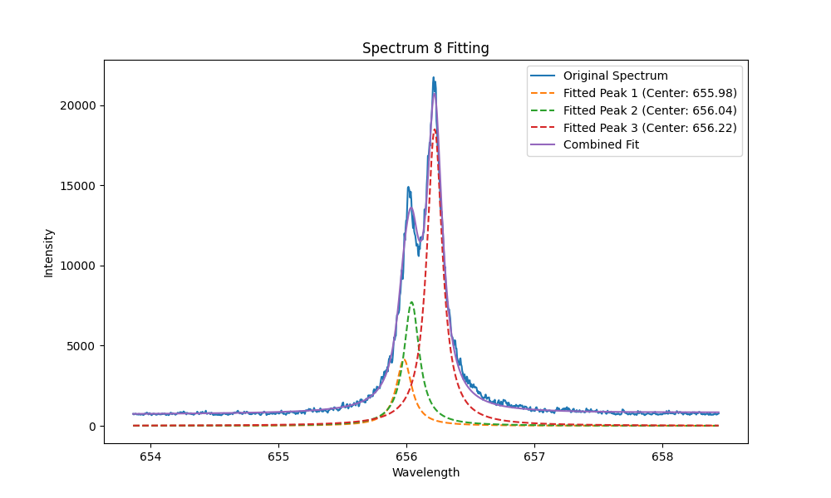
2. Results-Initial fitting(not so good)
758_RH2W_REC3
2 peaks fitting
D/H
3 peaks fitting
T/D/H
The peak position and peak difference between HD is not fixed.
Better give a +-2 pixels range for H, after H is fixed then subtract 44 pixel for D
Choose the right peak position is significant!!!
2-4pixels difference make huge deviation
The wavelength moved about 5pixels from the beginning to the end.
So the original calibration has a deviation now, to achieve better fitting result,
A new calibration should be made.
11

Slide 12
My new strategy is,
If there is significant(6times noise) W 657.39 nm line, use it to calibrate other lines
If the W line is weak(6 times noise,6N), do the fitting directly with H. Set the original value for H peak position(526-531) , after get the fixed value, use this value to calibrate other D, T, Ti lines, save data in red when signal intensity <6N(only when signal >6N, it is regarded good signal)
12

Slide 13
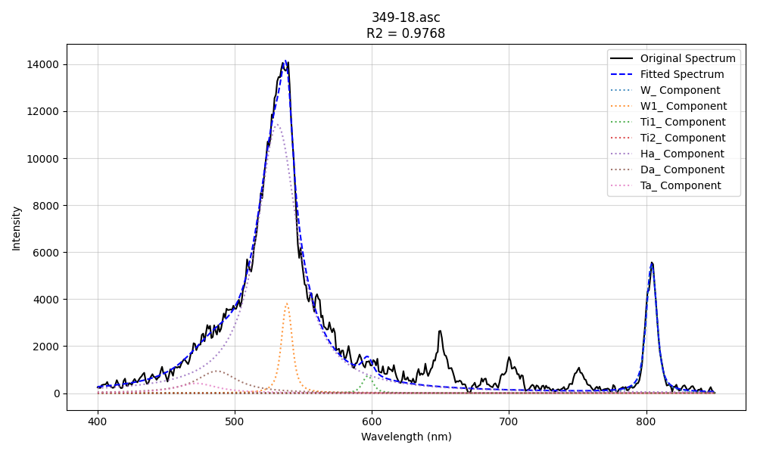
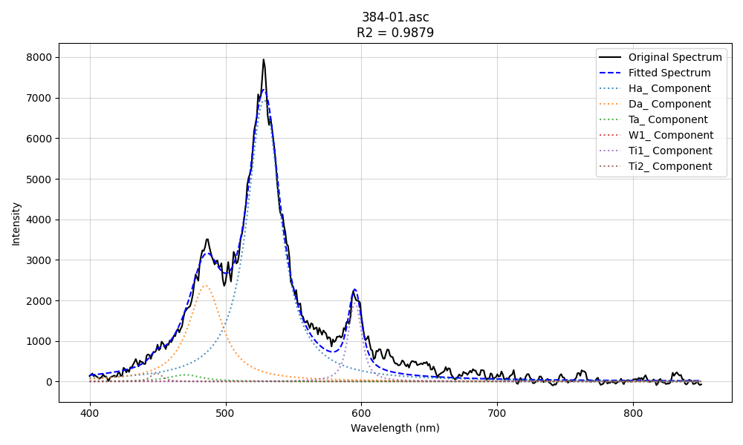
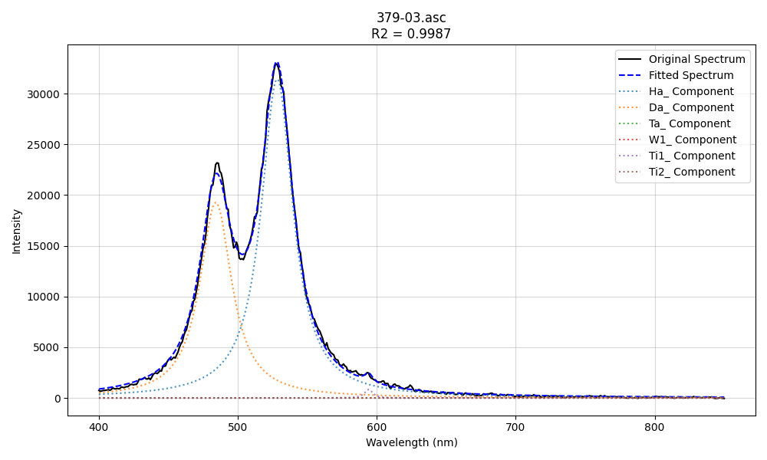
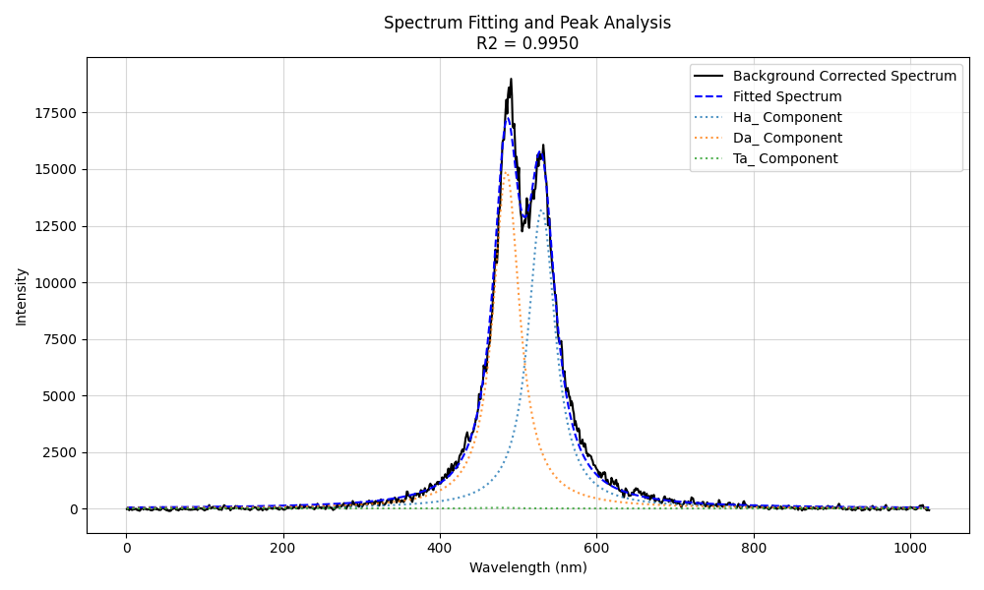
2. Results- new fitting
4 typical spectra in divertor and limiter
When there is not the unknow peak, fitting is very good
divertor G8B
divertor HFGC
We can see small amount of fitted T in some spectra of G8B and HFGC
divertor HFGC
limiter

Slide 14
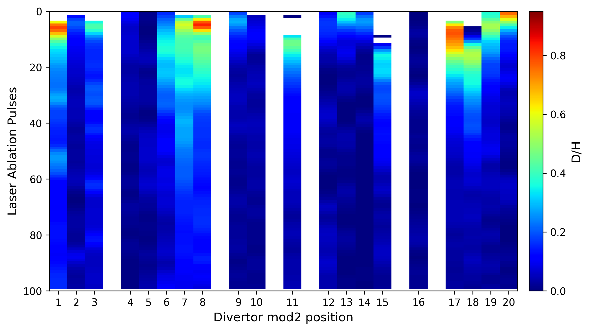
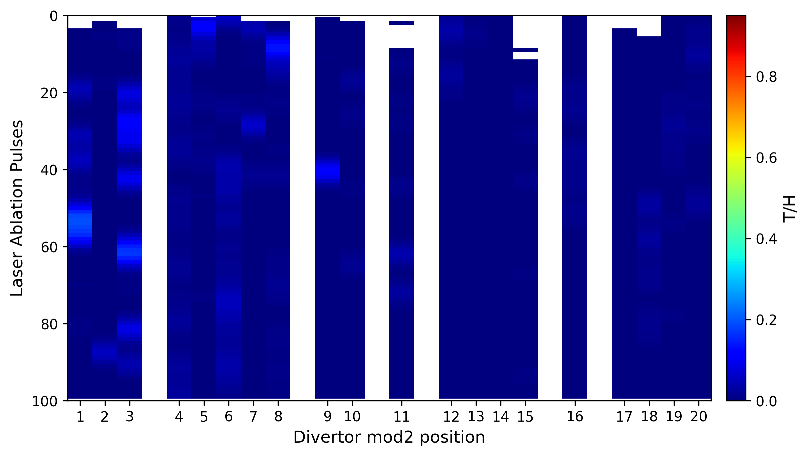
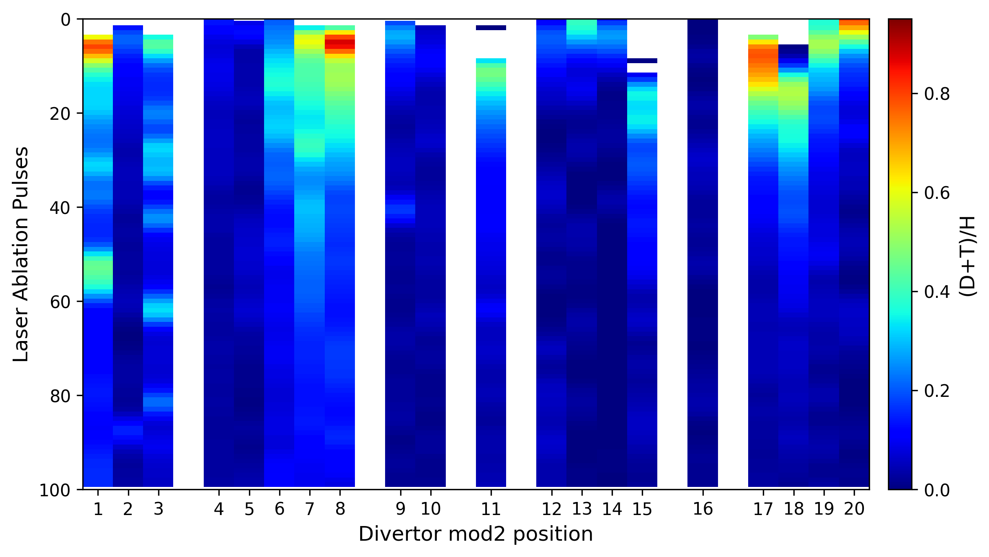
2. Results- new fitting
Fuel retention in mod2 divertor(poloidal from HFGC-Tile8)
20
1
White means no H date at all
Blue(0) means H is there, but no D or T
14

Slide 15
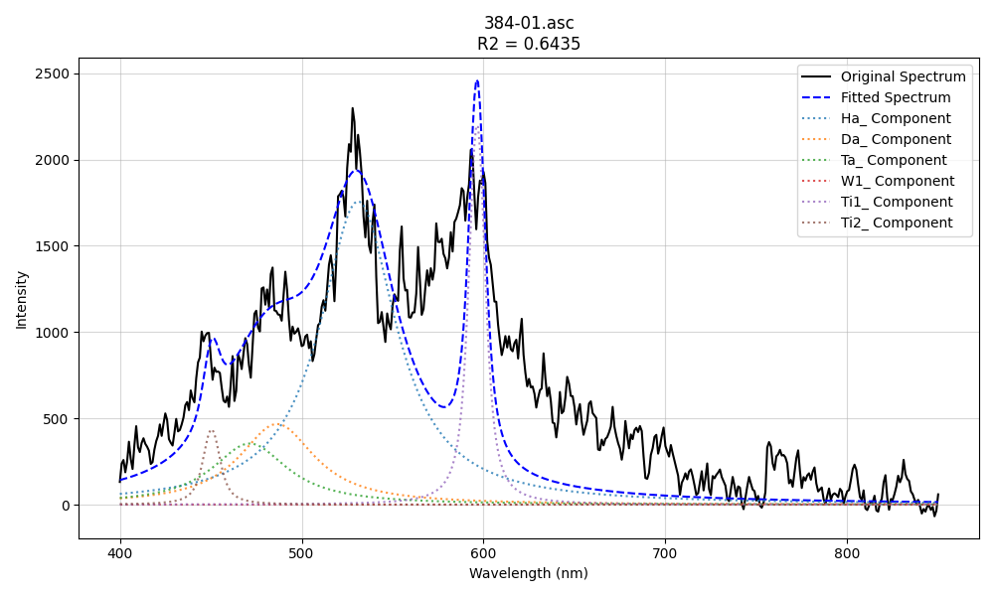
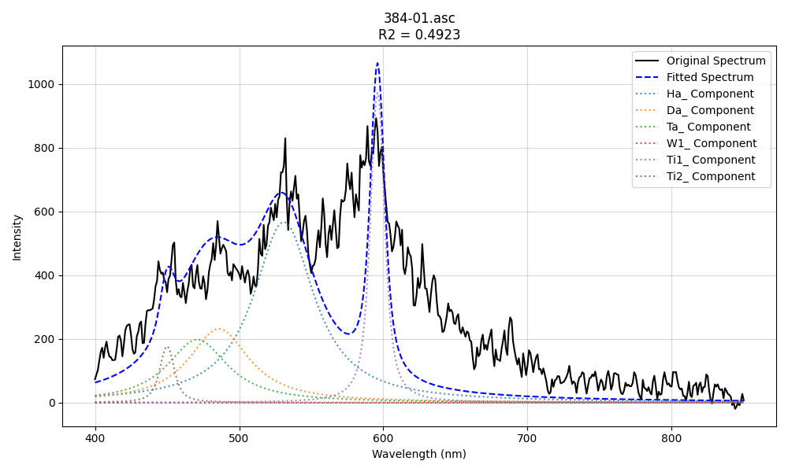
2. Results- new fitting
Fuel retention in mod2 divertor(poloidal from HFGC-Tile8)
Most T are fitted in this kind of spectra,
So not very reliable. This kind of peak consisted of unknown components, which are not suitable for fitting.
15

Slide 16
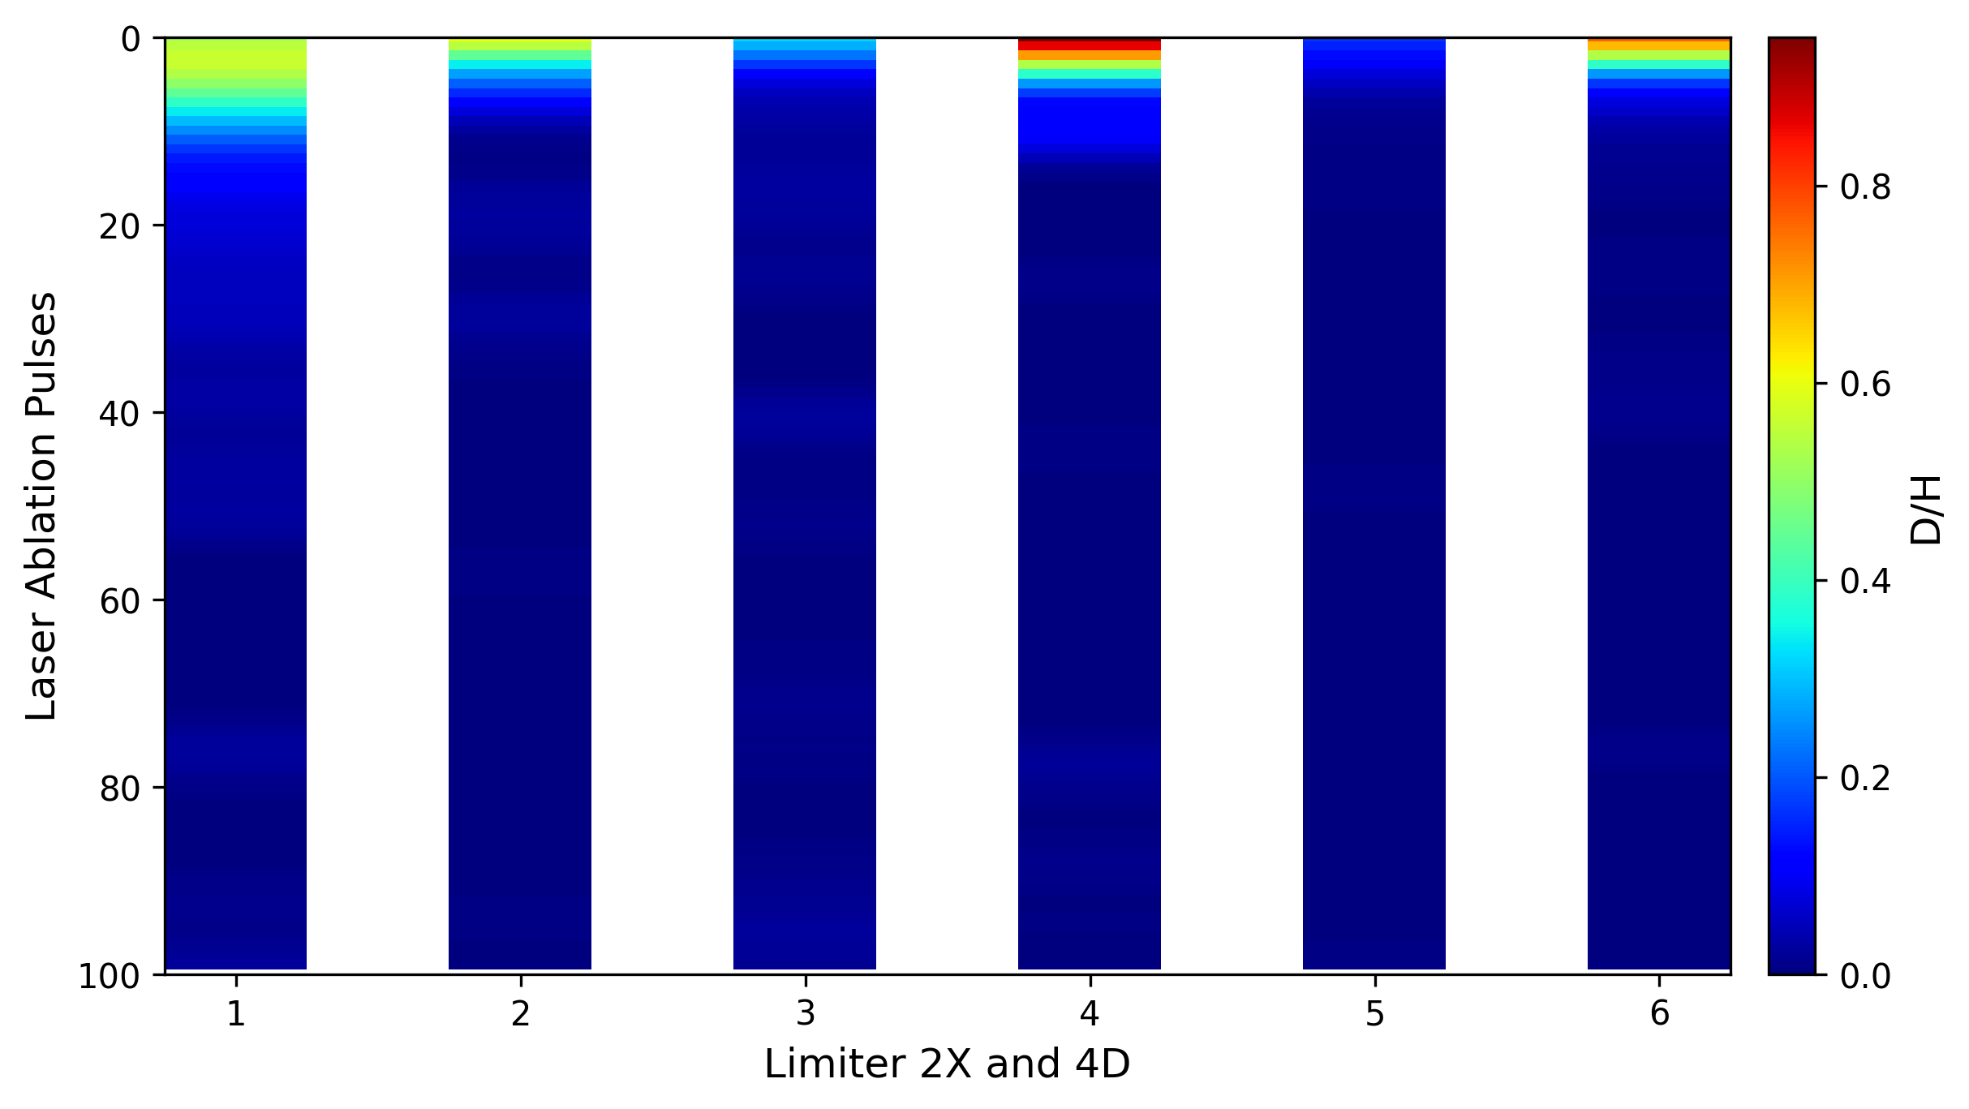
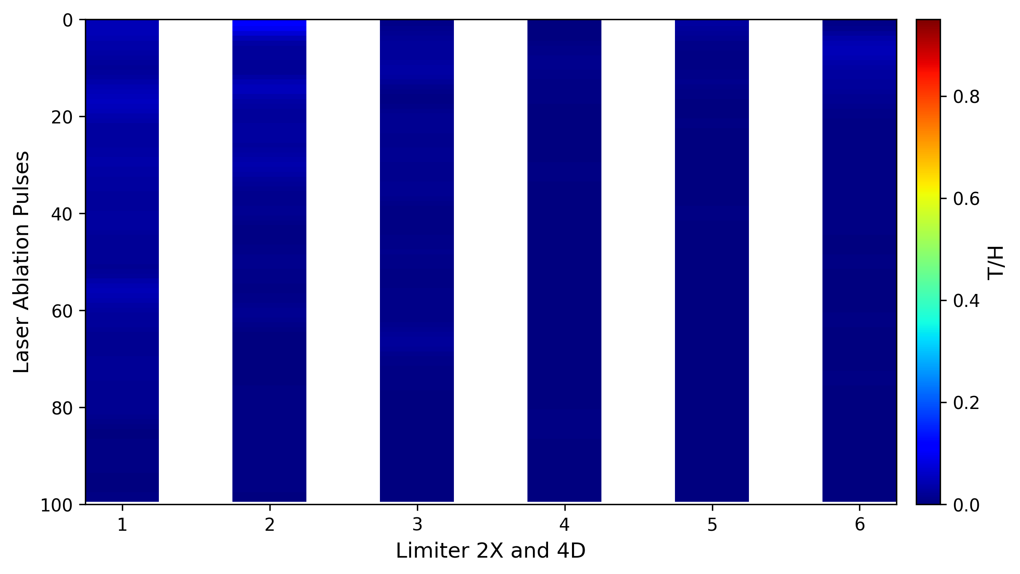
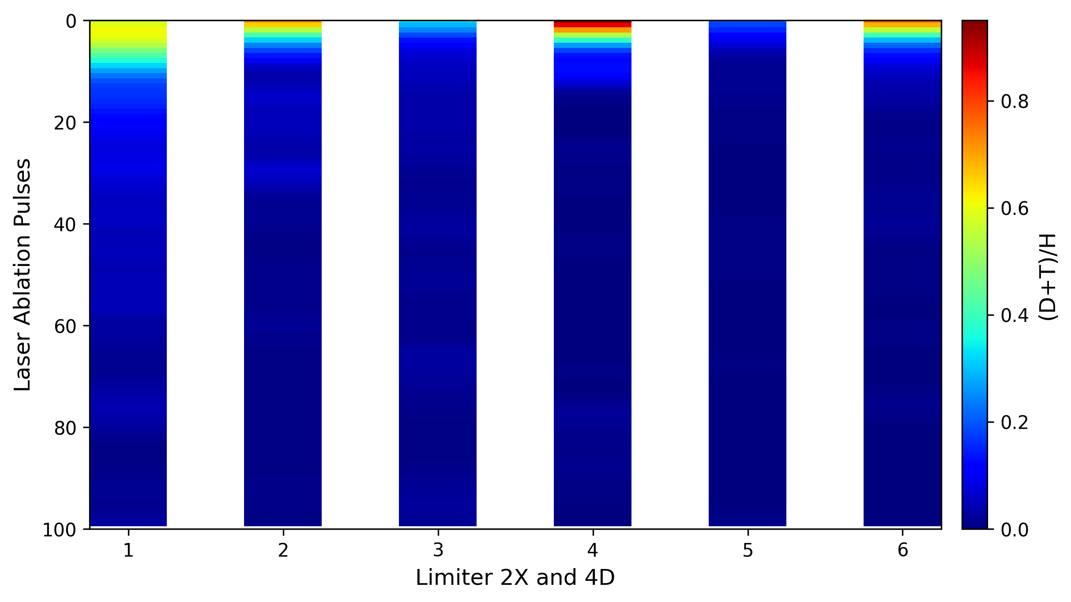
2. Results- new fitting
Fuel retention in limiter(WOPL 4D and IWGL 2X)
IWGL 2X
WOPL 4D
3
19
23
6
2
09
5
09
1
04
04
4
16

Slide 17
Then we try to acc. the initial 100 pulses, to increase the SNR.
17

Slide 18
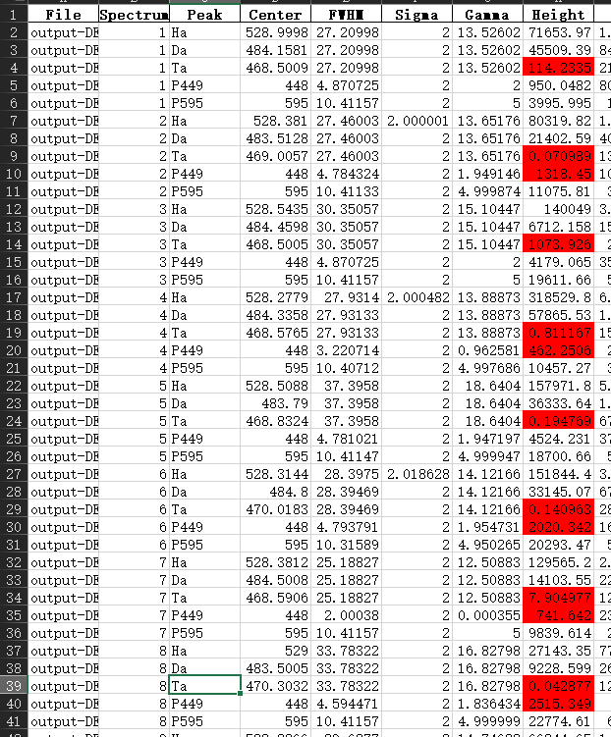
Delay from 8-18 us
H/D separated peaks can be observed
T doesn’t show any separated peak
1st-100th laser pulses acc.
H
H
H
D
D
D
H
H
H
D
D
D
Fitting results keep the same
18
Notes:
不是sheet名词，而分别是D/H, T/H, (D+T)/H

Slide 19
At last, we check the possible data frame by frame, and only acc 9-20 frames for Divertor 23 tile 4. Finally find some T, with high possibility.
(But in this case, the T results is very very very sensitive to peak position, even 1 pixel make huge difference. When you deal with weak overlapped signal, you cant avoid it.)
19

Slide 20
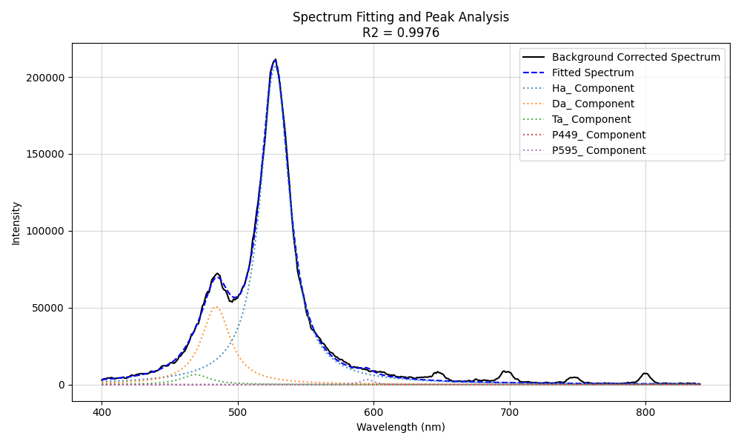
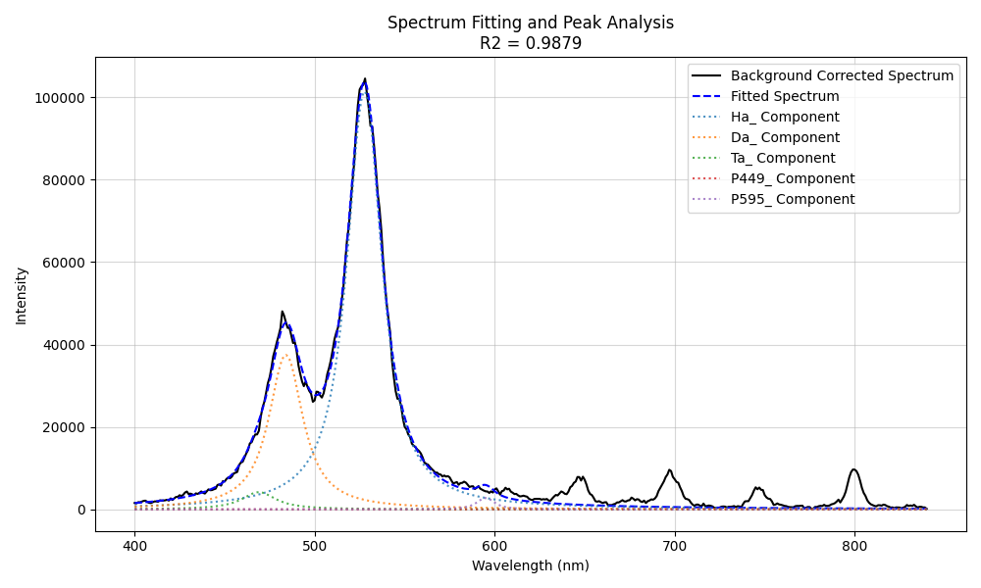
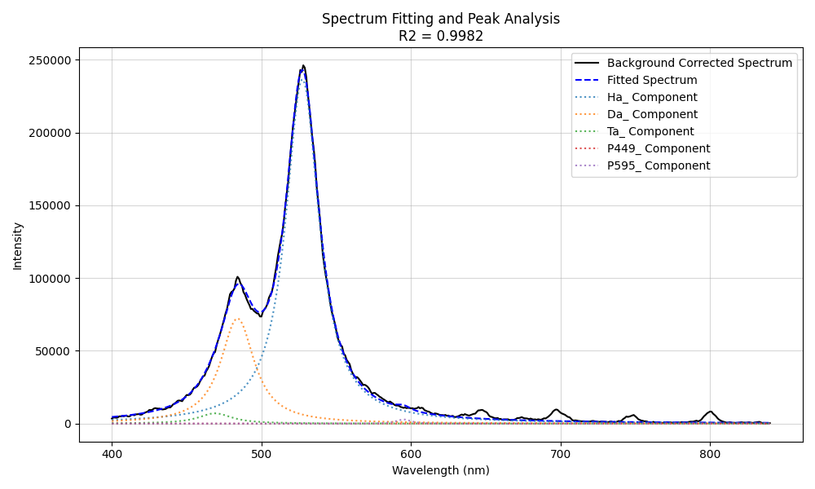
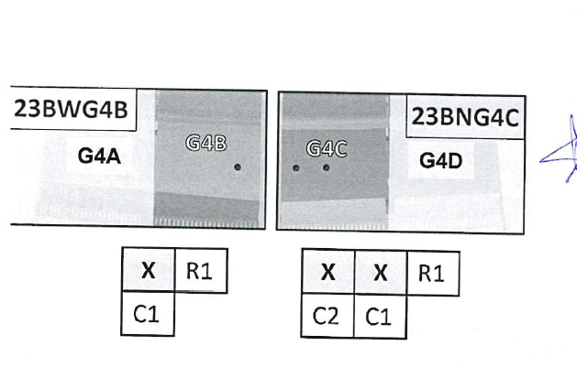
Ha wavelength optimized(D T fixed)
1
2
3
 | T/D
1 | 12.79%
2 | 11.11%
3 | 9.79%
3 2 1

Slide 21
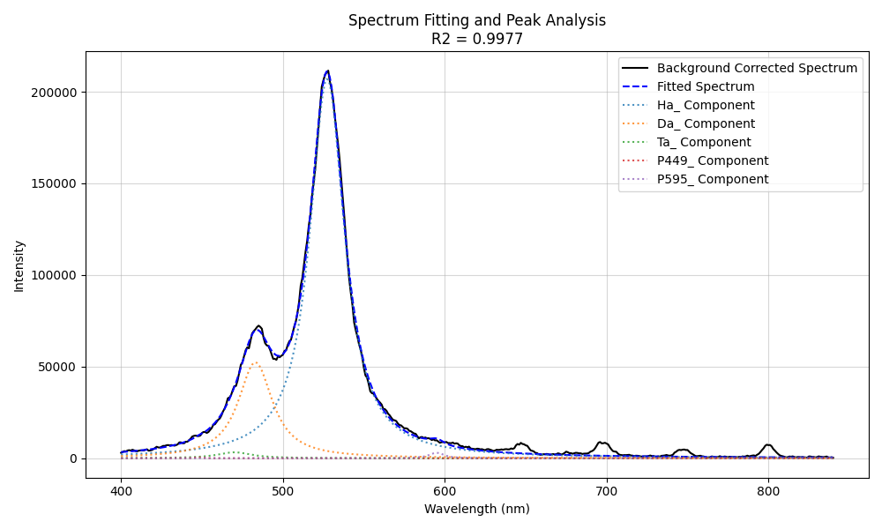
Ha wavelength optimized(D T optimized in 1 pixel)
1
2
3
 | T/D
1 | 6.20%
2 | 3.04%
3 | 3.04%
3 2 1
21

Slide 22
Conclusion
Total fuel retention(D+T) in tiles, we can extract this information well
T depends on its concentration ratio T/D, in our case, it seems lower than 10%. So not easy to detect.
H/D/T signals intensity drop fast when delay time increasing, if you want to have DT totally separated, it should be after 18us, but SNR become quit low for them in such a long delay time.
Fitting with high SNR signal and narrow FWHM can provide results with high accuracy and robustness, but in real measurement with our existing setup, high SNR and narrow FWHM is mutually exclusive.
22

Slide 23
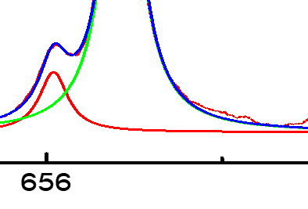
Fitting problem1
-- when there are multi peaks around Ha, there is always extra unfitted part
1000th laser pulse, when only Ha exists
When we have multi peaks around Ha, the unfitted right wing of the spectrum.
(multi Lorentz fitting method also cant fit this part, so it may come from other component)
Single voigt or even Lorentz fitting can fit the spectrum quite well. (I also tried multi-Lorentz fitting, no significant difference)

