Slide 1
LIBS ML data analysis
P. Gąsior, D. Sokulski
IPPLM Institute of Plasma Physics and Laser Microfusion, Hery Street 23, 01-497, Warsaw, Poland
JET LIBS data analysis meeting #1
Juelich, 08/02/2025

Slide 2
Outline
Machine learning concepts for LIBS for Fusion
Generalisation: bias vs overfitting
Finding an efficient representation with autoencoders
Results:
Application of evolutionary algorithms for hyperparameter tuning
Application of chemical contents analysis for complex spectra
Sumary and future work
Hyperparameter and their optimisation
Motivation
Machine learning – basic concepts
Clarifications on basic terms
Idea of ML
Deep learning
General ML scheme

Slide 3
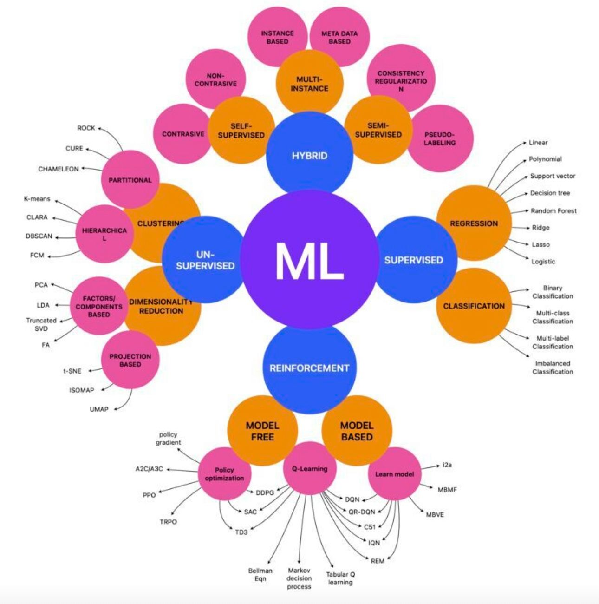
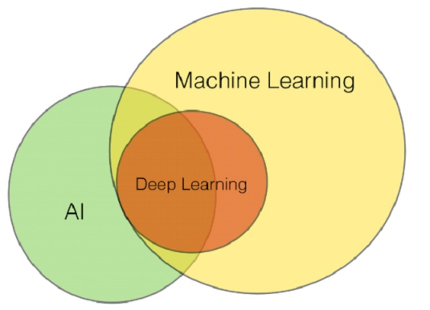
Basic concepts
Arthur Samuel, 1959
Machine Learning: Field of study that gives computers the ability to learn without being explicitly programmed.
John McCarty,
1956, Conference in Dartmouth
AI
Deterministic
Stochastic
ML
Regression
Classification
Reinforcement
ANN
Supervised
Unsupervised
Deep
Self-Learnig
Active Learning

Slide 4
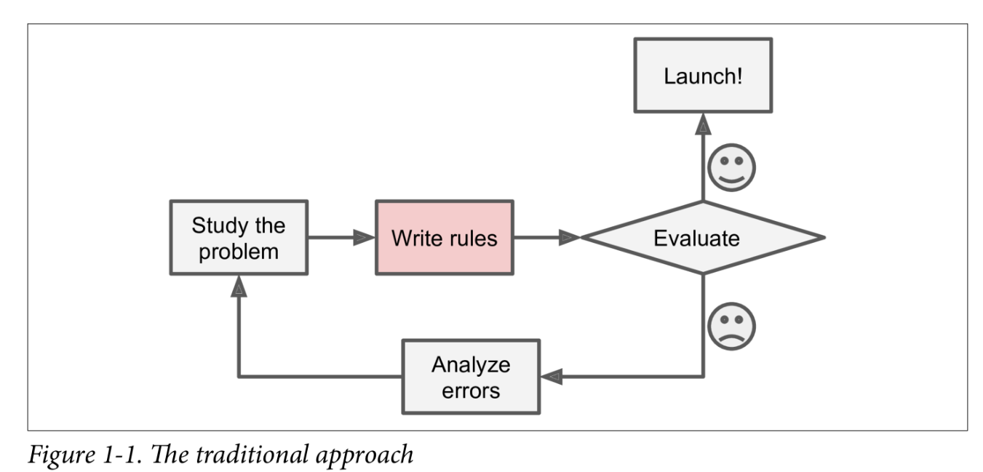
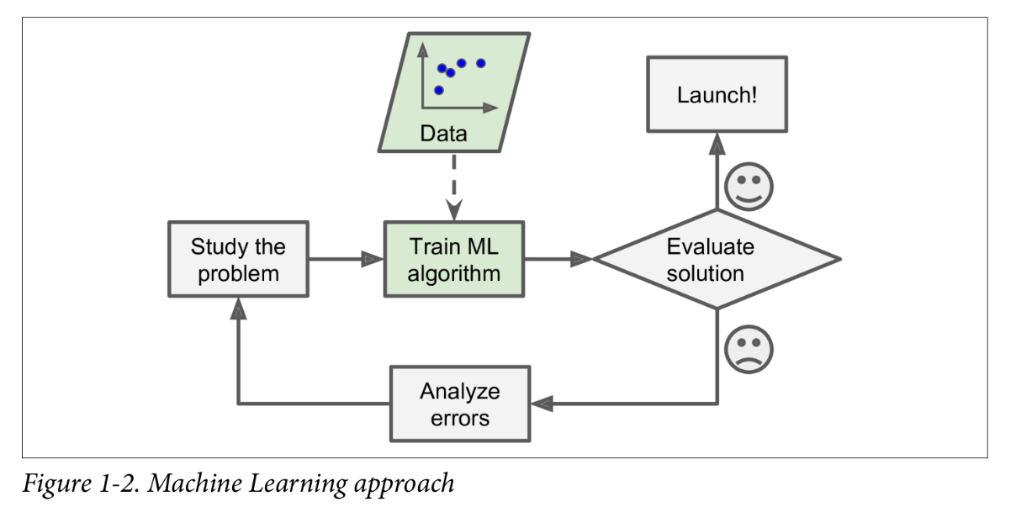
Advantages of ML approach
The model development may be supported by the use of synthetic data.
Two basic types of system may be used: classification and regression.
Its performance is based on patterns recognition and it depends on the amount of data used for training the system.
A modern and rapidly developing approach with proven successful performance in numerous fields of science, industry and commerce.
There is a number of modern tools which may be effectively used for this goal.
Working with this tools is very attractive for young researchers and gives a lot of fun !
A. Géron, Hands-On Machine Learning with Scikit-Learn, Keras, and TensorFlow.(2nd ed.).O’Reilly, 2019

Slide 5
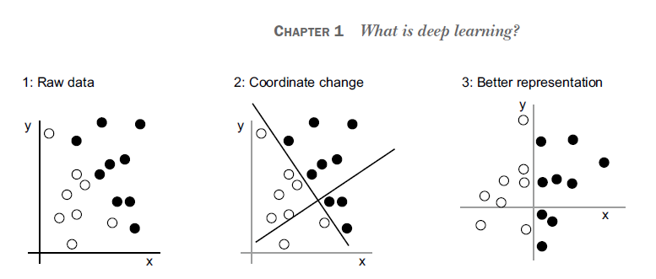
What is deep learning
F. Chollet, Deep Learning with Python (Manning Publications, New York, 582, 2017).

Slide 6
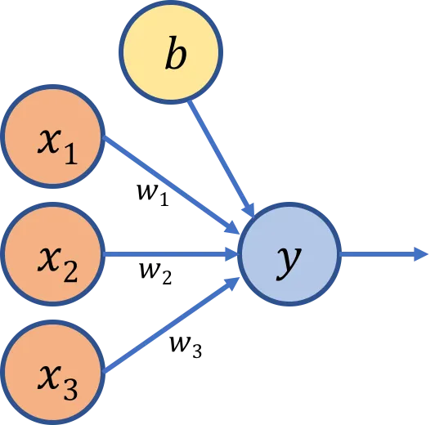
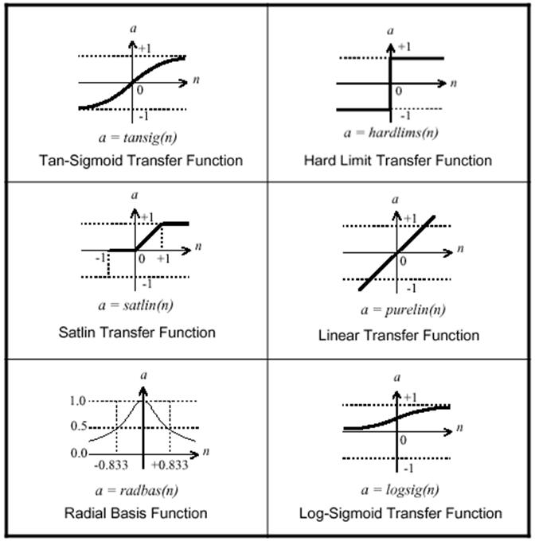
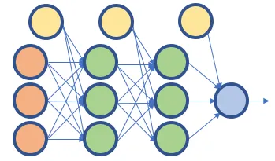
LR on steroids
https://medium.com/@melodious/understanding-deep-neural-networks-from-first-principles-logistic-regression-bd2f01c9e263

Slide 7
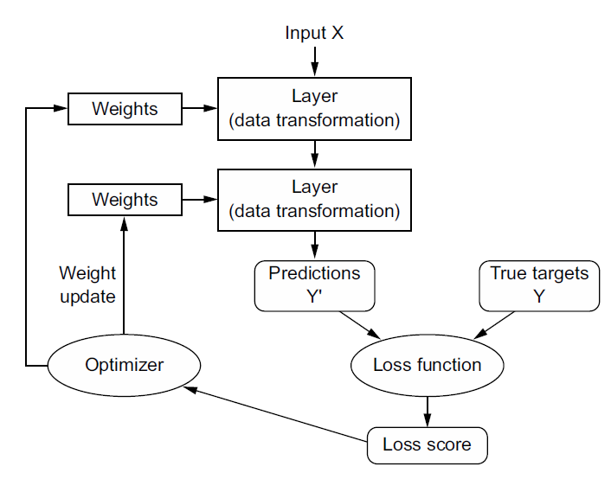
General ML scheme
F. Chollet, Deep Learning with Python (Manning Publications, New York, 582, 2017).

Slide 8
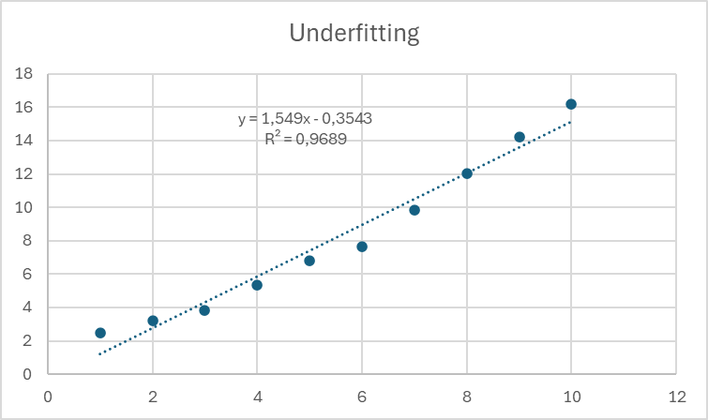
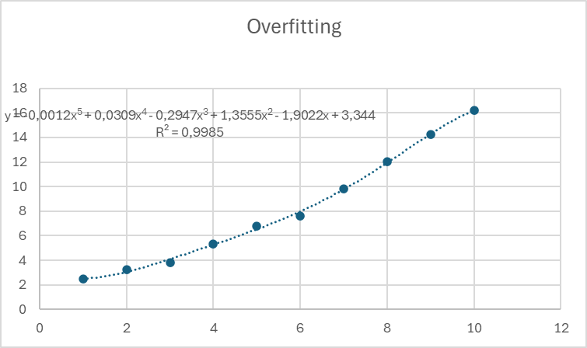
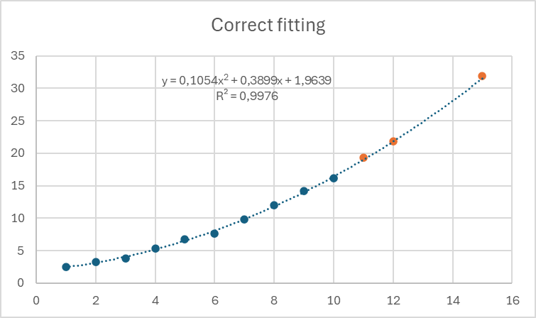
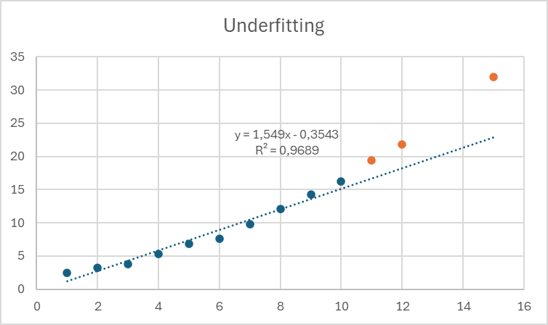
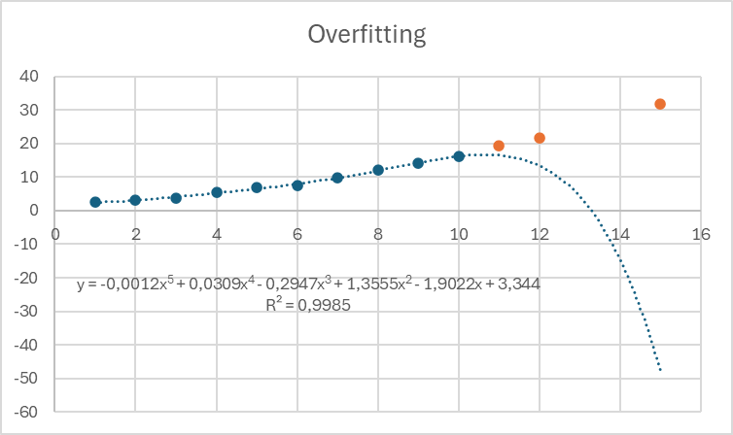
Memorisation vs generalisation
Real model:
x^{1.45}+1.9x+4 + noise
Regularisation aims at minimizing coefficients

Slide 9
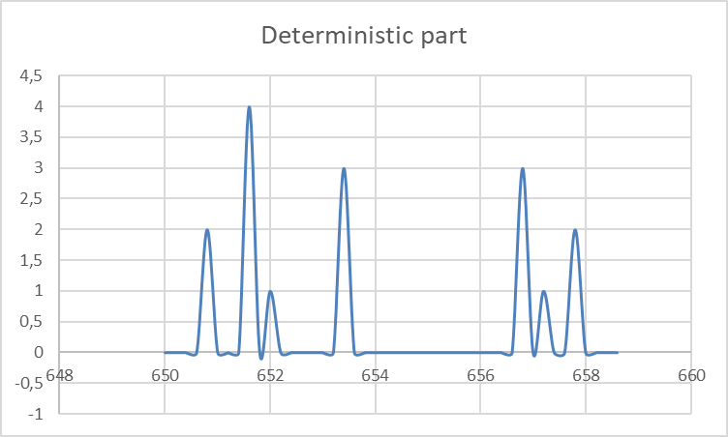
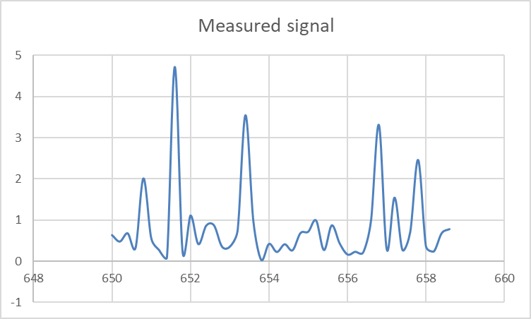
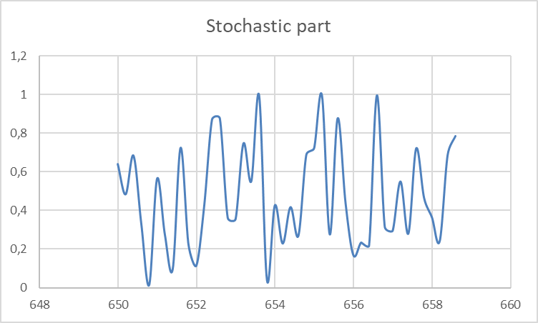
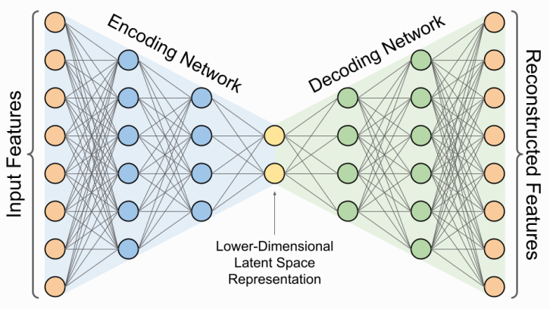
Finding efficient representation – autoencoder
Measurement
Autoencoder can solve two problems:
Data reduction
Noise removal
In generalisation mode, autoencoder can „learn” the signal, but fails to memorise the noise.
Input spectrum
Output spectrum

Slide 10
Human part of the machine learning
Parameters vs hyperparameters
The parameters of the model are learnt during the training. For the ANN based autoencoder, these are the weights of the neurons.
The hyperparameters are chosen by the model developer and are subject of optimisation. There are numerous hyperparameters, e.g.
Learning Rate: Controls how much to change the model in response to the estimated error each time the model weights are updated.
Batch Size: The number of training examples utilized in one iteration.
Number of Epochs: The number of complete passes through the training dataset.
Number of Layers: The number of hidden layers in the encoder and decoder parts of the autoencoder.
Number of Neurons per Layer: The number of neurons in each hidden layer.
Activation Functions: Functions like ReLU, Sigmoid, or Tanh used to introduce non-linearity into the model.
Optimizer: Algorithms like Adam, SGD, or RMSprop used to minimize the loss function.
Loss Function: Functions like Mean Squared Error (MSE) or Binary Cross-Entropy used to measure the difference between the predicted and actual outputs.
Dropout Rate: The fraction of neurons to drop during training to prevent overfitting.
Weight Initialization: Methods like Xavier or He initialization to set the initial weights of the network.
Regularization Parameters: Parameters like L1 or L2 regularization to prevent overfitting.

Slide 11
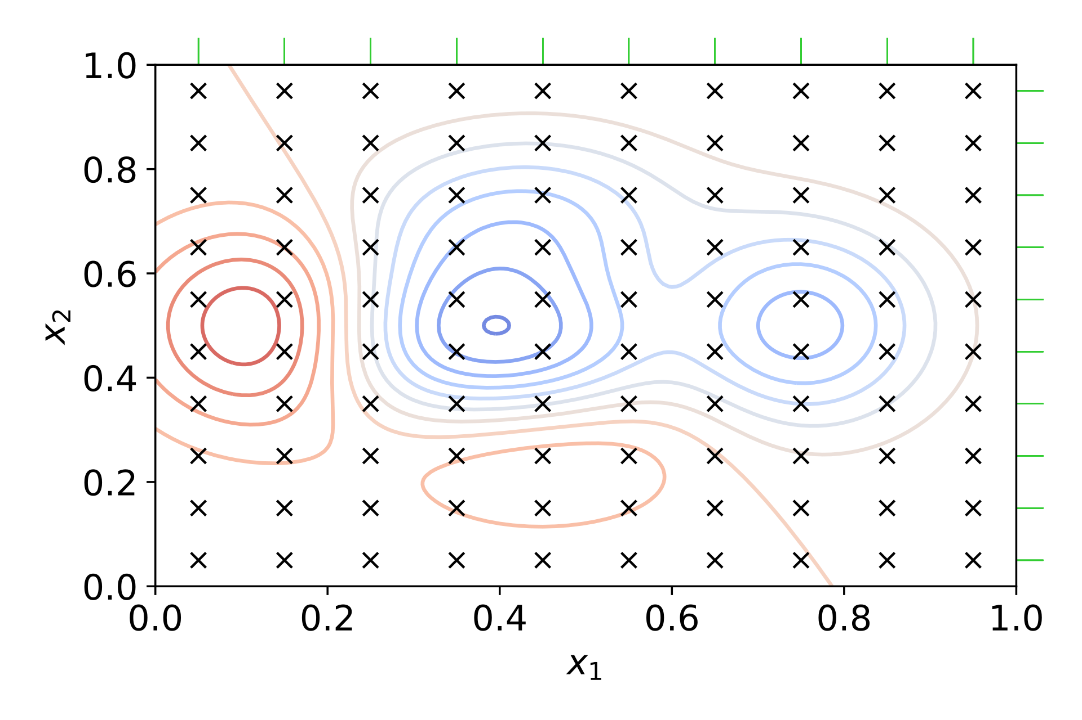
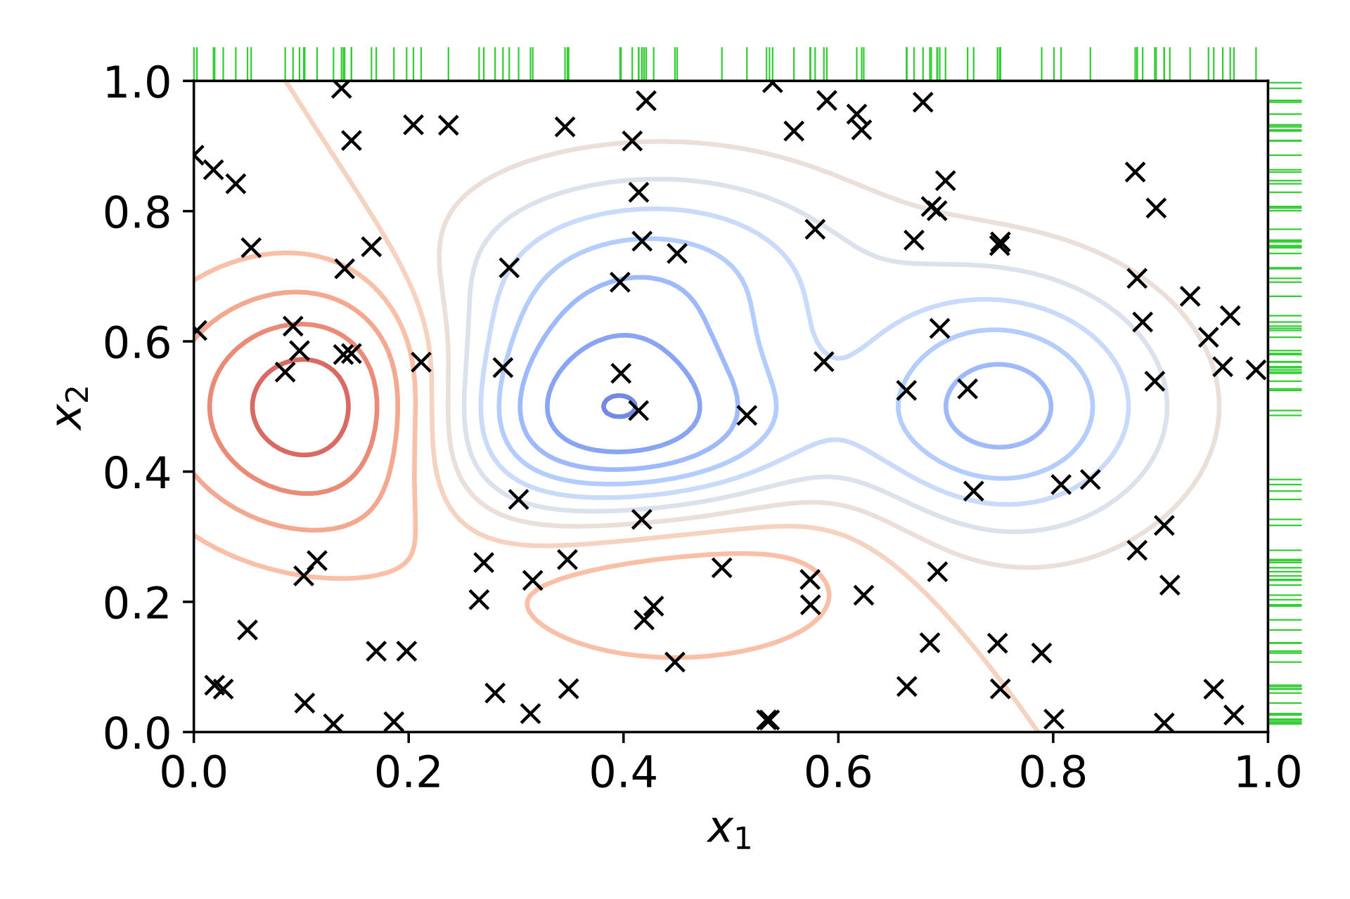
Hyperparameter tuning
Grid search:
High probability of finding global minimum
High computational cost
Random search:
High probability of finding local minima
Lower computational cost

Slide 12
Random initial population
Train and evaluate fitness of hyperparameter tuples
Generate new population based on best performers
Repeat until satisfactory performance is reached or is no longer improving
Output hyperparameters
Evolutionary hyperparameter optimization
Generating new population
Mutations
Random changes of hyperparameters
for example sampled from normal distribution centered on old hyperparameter value
Crossover
Select two parents, preferably of high fitness, and generate an offspring
Each offspring hyperparameter can be determined by either random choice or average
(x₁, y₁, z₁)
+
(x₂, y₂, z₂)
(x, y, z)
(x+Δ_{x}, y+Δ_{y}, z+Δ_{z})
((x₁+x₂)/2, (y₁+y₂)/2, (z₁+z₂)/2)

Slide 13
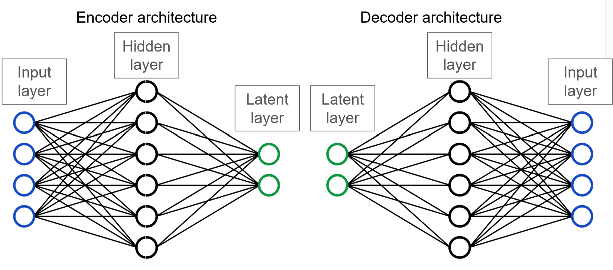
Why evolutionary algorithms?
Can be used for almost any optimization problem, including hyperparameter tuning in ML
Can produce high quality solutions compared to other methods
Simple, easy to implement algorithm, yet can solve very complex problems
Computationally expensive
True optimal solution may never be found, as with all metaheuristics

Slide 14
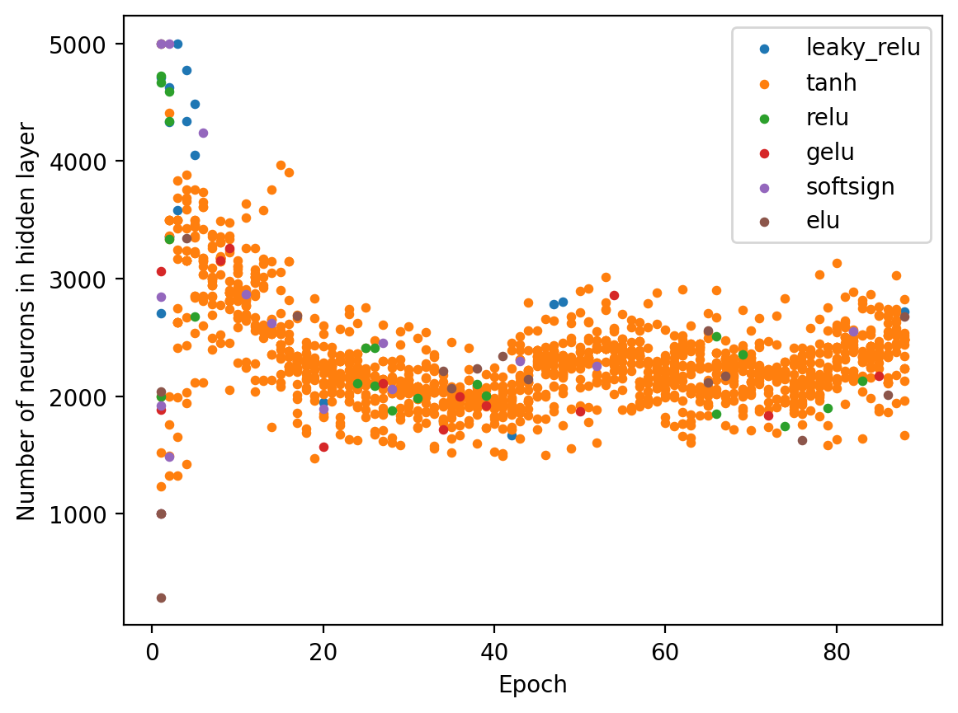
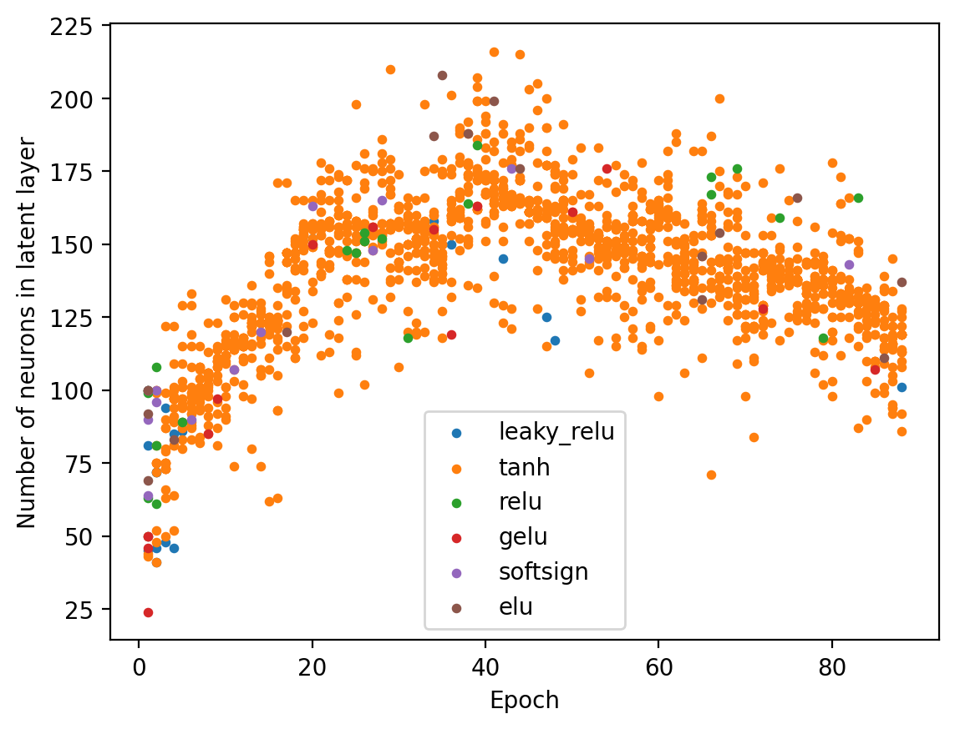
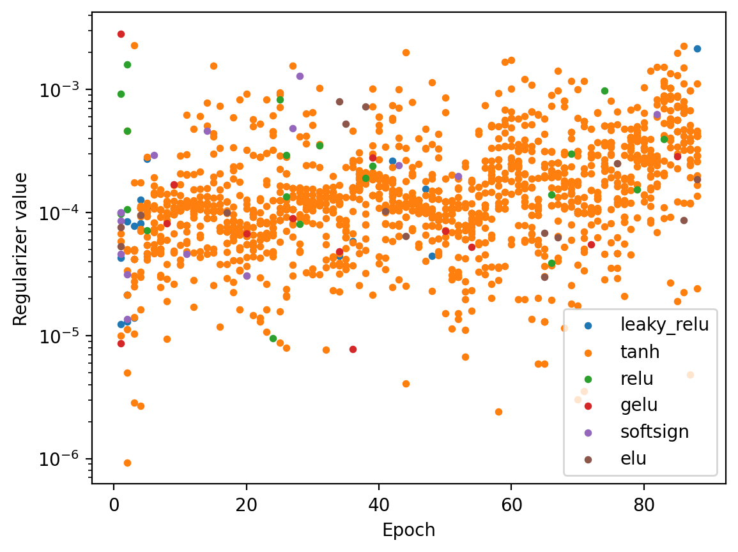
Optimizing autoencoder hyperparameters
Optimal parameters found:
hidden: 2231
latent: 146
regularizer: 2.6x10⁻⁴
activation function: ‘tanh’

Slide 15
Updated approach
Dimensionality reduction/ autoencoder
Simulated data
Bootstrapping
CNN/
ANN/
KAN for chemical contents estimation
Averaging/
filtering
Anomaly detection
CNN/ANN for specral connversion
CNN/ANN for conversion
Metadata integration
Experimental data

Slide 16
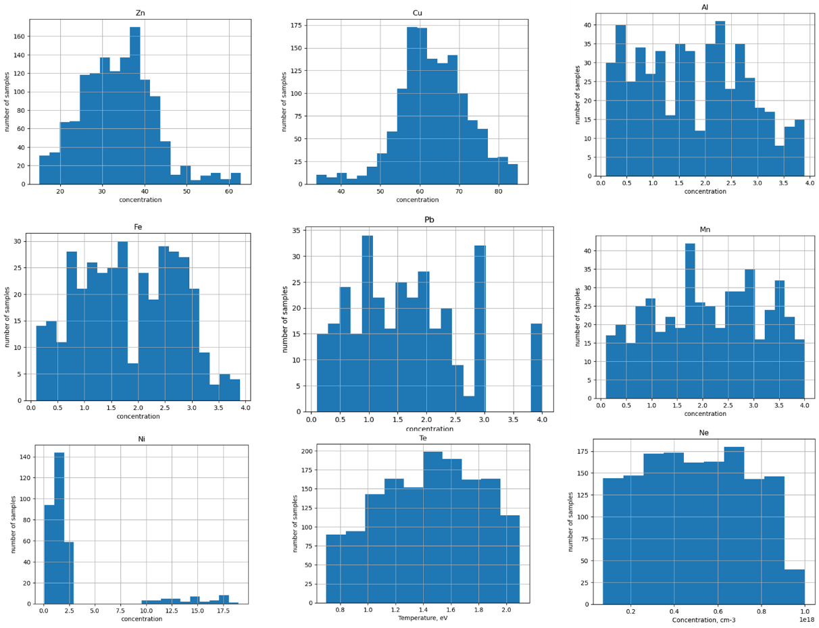
Models for synhetic brass brass alloys (I)
Alloy | number
CuZn | 300
ZnAlCu | 100
ZnNiCu | 300
ZnAlFeCu | 120
ZnMnPbCu | 250
ZnMnFeCu | 200
FeMnZnPbCu | 50
ZnPbCu | 50
ZnAlNiCu | 50

Slide 17
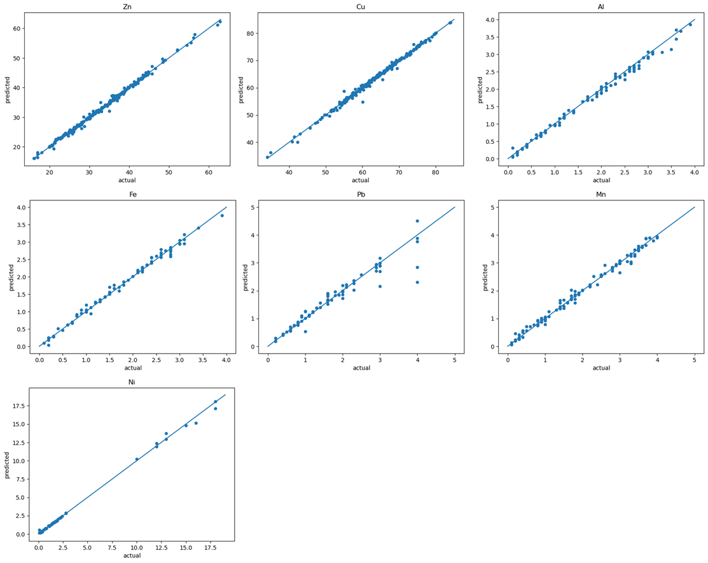
Models for synhetic brass brass alloys (II) results
Predictions for training
and validation
on synthetic data
Element | R2_score | RMSEP, conc. % | NRMSEP, % | Average Relative Error, %
Zn | 0.997 | 0.501 | 1.5 | 0.65
Cu | 0.998 | 0.438 | 0.7 | 0.35
Al | 0.994 | 0.081 | 4.6 | 3.40
Fe | 0.996 | 0.057 | 3.1 | 2.91
Pb | 0.968 | 0.175 | 10.7 | 7.31
Mn | 0.997 | 0.060 | 2.8 | 2.86
Ni | 0.997 | 0.218 | 7.5 | 4.41

Slide 18
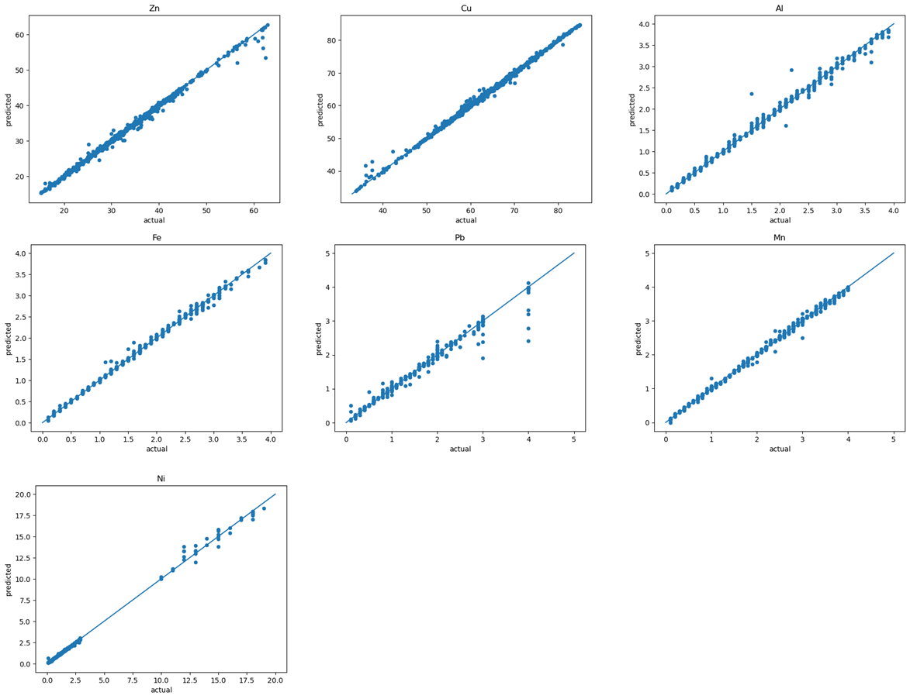
Models for synhetic brass brass alloys (II) results
Predictions for training
on synthetic data
and validation
on quasi-eperimental
data
Element | R2_score | RMSEP, conc. % | NRMSEP, % | Average Relative Error, %
Zn | 0.998 | 0.427 | 1.27 | 0.65
Cu | 0.998 | 0.396 | 0.63 | 0.36
Al | 0.980 | 0.130 | 7.62 | 4.60
Fe | 0.995 | 0.068 | 3.58 | 4.70
Pb | 0.928 | 0.279 | 16.59 | 13.7
Mn | 0.995 | 0.074 | 3.48 | 4.50
Ni | 0.998 | 0.193 | 6.40 | 10.9

Slide 19
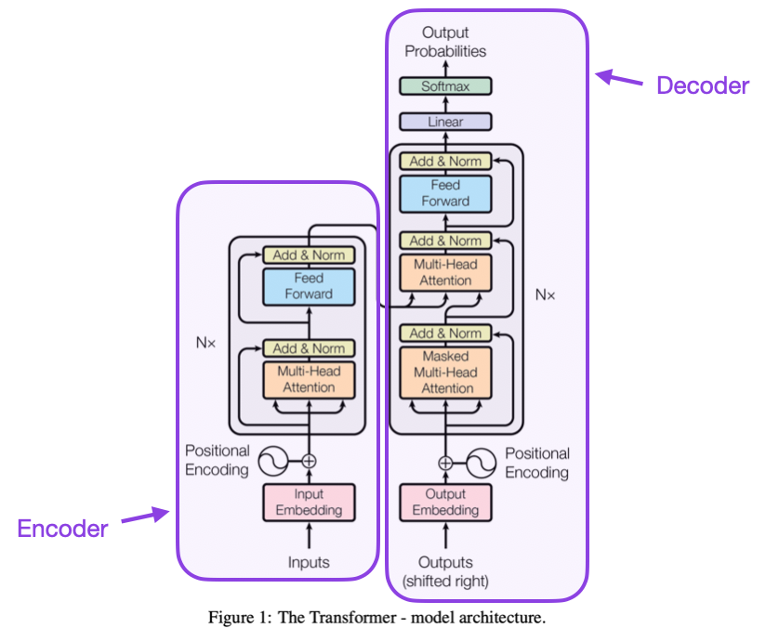
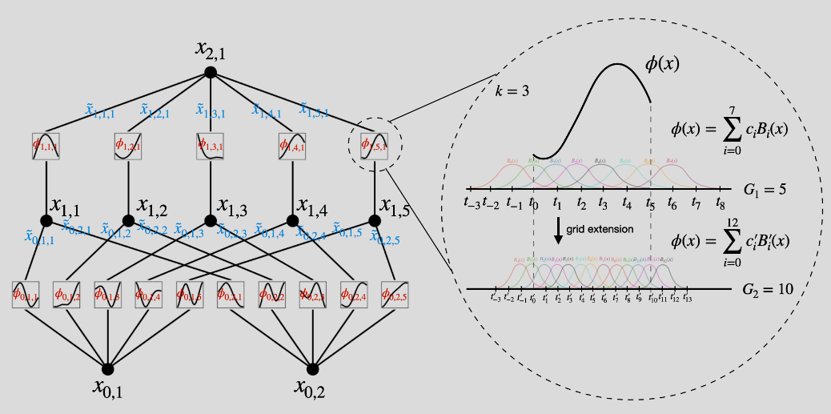
Step further
By Aphex34 - Own work, CC BY-SA 4.0, https://commons.wikimedia.org/w/index.php?curid=45679374

Slide 20
Summary and plans for future
Application of autoencoders brings a decent progres in experimental spectra analysis.
There is a big role of pre-processing which was not fully addressed in this short presentation.
Tests on the spectra collected at the VTT bring interesting results which will be addressed in the PFMC contribution.

Slide 21
