Slide 1
2025.02.06 JET LIBS data analysis meeting #1 - UT
Jasper Ristkok
Indrek Jõgi

Slide 2
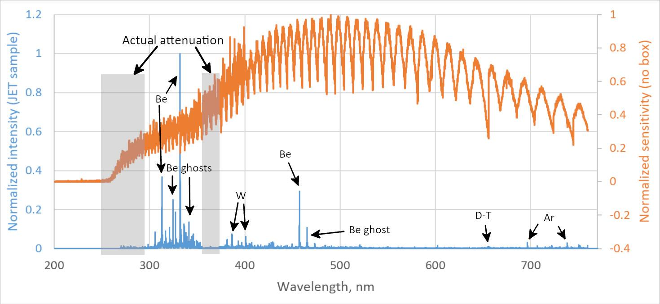
Spectra acquisition
Crucial to account for sensitivity of the acquisition system, the fiber and LIBS box
Orange – spectral sensitivity measured without LIBS box (VTT)
Data (lack of lines) suggests more attenuation regions
Notes:
Showed spectrum is already corrected with spectral sensitivity
295 nm should have relatively strong W I lines but I din’t see any
350 nm region should have many relatively strong Inconel lines but I din’t see any
Attenuation at 260 nm and below is also seen with measured spectral sensitivity

Slide 3
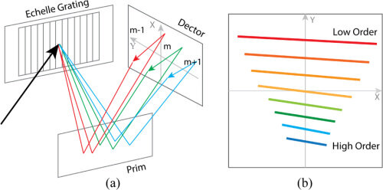
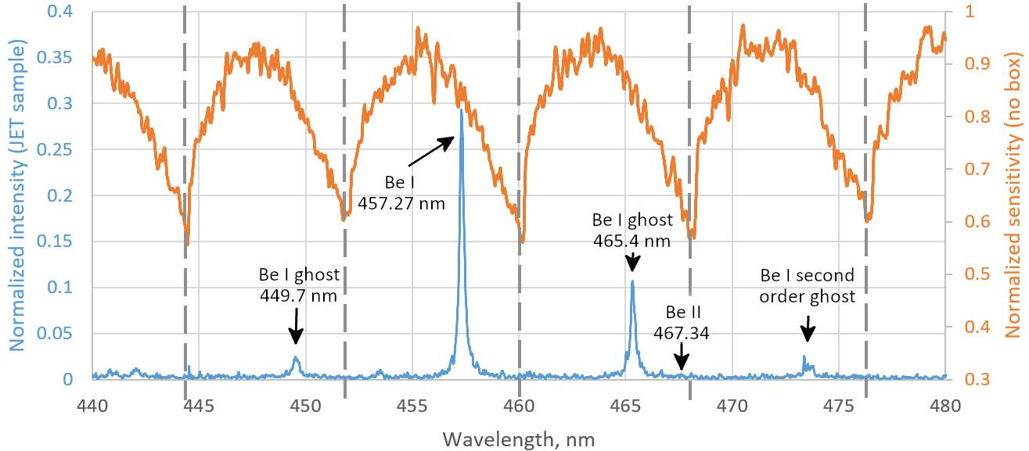
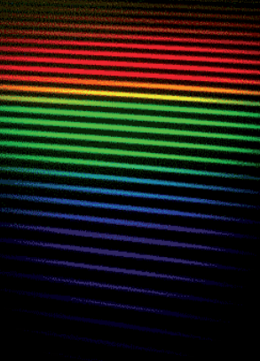
Ghost lines
Intense lines shine over multiple orders - be careful with line identification
Ghost line width is comparable to real line - Be is wider than W and other metals
Shen 2018. DOI: 10.1364/OE.26.034131
W lamp (datasheet)
Our image (samples)
Notes:
Aryelle spectrometer cuts rows from 2D image, pastes into 1D spectrum
Identification: determine the location of the line from database precisely and then check/consider how much the line can shift in the spectra (what’s the resolution of the spectrum)
Be I ghost was misidentified as Be II at first
Ghost line identification: width is comparable to real line (Be is wider than other metals)

Slide 4
Data analysis - line deconvolution
Good program: Fityk - has GUI and scripting possibility
Semi-automatic algorithm:
Manual work: lock as many variables as possible (e.g. line location and bounds), determine optimal configuration for these specific spectra (e.g. min line width), fit all encountered lines (also unknown)
Use as many lines as possible/reasonable. Can’t trust the intensity of a single line due to noise.
Batch process many spectra with script:
spectra correction: sensitivity, pixel => wavelength, gain etc.
moving window (e.g. 10 nm) fits lines only in the window, locks all variables of other lines
Levenberg-Marquardt fitting algorithm: Voigt by default, Lorentzian for broadened lines
Save all parameters of all lines (1000 shots with 150 lines each is 25 MB), image of the fit (optional, 50-500 kB) and the Fityk file after the fit for later checking (optional, 1000 shots is 2.7 GB)
Time:
2-4 weeks for manual work: line identification and spectra preparation
Script processes 1 spectrum in 1.5 minutes with 1 thread (25 % i5 CPU) (40 000 px and 150 pure Voigt lines)
Notes:
In my experience, neither fully manual nor fully automatic processes work well due to the amount of data and the complexity of it.
Best fit is when all appearing lines are fit. That way the useful lines aren’t influenced by “rogue pixels” nearby.
Hard drive space might be an issue. RAM was an issue unless script was written with that in mind.
Takes long time to process but it’s possible to essentially multithread by excecuting the script with different data.
Bottleneck is loading the datapoints (900 kB file) and the fitting itself. It could be done without the GUI and it might be faster that way (then no image output possible).

Slide 5
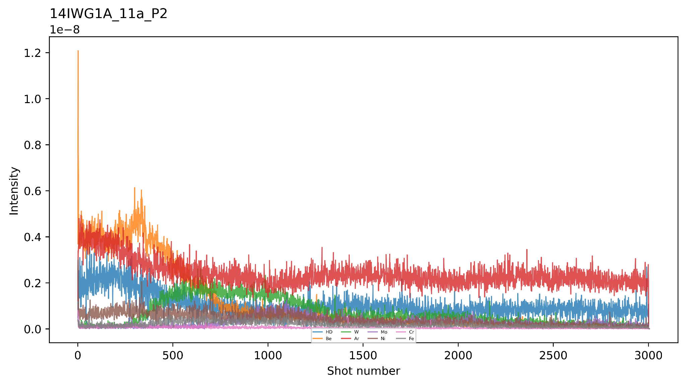
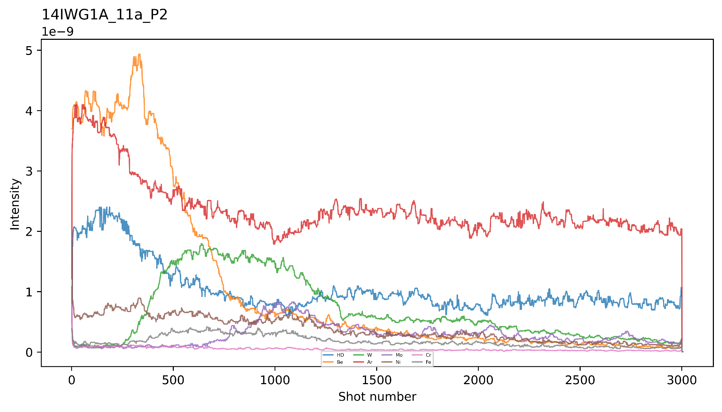
Data manipulation for visual analysis
Sum intensity of all trustworthy lines of one element to counter noise (shot-to-shot intensity variation 7-8 %)
Best results with:
Moving median smoothing (window relative to nr of shots) with replication padding at the edges
Logarithmic intensity scale in place of normalization (looks better than max-normalization for each element)
If using normalization, use max-normalization. Min-max loses relative intensity and noise info, and noise-level element seems more significant.
Original depth profile
Moving median: 21 shots
Notes:
7 % comes from Ar signal and Al signal from pure Al sample
Logarithmic scale looks better than max-normalization.
With min-max normalization a noise-level element seems more significant

Slide 6
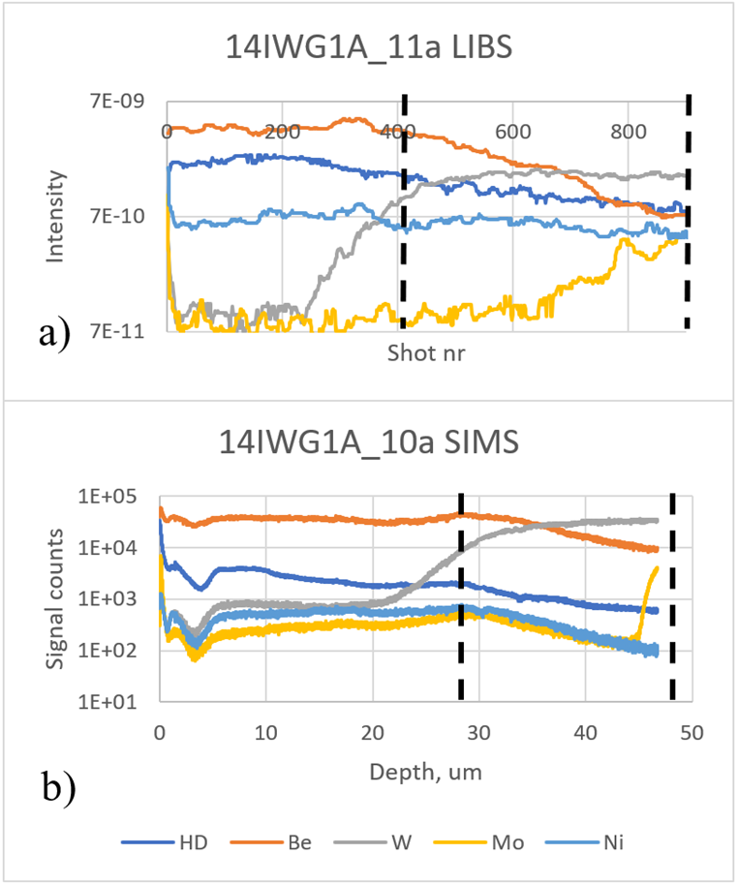
Depth profiles
Check depth profiles whether all lines have been identified correctly (e.g. if W line emerges in W layer)
Layer boundary: 50 % of max int on rising signal, otherwise 50 % of max int on falling signal (crater side ablation effects)
Previous intensities can’t be directly compared to in-situ JET intensities - optics have been changed and nearby locations produced variation of 30 % in intensity
Notes:
50 % rising edge due to gaussian beam ablation profile
Nearby = few mm
Outer-divertor samples didn’t have clear W layer - signal was high from the surface. Earlier articles say that that region din’t have dominant erosion nor deposition.
There’s so much to do that we won’t have time to determine the temperature for CF-LIBS

Slide 7
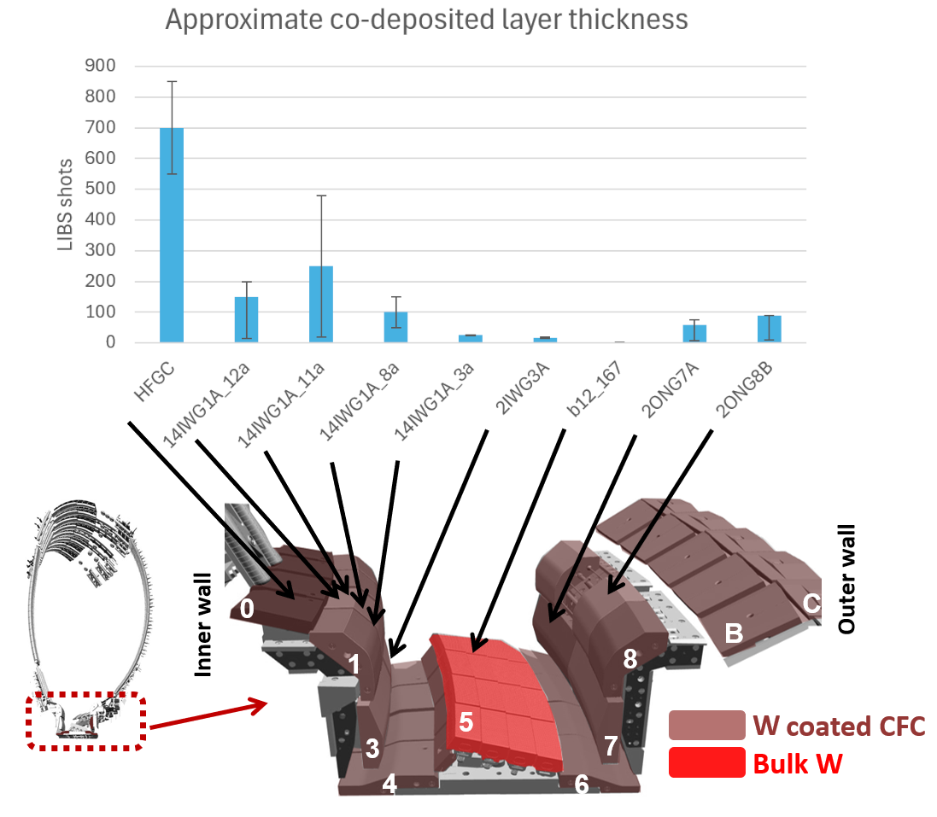
Co-deposited layer thickness overview (VTT)
In JET, layer is expected to be thicker.
Inner divertor layer thickness increased with height.
Outer divertor didn’t have defined W layer. Literature: neither erosion nor deposition is dominant.
Layer depth variation of nearby locations (few mm) typically 50 %, max 20-480 shots with 14IWG1A_11a.
Notes:
Error bars indicate range of determined layer thicknesses

Slide 8
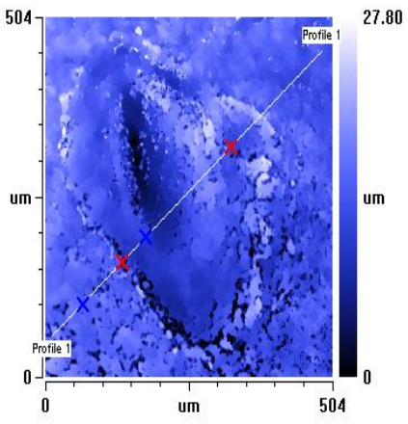
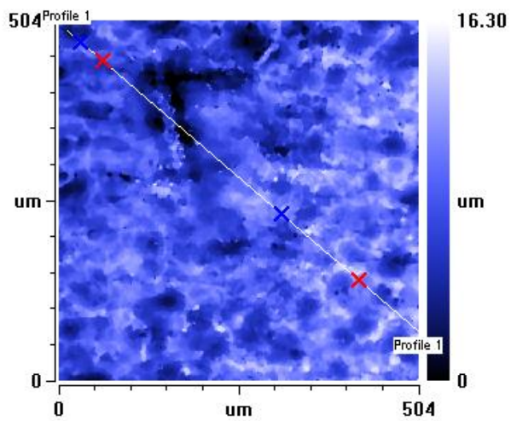
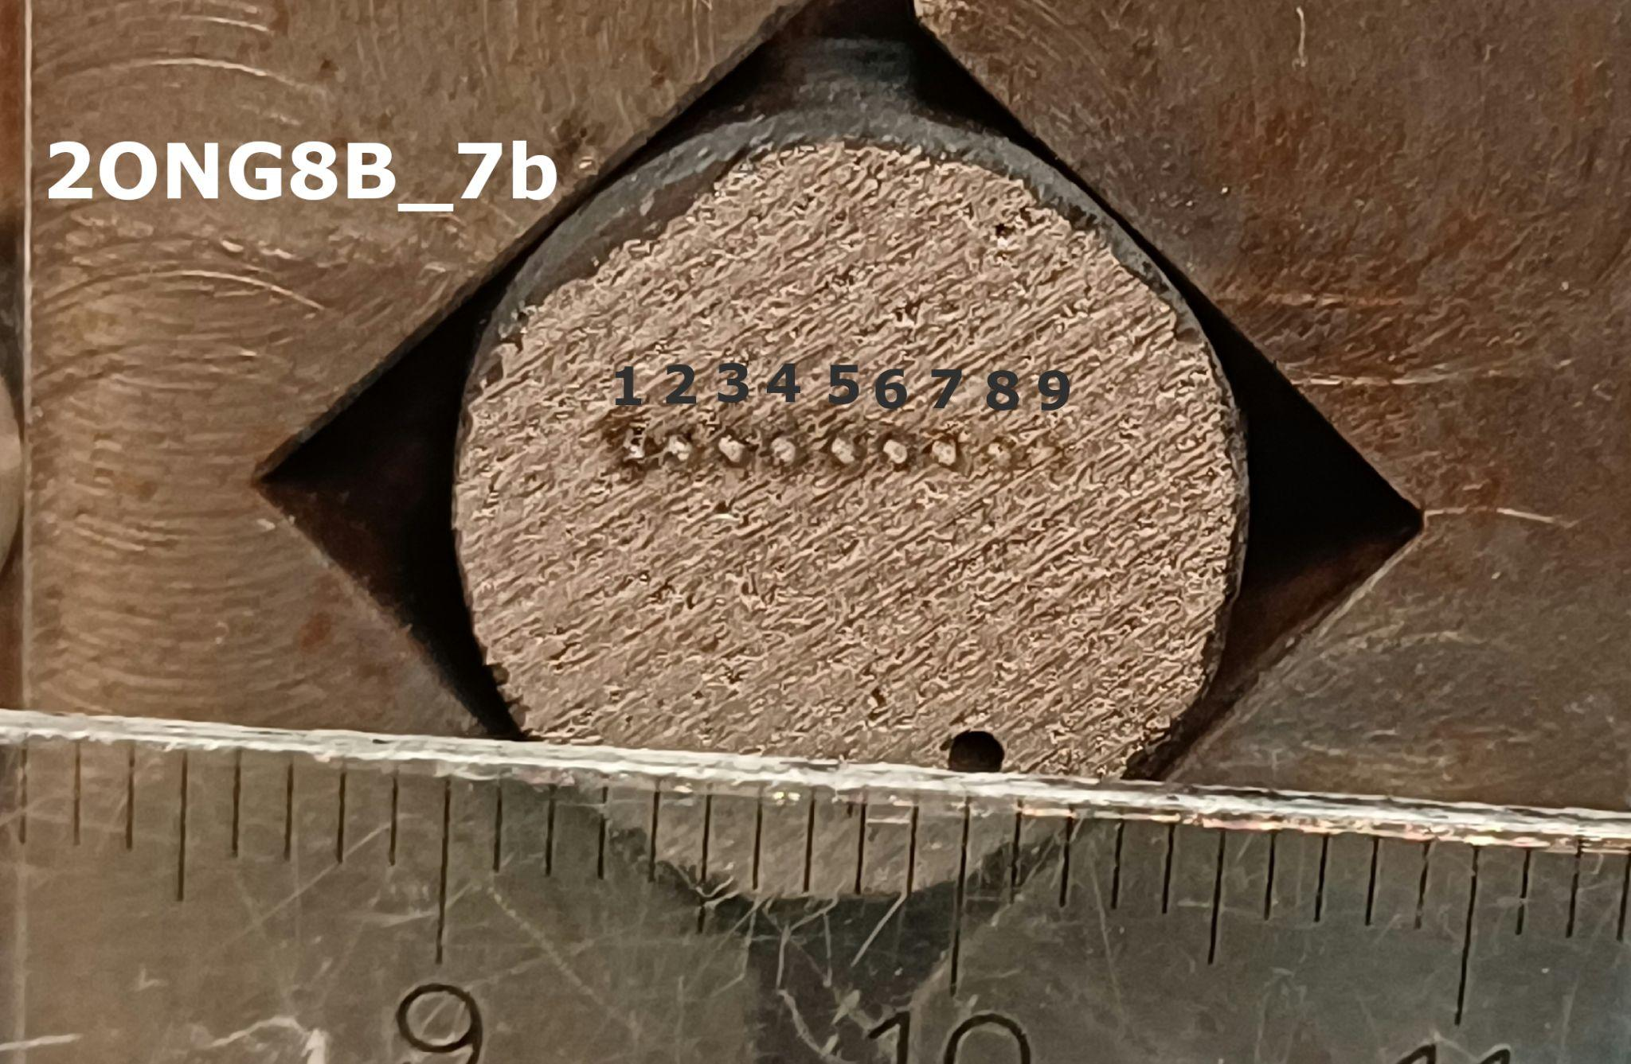
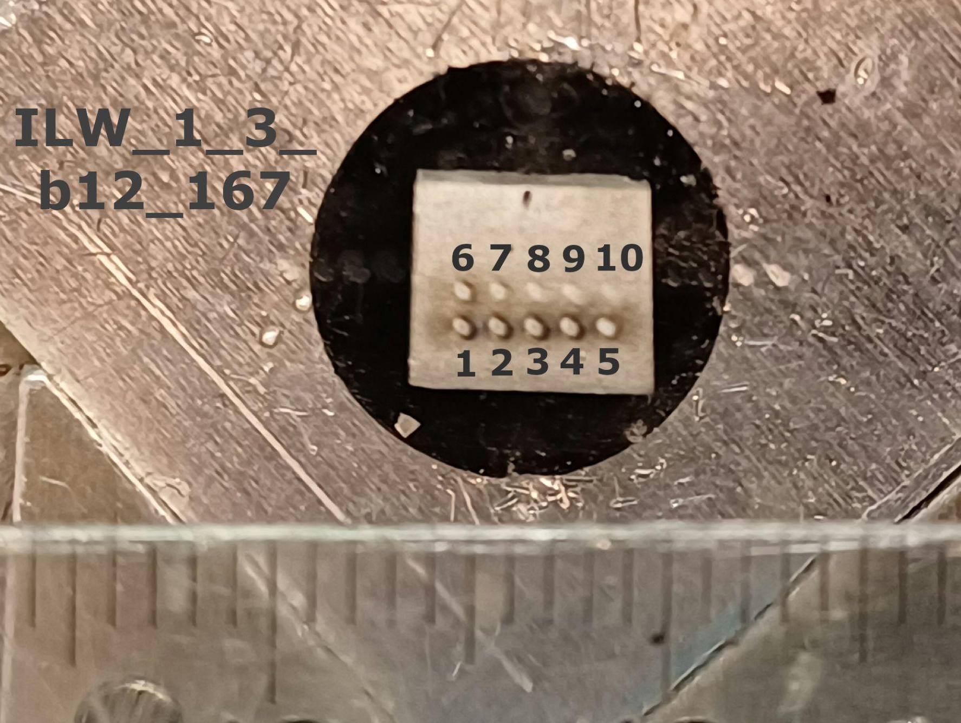
Ablation rate
120-140 nm/shot in Be limiter tiles.
Around 25-50 nm/shot in W layer (few datapoints)
Maybe 80-120 nm/shot in co-deposited layer (few datapoints, large spread)
Material structure varied a lot
If ablation rate is necessary knowledge for JET then profilometry should be re-done
Be limiter 2XR11_668 100 shots
W lamella
b12_167
100 shots
Notes:
Profilometry didn’t give confident results (basically it failed with important samples). If precise ablation rates are important for JET measurements then we might need to do profilometry on the VTT samples again.

Slide 9
Extra - Trustworthy lines
These need to be re-checked with in-situ JET samples.
Line is trustworthy when it isn’t influenced by self-absorption nor by another nearby lines and its intensity acts similarly to other lines of the same element in depth profiles
H_{α}/D_{α} | 656.28/656.10 nm
Be I | 381.35, 457.27, Be I ghost line 465.34 nm (ghost only usable for summed intensity)
Ar I | 696.54, 706.72, 738.44, 750.39, 751.53 nm
W I | 321.56, 400.88, 407.44, 429.46, 430.21 nm (strongest W II lines could be detected)
Mo I | 319.40, 379.83, 386.41, 390.30, 418.83, 550.65, 553.30, 557.04 nm
Ni I | 300.25, 301.20, 305.08, 310.16, 338.06, 341.48, 342.38, 344.63, 345.85, 346.17, 349.30, 351.04, 351.51, 352.45 nm
Cr I | 425.43, 428.97, 520.45, 520.60, 520.84 nm
Fe I | 344.06, 371.99, 373.49, 373.71, 374.56, 374.83, 374.95, 375.82, 382.04, 385.99, 388.63, 404.58, 438.36 nm
N I | 742.37, 744.23, 746.83 nm (at noise level)
Notes:
Be I ghost is in the table since it can be used for summed intensities.

