Slide 1
LIBS dat analysis at the ISSP UL
WP PWIE SPE 1: LIBS at JET
Jeļena Butikova
ISSP-UL

Slide 2
VTT data – identification of spectral lines
Spectral lines for the indentification of the elements of interest have been selected; strongly self-absorbed lines and ‘ghost’ lines have been excluded
Element | λ, nm | Transition probability
H | 656.28 | 4.41e+07
D | 656.10 | 6.47e+07
W I | 400.88 407.44 429.46 | 1.63e+07 1.00e+07 1.24e+07
Mo I | 319.40 379.83 386.41 550.65 553.30 557.04 | 1.53e+08 6.90e+07 6.24e+07 3.61e+07 3.72e+07 3.30e+07
Element | λ, nm | Transition probability
Ni I | 341.47 345.85 346.17 | 5.5e+07 9.8e+06 2.7e+07
Ar I | 706.72 738.40 750.39 751.47 | 3.8e+06 8.5e+06 4.5e+07 4.0e+07
Cr I | 425.43 428.97 520.60 520.84 | 3.15e+07 3.16e+07 5.14e+07 5.06e+07
Source: NIST database

Slide 3
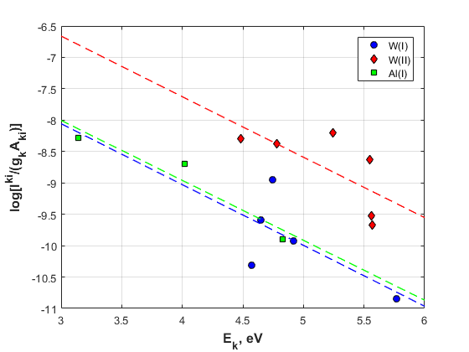
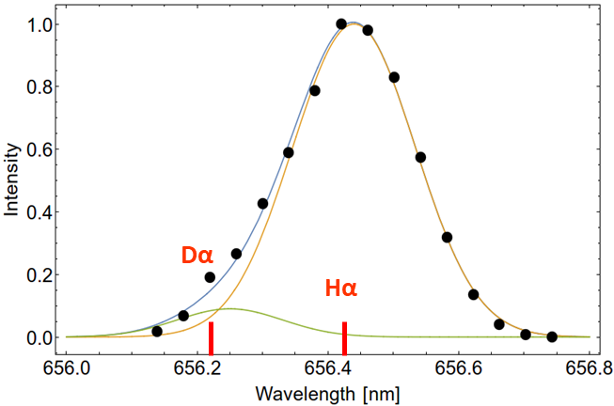


Approach to analysis
Averaging of spectra to improve S/N ratio; background substraction
$$\frac{I^{ki}}{g_{k}A_{ki}}$$
Electron temperature derived from Boltzman plot: log
vs E_{k} (1)
$$C_{s}= \frac{U_{s}(T_{e} )}{F}e^{q_{s}}$$
(1)
D/W concentration ratio
Pseudo-Voigt fitting (Gaussian for Doppler effect; Lorentzian for Stark)
Electron density is deduced from Lorentzian FWHM: Г_{L} = 4.63x10⁻¹² n_{e}^{2/3} (2)
(1) A, Ciucci et al, Appl. Spec. 53(8), (1999), 960-964
(2) R. Fantoni, S. Almaviva et al, Spectrochim. Acta B 87 (2013), 153-160

