Slide 1
On the challenge of high beta plasmas for predictive first integrated modelling
C. Bourdelle
5/3/2025

Slide 2
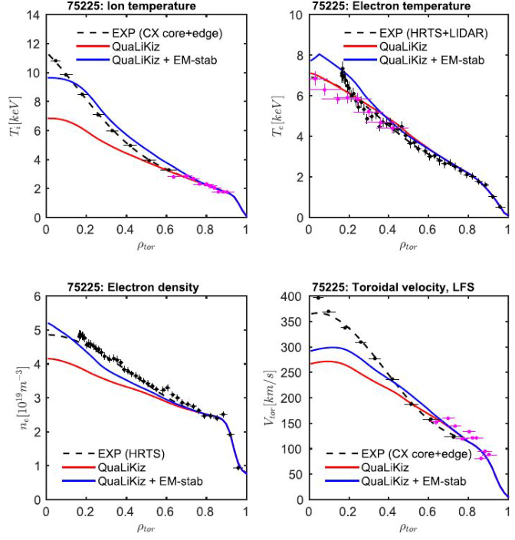
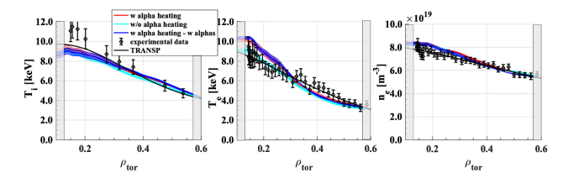
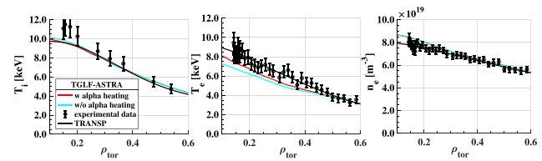
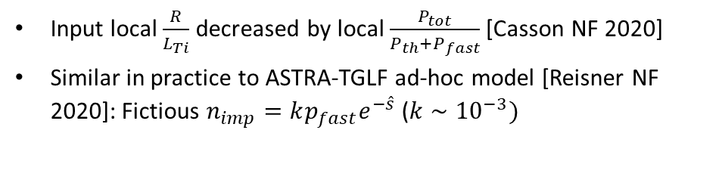
Available physics based quasilinear models not adequate for high β plasmas
Need of ad-hoc tricks:
Input local $\frac{R}{L_{Ti}}$ decreased by local $\frac{P_{tot}}{P_{th}+P_{fast}}$ [Casson NF 2020]
Similar in practice to ASTRA-TGLF ad-hoc model [Reisner NF 2020]: Fictious $n_{imp}=kp_{fast}e^{−\hat{s}}$ ($k∼{10}^{−3})$
but not always… [Di Siena NF 2025]
GENE-Tango
JET discharge #99912 at t = 8.6 s
TGLF with BC at ρ=0.6
Not predict first!

Slide 3
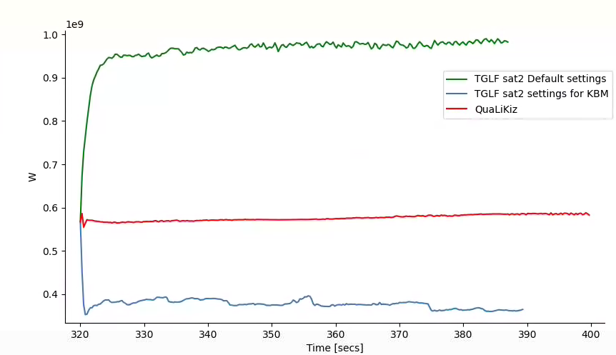
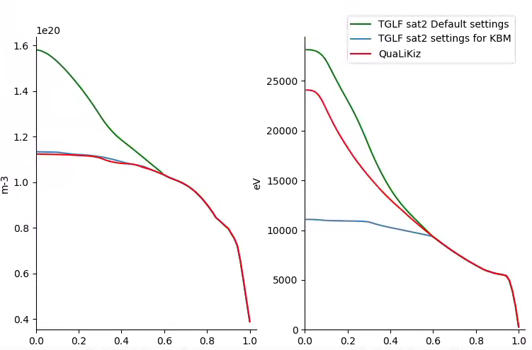
Predicting ITER 15 MA using different turbulent transport models inside ρ=0.6
HFPS modelling starting from published ITER case [Mantica PPCF 2020].
Turbulent transport model inside ρ = 0.6 :
QuaLiKiz (electrostatic)
TGLFsat2 (electromagnetic) using the default settings (width=1.65, alpha zf=1, kygrid=4 min(ky) ≃ 0.05, filter=2)
TGLFsat2 (electromagnetic) settings as recommended in [Najlaoui NF 2025] thanks to JET high β verification vs GKW (width=3, alpha zf=-1, kygrid=1 min(ky) ≃ 0.1, filter=-1.5)
P_{fus}
n_{e} at 385 s
T_{i} at 385 s
500 MW!

Slide 4
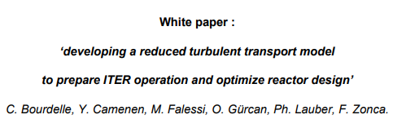
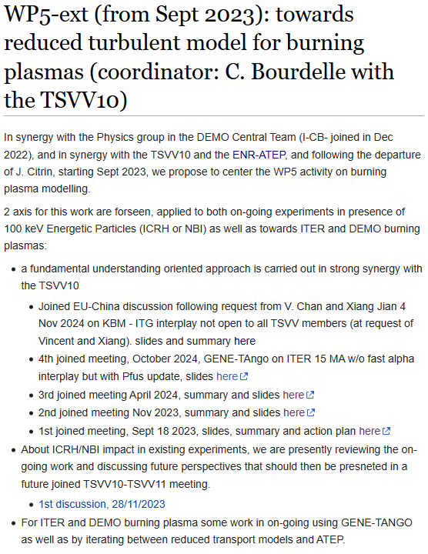
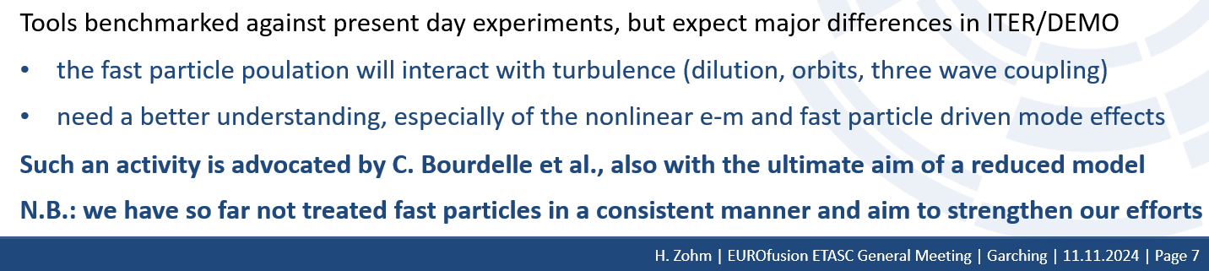
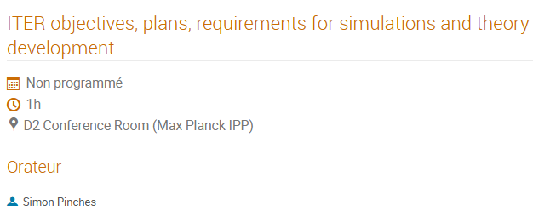
Next steps towards improved reduced turbulent model for high β and EP
2023-2024
4 joined TSVV10-TSVV11 meetings
See wikipages
June 2024
White paper to V. Naulin, F. Jenko
Nov 2024 during ETASC General Meeting support from DEMO and ITER
Now: starting informally Working Group March 27 2025 wiki
Goal propose a new theory and modelling activity for 2026-2027

Slide 5
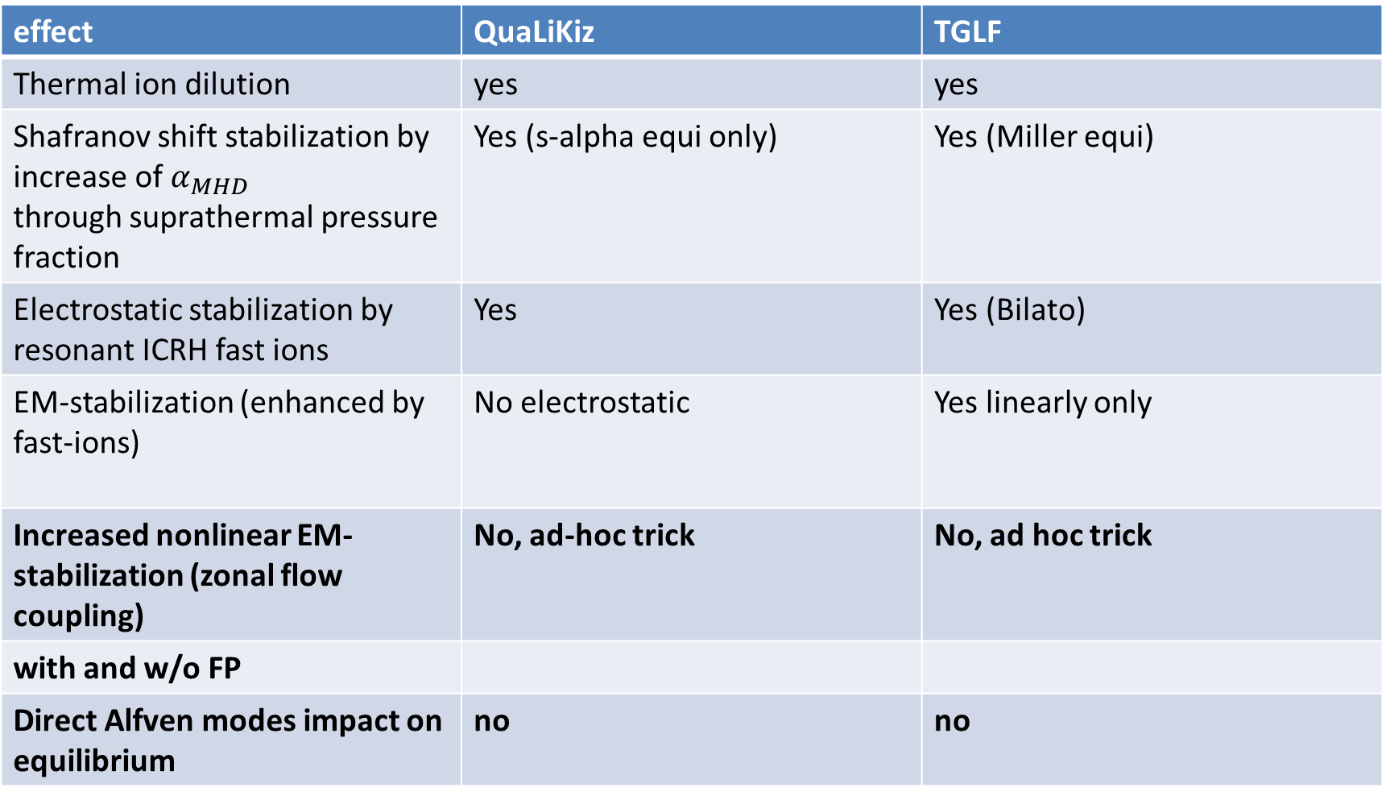
Fast particles and el-mag impacts in reduced models
effect | QuaLiKiz | TGLF
Thermal ion dilution | yes | yes
Shafranov shift stabilization by increase of $α_{MHD}$ through suprathermal pressure fraction | Yes (s-alpha equi only) | Yes (Miller equi)
Electrostatic stabilization by resonant ICRH fast ions | Yes | Yes (Bilato)
EM-stabilization (enhanced by fast-ions) | No electrostatic | Yes linearly only
Increased nonlinear EM-stabilization (zonal flow coupling) | No, ad-hoc trick | No, ad hoc trick
with and w/o FP
Direct Alfven modes impact on equilibrium | no | no

Slide 6
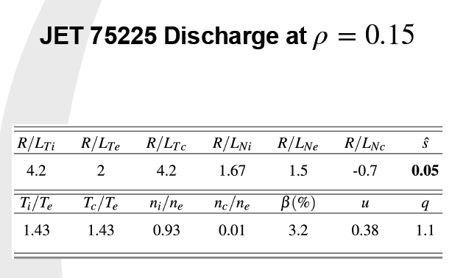
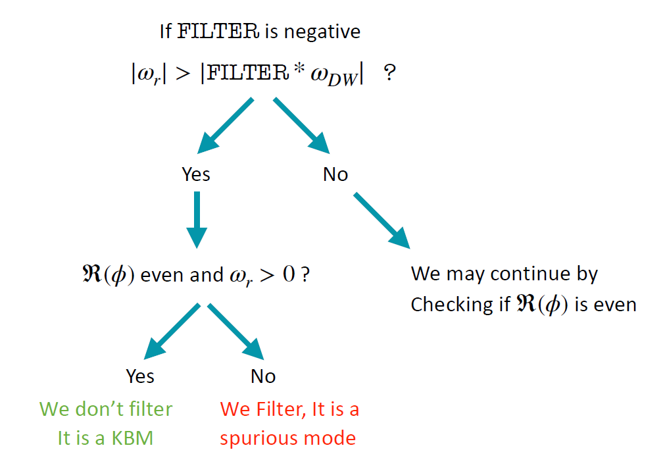
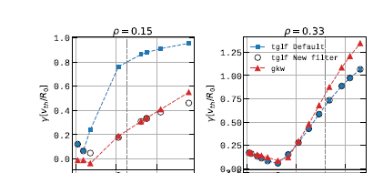

TGLFsat2 options and their impact at high β
[Najlaoui NF 2025]

Slide 7
Proposal for 2026-2027, tbd
Deliverable:
Provide an advanced turbulent transport model (heat, particle and momentum) applicable in all the plasma phases, including high beta burning plasmas. The CPU or GPU time scale of such a model should be compatible with its usage within High Fidelity Integrated modeling as well as Pulse Design Tools.
Milestones:
M.1 Understand the frontier between local and global effects in presence of Energetic Particles both on the linear response as well as on non-linear interplays between turbulence, Zonal Flows and EP driven modes.
M.2 Use ML techniques to speed up the linear response calculation, including high beta plasmas and plasmas with a significant contribution of Energetic Particles.
M.3 Start to develop saturation rules robust to all plasma phases, ion heated vs electron heated, various collisionality regimes, various beta, and Energetic Particle contribution.
Ressources needed:
In terms of manpower, to achieve the above milestones, an effort of ~7 ppy.
M.1 This work requires numerical global gyrokinetic nonlinear modeling and analytical understanding to diag, 2 ppy
M.2 This work requires active exchange between experts and students, tests of various ML techniques, starting from the on-going effort on local gyrokinetics simulations within the French granted ENR FASTER project running until 2026. 2 ppy
M.3 This is a very challenging theoretical work, testing understanding of the non-linear saturation physics on simpler non-linear models before extending the tests on state of the art global nonlinear simulations. It requires dedicated efforts and training of PhD students and needs to be continued after 2027. 3 ppy.

