Slide 1
WPSA report 2025-05-06
EUROfusion PSD Management Meeting
Carlo Sozzi, G. Falchetto

Slide 2
ME1 status

Slide 3
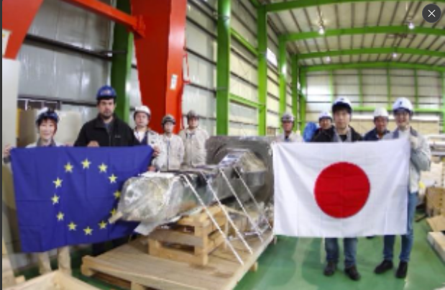
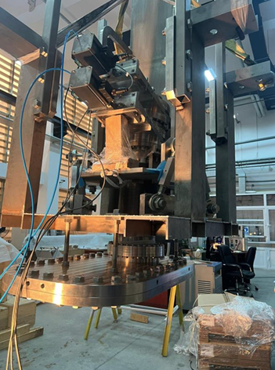
Enhancements
Edge Thomson Scattering port plug, retractable supporting structure, collection optics delivered to Naka. Last TS components, well in time for installation (September 2025). Installation procedure agreed with QST and F4E
Divertor VUV in preparation for acceptance test in ENEA Frascati, confirmed for week of 18th May
On site visit of Doppler Reflectometer team (CIEMAT) planned for first week of June for port inspection => postponed after summer for CIEMAT internal organizational reasons.
Final (formal) Design Review Meeting for Tangential Phase Contrast Imaging on 12th of May to allow PA signature. Agreed partial installation of ex-vessel components (being procured by EPFL) to facilitate complete installation in ME2
New tender process for procurement of pellet sources (F4E) starting (Pelin contract definitely closed).

Slide 4
Data access and IMAS
IMAS preparation advancing aiming to have usable set of tools and data mapping before OP2 (target June 2026)
Machine description (OP1+OP2 items) can proceed in parallel until data access available again
Inspection concerning cyber attack completed, if solution accepted by MEXT the analysis server might be available before transfer under IFERC network planned for September 2025.
In the meanwhile local data access available (request for specific data may in principle be asked taking into account bottleneck of only one person that can perform the data collection for EU researchers)

Slide 5
Meetings
Technical Coordination Meeting in Frascati week of 19th May. Topics:
M/E-1 schedule update and Tokamak Assembly
Transition to W
Installation of Cryopumps, MGI, VUV, TS,[EU], FIDA [US]
Neutronics
Machine Protection
CS activities
OP2 planning

