Slide 1
Briefing
PSD Management Meeting
M. Wischmeier
Plasma Science for ITER, DEMO and stellarators department → PSD
8th of July 2025

Slide 2
Topics for discussion today
Status exploitation of JT-60SA
WP leader for WP TM
JET data access – ITER – STAC / GA
Call for deputy PWIE WP leader
Call for WP TE DTFL
Reminder for feedback on ITER related items (list of Alberto Loarte)
WG on Fusion Pilot Plant for EUROfusion established with 3 sub groups:
1) Fusion Pilot Plant(H. Zohm/F.Villone) 2) Physics Gaps to DEMO including Pilot Plant and Stellarator (M. Wischmeier / M. de Baar + D. Borba, A. Loarte, M. Jakubowski) 3) Nuclear Qualification and Tritium Availability (K. Hesch, J. Elbaz-Uzan)
EFPW
News items :
TE | 10.06.2025
PWIE | 25.06.2025
TE | 10.07.2025
SA | 25.07.2025
TE | 10.08.2025
W7X | 25.08.2025

Slide 3
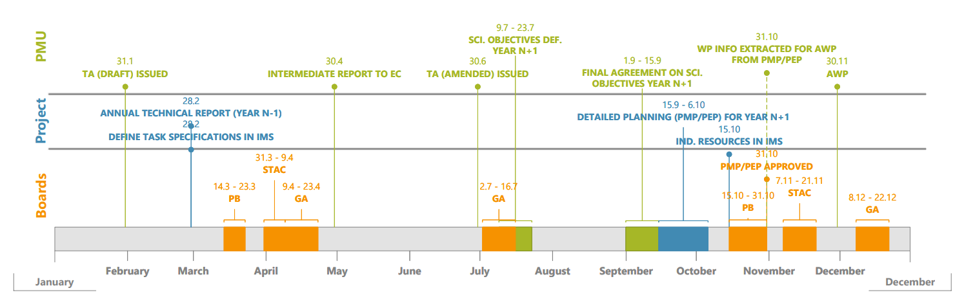
3.1 - Planning of events - EUROfusion calendar
Upcoming events
51st Bureau meeting | 23 June 2025 | Remote
51st General Assembly meeting | 15-16 July 2025 | Poland
52nd Bureau meeting | 22 September 2025 | Prague, Czech Republic
52nd General Assembly meeting | 7-8 October 2025 | Remote
53rd Bureau meeting | 14 November 2025 | Remote
53rd General Assembly meeting | 16-17 December 2025 | Saariselkä, Finland

