Slide 1
DIFFER TSVV-5 2025
Planned activities and options
Team (unchanged): P.W.C. Groen and E. Westerhof

Slide 2

Work done in 2024
Reproducing a coupled run (SOLPS-ITER with FreeFEM) of Jorge Gonzalez
Code refactoring, i.e. introduce derived type “particle” in EIRENE (concept)
Document coding rules for EIRENE
Expanding Magnum-PSI simulations to vibrationally resolved H₂

Slide 3
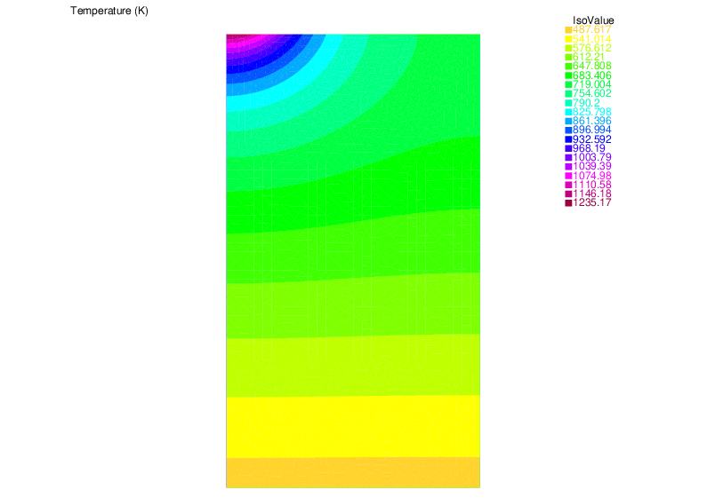
Reproducing coupled run SOLPS-ITER - FreeFEM
Simulation of plasma heat flux on (linear device) Magnum-PSI target,
calculating the target’s temperature
Coupling SOLPS-ITER, i.e. B2.5 with FreeFEM [1] code describing the target,
as done by J. Gonzalez [2] and G.F. Nallo [3]
Performed steps in short
  In SOLPS-ITER code, work in feature/eunomia_FEWall branch
  Take coupled (i.e. SOLPS-ITER w/ EIRENE) successful run of E. Westerhof’s
  Adapt/add/modify the files, links, etc. needed for running it with FreeFEM,
  and run (Marconi)
  Report it
[1] freefem.org (Finite Element Method code)
[2] J. Gonzalez et al., Plasma Phys. Control. Fusion 65 (2023) 045009
[3] G.F. Nallo et al., Journal of Fusion Energy (2023) 42:41
Target temperature output

Slide 4
Code refactoring (concept)
Inventory candidates for derived type, suggestion by Y. Marandet: in eirmod_comprt.f
Choice: at first,
  let position and velocity be derived types themselves
  let these derived types in turn be ‘attributes’ of the particle derived type
First tested only passing particle%pos%x0 in arguments (for the sake of overview),
then passing an ei_particle_type instance, using this x0
In this way, only one (particle) argument is needed instead of X0, Y0, Z0, VELX, VELY, VELZ, …
TYPE ei_position_type
REAL (DP), POINTER :: x0
REAL (DP), POINTER :: y0
REAL (DP), POINTER :: z0
END TYPE ei_position_type
TYPE ei_velocity_type
REAL (DP), POINTER :: x
REAL (DP), POINTER :: y
REAL (DP), POINTER :: z
END TYPE ei_velocity_type
TYPE ei_particle_type
TYPE (ei_position_type) :: pos
TYPE (ei_velocity_type) :: vel
END TYPE ei_particle_type

Slide 5
Document EIRENE coding rules
In order to have a clean and uniform way of coding EIRENE a set of rules has been suggested (that are strongly advised to follow once established)
After a number of iterations in the TSVV-5 VCs a version has been realized ready to share in the Juelich GitLab
The Word document has been transferred to a Markdown document for uploading in GitLab

Slide 6
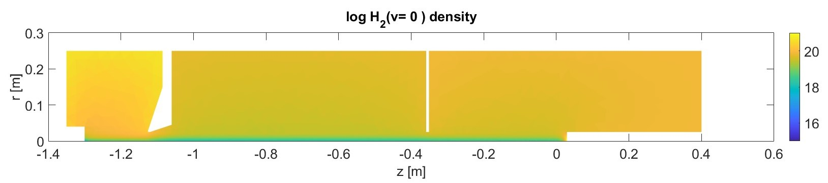
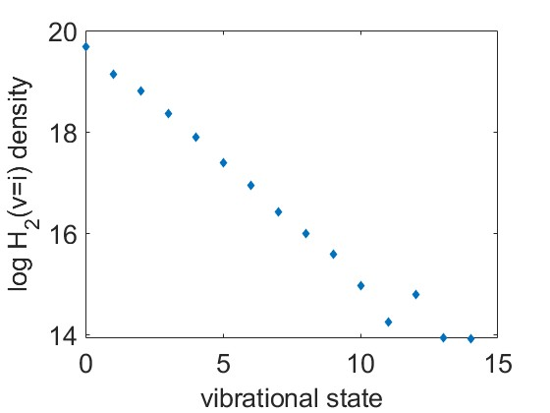
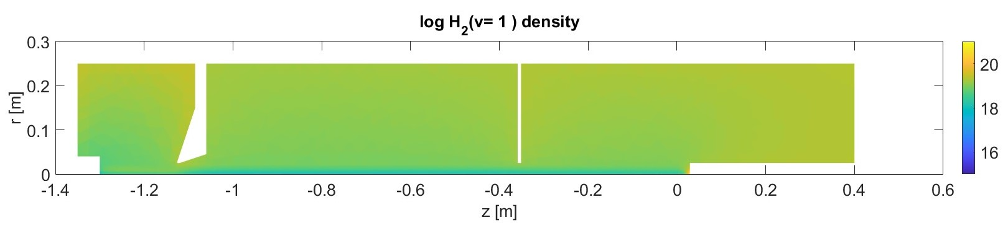
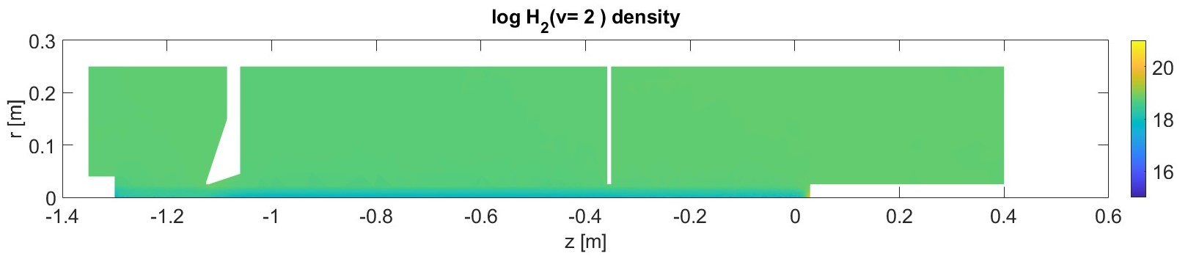
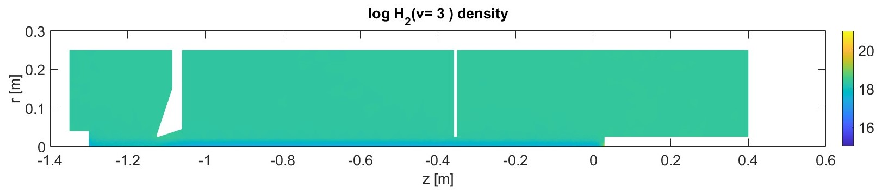
Magnum-PSI simulations with vibrationally resolved H₂
Based on high density (0.47 Pa) case from Chandra and Gonzalez et al.
vibrational distribution outside plasma beam

Slide 7
Magnum-PSI simulations outside TSVV-5
Improvements to solps-iter physical model to include rotation of the plasma beam and its coupling to the neutral particle distribution (HJ de Blank)
Radial conductivity, caused by ion-neutral CX-friction, reduces the parallel current in the plasma beam.
SOLPS-ITER adapted to take into account co-rotation of neutrals with the plasma beam.
Analysis of directed spectra of the neutral velocity distributions in EIRENE shows a radially peaked profile of hot co-rotating H-atoms (red curve) and a hollow profile of cooler non-rotating H-atoms (blue curve).
Dots: standard 1-fluid Eirene quantities over all H-atoms

Slide 8
Work planned (2025)
Magnum-PSI simulations
Vibrationally resolved H2 – further analysis
Outside TSVV: including effect rotation of the plasma beam (H.J. de Blank) [to be published]
Coupled run SOLPS-ITER-FreeFEM for Magnum-PSI simulation
Implement the coupling with FreeFEM in the SOLPS-ITER master branch
(including descriptions, manual etc.)
Implement the neutral particle heat load on the target
Code refactoring (options to be discussed)
Implementation of the particle derived type
ModCR / Investigate and possibly add extension of the particle type with internal states
Adding tallies for individual reactions

