Slide 1
Annual report 2025
14-02-2025
Yannick MARANDET (AMU CNRS), Paul Genesio (CNRS), Nicolas RIVALS (CEA IRFM), Srikanth SURESHKUMAR (CEA IFRM)
With contributions of Patrick TAMAIN (CEA IRFM), Hugo BUFFERAND (CEA IRFM)

Slide 2
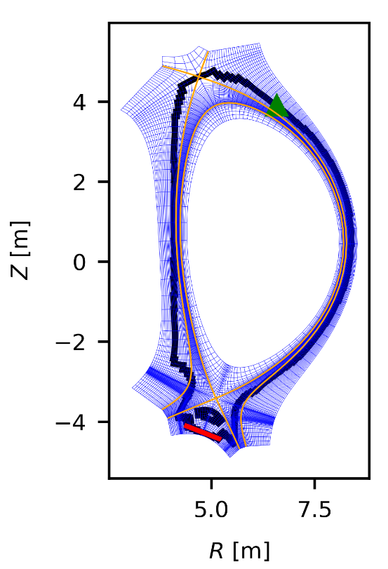
Scenarios discussed – ITER FPO and PFPO
Extending the database of SOLEDGE3X simulations to 100 MW D+Ne+He scenarios
Gas puff
20MW, pure H (PFPO)
100MW, Burning plasma (FPO)
Pure D
$P_{SOL}=20MW$
L mode
Typical no of Eirene particles used: $N_{part}^{EIR}=45,000$
D with seeded Ne and He fusion ash
$P_{sol}=100MW$
H mode (no enhanced far SOL transport)
Typical no of Eirene particles used: $N_{part}^{EIR}=10,000$
Separatrices
Pumping surface
Eirene run with Kotov model and neutral-neutral collisions turned on.

Slide 3
No of collisions – PFPO vs FPO
PFPO
FPO
For the same scenario - total no of collisions undergone by each Eirene particle from when it is created to destroyed.
FPO simulation has a fraction ~5% of particles that undergo a large number of collisions.
Increase in no of collisons much more dramatic than particle lifetime.
Only ~0.04% of paricles undergo >30,000 collisions

Slide 4
Lower generations show wide spread in lifetimes
Lifetime vs No of generations for each Eirene particle in log log scale
FPO (blue dots) vs PFPO (red crosses)
Very few particles have a linear relationship between generations and lifetimes
Impact of this linear section on the plasma solution?

Slide 5
Initial situation: STYX 1.0 interface SOLEDGE-EIRENE interface
Goal: Interface code to manage all setup (input file generation and other parameters) and back & forth communications with SOLEDGE2D plasma solver and EIRENE
“STYX” developed initially for SOLEDGE2D code and then TOKAMK3X (legacy codes, deprecated, both superseded by SOLEDGE3X code)
Incremental improvements up to 2020
Many diverse features implemented over the years (hybrid, sheath database, etc.)
Modified for SOLEDGE3X from 2020- on
➔ Work-horse of SOLEDGE-EIRENE simulations for ~10 years
Slow built up of *technical debt*…
No modularity, intertwined with both EIRENE and plasma solver ➔ very complex to modify
Frozen EIRENE version (Dec. 2020, manual updated a few with lot of effort)
Objectives for new projects with SOLEDGE3X from different parties WEST, ITER, linear machines, etc.: (dynamic wall models H-D, D-T simulations, hybrid neutrals, 3D) would require unreasonable efforts and expertise to implement due to technical debt…
➔ Develop new interface leveraging current knowledge, modern, modular, and as user/developer friendly as possible: ➔ Project STYX 2.0

Slide 6
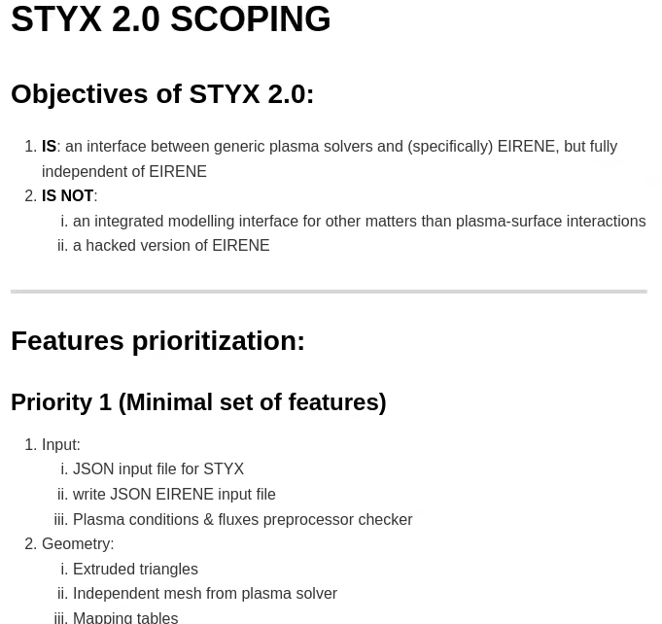
Project started in 2023
Code like this sounds simple…
But actually is not at all (a lot of tasks needs to be done “under the hood”)
Currently ~10k lines of code, over a year (though not full time)
Some “project management” done:
Kick off with scoping workshop in Marseille 2023:
What is / what is not (target/vision)
Feature full listing
Prioritization
Definition of minimal set for v1.

Slide 7
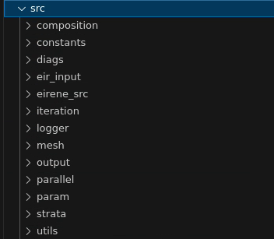
STYX 2.0: A generic <plasma solver>-EIRENE interface code
Main features:
Modular:
STYX library (→ depending on EIRENE library) simply called by plasma solver
STYX repository only includes a link to EIRENE repo (“submodule”)
JSON input (also EIRENE JSON input) ➔ GUI module planned
Plasma solvers’ only difficult job is mapping/interpolation of plasma mesh to EIRENE mesh (background plasma-solver → EIRENE, source EIRENE → plasma solver)
➔ Mesh for EIRENE fully independent from the plasma solver (reduced memory footprint). Plasma solver just has to write the mapping routine.
Library: Much improved program flow: initialization phase THEN run phase, all passed in-memory, no file reading, even for the mesh (and as few as possible user ifX_cop calls)
modules

Slide 8
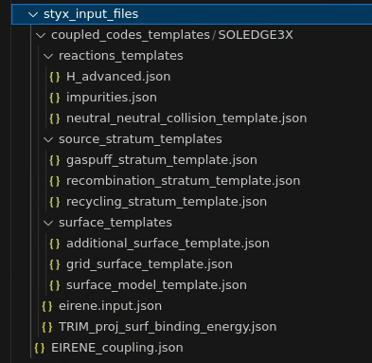
Input file generation less error prone, more flexible
Quality of life improvements: remove as much choices/free parameters as possible (where there “reasonably” shouldn’t be):
Easy/flexible species setup (only requires chemical formula “spec = array[A,Z,mult]”)
Template-based system (JSON edits, no recompilation required):
For reactions
For primary sources
For surfaces
EIRENE reaction format « extension »

Slide 9
Outputs
To plasma solver, with unit choice (SI, or CGS)
Save to own HDF5 file, or to any existing HDF5 group identifier
Some plotting routines
Split by stratum
Automated checks (particle balance)

Slide 10
Current status & future steps
Current:
Close to minimum viable, should be in first half of 2025. Minimal: no NN collision, no time-dependent, basic short cycling
Dummy plasma-solver code working (in STYX repo)
First coupled run with SOLEDGE3X working (Needs further testing, remaining features to implement)
Merge request on EIRENE side (few changes, mainly exits points to EIRENE_COUPLE)
Future:
Once first coupling with SOLEDGE3X OK:
Add NN-collisions, time-dependent, and rescaled short-cycling (particle balance conservation)
Then go to hybrid models, source linearization, H-D-T mixes, interfaces for dynamic wall models…
GUI
OpenMP tests
Test with other plasma solvers (in the 26/27 WP for TSVV3)
SOLEDGE3X-STYX2.0 coupled run test run: Particle source per stratum

Slide 11
EIRENE coding
Parallel Colrad still ongoing (develop merged in the MsV state, WIP_parallel_colrad)
CI test ok (except a few issues with OpenMP, likely threshold issue in comparisons)
Additions needed in photon routines, as well as documentation and cleaning
Work on identifying CI issues (error code not reported in sequential tests) following apparent issues with OpenMP cases
Issues with ifx compiler when running with OpenMP started being investigated in December, still debugging that one (will likely need workarounds) – still there in most recent compiler version

Slide 12
Thank you for your attention

