Slide 1


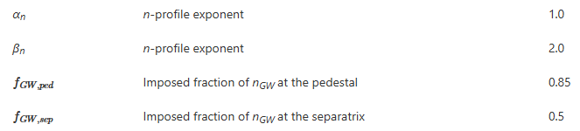

DEMO A=2.8: Ip as a design driver
Physics assumptions related to Ip in PROCESS for DEMO A=2.8 baseline proposal [Coleman et al NF 2025]
q95 as a design margin for plasma physics uncertainties: design done for q95=3.6, assuming that Energy content scales up with Ip^{0.93} as predicted by IPB98(y,2)
Energy content assumed to be 1.1 times IPB98(y,2), scales as Ip^{0.93}
Density profiles follows Greenwald, increases with Ip
Xe content adjusted to keep: P_{sep}=1.1P_{LH,Martin} here no Ip…
Today: C. Angioni
PSD² meeting May 14: M. Giacomin, P. Manz
Today: E. Fable
PSD² meeting Nov 2024: E. Delabie, T. Görler

Slide 2
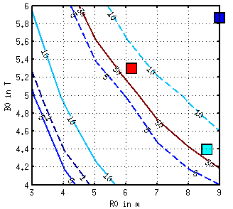
Illustration: Impact of Ip on attractiveness of A=2.8 vs 3.1
Q
Initial question:
R, B scans using METIS with H98(y,2)
At fixed q95
Changing A from 3.1 to 2.8 makes ITER more attractive with Q>30!
Why?
Mostly because lower A allows for higher Ip
Essential to understand the physics at play behind Ip scaling, at fixed q. Impact of q expected in core turbulence, Ip on pedestal? Discussions with C. Angioni, M. Dunne, T. Luda, E. Flable triggered this meeting.
DEMO 2019 A=3.1
_ A=2.8
-- A=3.1
ITER A=3.1
+~30 %
+4 %
DEMO 2024 A=2.8
+6 %

