Slide 1




Magnetic Flux Pumping at JET
PSD-DCT Coordination Meeting
A Bock¹, A Burckhart¹, G Pucella², F Auriemma³,
D King⁴, M Poradzsinski⁴, E Aymerich⁵, D Keeling⁴,
C Challis⁴, N Hawkes⁴, P Jacquet⁴, E Joffrin⁶,
M Baruzzo², R Dumont⁶, C Piron², E Giovannozzi²,
T Pütterich¹, G Sias⁵, R Schramm¹, JET Contributors⁷
¹ Max-Planck-Institut für Plasmaphysik, Garching, Germany
² ENEA, Fusion and Nuclear Safety Department, Frascati, Italy
³ Consorzio RFX-CNR, ENEA, INFN, Università di Padova, Aiaierie Venete SpA, Padova, Italy
⁴ CCFE, Culham Science Centre, Abingdon, United Kingdom
⁵ CNR-ISTP, Corso Stati Uniti 4, 35127 Padova, Italy
⁶ CEA, IRFM, Saint-Paul-lez-Durance, France
⁷ See author list of J. Mailloux et al. Nucl. Fusion 62 (2022) 042026

Slide 2
Outline
About 1/1 Flux Pumping
Experimental Results in JET
Conclusions and Outlook

Slide 3
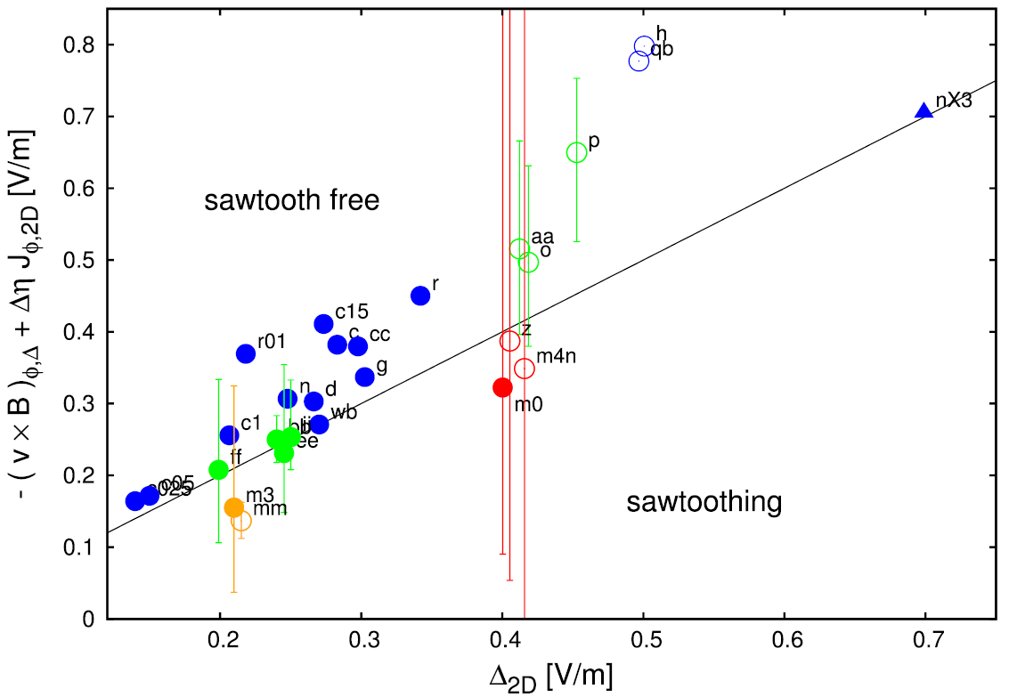
Flux Pumping: Theoretical Background
Magnetic flux pumping with 1/1 mode investigated theoretically
Simulations with varying inputs reveal dependency on:
  Core pressure ➔ drives the mode, more flux pumping, q₀ ~ 1
  Current peaking ➔ drives q₀ under 1. If too peaked, FP not sufficient to keep q₀ at unity
[Krebs, PoP 2017]
Theory
Electric field created by the mode
[Krebs, PoP 2017]
Electric field needed to keep q₀ ~ 1

Slide 4
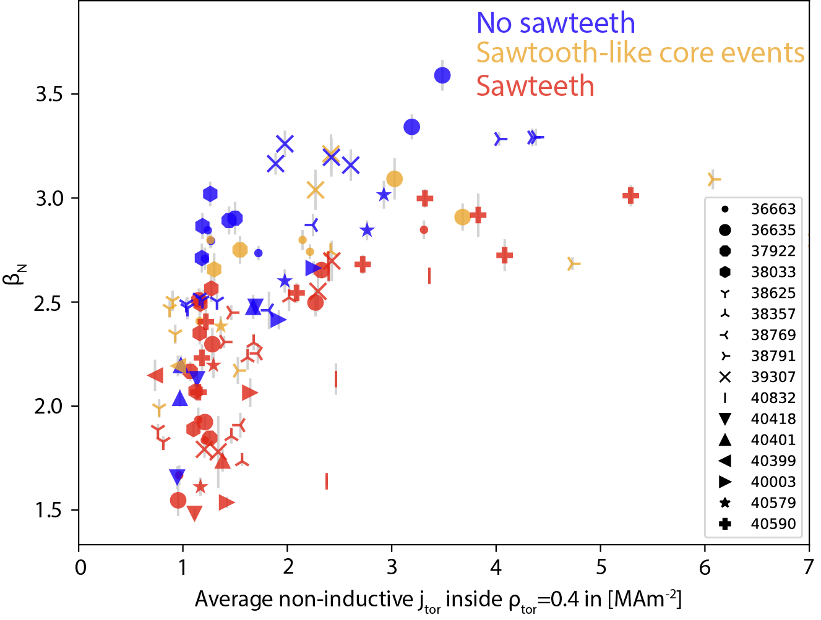
Flux Pumping: Theoretical Background
Magnetic flux pumping with 1/1 mode investigated theoretically
Simulations with varying inputs reveal dependency on:
  Core pressure ➔ drives the mode, more flux pumping, q₀ ~ 1
  Current peaking ➔ drives q₀ under 1. If too peaked, FP not sufficient to keep q₀ at unity
[Krebs, PoP 2017]
Theory
Experiment
AUG
Electric field created by the mode
β_{N}
[Krebs, PoP 2017]
[Burckhart, NF 2023]
Electric field needed to keep q₀ ~ 1
Co-current on-axis ECCD (lowers q₀) →

Slide 5
Outline
About 1/1 Flux Pumping
Experimental Results in JET
Conclusions and Outlook

Slide 6
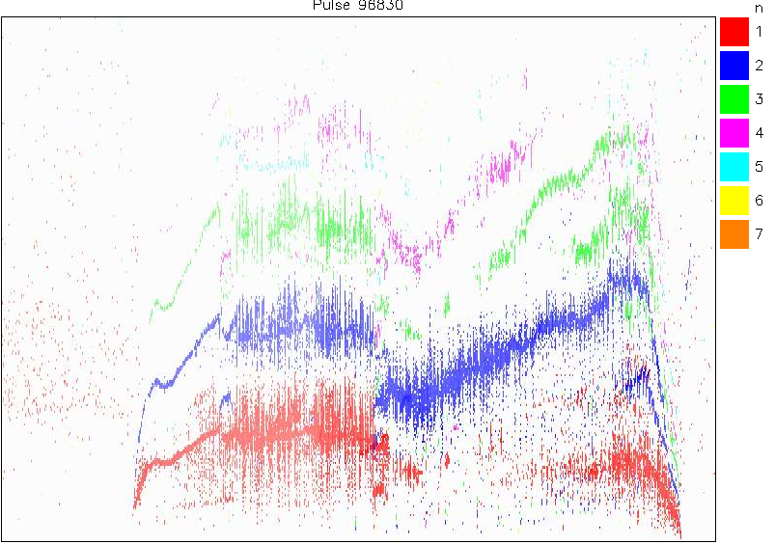
Studying FP at JET: Starting Point
Flux pumping not yet observed in large machines
Start from JPN 96830:
  β_{N}= 2.6, B_{T}= 1.7 T, I_{p}= 1.4 MA, q₉₅= 4
  P_{NBI}= 14 MW
  Central n=1 mode in high β phase
high beta
phase
n
1
2
3
4
5
6
7
50
40
30
Frequency [kHz]
20
10
3
4
5
6
7
8
9
Time [s]

Slide 7
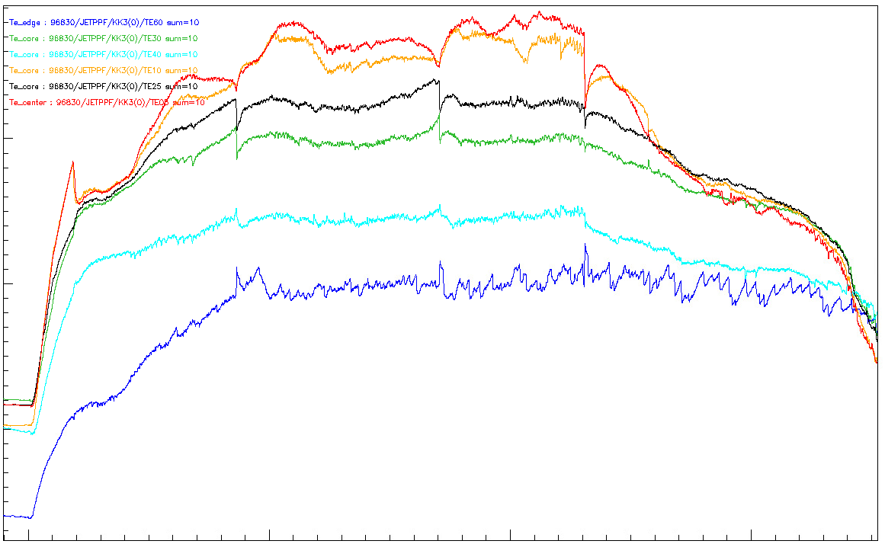
Studying FP at JET: Starting Point
T_{e} (ECE)
Flux pumping not yet observed in large machines
Start from JPN 96830:
  β_{N}= 2.6, B_{T}= 1.7 T, I_{p}= 1.4 MA, q₉₅= 4
  P_{NBI}= 14 MW
  Central n=1 mode in high β phase
  However: sawteeth
  High β phase ended by ST-triggered 3/2 NTM
3
keV
2
1
sawteeth
4
5
6
7
high beta
phase
n
1
2
3
4
5
6
7
50
40
30
Frequency [kHz]
20
10
3
4
5
6
7
8
9
Time [s]

Slide 8
Studying FP at JET: Starting Point
T_{e} (ECE)
Flux pumping not yet observed in large machines
Start from JPN 96830:
  β_{N}= 2.6, B_{T}= 1.7 T, I_{p}= 1.4 MA, q₉₅= 4
  P_{NBI}= 14 MW
  Central n=1 mode in high β phase
  However: sawteeth
  High β phase ended by ST-triggered 3/2 NTM
  3/2 NTMs in subsequent experiments
Optimise q-profile to avoid NTM (lower q₉₅)
3
keV
2
1
sawteeth
4
5
6
7
high beta
phase
n
1
2
3
4
5
6
7
50
40
30
Frequency [kHz]
20
10
3
4
5
6
7
8
9
Time [s]

Slide 9
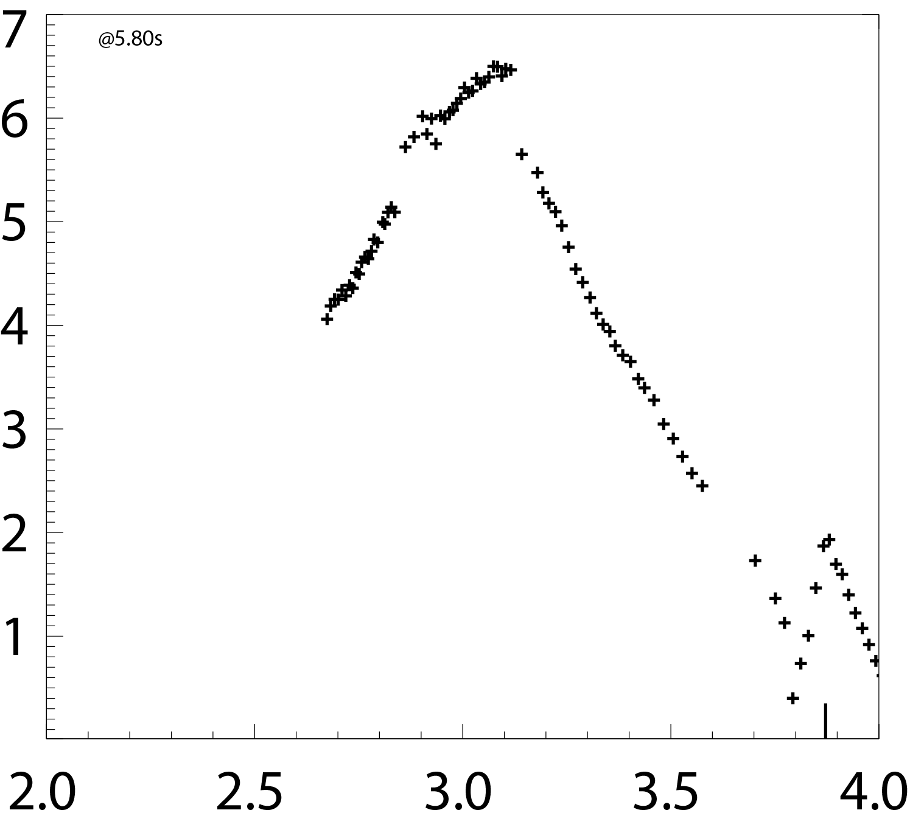
Caveat for 1/1 FP: first sawtooth flattens T_{e}
JPN 102440
Peaked core T necessary for flux pumping?
Before 1st ST
ECE shinethrough
Te [keV]
R [m]

Slide 10
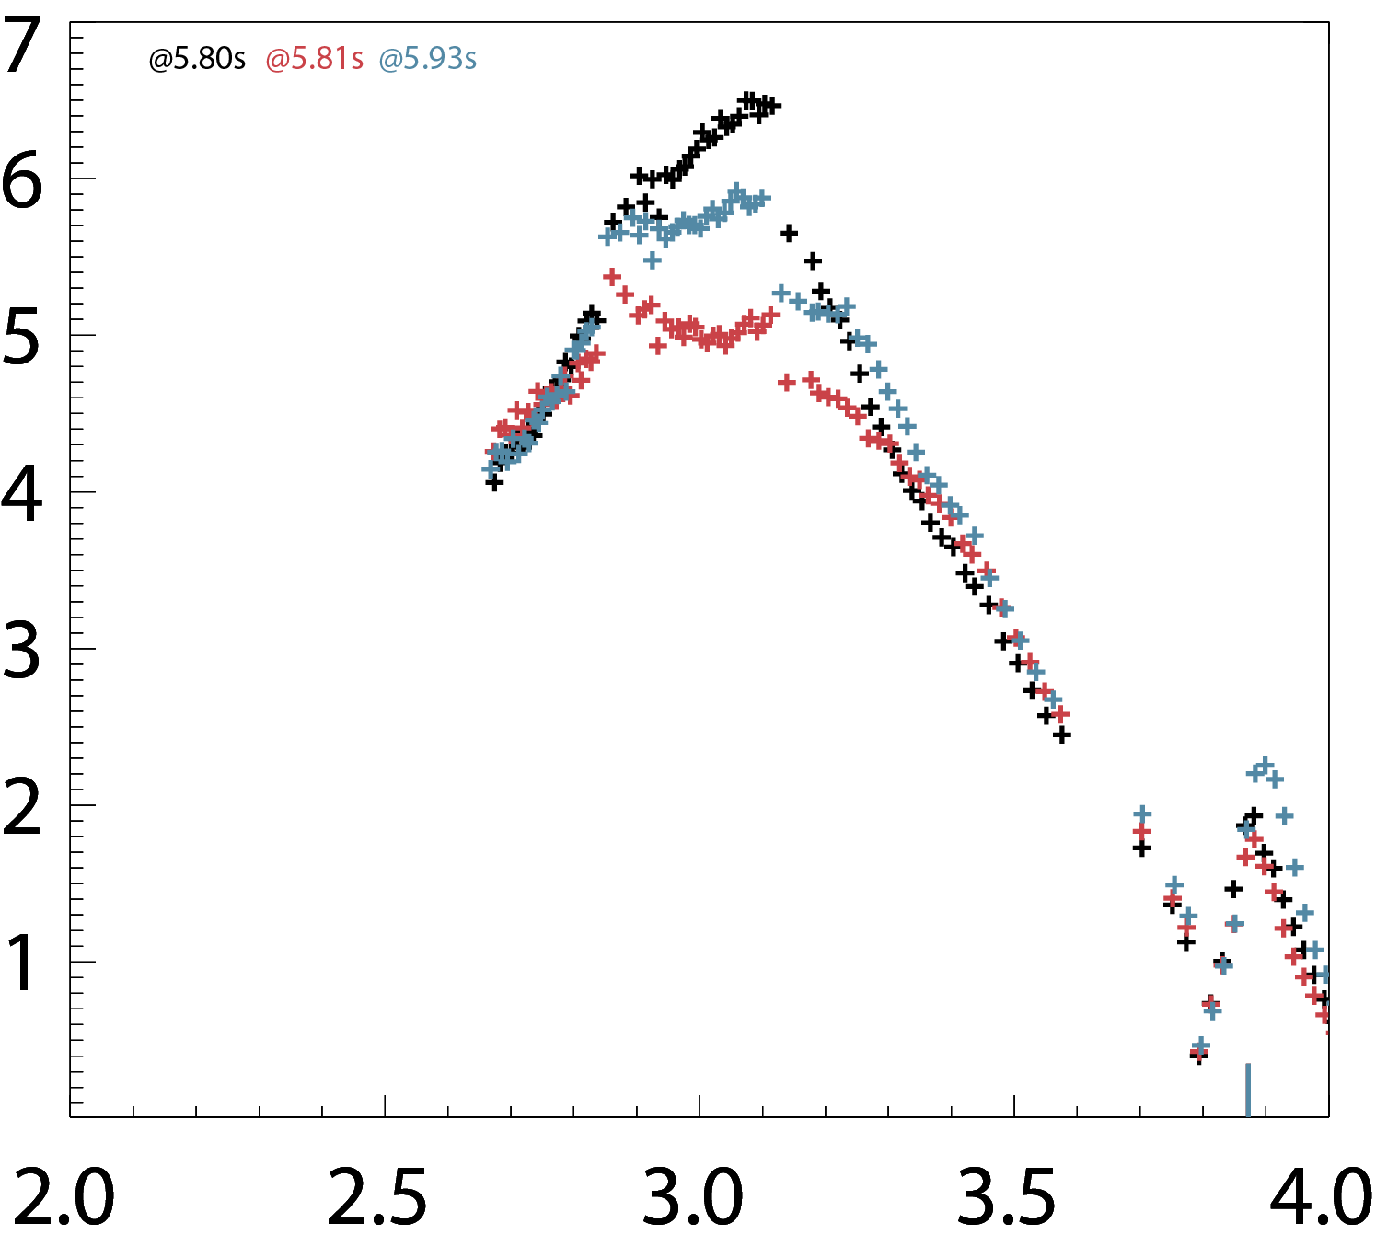
Caveat for 1/1 FP: first sawtooth flattens T_{e}
JPN 102440
Peaked core T necessary for flux pumping?
At AUG, FP-regime accessible from sawtoothing, but: no ECRH at JET for core heating
Sawteeth can trigger 3/2
Solution: reach high-β phase just before 1/1
➔ avoiding sawteeth altogether
Before 1st ST
After ST
recovery
ECE shinethrough
Te [keV]
After 1st ST
R [m]

Slide 11
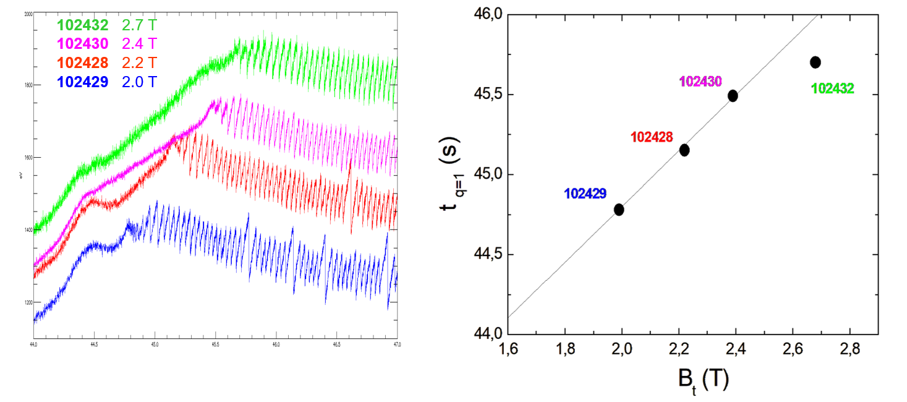
Ohmic pulses to determine necessary NBI timing
Ohmic discharges to determine q₀=1 timing at different B_{T}
46.0
1800
45.5
1600
Te [eV]
t_{q=1} [s]
45.0
1400
44.5
1200
44
45
46
47
1.6
1.8
2.0
2.2
2.4
2.6
2.8
Time [s]
B_{t} [T]

Slide 12
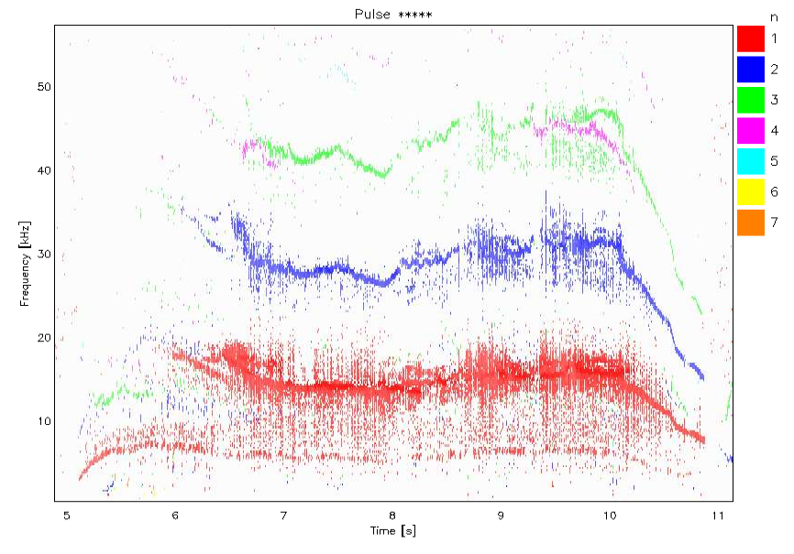
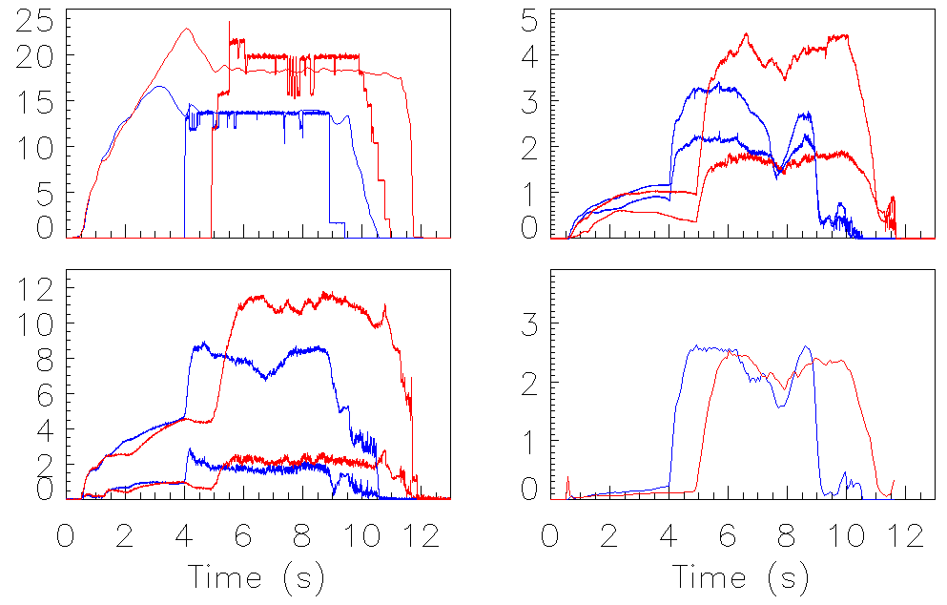
Result of Optimisation: Only 1/1-mode remains, no ST Crashes
JPN 103110:
  β_{N}= 2.3-2.5 → marginal
  B_{T}= 2.25 T, I_{p}= 1.85 MA, q₉₅= 4
  P_{NBI}= 20 MW
  Central n=1 mode in high β phase
  No clear sawteeth!
103110
n
1
2
3
4
5
6
7
50
harmonics
40
Frequency [kHz]
T_{e} [keV]
30
I_{p} [100kA] P_{NBI} [MW]
20
1/1
n_{e} [10¹⁹m⁻³]
β_{N} 96830 103110
10
5
6
7
8
9
10
11
Time [s]

Slide 13
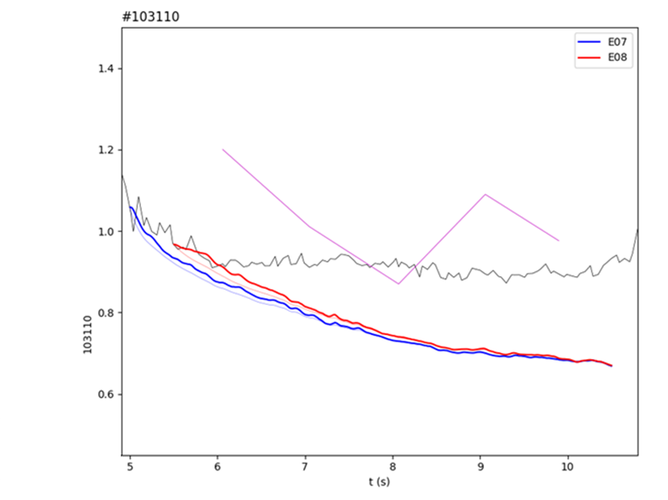
No ST Crashes and preliminary modeling suggest flux pumping
TRANSP suggests q_{min} < 1, but experimental q_{min} ~ 1 and no sawteeth
➔ Evidence for flux pumping
103110
n
1
2
3
4
5
6
7
50
harmonics
1.4
40
1.2
Exp (MSE & POL)
Frequency [kHz]
30
q_{min}
1.0
20
1/1
0.8
10
0.6
TRANSP
5
6
7
8
9
10
11
5
6
7
8
9
10
Time [s]
Time [s]

Slide 14
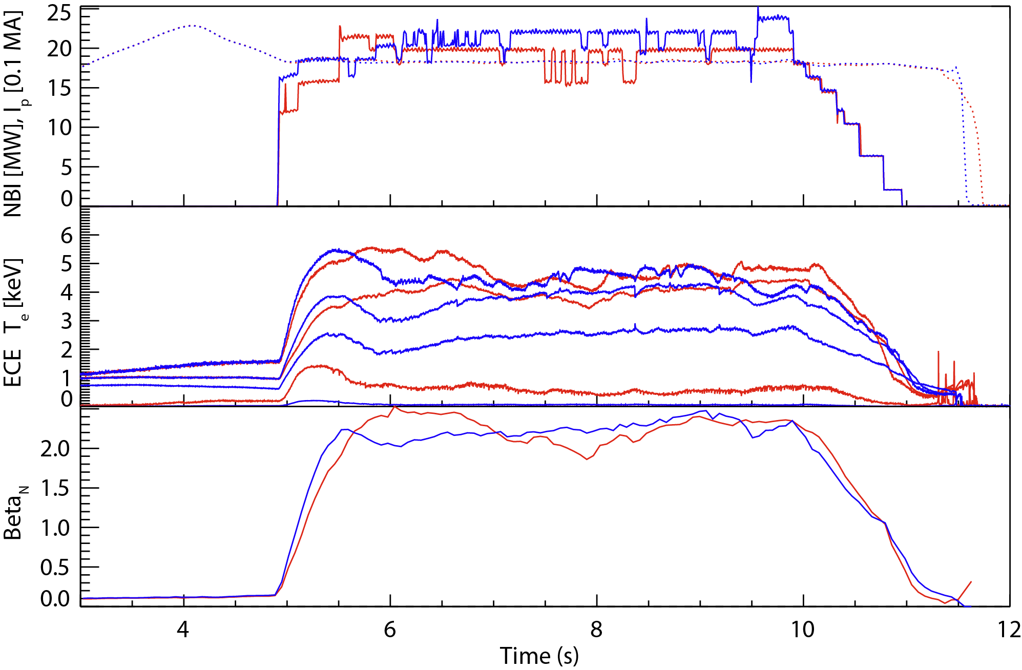
3 pulses suggesting the presence flux pumping
Pulses relatively stable, some impurities, but scenario seems to be robust:
1/1 throughout
Reasonably constant β
103110
103818

Slide 15
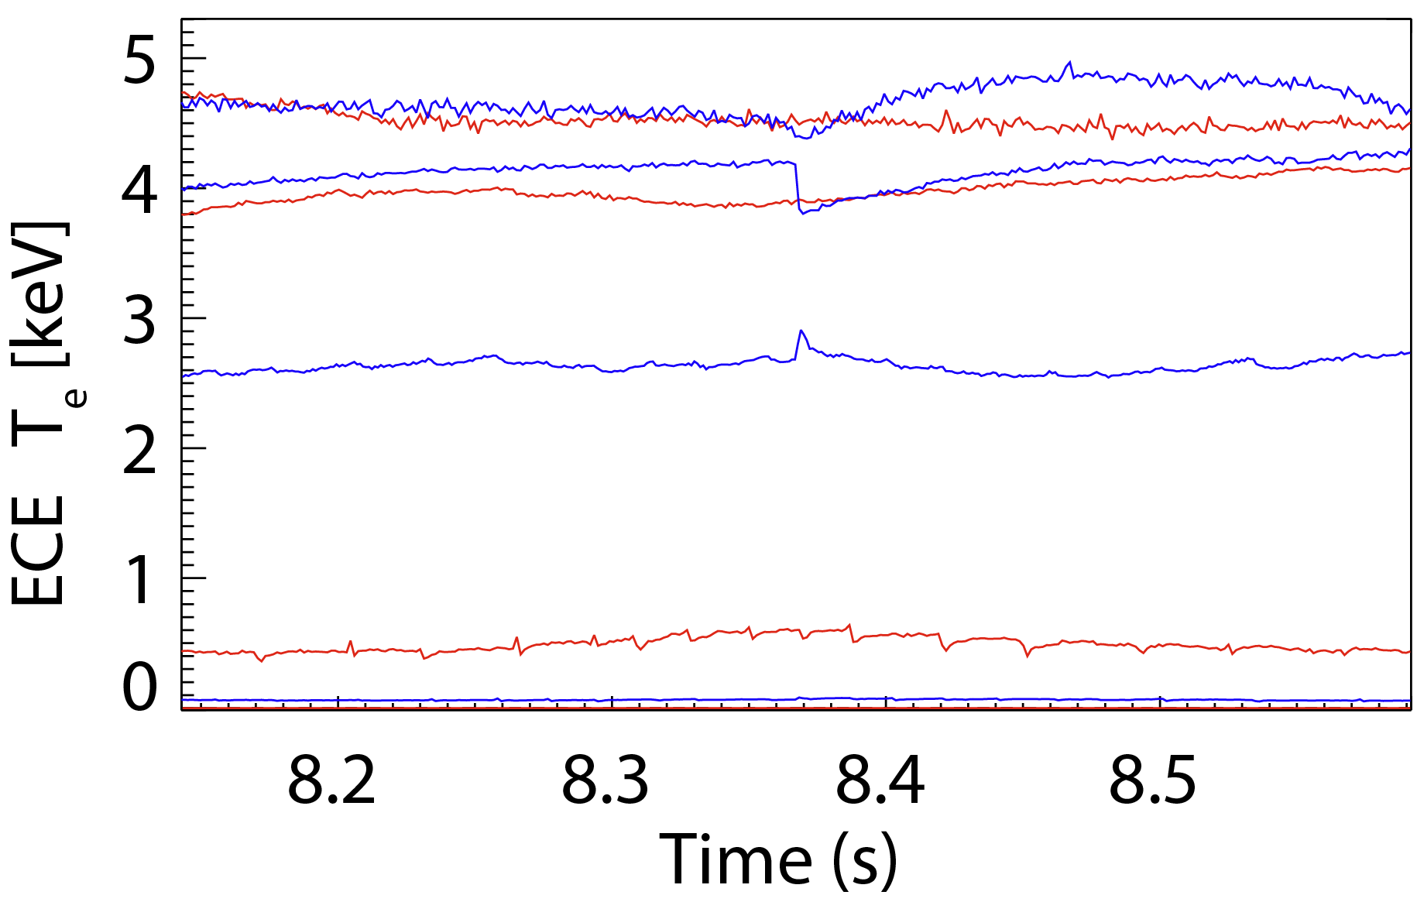
3 pulses suggesting the presence flux pumping
Pulses relatively stable, some impurities, but scenario seems to be robust:
1/1 throughout
Reasonably constant β
Caveat: 2 off-axis events (Double tearing mode?)
103110
103818

Slide 16
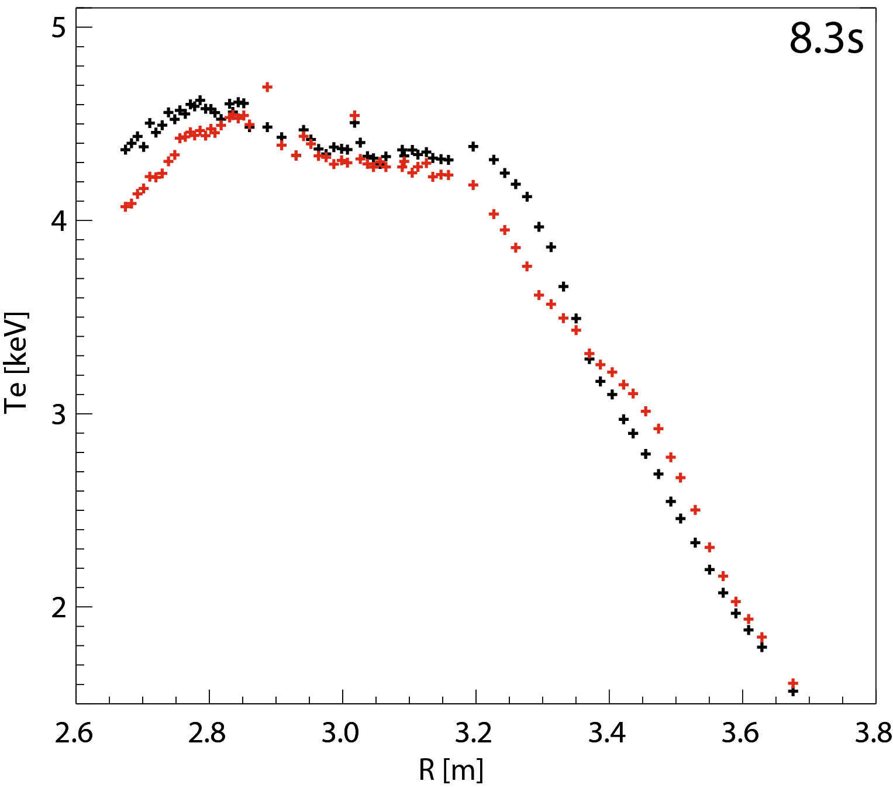
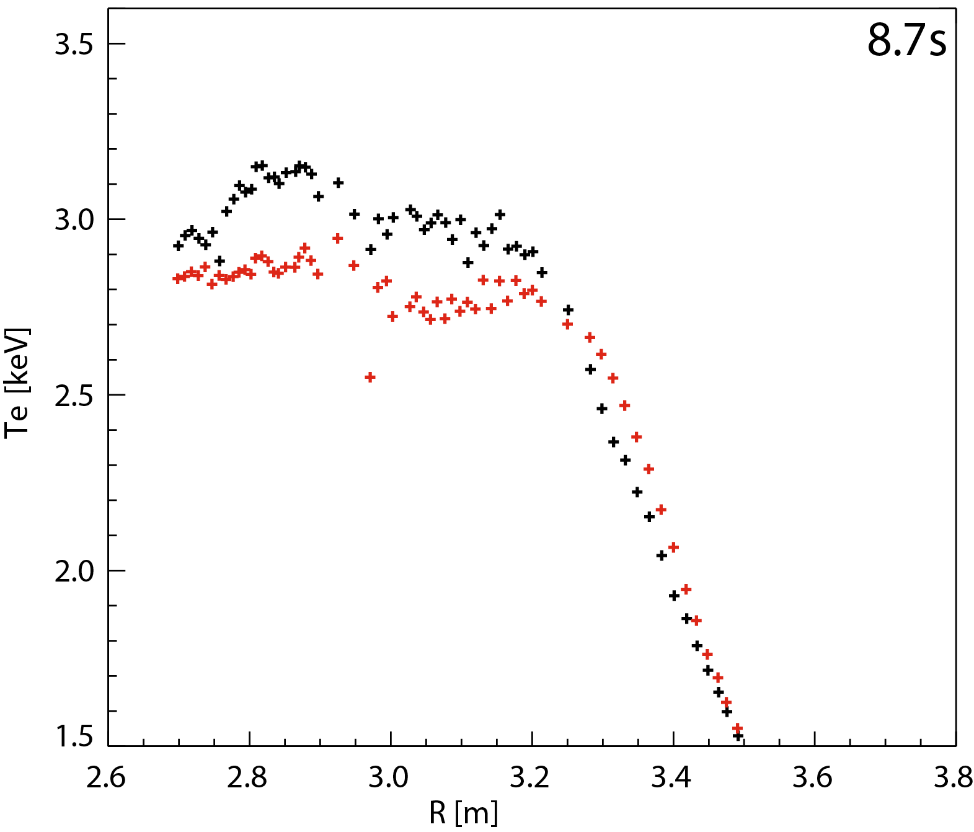
Sporadic events: double tearing mode?
Off-axis events with clear
inversion radius
Density below ECE cutoff
Appears to be double tearing mode
Double tearing mode
Sawtooth (reference)
103818
105293
Before event
Before event
After event
After event

Slide 17
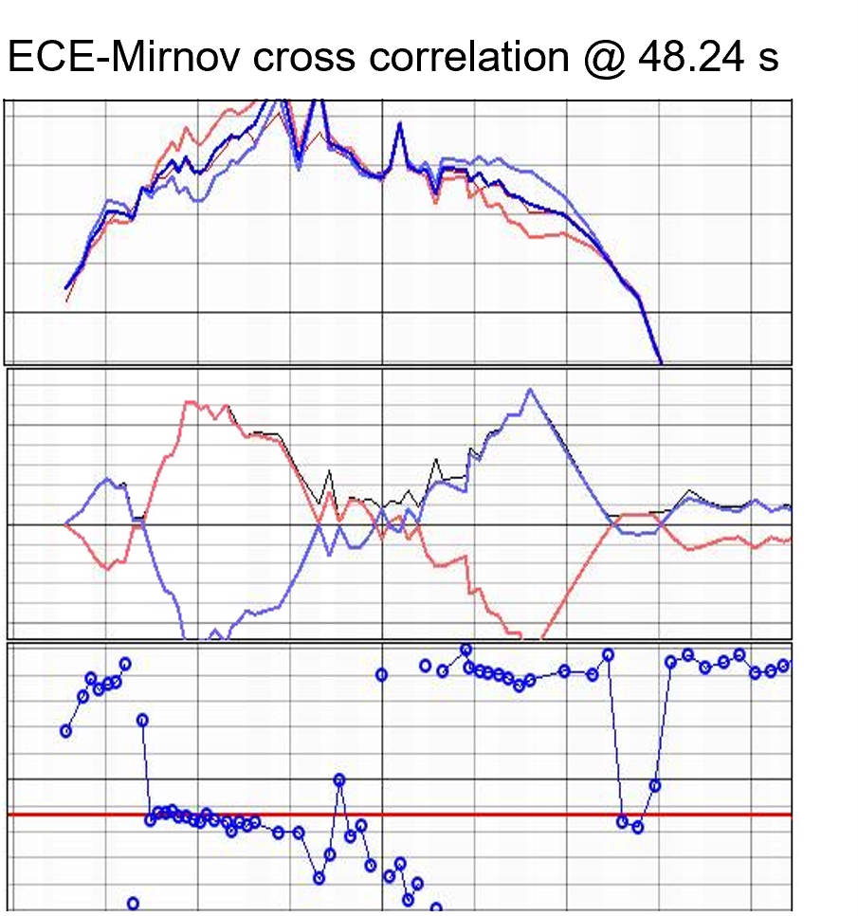
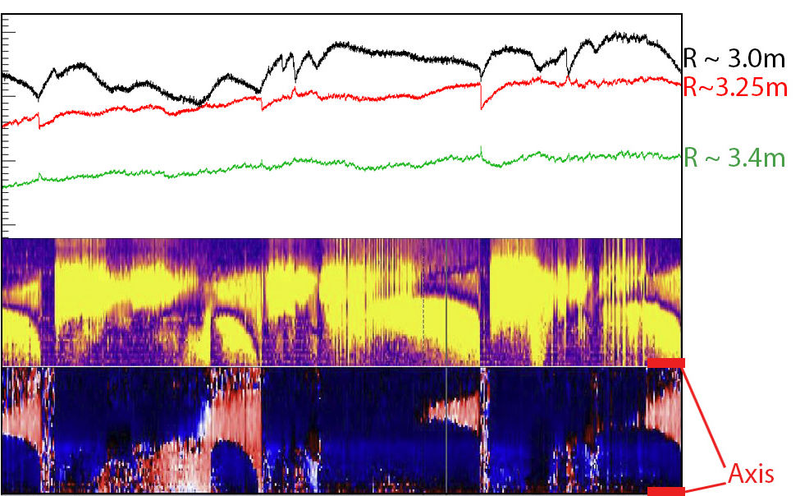
Sporadic events: double tearing mode?
4.8
103818
4.6
5
4.4
T_{e} [keV]
4.2
4.0
3.8
4
100
ECE T_{e} [keV]
ΔT_{e} [eV]
0
3
-100
1
2
0
7
8
9
Phase/π
Time [s]
-1
2.6
2.7
2.8
2.9
3.0
3.1
3.2
3.3
3.4
R [m]

Slide 18
Sporadic events: double tearing mode?
4.8
103818
4.6
5
4.4
T_{e} [keV]
4.2
4.0
3.8
4
100
ECE T_{e} [keV]
ΔT_{e} [eV]
0
3
-100
1
2
3.4
0
Phase/π
3.3
Ampl. Vs R [m]
-1
3.2
2.6
2.7
2.8
2.9
3.0
3.1
3.2
3.3
3.4
R [m]
3.1
3.4
3.3
Phase Vs R [m]
3.2
3.1
7
8
9
Time [s]

Slide 19
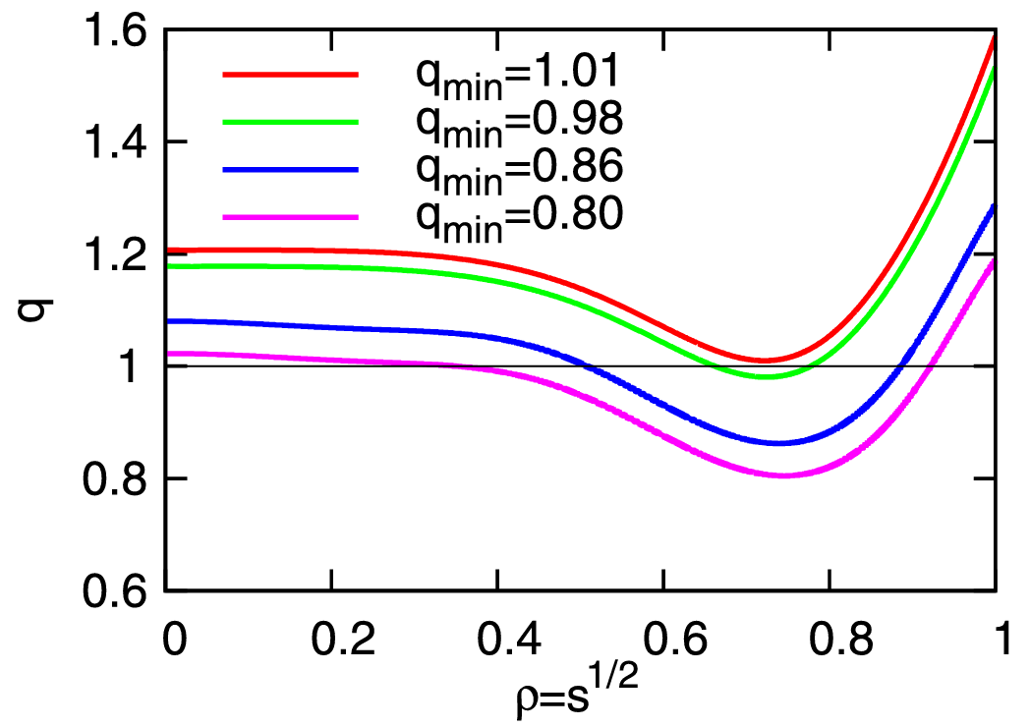
Sporadic events: double tearing mode?
4.8
103818
4.6
5
4.4
T_{e} [keV]
4.2
4.0
3.8
4
100
ECE T_{e} [keV]
ΔT_{e} [eV]
0
3
-100
1
2
3.4
0
Phase/π
3.3
Ampl. Vs R [m]
-1
3.2
2.6
2.7
2.8
2.9
3.0
3.1
3.2
3.3
3.4
R [m]
3.1
[Kawagoe, PPCF 2022]
3.4
3.3
Phase Vs R [m]
3.2
3.1
7
8
9
Illustration (generic tokamak)
Time [s]

Slide 20
Sporadic events: double tearing mode?
➔ „too“ much current redistribution,
off-axis q below 1?
Avoid double tearing mode?
103818
5
4
ECE T_{e} [keV]
3
2
3.4
3.3
Ampl. Vs R [m]
3.2
3.1
3.4
3.3
Phase Vs R [m]
3.2
3.1
7
8
9
Time [s]

Slide 21
Sporadic events: double tearing mode?
➔ „too“ much current redistribution,
off-axis q below 1?
Avoid double tearing mode?
Other open questions:
Existence conditions
➔ needs cross-machine comparison
Is flux pumping too close to
operational limits of large machines ?
(Central gradients not strong enough in JET?
Different with alpha heating or core ECRH?)
103818
5
4
ECE T_{e} [keV]
3
2
3.4
3.3
Ampl. Vs R [m]
3.2
3.1
3.4
3.3
Phase Vs R [m]
3.2
3.1
7
8
9
Time [s]

Slide 22
Outline
About 1/1 Flux Pumping
Experimental Results in JET
Conclusions and Outlook

Slide 23
Summary and Outlook
FP has potential to tangibly improve FPP designs through increased ideal stability and external current drive efficiency
Experiments at JET seem to confirm existence of FP in larger devices
Continue FP investigations in AUG and MAST-U:
    Integrate FP with Exhaust Solutions
    Quantify parameter space of 1/1 FP
    ECCD efficiency studies
Develop a quantitative FP model describing ALL current machines and capable of extrapolation to larger devices

