Slide 1
Update on flux pumping modelling (JOREK) and the development of the reduced model
Haowei Zhang*, Federico Stefanelli, Matthias Hölzl, Isabel Krebs, Andreas Burckhart, Alexander Bock, Sibylle Günter, Valentin Igochine, Karl Lackner, Rohan Ramasamy, Hartmut Zohm, Emiliano Fable, Jonas Puchmayr, the JOREK team, and the ASDEX Upgrade team
haowei.zhang@ipp.mpg.de
PSD–DCT coordination Meeting (April 16, 2025)

Slide 2
Outline
  JOREK modelling
      Two-temperature full MHD model and simulation parameters
      Simulation results for flux pumping and sawteeth phases in AUG
  On the reduced model
      Parameter scan in support of the reduced model
      Linear calculations in collaboration with CASTOR3D
  Summary and outlook

Slide 3
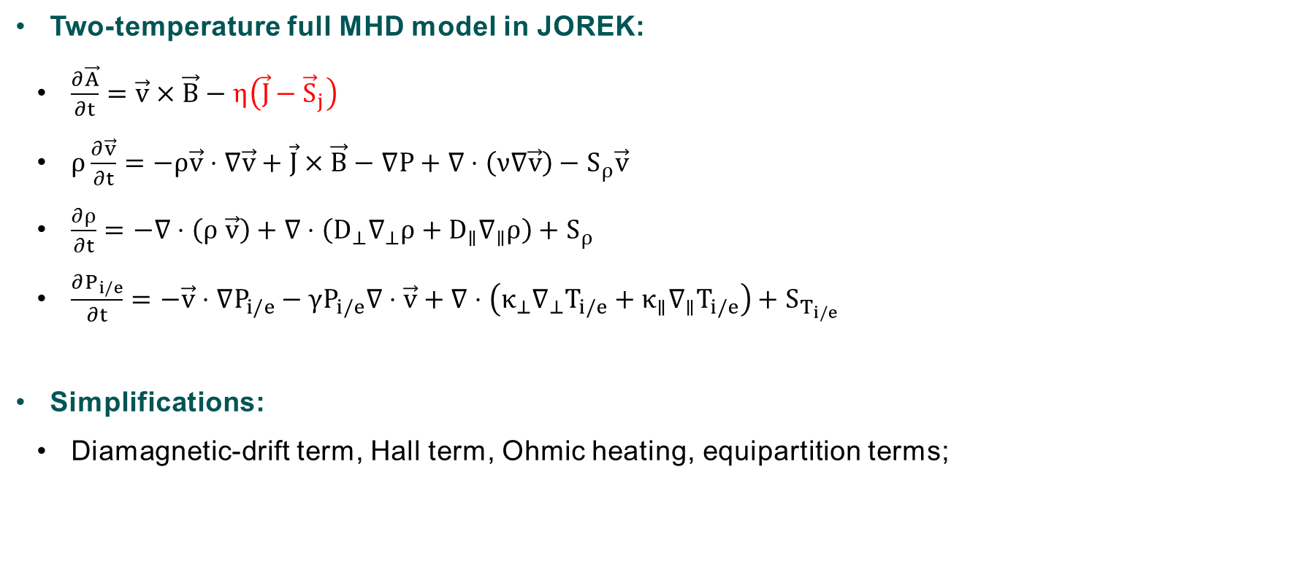
JOREK modelling
  Two-temperature full MHD model in JOREK:
      $\frac{∂\vec{A}}{∂t}=\vec{v}×\vec{B}−η\left(\vec{J}−{\vec{S}}_{j}\right)$
      $ρ\frac{∂\vec{v}}{∂t}=−ρ\vec{v}⋅∇\vec{v}+\vec{J}×\vec{B}−∇P+∇⋅\left(ν∇\vec{v}\right)−S_{ρ}\vec{v}$
      $\frac{∂ρ}{∂t}=−∇⋅\left(ρ \vec{v}\right)+∇⋅\left(D_{⊥}∇_{⊥}ρ+D_{∥}∇_{∥}ρ\right)+S_{ρ}$
      $\frac{∂P_{i/e}}{∂t}=−\vec{v}⋅∇P_{i/e}−γP_{i/e}∇⋅\vec{v}+∇⋅\left(κ_{⊥}∇_{⊥}T_{i/e}+κ_{∥}∇_{∥}T_{i/e}\right)+S_{T_{i/e}}$
  Simplifications:
      Diamagnetic-drift term, Hall term, Ohmic heating, equipartition terms;

Slide 4
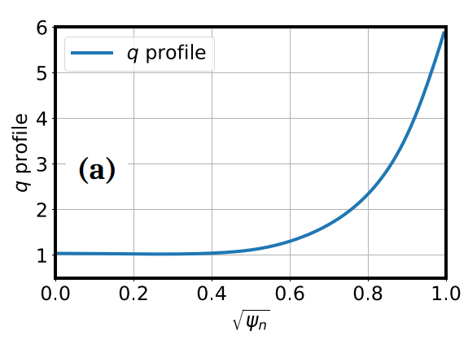
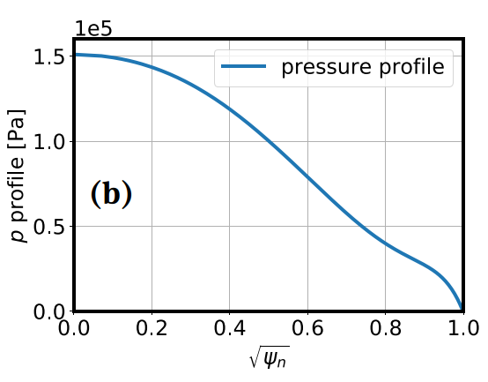
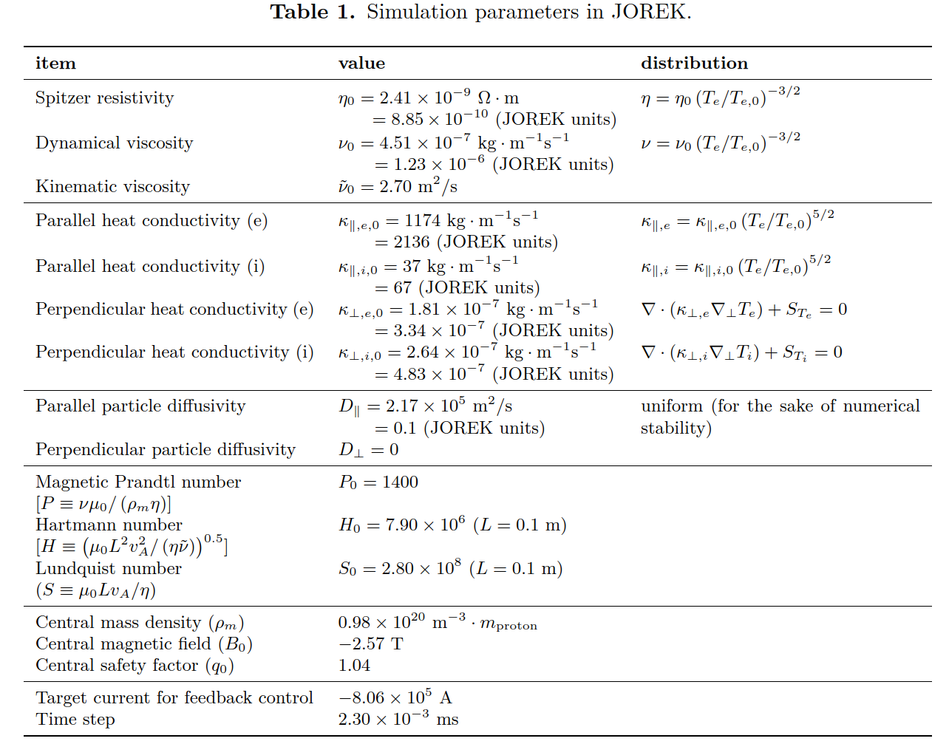
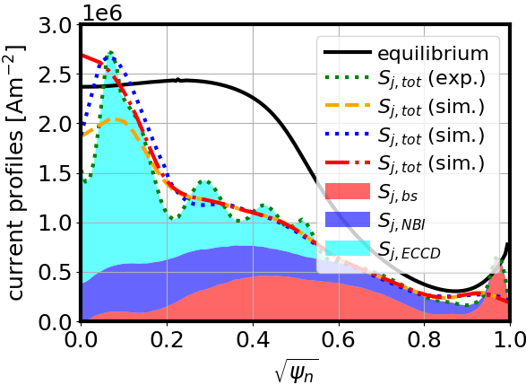
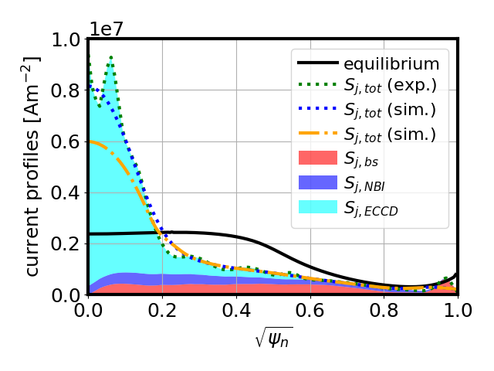
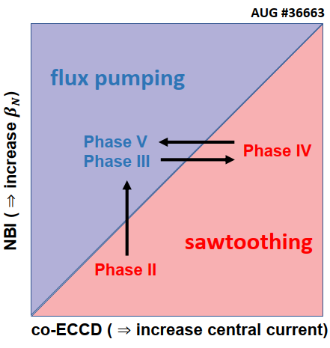
JOREK modelling
  Simulation parameters
current source (phase III, FP)
current source (phase IV, ST)
H. Zhang, et al., NF submitted (2025)

Slide 5
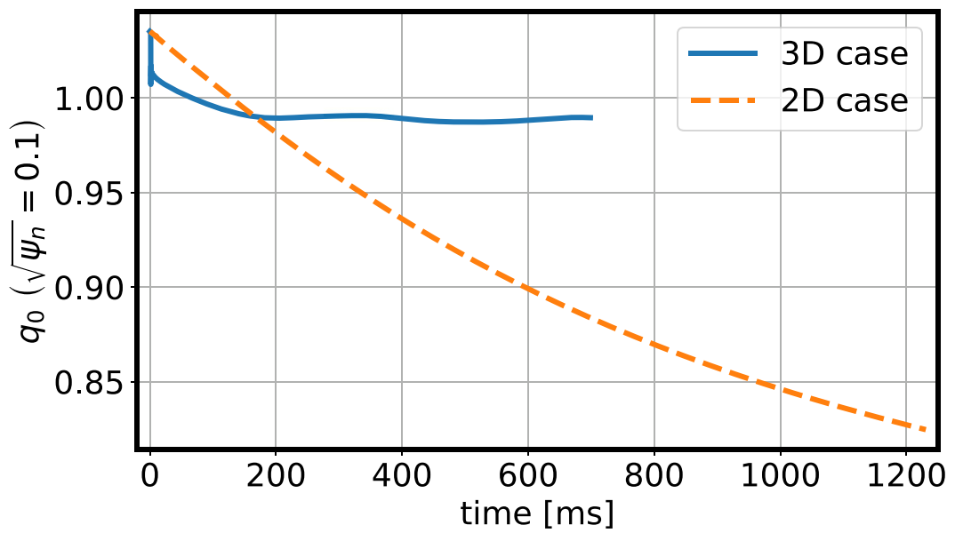
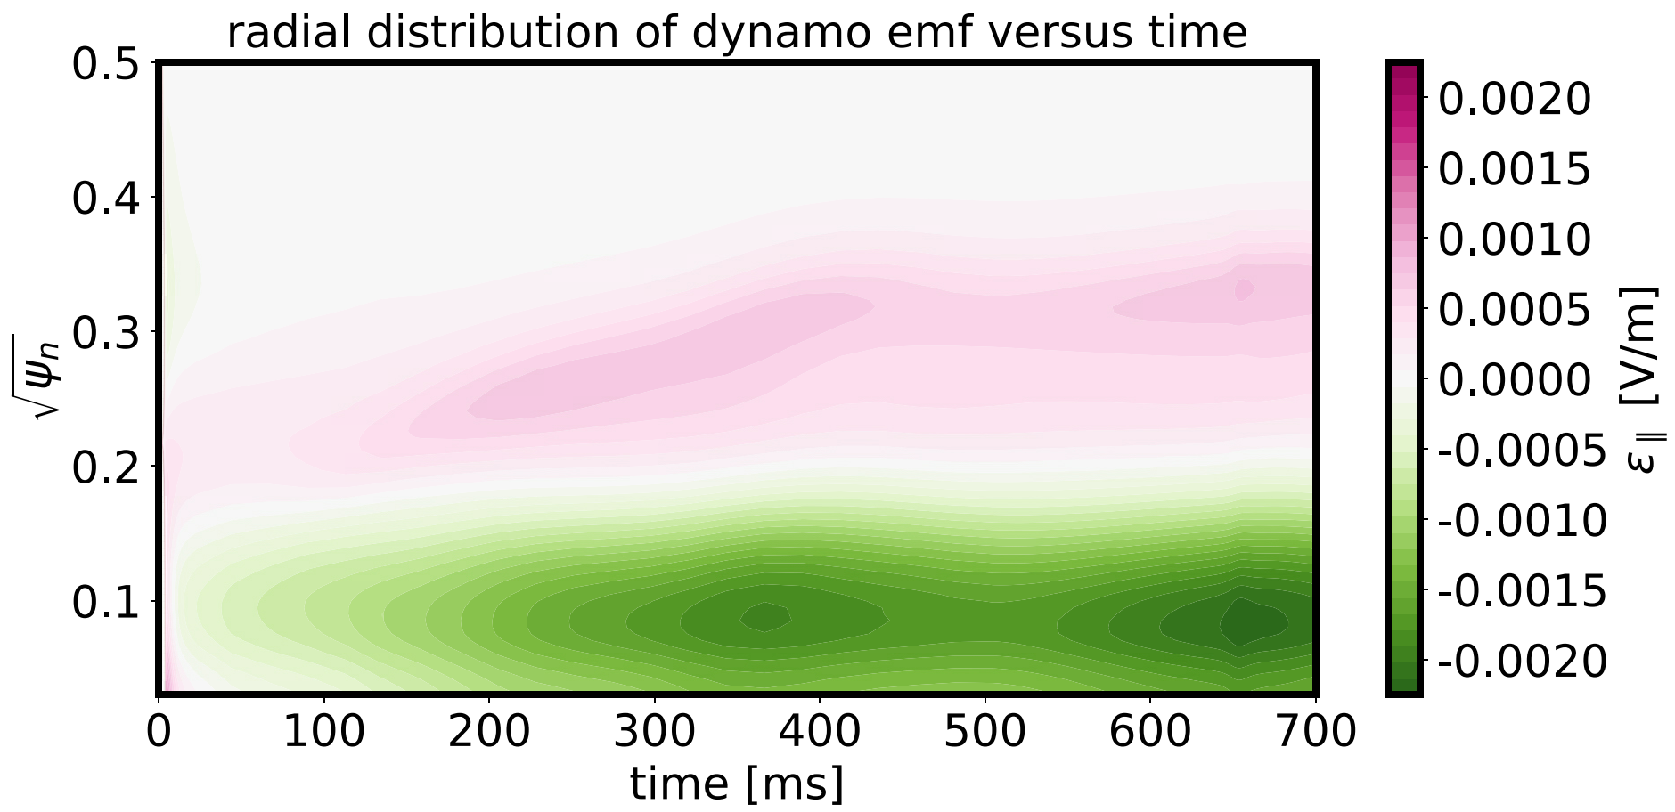
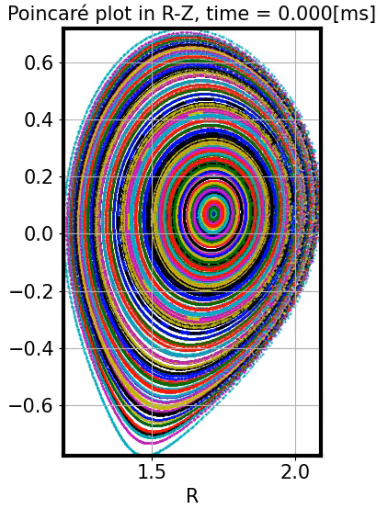
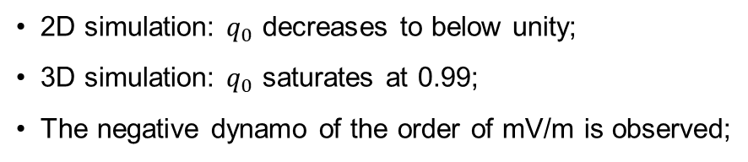
JOREK modelling: simulation on resistive diffusion timescale
2D simulation: $q_{0}$ decreases to below unity;
3D simulation: $q_{0}$ saturates at 0.99;
The negative dynamo of the order of mV/m is observed;
H. Zhang, et al., NF submitted (2025)

Slide 6
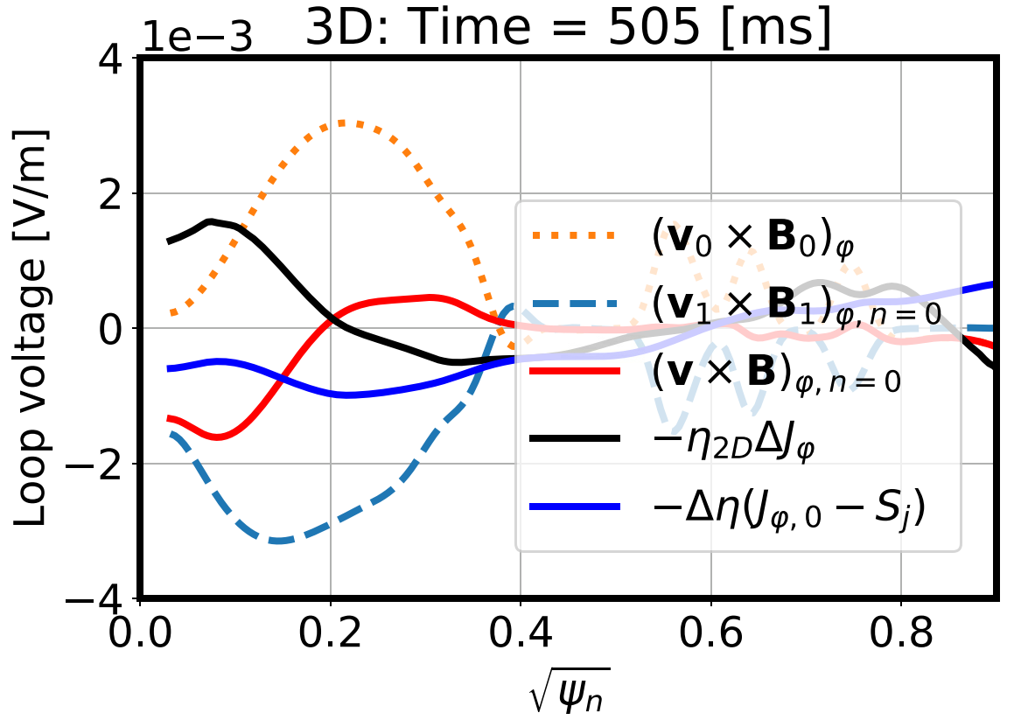
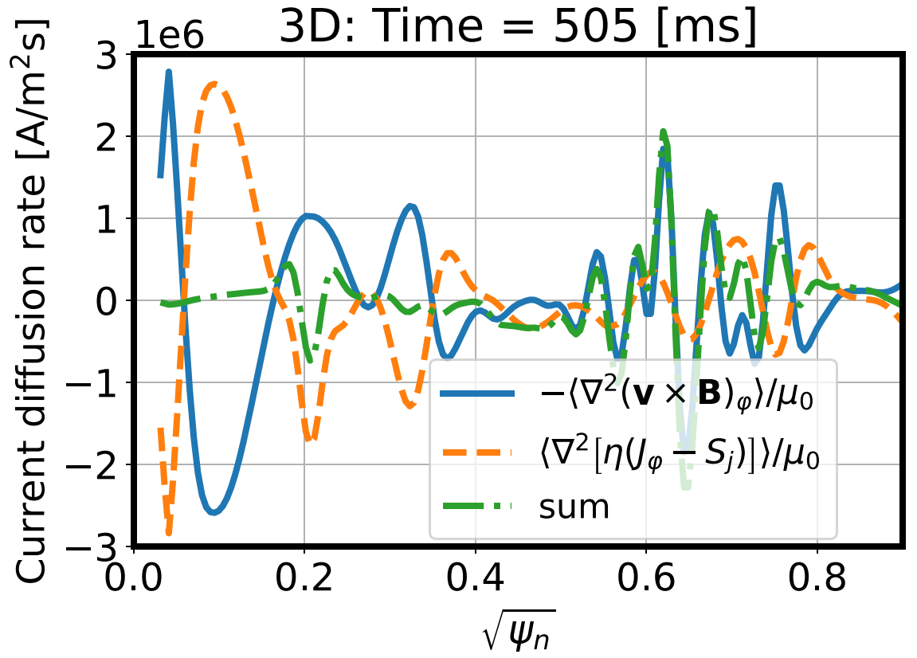
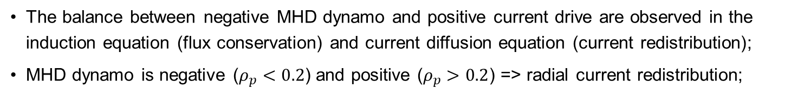

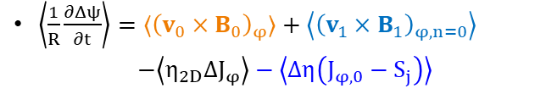
JOREK modelling: saturation due to balance of dynamo and current drive
$\left\langle \frac{1}{R}\frac{∂Δψ}{∂t}\right\rangle ={⟨\left(v_{0}×B_{0}\right)}_{φ}⟩+\left\langle {\left(v_{1}×B_{1}\right)}_{φ,n=0}\right\rangle$
$$−\left\langle η_{2D}ΔJ_{φ}\right\rangle −\left\langle Δη\left(J_{φ,0}−S_{j}\right)\right\rangle$$
$\frac{∂{⟨J}_{φ}⟩}{∂t}=\frac{1}{μ_{0}}\left\langle ∇^{2}\left[{−\left(v×B\right)}_{φ}+η\left(J_{φ}−S_{j}\right)\right]\right\rangle$
The balance between negative MHD dynamo and positive current drive are observed in the induction equation (flux conservation) and current diffusion equation (current redistribution);
MHD dynamo is negative ($ρ_{p}<0.2$) and positive ($ρ_{p}>0.2$) => radial current redistribution;
H. Zhang, et al., NF submitted (2025)

Slide 7
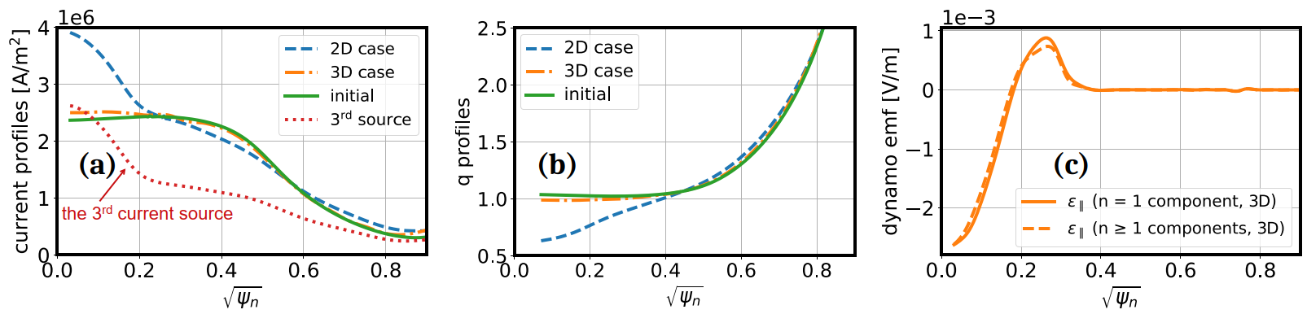
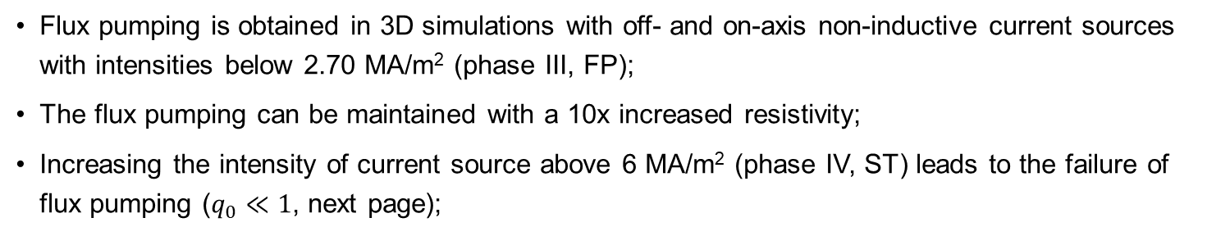
JOREK modelling: influence of the current sources
Base case
current source (phase III, FP)
Flux pumping is obtained in 3D simulations with off- and on-axis non-inductive current sources with intensities below 2.70 MA/m² (phase III, FP);
The flux pumping can be maintained with a 10x increased resistivity;
Increasing the intensity of current source above 6 MA/m² (phase IV, ST) leads to the failure of flux pumping ($q_{0}≪1$, next page);
H. Zhang, et al., NF submitted (2025)

Slide 8
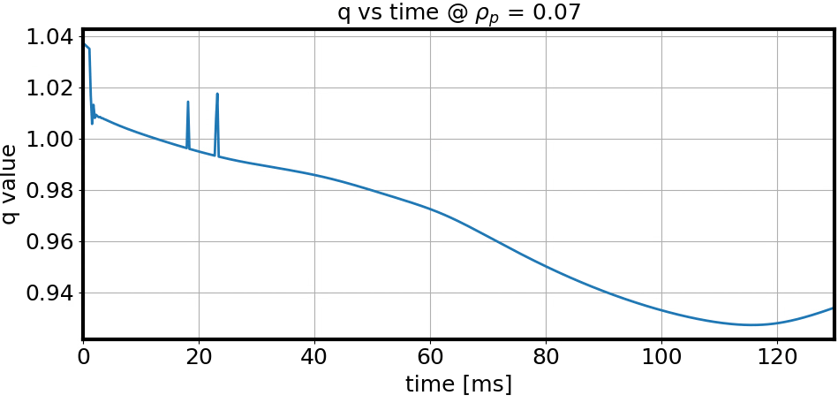
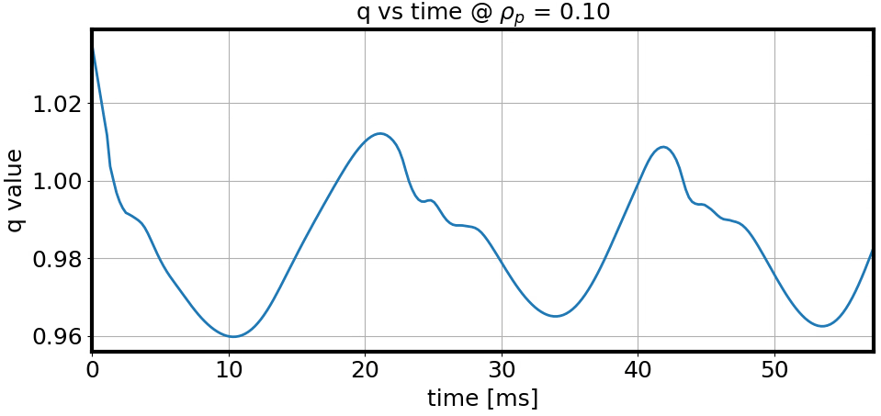
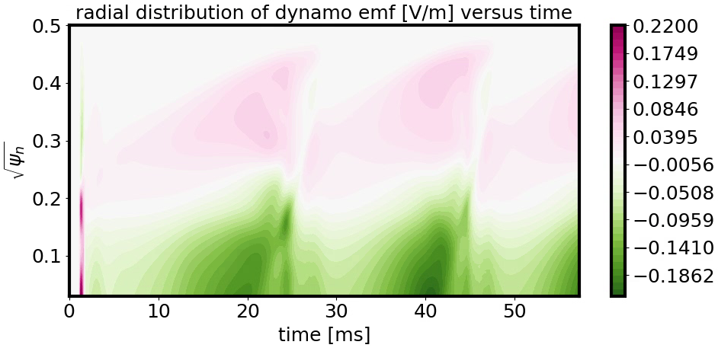
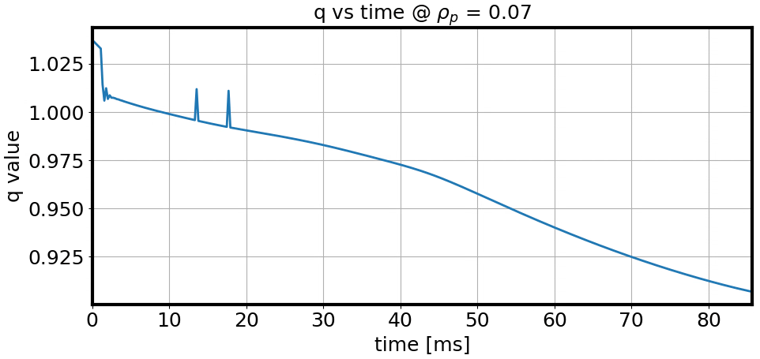
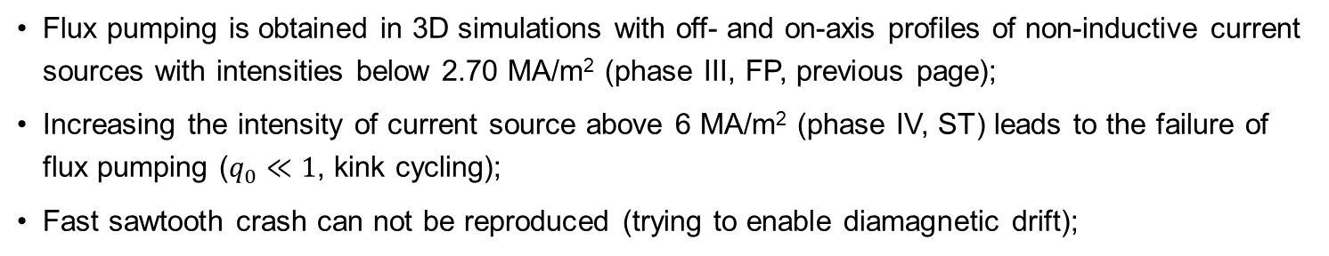
JOREK modelling: influence of the current sources
Spitzer resistivity
resistivity x10, viscosity x10
current source (phase IV, ST)
Flux pumping is obtained in 3D simulations with off- and on-axis profiles of non-inductive current sources with intensities below 2.70 MA/m² (phase III, FP, previous page);
Increasing the intensity of current source above 6 MA/m² (phase IV, ST) leads to the failure of flux pumping ($q_{0}≪1$, kink cycling);
Fast sawtooth crash can not be reproduced (trying to enable diamagnetic drift);

Slide 9
Outline
  JOREK modelling
      Two-temperature full MHD model and simulation parameters
      Simulation results for flux pumping and sawteeth phases in AUG
  On the reduced model
      Parameter scan in support of the reduced model
      Linear calculations in collaboration with CASTOR3D
  Summary and outlook

Slide 10
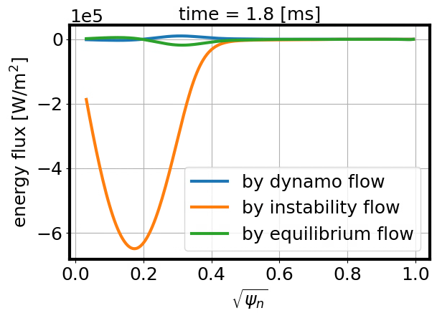
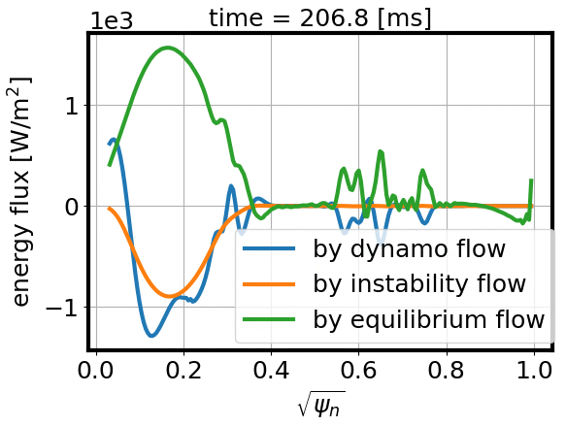
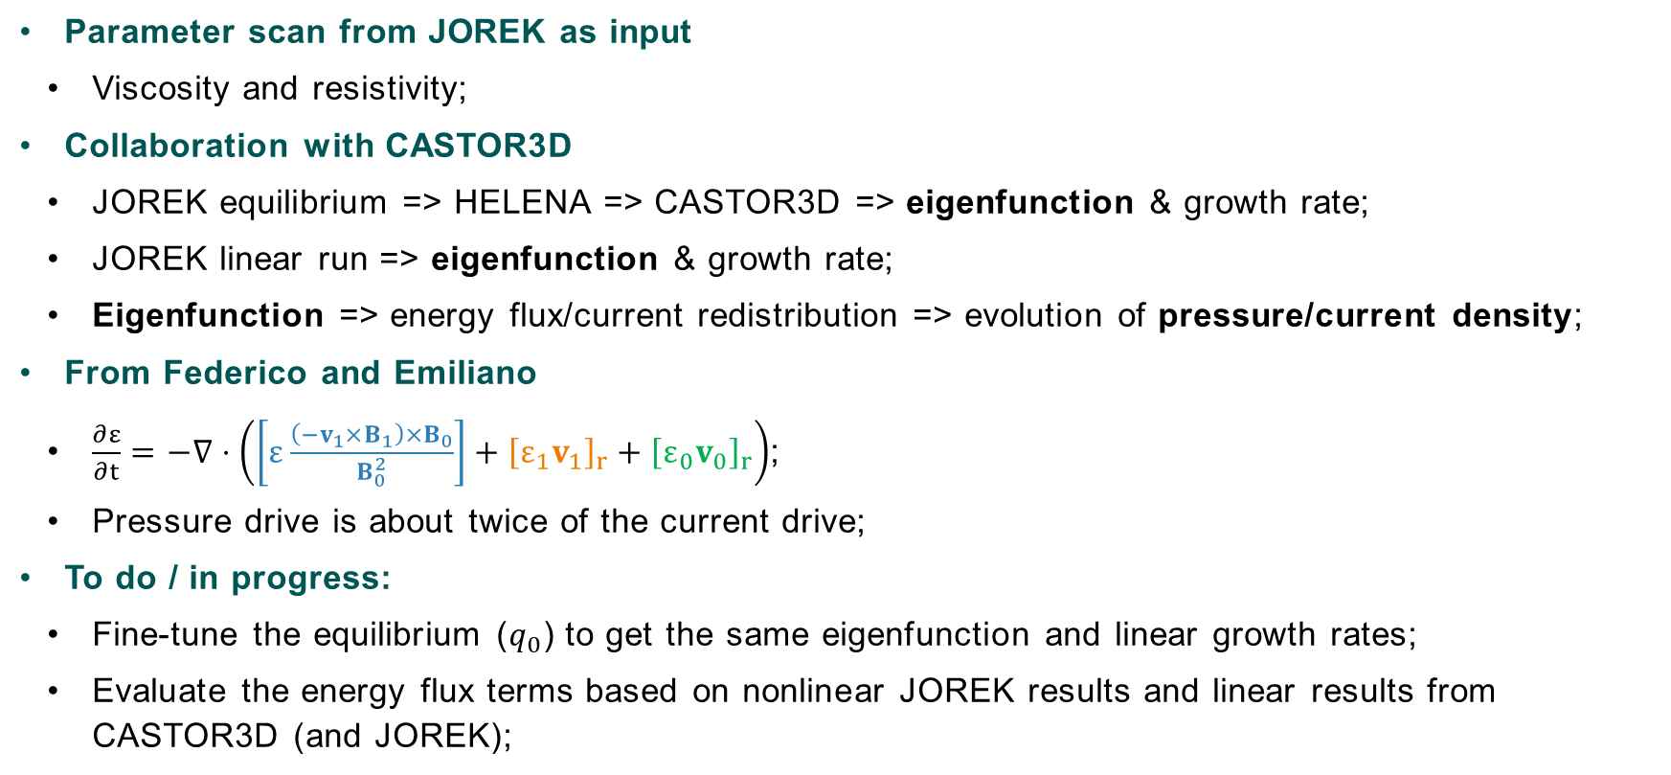
On the reduced model (linear calculations)
  Parameter scan from JOREK as input
      Viscosity and resistivity;
  Collaboration with CASTOR3D
      JOREK equilibrium => HELENA => CASTOR3D => eigenfunction & growth rate;
      JOREK linear run => eigenfunction & growth rate;
      Eigenfunction => energy flux/current redistribution => evolution of pressure/current density;
  From Federico and Emiliano
    $\frac{∂ε}{∂t}=−∇⋅\left(\left[ε\frac{\left(−v_{1}×B_{1}\right)×B_{0}}{B_{0}^{2}}\right]+{\left[ε_{1}v_{1}\right]}_{r}+{\left[ε_{0}v_{0}\right]}_{r}\right)$;
    Pressure drive is about twice of the current drive;
  To do / in progress:
      Fine-tune the equilibrium ($q_{0}$) to get the same eigenfunction and linear growth rates;
      Evaluate the energy flux terms based on nonlinear JOREK results and linear results from CASTOR3D (and JOREK);
system saturation
mode saturation
Notes:
plot_multiple_files.py postproc/exprs_averaged_s090000.dat -sk 1 -yc 39 40 41 -xp 0.5 -xl '$\sqrt{\psi_n}$' -yl 'energy flux [W/m$^2$]' -legends 'by dynamo flow' 'by instability flow' 'by equilibrium flow' -ti 'time = 206.8 [ms]'

Slide 11

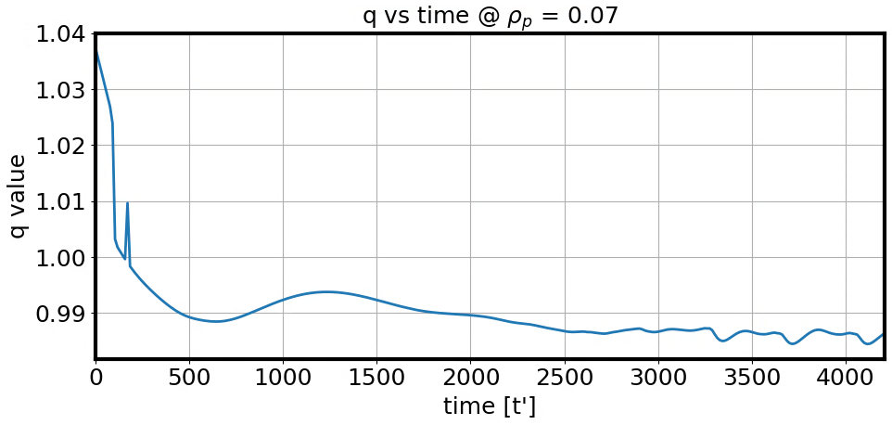
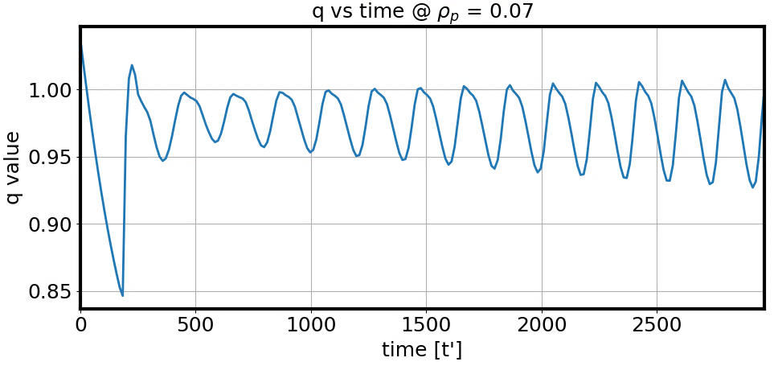
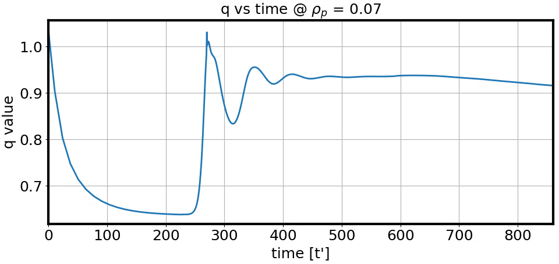
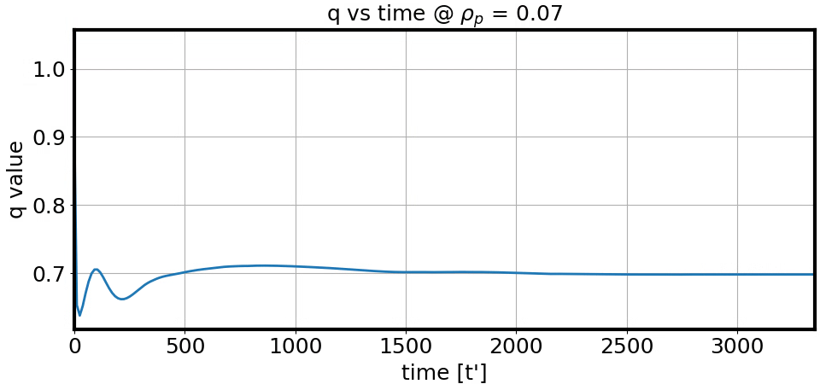
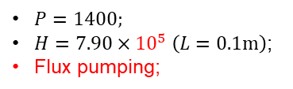
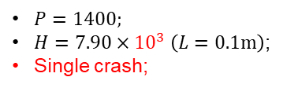

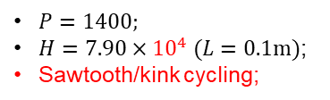
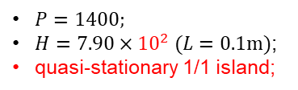
On the reduced model (scan viscosity and resistivity)
      Normalization: $t^{′}=\sqrt{\frac{τ_{μ}}{τ_{R}}}\frac{v_{A}}{L}t;{\vec{v}}^{′}=\sqrt{\frac{τ_{R}}{τ_{μ}}}\frac{1}{v_{A}}\vec{v}$
        $\frac{∂\vec{B}}{∂t}=∇×\left(\vec{v}×\vec{B}\right)−∇×\left[H^{−1}\left(∇×\vec{B}−\vec{S_{j}}\right)⋅\hat{φ}\right]$
        $P^{−1}\left(\frac{∂\vec{v}}{∂t}+\vec{v}⋅∇\vec{v}\right)=\frac{1}{ρ}\left[\left(∇×\vec{B}×\vec{B}−∇p\right)+∇⋅\left(H^{−1}∇\vec{v}\right)\right]$
      Changing Hartmann and magnetic Prandtl numbers by scanning viscosity and resistivity;
        $H={\left(\frac{τ_{A}}{τ_{R}}⋅\frac{τ_{A}}{τ_{μ}}\right)}^{−1/2}=\sqrt{\frac{μ_{0}}{ημ}}Lv_{A};P=\frac{τ_{R}}{τ_{μ}}=\frac{μ_{0}μ}{η}$;
      4 different states at different Hartmann numbers;
$P=1400;$
$H=7.90×{10}^{5} \left(L=0.1m\right)$;
Flux pumping;
$P=1400;$
$H=7.90×{10}^{2} (L=0.1m)$;
quasi-stationary 1/1 island;
$P=1400;$
$H=7.90×{10}^{4} (L=0.1m)$;
Sawtooth/kink cycling;
$P=1400;$
$H=7.90×{10}^{3} \left(L=0.1m\right)$;
Single crash;
H. Zhang, et al., in preparation (2025)

Slide 12
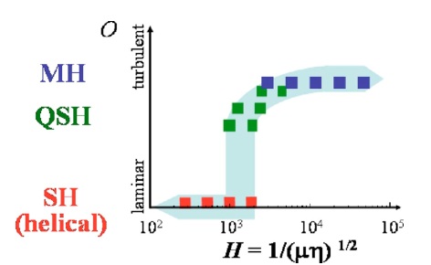
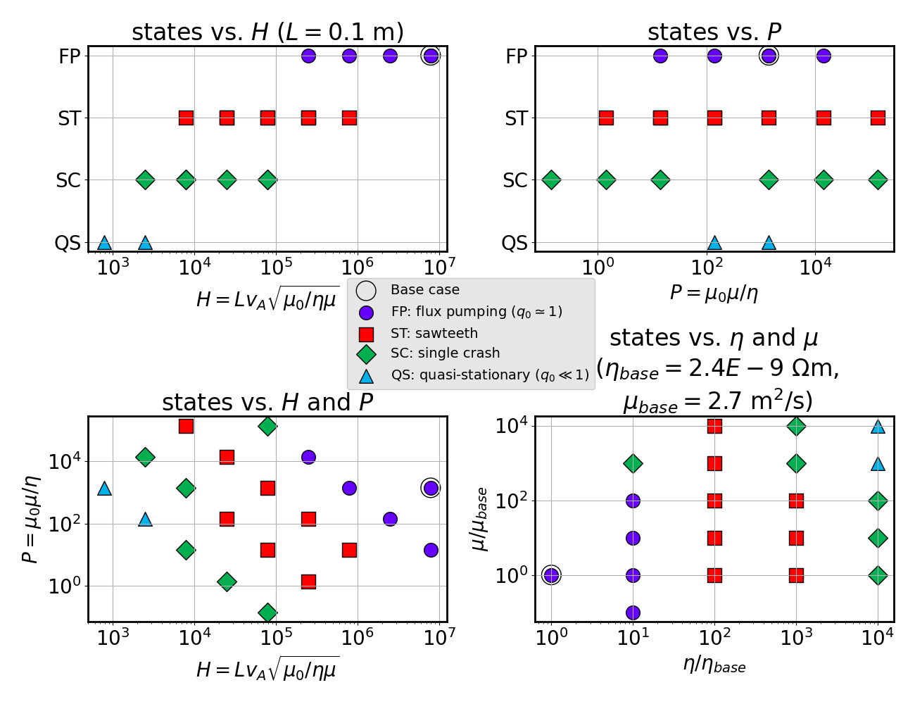
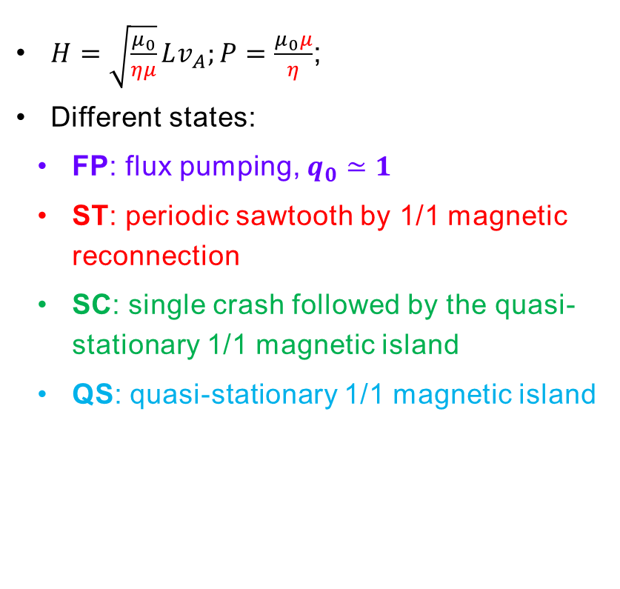
On the reduced model (scan viscosity and resistivity)
RFX modelling
$H=\sqrt{\frac{μ_{0}}{ημ}}Lv_{A};P=\frac{μ_{0}μ}{η}$;
Different states:
      FP: flux pumping, $q_{0}≃1$
      ST: periodic sawtooth by 1/1 magnetic reconnection
      SC: single crash followed by the quasi-stationary 1/1 magnetic island
      QS: quasi-stationary 1/1 magnetic island
S. Cappello, et al., Phys. Plasmas 13, 056102 (2006)
S. Cappello, et al., PRL 85 18 (2000)
12
AUG modelling
H. Zhang, et al., in preparation (2025)

Slide 13
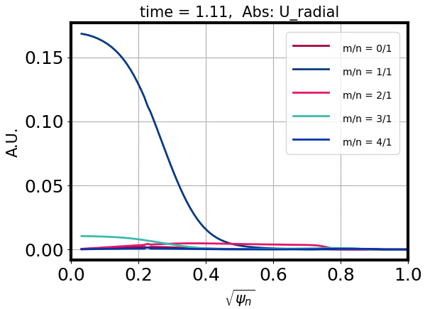
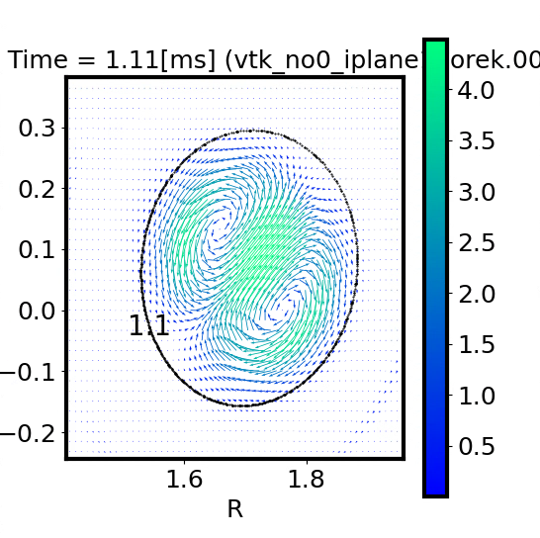
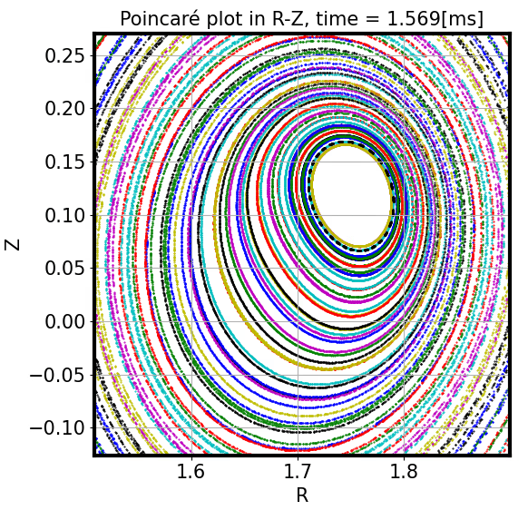
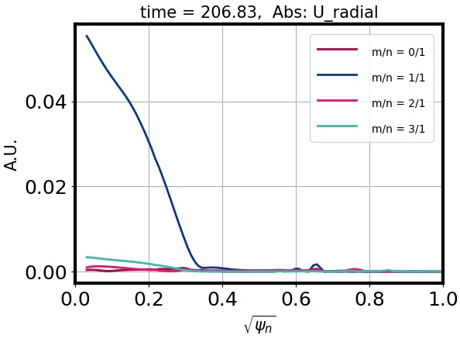
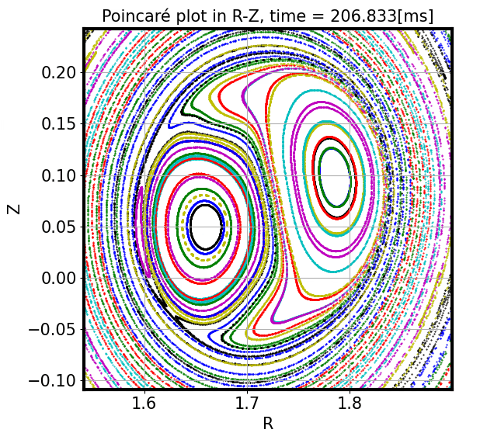
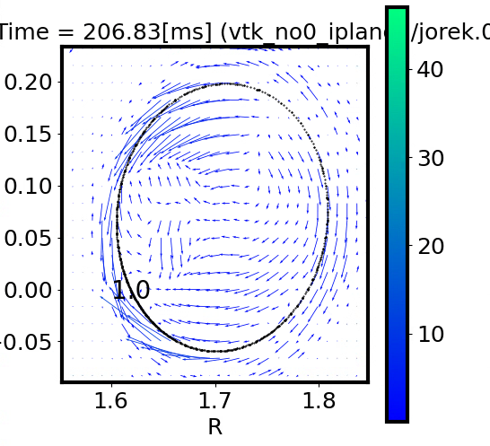

Eigenfunctions from JOREK
$$\frac{v⋅∇ψ}{\left|∇ψ\right|}$$
initial equilibrium
quasi-stationary stage
Notes:
/u/hazh/SCRATCH/20230825_fix_axis_bug_get_all_commits_jfrs/AUG_36663_3.75_ed22_711_00_ultimate1_eta_zk_fg_q0_gt_1_nmax_4_ngrid_100_lft_q0_v4_Dpar0.1_current_source_2
plot_mn_mode_structures.py four_results -va U_radial U_poloidal Uphi -nl 1 -ml 0 1 2 3 -st 000700 -tm $time2si -ym $2170378.643194606
U_radial_n001_m001_step000700
U_poloidal_n001_m001_step000700
UR_n001_m001_step000700
UZ_n001_m001_step000700
Uphi_n001_m001_step000700
A_radial_n001_m001_step000700
A_poloidal_n001_m001_step000700
AR_n001_m001_step000700
AZ_n001_m001_step000700
Psi_n001_m001_step000700
B_radial_n001_m001_step000700
B_poloidal_n001_m001_step000700
BR_n001_m001_step000700
BZ_n001_m001_step000700
Bphi_n001_m001_step000700
rho_n001_m001_step000700
T_i_n001_m001_step000700
T_e_n001_m001_step000700

Slide 14
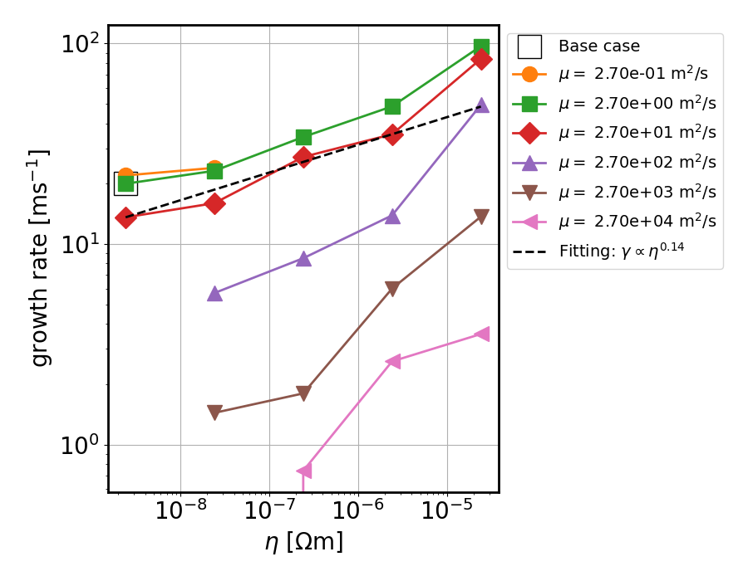
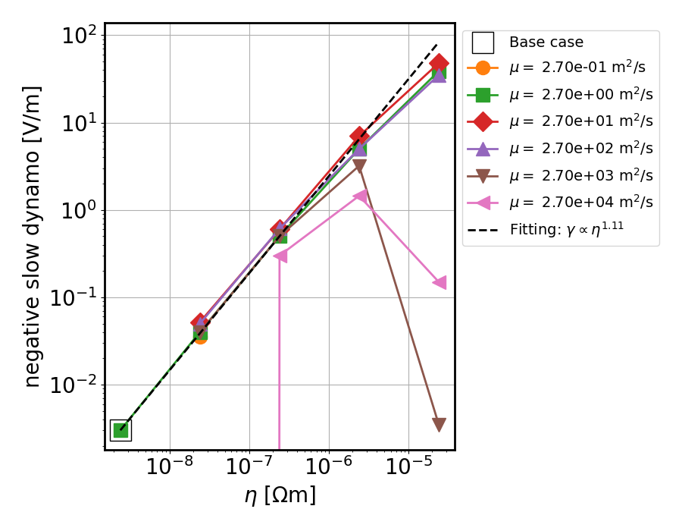
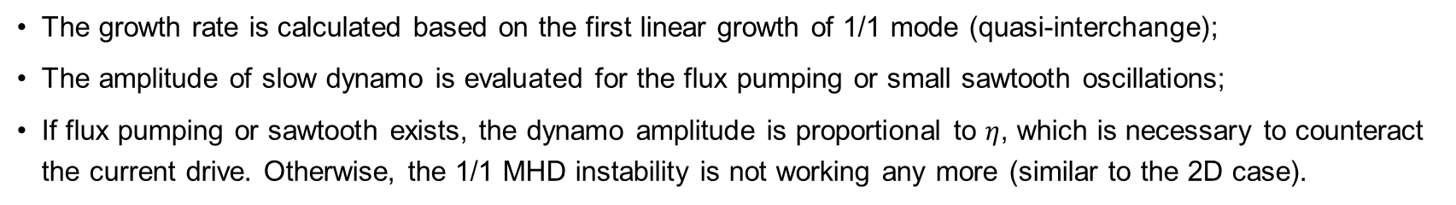
JOREK: growth rate and dynamo vs. resistivity and viscosity
The growth rate is calculated based on the first linear growth of 1/1 mode (quasi-interchange);
The amplitude of slow dynamo is evaluated for the flux pumping or small sawtooth oscillations;
If flux pumping or sawtooth exists, the dynamo amplitude is proportional to $η$, which is necessary to counteract the current drive. Otherwise, the 1/1 MHD instability is not working any more (similar to the 2D case).

Slide 15
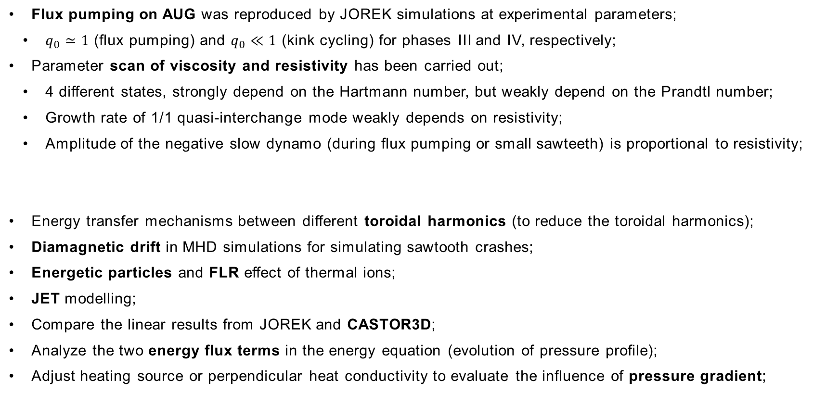
Summary
Flux pumping on AUG was reproduced by JOREK simulations at experimental parameters;
      $q_{0}≃1$ (flux pumping) and $q_{0}≪1$ (kink cycling) for phases III and IV, respectively;
Parameter scan of viscosity and resistivity has been carried out;
      4 different states, strongly depend on the Hartmann number, but weakly depend on the Prandtl number;
      Growth rate of 1/1 quasi-interchange mode weakly depends on resistivity;
      Amplitude of the negative slow dynamo (during flux pumping or small sawteeth) is proportional to resistivity;
      Energy transfer mechanisms between different toroidal harmonics (to reduce the toroidal harmonics);
      Diamagnetic drift in MHD simulations for simulating sawtooth crashes;
      Energetic particles and FLR effect of thermal ions;
      JET modelling;
      Compare the linear results from JOREK and CASTOR3D;
      Analyze the two energy flux terms in the energy equation (evolution of pressure profile);
      Adjust heating source or perpendicular heat conductivity to evaluate the influence of pressure gradient;
Outlook
Thanks for your attention!

