Slide 1
SP B kick-off meeting 2025
Overview and discussion of tasks, 12 February, 2025
Antti Hakola
On behalf of the SP B team and task holders

Slide 2
Overview of SP B in 2025 – high-level plans for activities
In 2025, SP B will continue work under the same activity areas (SP B.1-SP B.6) as in 2024:
SP B.1: Physics of erosion and deposition - focus on cross-machine investigations
Impact of flux on erosion – work that was foreseen in 2024 but was partly or completely delayed into 2025
Both W and B layers: sample production matrix compiled in late 2024 while the exposure parameters still not fully consolidated
SP B.2: Material migration in toroidal devices - concentrate on samples from boronization studies and WEST monoblocks
Analyses of WEST monoblock samples once available
Analysis of boronization samples (AUG, WEST, W7-X) as well as manipulator samples (AUG, W7-X)
SP B.3: Characterization of plasma-exposed materials - samples coming from SP B.1 and SP B.2 (+ SP B.4)
Now includes also LIBS as a characterization tool - but LIBS development under SP X
SP B.4: Reference coatings for ITER and DEMO - production of B and W layers
Large programme to compare B layers produced by different labs by different techniques – survey similarities/differences wrt. experimental layers
Includes coatings simulating re-deposits following material migration
SP B.5: Production of metallic dust in toroidal devices – re-scoping to primarily deal with dust analyses
Analyses of AUG, WEST (jointly with WPSAE), and W7-X dust following boronizations
Continue studying the physics basis for the formation of B and W dust particles and their production via arcing/flaking
SP B.6: B deposition on diagnostics mirrors
Post-exposure analyses of the mirrors for changes in their optical properties (AUG, W7-X)

Slide 3
Proposed high-level deliverables and milestones for SP B in 2025
Erosion and deposition patterns at the divertor and main-chamber structures of toroidal fusion devices following operations with and without boronizations
Reporting the role of fluence and pulse length in the erosion-deposition balance in toroidal fusion devices under reactor-relevant operational conditions
WMxx | SP B | Erosion rates of co-deposited/re-deposited W layers at reactor-relevant particle fluxes and fluences determined. (ITER+DEMO) | 31.12.2025
WMxx+1 | SP B | Material migration pathways elucidated for W and B in toroidal devices (AUG, WEST, W7-X) during and after boronizations. (ITER) | 31.12.2025
WMxx+2 | SP B | Erosion and deposition patterns on PFUs removed after Phase 1 and Phase 2 operations on WEST compared. (ITER) | 31.12.2025
WMxx+3 | SP B | Co-deposited boron layers with varying oxygen contents and surface morphologies delivered and characterized. (ITER) | 31.12.2025
WMxx+4 | SP B | W dust samples from toroidal fusion devices (AUG, WEST, W7-X) characterized and extrapolations made towards fusion reactors. (DEMO) | 31.12.2025
WMxx+5 | SP B | B contamination determined on diagnostics mirrors after AUG and W7-X boronization experiments. (ITER) | 30.06.2025

Slide 4
SP B.1 deliverables 2025
Activity | Deliverable ID(s) | Title
SP B.1 | D001 3 PM | Erosion rates of W/B model systems and re-deposited W with different morphologies and compositions as well as the formation and erosion rates of thick re-deposits in MAGNUM-PSI with flux and fluence (DIFFER)
SP B.1 | D002 4 PM | Erosion rates of W/B model systems and re-deposited W with different morphologies and compositions in GyM with flux and fluence (ENEA)
SP B.1 | D003 7 PM | Erosion rates of W/B model systems and re-deposited W with different morphologies and compositions in PSI-2 with flux and fluence (FZJ)
SP B.1 | D004 5 PM | Erosion rates of co-deposited W- and B-based model systems following exposure to controlled ion beams (ÖAW)
SP B.1 | D005 1 PM | Erosion rates following high-energy dust impacts on W model systems and comparison to data from tokamaks (ENEA)

Slide 5
Cross-machine studies in linear devices
DIFFER:
Study 1: comparison of W erosion rates by Ar (and other plasma gases) in MAGNUM-PSI
Comparison data generated to PSI-2 and GyM
Study 2: growing thick (WEST-like) re-deposits (containing W and B) in MAGNUM-PSI
Finding out best parameter space to produce thick layers and study their erosion properties
Study 3: exposure of B samples produced by different methods in MAGNUM-PSI
Includes at least samples produced locally and those from FZJ – see also the production matrix
ENEA:
Study erosion of W model systems and re-deposited W - cross-machine experiment, GyM (continuation)
Exposure of W model systems (available) and re-deposited W samples (once available) from SP B.4 to Ar plasma.
Study erosion of B-based layers
Looking forward to compact B samples becoming available.
Characterizations in Milan for these activities: weighing, AFM and SEM-EDX.
Please note: GyM is scheduled for shutdown in summer 2025 for its upgrade to BiGyM.
FZJ:
Study 1: expose various B layers to PSI-2 plasmas
Samples to be produced under SP B.4 and SP F
Study 2: continue cross-machine experiments with different W layers in PSI-2
Combined with post-mortem FIB/SEM investigations – also erosion FIB markers on the agenda
Study 3: improved spectroscopic detection methods for studying W and B erosion in PSI-2
See next slide

Slide 6
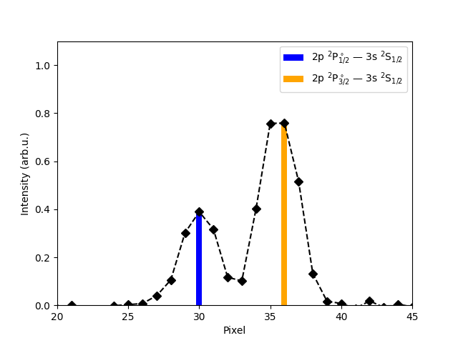
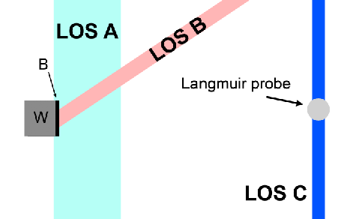
Cross-machine studies in linear devices – spectroscopic studies
High resolution (HRS) and imaging spectroscopy (IS) of bulk and re-deposited W and B layers in PSI-2
VUV Spectroscopy for W and D atomic and molecular lines
B I and BD lines in UV and VUV at different flux of D (physical vs chemical sputtering)
Measurements of energy and angular distribution of B I lines @ 250 nm
Example of B on W erosion
B I 250 nm lines
LOS B
Data from 43 V (floating), 100 A, 100 sccm D
Blue: First 4min (Erosion of Boron layer)
Red: Last 4min (No Boron layer)
79 grooves/mm
Plasma on
Measurement of rotational temperature
W substrate
Fit with Voigt profile
Considering only ${}_{ }^{11}B{}_{ }^{2}H$
B I lines using imaging spectrometer
UV Optics (LOS B 35°)

Slide 7
Laboratory erosion studies
ÖAW:
Erosion measurements on pure W, pure B and mixed layers
Apply the high sensitivity QCM technique
Quantify sputter yields for various incidence angles and different projectile species
Investigate the effects of pure B on the implantation of projectiles during irradiation
Determine sputtering yield for W+B mixed layers
Synergistic effects between erosion yield and B concentration
Characterize surface morphology before and after irradiation
Study if irradiation induced morphology changes are present and whether they are different for different B concentrations
ENEA:
Repeat dust impacts on samples similar to the last ones provided last year by POLIMi
5 μm W co-deposits on W and Mo substrates to compare co-deposit delamination
Surface analyses by SEM/BSE.
Investigate delamination of coatings for oblique dust impacts.
Study delamination of coatings for normal and oblique impacts vs. target temperature (up to 400°C).

Slide 8
SP B.2 deliverables 2025
Activity | Deliverable ID(s) | Title
SP B.2 | D001 6 PM | WEST campaigns: erosion and deposition patterns on PFUs after WEST Phase 1 (C1-C5) and Phase 2 (C6-C10) operations and thickness profile of layers originating from boronizations (CEA)
SP B.2 | D002 2 PM | WEST campaigns: microscopy investigations of He-exposed PFUs after Phase 1 and Phase 2 operations on WEST (CEA)
SP B.2 | D003 2 PM | WEST campaigns: detailed investigation of selected PFUs, including side faces of marker tiles, for their erosion, deposition, and surface-modification patterns at different locations with respect to magnetic ripple (MPG)
SP B.2 | D004 5 PM | AUG manipulator experiments: pre- and post characterization of samples exposed to AUG plasmas and/or boronizations on AUG for their erosion and surface-modification patterns as well as boron deposition profiles (MPG)
SP B.2 | D005 3 PM | AUG manipulator experiments: deposition profiles of B and D on samples exposed to AUG plasmas and/or boronizations on AUG at high spatial and depth resolution (VTT)
SP B.2 | D006 2 PM | AUG campaigns: deposition profiles on samples originating from boronizations on AUG (RBI)
SP B.2 | D007 2 PM | AUG campaigns: changes in the surface properties of samples exposed to AUG plasmas and/or boronizations on AUG (FZJ)
SP B.2 | D008 2 PM | W7-X manipulator experiments: erosion and deposition characteristics on manipulator and other samples exposed to OP2 plasmas on W7-X (FZJ)
SP B.2 | D009 3 PM | W7-X manipulator experiments: erosion and deposition patterns on manipulator samples and wall components from OP2 experiments and/or boronizations on W7-X (MPG)

Slide 9
Priorities for WEST analyses
CEA:
WEST PFCs :
Continue cutting ITER-like PFUs from phase 2 and establish a characterization sequence
Continue investigating the formation of He bubbles (SEM, FIB, TEM, EBSD at Aix Marseille Uni.) → article
Collect all the data for overviews (PFMC, IAEA FEC) on WEST post mortem analyses and material migration pathways
Samples from boronizations:
Pre-characterization and installation of samples on collecting probes
Exposing 40-80 samples to WEST boronizations (WPTE experiments)
Develop a protection procedure (Au coating at Aix Marseille Uni.) for samples and establish a characterization sequence
MPG:
Finalize analyses and prepare talk/poster for PFMC on IBA+SEM analyses on W-coated standard divertor tiles from different positions wrt. to the magnetic ripple.
Publish the “ripple” erosion results together with the IBA+SEM data of C3-, C4-, and C5-marker tiles.
Analyse and evaluate the sides of the skeletons of marker tiles (retrieved after C3, C4 and C5) and standard tiles → deposition into poloidal gaps (pending activity from 2024)
IBA+SEM analyses of ITER-like PFU segments

Slide 10
Huge number of boronization samples requires coordinated analyses programme
In total there are about 40 samples (20 on 316L steel / 20 on W) to be characterized to check the efficiency of non-uniform boronization on WEST
40 more samples might follow if a uniform boronization is carried out at the end of C11 (April 2025)
Possible analysis programme – mainly under SP B.3, open for comments:
20 samples of W → @MPG for IBA + @PIIM for FIB/Raman/TDS + @VTT for TOF-SIMS
17 samples of 316L → @VR or @NCSRD or @JSI for IBA + @IPPLM for FIB + @VTT for TOF-SIMS
5 samples of 316L+W → @VR or @NCSRD or @JSI for IBA + @IPPLM for FIB + @VTT for TOF-SIMS

Slide 11
Priorities for AUG analyses
MPG:
IBA analyses of collector samples to study boronisation efficiency
exposure on DIM, (MEM), and LBO manipulators
Pre- and post characterisation of DIM insert samples of the melting experiment (under WPTE)
VTT:
Production and exposure of new marker samples for the Ne-seeded plasma experiment (under WPTE, in 2025/2026)
Additional set of samples to be used for modelling efforts under SP D
Testing the capabilities of the new TOF-SIMS system for the analysis of boronization samples from AUG and WEST samples
Commissioning of the device expected in Feb/Mar 2025
FZJ:
Characterize W samples with cross-section marking following exposure to Ne-seeded plasmas (under WPTE, in 2025/2026)
SEM measurements, connected with a similar experiment under SP A: mixed plasma exposure in PSI-2
Investigate the properties of B layers following boronizations
SEM measurements
RBI:
TOF-ERDA+PIXE analyses for selected AUG samples, incl. microbeam
Detailed contents of the task to be discussed

Slide 12
Priorities for W7-X analyses
MPG:
Analyses and evaluation of cavity samples exposed during boronisations on W7-X
Connected with the PFMC contribution of M. Mayer
Any other PFCs that we should analyse – to be discussed
FZJ:
Continuation from previous years with samples exposed during OP2.1/2.2 + new samples from OP2.3 experiments
Details of the samples and analysis programme (SEM? IBA? LIBS?) to be be discussed

Slide 13
SP B.3 deliverables 2025
Activity | Deliverable ID(s) | Title
SP B.3 | D001 2 PM | Depth profiles and surface morphology of selected B or W layers (CIEMAT)
SP B.3 | D002 4 PM | Surface modifications and fuel content of selected AUG, WEST, W7-X, and PSI-2 samples (FZJ)
SP B.3 | D003 2 PM | Composition of layers on selected WEST monoblock samples (IAP)
SP B.3 | D004 3 PM + 2 PM (AR) | Surface modifications of selected WEST, W7-X, MAGNUM-PSI, PSI-2, and GyM samples (IPPLM)
SP B.3 | D005 3 PM | Composition and fuel content of layers on selected WEST monoblock samples and on samples originating from SP B.1 or SP X experiments (IST)
SP B.3 | D006 3 PM | Micro- and macroscale composition of layers on selected AUG, WEST, MAGNUM-PSI, PSI-2, and GyM samples (JSI)
SP B.3 | D007 2 PM | Surface modifications and erosion/deposition profiles of samples and wall tiles from AUG, WEST, and W7-X (MPG)
SP B.3 | D008 5 PM | Surface modifications and composition of layers on selected WEST, MAGNUM-PSI, PSI-2, and GyM samples (NCSRD)
SP B.3 | D009 2 PM | Micro- and macroscale composition of layers on selected AUG, WEST, MAGNUM-PSI, PSI-2, and GyM samples (RBI)
SP B.3 | D010 1.5 PM | Erosion and deposition patterns on selected WEST samples as well composition of plasma-exposed B and W layers (VR)
SP B.3 | D011 2 PM | Depth profiles and composition of deposited layers of selected samples from AUG, WEST, W7-X, MAGNUM-PSI, PSI-2, and GyM (VTT)
SP B.3 | D012 2 PM | Depth profiles for layers on selected WEST monoblock samples (UT)

Slide 14
Priorities for surface analyses (ion-beam analyses)
IST:
Continue analysis of WEST samples, focus on comparison between SIMS (VTT) and NRA/EBS/PIXE (IST) – MB samples
Analysis of D, C, B contents by NRA, erosion studies by RBS/EBS
Analysis of main heavier contaminants by PIXE
JSI:
Broad-beam analyses (NRA, RBS, PIXE) for samples from AUG, WEST, and GyM – list not exhaustive
Micro-beam analyses (RBS, PIXE) for selected samples
MPG:
Post-characterisation (IBA+SEM) of pre-characterised AUG tiles regarding boronisation layers
pending for vessel opening during summer 2025.
NCSRD:
Determination of composition, crystalline structure and surface analysis of MB samples from WEST and other plasma devices (such as GyM) using ion beam analysis (RBS/NRA, PIXE/PIGE, TOF-ERDA, SEM/EDS, XRD) – TOF-ERDA is a new capability
RBI:
RBI - broad beam (RBS, NRA, TOF ERDA, PIXE) and micro beam (RBS, NRA, PIXE) analysis of samples from AUG, WEST, MAGNUM-PSI and PSI-2) samples
VR:
Surface composition and depth profiles using ion beam analysis, with focus on TOF-ERDA and RBS
Resonant-NRA at low energies combined with RBS will be performed in selected samples to obtain high-sensitivity and high-resolution boron depth profile (E. Pitthan et al. Surf. Coat. Tech. 417 (2021) 127188)
Setups at Tandem Laboratory at Uppsala University (P. Ström and D. Primetzhofer, J. Instrum. 17 (2022) P04011)

Slide 15
Priorities for surface analyses (microscopy, LIBS, other methods)
CIEMAT:
SIMS and SEM analyses for samples coming from SP B.1 cross-machine experiments
FZJ:
SEM and LIBS analyses of selected samples coming from SP B.1 experiments
IAP:
GDOES and XPS for WEST samples (similarly to C3-C5 marker tiles)
IPPLM:
SEM and TEM analyses of WEST samples and samples coming from SP B.1 experiments
VTT:
TOF-SIMS analyses of samples from SP B.1 and SP B.2 experiments
UT:
LIBS analyses of WEST samples

Slide 16
SP B.4 deliverables 2025
Activity | Deliverable ID(s) | Title
SP B.4 | D001 3 PM | W- and B-based coatings with pre-defined composition and morphology for experiments in linear plasma facilities (ENEA)
SP B.4 | D002 4 PM | W-based coatings with pre-defined composition and morphology for experiments in linear plasma facilities (IAP)
SP B.4 | D003 6 PM | B reference layers with pre-defined composition and morphology for comparison with data from tokamaks (IAP)
SP B.4 | D004 2 PM | Raman analyses of selected B reference samples (CEA)
SP B.4 | D005 1 PM | SEM and SIMS analyses of selected B and W reference samples (CIEMAT)
SP B.4 | D006 2 PM | LIBS and SEM analyses of selected B reference samples (FZJ)
SP B.4 | D007 2 PM + 1 PM (AR) | Microscopy investigations of selected B and W reference samples (IPPLM)
SP B.4 | D008 5 PM | Ion-beam analyses of selected B and W reference samples (IST)
SP B.4 | D009 4 PM | XPS and TDS analyses of selected B reference samples (JSI)
SP B.4 | D010 5 PM | Ion-beam and structural analyses of selected B and W reference samples (NCSRD)
SP B.4 | D011 1 PM | TOF-ERDA analyses of selected B and W reference samples (RBI)
SP B.4 | D012 1.5 PM | Ion-beam analyses of selected B reference samples (VR)
SP B.4 | D013 1 PM | SIMS measurements and ion-beam analyses of selected B and W reference samples (VTT)
SP B.4 | D014 1 PM | Mechanical testing and crystallographic analyses of thick B and W reference layers (DIFFER)

Slide 17
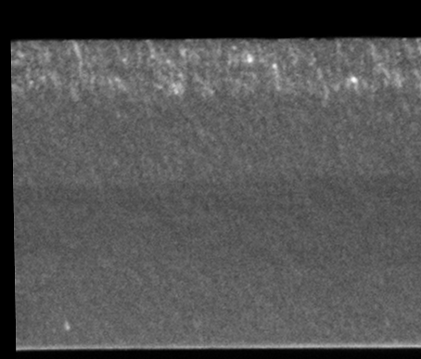
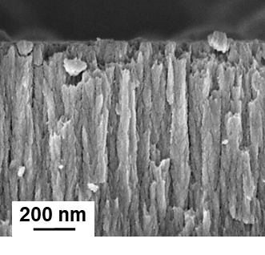
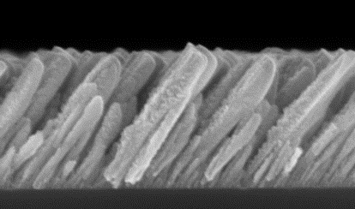
Production and analyses of B- and W-based reference coatings
ENEA:
Deposition of several kinds of W layers by means of PVD techniques varying morphology and crystallinity of the coatings.
Amorphous W films (by PLD), porous W films (by PLD) and compact W films (by PLD, HiPIMS or RF-MS)
Nanocolumnar W films by tilted magnetron sputtering
Thickness: from 10 nm up to 2-3 µm
Substrate roughness: from flat to 100s of nm random or pyramidal-shaped
Deposition of several kinds of B layers by means of PVD techniques (PLD and RF-MS) varying morphology and porosity.
Deposition of compact or porous B films using both nanosecond and femtosecond PLD
Thickness: up to 10 µm
Substrate roughness: from flat to 100s of nm random or pyramidal-shaped
200 nm
Amorphous-W
Porous-W
Compact-W
Nanocolumnar-W

Slide 18
Production and analyses of B- and W-based reference coatings
IAP: production of W layers
Production of reference coatings according to the agreed specifications – see Master Excel
Analysis of produced coatings:
GDOES + XPS + XRD
IAP: production of B layers
Repeat the exercise performed with CEA in 2022 and 2023:
BD and BH with high H and D content (more than 10%), thermally treated from 50 to 500°C + O₂ addition
Samples for permeation studies under SP C as follows:
different thickness samples 500 to 5000 nm, pure B + gaseous inclusions
For micromechanical measurements to check the delamination behavior of B surface layers exposed to boiling water
B-coated W substrates, 12×15×1 mm³, 5 μm, dense and porous + boron with D 10 % of 10×10×1 mm³ samples
Analysis of the produced coatings using SEM, TDS, XRD, Sputtered XPS and nanoindentation
NEW IDEA: investigate the oxidation behavior of B layers under annealing (see next slide) – together with IST

Slide 19
Oxidation behaviour of boron layers
Investigate the oxidation behavior of Boron layers under annealing
(see in - N. Catarino et al., Oxidation behaviour of neutron irradiated Be pebbles, Nucl. Mater. Energy 23 (2020) 100748. https://doi.org/10.1016/j.nme.2020.100748 )
B layers on W plates for relevance and Si to remove substrate influence etc..
Controlled atmospheres: air, 50 % humidity (other percentage ?)
mixture of 40 % N₂ + 60 % O₂ (other percentages ?)
Controlled air temperature: from room temperature up to 1000 °C
Use of distinct annealing times: 1h, 2h, 4h, 8h, 16h, 48h, 72h, longer ?
Use of one annealing time and distinct annealing temperatures ?
Boron oxide B₂O₃ (4B + 3O₂ = 2B₂O₃)
(see in H.F. Rizzo, Oxidation of Boron at Temperatures between 400 and 1300°C in Air, conference paper. https://doi.org/10.1007/978-1-4899-6572-1_21 )
Crystaline B₂O₃ - melting point of 450°C
Amorphous B₂O₃ - no definite melting point but softening temperature around 560-630°C

Slide 20
Production and analyses of B- and W-based reference coatings
FZJ:
Preparation of homogeneous, amorphous and pure B-layers and mixed layers by magnetron sputter deposition and characterization in house
Analysis of the samples with LIBS, FIB/SEM/EDX and TEM when required; NRA for comparison
Comparison to magnetron produced B-D films on W
VR:
Production in-house (Tandem Laboratory at Uppsala University) of sputter-deposited layers from B and W targets (co-deposition) in Ar and Ar+D₂ atmospheres on different substrates (W, QCM, Mo, Si, C, and MgO)
Followed by characterization (IBA, SEM, TEM+EDX).

Slide 21
Production and analyses of B- and W-based reference coatings
CEA: Raman analyses of B layers from IAP
CIEMAT: SIMS measurements of different B and W layers – including B layers for permeation studies
IPPLM: SEM, TEM, FIB, XRD, nano indentation measurements of different B and W layers
IST:
Analysis of implanted W samples
Analysis of samples from B oxidization studies (see previous slide)
JSI: TDS and XPS analyses of the produced W and B layers
Specific set to be produced for permeation studies (influence of B layers on retention and permeation through W and Eurofer)
NCSRD:
Analysis of B and W+B based reference samples as a function of their H/D content, fabrication parameters (deposition/annealing temperature, roughness, etc) using IBA, XRD, SEM/EDS. Capability to carry out in-situ (GI)XRD analysis to follow the crystalline structure, phase formation and crystallize size evolution – for annealing studies under vacuum/air
RBI: TOF-ERDA analyses of different B and W layers
VTT: TOF-SIMS analyses of different B and W layers
DIFFER: XRD and mechanical testing of different B and W layers – produced by DIFFER, coordination

Slide 22
SP B.5 deliverables 2025
Activity | Deliverable ID(s) | Title
SP B.5 | D001 1.5 PM | Database of the characteristics of produced W dust particles in the presence of different gas mixtures and comparison with data from tokamaks (IAP)
SP B.5 | D002 1.5 PM | Database of the characteristics of produced B dust particles in the presence of different gas mixtures and comparison with data from tokamaks (IAP)
SP B.5 | D003 2 PM | Surface analyses of dust generated on AUG, WEST, and W7-X and comparison to the data originating from laboratory experiments (MPG)
SP B.5 | D004 2 PM | Report on surface properties of boron dust on plasma-facing components and assessment for heat balance for boron powder injected into AUG plasmas (VR)
SP B.5 | D005 4 PM | Ion-beam analyses of dust samples originating from AUG, WEST, and W7-X (RBI)
SP B.5 | D006 2 PM | Microscopy and LIBS analyses of dust samples originating from AUG, WEST, and W7-X (FZJ)
SP B.5 | D007 4 PM | Ion-beam analyses of B dust originating from AUG, WEST, and W7-X (VR)
SP B.5 | D008 4 PM | Microscopy analyses of B dust originating from WEST and W7-X (IPPLM)
SP B.5 | D009 1 PM | Report on the properties, composition, and amounts of dust produced on WEST during the Phase 1 operations (CEA)
SP B.5 | D010 2 PM | Fracture and strentgh properties of B and W reference layers on W (UKAEA)

Slide 23
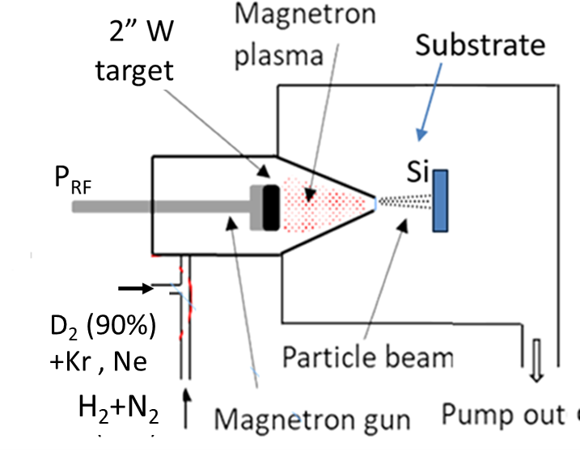
Dust production activities
IAP:
Continuation of the W dust synthesis activities performed in 2024 by MSGA and plasma-arc device:
W dust generation in the presence of radiative impurity gases
Investigations for the synthesis of B dust using MSGA and plasma-arc device:
Extend the studies initiated in 2024 to deal with varying gases and off-normal events (air/water leaks)
Comparison with the dust collected from WEST and validation of the relevance and production capability
MSGA experimental setup:
W dust generation by MSGA in the presence of gases relevant for radiative cooling:
Ne and Kr :
Will be focused on: dust synthesis rate, morphology, chemical composition, and D₂ retention.
Nitrogen:
Exploratory parametric study regarding the synthesis of dust in H₂/N₂ discharges.
Will be focused on:
Identification of the experimental parameters for dust synthesis;
Evaluation of the dust synthesis rate and properties (morphology, chemical composition) upon the N₂ content in discharge.
- Working gases:
D₂ (90%) , Ne or (10%);
H₂ +N₂ ( variable ratios).

Slide 24
Dust analysis activities
Do we have dust from AUG and W7-X to be sent to the partner labs?
What is the expected timeframe to obtain WEST dust samples for analyses?
MPG:
Restart AUG dust collector analyses with automated EDX data acquisition (campaigns 2017 to 2022)
Compare W dust particle size distributions collected in lab arc device with those measured optically therein and with those observed on AUG
RBI:
Microbeam analyses for selected dust samples – pending for sample delivery
FZJ:
LIBS and SEM analyses – pending for sample delivery
VR:
Microbeam analyses – pending for sample delivery
Report on surface properties of B dust on PFCs and assessment for heat balance for B powder injected into AUG (VR)
IPPLM:
SEM and TEM analyses – pending for sample delivery
CEA:
Coordination of dust analysis performed in 2025 under WPSAE
Activities to be moved under WPPWIE from 2026 onwards
Approach
Dust collection using (i) dust boxes, (ii) double-sided carbon tape, and (iii) filtered vacuum technique
SEM/EDX analyses and optical microscopy to characterize the shape, size, and composition of the dust particles
Tritium loading of representative W dust particles @CEA Saclay

Slide 25
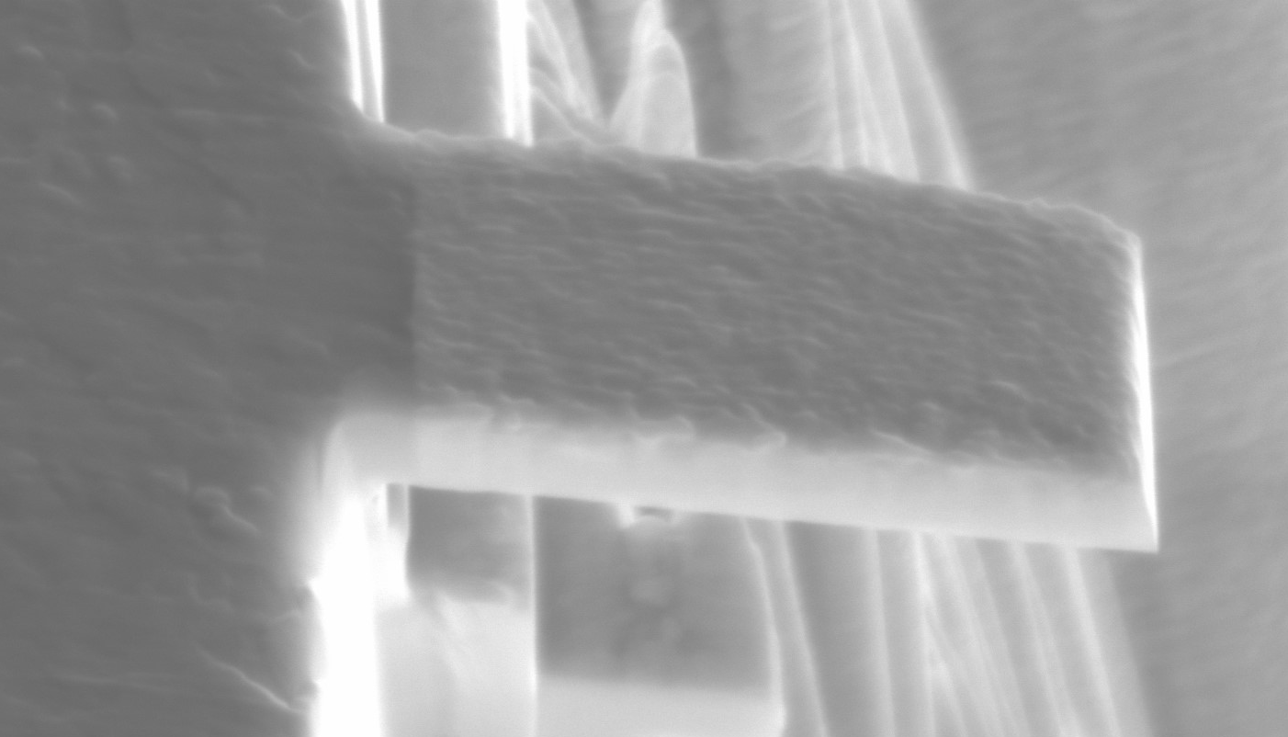
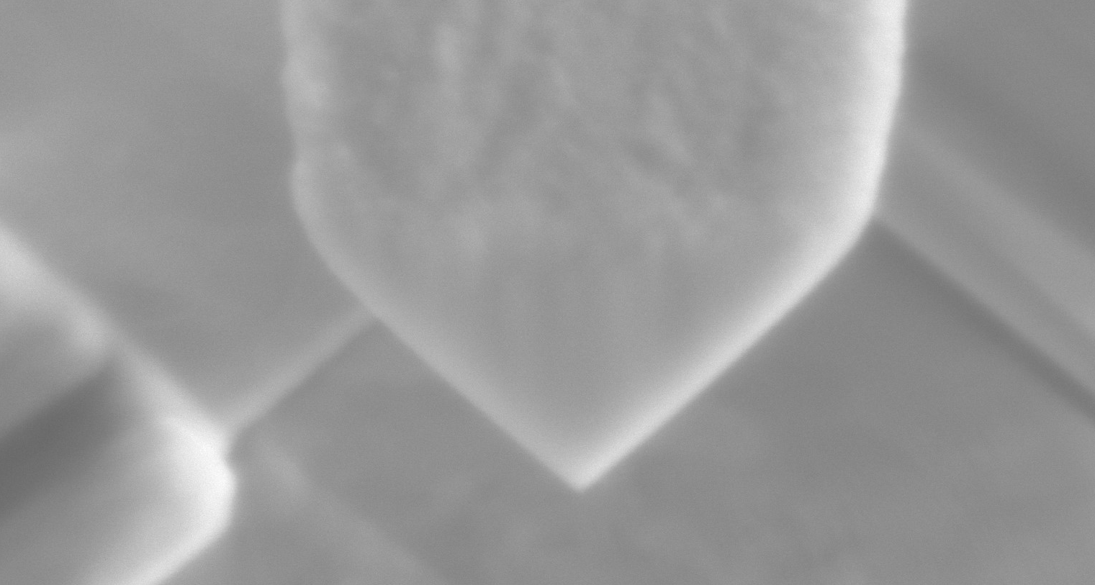
Fracture and strength properties of B and W reference layers on W
The aim of this task is to use micromechanical testing techniques (bending of FIB-produced microcantilevers in a nanoindenter) to determine interfacial and bulk mechanical properties (strength and toughness) of reference B and W layers on W substrates.
Task and questions to be addressed
Information about mechanical properties of reference layers and layer-substrate interface is to be used to improve the fundamental understanding of the propensity of deposit layers relevant for full-W device (i.e., B, W and mixed) for dust generation, and provide materials data for modeling of dust formation due to deposits fracture and exfoliation.
Focus on a dependence of mechanical properties on thickness, consistency and composition of layers, and surface state of substrates.
Mo
substrate
W layer
Approach
Task uses instruments and facilities in Materials Research Facility (UKAEA):
FEI Helios NanoLab 600i dual-column SEM-FIB for manufacturing of microcantilevers using FIB (focused ion beam) micromachining.
Agilent G200 nanoindenter for bending/fracture testing of microcantilevers.
Results
Preliminary proof-of-principle experiments performed on model W-layers on Mo substrates.
Methodology for sample preparation and FIB-machining of microcantilevers established.
First batch of samples procured – produced by IAP, received at UKAEA. These include two sets of 10x10x1 mm W substrates with 5 µm thick B layers, with different consistency (compact vs porous).
1 µm
5 µm
1 µm
Status from November meeting – any updates?

Slide 26
SP B.6 deliverables 2025
Activity | Deliverable ID(s) | Title
SP B.6 | D001 3 PM | Preparation and post characterization of exposed Mo mirrors (FZJ)
SP B.6 | D002 1 PM | Handling and exposure of Mo mirrors using AUG LBO-manipulator during boronizations (MPG)
SP B.6 | D003 1 PM | Handling and exposure of Mo mirrors using W7-X multipurpose manipulator during boronizations (MPG)
SP B.6 | D004 3 PM | Changes in the optical properties of the exposed Mo mirrors (EPFL)
Exposure of the mirrors on AUG and follow-up experiments on W7-X in 2025
Analyses of the mirrors in FZJ and EPFL

Slide 27
Next steps
Your SP B contact
Antti Hakola (antti.hakola@vtt.fi)
Project leader
Sebastijan Brezinsek (s.brezinsek@fz-juelich.de)
Project Support Officer
Michael Reinhart (m.reinhart@fz-juelich.de)
PMU Coordination Officer
David Douai (david.douai@euro-fusion.org)
Thematic meetings for detailed task definitions
March-April-May 2025
PWIE meeting in Prague in 24-27 March
Please check if you have colleagues that are not included in the SP B mailing list!
Minutes and slides of the meeting at
https://indico.euro-fusion.org/event/3432/

