Slide 1

2026-2027 Planning WP Plasma-Wall Interactions and Exhaust
6th Physics Department Project Board
Sebastijan Brezinsek (PL)
Forschungszentrum Jülich
Heinrich-Heine-Universität Düsseldorf
J.W. Coenen (FZJ), A. Hakola (VTT), K. Schmid (MPG),
A. Kirschner (FZJ), A. Goriaev (ERM/KMS), J. Likonen (VTT), I. Classen (DIFFER) M. Reinhart (FZJ, PSO) and D. Douai (CEA, CO)

Slide 2
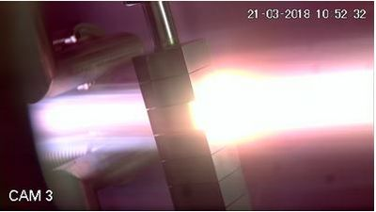
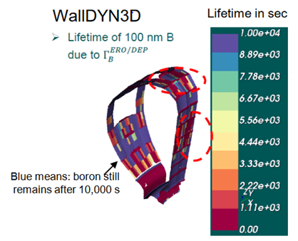
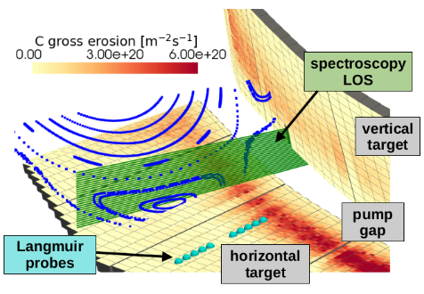
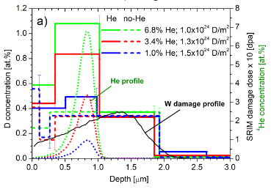
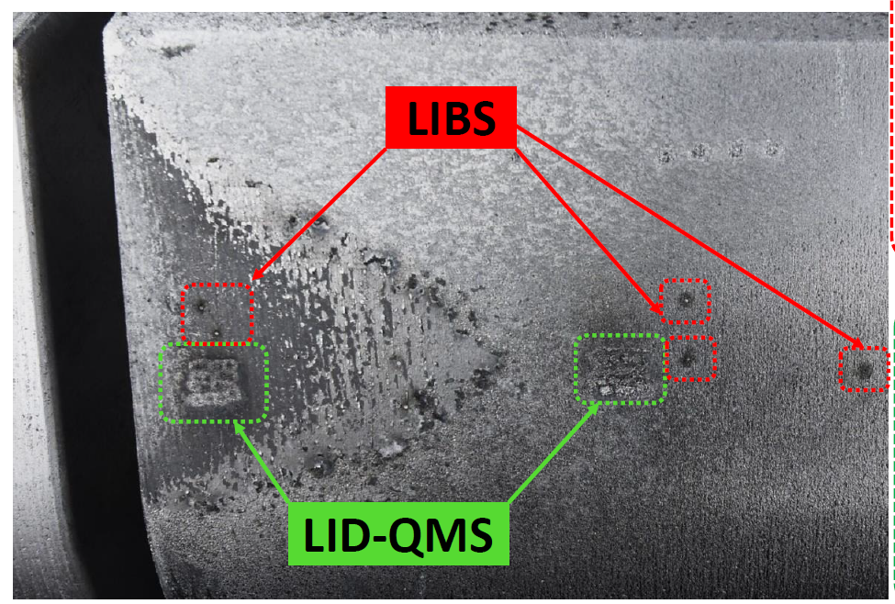
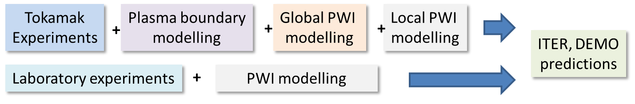
Work Package Plasma-Wall Interactions and Exhaust
Focus on ITER and DEMO materials, H and isotopes, He, seeding gases, and impurities
Particle and heat flux
Tungsten + Deuterium
In linear devices
Runaway beam damage
of PFCs analysis and interpretative simulation
Support in WPTE exploitation
In AUG, WEST and JET in PWIE
area with metallic PFCs
Goal: steady-state operation
MAGNUM
Support in WPW7X exploitation
operating with C towards W
ITER
[T. Morgan]
[I. Jepu]
[K. Schmid]
[J. Romazanov]
[S. Markelj]
Synergistic effects by heat flux and plasma loading of W materials
3D erosion & deposition modelling
Tungsten and Boron
Fuel retention in steel and tungsten
Neutrons + Deuterium/Helium
Surface analysis (D,T) by
Laser-based techniques
Recombining H,D plasmas in PSI-2 and MAGNUM-PSI (CRMs)
Wall conditioning in TOMAS and boronization assessment

Slide 3
WPPWIE Fact Sheet 2025
WPPWIE covers high priority activities for ITER (new baseline), supports DEMO and reactor-class devices, supports tokamak and stellarator exploration, and addresses open physics questions in the area of PWIE
WPPWIE includes machine operation (~1,2 M€ Commission Contribution in 2025)
Plasma exposure: MAGNUM-PSI, UPP, PSI-2 [JULE-PSI] (DIFFER, FZJ) => EUROfusion facilities
High heat flux facilities: GLADIS, JUDITH-2[3] and QSPA, OLMAT (MPG, FZJ, KIPT, CIEMAT)
Plasma facilities: GyM, TOMAS (ENEA, FZJ)
Accelerators for ion damage and post-mortem analysis with different energies, resolution, ions
at different labs: MPG, JSI, VR, VTT, RBI, IST, FZJ, DIFFER, NCSRD
Set of unique post-mortem analysis devices, in-operando facilities, tritium laboratories etc.
All facilities used according physics needs, technical and personal capabilities, and availability
WPPWIE includes personal from 24 RUs: FZJ, CEA, CIEMAT, CU, DIFFER, DTU, ENEA, EFPL, IAP, IPP.CR, IPPLM, UT, VR, VTT, ISPP-UL, IST, JSI, KIPT, KIT, LPP-ERM-KMS, MPG, NCRSD, ÖAW, RBI and UKAEA
Human resources distributed according expertise/costs: effectively 64 ppy in 2025 („low av. salary rate“)
Excellent teams build in the last decade and an unique workflow for testing and PFC/sample analysis developed
Excellent modelling teams established with personals also linked to TSVVs, TE and W7X
Each RU is getting a fair share in research, presentations, publications within their expertise and available budget

Slide 4
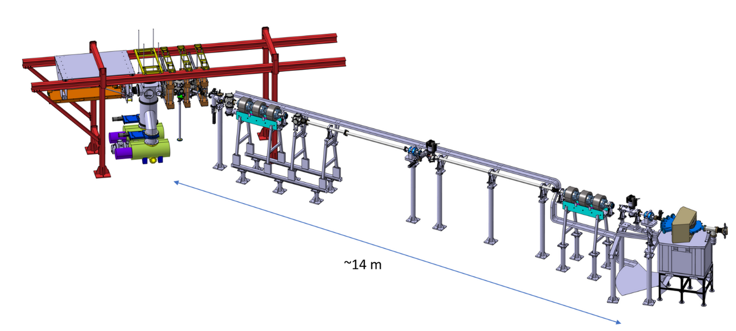
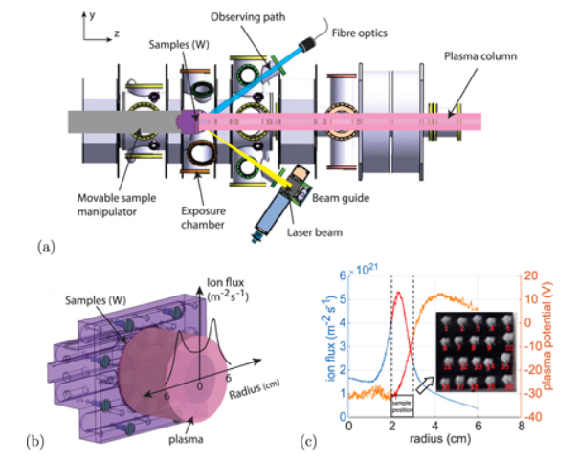
Improved in-situ/vacuo fuel retention and recovery capabilties
SP C + SP F + SP X (in-vacuo) + SP D
Fuel retention and release properties of B layers exposed to fuel species and build with fuel
Simulation related to fuel trapping and release
Ion-damage W material studies
SP C + SP F + SP X (in-operando) + SP D
Fuel retention and release properties of B layers exposed to fuel species and build with fuel
Simulation related to fuel trapping and release
Recycling-studies on surface for W, B, layers
H. van Eeck et al.
DIFFER
Need time to explore these in 2026/2027
Upgrade to create “boronization”-like layer growth with plasma
Candidates: powder injection, evaporation, review again diborane,
Laser-pulse ablation technique not homogenous and low rate

Slide 5
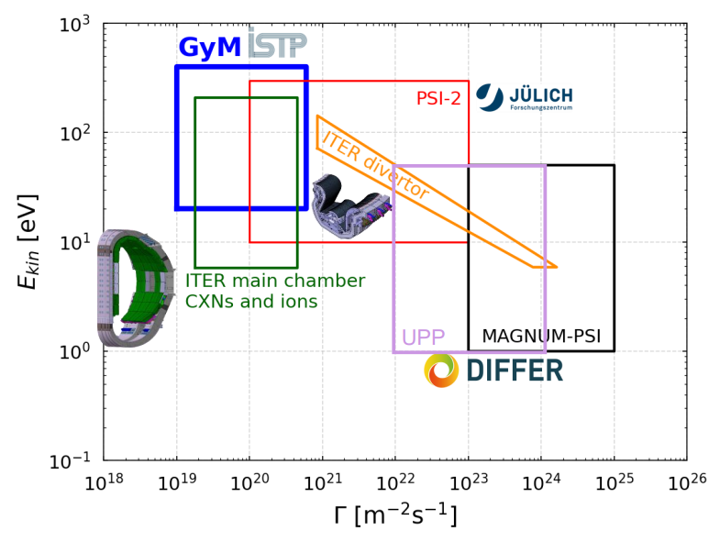
Operational space of linear devices: Impact energy vs. flux
Steady-state devices and can
reach fluences up to 10³⁰Dm⁻²
per operational day
Link to WEST experiments
Relevant fluence for ITER
JULE-PSI space as PSI-2,
but in controlled area suitable
for T, activated and toxic materials

Slide 6
Main Objectives for 2026/2027 I
WPPWIE covers high priority activities for ITER (new baseline), supports DEMO and reactor-class devices, supports tokamak and stellarator exploration, and addresses open physics questions
WPPWIE core program of 2025 will continue in 2026 and 2027 addressing these priority items
Support program for ITER: W sources, transport, influx, and deposition at the first wall and divertor |T retention, quantification, and removal from B | (temporary) first wall material qualification
Support program for DEMO (VNS): (novel) material qualification | transients and high fluence | PWIE simulations (e.g. lifetime) via TSVV-7| retention/diffusion/permeation in PFCs/blanket (W/steel)
Support program for JT-60SA/Wendelstein7-X: transfer from C towards W PFCs | power handling | material migration | divertor functionality optimization| long-pulse PWI operation aspects
Note: DTT, COMPASS-U, VNS needs for PWIE facilities/analysis/modelling to be assessed and additional funding support might be required (WPDTT, WPDES, ??)

Slide 7
Main Objectives for 2026/2027 II
PFC qualification and lifetime: synergistic effects in loading and operation beyond damage | RE beam damage analysis / interpretative modelling / predictions
PWIE code development and benchmark experiments: pedestal⬄ plasma-wall interface ⬄ material using linear machines, laboratory experiments, reference experiments in full-W devices (ASDEX Upgrade, WEST and incl. EAST collaboration for CXN)
PWIE simulations for novel tokamak scenarios QCE, XPR| first wall vs. divertor W sources | material migration studies | benchmark experiments
Completion of JET components analysis: tungsten, steel, RE-damaged PFCs, T and He retention
Benchmark of CRM with A&M data for H, D, T (atoms and molecules) | W collisional-radiative models | B chemistry, MD calculations
In-operando diagnostics optimisation for material composition and retention | lessons learned from LIBS and LID-QMS at JET towards next step devices |analysis stations in hot cells | simulation and fast analysis tools
Support in surface analysis for toroidal devices and linear plasma experiments
First exploration of PEX JUDITH-3/PSI-2 with tungsten samples (end of 2027)

Slide 8
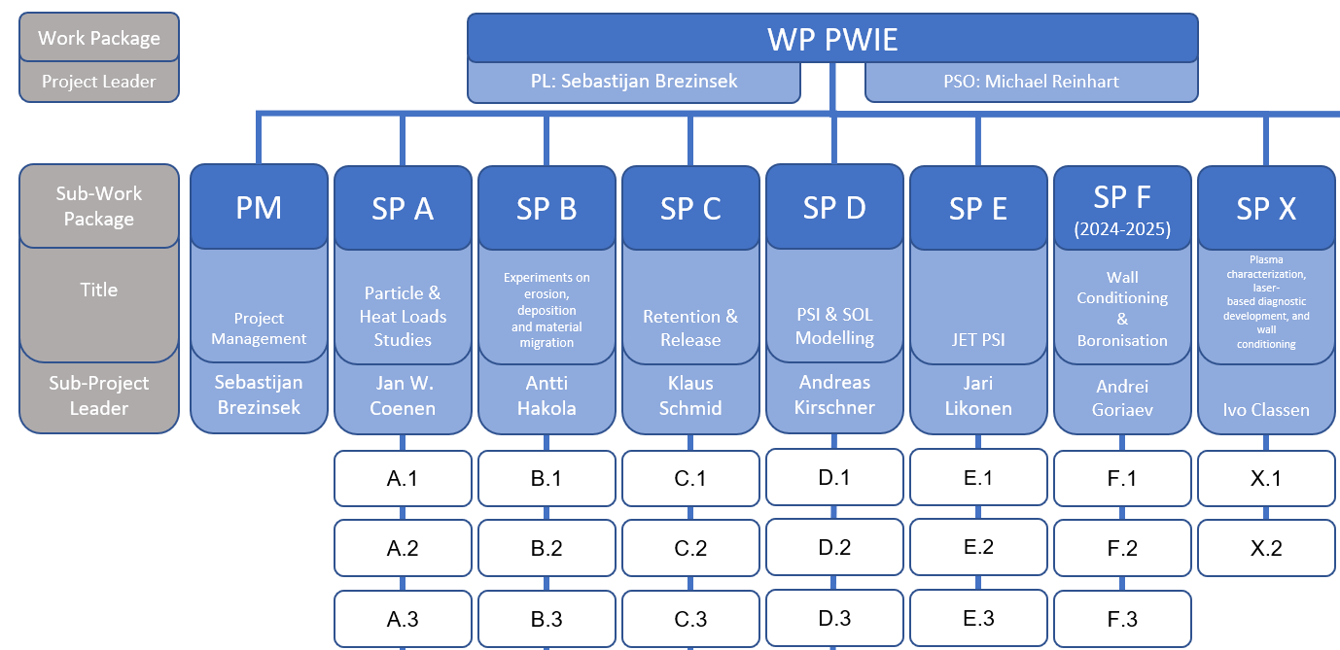
WPPWIE 2026/2027 structure and tasks
Seven subprojects will remain with their main scope
Restructuring of tasks, further focusing, and introduction of scientific readiness levels were appropriate
Reduction of task activities from 28 down to about 18-20
JET LIBS analysis to be closed in 2026 (SP E2)
TSVV-6, TSVV-7 and parts of TSVV-5 could be implemented as tasks in SP D with links to ETASC remaining
AI activities closed and knowledge absorbed in SP D1 and SP X2

Slide 9
WPPWIE Budget Constraints for 2026 and 2027
Calculation basis 5-years-averaged budget:
Rise of PWIE budget from 2021 to 2025
Key ITER new baseline areas added in 2025
Number of PCRs for 2024 and 2025
Two AI-activities for 2024 and 2025
Total Budget for 2025: 5,725 M€/y (Commission Contr.)
of which PEX: 0,641 M€/y (Commission Contr.)
Available budget for 2025: 5,08 M€ (Commission Contr.)
Predicted budget for 2026: 3,91 M€ (Commission Contr.)
Proposed reduction by PSD (w/o PEX):
Available budget for 2025: 5,080 M€ (Commission Contr.)
Reduced budget for 2026: 3,558 M€ (Commission Contr.)
Budget reduction accordint to PSD proposal:
1522 k€ reduction in comparison with 2025 budget
30% reduction in comparison with 2025 budget
Effect of 5-years-averaged budget calculations:
1170 k€ reduction in comparison with 2025 budget
23% reduction in comparison with 2025 budget

Slide 10
WPPWIE 2026/2027 reductions in comparison with 2025 (i)
° PCR 2024
* AI projects
Plan A: REDUCTION with respect to 2025 numbers (PEX excluded):
Closure of AI-LIBS project (IPPLM, FZJ, CU)* 41 k€
Closure of AI-SOL project (CEA)* 71 k€
SP A: No prolongation of COMPASS-U material support and test (div RUs)° 190 k€ (close SP A5)
SP A: Recrystallization - topping (DTU, CEA)° 57 k€
SP B: No prolongation of ITER mirror B cleaning activity (FZJ, MPG, EFPL out)° 50 k€ (close SP B6)
SP B: B-Layer development - topping (IAP)° 18 k€
SP B: Reduction of reference layer production (ENEA) 5 k€
SP C: EUROFER - H permeation studies completed (JSI) 21 k€
SP D: No specific JT-60SA support modelling (LPP-ERM-KMS)° - (only if budget from F4E) 67 k€
SP D: Closure of DIVGAS/JET NG modelling activities (VTT, KIT out) 30 k€ (close SP D4)
SP E: JET material containers + Cutting + transport (once: VTT, FZJ, IAP)° 175 k€ (close SP E2)
SP F: Boronization procedure documentation completed (FZJ, CEA, MPG)° 48k€ (close SP F1)
Savings PM: 770 k€
Most of these activities will be completed in 2025 => residual questions can be absorbed in core program
2 AI projects mature enough to be transferred to PWIE core program
JT-60SA is a strategical decision and related to needs and F4E discussions
5 Tasks closed and two RUs will not be in 2026 and 2027 part of WPPWIE

Slide 11
WPPWIE 2026/2027 reductions in comparison with 2025 (ii)
° PCR 2024
* AI projects
Plan A: REDUCTION with respect to 2025 numbers (PEX excluded):
Savings PM: 770 k€
Mission (70%) (limit to 60 k€) ° 85 k€
Facilities (40%) => HHF, Analysis, Íon damage , TOMAS ° 100 k€
Facilities (70%) => HHF, Linear plasma devices ° 100 k€
Hardware (40%) (limit to 60 k€ ) 55 k€
Savings HW and Facilities: 340 k€
Total savings: ~1110 K€ (Commission Contribution) or 22 % of 2025 budget => close to 5-years-average budget
Reduction of Facility usage by ~18 % with respect to 2025
Mission and Hardware adapted (no JET-LIBS experiment activities)
But need to reduce another ~412 k€/y of budget according to PSD prediction

Slide 12
WPPWIE 2026/2027 – additional reductions according PSD projection
Plan B: Additional actives to be stopped or delayed to FP10:
SP B and SP D: Dust activities after new successful start in 2025 => ITER and DEMO safety (SP B5 closed)
Metallic dust collection, characterisation, and analysis (from WEST and AUG) => 125 k€ (incl. facilities)
Dust simulation (condensation/conversion/self-charging of tritiated dust) => 30 k€
Savings B1: 155 k€ (2025 costs)
SP C: Tritium laboratory related activities: tritium retention, permeation and outgassing => ITER and DEMO safety
Tritium permeation and outgassing from W, steel and EUROFER into gas and water => 155 k€ (incl. facilities)
CEA Saclay (including modelling) and ISSP-University of Lativa (new task started 2025!) (SP C5 closed)
Savings B2: 155 k€ (2025 costs)
SP A: KIPT and QSPA activities: machine status and personal [Large uncertainty]
Useful to study synergistic effects as well as RE and VDI damage of ITER and other material
High number at PM (40 PM) at low salary rate / EU funding to recover machine and diagnostic
Savings B3: 65 k€ + 35 k€ (2025 costs)
Total savings: ~1520 K€ (Commission Contribution) or 30 % of 2025 budget => as PSD proposal
Cut of these three projects reduce significantly the scientific output and have impact on ITER dust assessment
2 Tasks to be closed and two RUs will be severely hit: ISSP-UL and KIPT
If KIPT and QSPA shall remain: OLMAT activities stopped, JUDITH and GLADIS activities adapted in 2027

Slide 13
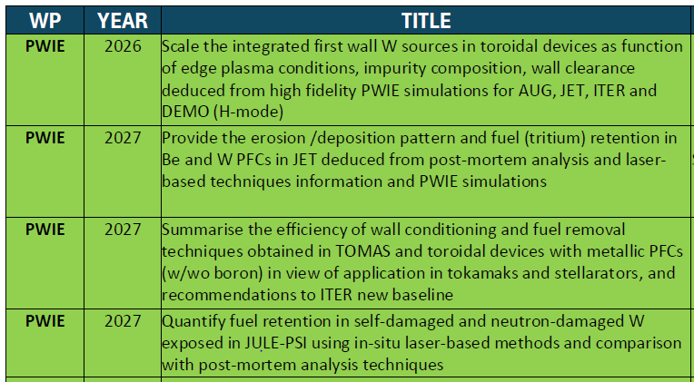
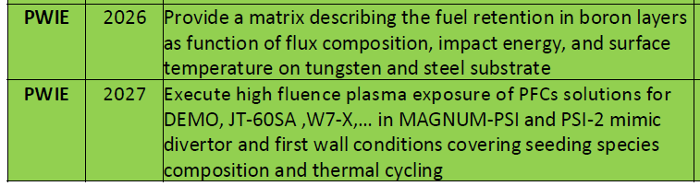
Preliminary deliverables and milestones / Conclusion
Deliverables
PWIE program for 2026/2027 proposed and PWIE budget trimmed down by 22% from 2025 to the 5-years-average reasonable (with more focus)
Further reduction hits critical physics topics and laboratories. Loss of expertise possible.
Alternative Ansatz: Keep 2026 high with no additional cuts and reduce 2027 stronger if needed, but FP10 start in 2028 will be SLOW!
But:
More detailed program planning within 2 weeks not possible
No detailed interaction with RUs possible
Estimates on human resources in loading table are based on average EF salary rates. Real PM usage in PWIE higher (many small RUs with low rates)
Machine costs might be significant higher, less days available => update from RUs needed
Call for Manning will be required
Milestones

Slide 15
AWP 2025 – Main objectives transferred into Tasks
Supporting ITER re-baselining and addressing critical question in experiments / modelling:
Simulation of first wall W erosion, W deposition, and W screening in limited and diverted plasmas
Boronization and B layers: homogeneity, B layer properties, lifetime, and impact of B on wall conditions
T retention (scaling law), T removal techniques (ICWC, ECWC), T quantification (laser-techniques),
active removal of B layer by erosion, dust formation, dust properties, and dust removal (incl. TOMAS and other facilities)
Advanced modelling of B physical and chemical erosion process as input for PWIE models (MD simulations)
Qualification of ITER TFW design solutions in HHF and plasma devices (inertially cooled PFCs)
W PFCs damage predictions under VDE and RE impact in ITER (JET benchmark)
Supporting ITER first mirror performance in the presence of boron (boronization / boronization + plasma)
Linked to ITPA activities and
needs defined in ITER research plan
Continuation into 2026-2027!

Slide 16
AWP 2025 – Main objectives transferred into Tasks
Material qualification for DEMO and other facilities with plasma and combined load, damage evolution, limits
Support of WEST and ASDEX Upgrade experiments, analysis, and interpretative modelling
(PWIE aspects only e.g. migration, 3D aspects, layer formation, stability)
Address T-retention by trapping/diffusion/permeation in damaged tungsten/EUROFER PFCs
Prompt re-deposition physics of W and properties of re-deposited W (experiments and modelling)
Analysis of JET-LIBS data and prepare/start for post-DT tile analysis
Support of W7-X PWIE in long-pulse operation, wall conditioning, material migration, transfer to W
Properties of cold, recombining plasmas in view of molecular assisted processes in H,D
Development and application of laser-based technologies for in-situ and in-operando studies (W, steel, B)
Support of COMPASS-U (and JT-60SA regarding transfer to W by modelling, divertor design, and PFC test)
Continuation into 2026-2027 with reductions!

Slide 17
New/updated activities in 2025: Focus on WEST support
SP B : Understanding the formation of WEST-like deposits with W
Final analysis of WEST-like deposits from long-pulse operation: stability and dust conversion factor
Mimic WEST-like divertor plasma conditions and pulses in MAGNUM-PSI (and PSI-2)
Thermal cycling of actively cooled W PFCs in NAGNUM-PSI and secondary upstream W source
Role of surface temperature, thermal stresses, impurities, oxide formation, duty cycle etc. as parameters
Pre- and post-characterisation and spectroscopy
ERO simulations for linear plasma experiments (same A&M data for WEST)
Dust formation and characteristics (tbc with FTD)
SP D: Simulation of WEST long-pulse plasmas in full 3D geometry (incl. ripple)
Plasma boundary simulation with SOLEDGE3X-EIRENE
ERO2.0 simulation of WEST long-pulse devices incl. W local redeposition and MB shaping
Dust simulation
SP A: HHF exposure of W MB exposed in WEST
Damage evolution under e-beam loading
Deposit stability assessment

Slide 18
New/updated activities in 2025: Focus on first wall W erosion
SP D : Simulation of fluxes to the first wall and W sputtering
CXN and ion flux composition in simulations for COMPASS-U, AUG, (JET), ITER and DEMO
SOLPS-ITER H-mode plasma simulations (ELM-averaged)
Poloidal distribution of CXN with energy and angular distribution (universal EIRENE solution)
Role of inner and outer wall W source variation with change of CXN, D+, impurity ionisation level
ERO2.0 simulations / WallDYN-3D simulations for AUG, JET, ITER
Comparison of cases with extended grid to the wall and normal grid to assed far-SOL profiles
SP B: Gross and net W erosion at the first wall (manipulators) jointly with WPTE
Experiments with wall clearance variation and light impurity seeding
Pre- and post characterisation of materials with different sputtering threshold and FIB cuts
Comparison with PSI-2 plasma experiments
WPTE/PWIE Proposal of dedicated W (and B) migration experiment in AUG approved

Slide 19
New/updated activities in 2025: Focus on boronisation and retention
SP C+ SP F : B layer database
Development artificial B layers for physics studies and comparison with tokamak samples
Matrix about fuel content: impact energy, temperature, material mixing, stability, fuel content, release as function of temperature
In-operando analysis
Use of TOMAS (upgrade), new facilities in IAP, and other abs to create variety of B layers with and without D content as reference
Magnetron-sputtering or laser-ablation-induced deposition used as replacement for boronization (later not possible in labs)
Transfer knowledge from Be to B => need for B database with D content in B layers for PWI modelling

