Slide 1
Overview of DSD
R. Kamendje
Physics Project Board, April 1, 2025

Slide 2
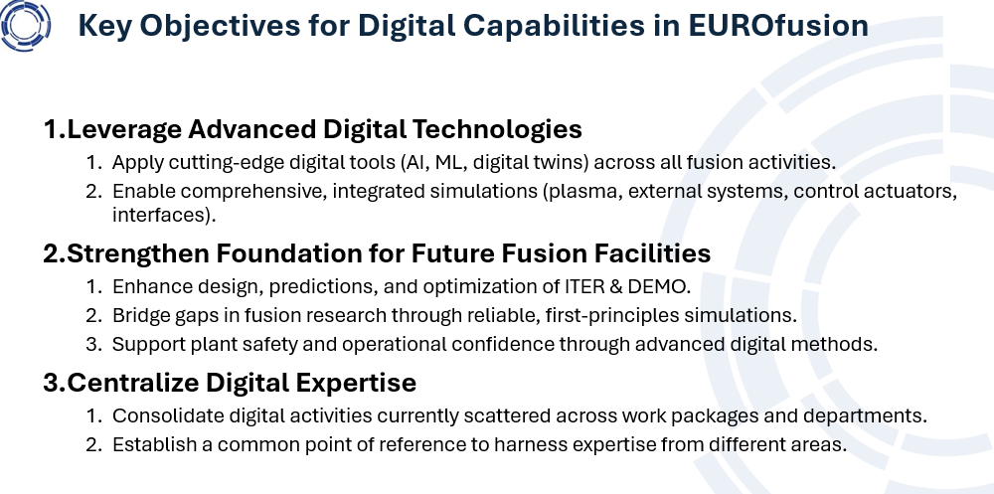
Outlined Objectives for DSD at the Outset

Slide 3
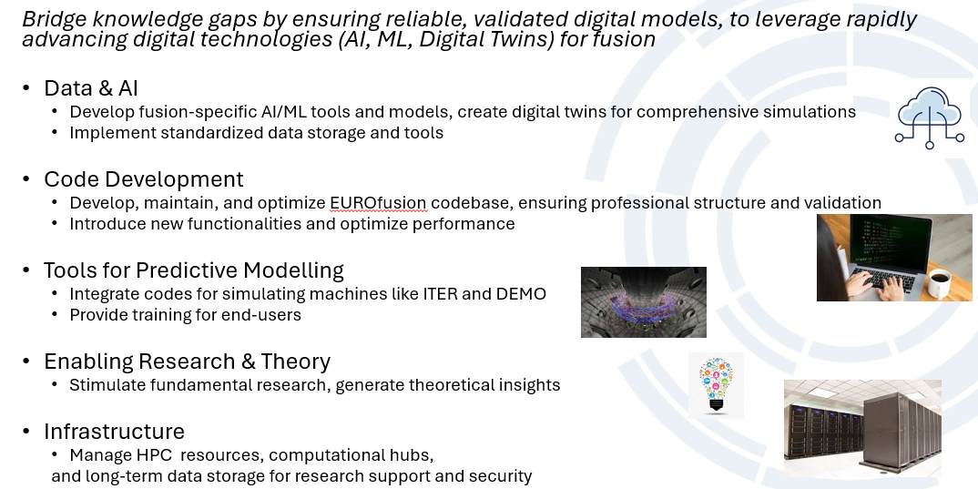
Vision for DSD being implemented in 2025

Slide 4
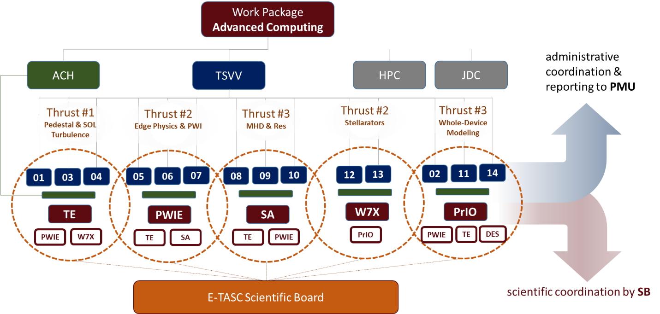
WPAC in 2025

Slide 5
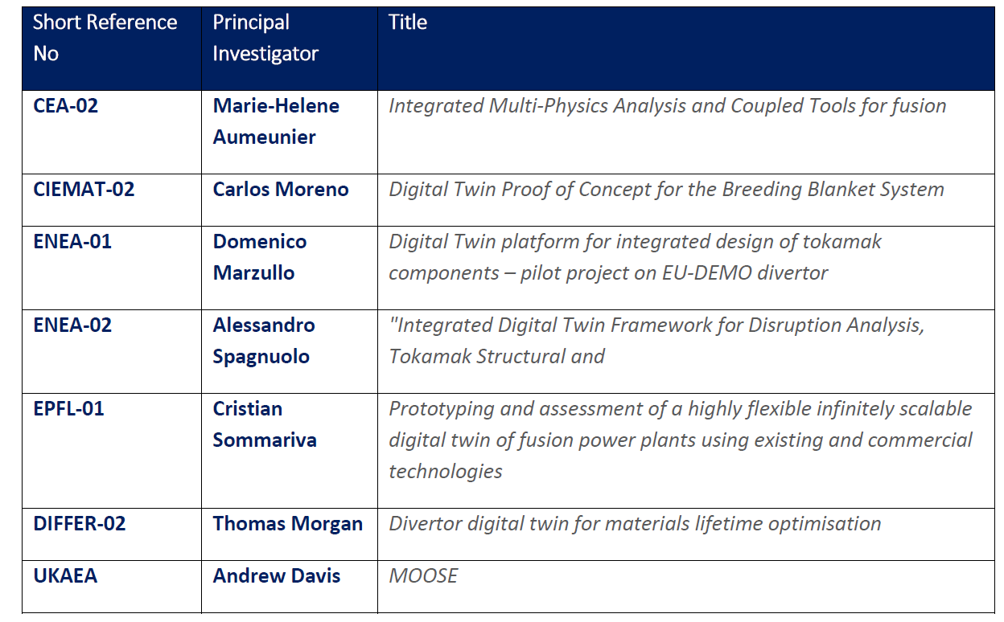
New DSD Activities in 2025: Digital Twins Pilot Projects selected
7 out of 12 Digital Twin Proof of Concept projects selected for the 2025 Work Programme 2025

Slide 6
Long Term Data Storage Facility (LTDSF): Selection completed
Technical Specification:
Long-Term Archival Storage (slow, disk storage): 10PB
Immediate Data Access (SSD high-speed storage):1PB
Data Transfer Link: Fast connection to CINECA HPC (Pitagora) in Bologna.
Bandwidth (sustained): 40 GBit/s
External Network (bandwidth): 20 GBit/s with a back-up at similar speed

Slide 7
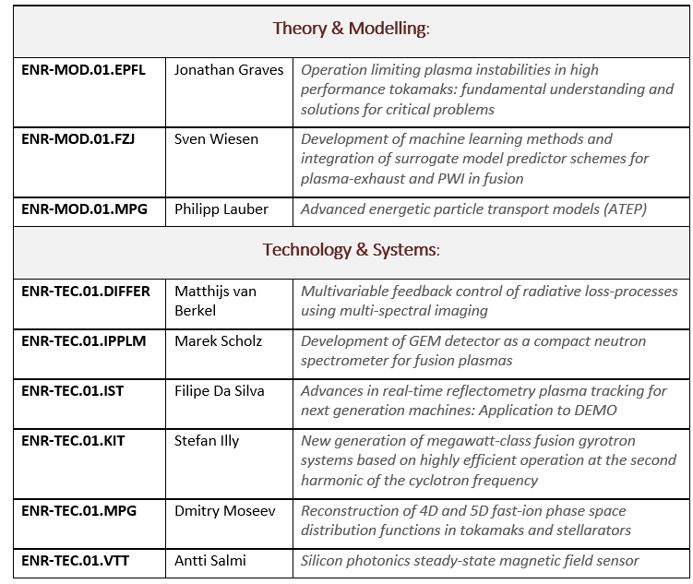
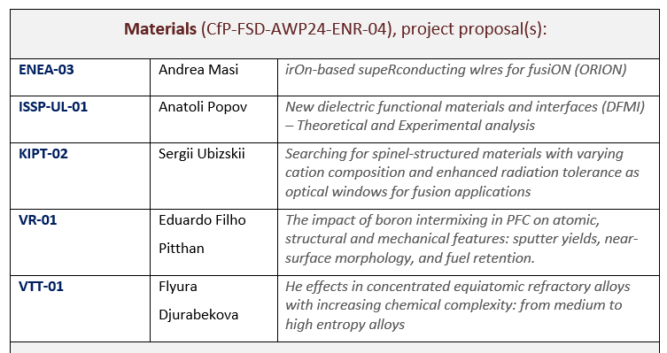
ENR
Projects running until the end 2025

