Slide 1
Financial Overview 2021-25
Physics Project Board #6
1st-2nd April 2025
E. Genangeli

Slide 2
Revision AWP25 and budget update
The AWP25 has been revised to address STAC and EC comments and update the financial resources
It will be submitted for approval by the GA in April
The budget has been updated following the preparation of 2025 Task Specification and allocation of resources for campaigns and new calls
In preparation of the 2026-27 budget plan, all PLs have been asked to mark the 2025 unused resources and release the budget.
All data from IMS export on 14 March 2025

Slide 3
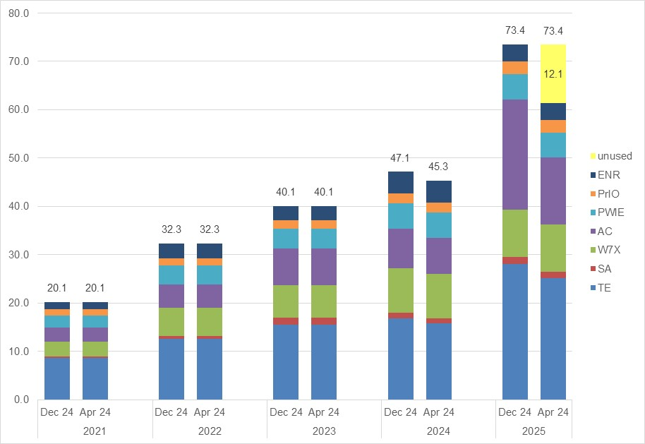
Evolution of 2021-2025 EC budget
12.1 M€ unused resources identified in 2025 budget
  AC 9.7 M€ (HPC, LTDS, ACH)
  TE 2.3 M€ (missions, AUG operation)
  PrIO 0.1 M€
2024 budget decreased by 1.8 M€
  TE 1.1 M€ campaign resources shifted to 2025
  AC 0.7 M€ HPC shifted to 2025
IMS data export 14.03.2025 (M€ CC)

Slide 4
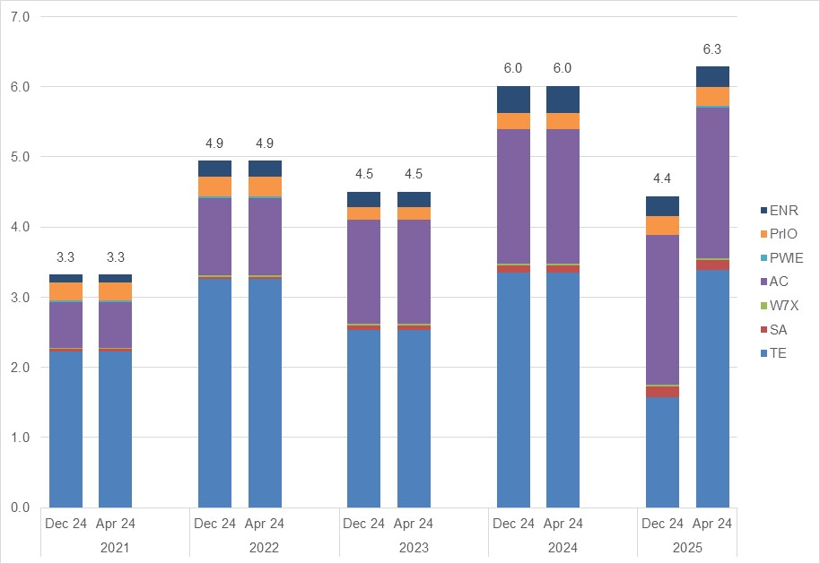
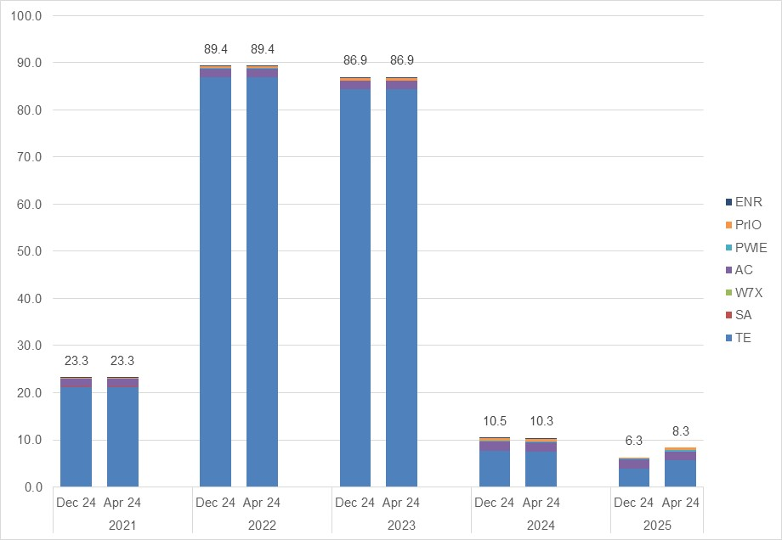
Resources 2021-2025 EPFL and UKAEA
EPFL (CC):
2025 budget increased by 1.8 M€, mainly in TE (campaign res., DTFL, Enhancements, missions)
UKAEA (Total resources):
2025 budget increased by 2.0 M€, mainly in TE (campaign res., DTFL)

Slide 5
2025 EC budget update
TE: resource shift to EPFL -3.6 M€/-1.8 M€; unused campaign res. from 2024 +2.2 M€/+1.1 M€; AR +1.0 M€ TR
SA: CC -169k transfers to other “FSD” WPs
W7X: CC +93k transfer from SA, +45k unused campaign resources from 2024; AR + 1.3 M€ TR
AC: +1.2 M€/0.7 M€ unused HPC resources from 2024; CC +15k transfer from SA
PWIE: CC +47k transfer from SA; -43k/-21k shift to EPFL (3 pm not foreseen)

Slide 6
2025 EPFL and UKAEA Budget update
(both no unused resources)

