Slide 1

2024/2025 Update
WP Plasma-Wall Interactions and Exhaust
6th Physics Department Project Board
Sebastijan Brezinsek (PL)
Forschungszentrum Jülich
Heinrich-Heine-Universität Düsseldorf
J.W. Coenen (FZJ), A. Hakola (VTT), K. Schmid (MPG),
A. Kirschner (FZJ), A. Goriaev (ERM/KMS), J. Likonen (VTT), I. Classen (DIFFER) M. Reinhart (FZJ, PSO) and D. Douai (CEA, CO)

Slide 2
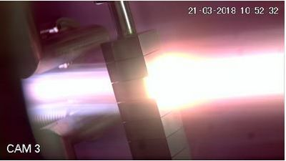
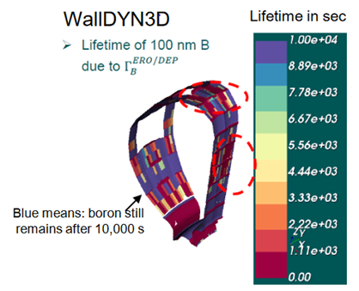
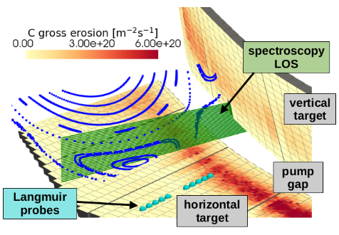
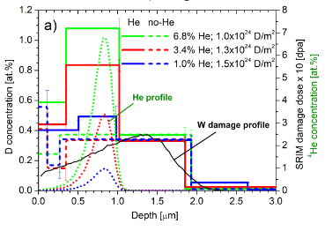
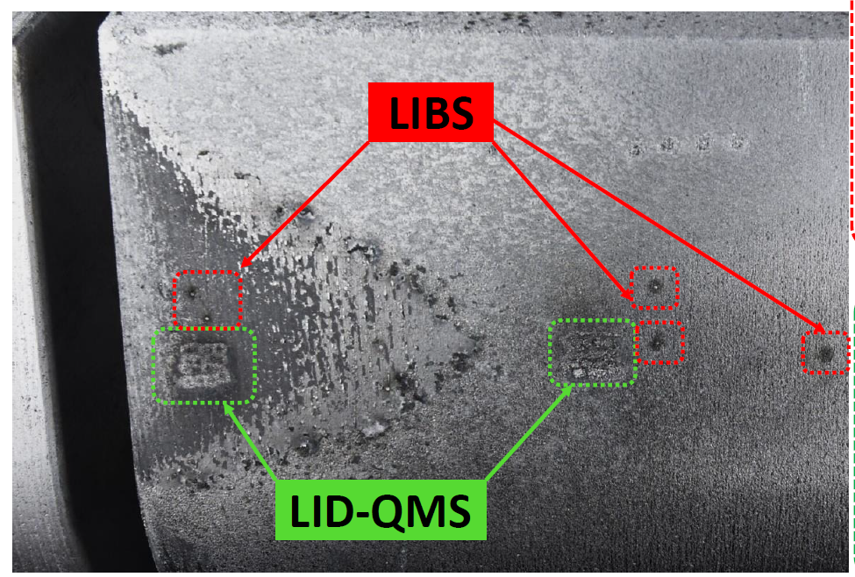
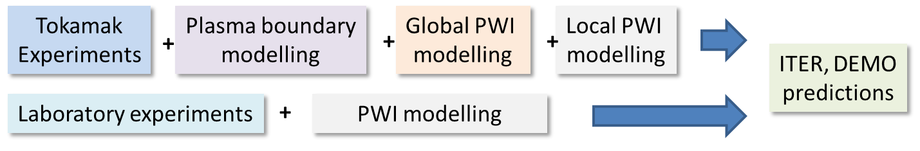
Work Package Plasma-Wall Interactions and Exhaust
Focus on ITER and DEMO materials, H and isotopes, He, seeding gases, and impurities
Particle and heat flux
Tungsten + Deuterium
In linear devices
Runaway beam damage
of PFCs analysis and interpretative simulation
Support in WPTE exploitation
In AUG, WEST and JET in PWIE
area with metallic PFCs
Goal: steady-state operation
MAGNUM
Support in WPW7X exploitation
operating with C towards W
ITER
[T. Morgan]
[I. Jepu]
[K. Schmid]
[J. Romazanov]
[S. Markelj]
Synergistic effects by heat flux and plasma loading of W materials
3D erosion & deposition modelling
Tungsten and Boron
Fuel retention in steel and tungsten
Neutrons + Deuterium/Helium
Surface analysis (D,T) by
Laser-based techniques
Recombining H,D plasmas in PSI-2 and MAGNUM-PSI (CRMs)
Wall conditioning in TOMAS and boronization assessment

Slide 3
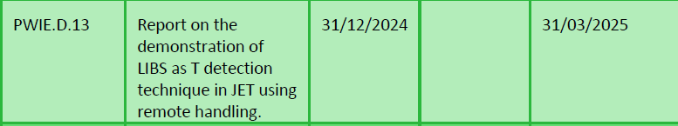
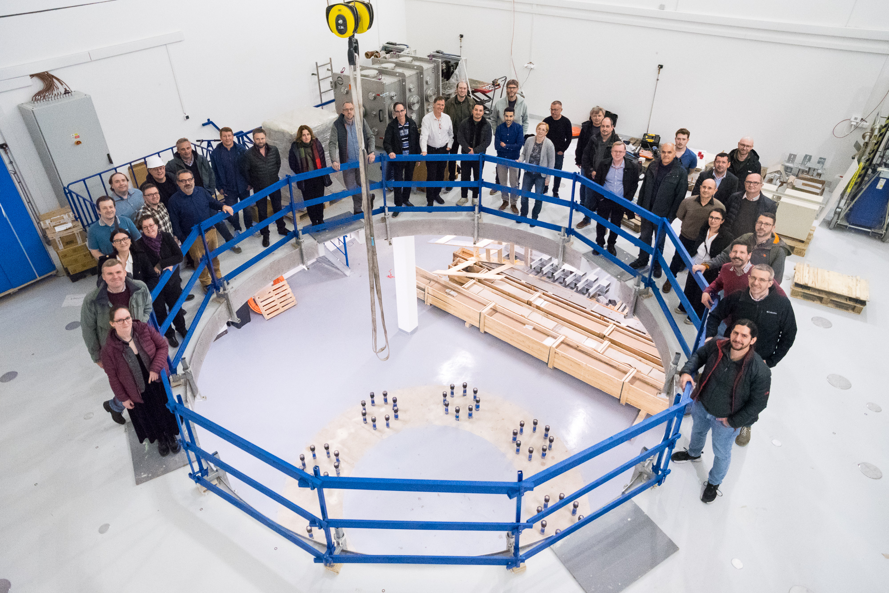
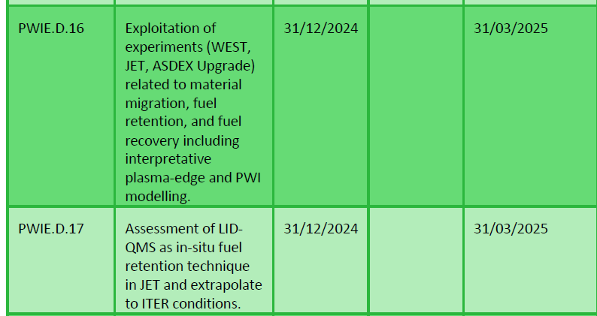
Status WPPWIE 2024
Vast majority of activities within the 7 subprojects were successfully completed
Level 3 reports for each subproject and PWIE technical report completed
PWIE GD 13, 16, 17, 18 in principle fulfilled, but delay in reporting (caused by the PL)
PWIE GD 14 shifted to 2025 to include one post-DT sample analysis / PWIE GD 15 cancelled (FZJ - PEX)
Many contributions to PFMC, EPS, PET, IAEA conference
Scientific presentations
on INDICO:
WPPWIE project meetings
end of November 2024
and end of March 2025
PWIE meeting
last week in Prag

Slide 4
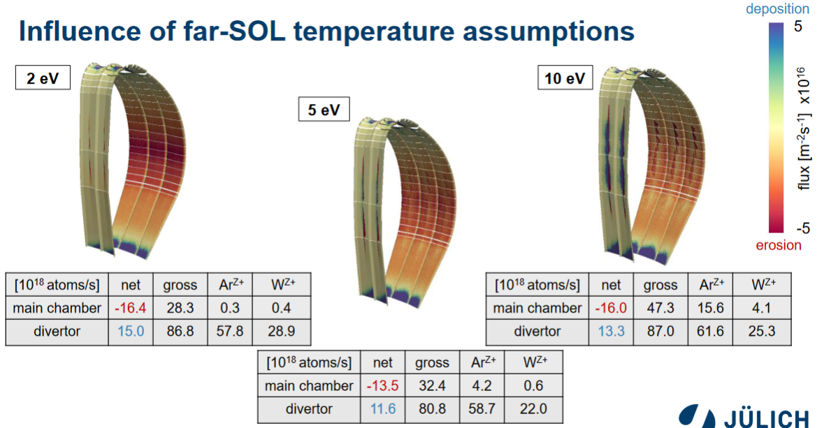
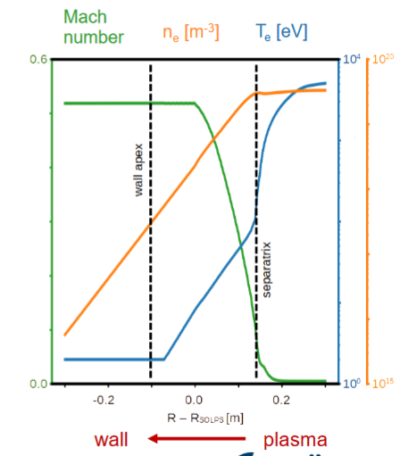
Highlight: Simulation of tungsten erosion in DEMO (with TSVV-7)
Ch. Baumann
SOLPS from F. Subba
Comprehensive set of physics for full-W PWI simulations in ERO2.0 implemented
Plasma background from SOLPS-ITER extrapolated to the first wall and 3D
Largest uncertainty are the far-SOL flux extrapolations, but in all cases
main chamber is net erosion zone, divertor is net deposition zone, good screened
Note ITER baseline:
T_{e}=20 eV and Neon
same work flow
=> W influx estimates

Slide 5
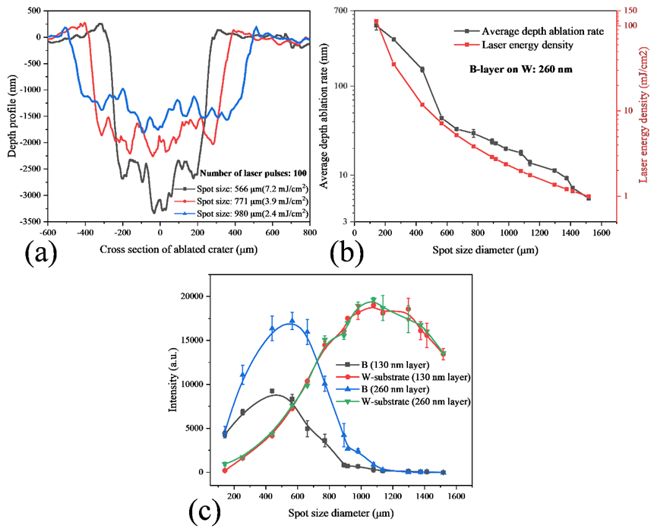
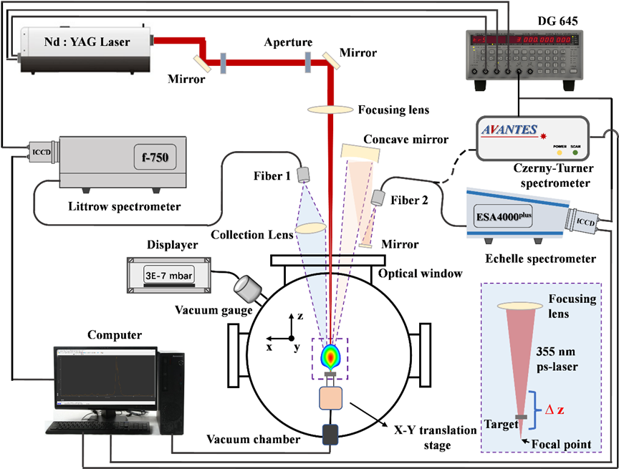
Highlight: Development of LIBS to measure thin B layers
Qualify LIBS for in-situ thin boron layer analysis
H. Wu et al. NME 2024
ps-LIBS technique optimized to measure thin B layers on W substrate
Thin deposits can be studied considering thin layer effects (reflection)
Tests on artificial boron layers from magnetron sputtering (130/260 nm)
Successful test on boron layer samples from Wendelstein7-X pure boronization exposure with deposits below 10nm on W samples
Limitations due to B and W line overlapping
Parallel recording of O, H, C and other impurities possible
FZJ
Allows B layer diagnosis
for ITER „boron matrix“

Slide 6
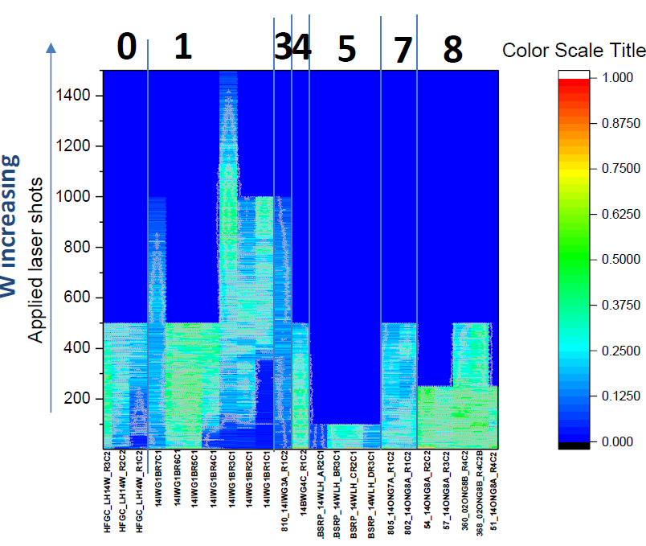
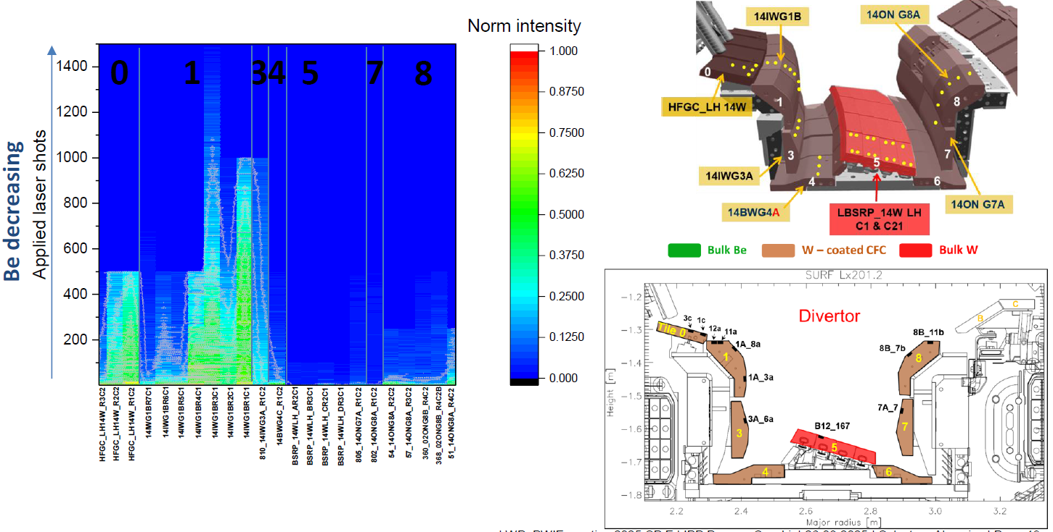
Highlight PCR 2024: LIBS analysis at JET
S. Amarviva et al. PFMC2025
Analysis is progressing and in-line with post-mortem analysis of earlier campaigns regarding Be and W pattern
Calibration is challenging and needs more time than expected => monthly meetings
Tritium in co-deposits far below 1% and potentially only at limiter side deposits
Campaign at VTT with same system required to convert ablation rate into nm/pulse
Last “RE-beam” experiment at JET impacted tile 0 and tile 1 fuel content => perfect cleaning
Technical demonstration
of LIBS on remote handling
arm on W divertor

Slide 7
WPSA: JT-60SA divertor optimisation with SOLPS-ITER (since January)
KU Leuven
Existing SOLPS narrow grid simulations transferred
to SOLPS-ITER wide grid
Issues with plasma solutions at the target
Target inclination as suggested from F4E implemented
Requires change of equilibrium or x-point height

Slide 8
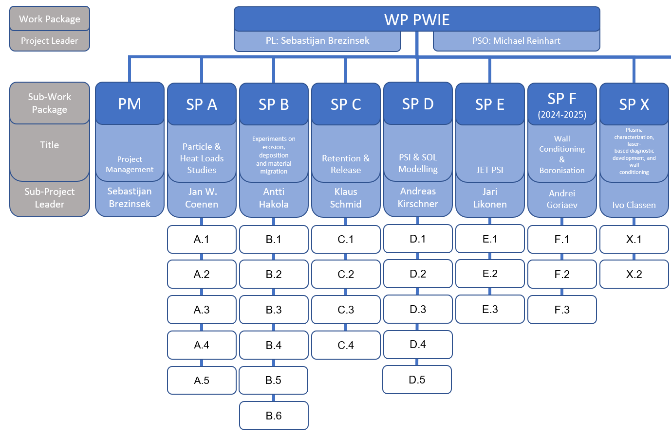
AWP 2025 – Status Update
All tasks including 2024 PCRs defined and implemented in IMS. Not all approved in IMS as of today (tbc).
IDM contains all activity sheets (Research Unit resolved deliverables and tasks) apart from SP F1/F2 (new SPL: Goriaev)
SP A, SP B, SP C, SP D, SP E, SPF(3) and SPX(1) activities had meetings and work started
SP F1/F2/X2/B6 kick-off meetings not yet done => in April (e.g. new SPL in place, WPTE/PWIE interaction)
JET tile distribution, transportation, and post-mortem analysis progressing (with UKAEA support), but main analysis 2026
Thrust 2:
TSVV-5
TSVV-6
TSVV-7
AI:
AI-farSOL
AI-LIBS
ITER mirror
COMPASS
Bor
chemistry

Slide 9
AWP 2025 – Main objectives transferred into Tasks
Supporting ITER re-baselining and addressing critical question in experiments / modelling:
  Simulation of first wall W erosion, W deposition, and W screening in limited and diverted plasmas
  Boronization and B layers: homogeneity, B layer properties, lifetime, and impact of B on wall conditions
  T retention (scaling law), T removal techniques (ICWC, ECWC), T quantification (laser-techniques),
  active removal of B layer by erosion, dust formation, dust properties, and dust removal (incl. TOMAS and other facilities)
  Advanced modelling of B physical and chemical erosion process as input for PWIE models (MD simulations)
  Qualification of ITER TFW design solutions in HHF and plasma devices (inertially cooled PFCs)
  W PFCs damage predictions under VDE and RE impact in ITER (JET benchmark)
  Supporting ITER first mirror performance in the presence of boron (boronization / boronization + plasma)
Linked to ITPA activities and
needs defined in ITER research plan
Summary: 2025 activities in full swing with strong focus on ITER

Slide 10
AWP 2025 – Main objectives transferred into Tasks
Material qualification for DEMO and other facilities with plasma and combined load, damage evolution, limits
Support of WEST and ASDEX Upgrade experiments, analysis, and interpretative modelling
(PWIE aspects only e.g. migration, 3D aspects, layer formation, stability)
Address T-retention by trapping/diffusion/permeation in damaged tungsten/EUROFER PFCs
Prompt re-deposition physics of W and properties of re-deposited W (experiments and modelling)
Analysis of JET-LIBS data and prepare/start for post-DT tile analysis
Support of W7-X PWIE in long-pulse operation, wall conditioning, material migration, transfer to W
Properties of cold, recombining plasmas in view of molecular assisted processes in H,D
Development and application of laser-based technologies for in-situ and in-operando studies (W, steel, B)
Support of COMPASS-U (and JT60SA regarding transfer to W by modelling, divertor design, and PFC test)
In general very strong links with: WPTE and WPW7X as they offer platform to bridge: laboratory results with tokamak / stellarator via modelling
Strong link to technical departments: WPDES, WPDIV, WPMAT, WPSAE …

Slide 11
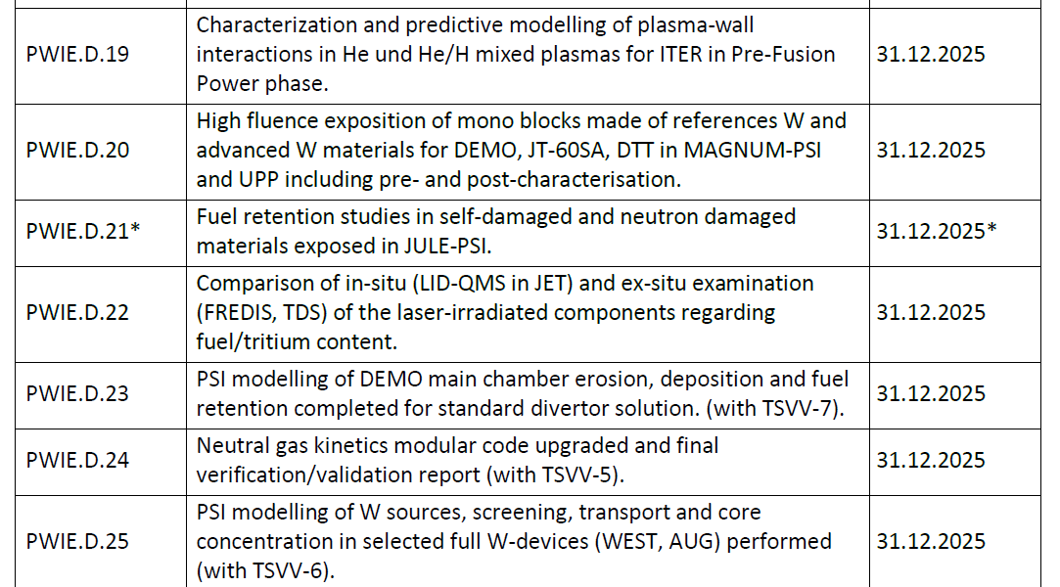
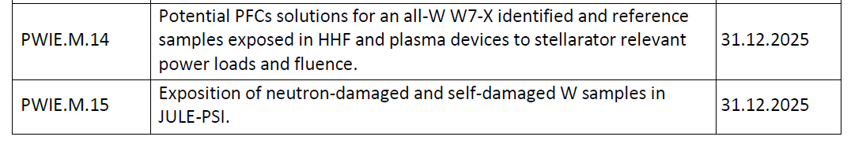
Deliverables and Milestones 2025
Cancel
Cancel

Slide 12
WPPWIE 2025 Activities (Tasks) List
ID | Title
SP A.1 | Synergistic Load Studies of Plasma-Facing Materials for ITER & DEMO
SP A.2 | High Particle Fluence Exposures of Plasma-Facing Components for ITER
SP A.3 | Advanced Materials under thermo-mechanical and plasma loads
SP A.4 | High Temperature performance of Armour Materials: Recrystallization and Melting
SP A.5 | COMPASS-U – Materials Assessment
SP B.1 | Physics of erosion and deposition
SP B.2 | Material migration in toroidal devices
SP B.3 | Characterization of plasma-exposed materials
SP B.4 | Reference coatings for ITER and DEMO
SP B.5 | Production of metallic dust in toroidal devices
SP B.6 | B-deposition on diagnostic mirrors
SP C.1 | Transport of Hydrogen through the first wall of fusion devices
SP C.2 | T retention Release from B layers
SP C.3 | Influence of He, high-flux D and impurities on Hydrogen retention and transport
SP C.4 | Influence of n-damage on Hydrogen retention and transport
SP C.5 | T-permeation experiments in 316L
Notes:
Info: Human Resource estimate (if you have one)

Slide 13
WPPWIE 2025 Activities (Tasks) List
ID | Title
SP D.1 | Plasma Boundary Modelling
SP D.2 | Production of Atomic/Molecular and Surface Data
SP D.3 | Impurity Migration Modelling
SP D.4 | Neutral Particles Modelling
SP D.5 | COMPASS-U
SP E.1 | LIBS at JET
SP E.2 | Comparison of hydrogenic retention quantification by different techniques and fuel removal assessment
SP E.3 | Post-mortem analysis of PFC and other objects in JET
SP F.1 | Coordination with WPTE
SP F.2 | Boronisation and in-situ anlaysis of boron
SP F.3 | TOMAS wall conditioning
SP X.1 | Atomic and molecular processes in attached/detached plasma
SP X.2 | Optimization of laser-based surface analysis diagnostics
AIP.1 | AIP: LIBS data-processing with Deep Neural Networks and Convolutional Neural Networks for chemical composition quantification in the wall of the next step-fusion reactors
AIP.2 | AIP: AI-augmented SOL modelling for capturing impact of filaments on transport and PWI in mean field codes simulations
PEX | PEX commissioning of hot cells and test facilities
Notes:
Info: Human Resource estimate (if you have one)

Slide 15
New/updated activities in 2025: Focus on WEST support
SP B : Understanding the formation of WEST-like deposits with W
  Final analysis of WEST-like deposits from long-pulse operation: stability and dust conversion factor
  Mimic WEST-like divertor plasma conditions and pulses in MAGNUM-PSI (and PSI-2)
    Thermal cycling of actively cooled W PFCs in NAGNUM-PSI and secondary upstream W source
    Role of surface temperature, thermal stresses, impurities, oxide formation, duty cycle etc. as parameters
    Pre- and post-characterisation and spectroscopy
  ERO simulations for linear plasma experiments (same A&M data for WEST)
  Dust formation and characteristics (tbc with FTD)
SP D: Simulation of WEST long-pulse plasmas in full 3D geometry (incl. ripple)
  Plasma boundary simulation with SOLEDGE3X-EIRENE
  ERO2.0 simulation of WEST long-pulse devices incl. W local redeposition and MB shaping
  Dust simulation
SP A: HHF exposure of W MB exposed in WEST
  Damage evolution under e-beam loading
  Deposit stability assessment

Slide 16
New/updated activities in 2025: Focus on first wall W erosion
SP D : Simulation of fluxes to the first wall and W sputtering
  CXN and ion flux composition in simulations for COMPASS-U, AUG, (JET), ITER and DEMO
  SOLPS-ITER H-mode plasma simulations (ELM-averaged)
  Poloidal distribution of CXN with energy and angular distribution (universal EIRENE solution)
  Role of inner and outer wall W source variation with change of CXN, D+, impurity ionisation level
  ERO2.0 simulations / WallDYN-3D simulations for AUG, JET, ITER
  Comparison of cases with extended grid to the wall and normal grid to assed far-SOL profiles
SP B: Gross and net W erosion at the first wall (manipulators) jointly with WPTE
  Experiments with wall clearance variation and light impurity seeding
  Pre- and post characterisation of materials with different sputtering threshold and FIB cuts
  Comparison with PSI-2 plasma experiments
WPTE/PWIE Proposal of dedicated W (and B) migration experiment in AUG approved

Slide 17
New/updated activities in 2025: Focus on boronisation and retention
SP C+ SP F : B layer database
  Development artificial B layers for physics studies and comparison with tokamak samples
  Matrix about fuel content: impact energy, temperature, material mixing, stability, fuel content, release as function of temperature
  In-operando analysis
  Use of TOMAS (upgrade), new facilities in IAP, and other abs to create variety of B layers with and without D content as reference
  Magnetron-sputtering or laser-ablation-induced deposition used as replacement for boronization (later not possible in labs)
  Transfer knowledge from Be to B => need for B database with D content in B layers for PWI modelling

Slide 18
PCR 2025 – Status
WP | PCR proposal description | 2025 [k€ CC] | means of expenditure | Implement 2025
PWIE1 | Support in the analysis of the impact of boronization on the new ITER re- baseline (O getter, fuel retention and removal, lifetime, properties) and associated A&M data calculations / modelling (SP B, SP C, SP D, SP X, SP F) | 100 | PM Mission Facilities | Done
PWIE2 | Analysis of JET tiles including some extracted post DT tiles (2025) and JET RH LIBS analysis completion [Note containers manufacture Croft identified – licensing] | 200 | PM Mission Facilities | Ok, but more budget needed for completion
PWIE3 | SPA: Experiments and modelling of W recrystallisation and impact on power handling and retention. Support for W samples and OG&S (different SPs) | 50 | PM Hardware | Done
PWIE4 | SPB: dust studies for DEMO with W (and B dust) | 75 | PM Facility | Done
PWIE5 | Characterization of ITER/DEMO Mo mirrors exposed to B flux | 77 | PM, Hardware Mission, Facility | Done
PWIE6 | SPC: increase resources for permeation / retention studies with real T (T-lab in USPPL) including facility costs | 70 | PM | Done
PWIE7 | Support to COMPASS-U PFCs selection, qualification and W source estimation. | 200 | PM, Hardware Mission, Facility | Done
1 ppy transferred from JT-60SA to PWIE to support divertor optimization

Slide 19
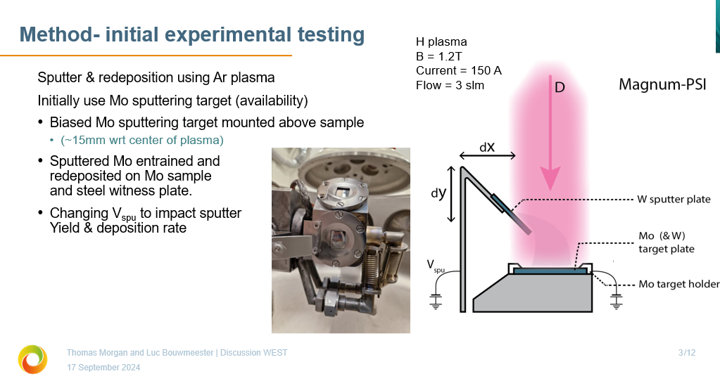
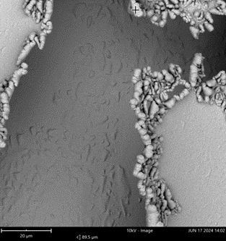
MAGNUM-PSI: Simulation of WEST high fluence campaign
Mimic high W influx from WEST main chamber into W divertor by artificial impurity source
Test experiments in Ar plasma to get high W source in plasma
Final step: try to mimic ITER conditions => Lower W flux from wall into divertor => different balance of W erosion/deposition
Flaking Mo layers observed

Slide 20
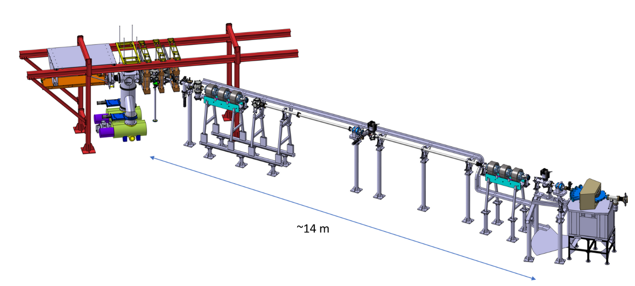
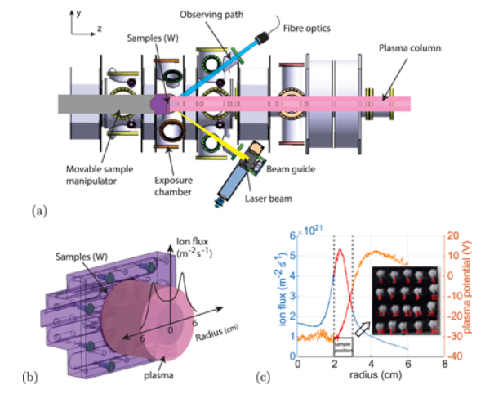
Boron-related in-situ/vacuo fuel retention and recovery studies
SP C + SP F + SP X (in-vacuo)
Fuel retention and release properties of B layers exposed to fuel species and build with fuel
Simulation related to fuel trapping and release
Ion-damage W material studies
SP C + SP F + SP X (in-operando)
Fuel retention and release properties of B layers exposed to fuel species and build with fuel
Simulation related to fuel trapping and release
Recycling-studies on surface
H. van Eeck et al.
DIFFER
In-situ deuterium content measurement by in-operando LIBS (PSI-2) or in-operando NRA (UPP) in 2025 foreseen without breaking vacuum and controlled B+D interaction

