Slide 1
Scope and budget optimization within Work Packages for 2026-27 : Work Package Tokamak Exploitation (WP TE)
PSD Project Board # 06
E. Tsitrone and N. Vianello for TE TFL
E. Tsitrone, N. Vianello, M. Baruzzo, A. Hakola, V. Igochine, D. Keeling, B. Labit

Slide 2
WP TE strategy for facing budget shortage for 2026-2027
Strong budget cuts compared to 2025 (> 30%) , in particular :
Staffing for campaign participation
Machine operation
* Missions 2025 underestimated, ** secondment : for JET/JT-60SA, not shown here, *** AR not accounted for **** committment from FP8 > 3 Mio
Focus on selected ITER urgent R&D issues (secure shot allocation/manpower for running related experiments)
Delay or stop other activities :
Decreased support to DEMO design
Decreased modelling effort (extraplolation of TE results to ITER/DEMO)
Streamlined support to JET data analysis
Enhancements : continuation of support only to highest priority diags + FP8 committment
No extension of AI projects
No support available for the scientific exploitation of JT-60SA (F4E ?)

Slide 3
Focussing on ITER urgent issues
Basis : ITER Research Plan for new ITER baseline, recent input from IO/PSD discussion (document by A. Loarte)
Disruptions : SPI, RE benign termination (RT03), TE.D.20
Scenario development (Mission 1) :
Integrated modelling of high current seeded scenario (JET), TE.D.16 ➔ ITER baseline (RT01)
QCE as both ITER/DEMO relevant (RT02), TE.D.19
Highly radiative long pulse / high beta compatible with exhaust, extrapolable to ITER/JT-60SA (RT08)
Impurity transport (RT01, RT02, RT08, RT05)
Study of power exhaust (Mission 2):
Divertor reattachment (RT05), TE.D.17
X Point Radiator regime as both ITER/DEMO relevant (RT05), TE.D.19
Plasma control : start up on W limiters and current ramp up optimization (ICRH/ECRH) (RT04)
New ITER full W baseline :
Far SOL transport and wall loads (RT01, RT02, RT05)
W sources from first wall, screening, transport (RT01, RT06)
Boronisation (RT06), TE.D.18
RE impact on W walls (RT06)

Slide 4
Decreased support in other R&D areas
Reduced effort on DEMO :
Effort reduced on less mature no ELM scenario (EDA, QH …) + Negative Triangularity (NT) (RT02)
Effort reduced on Alternative Divertor Configuration (ADC) : concentrate on configurations with minimum engineering constrains while keeping benefits (RT07). NB: impact on AUG upper divertor programme.
Streamlining of JET activities
Decrease effort on scenarios analysis not directly extrapolable to ITER, but keep focus on specific physics items in support of ITER : ICRH schemes, isotope effect on transport, L-H transition (RT11)
Fuel retention in T : LID-QMS (RT06), in connexion with WP PWIE
Focus on data analysis/modelling related to TE 2026-2027 GD (contribution to 4 GD out of 5)
EUROfusion support to data validation stopped after 2026 (significant backlog, assumption = UKAEA resources kept at same level as 2025)
Risk : unsupervised work on JET data performed outside of the TE framework and/or no full scientific output from JET (private sector / international collaborators interested)

Slide 5
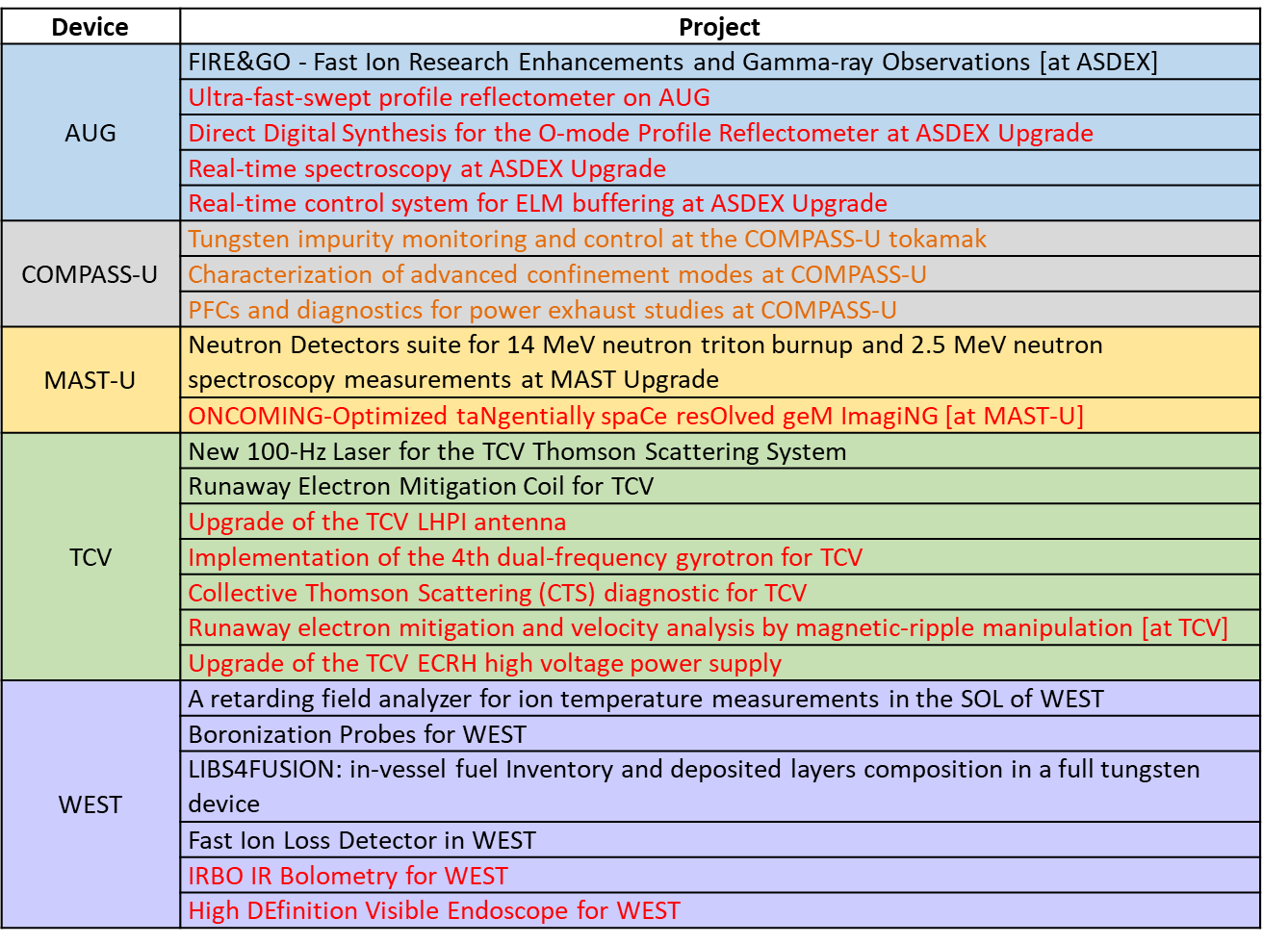
Strongly reduced support to TE enhancements launched in 2024
TE enhancements launched in 2024, targeted at short lead items (2027 at the latest) : effort strongly reduced (~ 1/3 of budget kept), only highest priority diagnostics supported (TE ranking)
COMPASS-U projects : cut of ~1/3 of the budget across all projects. This will delay these enhancements.
To be further discussed between PMU and Beneficiaries involved
Red : support cancelled in 2026-2027
Orange (COMPASS-U) : support reduced by 1/3 in 2026-2027

Slide 6
No support for providing impactful EU contribution to JT-60SA
call for experimental proposals
call for participation
[BASC-34, December 2024]
Getting ready for scientific exploitation of JT-60SA
EU-JA Experimental Team at work for building the scientific programme
High level objectives for OP2 and OP3 defined
EU-JA call for experimental proposals in fall 2025, call for participation early 2026
High priority for EU participation :
Urgent issues for ITER : N-NBI shine through, error field characterization and impact on MHD
Disruptions at high stored energy
ITER baseline scenario at high current, high beta / low collisionality operation
Activities towards transition to W (ECRH, plasma exhaust modelling)
Resources estimated but not included in present plan :
EU core team on site required during operation (WP TE / WP SA)
Staged increase of manpower over OP2/OP3
Discussion started between EUROfusion / F4E top management for providing support

Slide 7
Potential impacts of budget shortage
Reduced staffing for campaign participation
Staffing focused on preparation / execution / preliminary analysis of experiments ➔ Impact on modelling capabilities, full scientific output delayed
Risk of unsupervised JET work on voluntary basis (+ interest from private sector and non EU collaborators)
Reduced fraction of operation time on TE devices
issue for full exploitation of upgrades (AUG upper divertor, ECRH on WEST, additional power on TCV/MAST-U …)
issue on shot intensive items (SPI, high fluence campaign …)
MAST-U : expected to be run for TE at same level as 2025
Reminder : TE devices overbooked by factor ~3 in machine requests when running at 40%
Combination of both
Risk that machines go back to national programmes run by national teams
No EU hub (as JET no longer in operation, RT have become « home » for building multi labs teams) ➔ building a pan EU team, key for preparing EU contribution to ITER scientific exploitation, at risk
Impact on international collaborations (no ELM with USA, KSTAR, EAST) to be assessed
More detailed analysis of programmatic impact in RT tables of draft AWP 26-27

Slide 8
Proposal for alternative plans
Plan B1 : getting back to meaningful resources for addressing ITER R&D issues
Staffing for campaign participation : 137 ➔ 180 ppy for 26-27 (still -20% compared to 24-25)
Missions : + 300 k for 26-27 (still -20% compared to 24-25)
% of operation time on TE devices : back to initial values proposed at “Bureau”
No change for enhancement support / plan A
No support to JT-60SA
Still critical (> 25% global TE budget cut compared to 2025) :
focus on ITER, reduced effort on DEMO, strong streamline on JET
+ ~ 4 Mio EC contribution * / plan A
Plan B2 : plan B1 + support to JT-60SA
Staffing for JT-60SA : 20 ppy for 2026, 30 ppy for 2027 (present level ~ 13 ppy in 2025)
Missions to JT-60SA (need for core team on site + short term visitors) :
2 months in 2026 with 10 people, 4 months in 2027 with 15 people for OP2
3 months in 2027 with 20 people for OP3
Secondment to JT-60SA : 3 seconded staff for 2026 and 2027 (2 EU Topical Group Leaders out of 3, as 1 TGL from UK not accounted for + 1 EU Experiment Team Leader)
EU diags Responsible Officers not included (initially under WP SA)
+ ~ 8 Mio EC contribution * / plan A
* Numbers to be checked with PMU

Slide 9
Back up slides

Slide 10
List of Grant Deliverables 2026-2027
ID | Deliverables Table | Date
TE.D.16 | Provide fully integrated simulation of high current partially detached plasma scenario including assessment of PFC erosion in D and DT plasma | Dec 2026
TE.D.17 | Validate reduced model for plasma reattachment on multiple devices and wide operational space | Dec 2026
TE.D.18 | Provide input on design and operation of conditioning systems for next step full W devices and focus on standard boronization systems | Dec 2026
TE.D.19 | Qualification with experiment/modelling of the most promising no-ELM scenario in terms of confinement, exhaust capabilities and plasma wall Interaction | Dec 2027
TE.D.20 | Optimized scheme for “benign termination” of runaway beams documented in view of possible applicability for ITER | Dec 2027
List of Milestones 2026-2027
ID | Milestones Table | Date
TE.M.08 | Peeling limited pedestal in metallic device achieved | Dec 2026
TE.M.09 | Proper figure of merit for cross-scenario comparison among no-ELM / ADC defined | Dec 2026
TE.M.10 | First wall particle and heat fluxes quantified in XPR in metallic devices | Dec 2026
TE.M.11 | ADCs characterized in H-mode conditions in all relevant TE devices | Dec 2026
TE.M.12 | Modelling of SPI experiment on JET and ASDEX-Upgrade completed | Dec 2027
TE.M.13 | Impact of N-NBI on plasma behaviour documented in JT-60SA and extrapolation to ITER investigated* | Dec 2027
* Pending resources are made available for JT-60SA related work

Slide 11
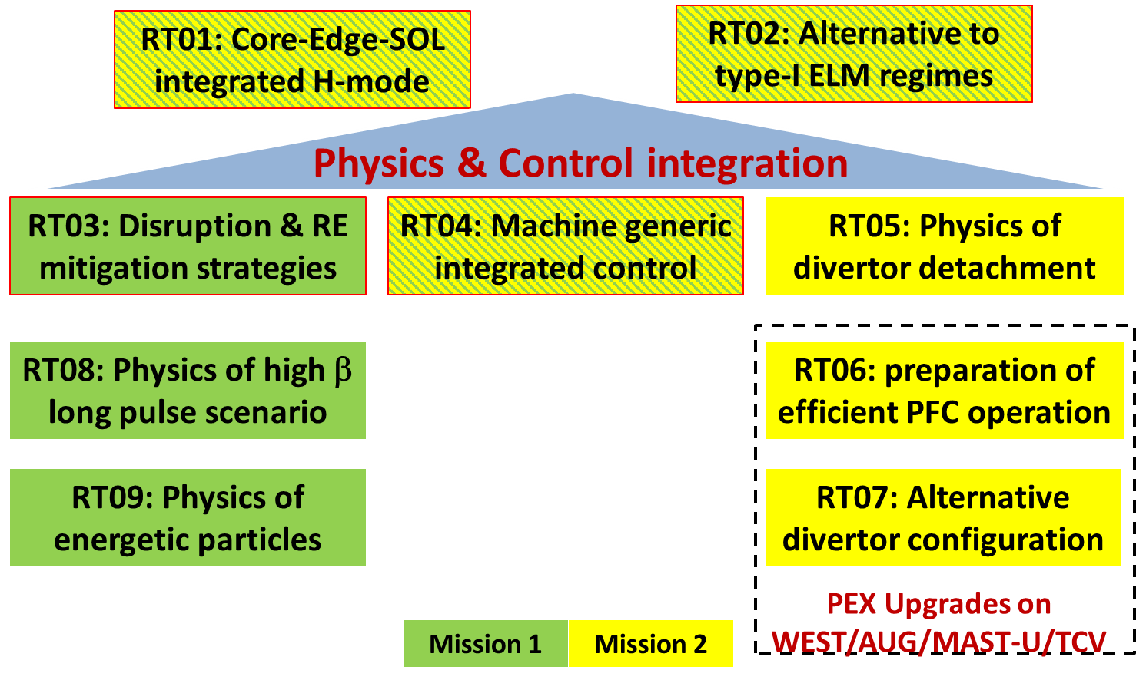
WP TE is organized in 9 programmatic Research Topics
JET RT :
RT10 : JET data validation
RT11 : experiments run before 2023
JT-60SA RT :
RT12 to RT18, reflecting the structure of the EU-JA Experimental Team (RT17 : Divertor, Scrape Off Layer and Plasma-Material Interaction)

Slide 12
2024 and 2025 are closest to nominal year for WP TE

Slide 13
RT-01 : CORE-EDGE-SOL INTEGRATED H-MODE SCENARIO COMPATIBLE WITH EXHAUST CONSTRAINTS IN SUPPORT OF ITER
RT02: PHYSICS UNDERSTANDING OF ALTERNATIVES TO TYPE-I ELM REGIME

Slide 14
RT03: STRATEGIES FOR DISRUPTION AND RUN-AWAY MITIGATION
RT-04: PHYSICS-BASED MACHINE GENERIC SYSTEMS FOR AN INTEGRATED CONTROL OF PLASMA DISCHARGE

Slide 15
RT-05: PHYSICS OF DIVERTOR DETACHMENT AND ITS CONTROL FOR ITER, DEMO AND HELIAS OPERATION
RT-06: PREPARATION OF EFFICIENT PLASMA FACING COMPONENTS (PFC) OPERATION FOR ITER, DEMO AND HELIAS

Slide 16
RT-07: PHYSICS UNDERSTANDING OF ALTERNATIVE DIVERTOR CONFIGURATIONS AS RISK MITIGATION FOR DEMO
RT-08: PHYSICS AND OPERATIONAL BASIS FOR HIGH BETA LONG PULSE SCENARIOS

Slide 17
RT09: PHYSICS UNDERSTANDING OF ENERGETIC PARTICLE CONFINEMENT AND THEIR INTERPLAY WITH THERMAL PLASMA

Slide 18
Total resources required for JT-60SA over 2026-2027
Minimal resources required for sound EU contribution to the JT-60SA scientific exploitation
Rationale :
OP2 : 2 months in 2026, 4 months in 2027
OP3 : 3 months in 2027
Staged approach, with manpower/missions progressive increase during OP2 and OP3
Diagnostics RO assumed to be funded under SA, not included here
Manpower : 20 ppy in 2026, 30 ppy in 2027 (NB : present effort in 2025 = 13 ppy under WP TE)
Missions :
2 months in 2026 with 10 people, 4 months in 2027 with 15 people for OP2
3 months in 2027 with 20 people for OP3
Secondment : 3 seconded staff for 2026 and 2027 (2 TGL, as 1 TGL from UK not accounted for + 1 ETL)
Assumption for calculation of total resources :
Manpower : 82 kEuros average salary / year
Missions : 340 Euros/day
Secondment : 70 kEuros/year
25% indirect cost included for manpower/missions
➔ To be checked with PMU
Total resources (kEuros) | Manpower | Missions | Secondment | Total
2026 | 2050 | 255 | 105 | 2410
2027 | 3075 | 1530 | 105 | 4710
 | 5125 | 1785 | 210 | 7120

Slide 19
TE enhancements projects
Device | Project
AUG | FIRE&GO - Fast Ion Research Enhancements and Gamma-ray Observations [at ASDEX]
 | Ultra-fast-swept profile reflectometer on AUG
 | Direct Digital Synthesis for the O-mode Profile Reflectometer at ASDEX Upgrade
 | Real-time spectroscopy at ASDEX Upgrade
 | Real-time control system for ELM buffering at ASDEX Upgrade
COMPASS-U | Tungsten impurity monitoring and control at the COMPASS-U tokamak
 | Characterization of advanced confinement modes at COMPASS-U
 | PFCs and diagnostics for power exhaust studies at COMPASS-U
MAST-U | Neutron Detectors suite for 14 MeV neutron triton burnup and 2.5 MeV neutron spectroscopy measurements at MAST Upgrade
 | ONCOMING-Optimized taNgentially spaCe resOlved geM ImagiNG [at MAST-U]
TCV | New 100-Hz Laser for the TCV Thomson Scattering System
 | Runaway Electron Mitigation Coil for TCV
 | Upgrade of the TCV LHPI antenna
 | Implementation of the 4th dual-frequency gyrotron for TCV
 | Collective Thomson Scattering (CTS) diagnostic for TCV
 | Runaway electron mitigation and velocity analysis by magnetic-ripple manipulation [at TCV]
 | Upgrade of the TCV ECRH high voltage power supply
WEST | A retarding field analyzer for ion temperature measurements in the SOL of WEST
 | Boronization Probes for WEST
 | LIBS4FUSION: in-vessel fuel Inventory and deposited layers composition in a full tungsten device
 | Fast Ion Loss Detector in WEST
 | IRBO IR Bolometry for WEST
 | High DEfinition Visible Endoscope for WEST
Meeting EUROfusion - the European Commission
February 2025

