Slide 1
Training on the ETS-6 workflow, 16 June 2020
Thomas Jonsson

Slide 2
What is the ETS-6
ETS is the European Transport Simulation
Predicts the evolution of…
1D kinetic plasma profiles (densities, temperatures…)
2D magnetic fields
2D, 3D or 4D fast particle distribution, etc.
It uses the IMAS infrastructure
Code-code communication with IDSs
Kepler workflow
autoGui

Slide 3
The ETS-6 predictions are generated in a time-loop
This graphical view is known as the Kepler Canvas

Slide 4
Convergence Loop
Each time step: Consistency between kinetic profiles and equilibrium is achieved in a convergence loop
Start with equilibrium
Calculate input to transport solver; transport coefficients, MHD, source
Solve transport equation and edge models

Slide 5
Installing dressed ETS-6
The main ETS-6 documentation is on the ITER Physics webpages https://users.euro-fusion.org/iterphysicswiki/index.php/ETS-6_Documentation
Note that the instructions for installing a private version of the ETS-6 are here: https://users.euro-fusion.org/iterphysicswiki/index.php/Setup_for_ETS-6
A dressed Kepler – a Kepler-installation with physics actors included.
Installing a dressed kepler:
Load a kepler module, at present: kepler/2.5p5-3.1.1_dressed_3.28.1
Create an installation with: kepler_install NAME
Load installation: kepler_load NAME
NOTE: you have to run kepler_load in every new window!
Check available installations: “kepler_avail”
Fetch the ETS-6 workflow svn checkout https://gforge6.eufus.eu/svn/keplerworkflows/trunk/imas/ETS ETSwf

Slide 6
Running the ETS-6
The workflow ETS6.xml is in the ETSwf directory (created on prev. page)
The ETS6.xml is executed using kepler. Three way to start ETS6.xml:
One option is to start kepler with the command > kepler and then load the workflow – click File, then Open….
Or you execute the command > kepler `pwd`/ETS6.wf
A third option is to use the autoGui > autoGui and then load the workflow – click “Load Workflow” …
We’ll now go though how to set up a run in the autoGui…
Temporarily (waiting for an official release): > ~g2tjohns/public/autoGui.py

Slide 7
Setting up and running the ETS-6
In the coming slides there is an overview of how to set up an ETS-6 simulation in the autoGui.
There’s also a tutorial on how to set up an interpretative simulation for TCV: https://users.euro-fusion.org/iterphysicswiki/index.php/Designing_an_ETS-6_simulation_for_TCV_shot_66565

Slide 8
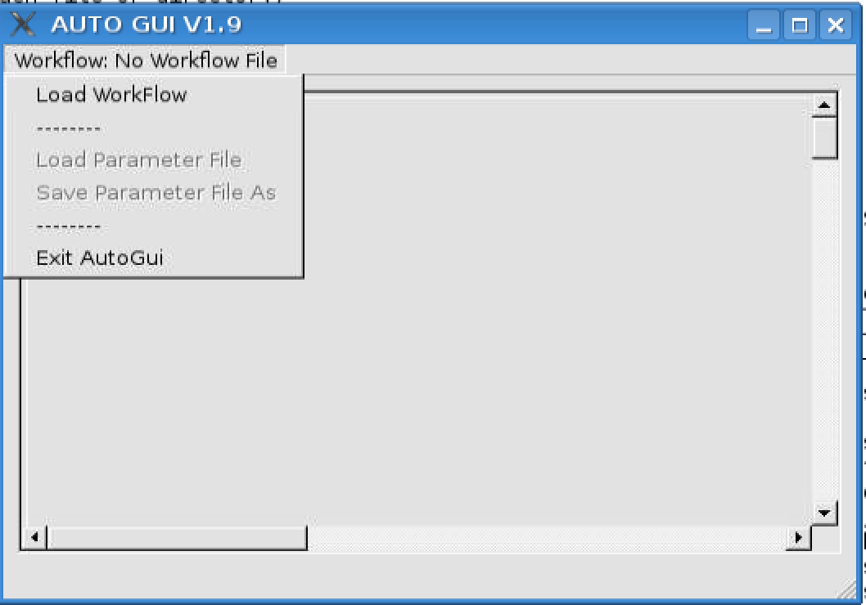
Load the workflow
In the autoGui you load a workflow by selecting “Load Workflow”
Then find the path to the ETS6.xml workflow.
NOTE: The autoGui design is documented here.

Slide 9
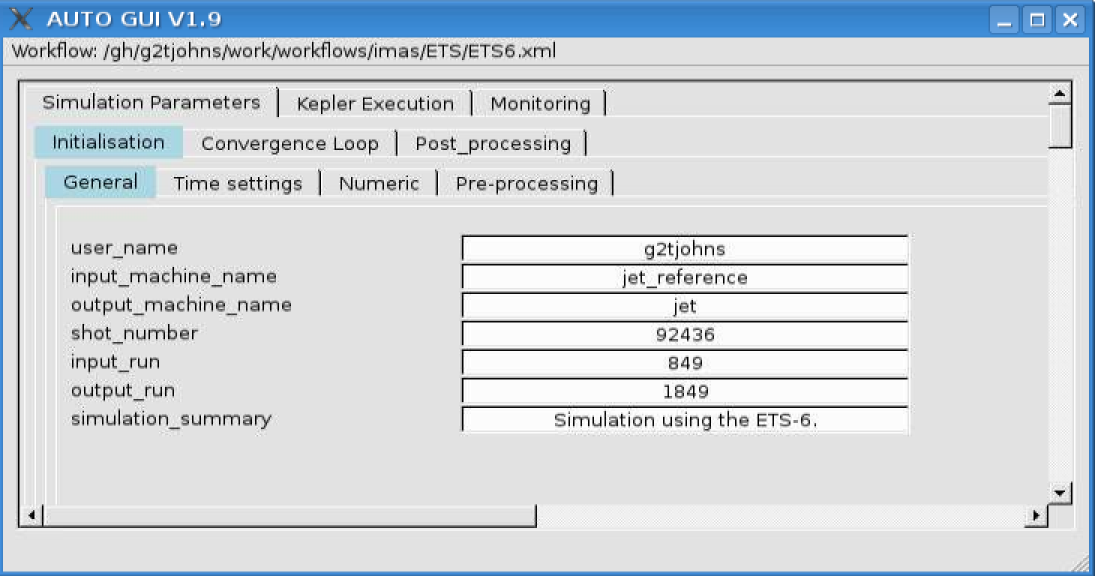
autoGui panels: Initialisation/General

Slide 10
autoGui panels: Initialisation/Time settings

Slide 11
autoGui panels: Initialisation/Numerics

Slide 12
autoGui panels: Initialisation/Pre processing

Slide 13
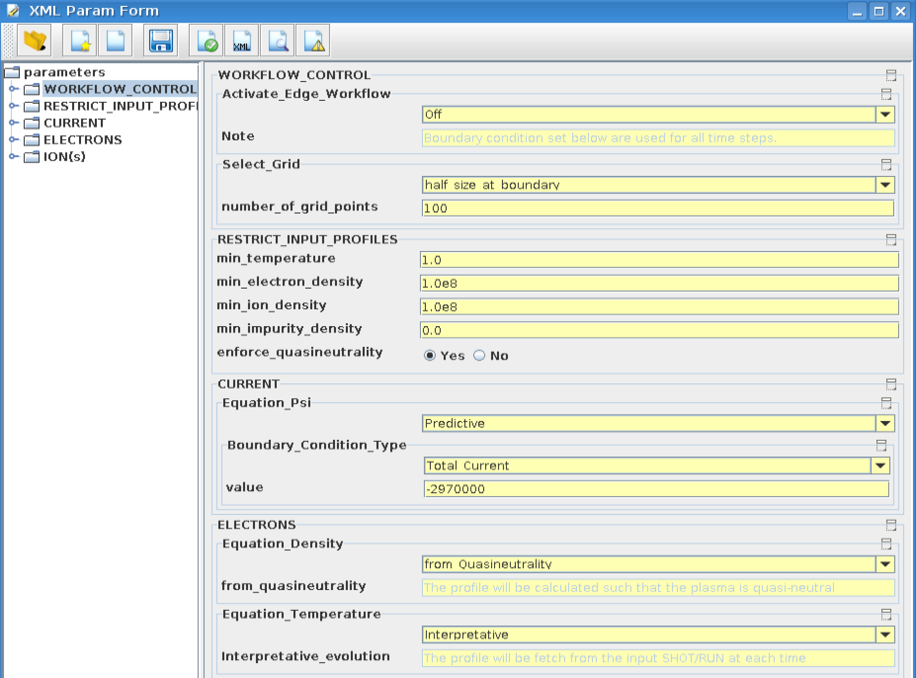
Code parameters for ETS-init, page 1

Slide 14
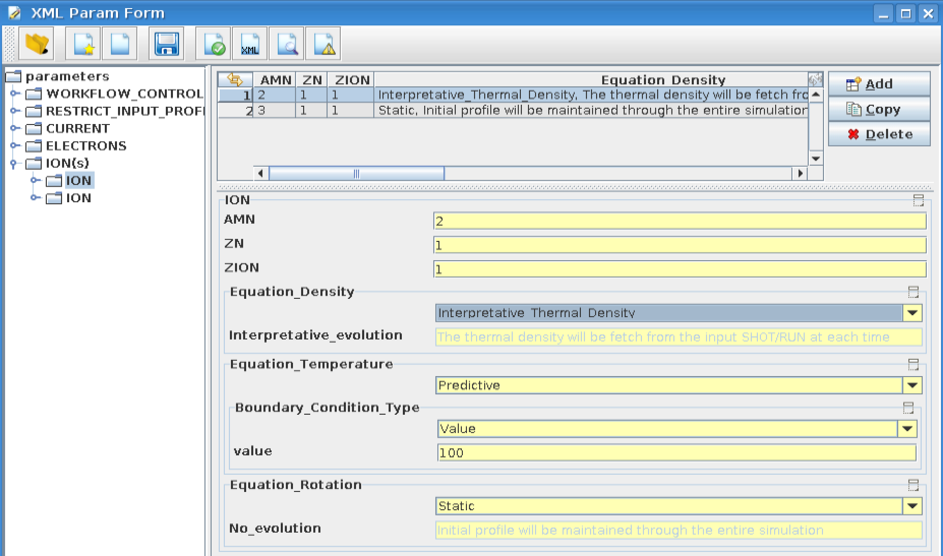
Code parameters for ETS-init, page 2

Slide 15
Code parameters for ETS-init, page 3

Slide 16
Code Parameters for eqinput

Slide 17
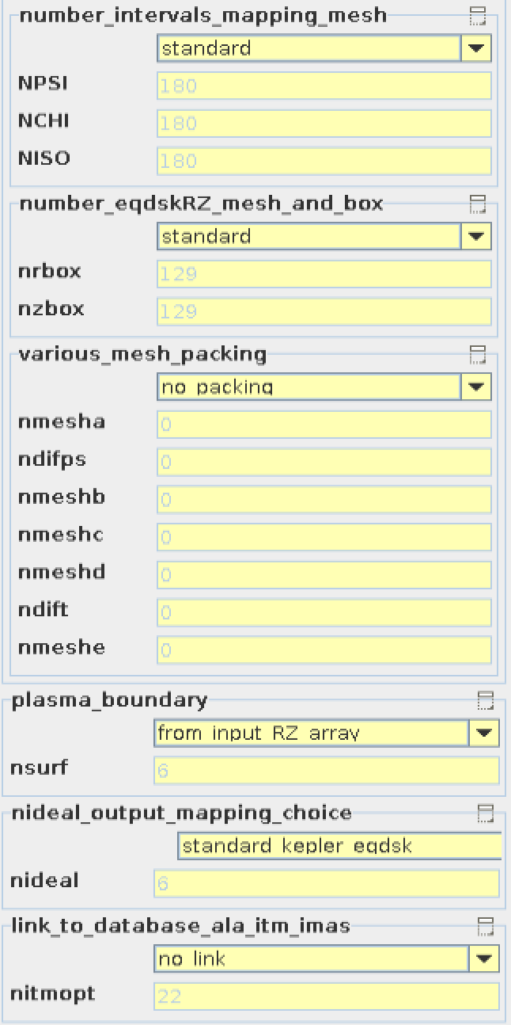
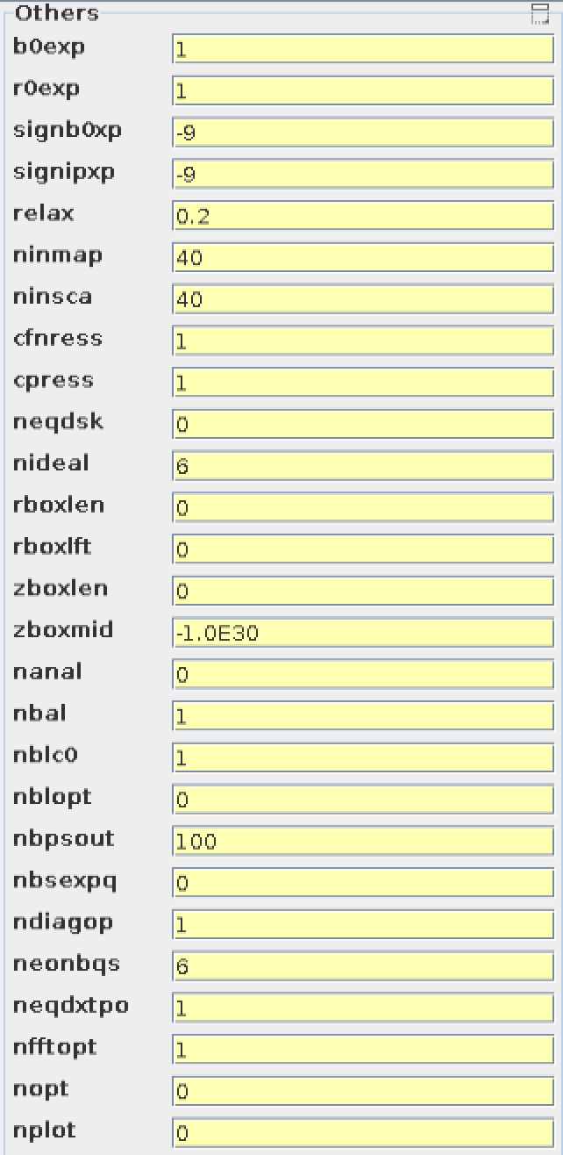
Code parameter for CHEASE, page 1

Slide 18
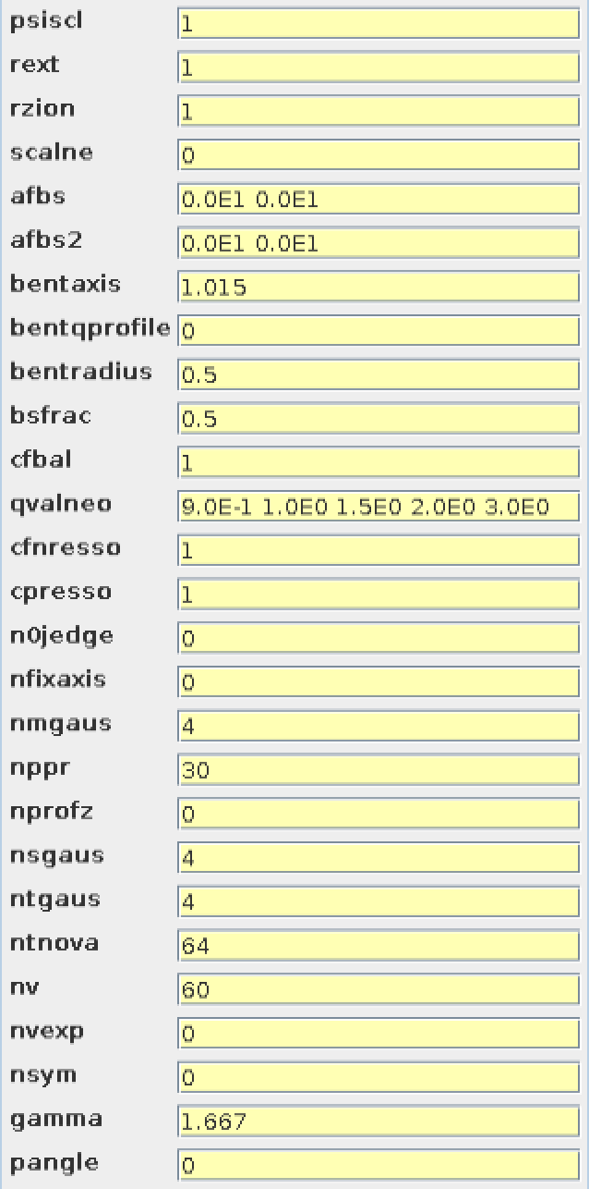
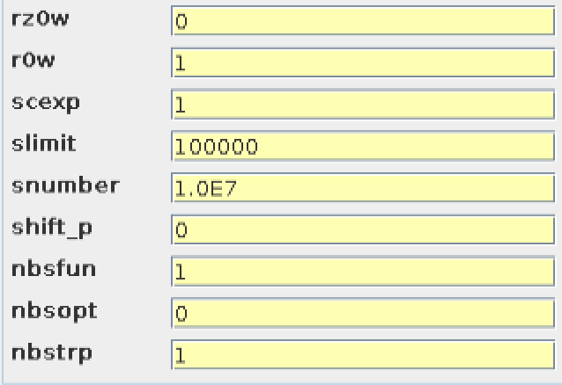
Code parameter for CHEASE, page 2

Slide 19
Convergence Loop / General

Slide 20
Convergence Loop / Transport

Slide 21
Convergence Loop / Equilibrium

Slide 22
Convergence Loop / Sources / General

Slide 23
Convergence Loop / Sources / ECRH

Slide 24
Convergence Loop / Sources / ICRH

Slide 25
Convergence Loop / Sources / NBI and nuclear

Slide 26
Convergence Loop / Sources / HCD sources and profiles

Slide 27
Convergence Loop / Sources / Runaway

Slide 28
Convergence Loop / Edge

Slide 29
Kepler Execution

Slide 30
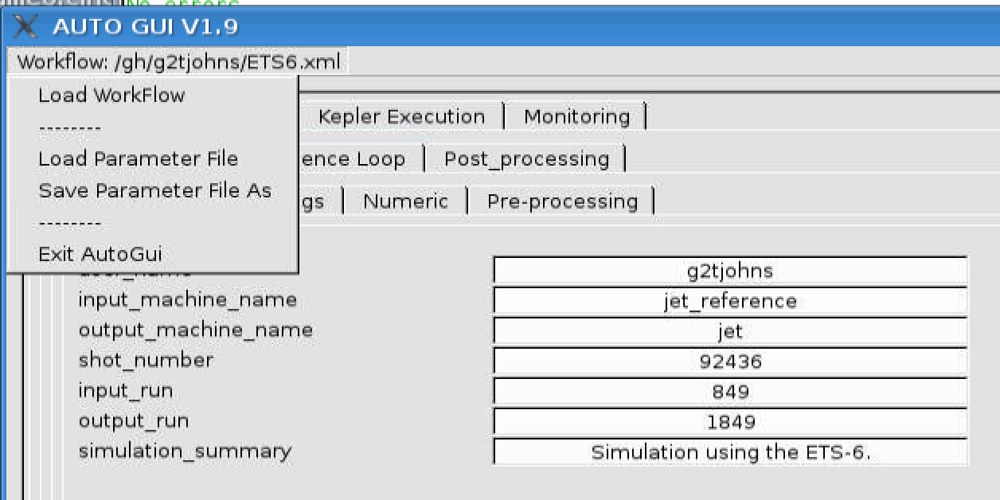
Loading and saving parameter files!
All parameters prepared in the autoGui can be saved to a “param” file
“param-files” can be loaded in either the autoGui, the Kepler canvas, or used to run Kepler from the command prompt

Slide 31
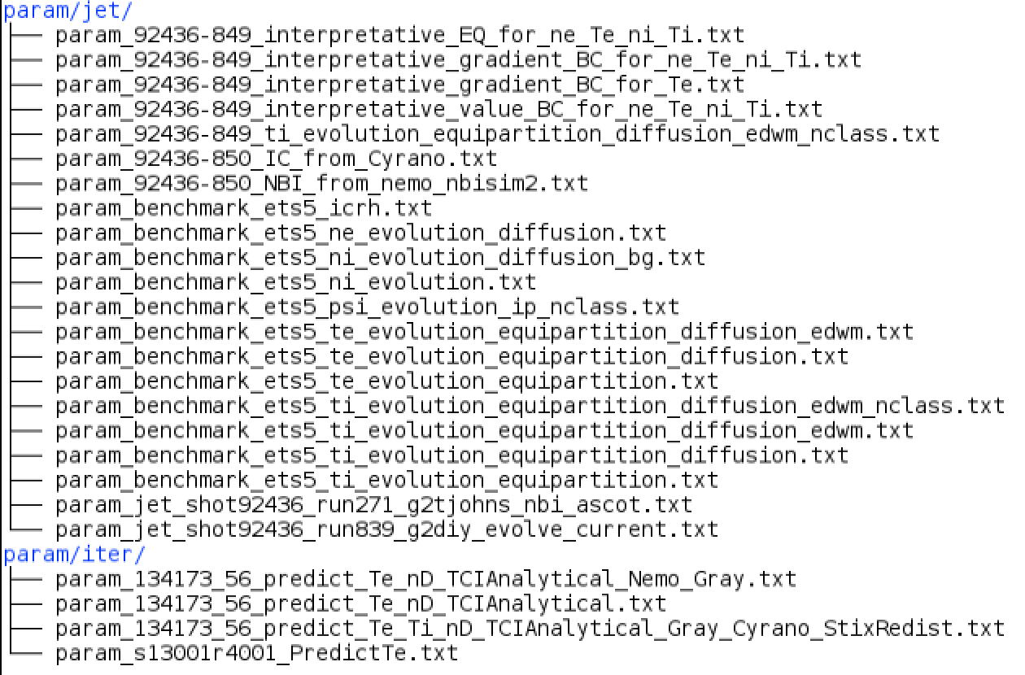
Saved param files for ETS-6
Folder ETSwf/ created on page 1

Slide 32
Regression testing
Run script > run_test.sh
Verify the result > cd kplots > ./cmp_test.py

Slide 33
Transport equations: Execution mode and BCs
Execution mode:
Static – keep initial profiles throughout the simulation (taken from input IDSs)
Interpretative – read profiles from input IDSs at each time step
Predictive – solve the transport equation
Boundary conditions
Value: set a fixed value as the boundary condition for the entire simulation
Gradient: set a fixed value for the gradient value as the boundary condition for the entire simulation
…
Interpretative-value: Read the value at the boundary from input IDSs at each time step
Interpretative-gradient: Read the gradient at the boundary from input IDSs at each time step
…
NOTE: For interpretative modes the data is fetch from the input IDS using actor, “database_*”. Many of these have code-parameters to help you do nice things!

