Slide 1
HEXOS Upgrade: Modernizing W7-X VUV Spectroscopy
B. Buttenschön – RO HEXOS

Slide 2
Reminder: HEX…who?
HEXOS = High Efficiency EUV/XUV Overview Spectrometer
4 channels operated as one spectrometer
built ~2004-2008 with FZ Jülich and Horiba Jobin Yvon specifically for W7-X
part of W7-X diagnostics since OP1.1

Slide 3
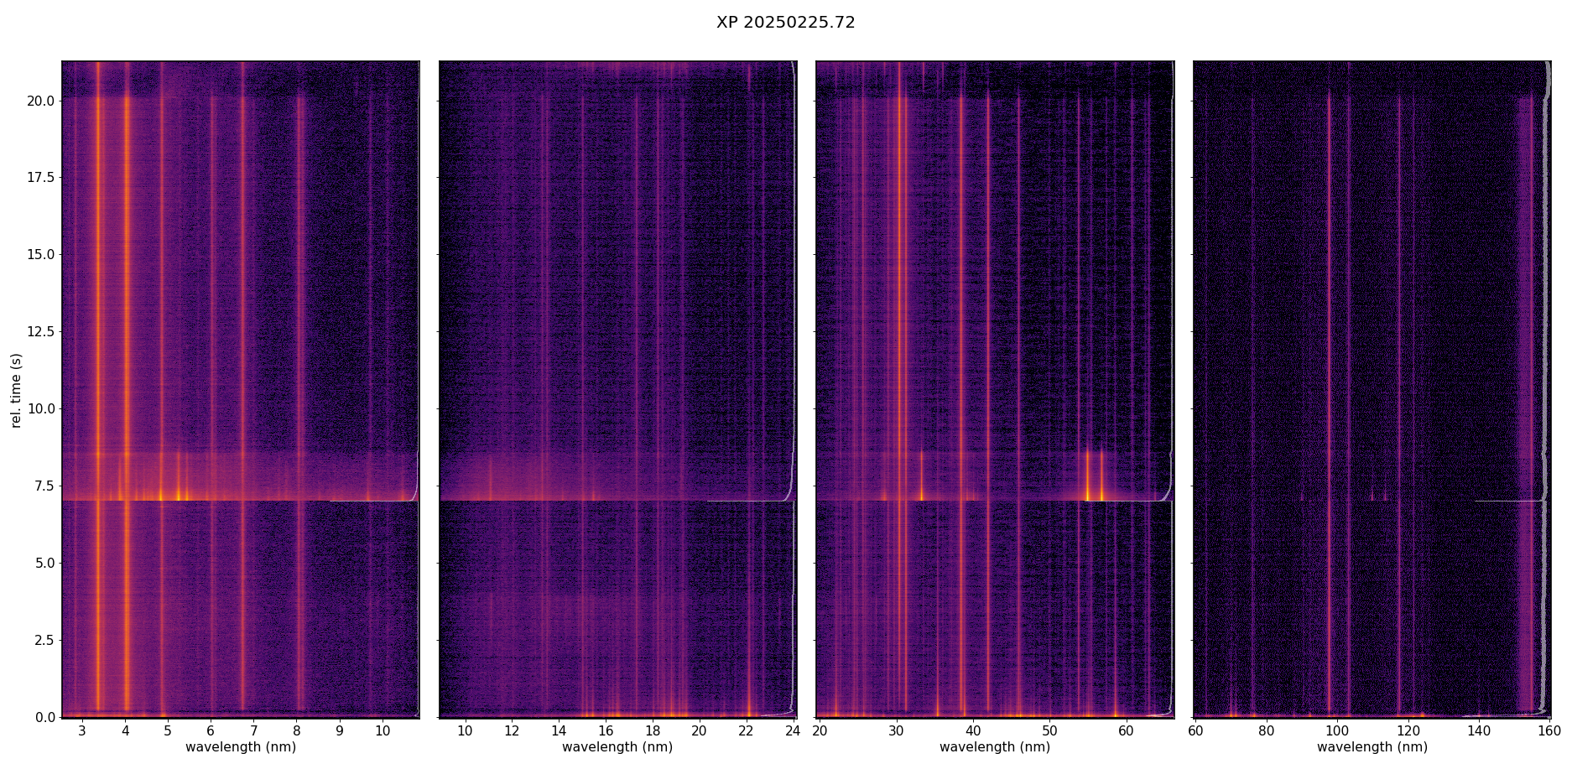
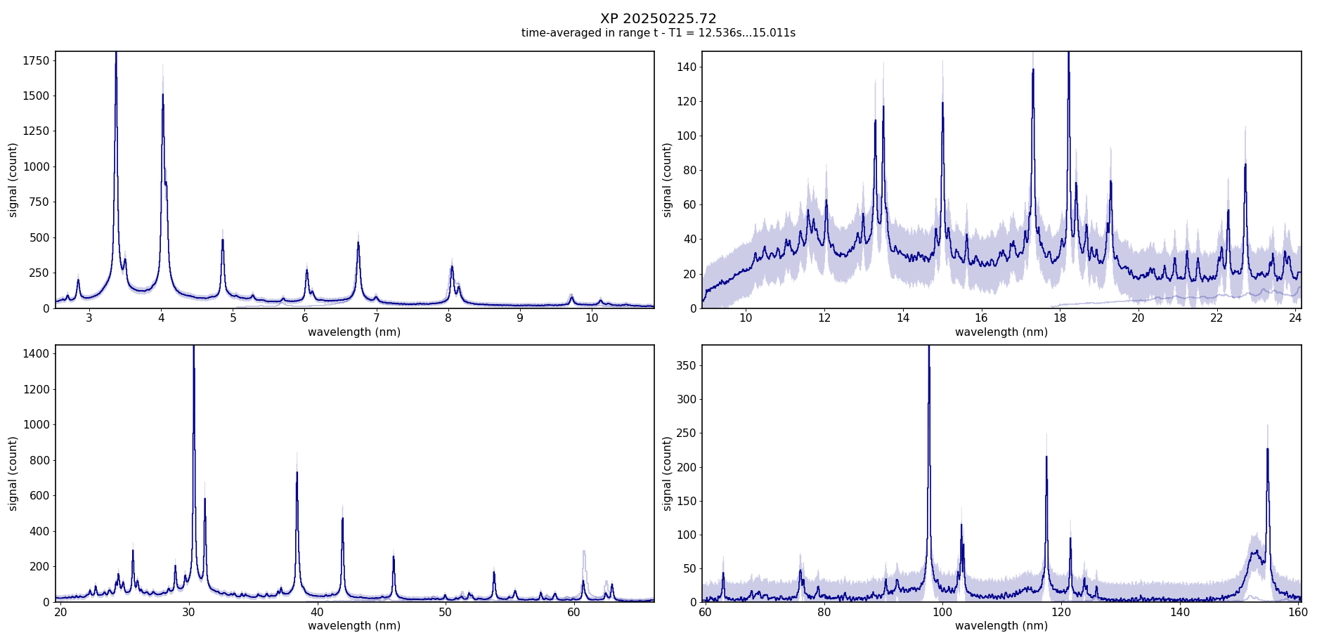
Reminder: HEX…who?
HEXOS = High Efficiency EUV/XUV Overview Spectrometer
4 channels operated as one spectrometer
built ~2004-2008 with FZ Jülich and Horiba Jobin Yvon specifically for W7-X
part of W7-X diagnostics since OP1.1
currently single VUV spectrometer at W7-X
used for
transport analysis with injected impurities
continuous monitoring of intrinsic impurities (B, C, N, O, Ti, Fe, Cu, W)

Slide 4
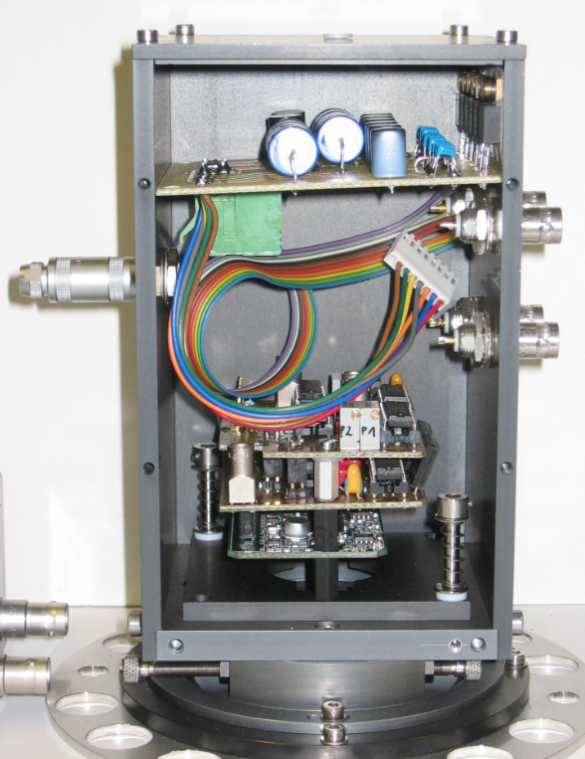
Technical Properties – current status
1000 full spectra/s
2.5nm … 160nm wavelength range in 4 channels (500eV … 7.5eV energy range)
detectors: micro-channel plates, CsI coated (work function ~7eV) + FZJ-developed camera

Slide 5
Technical Properties – current status
1000 full spectra/s
2.5nm … 160nm wavelength range in 4 channels (500eV … 7.5eV energy range)
detectors: micro-channel plates, CsI coated (work function ~7eV) + FZJ-developed camera
VUV → no optical elements except toroidal holographic diffraction gratings

Slide 6
Technical Properties – current status
1000 full spectra/s
2.5nm … 160nm wavelength range in 4 channels (500eV … 7.5eV energy range)
detectors: micro-channel plates, CsI coated (work function ~7eV) + FZJ-developed camera
VUV → no optical elements except toroidal holographic diffraction gratings
MCPs → multi-layered detector set-up

Slide 7
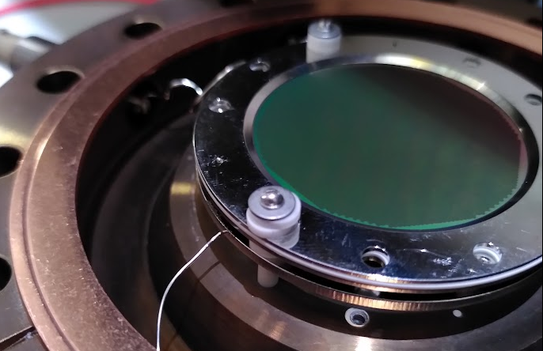
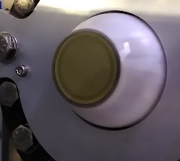
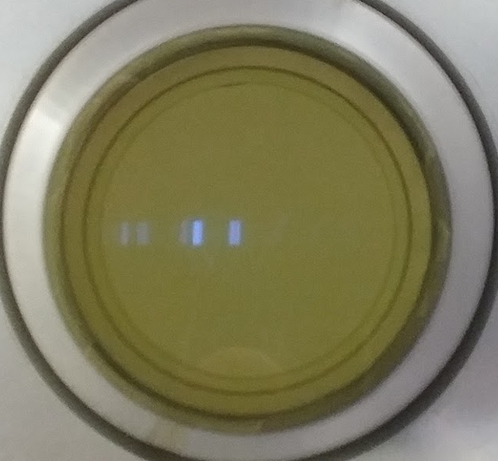
Technical Properties – current status
detector stack
CsI coated MCP, 55% open area
10µm holes at 12µm spacing
gain up to 10.000
active diameter ~40mm
P47 phosphor screen and fiber-optic taper 40mm → 25mm
NMOS line array 1024px with 2.5mm x 25µm pixel size (25.6mm active width)

Slide 8
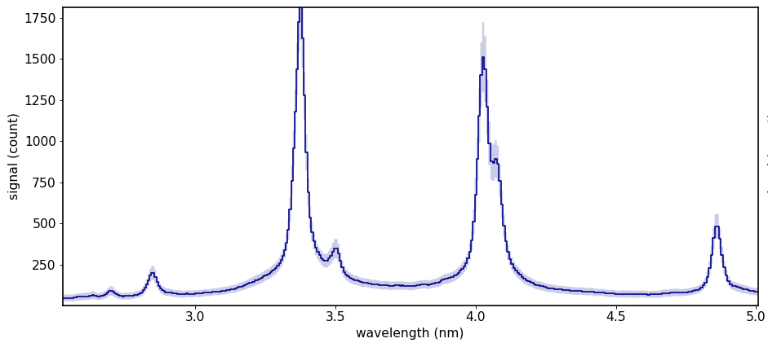
Technical Properties – challenges
detector stack
CsI coated MCP, 55% open area
10µm holes at 12µm spacing
gain up to 10.000
active diameter ~40mm
P47 phosphor screen and fiber-optic taper 40mm → 25mm
NMOS line array 1024px with 2.5mm x 25µm pixel size (25.6mm active width)
challenges
extremely broad wings in line shape → problematic to identify/evaluate overlapping lines. → → Typical for MCPs.

Slide 9
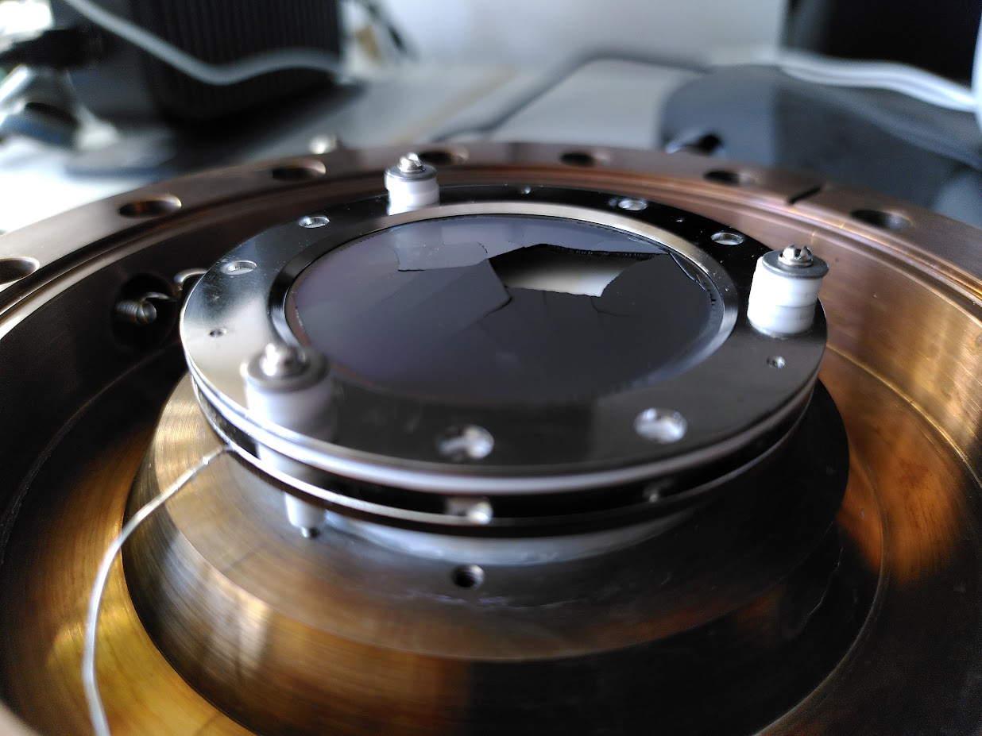
Technical Properties – challenges
detector stack
CsI coated MCP, 55% open area
10µm holes at 12µm spacing
gain up to 10.000
active diameter ~40mm
P47 phosphor screen and fiber-optic taper 40mm → 25mm
NMOS line array 1024px with 2.5mm x 25µm pixel size (25.6mm active width)
challenges
extremely broad wings in line shape
easily damaged by humidity

Slide 10
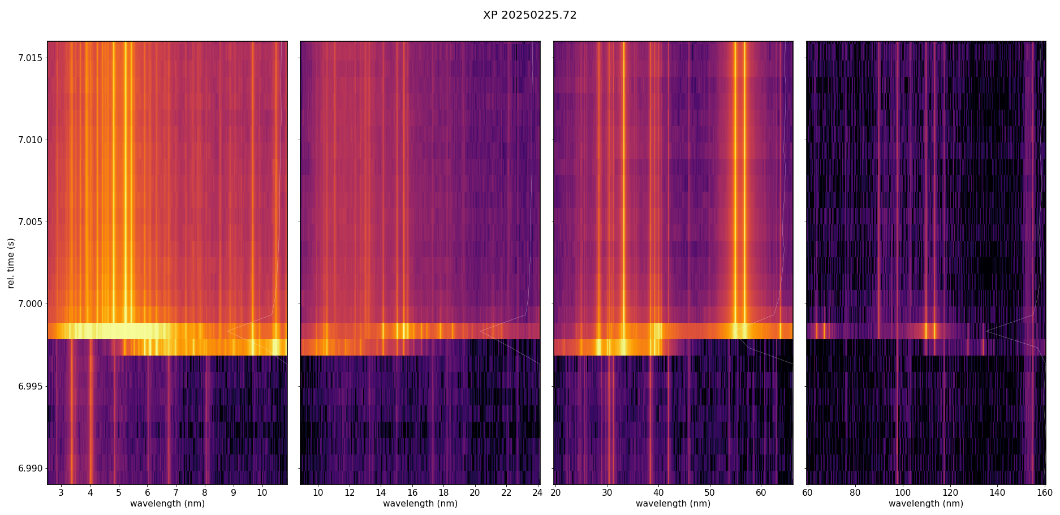
Technical Properties – challenges
detector stack
CsI coated MCP, 55% open area
10µm holes at 12µm spacing
gain up to 10.000
active diameter ~40mm
P47 phosphor screen and fiber-optic taper 40mm → 25mm
NMOS line array 1024px with 2.5mm x 25µm pixel size (25.6mm active width)
challenges
extremely broad wings in line shape
easily damaged by humidity
time resolution “barely sufficient”
20250222.72 Al TESPEL
readout direction

Slide 11
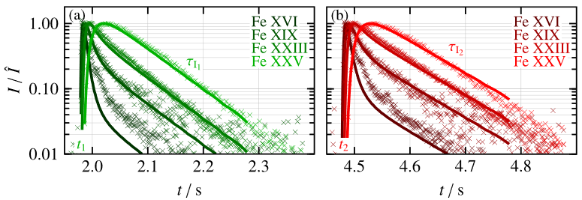
Technical Properties – challenges
detector stack
CsI coated MCP, 55% open area
10µm holes at 12µm spacing
gain up to 10.000
active diameter ~40mm
P47 phosphor screen and fiber-optic taper 40mm → 25mm
NMOS line array 1024px with 2.5mm x 25µm pixel size (25.6mm active width)
challenges
extremely broad wings in line shape
easily damaged by humidity
time resolution “barely sufficient”
[ Th. Wegner et al., Nucl. Fusion 60, 124004 (2020) ]

Slide 12
Motivation for Upgrade
technical
avoid occasional detector destruction by accidental flooding with air, vacuum system failures, remaining humidity in N2 supply …
overcome changing spectrometer sensitivity due to aging of the MCPs → less sensitivity calibrations → better accuracy of absolute signals
scientific
decrease analysis complexity by decreasing line width → more accurate time traces of line signals in ArchiveDB → better availability of absolute signals
(potentially) increase time resolution → better coverage of low…mid ionization states of injected impurities and thus better estimation of transport properties → better resolution of edge fluctuations

Slide 13
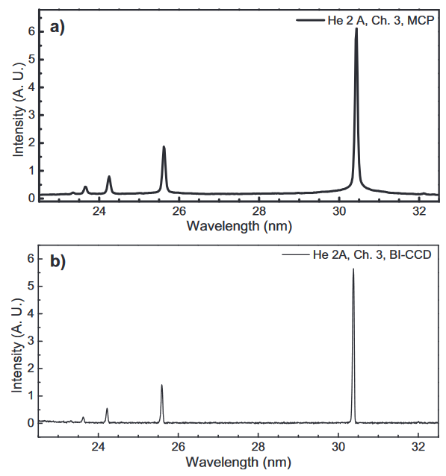
HEXOS Upgrade
KSTAR, ITER VUV Spectrometer Prototype
MCPs disregarded as detectors in ITER prototype at KSTAR in favor of CCDs [ Y.H. An et al., Fus. Eng. Des. 175 112992 (2022) ]
MCPs replaced by CCDs at AUG [ R. Dux, private communication (2023-2025) ]
CCDs used as VUV detectors at EAST [ L. Zhang, Rev. Sci. Instrum. 86, 123509 (2015) ]
W7-X VUV spectroscopy will be migrated away from MCPs now!
[ C.R. Seon et al., Rev. Sci. Instrum. 81, 10E508 (2010) ]

Slide 14
HEXOS Upgrade: Expected Cost
HEXOS Upgrade Planning
RSR held on April 17, 2024
generally agreed on
new vacuum system (failing components) ……
improvement of optical properties
new detectors ………………………………….
matching gratings ……………………………..
124.000 € total, incl. PLC changes
25.000 € per piece (x 4) 150.000 € per piece (x 4) 15.000 € for structural changes ------------- 839.000 € total expected investment

Slide 15
HEXOS Upgrade: Status
HEXOS Upgrade
vacuum system (pumps + pressure gauges)
new detectors (CCD / ?) ……………………….
new gratings ……………………………………..
✔ delivered Feb 2025, total cost ~75.000 € - PLC programming ongoing (CoDaC) - electrical planning ongoing / complete
✘ on hold
✔ ordered Jan 2025, expected cost ~607.000 € - production on hold, waiting for exact specification of detector geometry

Slide 16
HEXOS Upgrade: choice of detector … based on my market research
Andor Newton 940DP (CCD)
2048 x 512 pixels
13.5µm pixel size 26.7mm x 6.9mm image area
943 full spectra / second (20 rows crop) up to 1100 full spectra / second pushing the camera to the edge
Andor Marana-X-11 (sCMOS)
2048 x 2048 pixels
11 x 11µm pixel size 22.5mm x 22.5mm image area
≫1000 full spectra / second e.g. 5400 full spectra using 8 rows

Slide 17
HEXOS Upgrade: choice of detector … based on my market research
Andor Newton 940DP (CCD)
2048 x 512 pixels
13.5µm pixel size 26.7mm x 6.9mm image area
943 full spectra / second (20 rows crop) up to 1100 full spectra / second pushing the camera to the edge
22.500 € per piece 90.000 € total (4 channels)
Andor Marana-X-11 (sCMOS)
2048 x 2048 pixels
11 x 11µm pixel size 22.5mm x 22.5mm image area
≫1000 full spectra / second e.g. 5400 full spectra using 8 rows
63.900 € per piece 255.600 € total (4 channels)

Slide 18
HEXOS Upgrade: choice of detector … based on my market research
Andor Newton 940DP (CCD)
2048 x 512 pixels
13.5µm pixel size 26.7mm x 6.9mm image area
943 full spectra / second (20 rows crop) up to 1100 full spectra / second pushing the camera to the edge
22.500 € per piece 90.000 € total (4 channels)
Andor Marana-X-11 (sCMOS)
2048 x 2048 pixels
11 x 11µm pixel size 22.5mm x 22.5mm image area
≫1000 full spectra / second e.g. 5400 full spectra using 8 rows
63.900 € per piece 255.600 € total (4 channels)

Slide 19
HEXOS Upgrade: choice of detector … based on my market research
Andor Newton 940DP (CCD)
2048 x 512 pixels
13.5µm pixel size 26.7mm x 6.9mm image area
943 full spectra / second (20 rows crop) up to 1100 full spectra / second pushing the camera to the edge
22.500 € per piece 90.000 € total (4 channels)
will probably do the job
Andor Marana-X-11 (sCMOS)
2048 x 2048 pixels
11 x 11µm pixel size 22.5mm x 22.5mm image area
≫1000 full spectra / second e.g. 5400 full spectra using 8 rows
63.900 € per piece 255.600 € total (4 channels)
much more headroom

Slide 20
HEXOS Upgrade - Summary
HEXOS is being upgraded and modernized!
new vacuum system for better availability / reliability
new detectors for
better availability / lower risk of failure
better wavelength resolution → higher accuracy of any analysis
better time resolution → higher accuracy of transport investigations → access to fast(er) fluctuations in the plasma edge
new gratings tailored to the selected sensor’s geometry
CCD: known technology, no speed improvements, budget ok
sCMOS: not yet tested in VUV applications, potentially massive speed improvement, budget might require increase by ~150.000€

Slide 21
HEXOS Upgrade - Summary
HEXOS is being upgraded and modernized!
new vacuum system for better availability / reliability
new detectors for
better availability / lower risk of failure
better wavelength resolution → higher accuracy of any analysis
better time resolution → higher accuracy of transport investigations → access to fast(er) fluctuations in the plasma edge
new gratings tailored to the selected sensor’s geometry
CCD: known technology, no speed improvements, budget ok
sCMOS: not yet tested in VUV applications, potentially massive speed improvement, budget might require increase by ~150.000€

