Slide 1
TSVV 5 27.02.2025 Eirene compute time changes in ITER burning plasma vs 20 MW pure H scenarios
Srikanth SURESHKUMAR (CEA) P. TAMAIN (CEA IRFM), N. RIVALS(CEA), Y. MARANDET(CNRS, Aix-Marseille Université), X. BONNIN (ITER Organization), H. BUFFERAND (CEA IRFM), R.A. PITTS (ITER Organization), G. FALCHETTO (CEA IRFM), H. YANG (CEA IRFM), G. CIRAOLO (CEA IRFM)

Slide 2
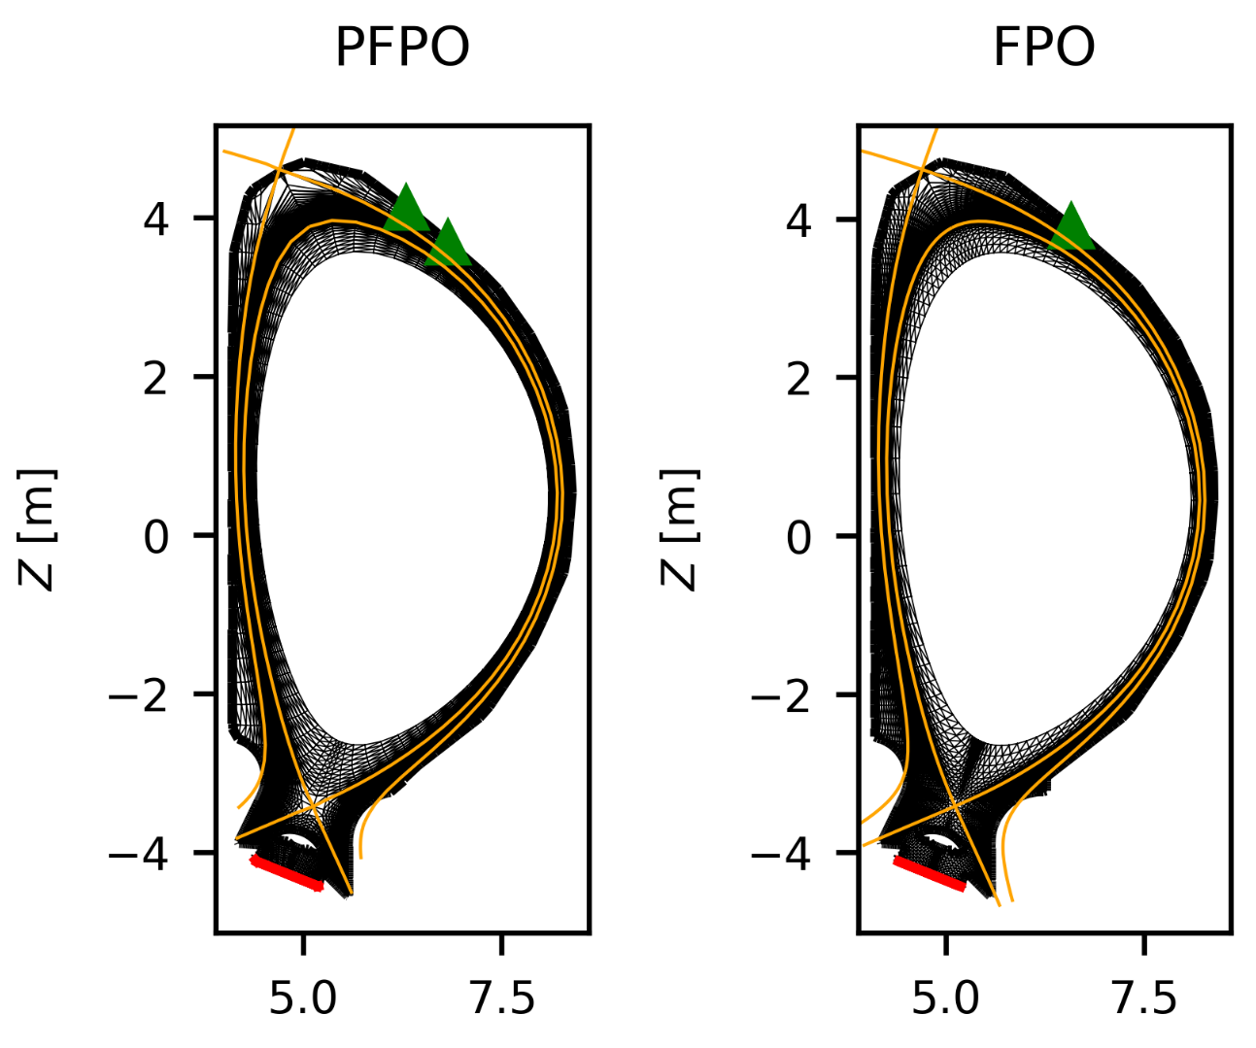
Scenarios discussed – ITER burning plasma and 20MW pure H with SOLEDGE3X-Eirene
SOLEDGE3X is coupled to Eirene in time independent mode.
Eirene version used is from ~ Dec 2020
Eirene is called at every iteration and plasma is run until steady state wrt. particle balace – “convergence” measured by a metric
Convergene metric = $\frac{Γ_{in}−Γ_{out}}{Γ_{in}}$
Two scenarios discussed – $P_{SOL}$ = 20 MW pure H (previously PFPO) and $P_{SOL}$= 100 MW D + Be + He (sometimes called FPO)
FPO – plasma has an H mode transport barrier, Ne and D puff from the top port. PFPO – L mode, only H from two gas puffs at the top port.
No of Eirene particles per strata:
FPO – 20,000 particles (8 strata)
PFPO – 45,000 particles (4 strata)
Eirene run with Kotov model and neutral-neutral collisons turned on.
Perfectly reflecting W walls: R=1.0
Gas Puffs
Pump: R= 0.9928

Slide 3
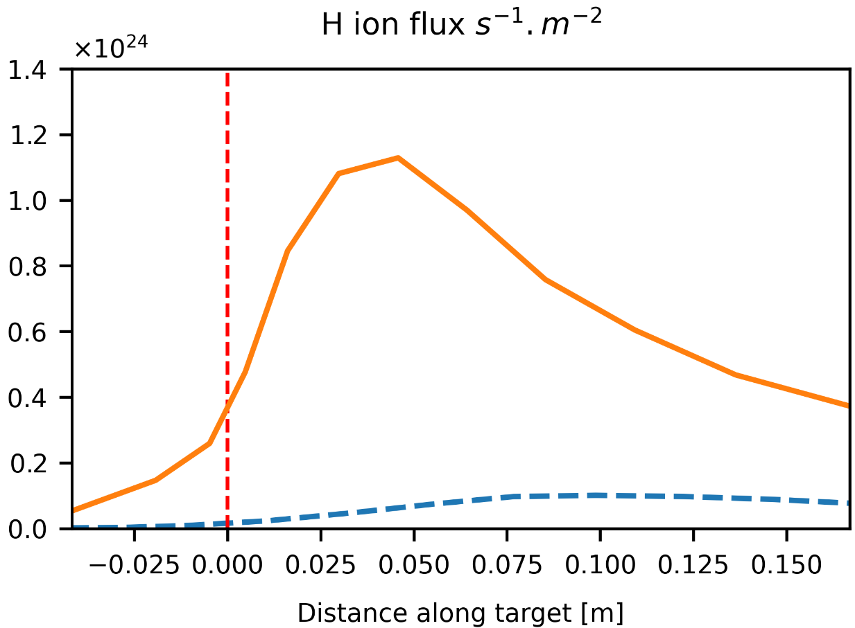
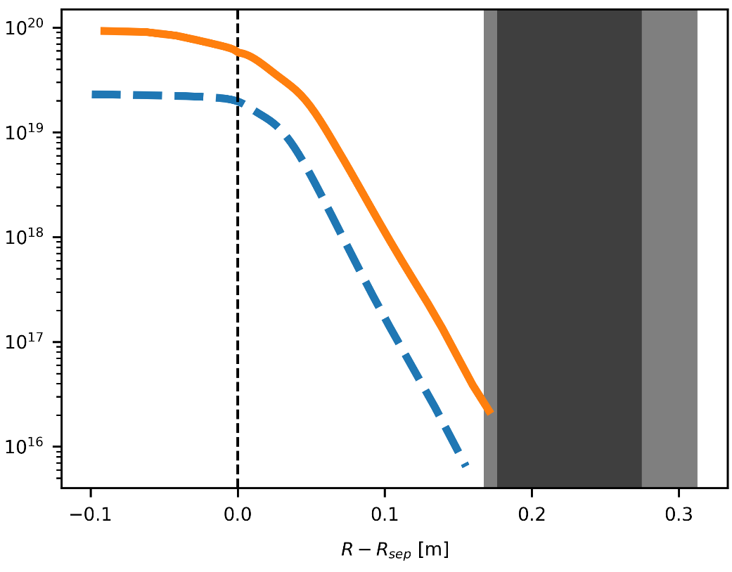
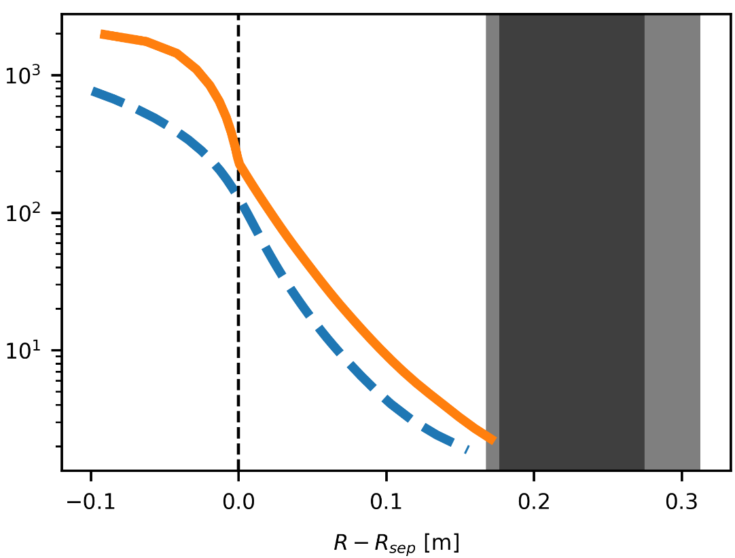
Plasma Conditions–PFPO vs FPO
PFPO
FPO
Compared cases –
20 MW, H : H throughput = $1.76×{10}^{23}s^{−1}$ (#102308 eq.), large density for typical PFPO
100 MW, D+Ne+He: D throughput = $1.95×{10}^{23}s^{−1}$, Ne seeding rate = $5.0×{10}^{19}s^{−1}$ (123010 eq.)
High density cases take the longest to converge in PFPO
$n_{H,D}$ outer Mid-plane [$m^{−3}$]
$T_{e}$ outer Mid-plane [eV]
Outer Strike Point – H,D flux

Slide 4
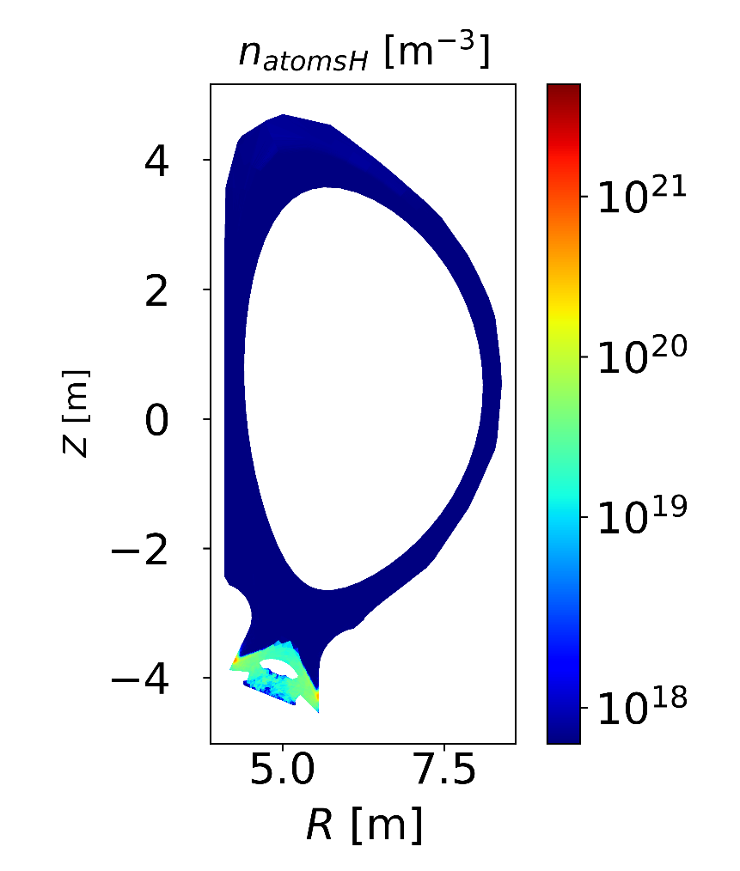
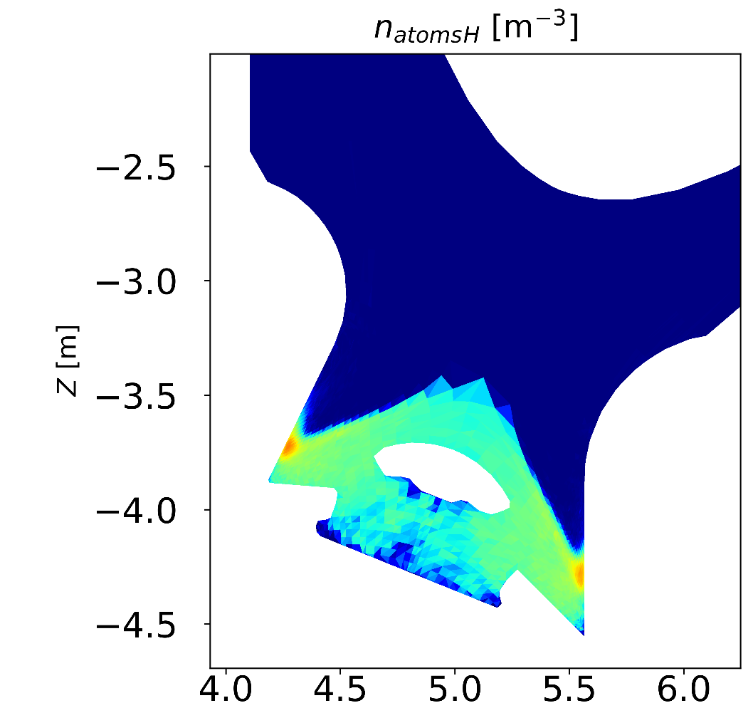
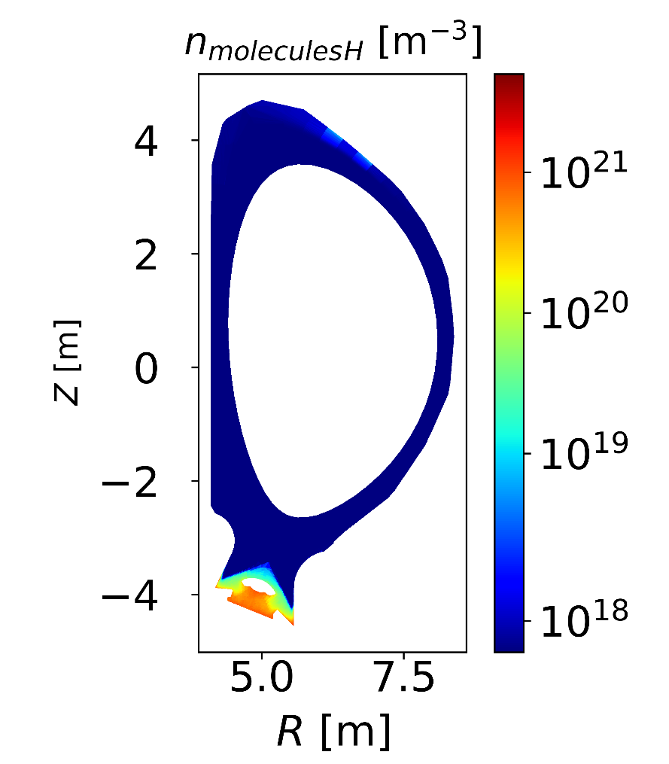
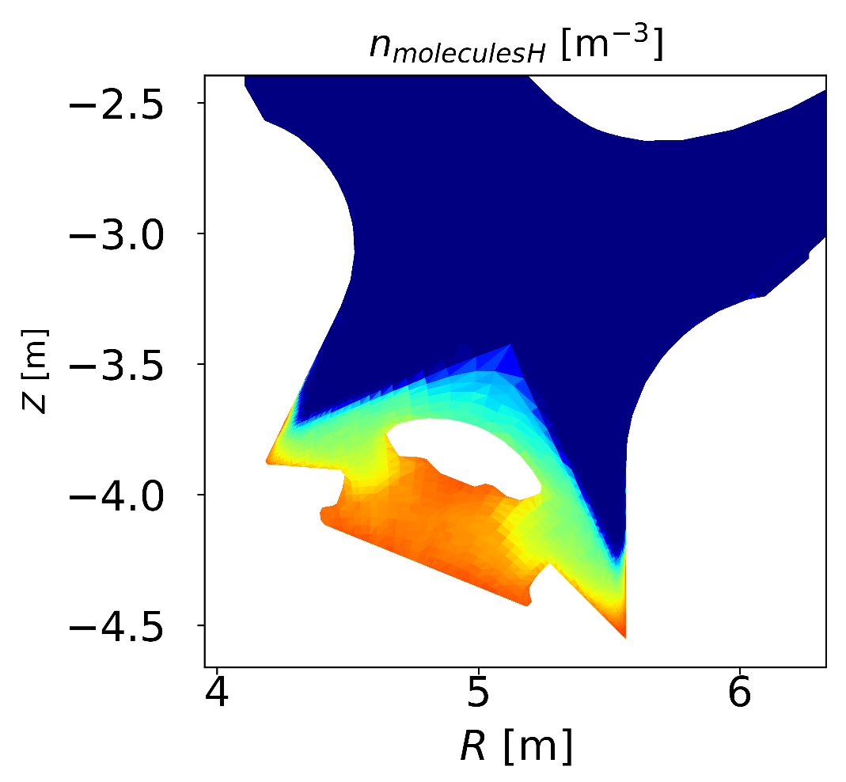
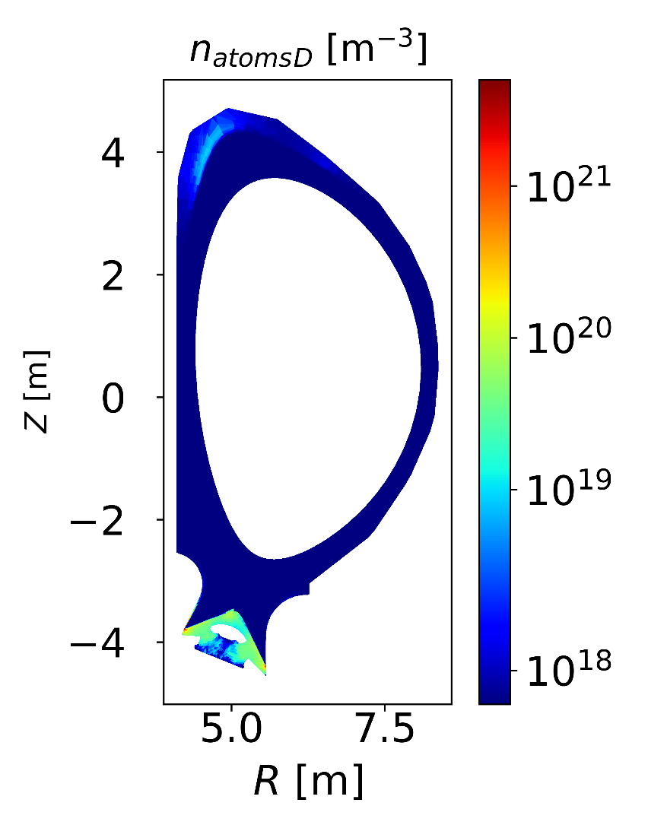
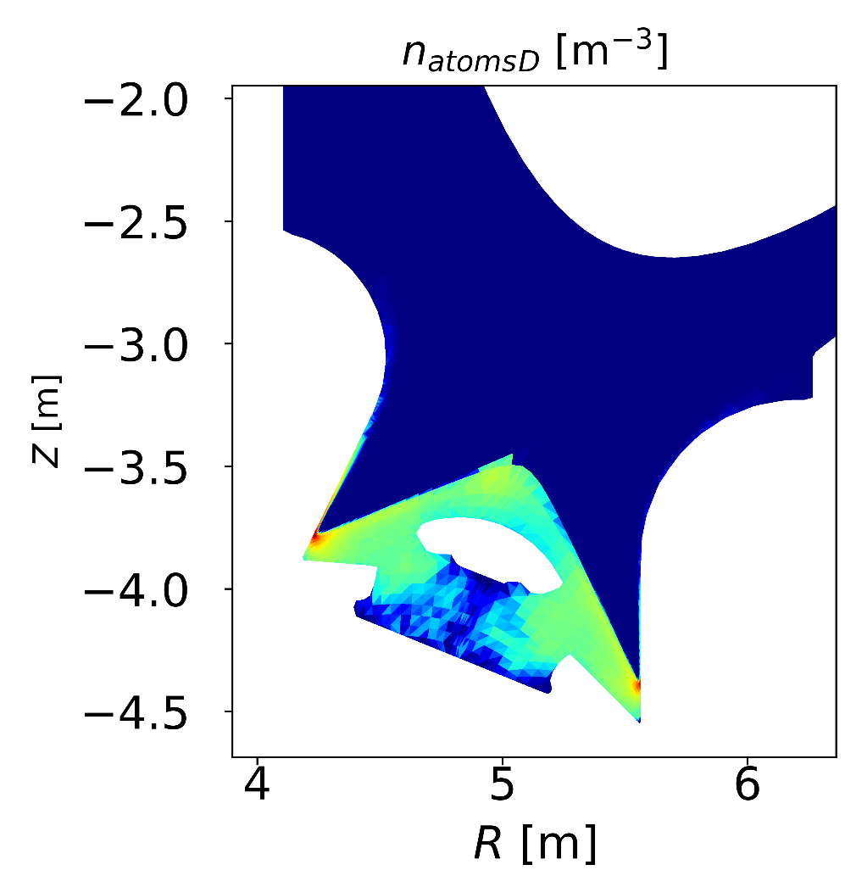
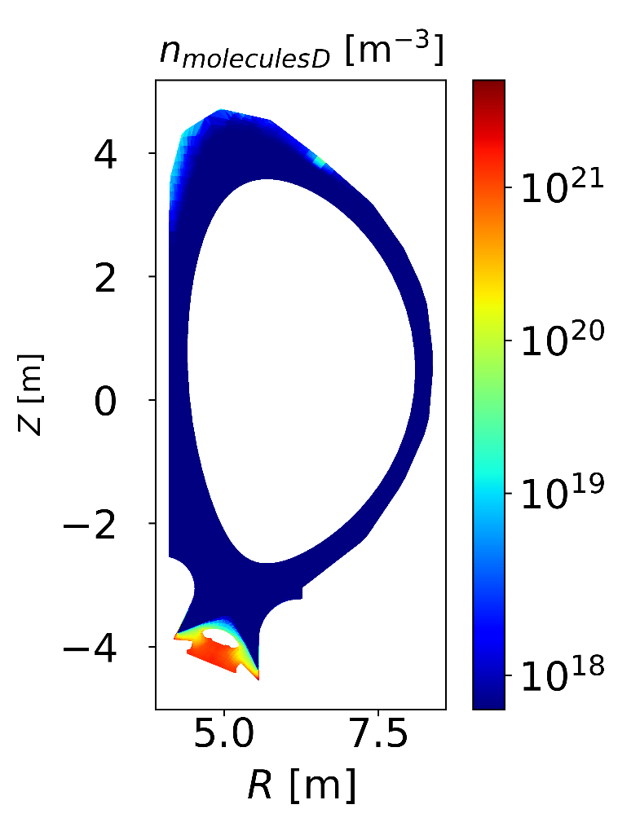
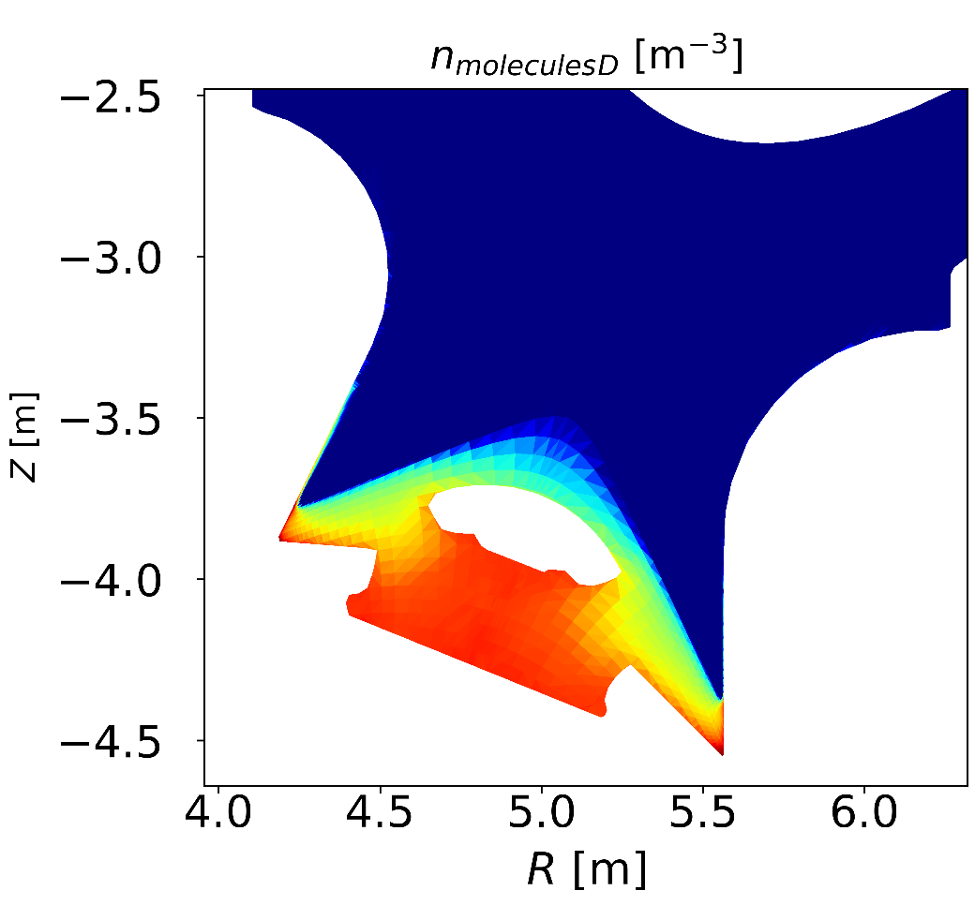
Neutral Conditions– PFPO vs FPO
$H_{2}$ / $D_{2}$ molecule density
H / D atom density
PFPO
FPO

Slide 5
Longer time per iteration in FPO for simillar number of total Eirene particles
Most of the total time taken per iteration is Eirene (95% in FPO and 94% in PFPO)
Run times in 1 node of ITER SDCC gen 11 partition (56 cores per node)
FPO: $N_{part/strata}^{EIR}=20,000, N_{stra}=8 ⇒{〈t}_{iter}〉=32s$
PFPO: $N_{part/strata}^{EIR}=45,000, N_{stra}=4 ⇒{〈t}_{iter}〉=11s$
FPO
Strata No | PFPO | FPO
1 | H recycling | D recycling
2 | H recombination | Ne reycling
3 | H puff 1 | He recycling
4 | H puff 2 | D recombination
5 |  | Ne recombination
6 |  | He recombination
7 |  | D puff
8 |  | Ne puff
PFPO

Slide 6
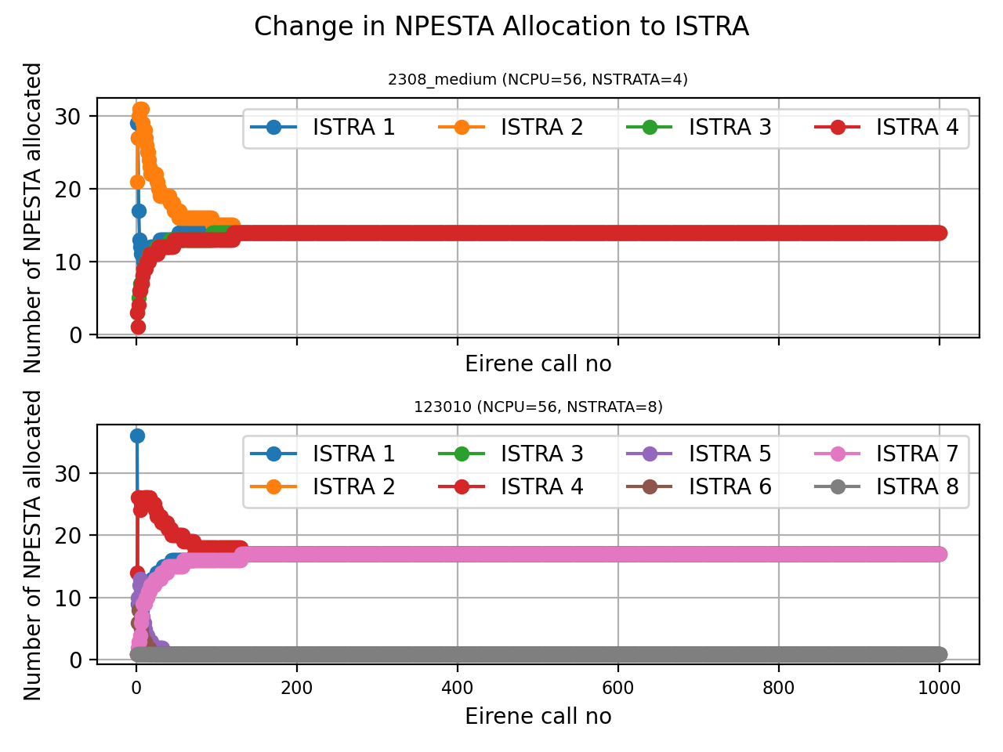
Processor allocation per strata– PFPO vs FPO
PFPO
FPO
FPO
PFPO
Stratified sampling: Processor allocation per strata vs iteration count
FPO: all three D strata converge to equal no of processors, Ne and He strata all allocated 1 processor
PFPO: all strata equally share available processors

Slide 7
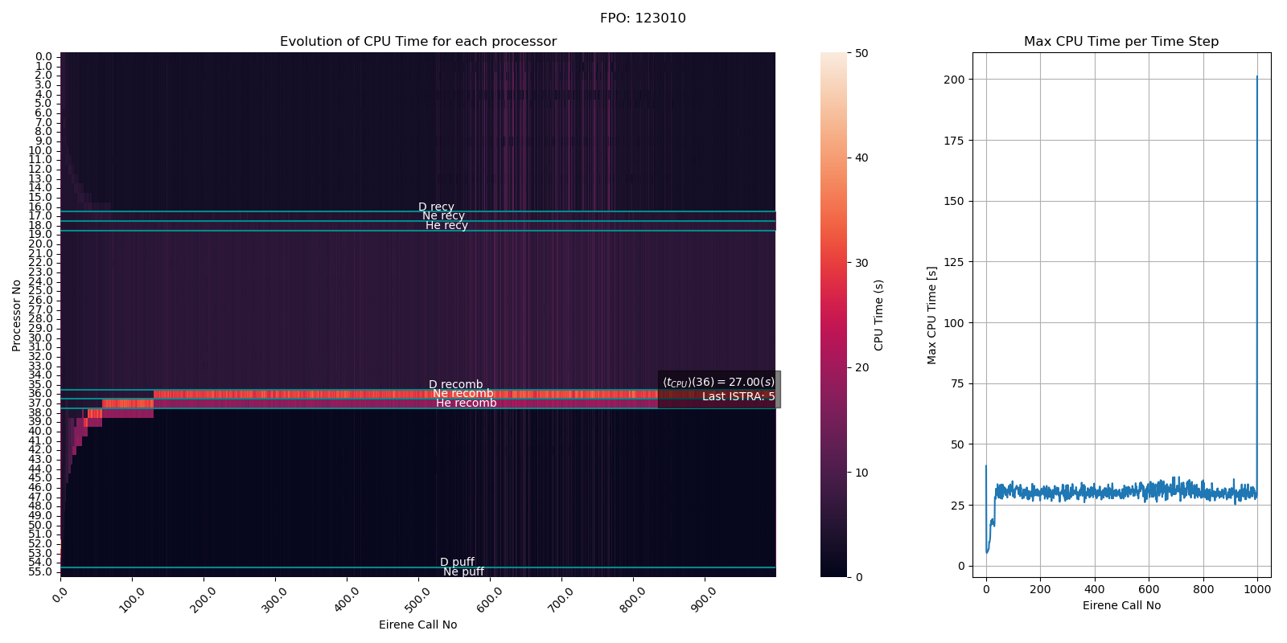
Processor allocation per strata–FPO

Slide 8
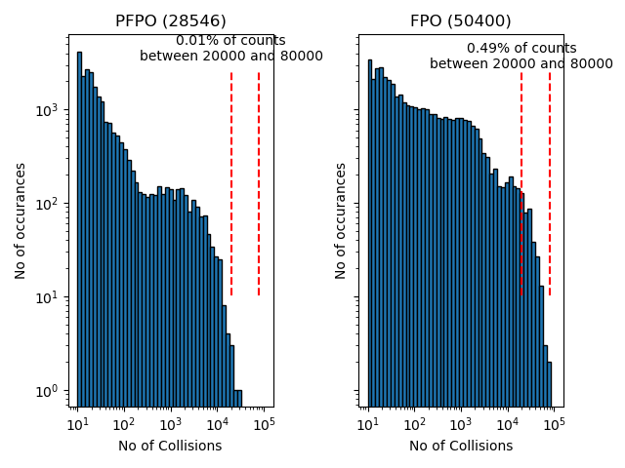
Distribution of no. of collisons wider in FPO
Trajectories of (upto) 900 particles per processor stored and analysed.
PFPO: 28,546 / 180,000 ~ 16% of particles sampled
FPO: 50,400 / 160,000 ~ 32% of particles sampled
Sampling per strata proportinal to no. of prcessors allocated to strata
Larger fraction of highly collisional particles in FPO
Increase in no. of collisions between FPO and PFPO is more pronoucned than increase in particle lifetime.
PFPO
FPO

Slide 9
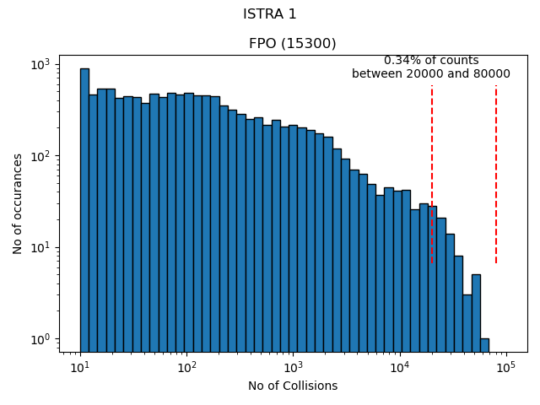
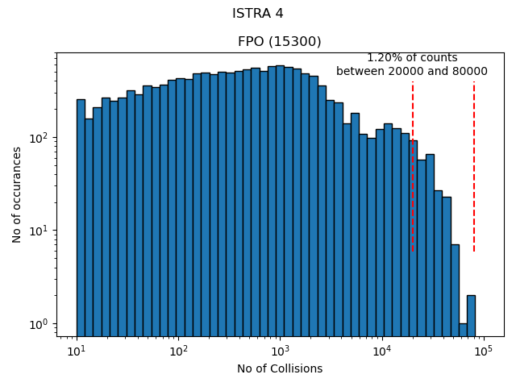
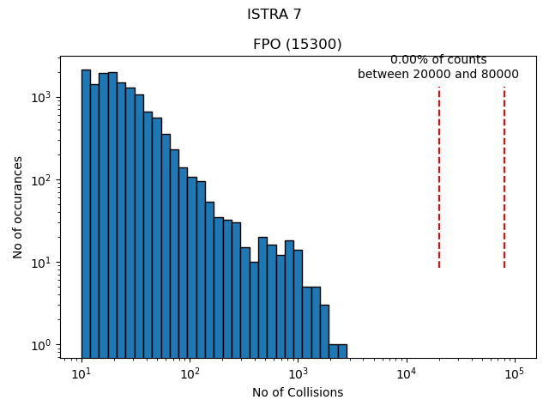
Distribution of no. of collisons per strata in FPO
Recombination stratum shows a different distribution – difficulty in detached cases?
D recycling stratum
D recombination stratum
D puff stratum

Slide 10
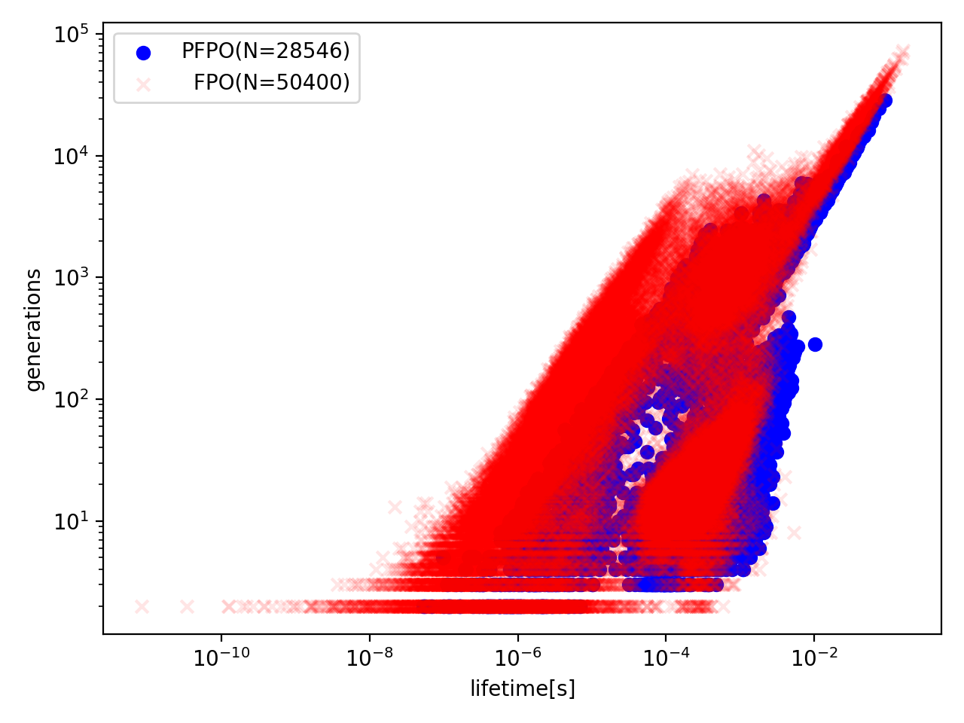
Lifetime vs collision count
FPO
FPO
PFPO – low density
PFPO
H puff rate - $3.81×10^{21}s^{−1}$
H puff rate - 1$.76×10^{23}s^{−1}$
Few particles have a linear relationship between lifetime and collision count.
For high density PFPO cases, simillar tail of long lived, highly collisional particles found.
Tail disappears at lower densities.
Tail has a simillar slope in PFPO and FPO scenarios – effect of large gas densities below the dome?

Slide 11
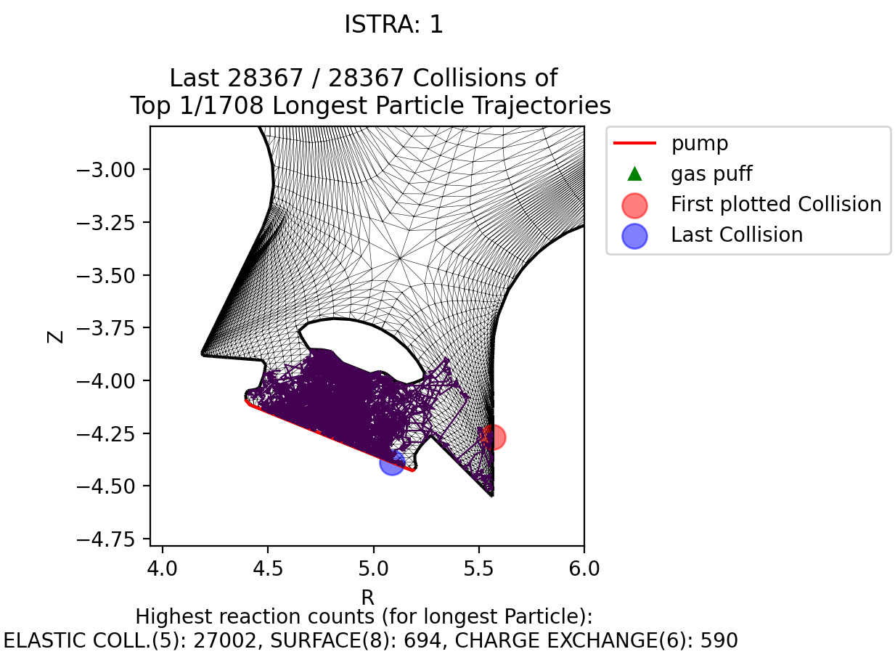
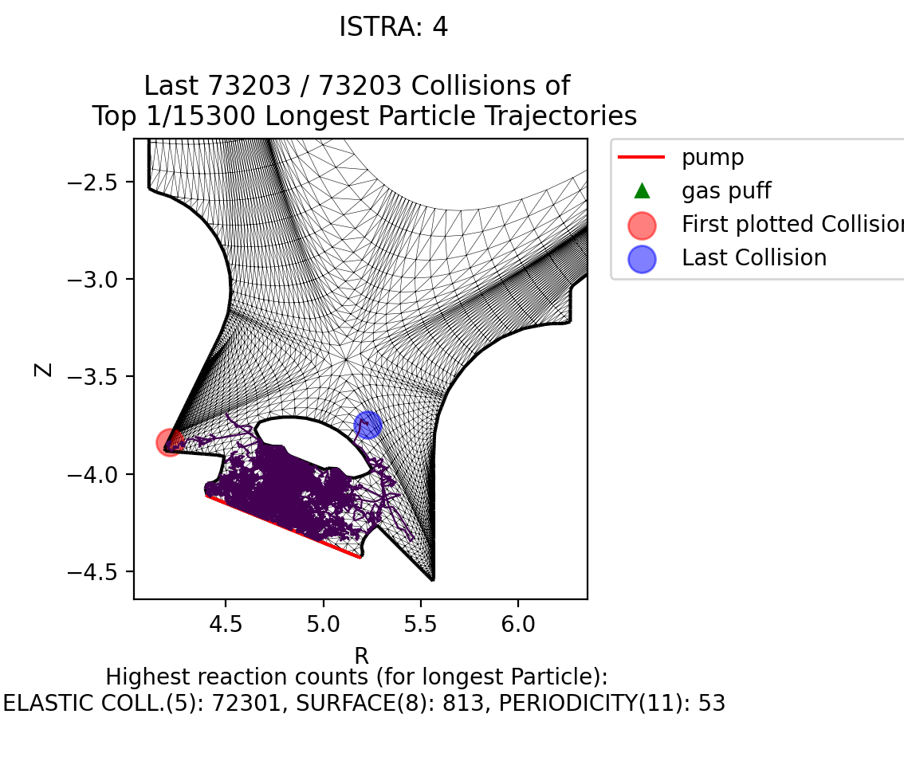
Longest trajectories simillar and dominated by elastic neutral-neutral collisions
PFPO – H recycling stratum
FPO – D recombination stratum
Longest trajetories are for recombination and recycling strata for particles trapped under the dome.
Elastic collisions dominate the collision count for the longest trajectories.
Trajectories much shorter when turning off neutral-neutral collisions.

Slide 12
Elastic collisions most frequent in FPO, CX in PFPO
PFPO
FPO
For each particle the counts for different Eirene reactions are plotted (FPO on right, PFPO on left)
The most dominant reaction for these high density cases are elastic collisions
For PFPO, this changes to Charge Exchange at lower densities

Slide 13
Discussion and conclusion
Large Eirene compute time presents a challenge in ITER 100MW simulations with high density D, Ne seeding and He flux from core.
What is the impact of these long trajectories on the plasma solution? Is it safe to apply a collision limit to them?
Most dominant process in these cases are elastic collisions. Turning off neutral-neutral collisions reduces the time per iteration dramatically but changes the plasma solution. How collisional are the cells under the dome – is a hydrid treatment useful?
Is there a set up issue with how we set up strata allocation in these simulations?
Is “embarassingly parallel” mode of Eirene worth the trade-off in variance reduction?

Slide 14
Extra Slides
Histograms by strata

Slide 15
Extra Slides
Without neutral- neutral collisions

Slide 16
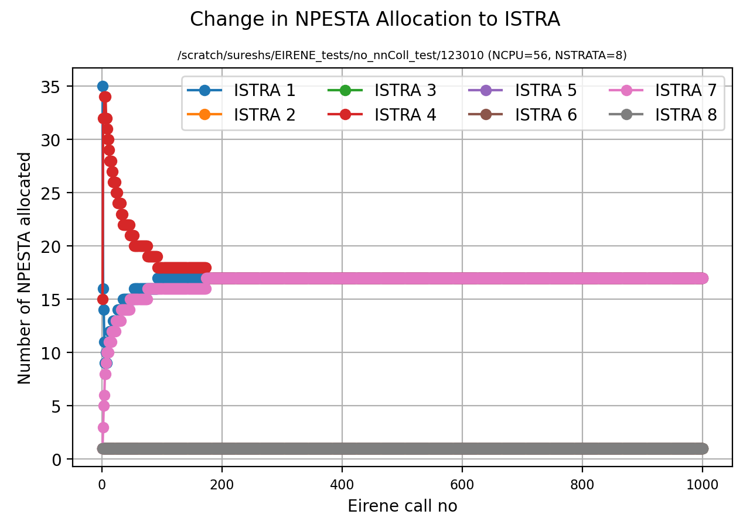
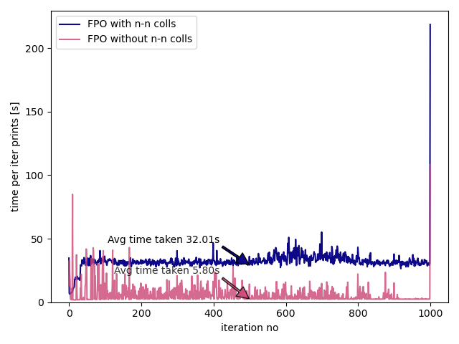
Time per iteration without neutral- neutral collisions

Slide 17
Extra Slides
Low density PFPO vs FPO 123011

Slide 18
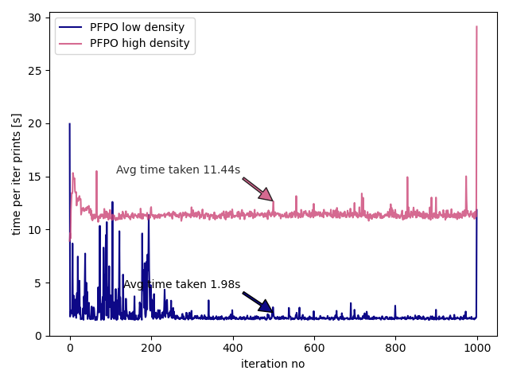
Time per iteration low density PFPO

Slide 19
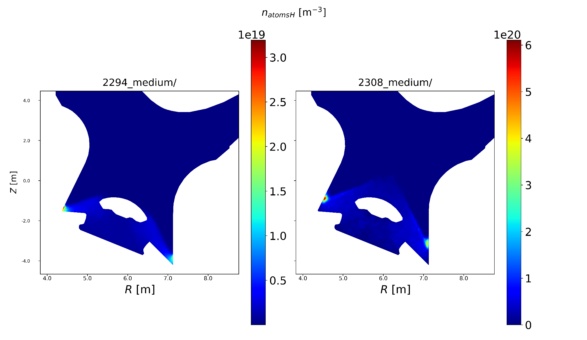
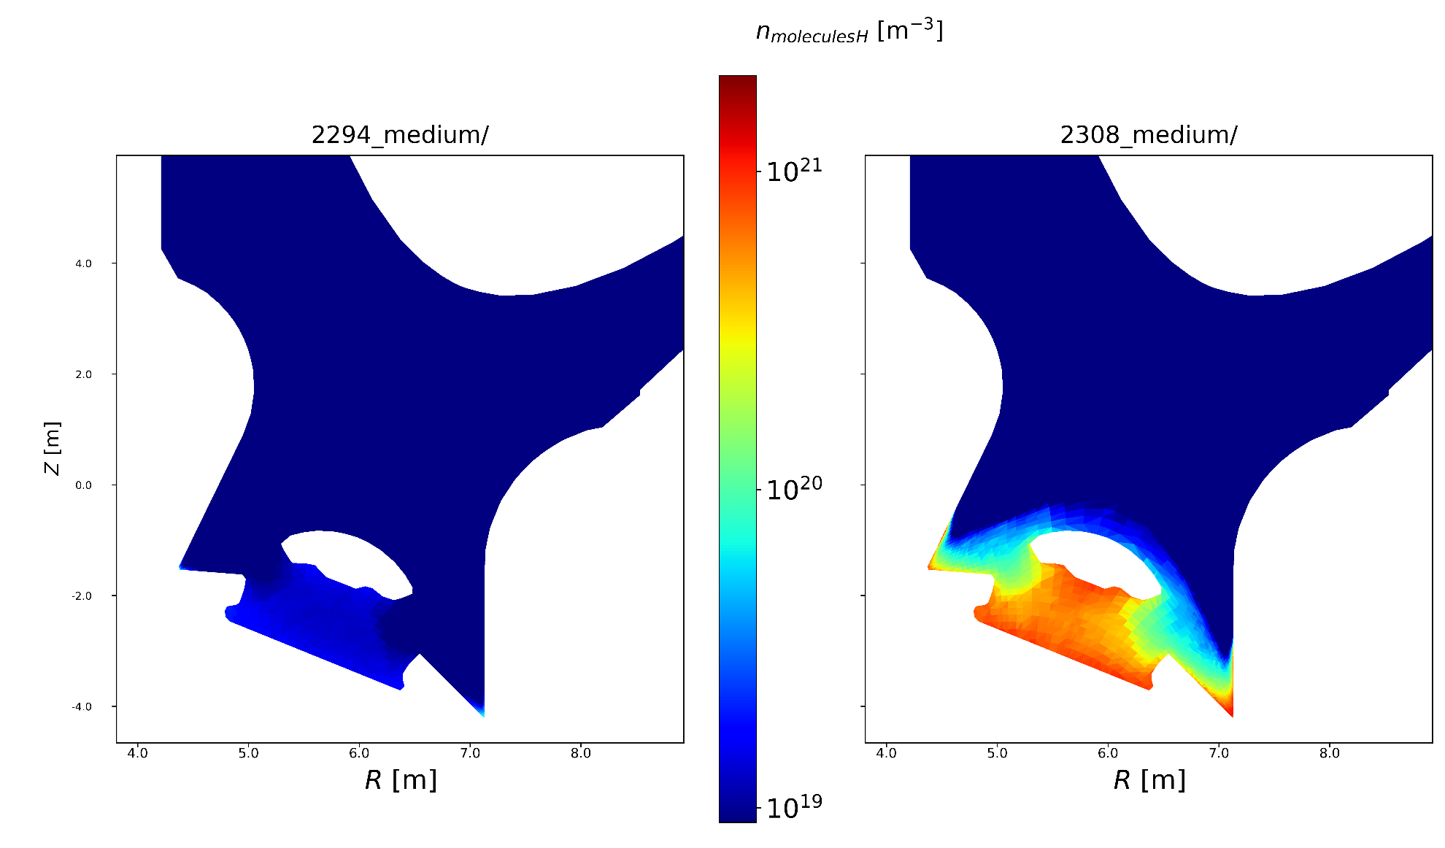
Neutral Conditions– PFPO low density bs high
H atom density
$H_{2}$ molecule density
PFPO -low
PFPO - high
PFPO -low
PFPO - high
H puff rate - $3.81×10^{21}s^{−1}$
H puff rate - 1$.76×10^{23}s^{−1}$
H puff rate - $3.81×10^{21}s^{−1}$
H puff rate - 1$.76×10^{23}s^{−1}$

Slide 20
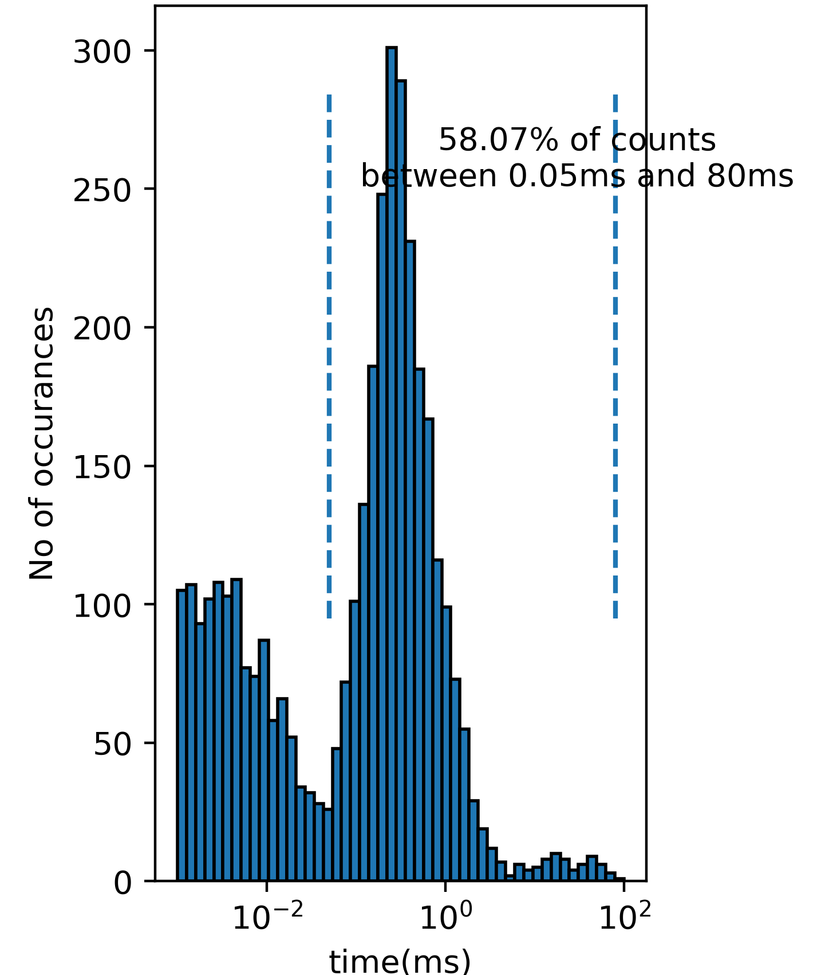
Low density PFPO vs FPO
PFPO – low density case
FPO - 123011
Eirene particle lifetimes for a PFPO (left) and FPO (right) time step.
Total number of particles are different (45,000 vs 10,000), 10s CPU time limt for each strata
FPO shows a second peak in the distribution and a population of long lived particles >50ms

Slide 21
Low density PFPO vs FPO
PFPO – low density
FPO - 123011
For the same scenario - total no of collisions undergone by each Eirene particle from when it is created to destroyed.
FPO simulation has a fraction ~5% of particles that undergo a large number of collisions.
Increase in no of collisons much more dramatic than particle lifetime.
Only ~0.04% of paricles undergo >30,000 collisions

Slide 22
Elastic collisions most frequent in FPO, CX in low density PFPO
For each particle the counts for different Eirene reactions are plotted (FPO on right, PFPO on left)
The most dominant reaction changes from Charge Exchange in PFPO to Elastic Collisions in FPO
Need too deterimine type of elasric collision –
$$D−D, D_{2}−D_{2},or D_{2}^{+}−D_{2}?$$
PFPO – low density
FPO

