Slide 1
Reports for 2024 and plans for 2025
FZJ report 2024
TSVV-5 regular VC, 14 Feb 2025
D.V.Borodin
This work has been carried out within the framework of the EUROfusion Consortium, funded by the European Union via the Euratom Research and Training Programme (Grant Agreement No 101052200 — EUROfusion). Views and opinions expressed are however those of the author(s) only and do not necessarily reflect those of the European Union or the European Commission, neither of the ITER organisation. Neither the European Union nor the European Commission can be held responsible for them.

Slide 2
Code maintainence: recent items
DCoC (developer code of conduct) is renamed to “Coding guidelines”, agreed, put to the EIRENE (also ModCR) git repo and to the website.
The document version changes together with the code, manual an license thanks to Git hooks (H.J.Leggate). The text formulation is coordinated by Pieter W. Groen (DIFFER)
The EIRENE + tools EPL licence
Above 100 (some outdated, not really in use) BD accounts and 20 ADs activated, B2 forms provided by 19 organisations, see www.Eirene.de/EPL
The ITER seems to be close for signing the license, however the dialog continues.
There is a high pressure to put all ITER-relevant codes on a “utterly free licence” like LGPL ➔ Dual license (EPL + CC BY-ND) is suggested by FZJ lawyers
The first MsV is released in Nov 2024 (just before E-TASC planning meeting)
It includes contributions like harmonising with SOLPS-ITER version, but also much more – e.g. significantly approved CI or CXN data output (H.Kampulainen).
Available in JuGit (FZJ), at ITER (mirror) and for download at www.eirene.de as a clone of the “master” GIT branch.

Slide 3
Recent EIRENE release (MsV = milestone version)
New EIRENE release V1.1.0 (31st October 2024)
New JSON input file format for EIRENE
Added OpenMP capabilities to EIRENE for shared memory usage (related to SOLEDGE code -> TSVV-6)
Updates to EIRENE database (some reactions in amjuel.tex, hydhel.tex, methane.tex, h2vibr.tex)
Unification of internal FZJ EIRENE versions
Started unification of EIRENE with SOLPS-ITER version (supported by X. Bonnin)
Restructuring of Continuous Integration (CI) pipeline (more provenance tests, increased code coverage by CI, OpenMP test cases)
Hotfix for EIRENE V1.1.1 (27th November 2024)
Fixed automatic updates to EIRENE forks (e.g. ITER and CEA fork)

Slide 4
Code maintanance: What needs to be done?
The EIRENE website is quite in good shape, still regular updates are necessary
The ITER/EUROfusion request automatic registration with their accounts.
Links with confluence, bug reporting forum etc. would be very useful.
E-TASC recommended tools (ACH is ready to provide support
Mattermost (Slack alternative) is to be set and used by all developers.
Gira/Confluence (available free of change due to ACH installations).
SimDB-based catalogued repository for simulations
The data server is physically provided by FZJ.
Installations with begin as soon as possible (D.V.Borodin, D.Harting?..)
Start using JSON Schema (in EIRENE, ModCR, etc.)
e.g. MIT Docs (https://json-schema.org/), use STYX (with TSVV-3)
We need to get used to coding guidelines, changelog etc. as a routine –
update those based on collected experience

Slide 5
Recent TSVV-5 events
TSVV-5 annual Code Camp (DIFFER, 19th – 21st November 2024)
Agenda and materials: https://indico.euro-fusion.org/event/3178/
Participants from all RUs, ITER, related TSVVs (3, 6 and 7) and ACHs
Moderated discussions along 3 main lines with the approved summaries on the last day. In addition Lots of bilateral discussions, joint look into the code and tools etc.
Examples of outcome: STYX (TSVV-3 interface to EIRENE) can be used as proxy for further IMASification, elaborated set of reference simulation cases prepared for SimDB, …., joint work with ACH (e.g. further steps on IMASification by ACH-IPPLM and utilisation of EIRON toy model for EIRENE from ACH-VTT discussed)
Large focus this time on CRMs with further updates on fluid-kinetic hybridisation
Meeting on unified A&M data policies (FZJ, 25th -27th November 2024)
Agenda and materials: https://indico.euro-fusion.org/event/3178/
Participants from EUROfusion (e.g. D.Coster – AMNS), ADAS, ITER, IAEA + EIRENE (with dedicated tools dedicated tools PLOUTOS and ModCR), YACORA and MCCC developers
Motivated by discussions at decennial IAEA AMPI Meeting in Helsinki (Jul-2024), likely will lead to a dedicated IAEA TM.
Joint document on data policies elaborated as a draft to be submitted for consideration by EUROfusion, ITER and IAEA.

Slide 6
ModCR interaction with EIRENE and other tools
YACORA
EIRENE
CRM condensing (“ColRad”)
Interface
Standalone
EIRENE
Main loop (neutral transport)
ModCR
Ploutos
ModCR
Flexible input files (JSON)
EIRENE
Post-processing (spectroscopy, etc.)
Data sources
MCCC, R-matrix, …

Slide 7
Pipelenes of CRMs
ModCR
ModCR
Pick up +
combine
Pick up +
combine
CRMs
(JSON)
CRMs
(JSON)
CRMs
…
Analyse (eigenvec.)
Analyse (eigenvec.)
Test +
correct
Test +
correct
Ploutos
Alternatives! Peculiar data, processes, assumptions
SA CRM Solver
Data sources
AMJuel,
MCCC, R-matrix,
…
Branching ratios, S/XBs
Other practical data

Slide 8
New code (also library for EIRENE): “ModCR”
Should provide BOTH standalone and build-in CRM for EIRENE
Therefore written in modern Fortran
Linked with Ploutos (uses the same JSON files for I/O)
Non-stationary approach utilising up-to-date Sundails solver (CVODE++) for stiff ODE systems (algebraic stationary option also available for control)
The whole specie-state and reaction basis is inside, however the code should form the list of “active states”
Provide different resolution on states being tracked
Provide flexible border for tracking of MC species and internal state populations as variables
Provide data processing pipe lines (easy to reproduce with updates)
All functionality available in EIRENE (e.g, photon tracing) must be preserved!
The code should be modular (library, API) for use in EIRENE, EIRON (toy model for parallelisation), ERO…
This
is unique and justifies creation of the new code

Slide 9
What is done?
The code is concepted and interest in its development triggered and studied
Interest from IAEA, JET, etc., potentially very good validation material from Be erosion experiments at JET.
There are new ideas due to that communication like data processing pipelines (strong IAEA interest, including dedicated CRP on A&M data ongoing).
Also unexpected ModCR advantages are revealed e.g. for GPU use…
The code development is started and ongoing (F.Cianfrani, D.V.Borodin, H.J.Leggate)
GitLab repo with CI, installation guide, cmake, ExtLibs (like in EIRENE)…
JSON input, already some developed files for Be (with and w/o MS), proxy for Ploutos file, ADAS adf11 data is in the database.
We need to go on using the JSON Schema.
Data read in (control JSONs, ADF11), stoichio- and transition matrixes constructed, i/o getting mature (JSON)
ODE (Sundails) and algebraic solutions in testing… implemented, however the results are still not good. Linear plasma parameter grid is provides to test stationary vs. dynamic solutions.

Slide 10
FZJ Team 2025
D.Harting (0.5 PPY)
CI, harmonisation of EIRENE version with ITER
Interface to EMC3 and kinetic ions (A&M side, main part is TSVV-6)
EMC3-EIRENE W7-X portfolio case + ITER BL case (with KIT)
NEW! M.Gordon, computer scientist (0.4PPY, other 0.4PPY are for ERO and TSVV-7)
Support of ModCR and Ploutos development with focus on perforance, sensitity analysis and UQ
PSI-2 simulation case (with support from D.Reiser – fluid side, B2)
D.Borodin (0.9 PPY)
ModCR development, appliocation to JET and PSI-2 spectroscopy
TSVV-5 and EIRENE maintainance administration
B.Küppers (0.1 PPY)
External Webmaster

Slide 11
Plans incl. publications – A&M physics
ModCR
Apply standalone version to JET and PSI-2 spectroscopy
➔ Be erosion with isotopes at JET paper should contain 1st ModCR simulations
Unify with ColRad, build in as a library into the EIRENE
Do first ModCR performance tests including as a load for EIRON
➔ compare ODE (balance equations vs. MC approach inside ModCR)
Build into Ploutos as alternative to the existing Perl solver
Ploutos
Continue filling it with old (HydKin) and new (MCCC, IAEA CollisionDB) data
Provide 1st validated ModCR/Ploutos JSON file chains
Publications/presentations
Overview on the EIRENE-related A&M data, physics and tools.
PET oral – first ModCR results

Slide 12
Thanks for the attention!

Slide 13
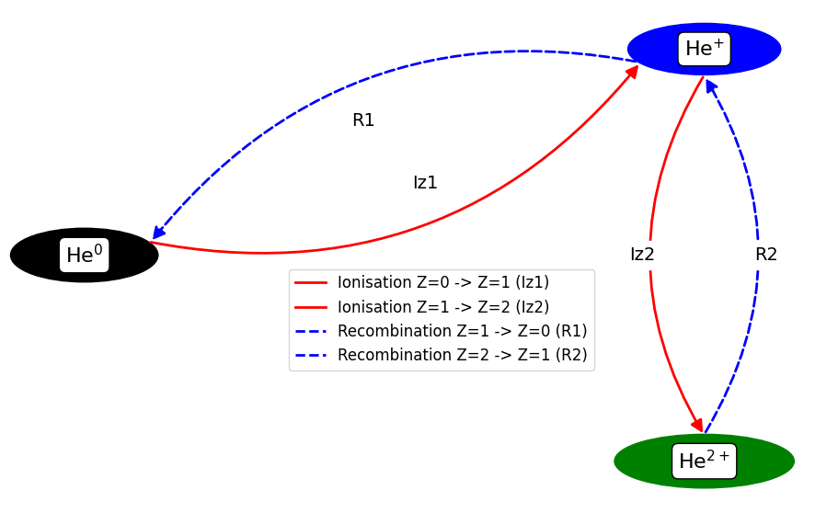
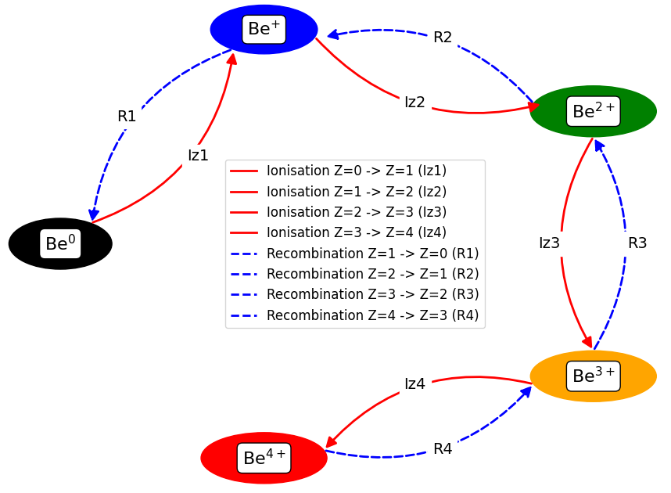
Trivial case – charge states in Be (and He?..)
Role of metastable (MS) states…
He-like
He-like
MS
GS
MS
GS
MS
GS
Established ADAS’96 dataset (GCR) – adf11:
“scd”/”acd” – ionisation/recombination
“qcd”/”xcd” – quasi-MS cross-coupling
All linear – easy to compare with Ploutous, observable transition matrix

