Slide 1
Stable small plasmas at the density limit in W7-X
A Pandey¹, T S Pedersen², G Fuchert¹, T Szepesi³, D Zhang¹, T Stange¹, V Perseo¹,
A Buzas³, S Kwak¹, G Kocsis³, G Cseh³, F Reimold¹, G Schlisio¹, and W7-X team
¹Max-Planck-Institut f¨ur Plasmaphysik, 17491 Greifswald, Germany
²Type One Energy Group, Madison, WI USA 53703 and
³HUN-REN Centre for Energy Research, Budapest, Hungary

Slide 2
Abstract
Experiments in the Wendelstein 7-X (W7-X) stellarator with plasma density beyond the established density limit in stellarators resulted in unusual plasma discharges with a reduced size lasting stably for many confinement times. In these experiments, the plasma had shrunk to a significantly smaller minor radius due to intense edge radiation from a radiating mantle and had no contact with material components, yet it remained relatively well confined for many confinement times with electron temperatures on the order of 1 keV. To our knowledge, this is the first definitive experimental long-time stability demonstration of such high-temperature contact-less plasmas in the laboratory. The stability of the plasma size is elucidated with a simple power-balance model. In other helical devices such as LHD and W7-AS, plasmas that start shrinking suffered core impurity accumulation leading to a collapse whereas this was generally not observed for these W7-X plasma

Slide 3
Introduction
Both in stellarators and tokamaks high-density (on the order of 10²⁰ m⁻³) operation is required for achieving high fusion performance.
Unfortunately, there are upper limits to the stably attainable plasma density. Stellarator density limits are generally higher than those of tokamaks with similar parameters [Sudo NF 30, 1990, Fuchert NF 60, 2020].
Stellarator density limit is dependent on magnetic field strength and heating power (and independent of plasma current), whereas the tokamak limit (Greenwald density limit) is directly proportional to the plasma current and independent of the plasma heating power.
Exceeding the density limit in tokamaks → potentially dangerous, disruptive plasma terminations [Gates PRL 108, 2012, Suttrop NF 37, 1997, White PoP 22, 2015],
Exceeding the density limit in stellarators leads to generally benign radiative-collapse plasma terminations in stellarators [Peterson PoP 8, 2001, Giannone PPCF 44, 2000], or, as we show in this article, to a shrinkage of the minor radius of the plasma and a decoupling from the device walls and still stably sustained by external heating.

Slide 4
Previous studies in stellarators
Density limit experiments in LHD showed impurity radiation increased with plasma density, leading to initial shrinkage followed by a collapse [Peterson PoP 8, 2001].
It was reported in ref [Peterson PFR 1, 2006] and quoted here – “as the radiation is enhanced the plasma column shrinks leaving an increasingly larger volume of low temperature plasma in which the light impurities radiate strongly". This drove the plasma into power starvation, shrinking and collapse.
Impurity accumulation in the core of these discharges, potentially caused by a negative radial electric field, may have played a role in the terminations of these discharges [Ida NF 45, 2005].
Similar observations were reported in W7-AS stellarator, where impurity radiation profile was centrally peaked and discharges terminated due to radiation instability when plasma density exceeded a certain threshold [Giannone PPCF 45, 2003].

Slide 5
In W7-X
ECRH plasmas in W7-X can surpass the Sudo density limit and the density limit derived for W7-X in Fuchert NF 60, 2020.
In the X-mode polarization ECRH discharges, the plasma may not go into a complete radiation collapse but rather may survive as a shrunken plasma for many confinement times, completely decoupled from the plasma-facing components.
The small plasma state can be very stable, achieving high central electron temperatures and plasma densities. As demonstrated in this paper, despite being significantly reduced in size, with a minor radius as small as 60% of its original value, resulting in a plasma volume of approximately 35% of its original size.
Some small plasmas shrank down to less than 50% of their original full-size minor radius, while remaining perfectly stable for many confinement times.

Slide 6
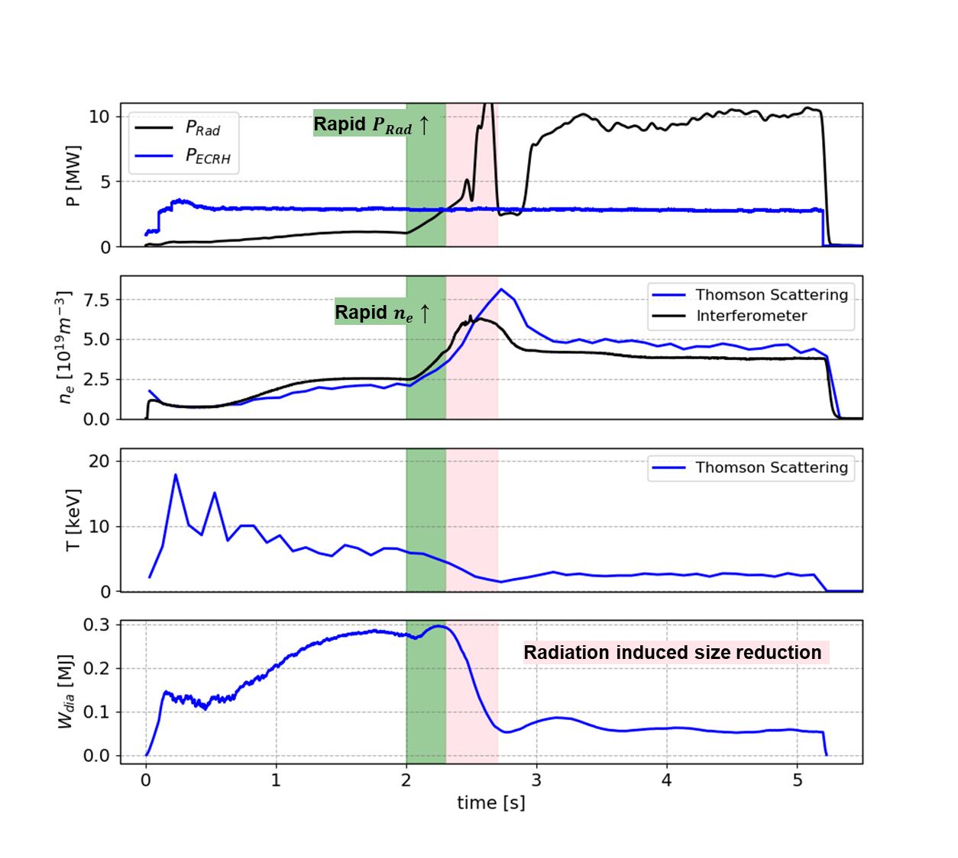
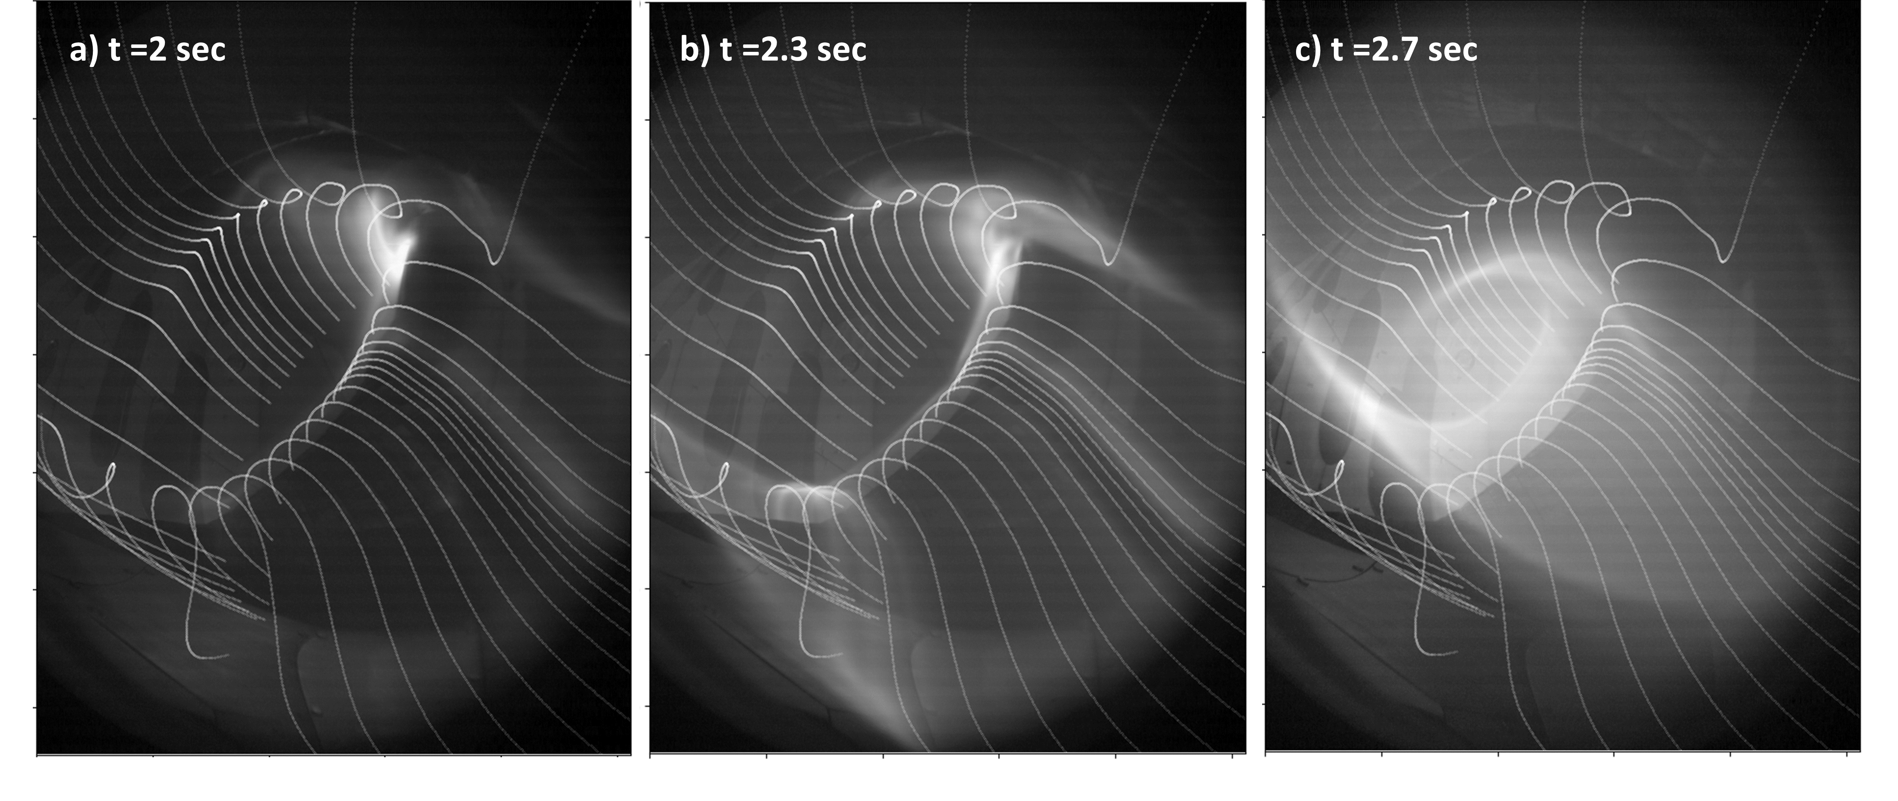
Observations
Initially, the ECRH plasma has a full minor radius of ~ 0.51 m.
A strong hydrogen gas puff at t = 2 sec increases the plasma density and edge radiation.
By t = 2.3 sec, the edge radiation intensifies as the line-averaged density approaches the Sudo density limit ~ 5.5 x 10¹⁹ m⁻³, causing the plasma to shrink.
approx. LCFS field line
approx. LCFS field line

Slide 7
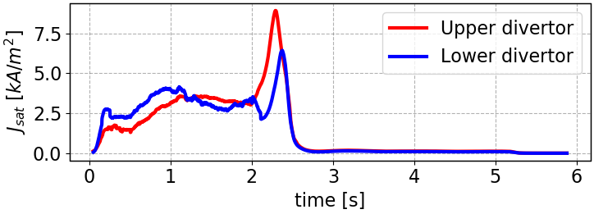
Observations contd..
This plasma shrank down to ~60% of its original radius and was decoupled from the PFCs.
Ion flux going to the divertor probe vanishes in the small plasma phase.
It remained stable and healthy for ~ 80 confinement times after shrinking until programmed ECRH shut down.

Slide 8
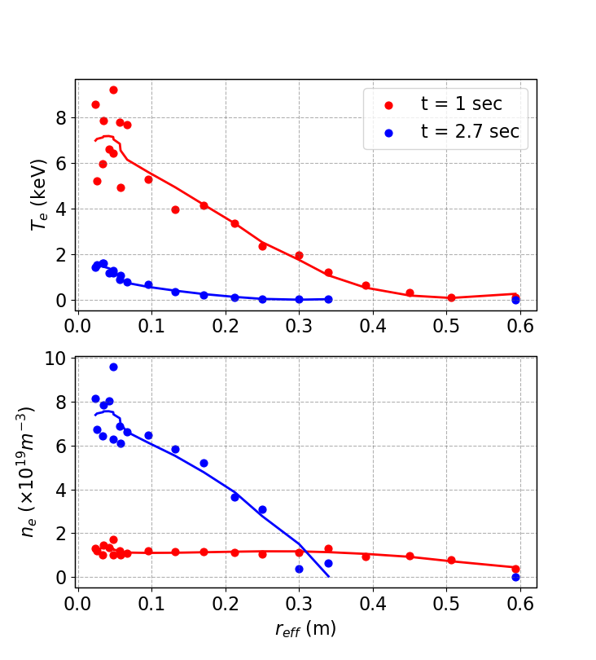
Confinement after transition
$$τ_{E} \sim 106 ms @ r\sim 0.51m$$
Comparison between full sized plasma and when the attained its smallest radius
$$τ_{E} \sim 30 ms @ r\sim 0.3m$$
$${\left(\frac{a_{small}}{a_{normal}}\right) }^{2.28}=0.3; \frac{τ_{E, small}}{τ_{E, normal}}\sim 0.28$$
$τ_{E, ISS04}∝a^{2.28}$;
This indicates that the small plasmas in W7-X are not poorly confined but are simply reduced in size.
The plasma is stable in the small plasma phase with central $n_{e}\sim 5×{10}^{19}m^{−3}$ and central $T_{e}\sim 2.5 keV$.

Slide 9
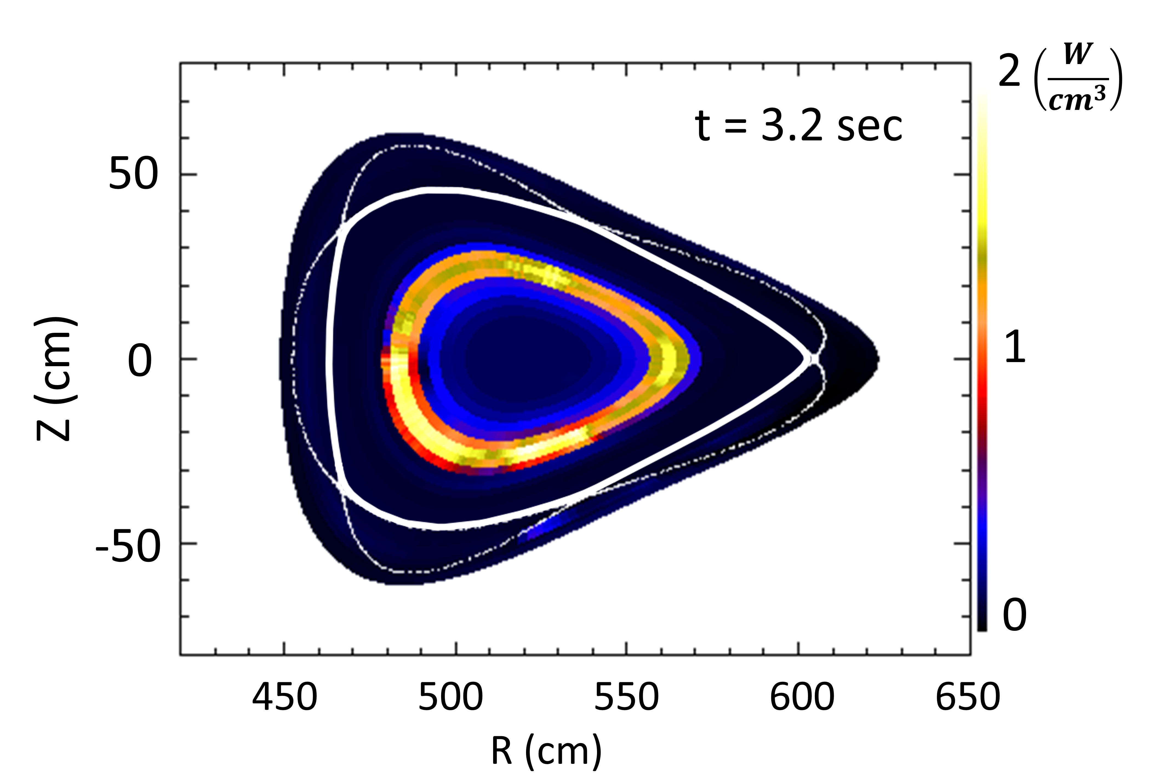
Radiating mantle, power balance and stability
Lower divertor
Cross section rotated by 45⁰ clockwise.
Plasma radiates away the power through a radiating mantle around it as it shrinks down
CIS data shows CIII emissions moving radially inward at 2.4 sec, forming an intense radiating mantle from 2.6 to 2.7 sec, then weakening by 2.7 sec as the plasma regains volume
The radiating mantle plasma as seen from the CIS camera recording CIII emission.
Radiating mantle
The radiating mantle, surrounds the plasma during the small-plasma phase, and we see that almost all radiation originates from this mantle post-shrinkage.
approx. LCFS

Slide 10
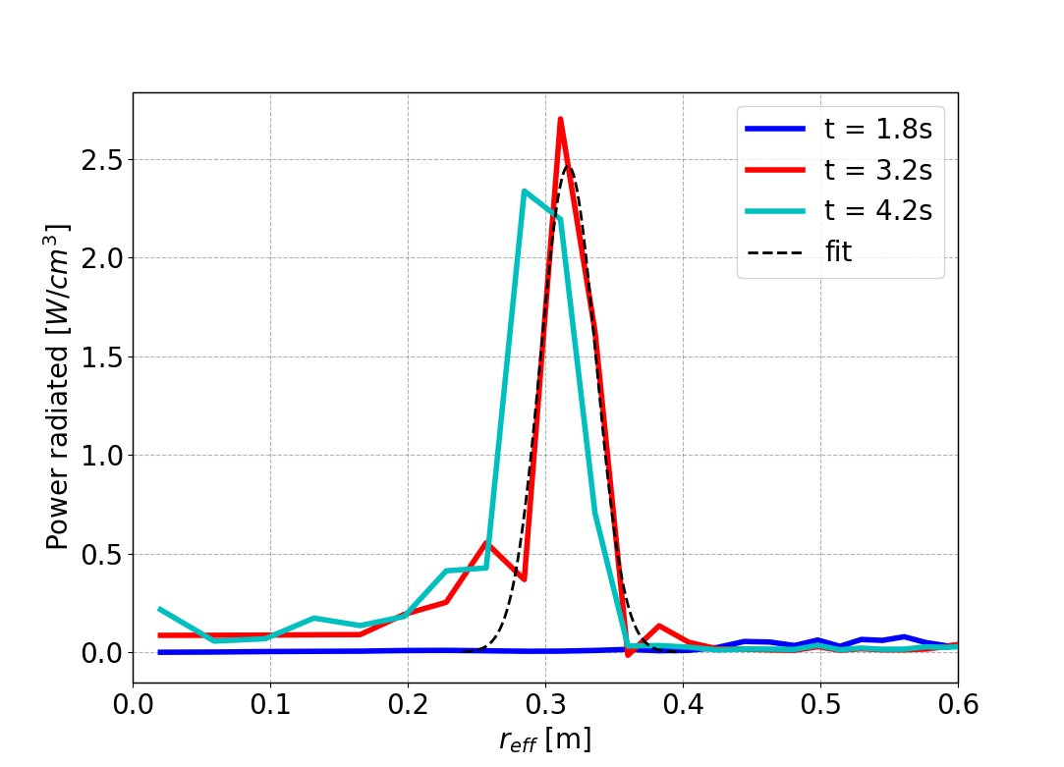
Radiating mantle, power balance and stability
1d radiation profile from bolometer: At t = 1 sec, small amount of radiation outside the LCFS r = 0.51, while at t = 3.2 sec, the radiation peak has moved well inside the LCFS.
Hollow impurity radiation profiles.
The profile, fitted with a Gaussian, indicates a radiating mantle thickness t_{rad} as the FWHM ~ 0.05 m.
$r_{eff}$ = 0.51 m

Slide 11
Simplified Power Balance in the radiation zone
$Q_{e, source}= Q_{e, ⊥}=χ_{⊥}∇T_{e}\left(r\right)n_{e}\left(r\right)A_{s}(r)=Q_{e, ⊥}^{∗}\left(r\right)n_{e}(r)$ [M. Hoelzl NF 49, 2009, Beurskens NF 61, 2021]
$χ_{⊥}≈r_{plasma}^{2}/τ_{E}$ [Giannone PPCF 45, 2003, Fuchert NF 60, 2020]
$Q_{e, loss}=Q_{e, rad}{+ Q}_{e, ion}{+ Q}_{e, cx}$
$Q_{e, rad}=n_{e}^{2}\left(r\right)f_{imp}\left(r\right)L_{z}\left(T_{e}\left(r\right)\right)V\left(r\right)=Q_{e, rad}^{∗}\left(r\right)n_{e}^{2}\left(r\right)$ → main contribution
$Q_{e, cx}=e n_{e}^{2}\left(r\right)<σ_{cx}v>\left(T_{i}−T_{n}\right)f_{n}V(r)=Q_{e, cx}^{∗}\left(r\right)n_{e}^{2}(r)$; f_{n} $≤$ 1% [Beurskens NF 61, 2021]
$Q_{e, ion}=e n_{e}^{2}\left(r\right)<σ_{ion}v>\left(E_{ion}+{2T}_{i}\left(r\right)−2T_{n}\right)f_{n}V\left(r\right)=Q_{e, ion}^{∗}\left(r\right)n_{e}^{2}\left(r\right)$
$T_{e}=T_{i}, T_{n}=3 eV \text{[}\text{Stroth} \text{NF}\text{ 62, 2022]}, T_{e}=10 eV$ in the radiation zone
$n_{e, max}\left(r\right)=\frac{Q_{e, cond}^{∗}(r)}{Q_{e, rad}^{∗}(r)+Q_{e, cx}^{∗}(r)+Q_{e, ion}^{∗}(r)}$
If $n_{e, max}\left(r\right)>n_{e, exp}(r)$ → unstable radius
If $n_{e, max}\left(r\right)<n_{e, exp}(r)$ → stable radius

Slide 12
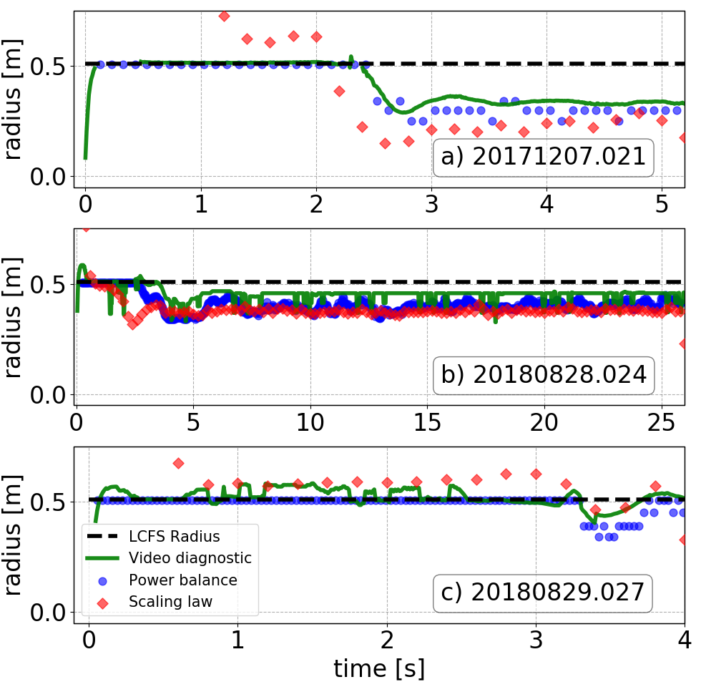
Density limit scaling
The density limit derived for W7-X plasmas [Fuchert NF 2020] based on the argument that at which density and heating power the plasma temperature falls to zero before reaching the actual minor radius of the vessel.
The predictive scaling law found for the critical density limit in W7-X is used and solved for the minor radius instead of the density
This radius is referred to as $r_{rad}$ and is given by:
$r_{rad}=\frac{1}{4}\frac{P[MW]^{0.7}n_{l, 19}^{−1.25}}{f_{imp}^{0.5}}$
At the density limit the plasma shrinks and goes to a smaller radius compatible with the density, f_{imp} and power.
This shrinkage dictated by the edge plasma density

Slide 13
Discussion
Plasma stability can, in principle, be controlled by adjusting heating power or neutral fueling to reduce the minor radius.
Not all small plasmas remain stable. In some cases, plasmas shrink and collapse following significant increase in density or impurity injection, even with constant heating power.
When the minor radius reduces, the core temperature drops
If the core temperature becomes too small, a cycle of reduced absorbed power and further temperature drops ensues, leading to plasma collapse.
Power balance calculations indicate that during shrinkage, the plasma boundary becomes unstable when radiated power exceeds the power entering the radiative zone due to excessive edge density. [Miyazawa NF 48, 2008], highlighting that edge plasma parameters are crucial for boundary stability in extreme detachment discharges.
A peaked density profile with lower edge density can stabilize the plasma boundary beyond the density limit in pellet injection discharges in LHD [Miyazawa NF 48, 2008] and W7-X [Bozhenkov NF 60, 2020].

Slide 14
Discussion
Some discharges avoid collapse and remain stable for several seconds, corresponding to $80−100τ_{E}$.
These keV-level plasmas are novel, being the first laboratory examples of stably confined plasmas with negligible contact with material objects.
Such plasmas significantly reduce plasma-wall interactions, mitigating the plasma-wall-lifetime issue.
Outlook:
The small plasmas could support studies of core plasma properties under various magnetic field configurations without excessive heat loads on plasma-facing components, though this requires further investigation.
Their stability might also make them promising candidates for addressing the heat-flux exhaust challenge in stellarators, potentially even at the reactor scale.
But
However, a significant drawback exists: these plasmas, being fully decoupled from the divertor, lack efficient neutral compression. As a result, much larger pumping capacities or absorbing areas are needed to exhaust particles, such as helium, effectively.
Additional research is also required to evaluate impurity screening, compatibility with high fusion performance, and their potential for achieving high performance.

Slide 15
Summary
ECH plasma in W7-X at density limit may not suffer total plasma collapses. They can be operated slightly above the plasma density limit. Such plasmas shrink but do not die.
The small plasma is relatively well confined and exhibit relatively high central T_{e} and n_{e}.
The radiation losses caused by high edge plasma density initiates the plasma shrinking.
Additional research is required to evaluate impurity screening, studies of core plasma properties under various magnetic field configurations without excessive heat loads on plasma-facing components, compatibility with high performance.

Slide 16
Additional slides

Slide 17
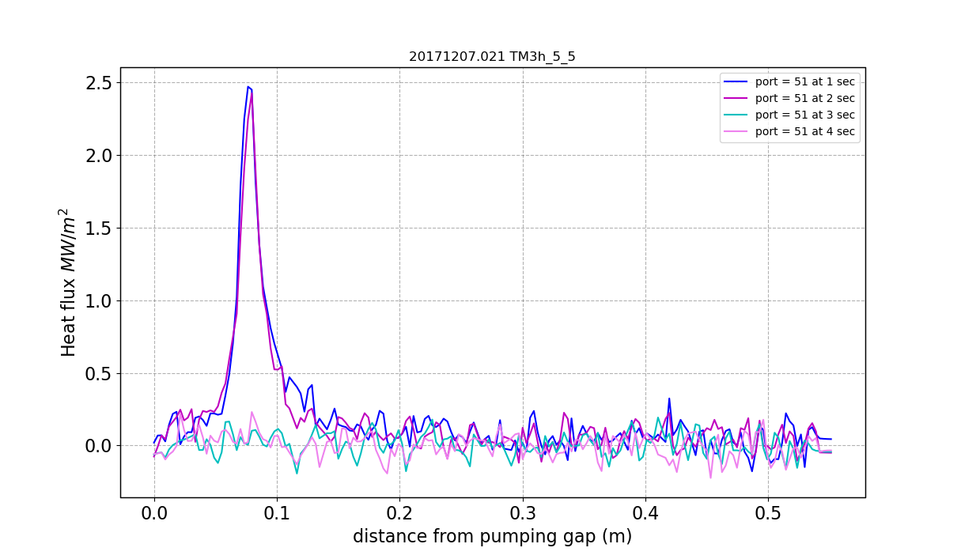
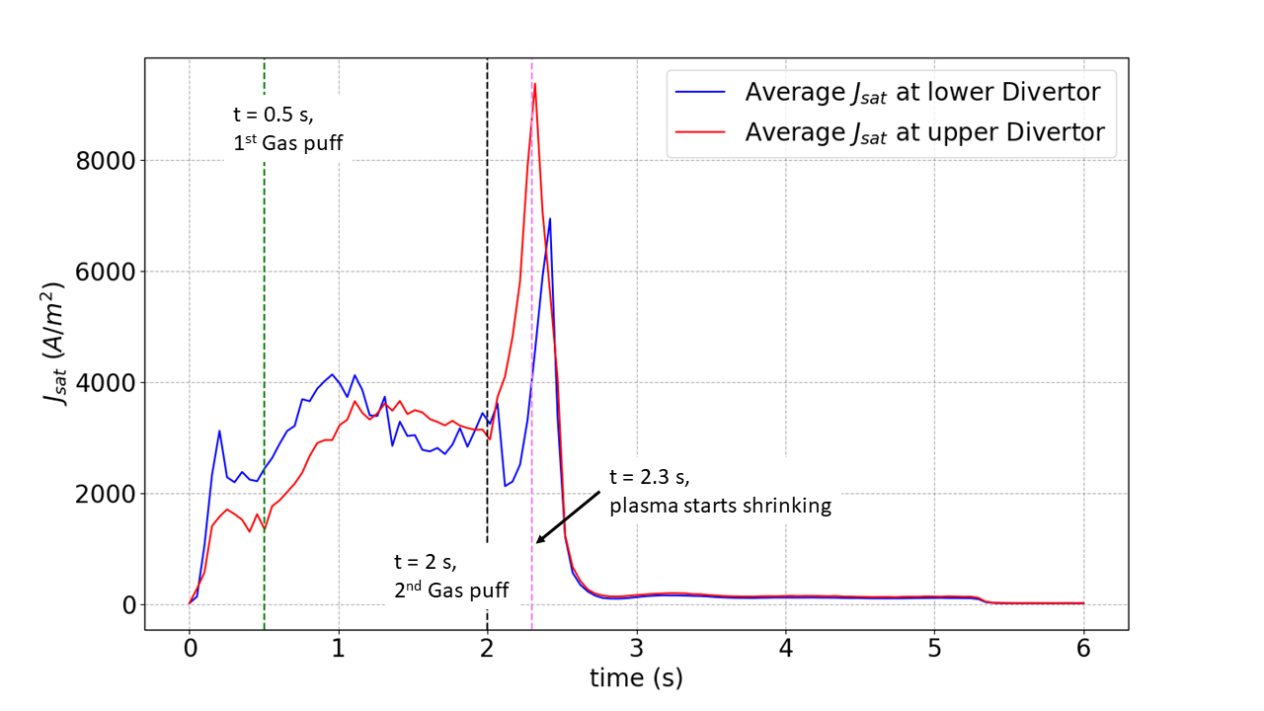
Heat and particle flux on the divertor : near/on the Langmuir probes
Plasma is completely detached from the divertors
Practically, vanishing particle and Heat flux on the divertors
Heat flux on the divertor finger adjacent to the Langmuir probes

Slide 18
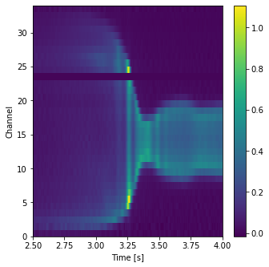
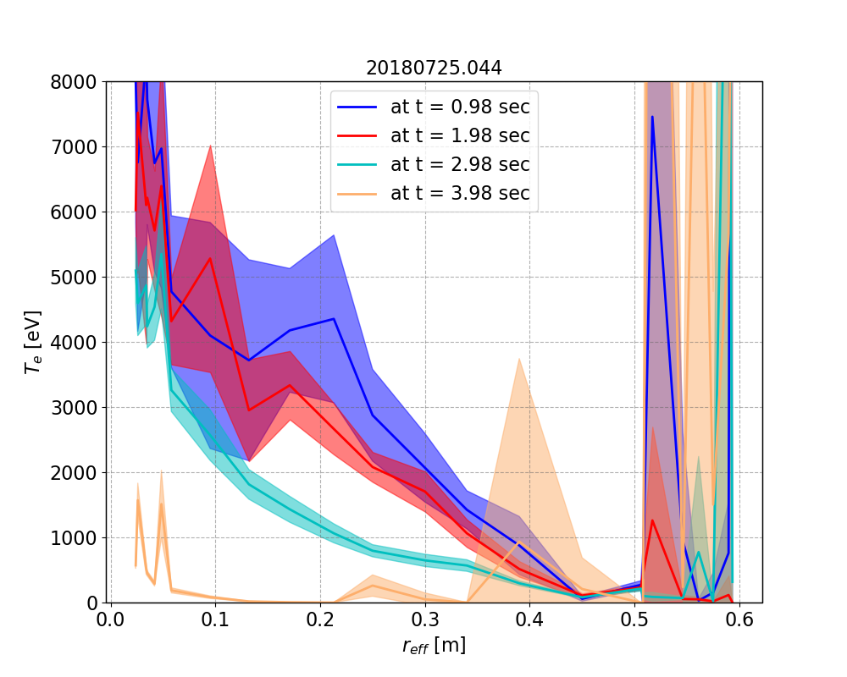
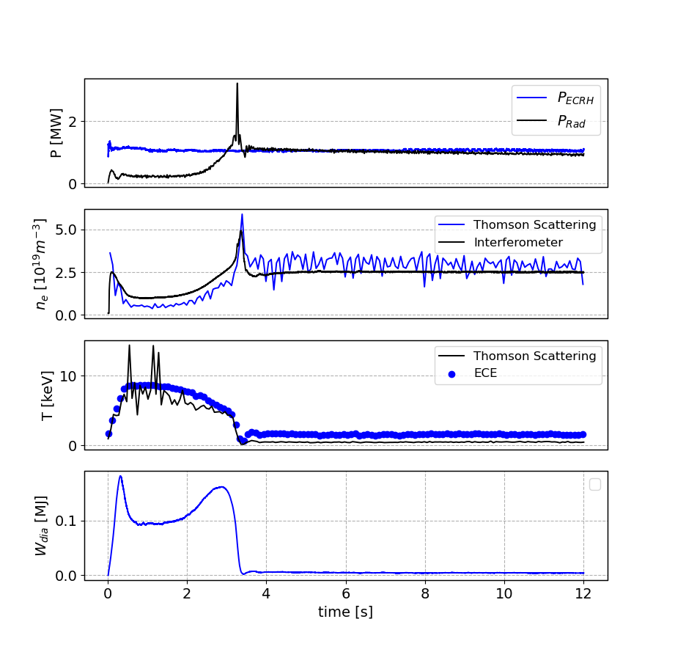
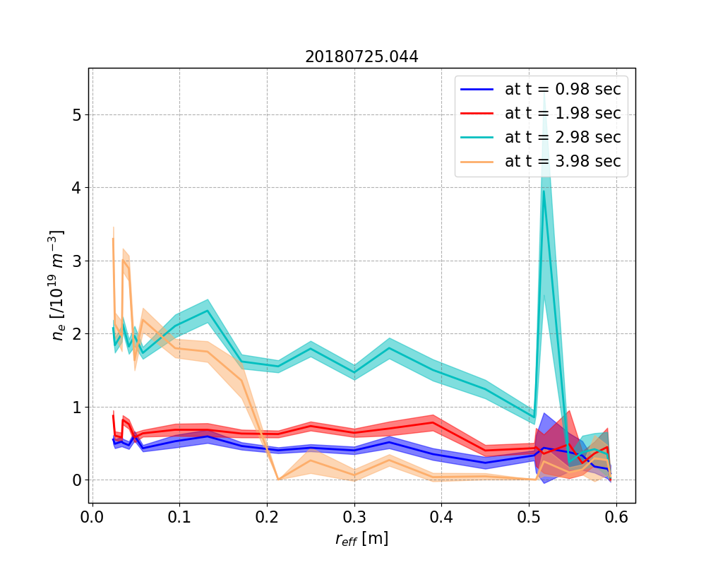
Smaller plasma
20180725.044, pre-boronization
Line integrated emissivity from Bolometer
Final radius of the plasma after collapse ~ 20 cm.
Small plasma remains stable for more than 9 seconds until the programmed end of the discharge.

Slide 19
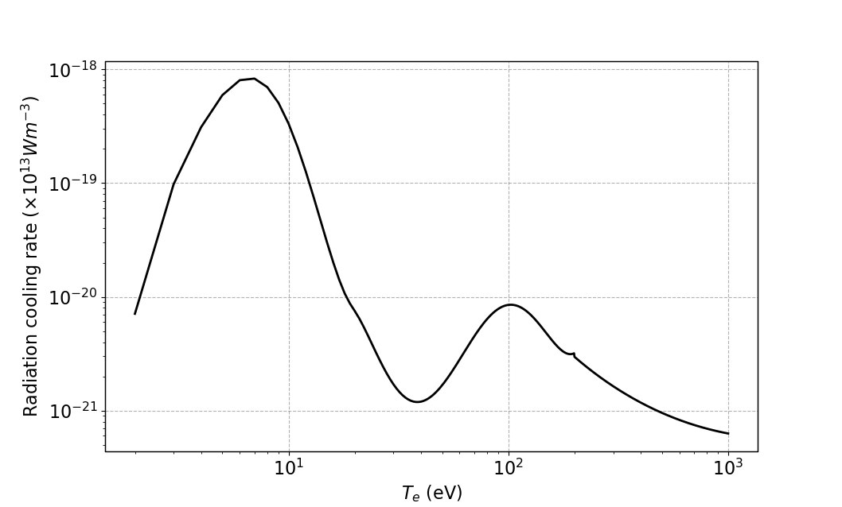
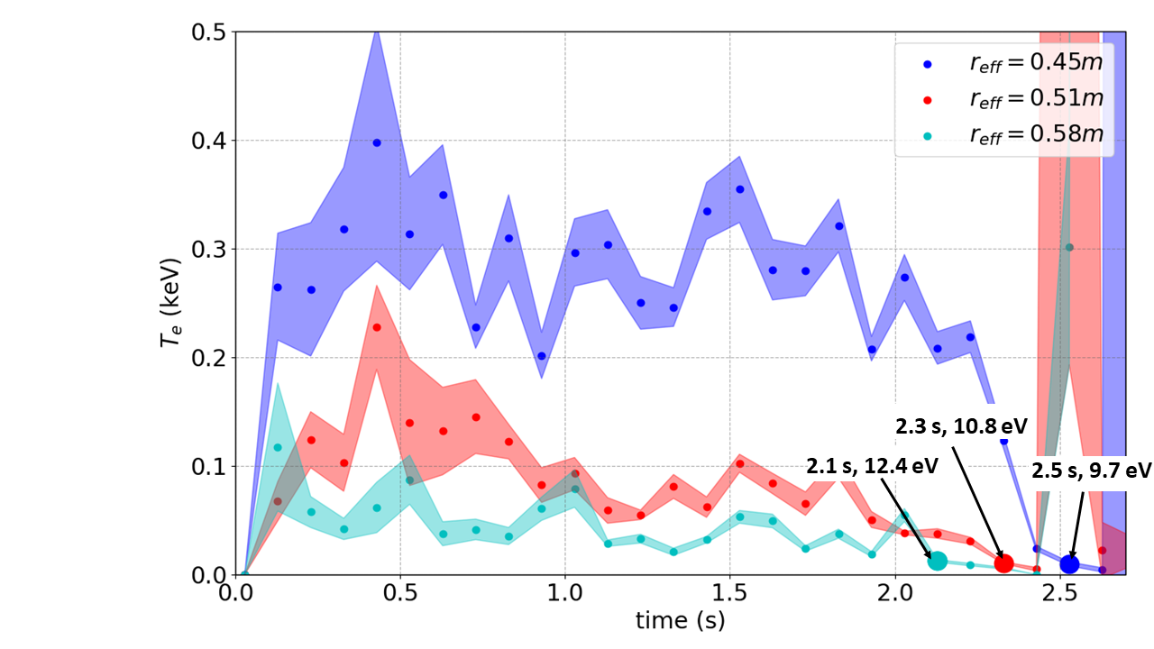
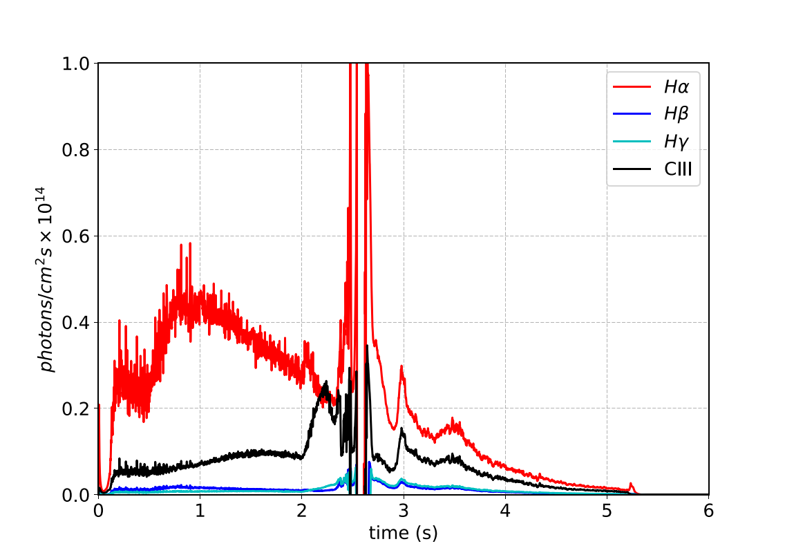
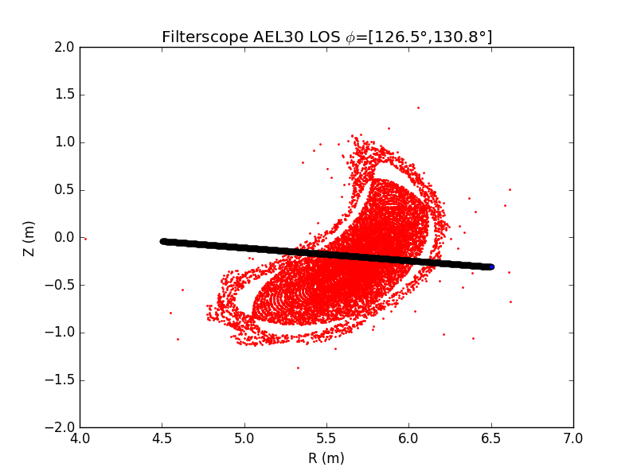
Radiation Zone movement
Carbon
Thomson Scattering
For Carbon
Rapid increase in CIII radiation
Signal saturation
LOS
Notes:
The movement of the radiation zone can also be seen from the time evolution of the edge temperature signal measured by Thomson scattering. In the figure on the left, the electron temperature is plotted for three radial locations with time. We see that the Te at the radial position inside the LCFS reff = 0.45 m also drops down to below 10 eV after 2.5 seconds before the uncertainties in the measurement become too high to get a good mean Te value. On the right we see the well known radiation cooling curve for carbon calculated assuming coronal equilibrium. The peak of the cooling curve around 10 eV Carbon radiation is very high in the range 10-30 eV, where the edge plasma is sitting. The figure at the bottom is the measured line radiation signal for H alpha, beta gamma and CIII from filterscopes. CIII signal is the most important in the current context. This is to show that CIII signal shows a rapid increase starting from 2 sec after the strong gas puff was made. This is at the time when the edge temperature corresponds to the electron temperature for which Carbon radiation is close to its peak. And the radiation zone residing in the edge plasma faces a power starvation and moves inwards. This kind of a radiation induced collapse puts an upper limit on the plasma density.

Slide 20
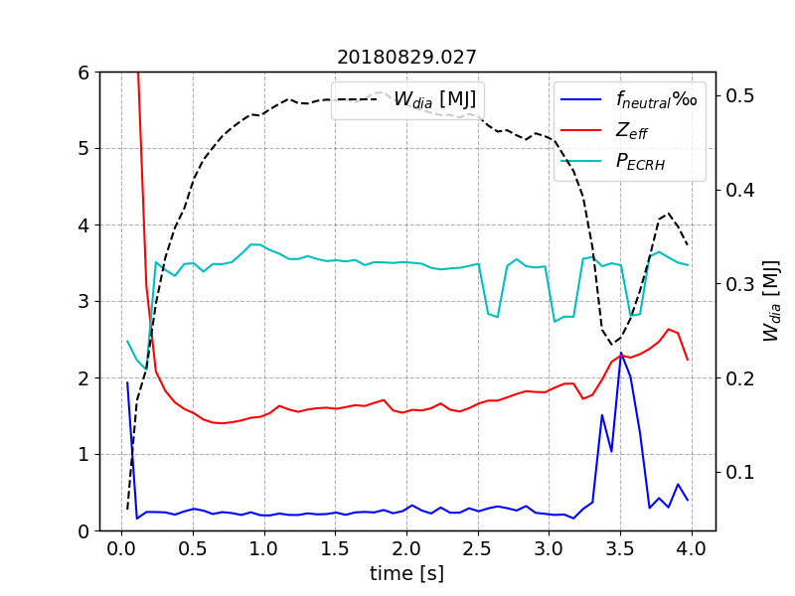
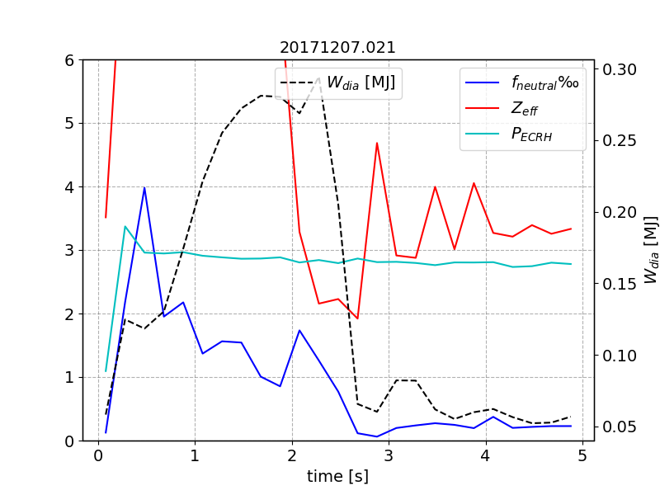
Parameters for Recovery : Fueling and Input Power + Impurity
Neutral fraction : Plasma goes into recovery state after fueling is stopped.
Impurity fraction : Post boronized discharges show better recovery.
Input Power : Higher input power discharges show better recovery.
Pre-boronization :
Post-boronization :
[MW]
[MW]

Slide 21
Stability of the small plasma: Power balance decides the radius
Assuming the plasma to have a circular cross section:
$$Radiated power density in the mantle=σ$$
$$P_{rad}=σd4π^{2}rR$$
At steady state, maximum $P_{rad}=P_{\begin{aligned}heating \\ \end{aligned}}$
$$r_{s}=\frac{P_{\begin{aligned}heating \\ \end{aligned}}}{σd4π^{2}R}$$
For, $r_{s}>a :$ the plasma will begin to touch the divertor and deposit the left-over energy there and the plasma will be full-size
For, $r_{s}<a$ : the plasma will shrink to $r_{s}$ since it is radiating more heat than it is receiving.
Radiating mantle
r
a
d

