Slide 1
WEST Upgrade: physics basis
Jeronimo Garcia

Slide 2
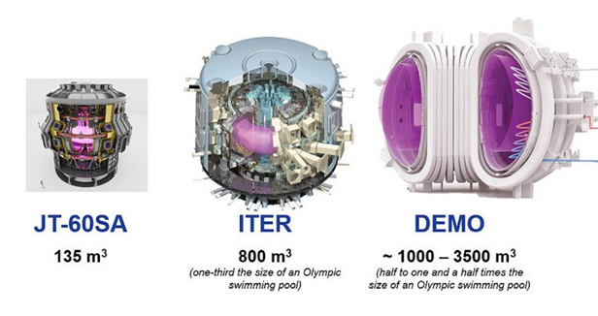
Context: long pulse operation in full W environment
Recent major changes in long pulse operation: JT-60SA and ITER move towards full W environment in >2030
DEMO could be a W PFC machine
Compatibility of steady-state, long pulse, high performance scenarios in full W environment (Divertor + first wall) to be proven
Target <2030 would be desirable for initial studies before JT-60SA and ITER come to operation

Slide 3
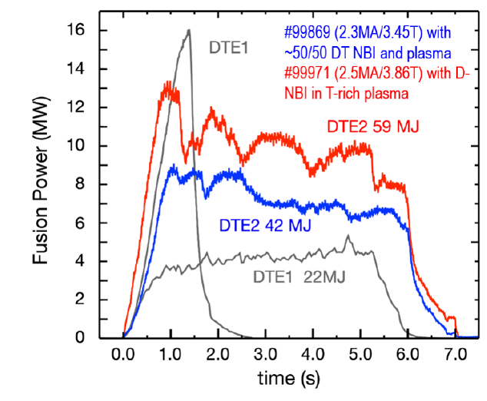
Lessons from JET and the importance of long pulse
High confinement plasmas in full W environment are a challenge
Edge W screening might not be 100% efficient→ acceptable for short pulses but unacceptable for long pulse operation
Edge W screening may depend on near to perfect machine conditions that can degrade in long pulse operation
Projections of optimistic low W source and transport in future devices depend on models validated mainly in short pulses
Controllability of W considering all the physics scales is essential
JET (W divertor and Be first wall)
<1τ_{R}

Slide 4
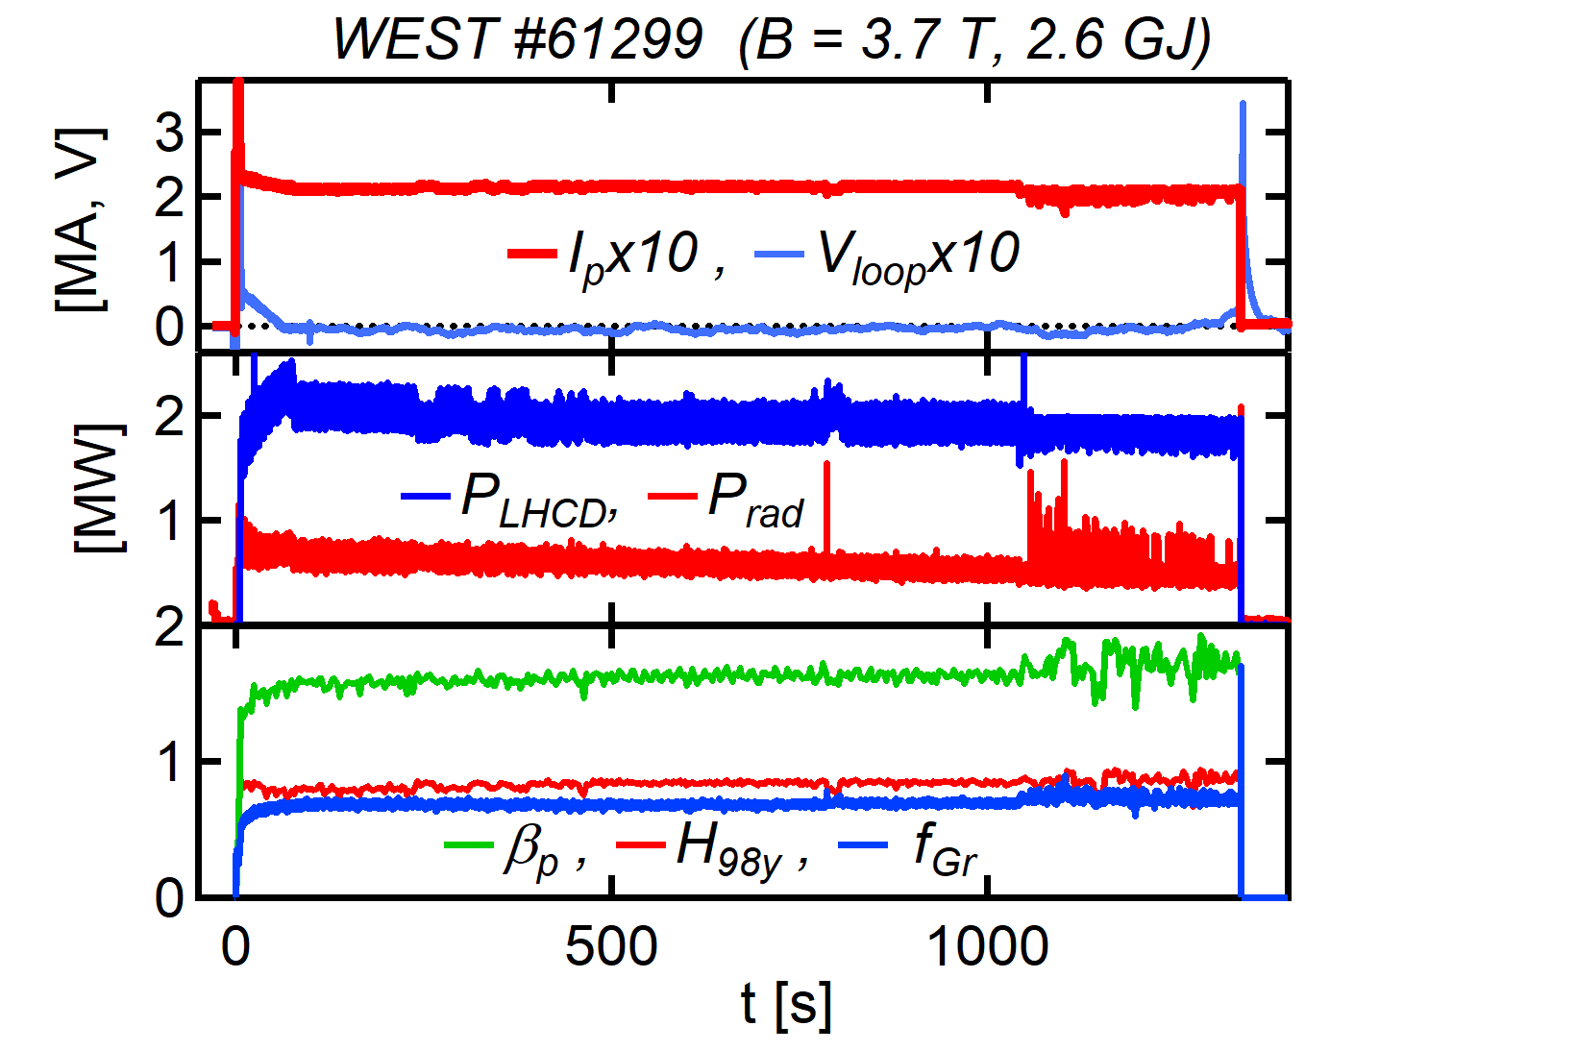
WEST long pulse steady-state plasmas
WEST has demonstrated the possibility of long pulse steady-state plasma operation
1336s plasma operation obtained in conditions of L-mode H₉₈(y,2)~1, β_{p}~1.7, β_{N}<1
In order to better assess JT-60SA, ITER and future tokamaks→ new objective:
High Confinement well controlled steady-state long pulse plasmas in full W environment

Slide 5
WEST long pulse steady-state plasmas
Proposed upgrades expand long pulse, steady state operational domain towards the integration of:
Full impact of W transport and sources and their control
High current and absolute density
H₉₈(y,2)~1, β_{p}~2, β_{N}~2 in H-mode
Plasmas with high fast ion component, electron heating and low rotation
ICRH specific physics (coupling, performance )
High confinement compatibility with power flux to divertor control

Slide 6
Specific physics studies in upgraded WEST
Steady-state, long pulse plasmas with high confinement at high density and Ip require high input power
Upgrade of first wall allows operation with 10MW of input power in W leading to:
H-mode access→ Pedestal and SOL W screening and ELMs W flushing for long time scales including many resistive times
Power through the separatrix similar to the one expected in ITER→Techniques for heat flux to divertor control and compatibility with high confinement and long pulse operation
H₉₈(y,2)~1, β_{p}~2, β_{N}~2 → Study of beta effects on transport and confinement
Mix of ECRH, ICRH and LH for transport studies at low plasma rotation with different fraction of electron vs ion heating at different plasma radius
q profile evolution dominated by bootstrap current→ Current profile alignment
Interplay between MHD and W transport in high beta regimes
Material fatigue in long fluence operation at high confinement

Slide 7
Specific physics studies in upgraded WEST
Steady-state, long pulse plasmas with high confinement at high density and Ip require high input power
Upgrade of first wall allows operation with 10MW of input power in W leading to:
H-mode access→ Pedestal and SOL W screening and ELMs W flushing for long time scales including many resistive times
Power through the separatrix similar to the one expected in ITER→Techniques for heat flux to divertor control and compatibility with high confinement and long pulse operation
H₉₈(y,2)~1, β_{p}~2, β_{N}~2 → Study of beta effects on transport and confinement
Mix of ECRH, ICRH and LH for transport studies at low plasma rotation with different fraction of electron vs ion heating at different plasma radius
q profile evolution dominated by bootstrap current→ Current profile alignment
Interplay between MHD and W transport in high beta regimes
Material fatigue in long fluence operation at high confinement
WEST can provide a key testbed for these topics in full W environment before the operation in JT-60SA and ITER with W PFC

Slide 8
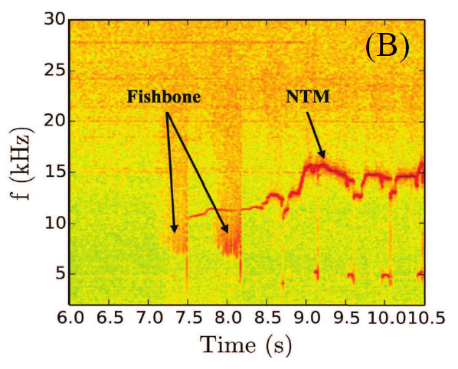
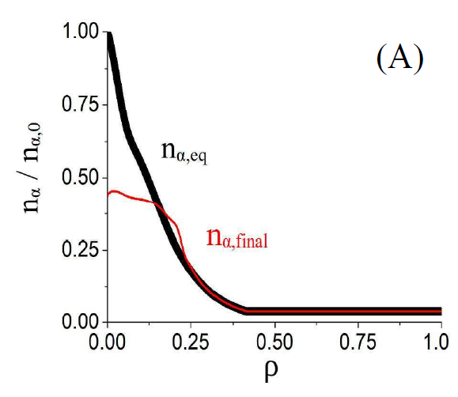
Confinement of Fast ions
Fast ions can have a positive impact on core confinement by reducing turbulence
Reduced ripple will increase the confinement of ICRH generated fast ions → Essential to qualify scenarios in the presence of fast ion content
MHD activity in high confinement steady-state plasmas can lead to fast ion loses as seen in JET(fishbone, NTM etc)
Small fraction of fast ion loses acceptable in short pulses
Concern of MHD driven fast ion loses in high confinement long pulse operation→ impact on W PFC components
FILD diagnostic being evaluated in the framework of WPTE enhancements

Slide 9
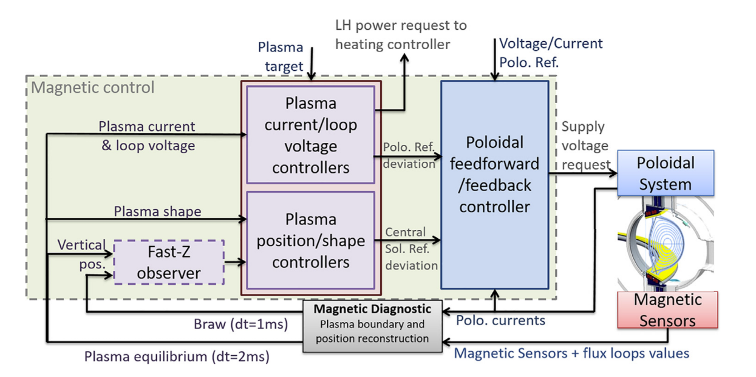
RT control and AI
Steady-state plasma development requires specific RT control techniques to ensure Vloop~0 for long pulse
Systems being already used in long pulse operation in WEST
Current WEST magnetic control logic

Slide 10
RT control and AI
Steady-state plasma development requires specific RT control techniques to ensure Vloop~0 for long pulse
Systems being already used in long pulse operation in WEST
High performance steady state plasmas step-up the complexity→ Significant increase in non-linear physics interplay
WEST upgrade will contribute to:
RT control development including complex physics coupled aspects (Vloop, q profile, Beta, ELM frequency, heat flux to divetor, W source and transport)
Development of AI techniques to ensure safe and machine assisted plasma steady-state development with increasing W_{th} and I_{p}
Current WEST magnetic control logic

Slide 11
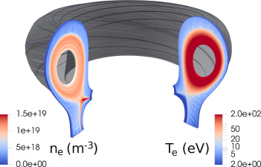
WEST: a testbed for physics models validation for extrapolations
Modelling is essential to extrapolate present day results towards ITER and DEMO
WEST will provide optimum conditions to validate new models notably those developed in IRFM:
New version of SOLEDGE including 3D geometry, electromagnetic effects and drifts→ Pedestal formation, SOL and PWI analyses
Modelling is essential to extrapolate present day results towards ITER and DEMO
WEST will provide optimum conditions to validate new models notably those developed in IRFM:
New version of SOLEDGE including 3D geometry, electromagnetic effects and drifts→ Pedestal formation, SOL and PWI analyses
SOLEDGE simulation for TCV

Slide 12
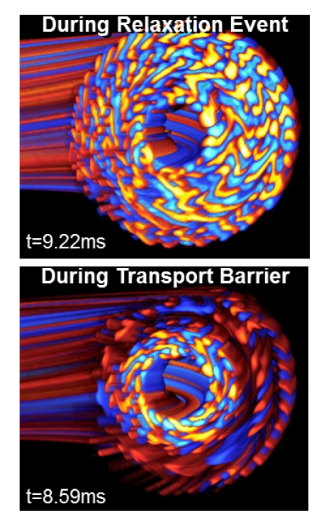
WEST: a testbed for physics models validation for extrapolations
Modelling is essential to extrapolate present day results towards ITER and DEMO
WEST will provide optimum conditions to validate new models notably those developed in IRFM:
New version of SOLEDGE including 3D geometry, electromagnetic effects and drifts→ Pedestal formation, SOL and PWI analyses
Full-f gyrokinetic code GYSELA being upgraded to exascale capabilities (2026)→ Electromagnetic and fast ions effects
Gysela simulation for ITB formation

Slide 13
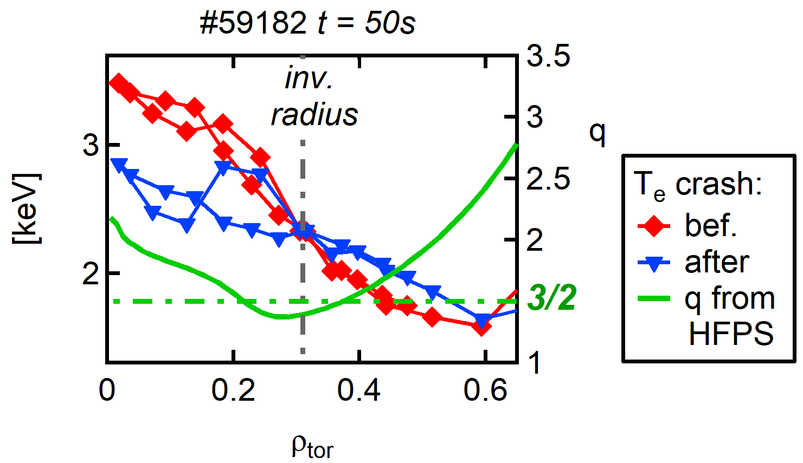
WEST: a testbed for physics models validation for extrapolations
Modelling is essential to extrapolate present day results towards ITER and DEMO
WEST will provide optimum conditions to validate new models notably those developed in IRFM:
New version of SOLEDGE including 3D geometry, electromagnetic effects and drifts→ Pedestal formation, SOL and PWI analyses
Full-f gyrokinetic code GYSELA being upgraded to exascale capabilities (2026)→ Electromagnetic and fast ions effects
Predict first activities and validation of integrated modeling suites (HFPS,ETS) in full IMAS environment→ Readiness for ITER
Experimental location of MHD crashes from ECE consistent with q-profile computed by HFPS

Slide 14
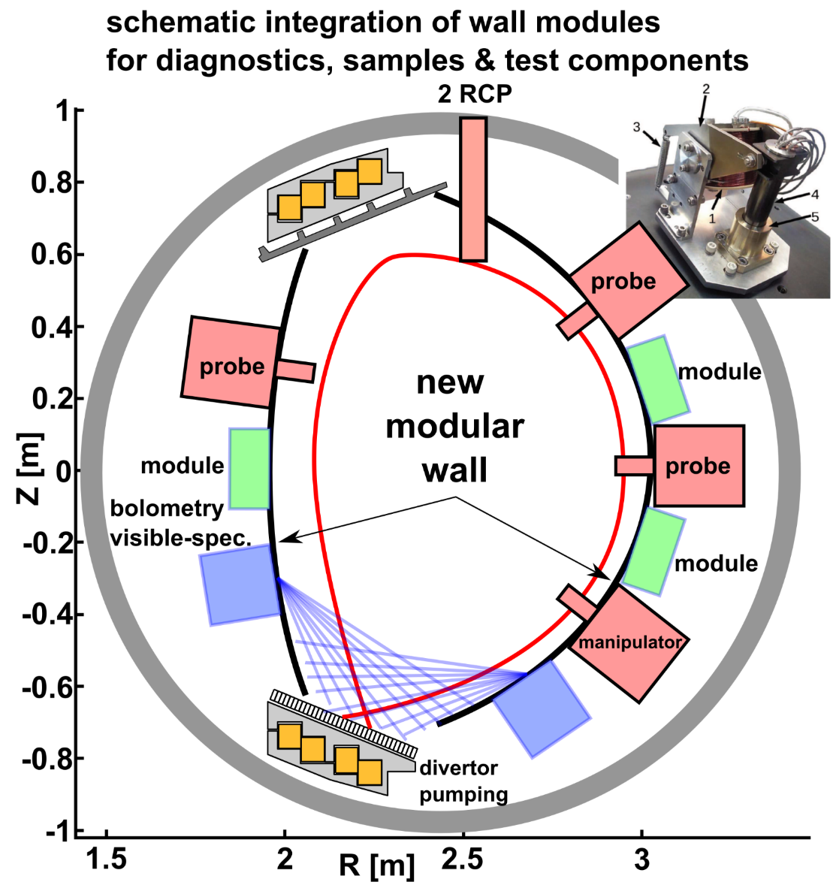
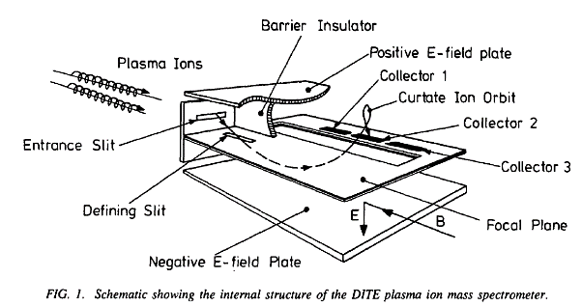
Wall modules integrating diagnostics & test components
Focus on PWI issues for ITER, combined with simulations (SOLEDGE/EIRENE/ERO,etc)
→ Far SOL heat & particle loads, erosion, migration
Magnetically driven reciprocating probes
Existing technology [Gunn et al. RSI 82, 123505 (2011)]
Tunnel probes, RFA, etc
Ion mass spectrometer [Matthews G. Nucl. Fus. 1991]
Impurity composition at wall (erosion)
Instrumented Sample holder
thermocouples, FBG, QMB, MEMs, etc
Optical modules
Visible spectroscopy
Bolometry (infra-red concept WPTE “enhancement”)
Test components
ITER like, innovative shapes & materials, blanket modules
migration markers, etc
Neutral particle analysers (charge exchange)
RFA head (2024)

Slide 15
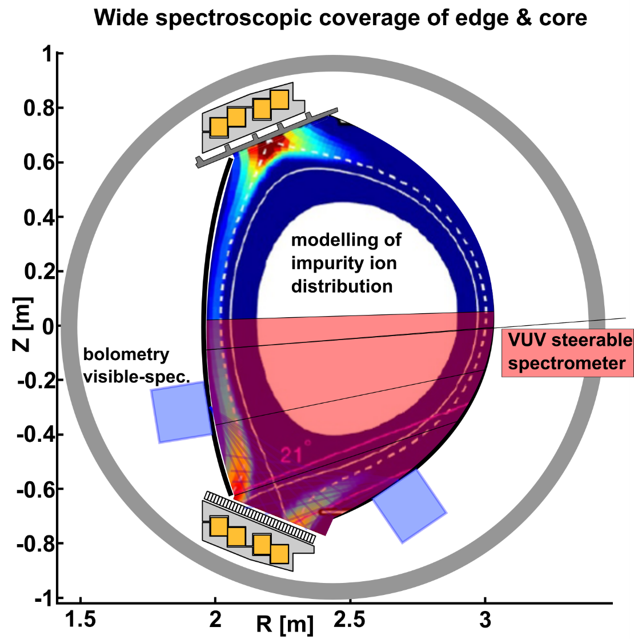
Specific focus on Tungsten erosion & transport
A strong effort should be put on spectroscopy to prepare ITER operation and analyses
Advanced spectral analyses (broadband, AI aided, etc) combined with simulations
Validation of atomic models & databases
Validation of transport models
Existing Visible spectroscopy + new modules
Standard & High spectral resolution → erosion/redeposition
Impurity mix at wall + divertors
Focus on metallic reflexions, wall surface evolution
Integrated analyses with simulation (SOLEDFGE/EIRENE/ERO/etc)
Ion mass spectrometer [Matthews G. Nucl. Fus. 1991]
Impurity composition at wall (erosion)
Update VUV steerable spectroscopy [Schwob J.L. RSI 1987]
High spectral resolution (0.2A)
Absolutely calibrated (w. calibration bench)
Increase spectral range to 15-340A
Vertically tunable line of sight (divertor + core plasmas)

Slide 16
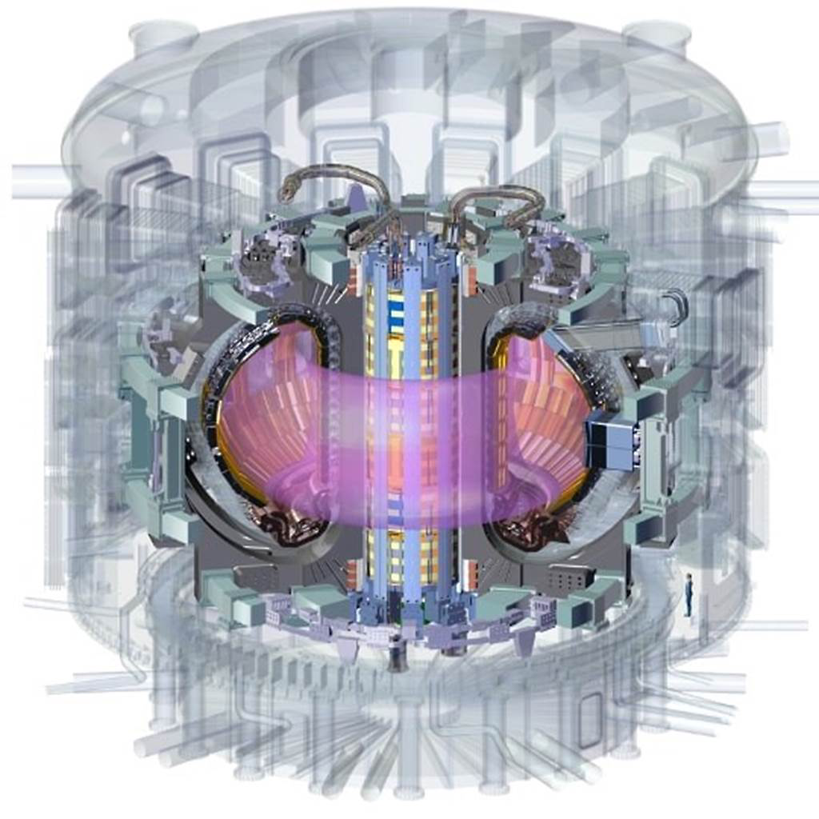
Assess ITER Research plan strategy
ITER is undergoing a redefinition of its research plan after the rebaseline
Initial development of short pulses (SRO and FPO1-3) will be followed by the extension of such pulses with Q=10 to long pulse operation
Extension to long pulse operation requires careful assessment of q profile evolution, MHD activity, W behavior etc→ Active and passive techniques being envisaged to extend the pulses in ITER
Such techniques can be tested first in WEST upgrade including the validity of models for predictions of long pulse from short pulse operation

Slide 17
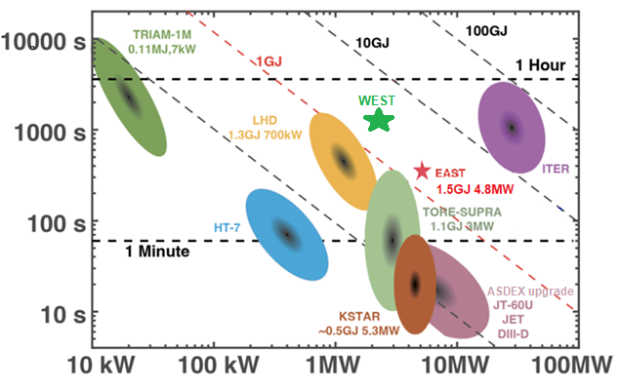
Conclusions
Challenges in long pulse operation should not be underestimated
Compatibility of steady-state, long pulse, high performance scenarios in full W environment remains to be proven
Injected energy in the plasma
Pulse duration
Injected input power in the plasma

Slide 18
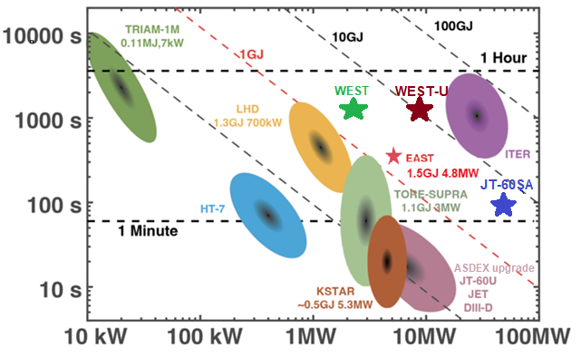
Conclusions
Challenges in long pulse operation should not be underestimated
Compatibility of steady-state, long pulse, high performance scenarios in full W environment remains to be proven
WEST upgrade can provide a unique European testbed to assess such plasma conditions before JT-60SA (W) and ITER operation
Contributing to assess the physics expected in such devices in some burning plasmas conditions
Contributing to speed-up the learning curve of long pulse operation in tokamaks
Training a full generation of young researchers, technicians and operators into the challenges of long pulse tokamak operation
Injected energy in the plasma
Pulse duration
Injected input power in the plasma

