Slide 1
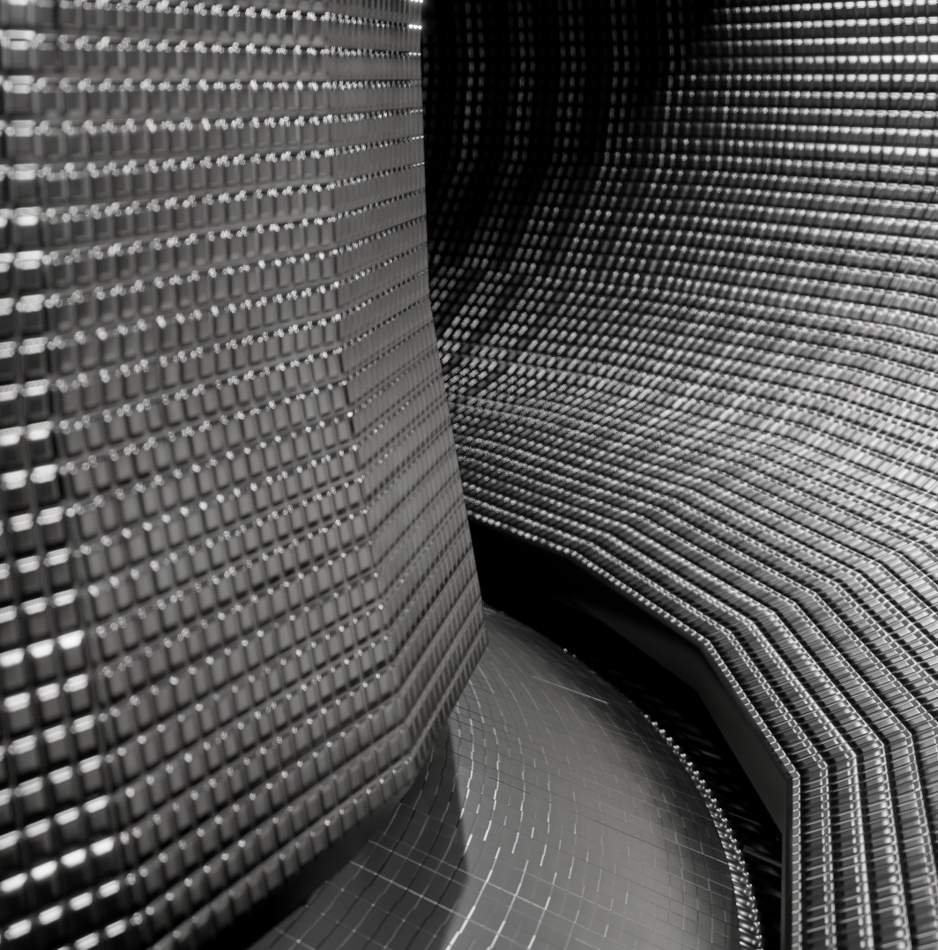
Overview of WEST platform: achievements and possible upgrades
Lionel Meunier
March 17th 2025

Slide 2
WEST Capabilities
1

Slide 3
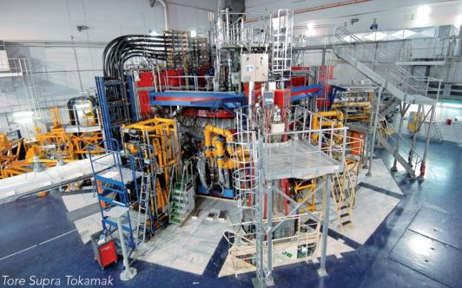

WEST: a MA class superconducting tokamak
I_{p} (q₉₅~2.5) | 1.0 MA
B_{ϕ} | 3.7 T
R | 2.5 m
a | 0.5 m
A | 5-6
κ | 1.35
δ | Up to 0.5
V_{p} | 15 m³
n_{GW} (1MA) | 1.5 10²⁰ m⁻³
P_{RF_Steady state} | 12MW (2025)
T_{flattop} | 1000 s
Full tungsten actively cooled PFC
Flexible magnetic configuration (LSN, USN, DN)
Large current drive capability
Long pulse operation >1000 s
3

Slide 4
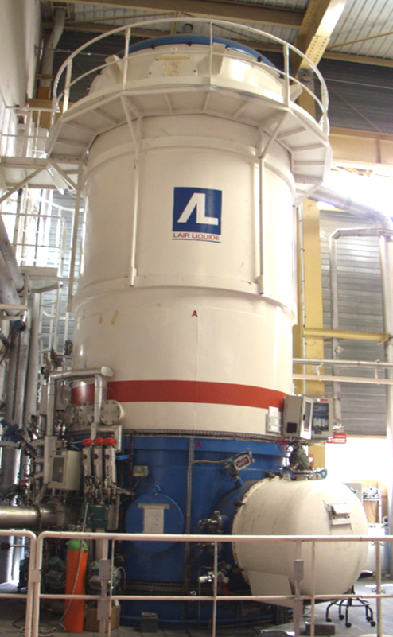
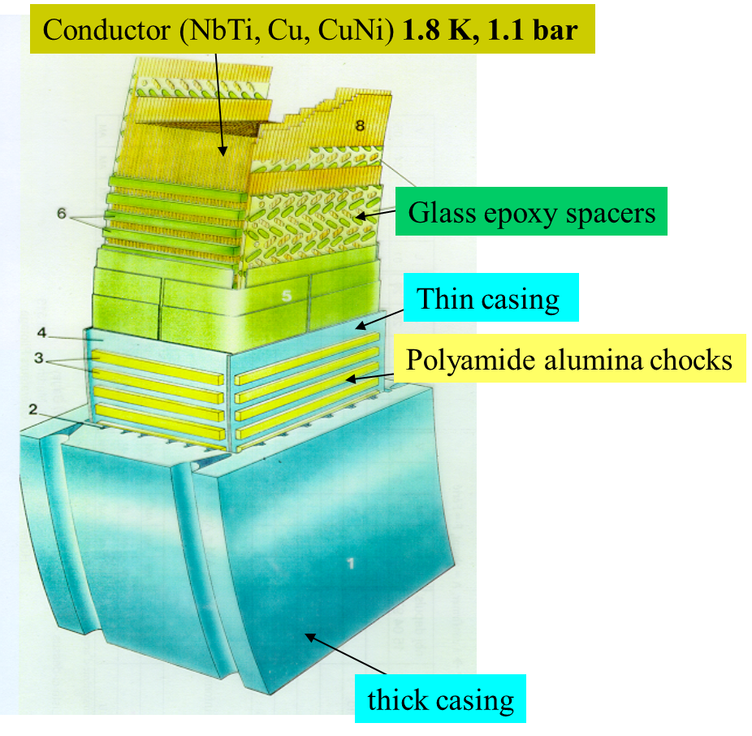
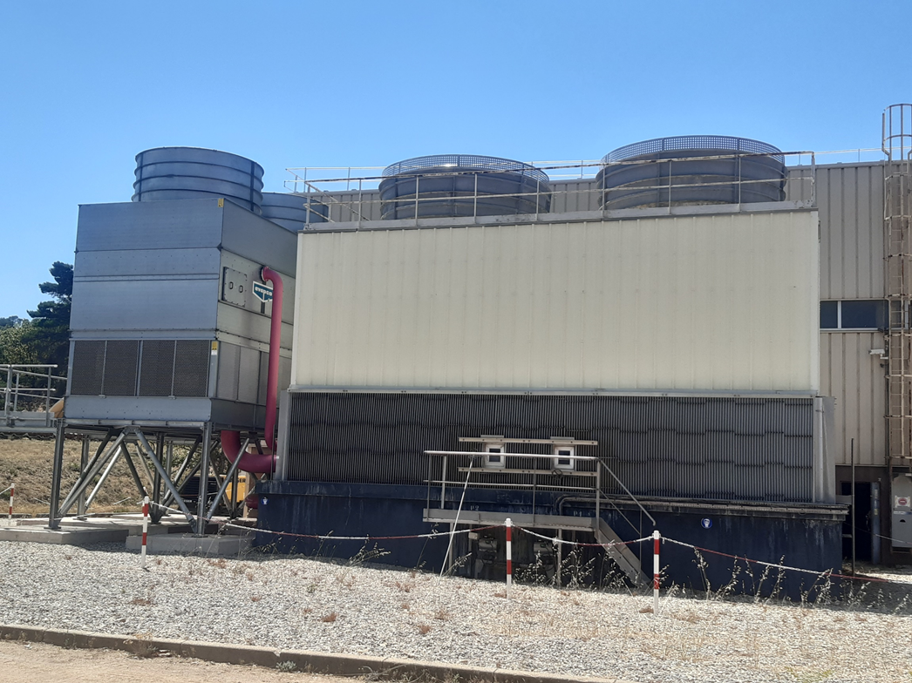
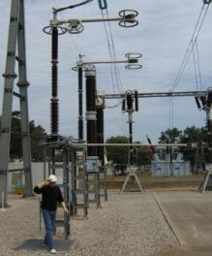
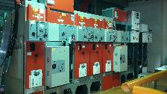
WEST auxiliary systems ready for 10MW-1000s
Magnets
  18 TF Superconducting NbTi magnets
  9 CS/PF water cooled Copper Coils
  Upper and Lower water cooled Copper Divertor Coils
Cryoplant to cool down magnets
  300W @ 1.8K, 1kW @ 4.5K
  3.5 tons of helium inventory
Water cooling system
  Recently upgraded to 15MW steady-state (third cooling tower)
  Dedicated high pressure and temperature water loop (PFC 200°C-40bars, LHCD, ICRH, ECRH)
~ 8m
Electrical Power Supplies
  400kV direct connection
10MW cooling water
towers
Heating systems
  Lower Hybrid: 6MW steady-state available
  ICRH: 3MW steady-state available
  ECRH: 3MW steady-state being installed
New cooling water tower
400kV
2 x 15kV
4

Slide 5
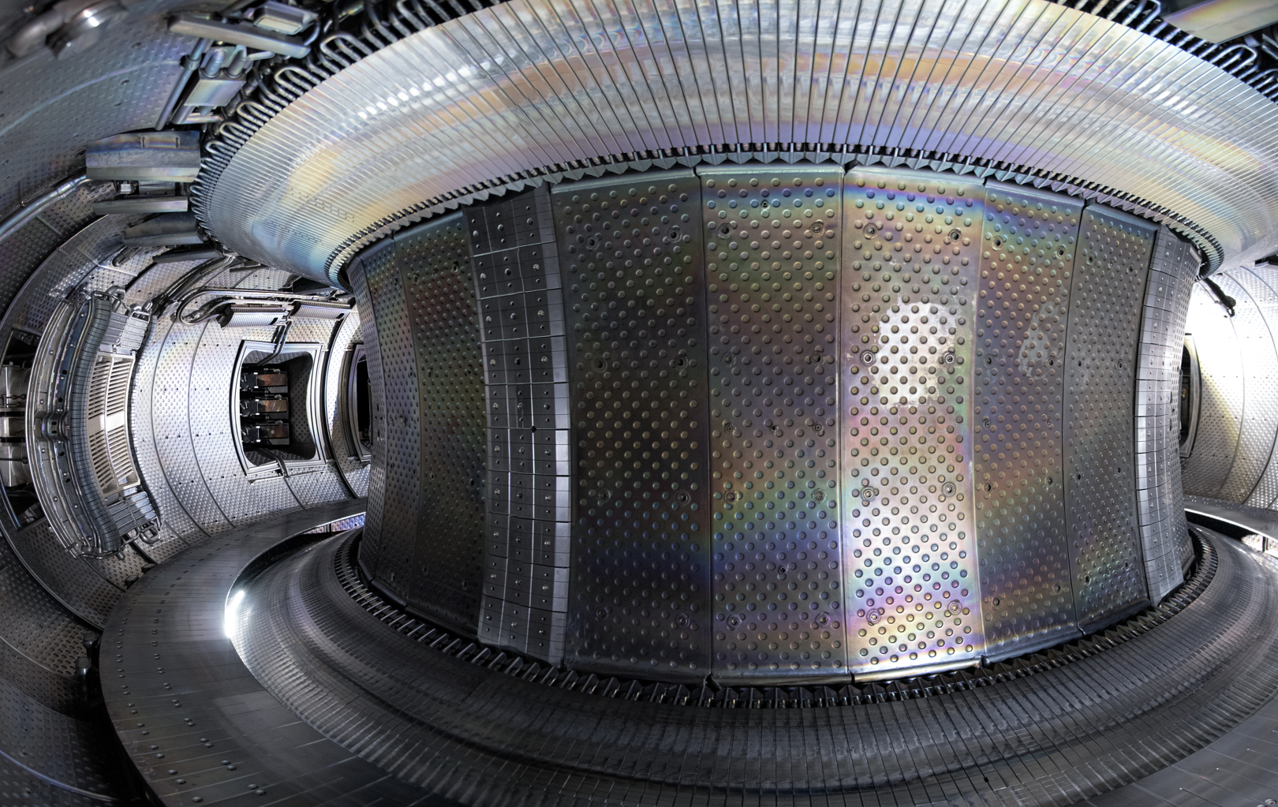
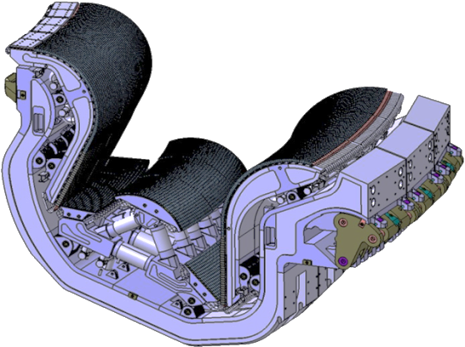
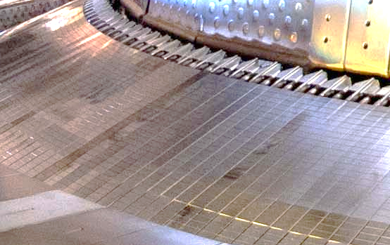
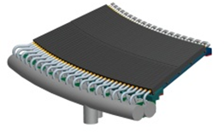


WEST: ITER-grade divertor and W limiters First Wall
WEST in 2025
Upper divertor
W coating/CuCrZr
ITER divertor cassette
VDE/Ripple protection
W coating / CuCrZr
Antenna protections
W coating / CFC
Inner limiters
Bulk W
Vessel protection panels
Stainless steel
Outer limiters
Bulk W
ITER like PFU
bulk W
Baffle
W coating /CuCrZr
ITER-like WEST divertor
Phase 1 (Dec 2016 – Jan. 2021) | Phase 2 (≥2021)
Actively cooled + W coated inertial divertor elements | Fully actively cooled ITER grade divertor
5

Slide 6
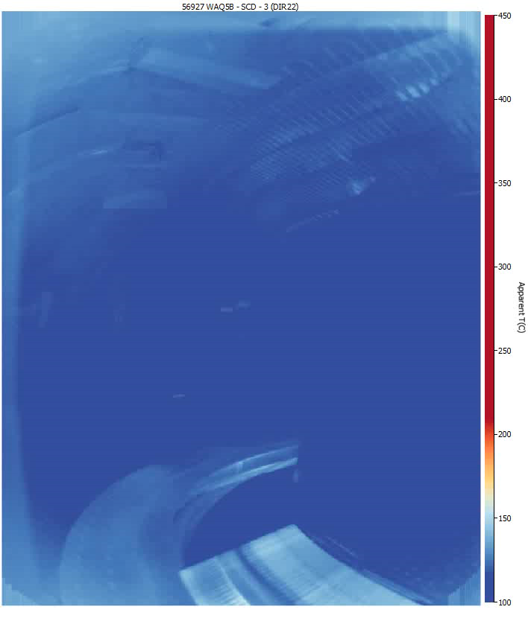
WEST real time wall protection key tool for Long pulse operation
IR diagnostics installed on the WEST tokamak covering 52% of the 1st wall, 85% of the lower divertor
Real time feedback control of the injected power on apparent temperature of multiple regions of interest
Interlock: temperature threshold leading to plasma soft landing
Advanced RT processing to address reflection and emissivity issues (IA)
Additional diagnostics for wall protection
VUV (Vacuum Ultra Violet) on cooper wavelength: Real time feedback control acting on the injected power
Calorimetry diagnostic (~200 sensors & flow meters implemented) with automatic Data processing tool
6

Slide 7
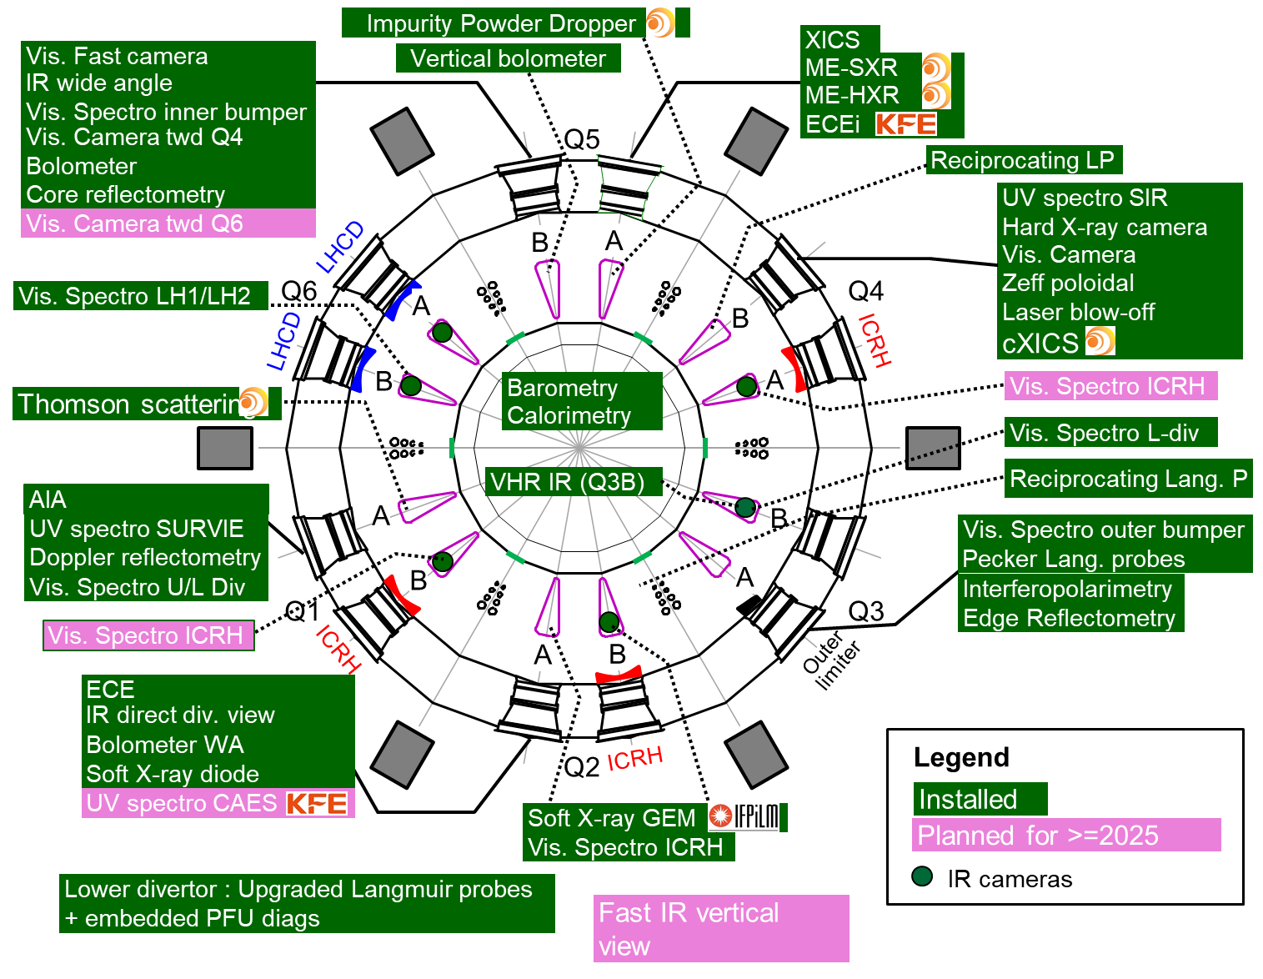
Wide range of diagnostics

Slide 8
WEST Achievements
2

Slide 9
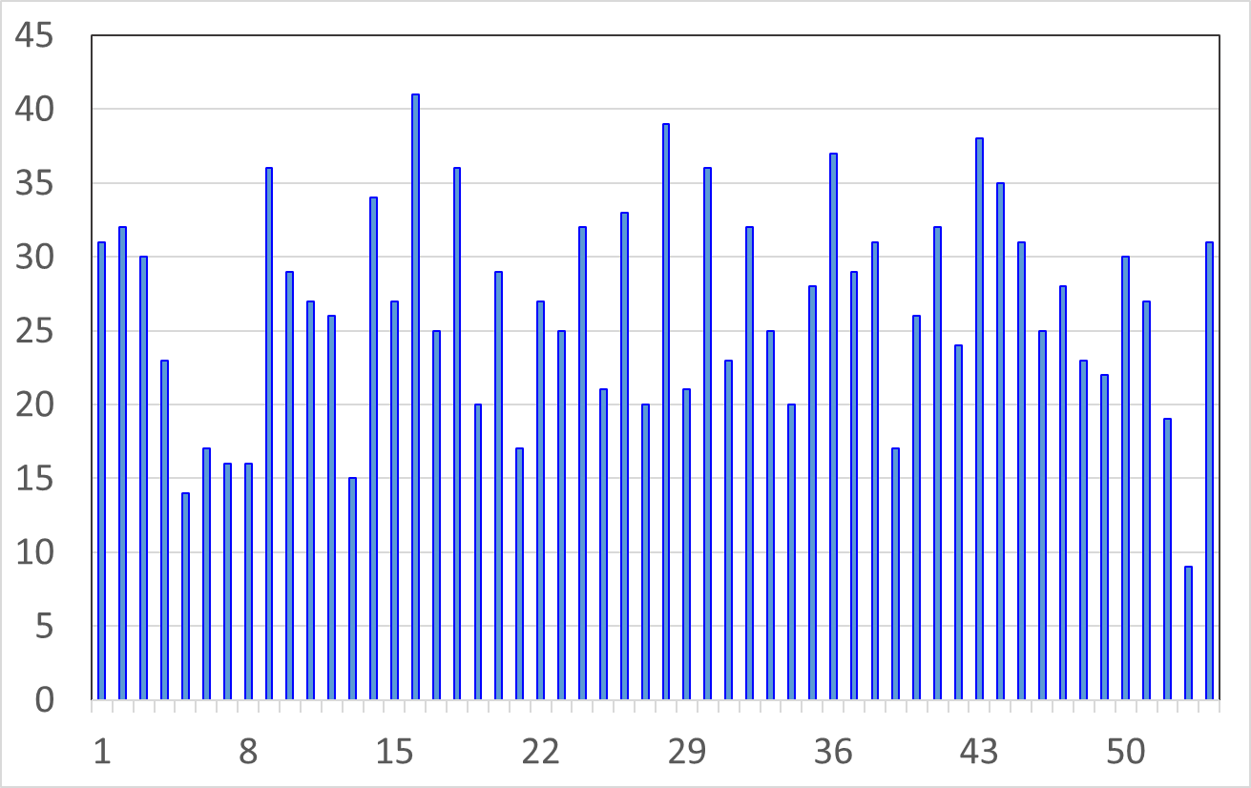
WEST plasma campaigns
  WEST availability > 70% since 2019 during plasma campaigns
Number of pulses/day
Plasma pulses
Year | Total | Failed | Commissioning plasmas | Physics program
2023 | 1420 | 13% | 15% | 72%
2024 | 1478 | 9% | 14% | 77%
  30 pulses/day (shift up to 9:00pm)
  22 pulses/day (shift up to 6:00pm)
Up to 45 pulses per day

Slide 10
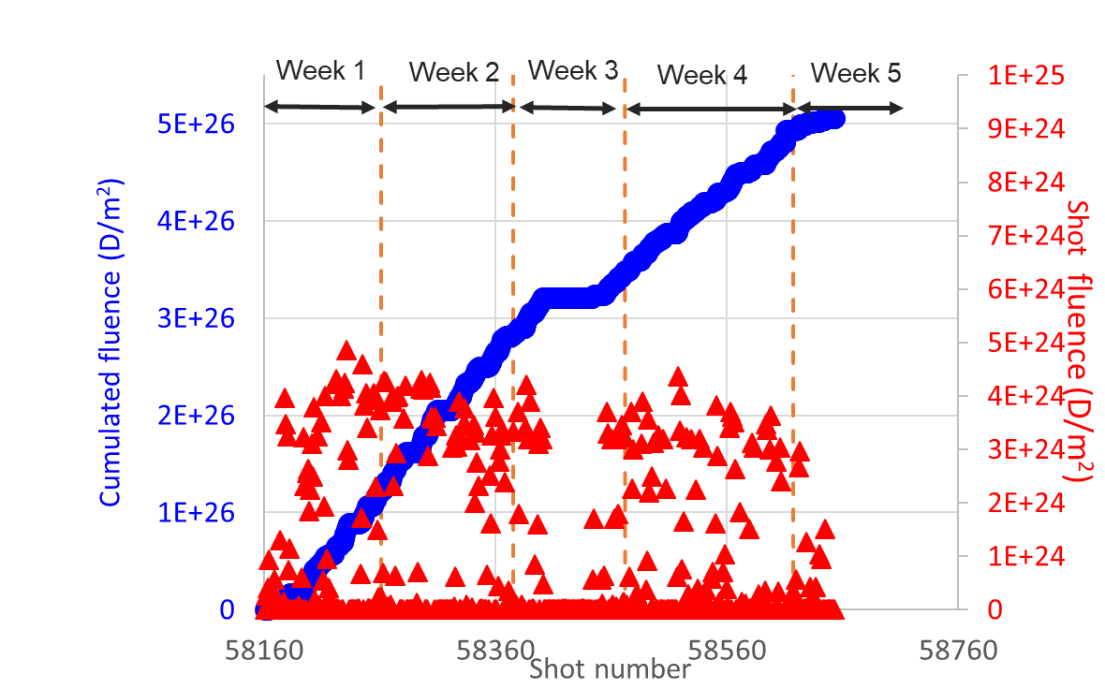
Long pulse operations
2023 plasma campaign was partly dedicated to high fluence
  1 months of repeated long pulses of 60s target
  3h of cumulated plasmas over 300 pulses
  111 pulses >50s
  145 stopped by UFO (W influx) → increasing over campaign
  55 stopped by IR (hot spot/deposit) or LHCD system (klystrons)
2024-25 : 11 sessions dedicated to long pulse operations :
79 plasma shots over 60s
40 plasma shots over 100s
7 plasma shots over 500s
Reaching 4h10 of plasma
Slower slope
PCS CODAC issue
Record pulse with 1337s and 2,6 GJ injected power
Repetition of long pulses on a single day (>2300s)
Paving the way towards high fluence operation → several hours of plasma per day (terra incognita!)
JET C30-C
1 shot
ITER PFPO
(200s)

Slide 11
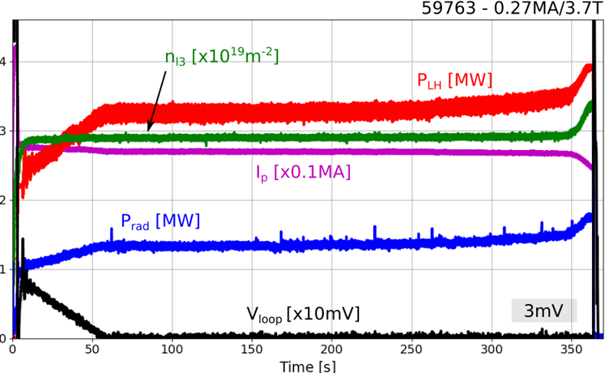
Very long pulse operations limitation
Outgassing observed after 100’s with conditioning effect
Around 2% of the VV is not perfectly protected (~1m²)
  Gaps between lower/upper divertor and first wall (to allow easy removal of the divertor PFUs)
  Few centimeters gaps in the ports
  Steel temperature of gap protections reaches at least 300°C on long pulses
  Cause outgassing limiting long pulses for specific scenario
Thermal radiation on VV

Slide 12
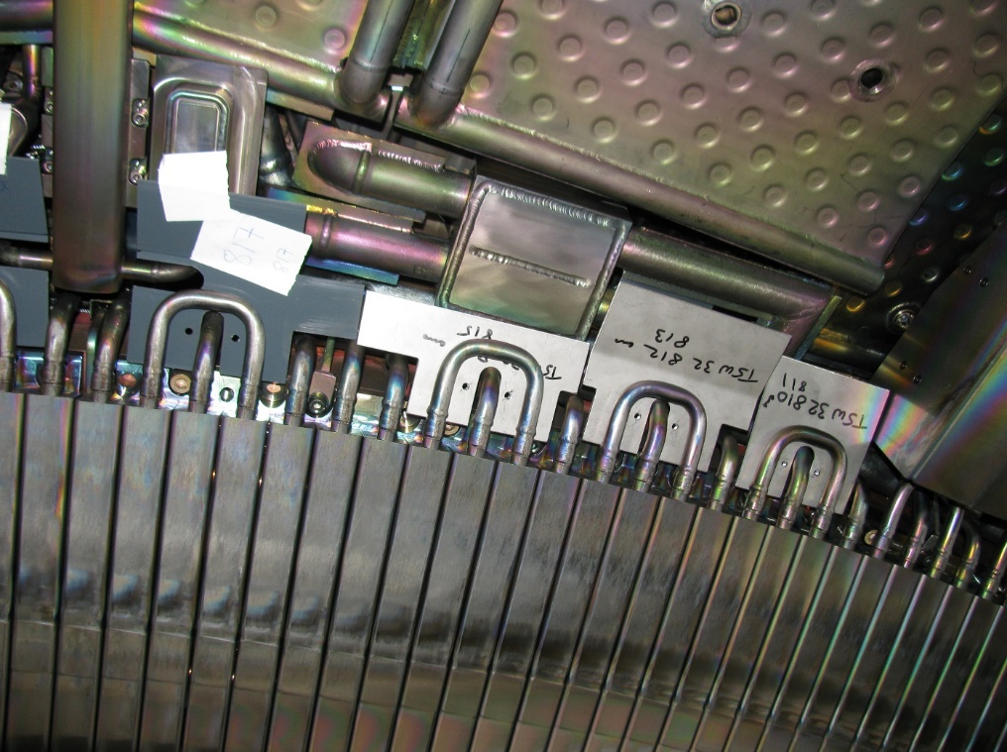
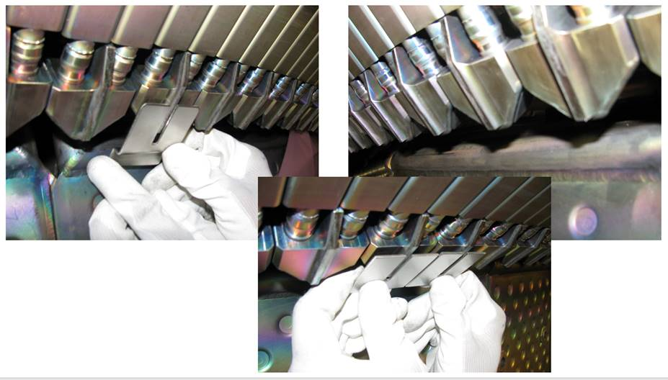
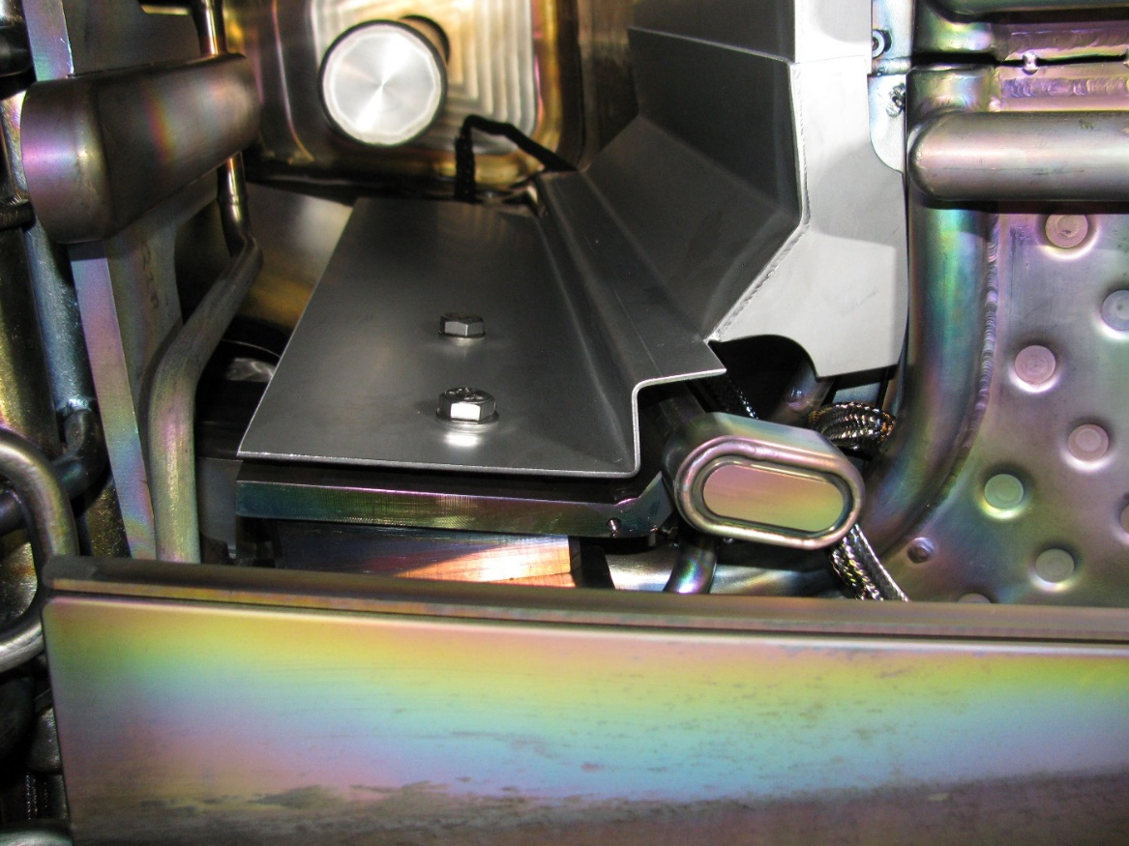
Gap protections: welded SS plates

Slide 13
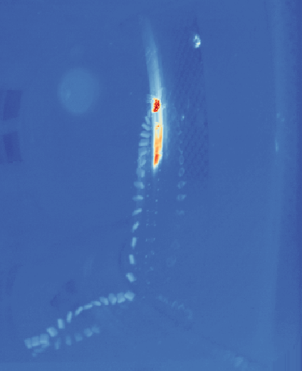
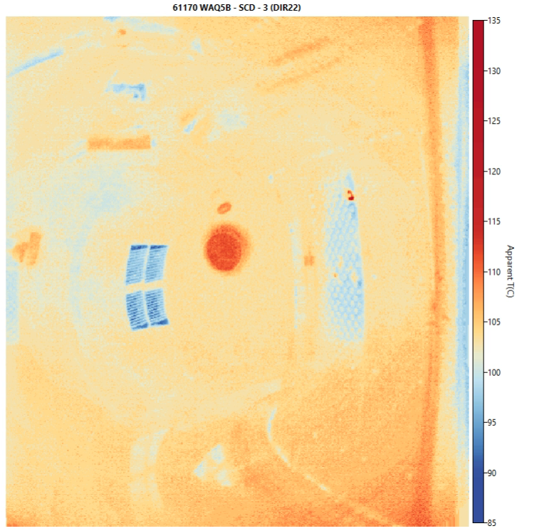
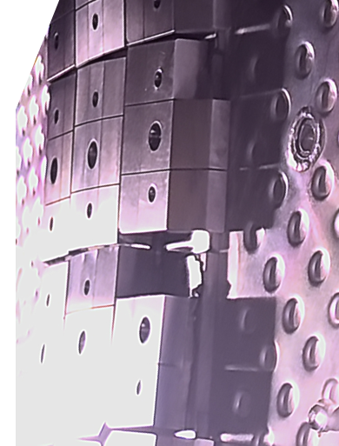
Issues with inner limiters
A phenomenon occurring on new Bulk W tiles of the inner limiters installed in 2024:
Components are 25mm thick bulk W, bolted on a Copper cooled support
30mm x 30mm castellations
Several castellations broke during C10/11 campaigns
Cause is under investigation
  Twisting effect?
  EM forces?
  Machining?
Experience of components in real Tokamak environment provides information on load cases to consider and engineering rules to apply

Slide 14
WEST proposed upgrades
3
Towards 10MW / 1000s

Slide 15
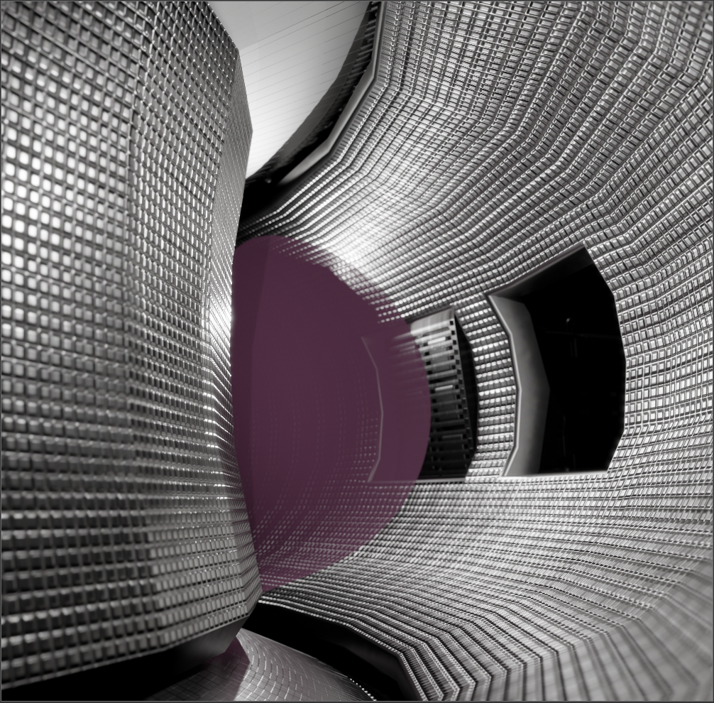
Full Tungsten Jacket
Modify WEST inner configuration
  10MW radiated - 1000s objective for all components
  Overcome component thermal limitations with 100% water cooled systems
ITER like wall
  Removed
    Baffle
    Inner and outer bumpers
    VDE and ripple protections
    Stainless Steel protection panels
  Full Tungsten Jacket
    W wall
    ITER relevant plasma / wall gap (6-10cm ?)
    Conform wall ? – Limiters ?
    Antennas integrated in the W wall
Cryopumps
  Gap between new wall and VV will allow installation of cryopumps
  Improved pumping mode

Slide 16
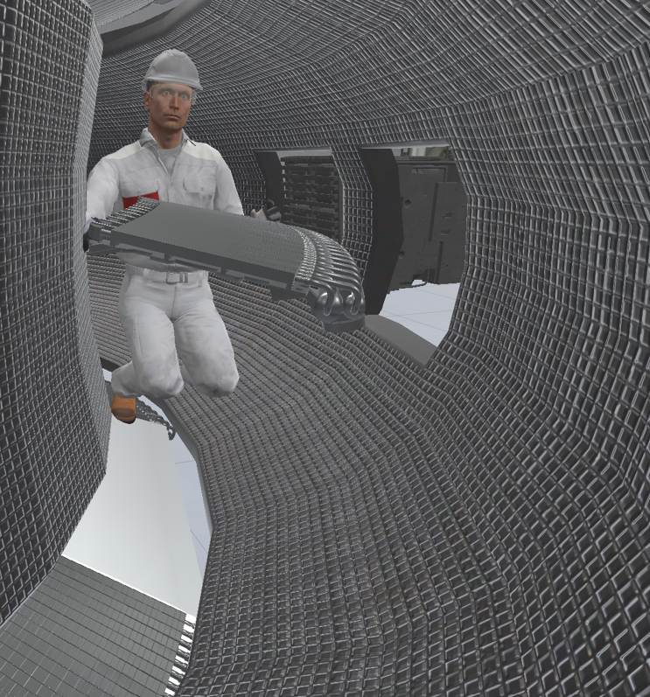
Full Tungsten Jacket
Modularity of FW
  Test ITER and DEMO relevant technologies / design
  Test advanced FW technologies
  Install and maintain FW diagnostics
  Maintenance of Lower and Upper divertor and inner components

Slide 17
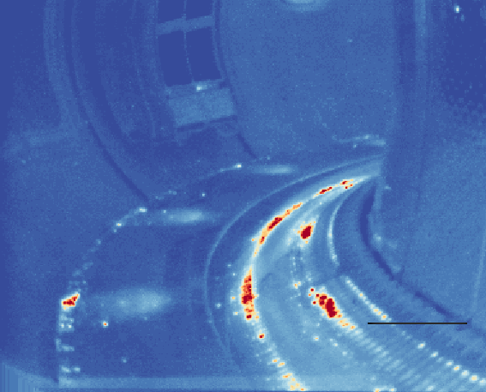
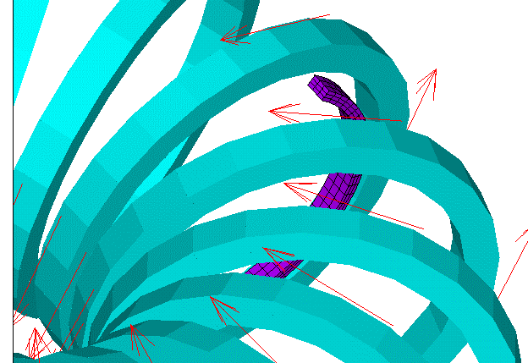
Ripple
Ripple Correction Coils
WEST ripple causes energy losses, warming up the Upper Divertor water pipes
Ripple correction with Ferromagnetic inserts installed in the VV has been studied:
Would divide ripple by a factor of 2 with 130mm inserts

Slide 18
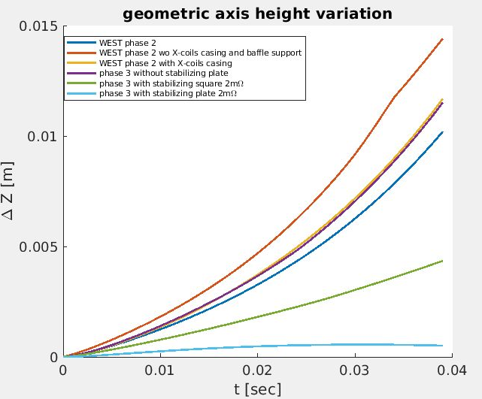
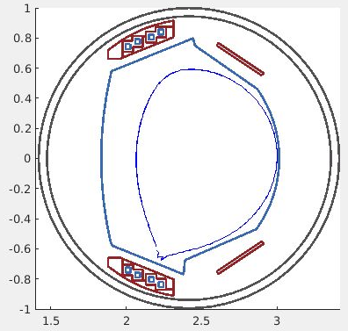
Stabilizing plates
Copper plates (Thickness: 2cm, width: 36cm) connected with resistances to get the desired total resistance

Slide 19
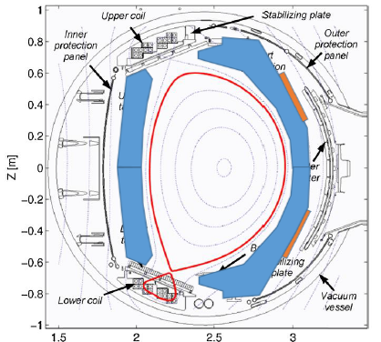

Slide 20
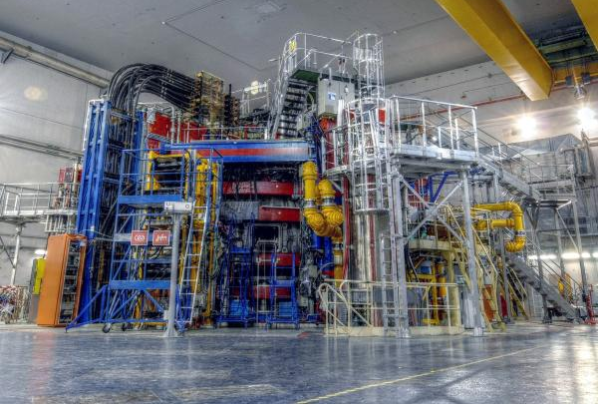
Torus hall configuration
Space available all around the tokamak
  Flexibility for integration of new systems
  Easy maintenance
Services available on all equatorial, upper and lower ports
  Water cooling: B30 loop (70°C in operation / 200°C baking) – STEFFI loop (20-30°C)
  Pressurized air / Electrical power / vacuum pumping

Slide 21
Gap protections limitation
Sacrificial protection panels have been included where possible
Adding actively cooled protections has been studied and would impose significant modification of internal components
→ Record WEST pulse already close to the limits
Objective is to overcome these limits towards long pulses with high power and high fluence

