Slide 1
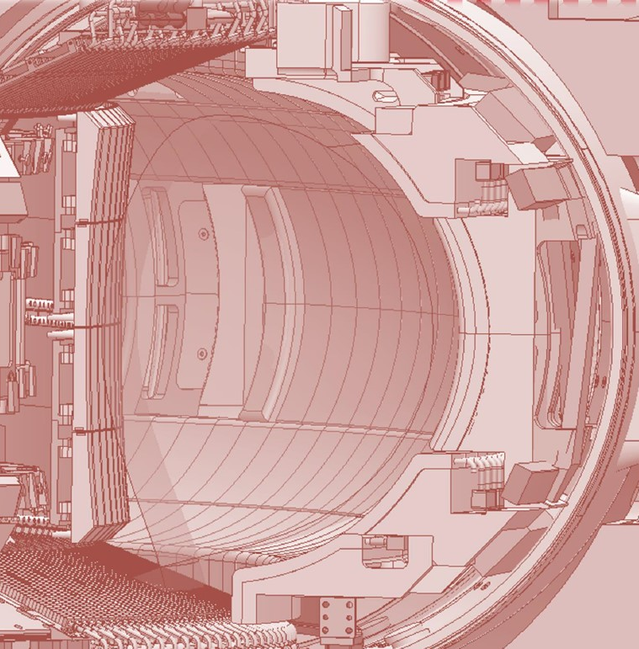

WEST – Technological case
17/03/2025
CEA / IRFM
© Iter organization

Slide 2
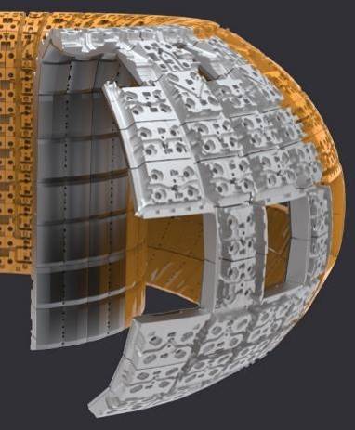
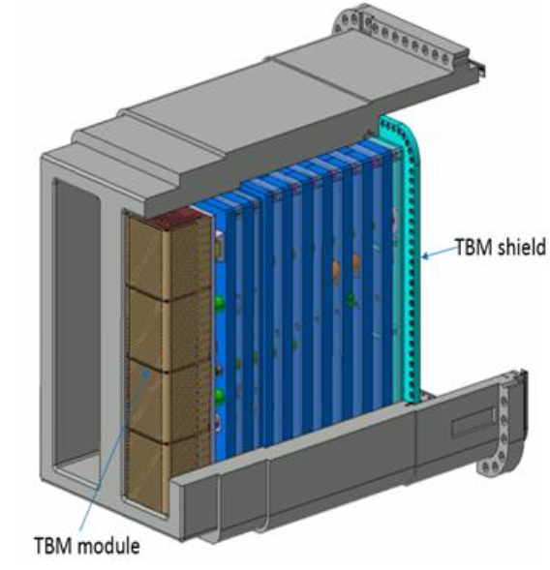
WEST 10 GJ: an opportunity to test fusion technologies in tokamak
FIRST WALL
BREEDING BLANKET
Tokamak environment : magnetic, heat, particle loads, etc.

Slide 3
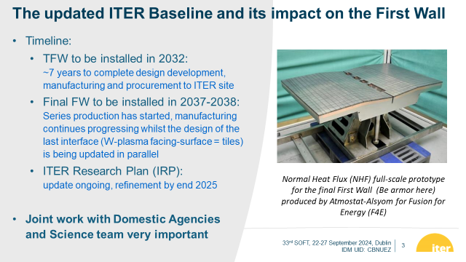
ITER FIRST WALL: key dates

Slide 4
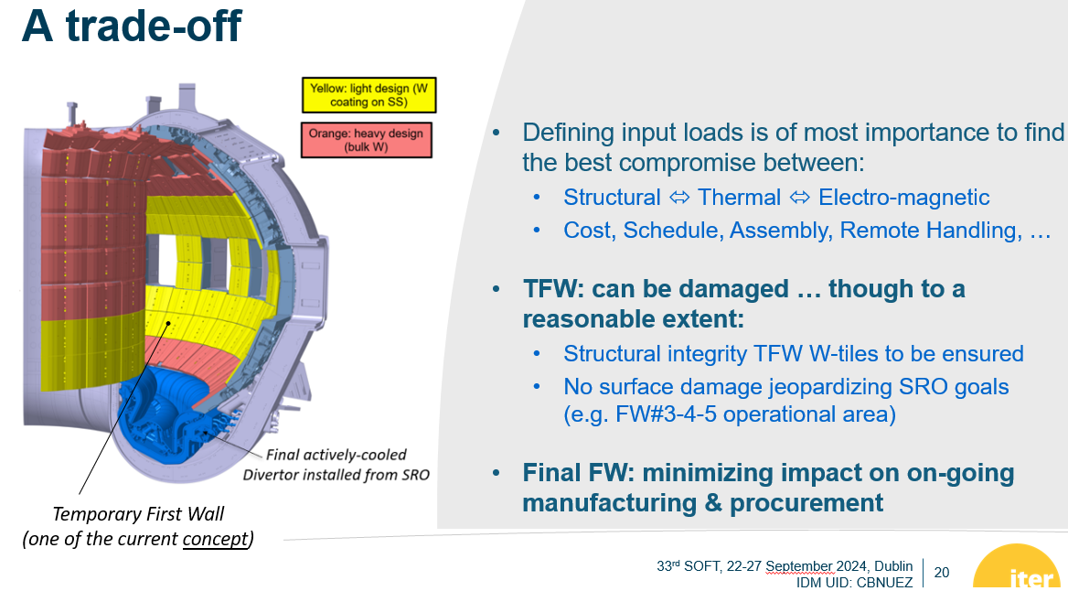
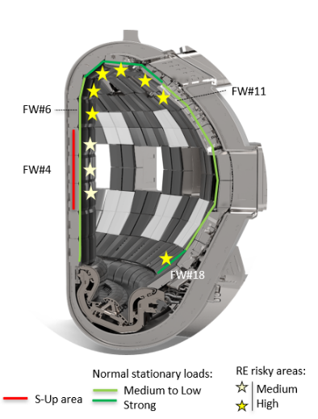
ITER Start of Research Operation phase (TFW)
Radiative flux on ITER FW ~0.1-0.2 MW/m² for P_{rad} ~75-150 MW

Slide 5
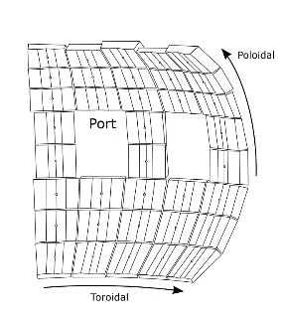
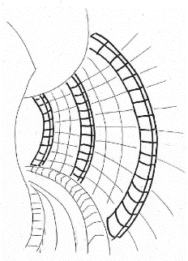
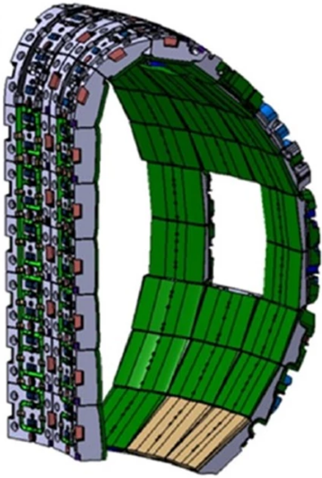
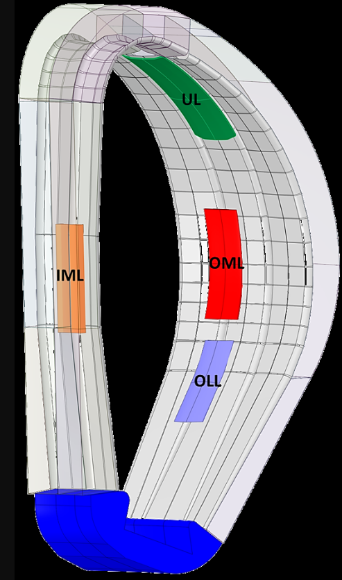
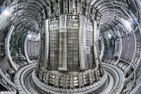
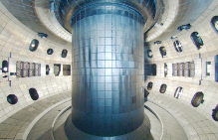
Test bed for first wall architecture
Limiters
Conformal wall
ITER
DEMO
Have a significant area fraction with recessed panels, components with reduced PWI, cheaper
Damages well localised and maintenance is easier, sacrificial components
Panels attempting at "fitting" the toroidal surface curvature. No protruding limiters.
Better usage of interior volume toward nuclear shielding against 14 MeV neutrons.
Regarding the surface heat flux, hope to better "spread" the heat load
JET
DIII-D
►Historical architecture
► Current conceptual trend
For WEST upgrade, it could be a combination of both, for example:
- a conformal wall on the inner side for a plasma start-up similar to ITER
- and limiters on the outer side (DEMO like) to reduce manufacturing and maintenance costs.
Open question…

Slide 6
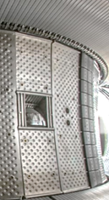
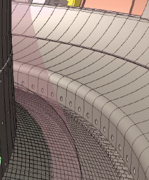
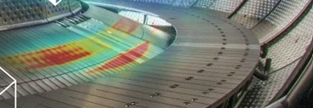
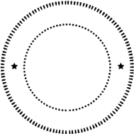
W-based First Wall technologies
Objective : cover the WEST chamber with modules depending on loads and FW architecture choices → conformal or limiters? ITER-like inner? DEMO-like outer?
Full coverage with W PFC, including lower and upper parts near the divertor areas
Current :
steel panels
(watercooled)
Radiative flux on WEST FW ~0.1-0.2 MW/m² for P_{rad}~5-10MW
First wall with W-coating
Water-cooled to sustain long pulse operation
Stainless steel heat sink sufficient for 1MW/m²
(coating thickness few tens µm - to be defined)
Note, CEA is part of the WPDIV/DEMO study related to W-coating on 316L, medium to large scale (500x500mm)
(cheaper !)
First wall with W-tiles
Water-cooled to sustain long pulse operation
Stainless steel heat sink sufficient for 1MW/m²
(tile thickness few mm – to be defined)
Resilience to abnormal events & erosion
(cost  ; weight )
Industrial
pre-series

Slide 7
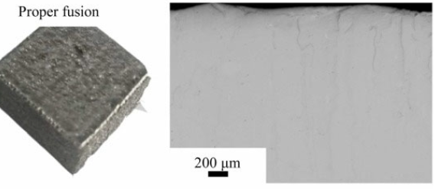
Test-bed for W-based First Wall technologies
Easily dismountable design for maintenance and divertor sector extraction
Objective : Modular design make it possible to integrate test modules to assess relevant technologies (for ITER, DEMO, JT-60SA,…
Assessing the limit (margin) of various technologies including embedded instrumentation & monitoring (IR cam., TC, calorimetry, Langmuir probes, FBG)
Inertial technology of the ITER Temporary First Wall
(solutions based on W-coating or bolted W-tiles,…)
Final ITER actively cooled First Wall technology
(also) Assessing the performance and lifetime of advanced technologies:
PFC produced using 100% additive manufacturing (cost savings)
W armour (nanostructured W alloy, fiber-reinforced, Diamond-W layers,...)
W fabricated through EBM
© Northwest Institute for Nonferrous Metal Research - China

Slide 8
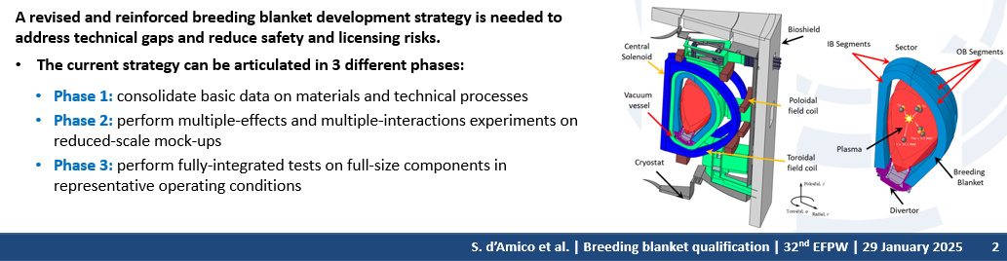
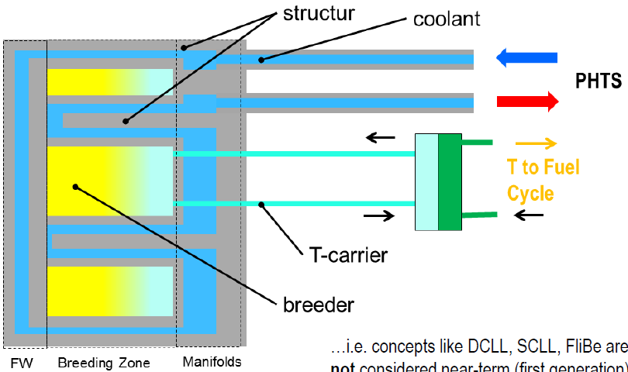
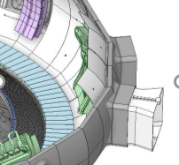

Test-bed for Breeding Blanket technologies
Objective : Contribute to TBM / Breeding Blanket qualification
e
Integration of a reduced-scale mock-up of a TBM / BB to design, manufacture, and test an EUROFER component under various environmental conditions and plasma interactions, through a dedicated port.
$©$ P. Arena (ENEA)

Slide 9

Test-bed for Breeding Blanket technologies
Objective : Contribute to TBM / Breeding Blanket qualification
To be done in coordination with F4E able to provide EUROFER and other EU partners: EUROfusion WPBB & WPMAT and the F4E TBM teams
Based on ITER Research Plan (ITR-18-003)– Test Blanket Module (testing program) :
Phase 1 – Consolidate data on material and manufacturing processes
Reduced-scale mock-ups manufacturability adressing critical aspects:
Structural material properties, joints, W-EUROFER and EUROFER-EUROFER interfaces,…
Qualification of Nuclear Pressure Equipment (ESPN)
Experimental campaigns (HHF testing)
On-going
Please note that it also makes sense to start with SS for design checkings
Phase 2a – Investigation of BB behaviour in tokamak conditions
Thermo-mechanical behaviour at relevant temperatures (thermal stresss of joint, interfaces)
Evaluation of the structural integrity under combined thermal, mechanical and EM loads (disruptions, VDEs) → with dedicated embedded diagnostics.
As a whole, contribution to codification of EUROFER in RCC-MRx in support of WPMAT and F4E: operation of EUROFER component in tokamak is needed to remove EUROFER of RPP rules of RCC-MRx.
~ 700Hx700Wx800D (mm)

Slide 10
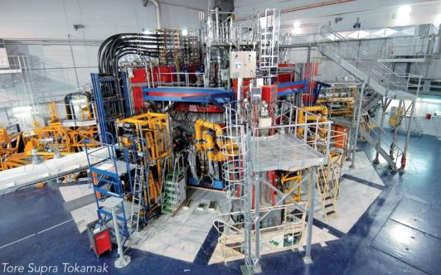
Test-bed for Breeding Blanket technologies
Objective : Contribute to TBM / Breeding Blanket qualification
Phase 2c – Current WEST Water cooling loop (70-120°C- 40 bars)
Validation of the performance and predictability of heat extraction from the First Wall, taking into account the deposited surface heat, TC measurements, cooling loop calorimetry.
FW based on thin EUROFER with 2 mm-W layer can be tested.
Phase 2d – WEST with DEMO Water cooling loop (300°C- 155 bars)
Participation of the qualification of ACPs code (OSCAR-Fusion) under magnetic field in support of WPSAE and WPPrIO. Determination of the ionic and particulate forms and their concentration compared to prediction.
Introduction of metal liquid behavior
Phase 2e – A dedicated Helium loop (300-500°C – 80 bars) – HCPB
~ 5.10¹¹ n_{D-D} /s /m² - 2.45 MeV
~ 10⁹ n_{D-T} /s /m² - 14 MeV
Room available for additional auxiliary systems in tokamak building
WEST neutron flux
SPND¹ and Optimized Fission chamber, assessed in WPBB / slim cassette tested in real environment (magnetic field)
¹SPND -> Self-Powered Neutron Detector

Slide 11
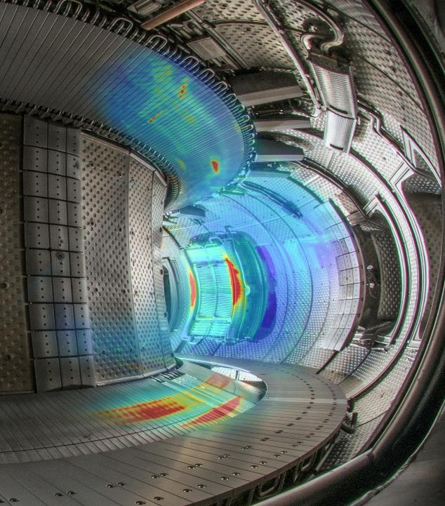
Thanks for your attention

Slide 12
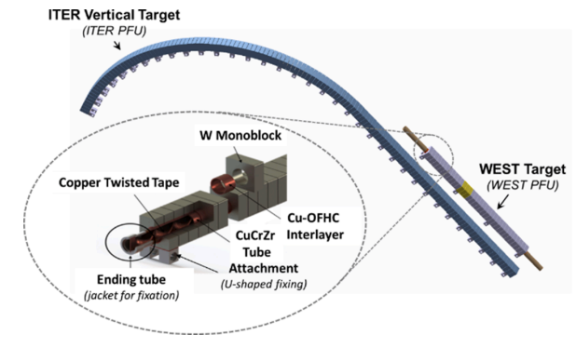
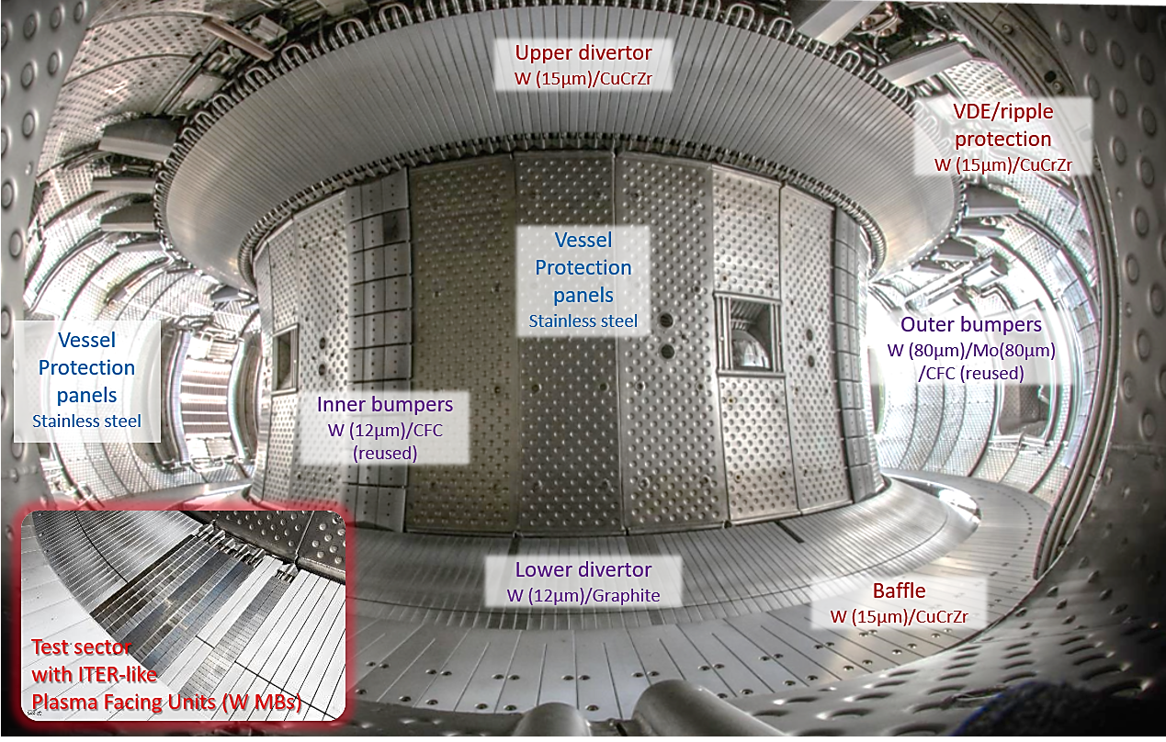
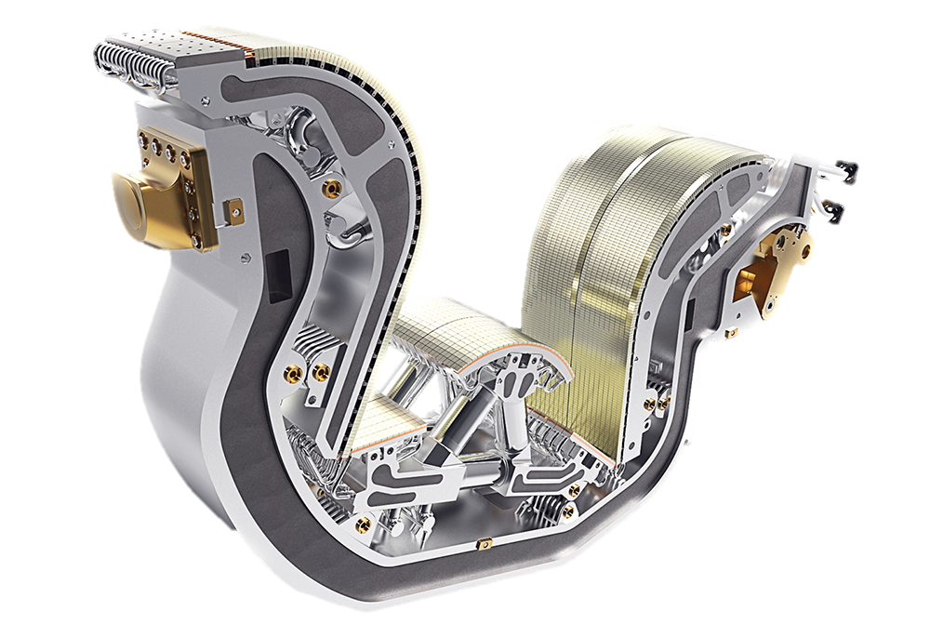
Inside WEST : a full tungsten environment
Full W environment (W coatings on CuCrZr/CFC, W bulk components)
WEST divertor PFU : representative of ITER high heat flux area (same monoblock geometry / thermohydraulic conditions (inlet pressure 2.5 MPa, coolant temperature 70 ◦C and axial velocity 10 m/s))

