Slide 1
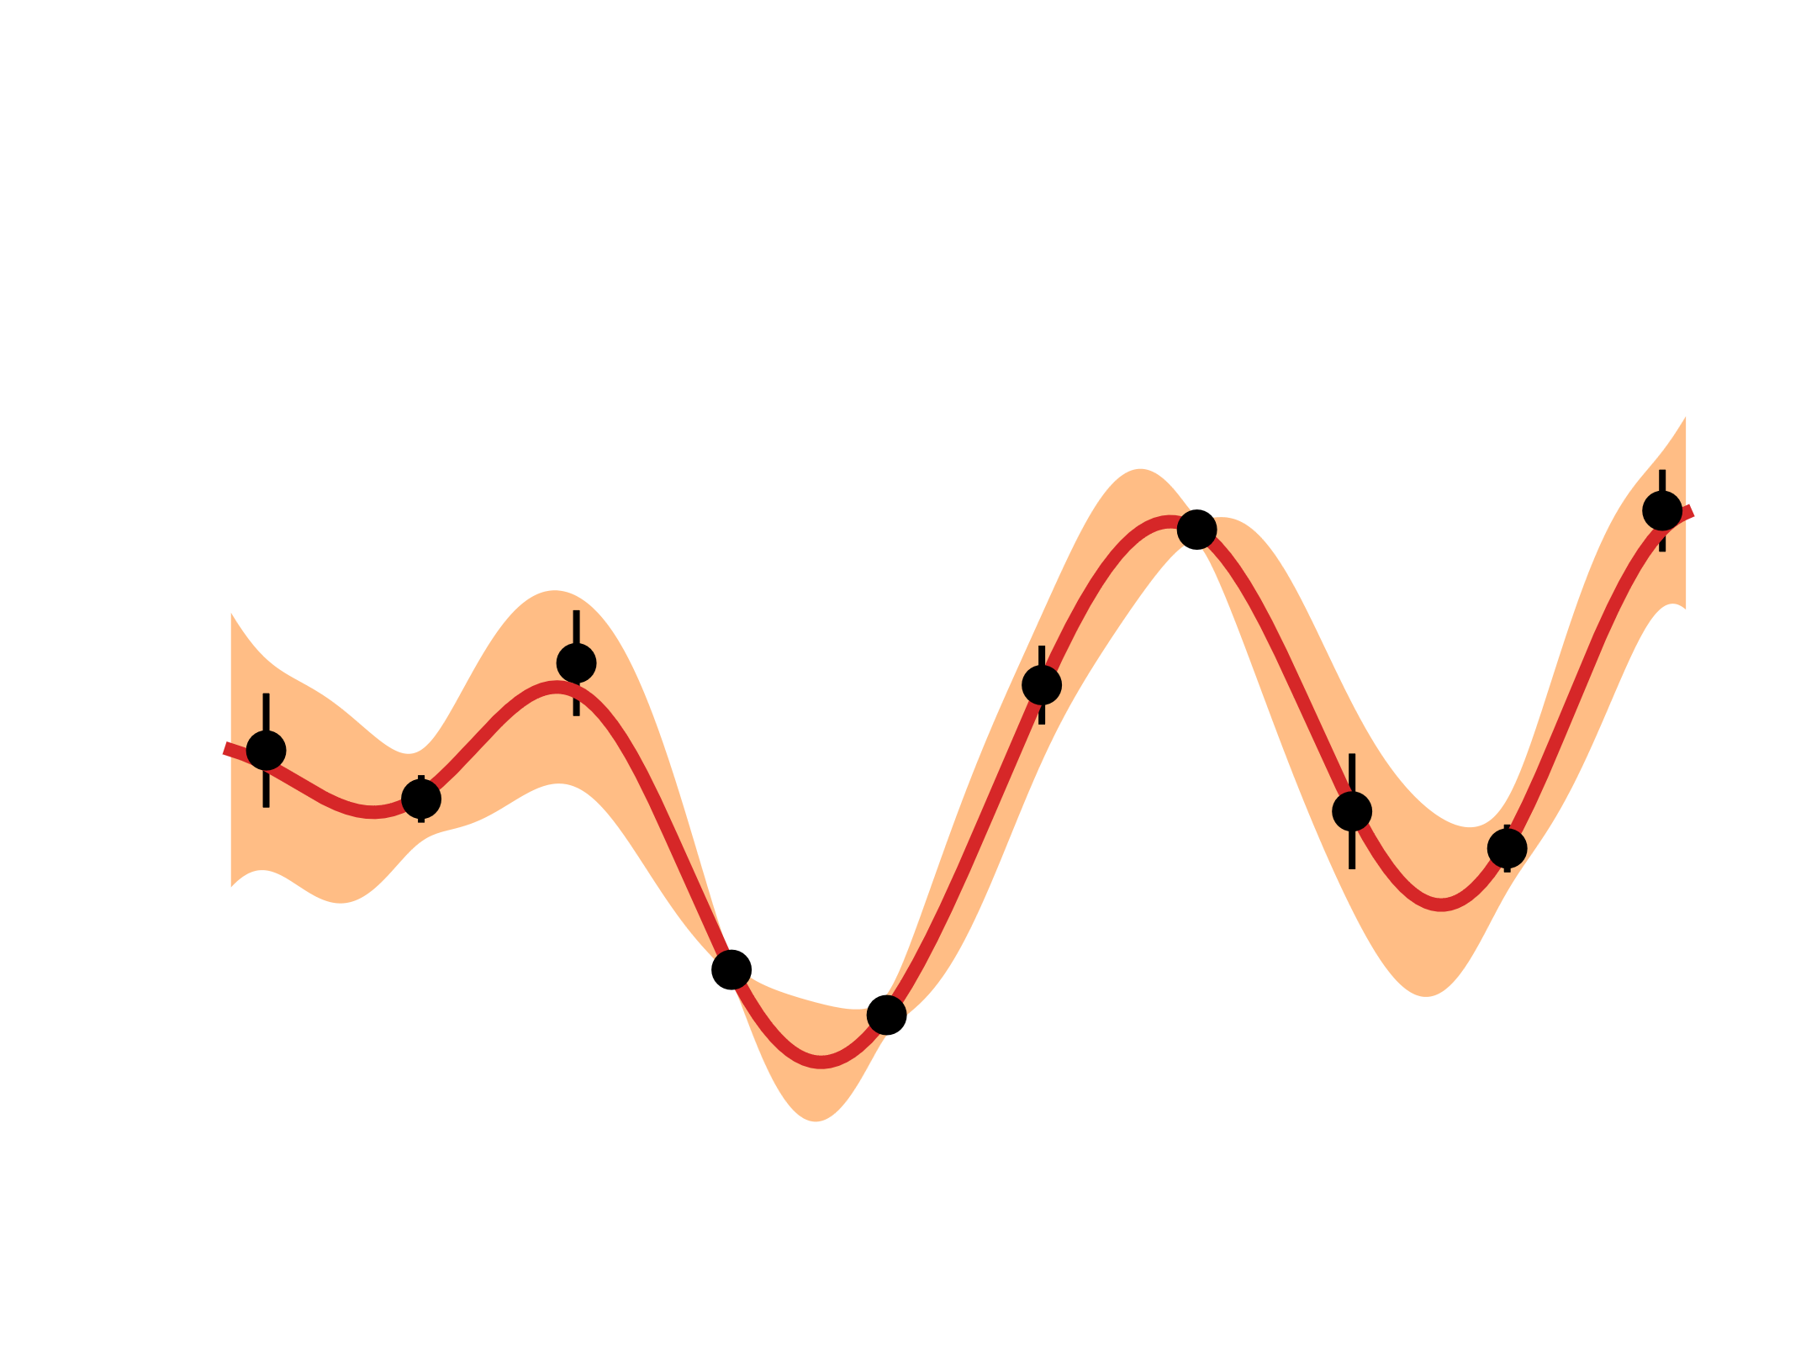
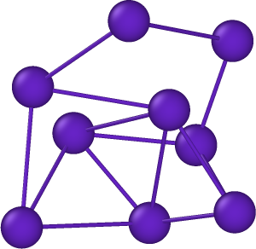
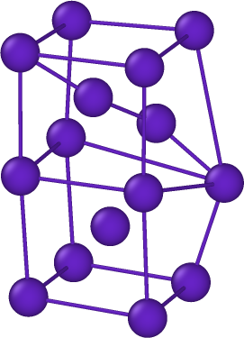
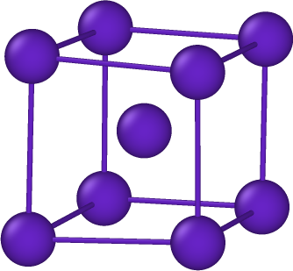
Diffusion of Helium
Guanying Wei
25th March, 2025
4th HeRHEA meeting

Slide 2
Outline
Different concentrations of V in WV
MSD simulation of Zhehao's sample (Ta, MoNbTa, WTaVMoNb)
Binding energy between He and vacancy void or vacancy loop
Accelerated molecular dynamics (CVHD) test on the effect of He atom addition on vacancy migration

Slide 3
Different concentration V in WV
NEB(climbing-image nudged elastic band)
The distributions of migration energy in W₉₀V₁₀, W₈₀V₂₀, W₅₀V₅₀.
Values are the average.
*Migration energy of He in W: 0.06 eV

Slide 4
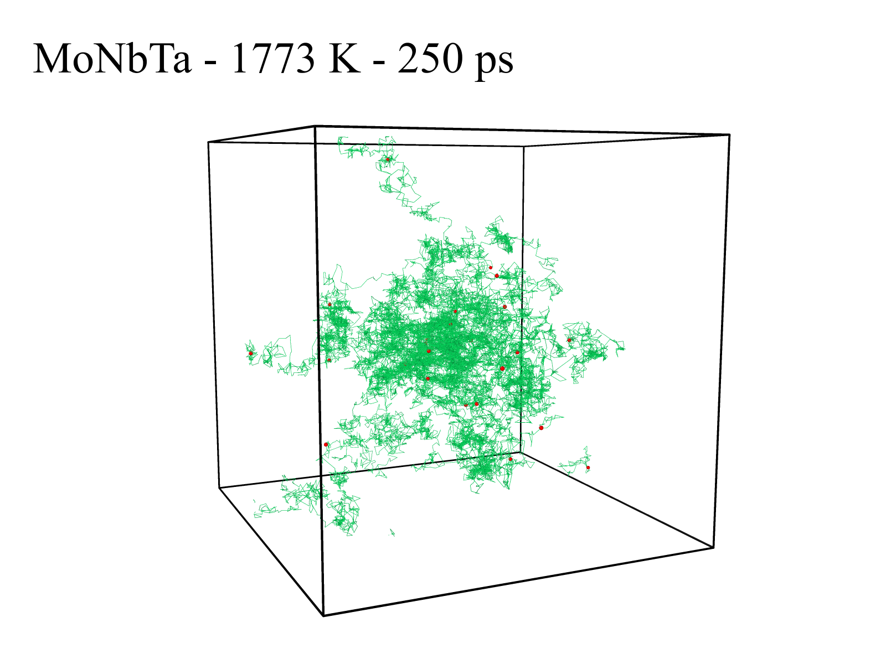
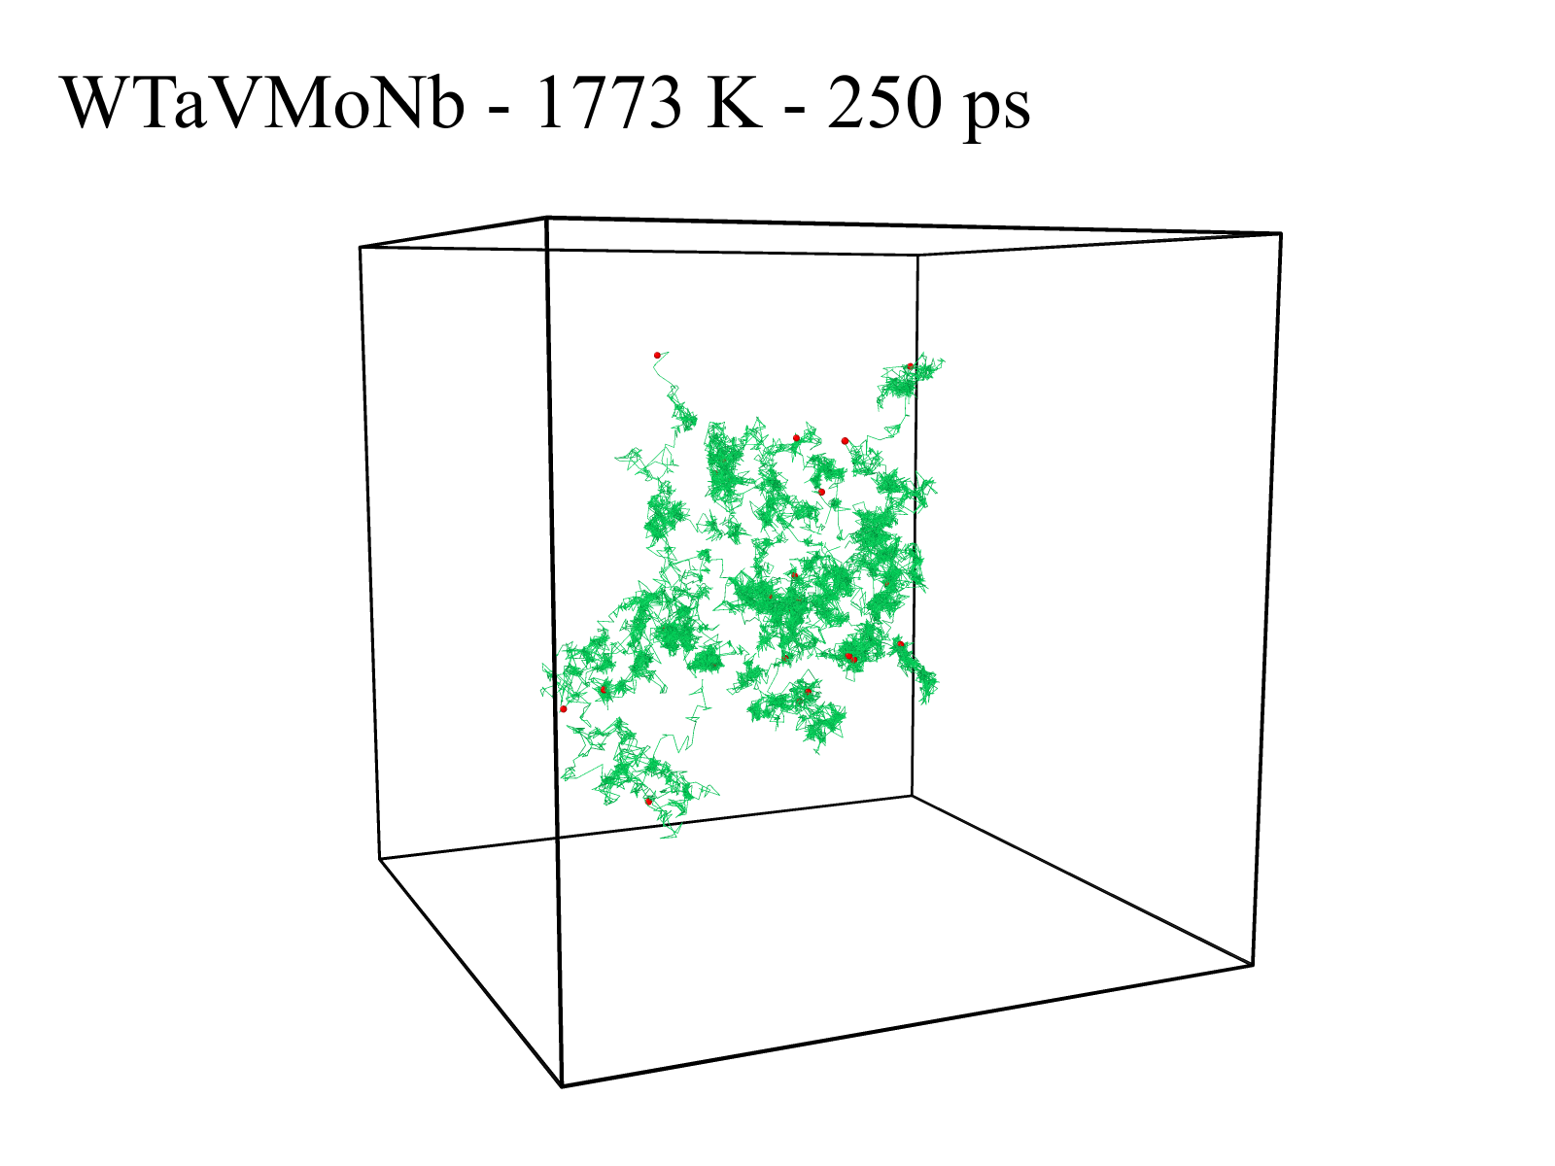
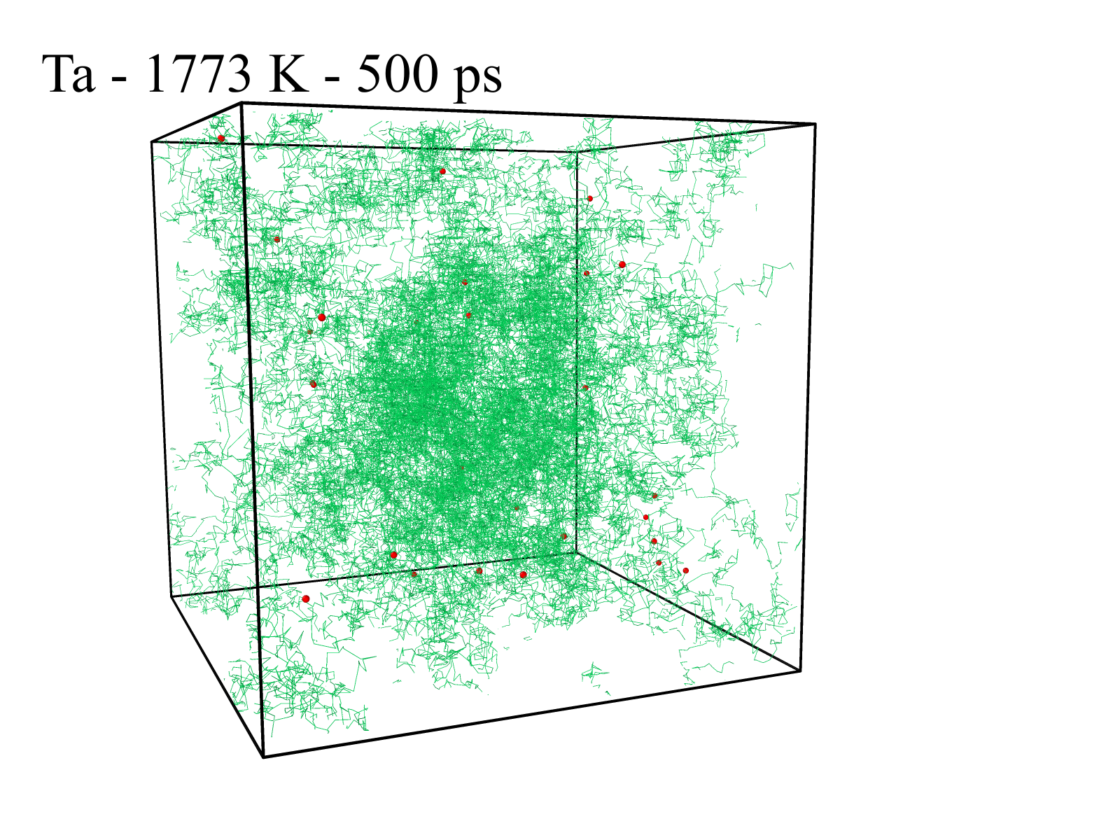
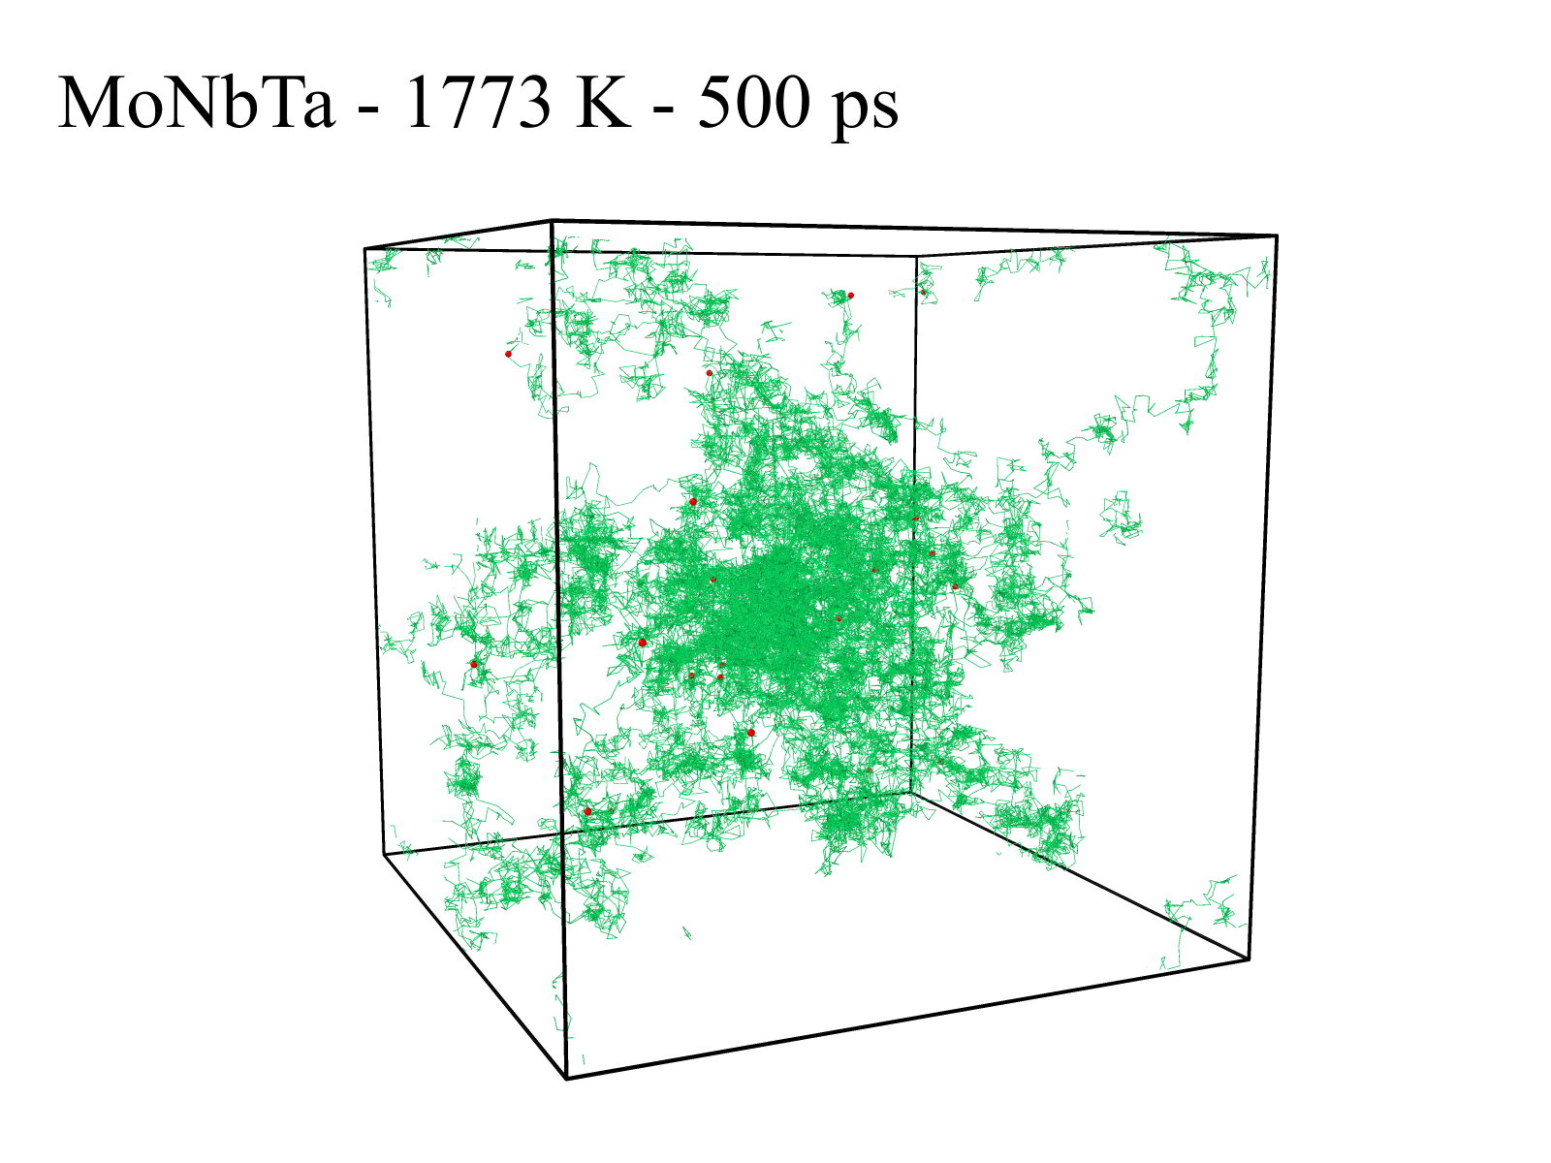
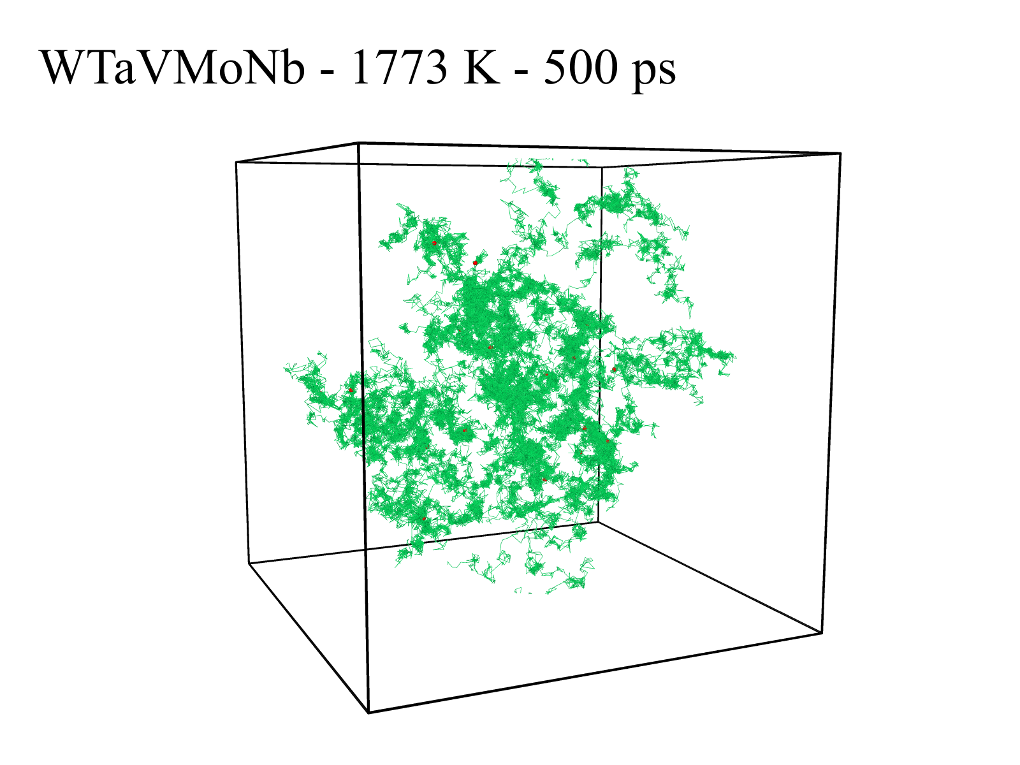
Zhehao's sample (Ta, MoNbTa, WTaVMoNb)

Slide 5
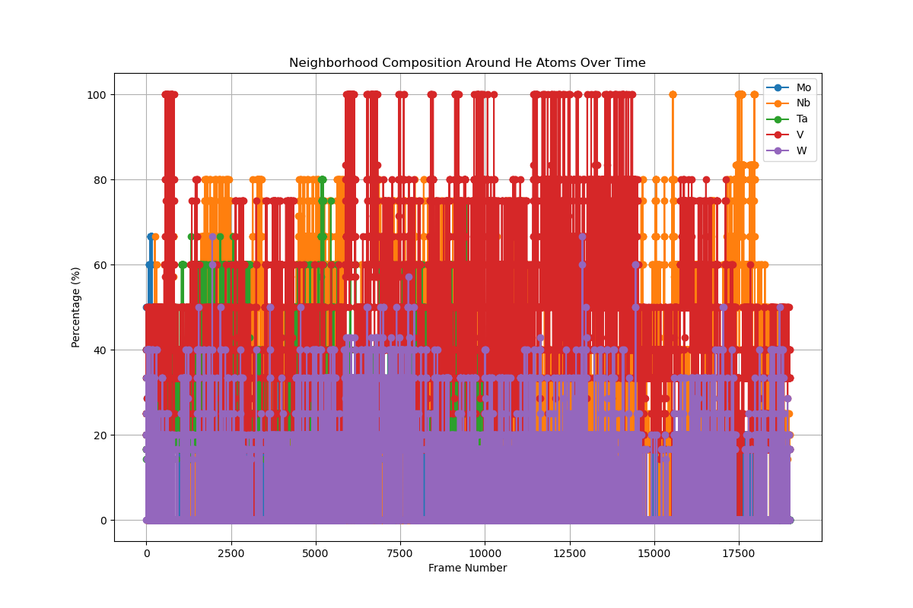
Mean squared displacement ( HEA)

Slide 6
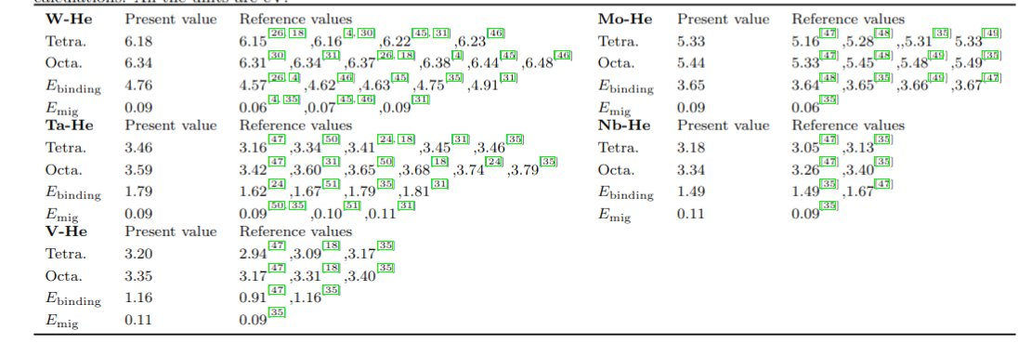
Test HEA-W
Box length: 96.6 Å (30*30*30)
Central HEA: radius is 10 Å
Insert a helium(red atom) inside the HEA
1773K, NPT, 1ns

Slide 7
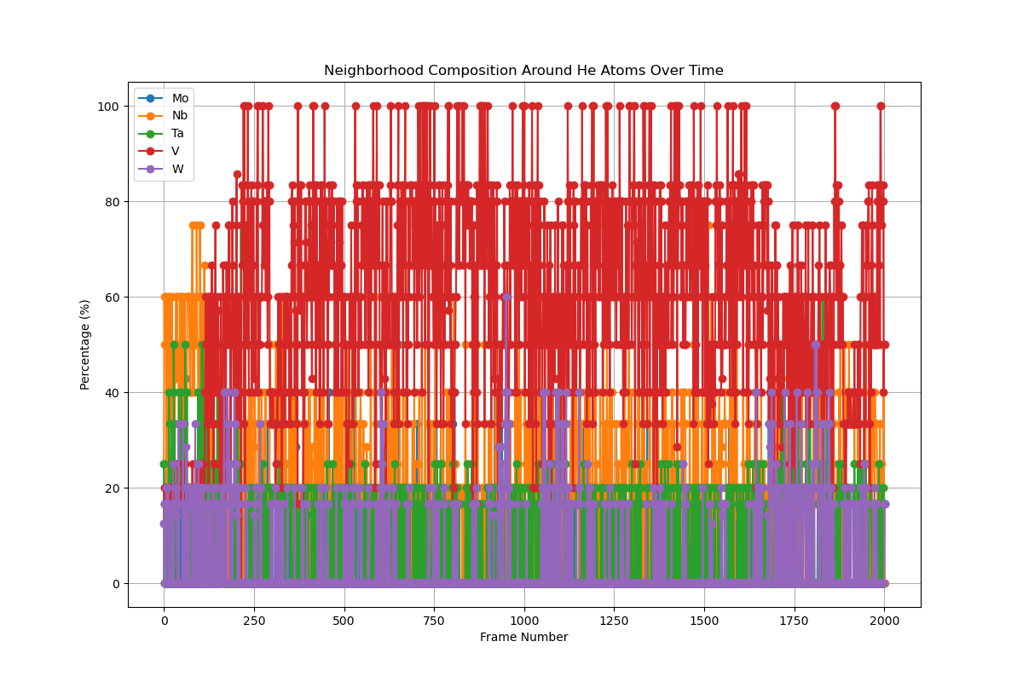
Test HEA-W

Slide 8
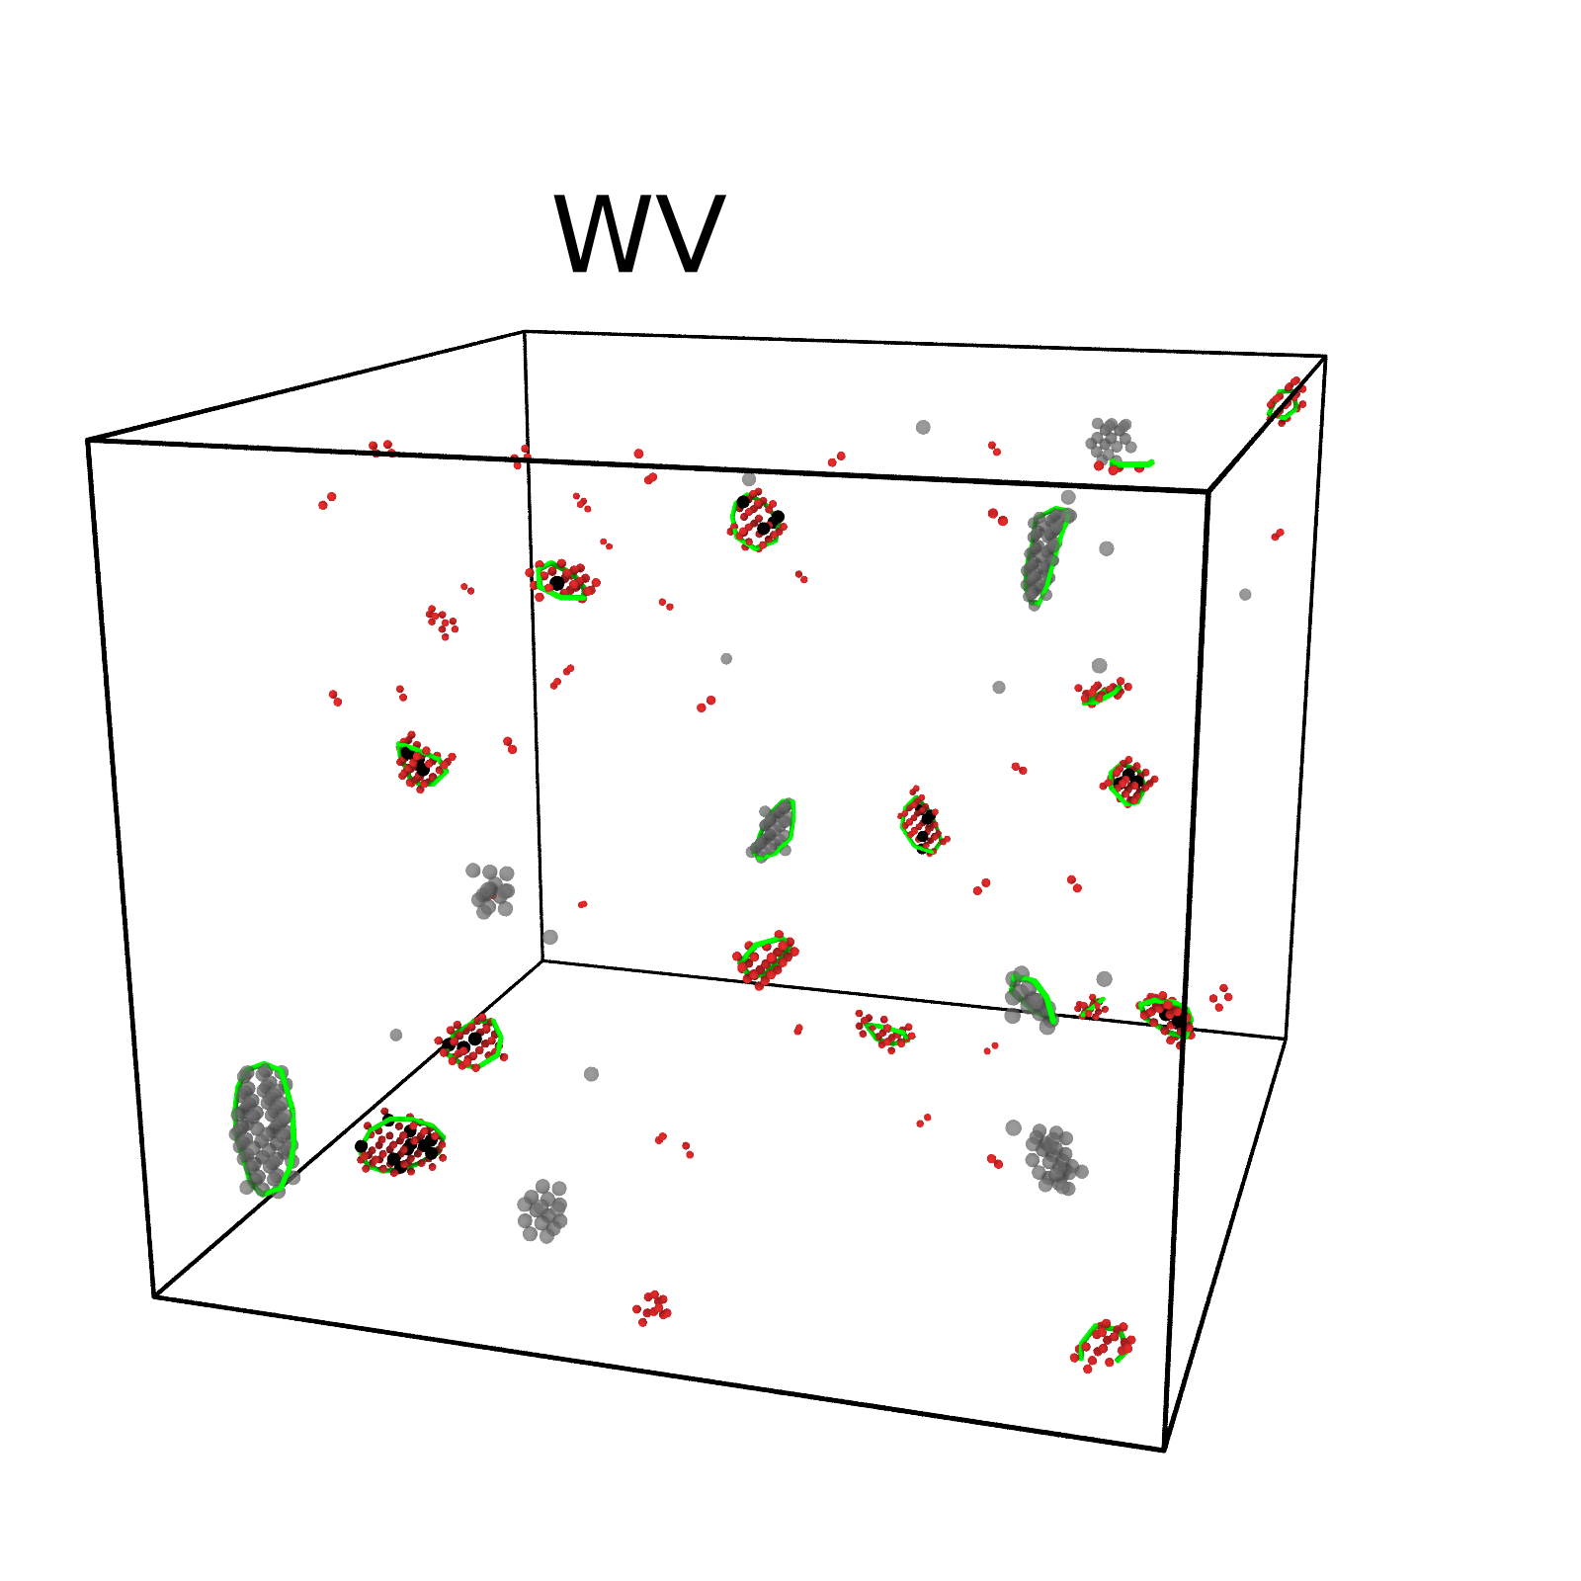
Helium atoms diffuse in the damage W and WV from overlapping cascades
Black: W, Red: V, Grey: vacancy, Green loop : ½<100> loop,
0.3 dpa(Saturation Defect) and after annealing at 2000 K for 5 ns

Slide 9
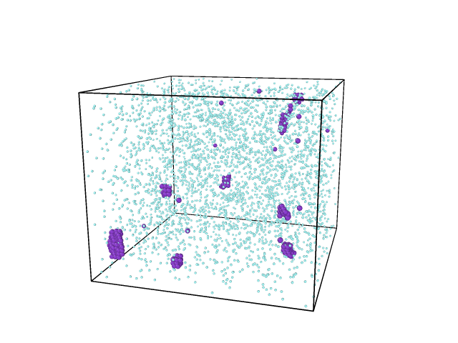
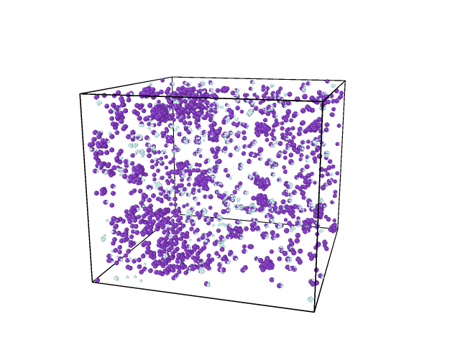
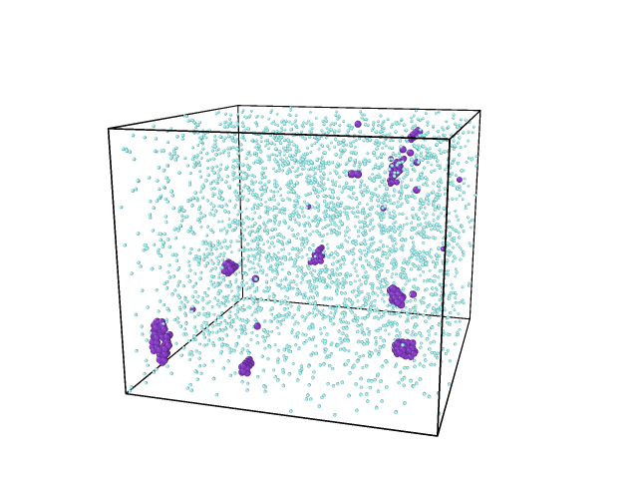
Helium atoms diffuse in the damage W and WV from overlapping cascades
WV-insert 1%He(3540 atoms) before diffusion
W-insert 1%He(3540 atoms) before diffusion
Diffuse at 1000K 1ns
After diffusion

Slide 10
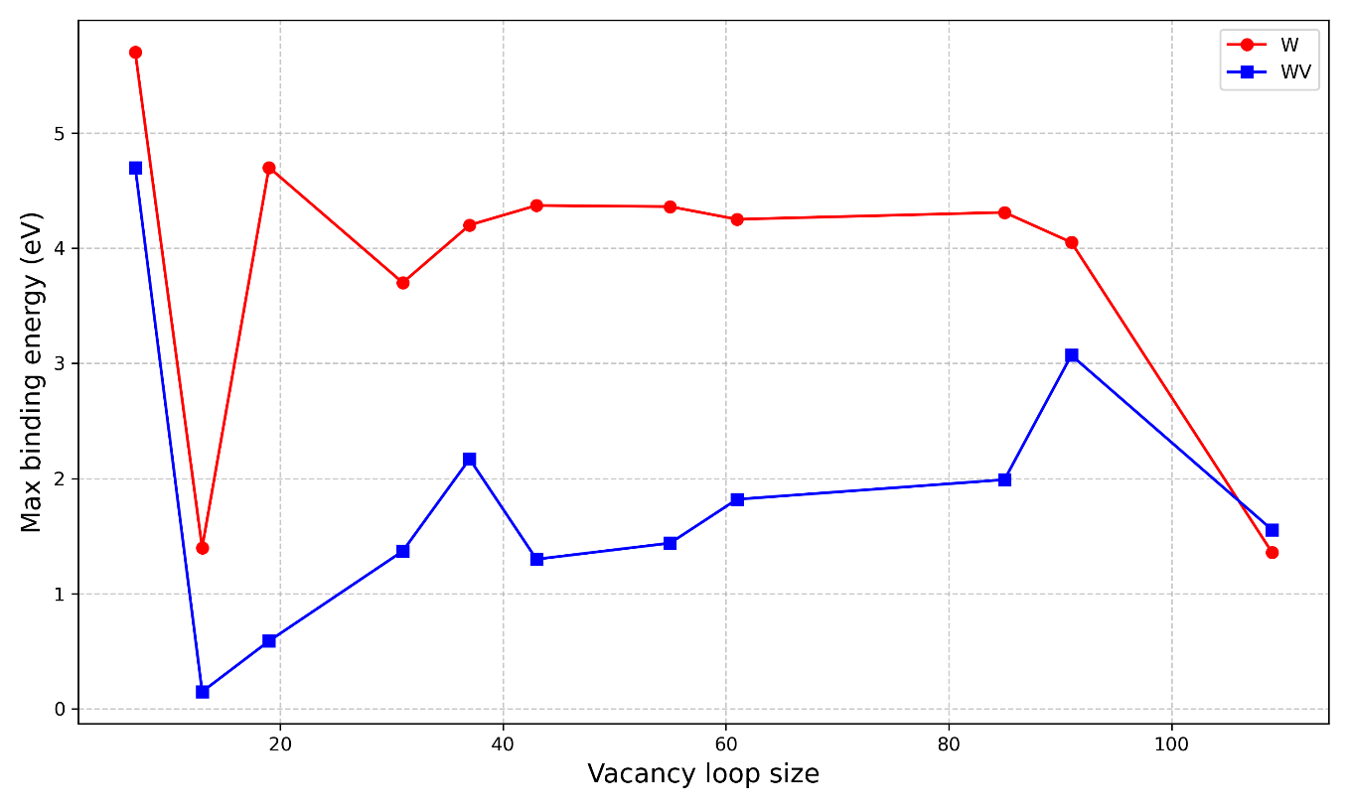
Binding energy between He and vacancy void or vacancy loop

Slide 11
Jump times by CVHD
Temp (K) | W(vacancy) | W(vacancy-He) | WV(vacancy) | WV(vacancy-He)
700 | 1(6*10⁸ s) | 0 | 378 (0.05 s) | 50
750 | 5 | 0 | 625 | 66
800 | 13(1*10⁶ s) | 0 | 581(0.002 s) | 190
850 | 11 | 0 | 769 | 136
900 | 14 (5.5*10³ s) | 0 | 883 (5 * 10 ^-5 s) | 223
The addition of helium makes vacancy diffusion more difficult.

Slide 12
Conclusions
If the chemical environment is complex, then the migration energy is high for He (NEB case, He is arranged to move one tetrahedron to another)
If He can move freely, it will move to the environment where it has low formation energy (MSD case)
He atoms prefer the vacancy void than the vacancy loop
Ongoing:
CVHD, Parameterization

