Slide 1

Runaway electron modelling tools
E. Nardon, PSD-DCT Coordination Meeting, 25/06/25

Slide 2
Outline
RE generation
RE termination
RE mitigation (access to benign termination)

Slide 3
Outline
RE generation
RE termination
RE mitigation (access to benign termination)

Slide 4
RE generation – Theory
Review papers: [Breizman NF 2019] [Boozer PoP 2015]
RE generation mechanisms:
  Primary (‘seeds’):
    Non-nuclear: Dreicer, hot tail
    Nuclear: Tritium β decay, Compton scattering
  Secondary: avalanche
Seminal works from decades ago (e.g. [Rosenbluth NF 1997]) but important recent developments:
  Effect of partial screening of the nuclear charge of partially ionized impurities [Hesslow JPP 2018]
    Bound electrons may boost the avalanche [Hesslow NF 2019]
  Hot tail generation during a thermal quench [Aleynikov NF 2017]
  Phase space dynamics
    Theory of 2 threshold E|| fields [Aleynikov PRL 2015]
    RE vortex [Guo PPCF 2017]
  …

Slide 5
RE generation – Modelling tools
Present European workhorses:
  DREAM kinetic code [Hoppe CPC 2021]
    Disruption-oriented (e.g. includes an SPI model)
    Solves 1D flux surface averaged transport equations
    Self-consistently evolves the electron distribution function using a bounce-averaged kinetic eqn.
      Different levels of description available, from fluid to full kinetic
  JOREK 3D MHD code [Hoelzl NF 2024]
    Can include REs as a fluid [Bandaru PRE 2019]
    Or as particles
      Either as test particles or coupled to the MHD [Bergström PPCF 2025]
        Kinetic hot tail and avalanche models in dev. [Puel REM 2025] [Woujters REM 2025]
Many other tools exist: Martin-Solis code [Martin-Solis NF 2017], GO, DINA, LUKE, ASTRA, …
  Often have limitations, e.g. avalanche growth rate not state of the art, recomb. ignored, no SPI model, …
Models for RE mitigation coil: DREAM+ASCOT5 or 3D MHD codes like NIMROD [Tinguely PPCF 2023]

Slide 6
RE generation – Model validation
Validation for quiescent plasmas is well advanced [Granetz PoP 2014] [Liu PRL 2018]
Validation during disruptions is in progress
  More difficult than quiescent situations because of 3D MHD activity, in particular during the TQ
    → Electron transport due to magnetic stochasticity, impurity mixing, …
3D MHD codes like JOREK…
  May produce plausible 3D disruption sims. [Nardon PPCF 2021] but this remains difficult
  Are working towards 3D disruption sims. including RE generation
    Hot tail [Puel REM 2025]
    Stochastic losses during the CQ? [Wang REM 2025]
  May also be used in 2D mode; much easier but needs ad hoc TQ model etc. [Nardon REM 2024]
≤2D codes like DREAM…
  Have performed more validation, e.g. [Hoppe JPP 2021] [Insulander PPCF 2021] [Linder JPP 2021]
  But ad hoc TQ model may be used as a knob to match experimental data → Validation or ‘fancy fit’?
    Bayesian framework can be applied for objectivity [Järvinen JPP 2022] [Järvinen EPS 2025]

Slide 7
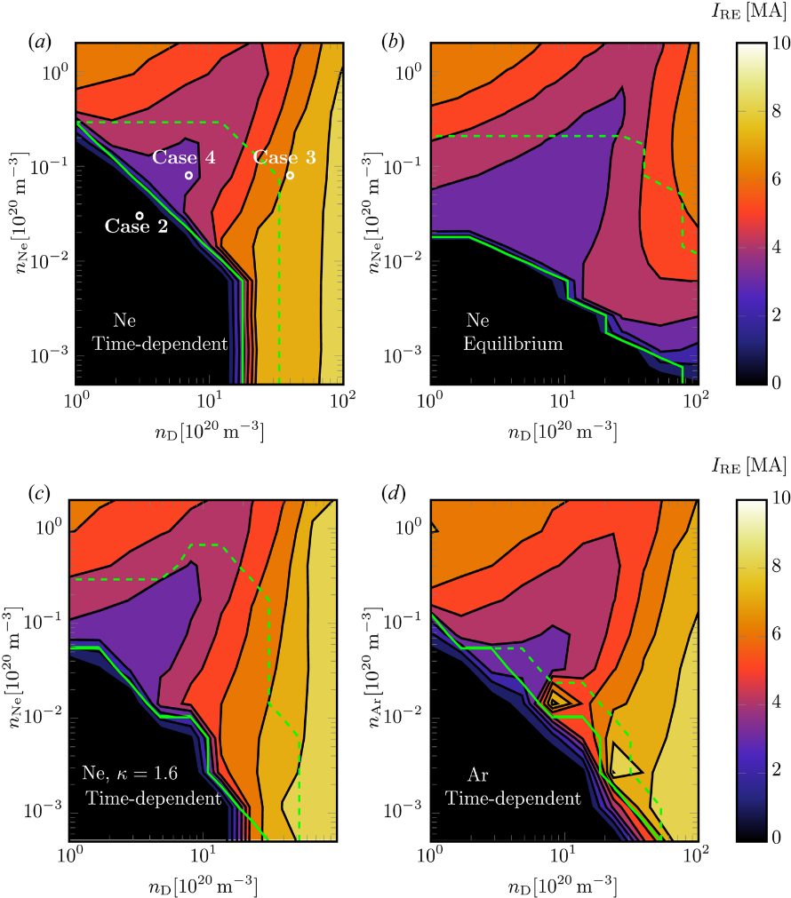
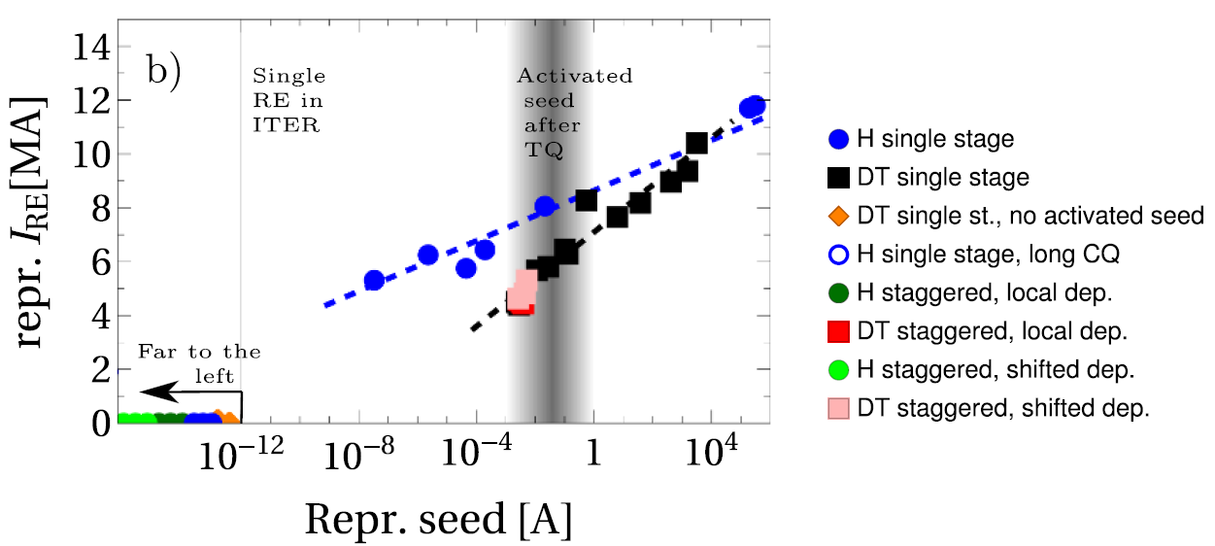
RE generation – Key lessons from ITER modelling (1/2)
Avalanche gain scales exponentially with I_{p} → Gain in ITER (and DEMO!) >>> Gain in present machines
Nuclear seeds are small but sufficient to result in a multi-MA RE beam due to the huge avalanche gain
Dreicer seed may be negligible with an appropriate SPI due to the relatively high post-TQ T_{e}
Hot tail seed hard to predict but could be large
Increasing n_{e} by injecting H or D reduces all seeds except Compton
Would need n_{e} ~ 2-4 x 10²¹/m³ to avoid large beam from Compton, according to [Martin-Solis NF 2017]
…but GO simulations predict that this will actually not work because of recombination [Vallhagen JPP 2020]
GO simulations
DREAM simulations (currently being revisited)
Too slow CQ
[Vallhagen NF 2024]
[Vallhagen JPP 2020]

Slide 8
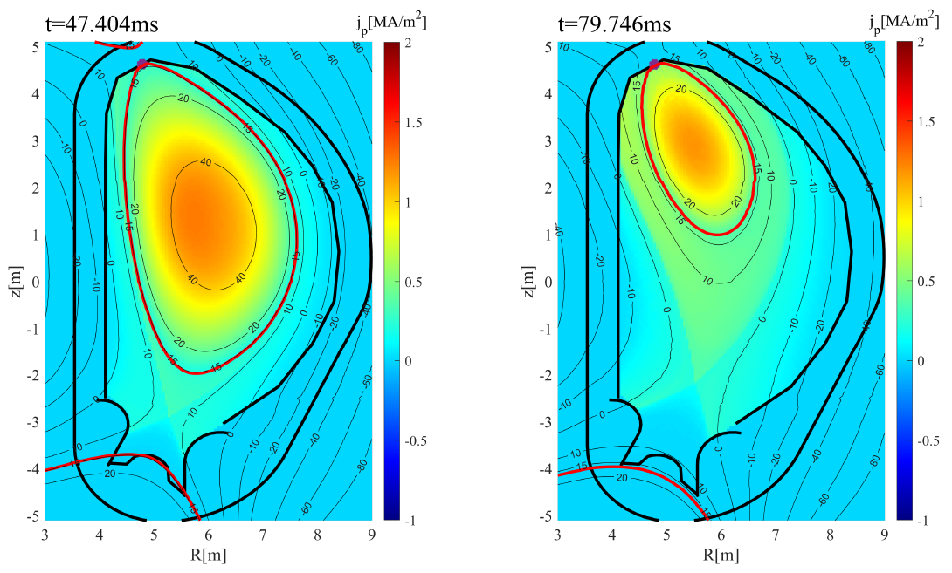
RE generation – Key lessons from ITER modelling (2/2)
Non-nuclear phase may be easier but hot tail generation remains a risk
Hot tail generation might be suppressed if the TQ happens in 2 steps: dilution, then radiation
  Led to studying the ‘staggered scheme’: H SPI then Ne+H SPI [Nardon NF 2020] [Vallhagen NF 2022]
  However, the drift of H ablation plasmoids towards the LFS may be a major issue
  → Much work about drifts, e.g. [Vallahgen JPP 2023] [Kong NF 2025]
  Perhaps a single Ne+H SPI with a low Ne fraction could lead to 2 step cooling without suffering too much from plasmoid drifts
  Remark: SPI from the HFS may be much more efficient!
JOREK 2D simulations
Vertical motion during the CQ and associated RE scrape-off reduce the avalanche gain [Wang NF 2025] [Bandaru JPP 2025]
→ DREAM predictions being updated
Also, JOREK sims. suggest stochastic losses may exist during the CQ [Wang REM 2025] → Might further reduce the avalanche gain

Slide 9
Outline
RE generation
RE termination
RE mitigation (access to benign termination)

Slide 10
RE termination – Key aspects
PPCF roadmap paper on ‘RE-induced PFC damage in tokamaks’ submitted: https://arxiv.org/abs/2506.10411
Scrape-off vs. stochastic terminations:
  Scrape-off = beam moves into the wall with (possibly distorted but) non-destroyed flux surfaces
  Stochastic = MHD activity generates stochasticity which deconfines REs
  Note: Both types may exist at different times for a given termination
Which type causes damage? What determines the deposition area and timescale? – Unclear!
A large fraction of the magnetic energy can be converted into RE kinetic energy during the termination
  Crucial for ITER and DEMO because typically E_{mag} >> E_{kin}
  The converted fraction grows with τ_{loss}/τ_{res} [Martin-Solis NF 2014]
  → A fast termination (small τ_{loss}) with a clean background plasma (large τ_{res}) is beneficial
A large RE beam may re-form after a stochastic loss event [McDevitt PRE 2023]

Slide 11
RE termination – Models
Reduced models, e.g. by Martin-Solis:
  0D
  Coupled circuit equations for {RE beam + background plasma} and vessel
  RE losses:
    Ad hoc diffusion [Martin-Solis NF 2014]
    Scrape-off due to vertical motion [Martin-Solis NF 2022]
3D MHD codes, e.g.
  JOREK [Bandaru PPCF 2021] (recently applied to DEMO [Vannini NF 2025])
  M3D-C1 [Liu PPCF 2021]
Models for PFC damage, e.g. [Ratynskaia NF 2025]
  (0) RE flux through PFC surface from reduced models or 3D MHD codes
  (i) Monte Carlo model for electron transport and energy deposition in the PFC
  (ii) Continuum mechanics model for thermo-mechanical PFC response

Slide 12
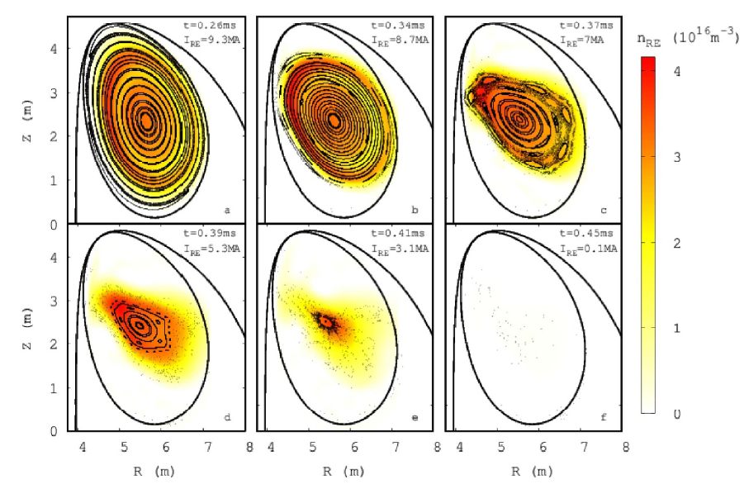
RE termination – 3D MHD sims. shed light on benign terminations
Benign RE beam term. observed in e.g. JET and DIII-D after a D SPI into the beam [Reux PRL 2021]
  Seems connected to the recombination of the background plasma
JOREK simulations suggest a strong RE flux spreading due to large MHD [Bandaru PPCF 2021] [Bandaru NF 2024] [Bergström PPCF 2024]
  May be due to the large resistivity of the background plasma
  following its recombination [Nardon PoP 2023]
Absence of E_{mag} → E_{kin} conversion thanks to fast termination and clean background plasma (after impurity ‘purge’) probably also plays a role
Still a lot to do and understand:
  Simulations starting from a stable situation?
    Note: In ITER sims., no stable point was found!?
  Inclusion of background plasma re-ionization, re-heating
  …

Slide 13
Outline
RE generation
RE termination
RE mitigation (access to benign termination)

Slide 14
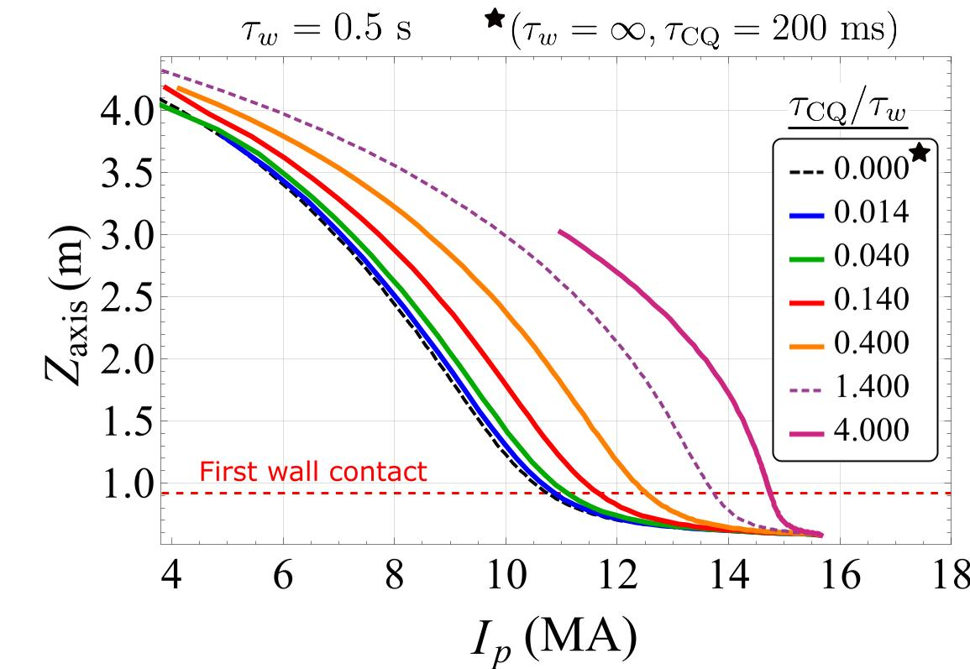
RE mitigation – Possible strategies: lessons from ITER sims.
2D JOREK simulations
Injection of high Z material into the RE beam used to be considered as a possible mitigation scheme, but…
In ITER, high vessel conductivity implies Z_{p} = f(I_{p}) for fast CQ [Kiramov PoP 2022]
→ Strongly limits the possibility to reduce I_{p} before the impact
→ E_{mag} → E_{kin} conversion could be very large
→ Pessimistic outlook according to DINA [Konovalov IAEA 2016]
Courtesy J. Artola
→ Reference strategy is now H SPI to (hopefully) access benign termination

Slide 15
RE mitigation (access to benign term.) – Models
1D radial diffusion model by Hollmann [Hollmann PoP 2020] [Hollmann NF 2023]
  Describes the coupled system {RE beam + background plasma}, including neutrals and molecules
  Main findings:
    Following H or D injection, plasma heating by the REs is balanced by neutral transport
    Molecules play a key role in the recombination
  Validation on TCV data ongoing [Wijkamp REM 2025]
SOLPS-ITER [Tonnello REM 2025]
Model by Hoppe for the upper neutral pressure limit [Hoppe PPCF 2025]
  Too many neutrals lead to n_{e} increasing again
There are plans to develop a model in JOREK

