Slide 1
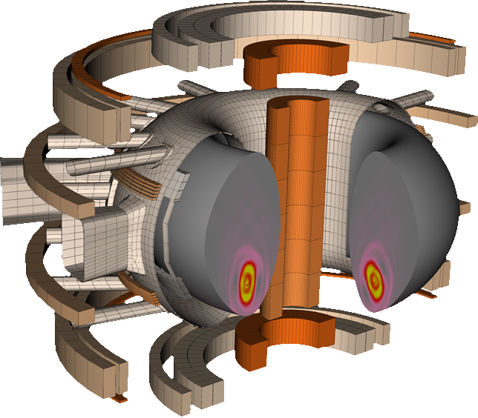
Disruption simulation codes available in Europe in view of DEMO
Matthias Hoelzl
for many

Slide 2
Goal of the simulations
Dynamics of disruptions
Thermal heat loads,
RE wall loads,
EM forces
2

Slide 3
Goal of the simulations
SPI,
impurities
Resistive walls,
halo currents
Dynamics of disruptions
Runaway electrons, companion plasma
Thermal heat loads,
RE wall loads,
EM forces
3

Slide 4
Different models
kinetic
0-2D
3D
fluid

Slide 5
Different models
kinetic
CarMa0NL
CARIDDI wall model
2D evolutionary equilibrium model for the plasma
Can provide insights regarding vertical EM forces
Unique tool with full CAD wall model and fast runtime, ideal for large parameter scans
Cannot assess 3D physics, horizontal EM forces, RE effects on VDE dynamics
0-2D
3D
CarMa0NL
fluid

Slide 6
Different models
kinetic
INDEX
Low dimensional code
Simple resistive wall model
Can provide insights for SPI ablation and assimilation
Can complement other codes by fast scans for different SPI scenarios
Cannot describe 3D physics, REs, and a self-consistent halo current
0-2D
3D
INDEX
CarMa0NL
fluid

Slide 7
Different models
kinetic
DREAM
1.5 D code with various fluid and kinetic RE models
Can account for VDEs in a simplified way
High fidelity RE sources
Unique code for studying RE generation and phase space evolution
Cannot describe 3D physics, VDE-RE interplay, self-consistent RE losses
DREAM
0-2D
3D
INDEX
CarMa0NL
fluid

Slide 8
Different models
kinetic
CASTOR3D
3D linear plasma model
3D thin resistive wall model (STARWALL like)
Can contribute to disruption prevention/prediction, post-TQ state
Unique linear extended visco-resistive MHD code
Cannot predict non-linear processes, no RE model
DREAM
0-2D
3D
INDEX
CASTOR3D
CarMa0NL
fluid

Slide 9
Different models
JOREK
2D or 3D fluid plasma model
CARIDDI resistive walls
Fluid and kinetic RE, neutrals and impurities
SPI model
Unique tool to address the full non-linear interaction of all disruption processes and consequences
Computationally expensive and sometimes numerically challenging
kinetic
DREAM
JOREK-CARIDDI
0-2D
3D
INDEX
CASTOR3D
CarMa0NL
fluid

Slide 10
Different models
kinetic
DREAM
JOREK-CARIDDI
0-2D
3D
Overlapping capabilities of this model hierarchy allows for efficient joint studies and easy verification of new developments
INDEX
CASTOR3D
CarMa0NL
fluid
Disclaimer: this is of course not a complete list of available codes

Slide 11
Focus of this talk
kinetic
This talk will focus
on JOREK-CARIDDI
and hardly address
RE physics
Eric presenting after
me will focus on
RE physics with
DREAM and JOREK
DREAM
JOREK-CARIDDI
0-2D
3D
INDEX
CASTOR3D
CarMa0NL
fluid

Slide 12
Relevant JOREK capabilities for disruptions & REs
Hierarchy of reduced & full-MHD with single/two-temperature etc.
– 2D/3D dynamics, RE transport, ..., (not all extensions below in full MHD)
Shattered pellet injection model
– disruption mitigation, (limited pellet plasmoid resolution, rocket effect in dev.)
Fluid & kinetic neutrals & impuritys
– CQ, RE companion plasma, SOL/halo region, (some collisions and molecules in dev.)
Fluid & kinetic REs
– RE formation, dynamics, termination, (kinetic RE sources in dev., optimization needed)
Coupling to STARWALL (thin walls) and CARIDDI (volumetric walls, same as for CarMa0NL)
– VDEs, locked modes, etc., (halo current model in dev.)

Slide 13
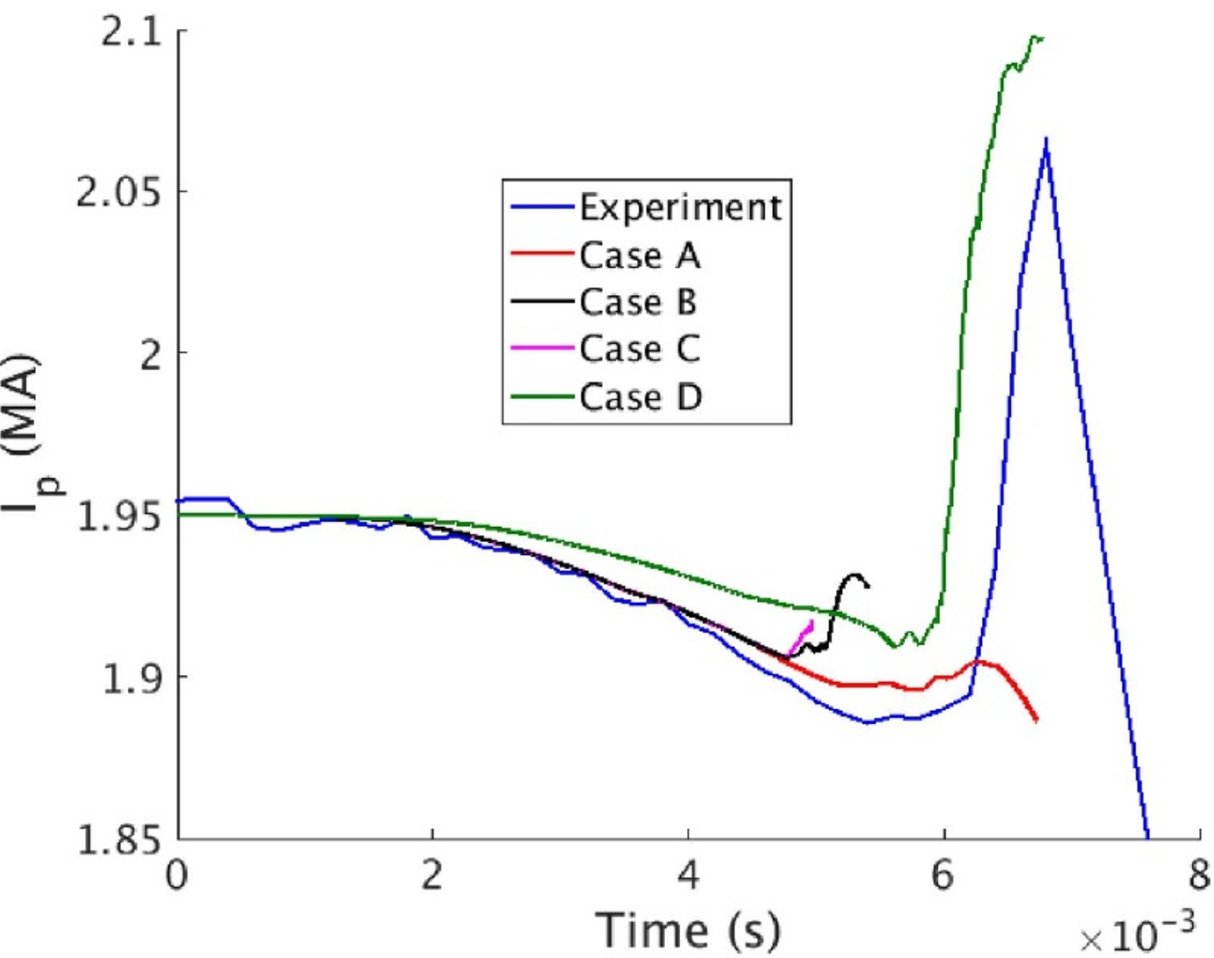
Selected findings: Current spike
Violent dynamics of a TQ in a natural or mitigated disruption can be simulated
This is very challenging and it is hard to reproduce all aspects of an experiment
A realistic current spike has been obtained, but this is not always the case
Nardon E., Hu D., Artola F.J., Bonfiglio D., Hoelzl M., et al. Plasma Physics and Controlled Fusion 63, 115006 (2021) doi:10.1088/1361-6587/ac234b
Nardon E., Särkimäki K., Artola F.J., et al. Nuclear Fusion 63, 056011 (2023) doi:10.1088/1741-4326/acc417
There is a concrete plan to identify realistic post-TQ states using linear CASTOR3D, which can then be used as starting point for 3D CQ simulations

Slide 14
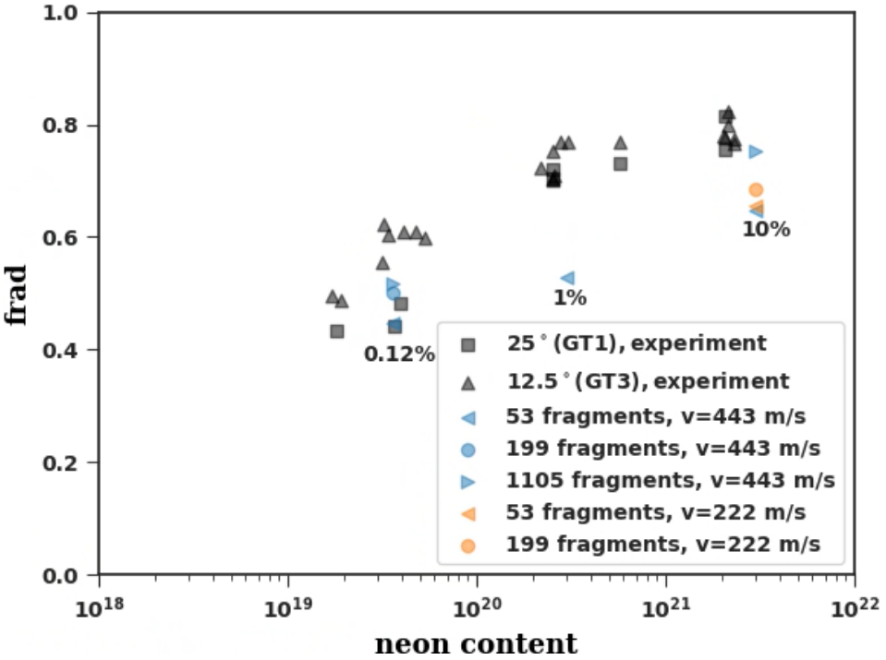
Selected findings: SPI in JET, AUG, etc.
The dynamics of mitigated disruptions can be simulated including realistic impurities
Of particular interest are varying amounts of impurity doping, which reduces the plasmoid drift, enhances material assimilation, prevents Ohmic plasma reheating via radiation, but increases RE formation
Hoelzl M, Hu D, Nardon E, et al. Physics of Plasmas 27, 022510 (2020)
Kong M., Nardon E., Bonfiglio D., Hoelzl M., et al. Nuclear Fusion 65, 016042 (2024)
Tang W, Hoelzl M, Lehnen M, et al. Nuclear Fusion (submitted) https://arxiv.org/abs/2412.03112
Bonfiglio D., Hu D., Kong M., Nardon E., et al. Nuclear Fusion (on the pinboard)

Slide 15
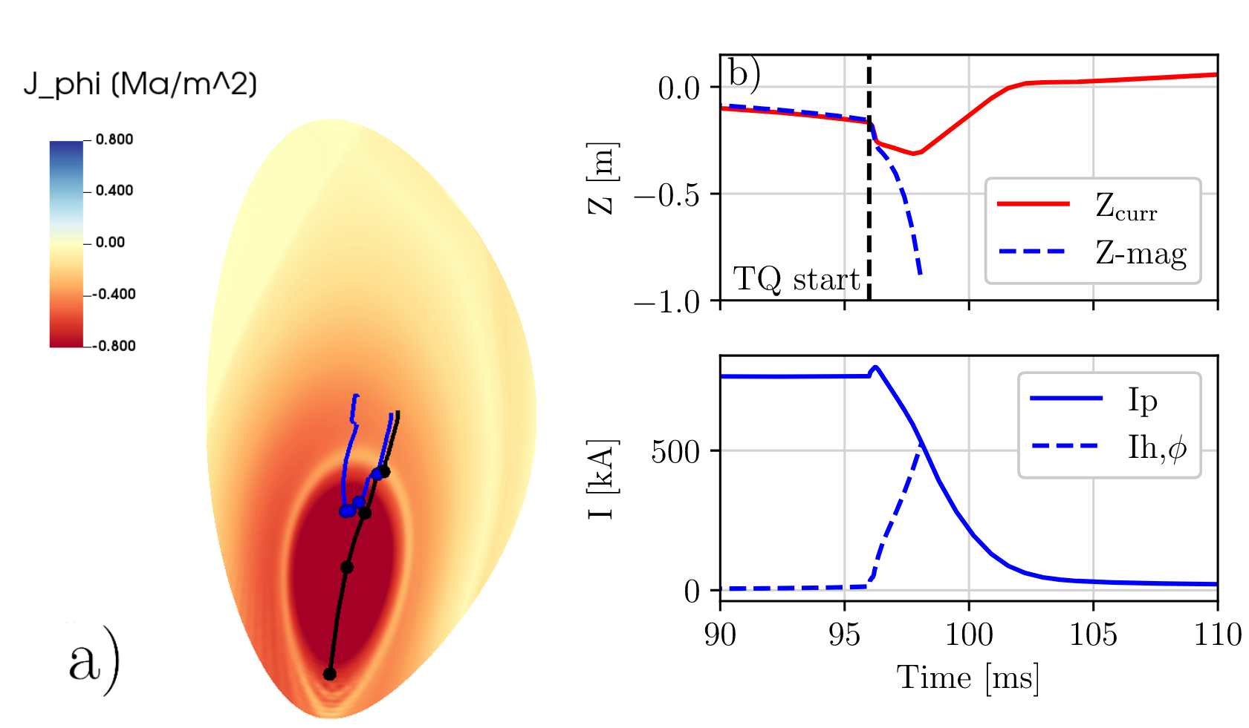
Selected findings: Vertical force mitigation
The dynamics of 2D VDEs can be simulated very efficiently
A fully self-consistent treatment of the SOL/halo region is still a challenging task
Gained understanding for the vertical force mitigation by impurity injection. It is linked to a decoupling of the vertical motion of the magnetic axis and the current centroid.
Schwarz N, Artola FJ, Vannini F, Hoelzl M, et al. The mechanism of the global vertical force reduction in disruptions mitigated by massive material injection. Nuclear Fusion 63 126016 (2023)
Schwarz N, PhD thesis (2024) https://mediatum.ub.tum.de/doc/1733821/1733821.pdf

Slide 16
Selected findings: Vertical force mitigation
The dynamics of 2D VDEs can be simulated very efficiently
A fully self-consistent treatment of the SOL/halo region is still a challenging task
Gained understanding for the vertical force mitigation by impurity injection. It is linked to a decoupling of the vertical motion of the magnetic axis and the current centroid.
Schwarz N, Artola FJ, Vannini F, Hoelzl M, et al. The mechanism of the global vertical force reduction in disruptions mitigated by massive material injection. Nuclear Fusion 63 126016 (2023)
Schwarz N, PhD thesis (2024) https://mediatum.ub.tum.de/doc/1733821/1733821.pdf

Slide 17
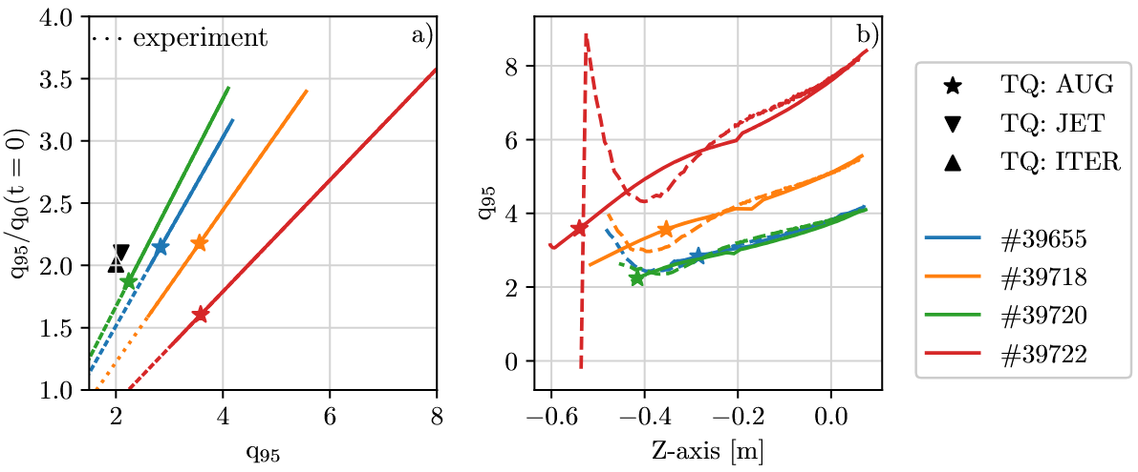
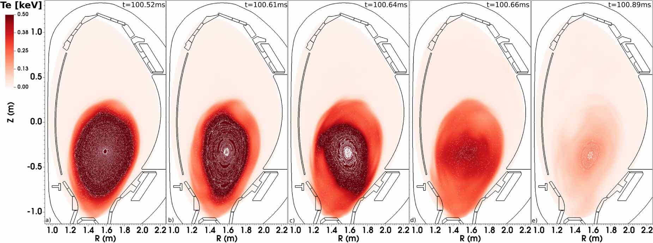
Selected findings: TQ during a hot VDE
The dynamics of 3D VDEs can be simulated (as example of a “natural” disruption)
In a hot VDE, the TQ arises at some point during the scrape-off process when the plasma moves into the material structures.
The onset of this TQ reproduces controlled AUG experiments, around q₉₅/q₀ ~ 2
Schwarz N, Artola FJ, Hoelzl M, et al. Plasma Physics and Controlled Fusion 65, 054003 (2023)
Schwarz N, PhD thesis (2024) https://mediatum.ub.tum.de/doc/1733821/1733821.pdf

Slide 18
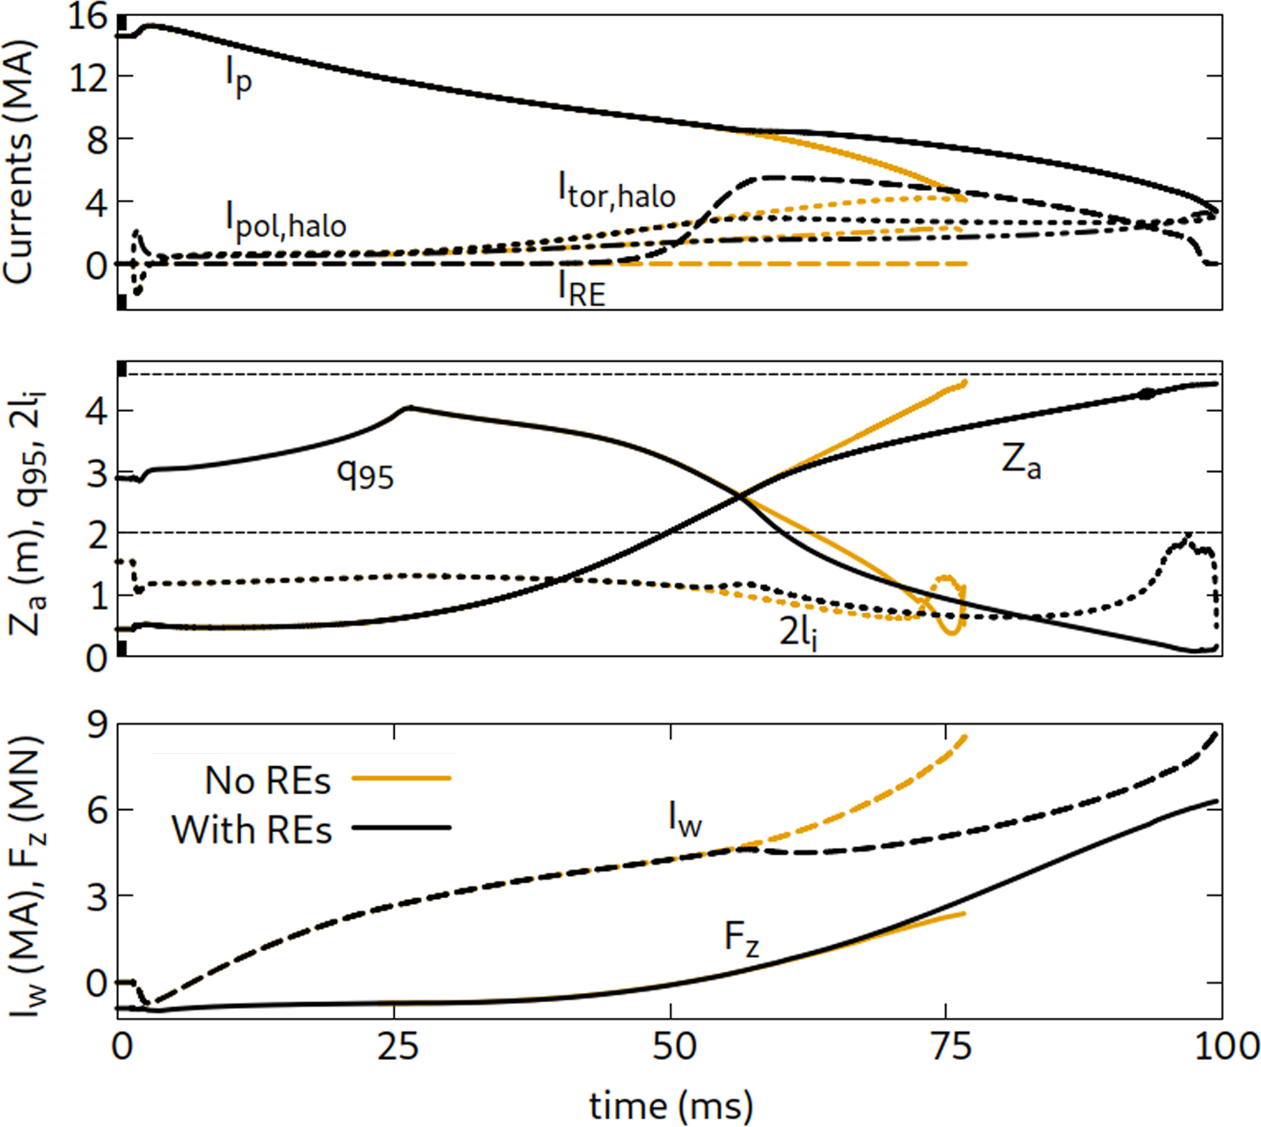
Selected findings: VDE-REs interaction
The self-consistent interaction between VDEs and REs can be studied (mostly RE fluid)
  A vertical plasma motion can prevent RE formation (in smaller devices)
  REs can slow down the vertical plasma motion (in larger devices)
Insights also into termination (more in Eric’s talk)
Bandaru V., Hoelzl M., Artola F.J., et al. Journal of Plasma Physics 91, E27 (2025)
Wang C, Nardon E, Artola FJ, Bandaru V, Hoelzl M. Nuclear Fusion 65, 016012 (2024)
There is a plan to couple JOREK and DREAM in the future for long time scales without MHD activity while keeping the phase space distribution

Slide 19

Summary:
Hierarchy of lower and higher-dimensional as well as fluid and kinetic models, complementing each other, efficiency <-> fidelity
This presentation focused on JOREK: Reduced and full-MHD, SPI model, fluid and kinetic extension for neutrals, impurities & REs, coupling to STARWALL (thin walls) and CARIDDI (volumetric, same as CarMa0NL)
Selected results: Current spike, SPI modeling, vertical force mitigation, thermal quench onset, VDE-RE interaction
Of course there are also various synthetic diagnostics, too much to discuss here
For details, refer to the original publications, see following slides
Some activities will find funding in 2026/27 from the new TSVV-F on disruptions & REs, but the project size can only accommodate a small fraction of the community

Slide 20
Relevant JOREK based publications: Overview
Huysmans GTA and Czarny O MHD stability in X-point geometry: simulation of ELMs Nuclear Fusion 47, 659 (2007)
Czarny O and Huysmans G Bézier surfaces and finite elements for MHD simulations Journal of Computational Physics 227, 7423 (2008)
Hoelzl M., Huijsmans G.T.A., Pamela S.J.P., Becoulet M., Nardon E., Artola F.J., Nkonga B., et al. Nuclear Fusion 61, 065001 (2021)
Hoelzl M., Huijsmans GTA, Artola FJ, Nardon E, Becoulet M, Schwarz N, Cathey A, Pamela SJP, et al. Nuclear Fusion 64, 112016 (2024)

Slide 21
Relevant JOREK based publications: VDEs & Resistive walls
Hoelzl M, Merkel P, Huysmans GTA, et al. Coupling the JOREK and STARWALL Codes for Non-linear Resistive-wall Simulations. Journal of Physics: Conference Series. 401, 012010 (2012)
Krebs I., Artola F.J., Sovinec C.R., Jardin S.C., et al. Axisymmetric simulations of vertical displacement events in tokamaks: A benchmark of M3D-C1, NIMROD, and JOREK. Physics of Plasmas 27, 022505 (2020) doi:10.1063/1.5127664
Artola F.J., Lackner K., Huijsmans G.T.A., Hoelzl M., et al. Understanding the reduction of the edge safety factor during hot VDEs and fast edge cooling events. Physics of Plasmas 27, 032501 (2020) doi:10.1063/1.5140230
Artola F.J., Loarte A., Matveeva E., et al. Simulations of COMPASS vertical displacement events with a self-consistent model for halo currents including neutrals and sheath boundary conditions. PPCF 63, 064004 (2021) doi:10.1088/1361-6587/abf620
Artola F.J., Sovinec C.R., Jardin S.C., Hoelzl M., Krebs I., Clauser C. 3D simulations of vertical displacement events in tokamaks: A benchmark of M3D-C1, NIMROD, and JOREK. PoP 28, 052511 (2021) doi:10.1063/5.0037115
Artola F.J., Loarte A., Hoelzl M., et al. Non-axisymmetric MHD simulations of the current quench phase of ITER mitigated disruptions. Nuclear Fusion 62, 056023 (2022) doi:10.1088/1741-4326/ac55ba
Schwarz N, Artola FJ, Hoelzl M, et al. Experiments and non-linear MHD simulations of hot vertical displacement events in ASDEX-Upgrade. Plasma Physics and Controlled Fusion 65, 054003 (2023) doi:10.1088/1361-6587/acc358
Schwarz N, Artola FJ, Vannini F, Hoelzl M, et al. The mechanism of the global vertical force reduction in disruptions mitigated by massive material injection. Nuclear Fusion 63, 126016 (2023) doi:10.1088/1741-4326/acf50a
Isernia N, Schwarz N, Artola FJ, Ventre S, Hoelzl M, et al. Self-consistent coupling of JOREK and CARIDDI: On the electromagnetic interaction of 3D tokamak plasmas with 3D volumetric conductors. Physics of Plasmas 30, 113901 (2023) doi:10.1063/5.0167271

Slide 22
Relevant JOREK based publications: MGI, SPI & TQ
Fil A, Nardon E, Hoelzl M, et al. Modeling a massive gas injection triggered disruption in JET with the JOREK code PoP 22, 062509 (2015)
Nardon E, Fil A, Hoelzl M, et al. Progress in understanding disruptions triggered by massive gas injection via 3D non-linear MHD modelling with JOREK PPCF 59, 014006 (2016)
Hu D, Nardon E, et al. 3D non-linear MHD simulation of the MHD response and density increase as a result of shattered pellet injection. Nuclear Fusion 58, 126025 (2018) doi:10.1088/1741-4326/aae614
Nardon E, Hu D, Hoelzl M, et al. Fast plasma dilution in ITER with pure deuterium shattered pellet injection. Nuclear Fusion 60, 126040 (2020) doi:10.1088/1741-4326/abb749
Hoelzl M., Hu D., Nardon E., et al. First predictive simulations for deuterium shattered pellet injection in ASDEX Upgrade. Physics of Plasmas 27, 022510 (2020). arXiv:1910.06095.
Hu D, Nardon E, Hoelzl M, et al. Radiation asymmetry and MHD destabilization during the thermal quench after impurity shattered pellet injection. Nuclear Fusion 61, 026015 (2021) doi:10.1088/1741-4326/abcbcb
Nardon E., Hu D., Artola F.J., Bonfiglio D., Hoelzl M., Boboc A., Carvalho P., Gerasimov S., Huijsmans G., Mitterauer V., Schwarz N., Sun H., JOREK Team, JET Contributors. Thermal quench and current profile relaxation dynamics in massive-material-injection-triggered tokamak disruptions. Plasma Physics and Controlled Fusion 63, 115006 (2021) doi:10.1088/1361-6587/ac234b
Hu D., Huijsmans G.T.A., Nardon E., Hoelzl M., et al. Collisional-radiative non-equilibrium impurity treatment for JOREK simulations. Plasma Physics and Controlled Fusion 63, 125003 (2021) doi:10.1088/1361-6587/ac2afb
Hu D, Liu C, JOREK Team. Hot-tail electrons’ impact on assimilation and injection penetration of D2 shattered pellet injections. Nuclear Fusion 62, 096002 (2022) doi:10.1088/1741-4326/ac7b99
Hu SL, Hu D, Li JQ, Hao GZ, Dong YB, Huijsmans G, JOREK Team. Magnetohydrodynamic features and particle transport during thermal quench in HL-2A with density source. Physics of Plasmas 30, 112509 (2023) doi:10.1063/5.0163120 Hu D., Nardon E., Artola F.J., Lehnen M., et al. Collisional-radiative simulation of impurity assimilation, radiative collapse and MHD dynamics after ITER Shattered Pellet Injection. Nuclear Fusion 63, 066008 (2023) doi:10.1088/1741-4326/acc8e9
Nardon E., Särkimäki K., Artola F.J., Sadouni S., JOREK Team, JET Contributors. On the origin of the plasma current spike during a tokamak disruption and its relation with magnetic stochasticity. Nuclear Fusion 63, 056011 (2023) doi:10.1088/1741-4326/acc417
Hu D., Artola F.J., Nardon E., et al. Plasmoid drift and first wall heat deposition during ITER H-mode dual-SPIs in JOREK simulations. Nuclear Fusion 64, 086005 (2024) doi:10.1088/1741-4326/ad53e1
Kong M., Nardon E., Hoelzl M., et al. Interpretative 3D MHD modelling of deuterium SPI into a JET H-mode plasma. Nuclear Fusion 64, 066004 (2024) doi:10.1088/1741-4326/ad3b1c
Lee S-J, Hu D, Lehnen M, et al. Nonlinear MHD modelling of neon doped shattered pellet injection with JOREK and its comparison to experiments in KSTAR. Nuclear Fusion 64, 106042 (2024) doi:10.1088/1741-4326/ad6ea1
Kong M., Nardon E., Bonfiglio D., Hoelzl M., et al. 3D MHD modelling of plasmoid drift following massive material injection in a tokamak. Nuclear Fusion 65, 016042 (2024) doi:10.1088/1741-4326/ad96ca
Tang W, Hoelzl M, Lehnen M, et al. Non-linear shattered pellet injection modelling in ASDEX Upgrade. Nuclear Fusion (submitted) https://arxiv.org/abs/2412.03112
Bonfiglio D., Hu D., Kong M., Nardon E., et al. Validation of 3D MHD simulations of mixed Ne-D2 shattered pellet injection in JET. Nuclear Fusion (on the pinboard)

Slide 23
Relevant JOREK based publications: REs
Sommariva C., Nardon E., Beyer P., Hoelzl M., et al. Test particles dynamics in the JOREK 3D non-linear MHD code and application to electron transport in a disruption simulation. Nuclear Fusion 58, 016043 (2018) doi:10.1088/1741-4326/aa95cd
Bandaru V., Hoelzl M., Artola F.J., et al. Simulating the nonlinear interaction of relativistic electrons and tokamak plasma instabilities: Implementation and validation of a fluid model. Physical Review E 99, 063317 (2019) doi:10.1103/PhysRevE.99.063317
Särkimäki K., Embreus O., Nardon E., et al. Assessing energy dependence of the transport of relativistic electrons in perturbed magnetic fields with orbit-following simulations. Nuclear Fusion 60, 126050 (2020) doi:10.1088/1741-4326/abb9e9
Bandaru V, Hoelzl M, Reux C, et al. Magnetohydrodynamic simulations of runaway electron beam termination in JET. Plasma Physics and Controlled Fusion 63, 035024 (2021) doi:10.1088/1361-6587/abdbcf
Särkimäki K., Artola F.J., Hoelzl M. Confinement of passing and trapped runaway electrons in simulation of ITER current quench. Nuclear Fusion 62, 086033 (2022) doi:10.1088/1741-4326/ac75fd
Bandaru V., Hoelzl M. Tokamak equilibria with relativistic runaway electrons. Physics of Plasmas 30, 092508 (2023) doi:10.1063/5.0165240
Bandaru V, Hoelzl M, et al. Assessment of runaway electron beam termination and impact in ITER. Nuclear Fusion 64, 076053 (2024) doi:10.1088/1741-4326/ad50ea
Bergström H, Särkimäki K, Bandaru V, et al. Assessment of the runaway electron load distribution in ITER during 3D MHD induced beam termination. Plasma Physics and Controlled Fusion 66, 095001 (2024) doi:10.1088/1361-6587/ad5fb5
Bandaru V, Hoelzl M, Artola FJ, et al. Runaway electron fluid model extension in JOREK and ITER relevant benchmarks. Physics of Plasmas 31, 082503 (2024) doi:10.1063/5.0213962
Liu S-J., Wang F., et al. Transport characteristic evaluation of runaway electrons in an ITER disruption simulation. Plasma Physics and Controlled Fusion 66, 085016 (2024) doi:10.1088/1361-6587/ad5c9a
Wang C., Nardon E., Artola F.J., et al. The effect of vertical displacements on the runaway electron avalanche in ITER mitigated disruptions. Nuclear Fusion 65, 016012 (2024) doi:10.1088/1741-4326/ad8d66
Bandaru V., Hoelzl M., Artola F.J., et al. Axisymmetric predictions for mitigated and vertically unstable disruptions in ITER with runaway electrons. Journal of Plasma Physics 91, E27 (2025) doi:10.1017/S0022377824001661
Bergstroem H., Liu S-J., Bandaru V., et al. Introduction of a 3D global non-linear full-f particle-in-cell model for runaway electrons in JOREK. Plasma Physics and Controlled Fusion 67, 035004 (2025) doi:10.1088/1361-6587/adaee7
Vannini F., Bandaru V., Bergstroem H., et al. Runaway electron beam formation, vertical motion, termination and wall loads in EU-DEMO. Nuclear Fusion 65, 046006 (2025) doi:10.1088/1741-4326/adac77
Liu S-J et al. Hybrid fluid-kinetic simulations of resistive instabilities in runaway electron beams. Journal of Plasma Physics (in preparation)
Emanuelli E, Vannini F, Hoelzl M, Schwarz N, et al. Simulation of runaway electron generation in the Day-0 scenario of DTT. Fusion Engineering and Design (submitted)

