Slide 1
JT-60SA W divertor modeling: Status of SOLPS-ITER modelling
6/5/2025
Wouter Dekeyser
Sander Van den Kerkhof
Wim Van Uytven

Slide 2
Content
Benchmark 3.0.8 vs WG
Narrow grid kinetic cases (with 9-point stencil)
Extended grids – SOLPS progress
Extended grids – alternative geometries

Slide 3
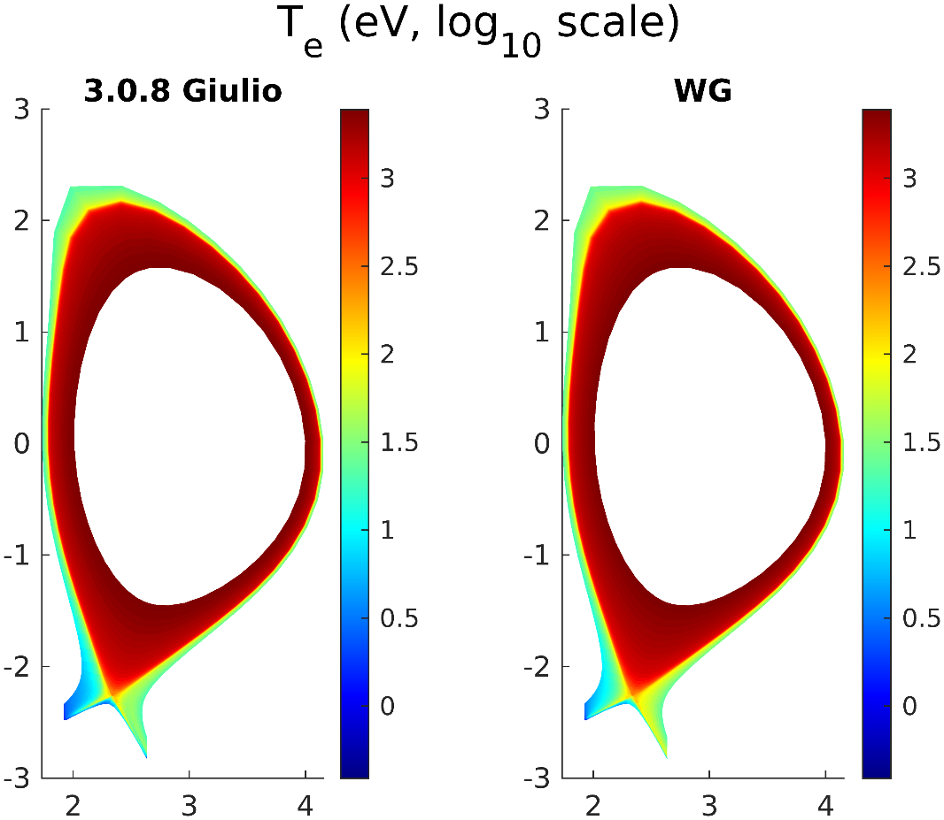
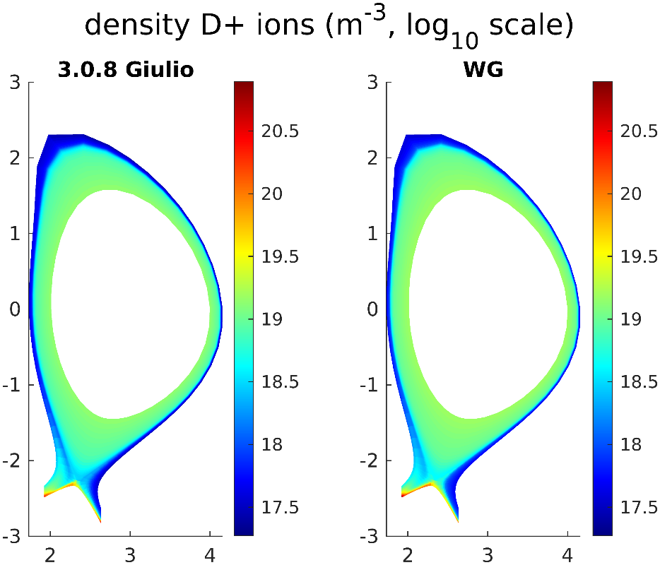
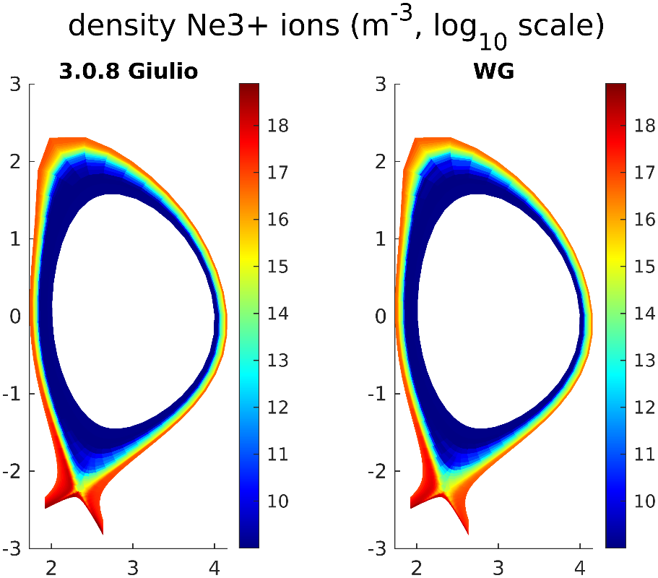
Motivation
After conversion to WG format, a benchmark run (turning off 9-point stencil in WG) was performed
Densities and parallel velocities OK
Upstream temperature profiles OK
Divertor temperatures: more substantial differences
→ Deeper investigation performed

Slide 4
Four differences found
Sheath boundary conditions
Flux limiter thermo-electric conductivity
Parallel electron velocity around X-point
EIRENE sources (on fixed BG)

Slide 5
1. Sheath boundary conditions
In WG, BCPOT = 3, BCON = 3, BCMOM = 3, BCENE = 3 and BCENI = 3 are automatically converted to “new” SpB sheath BCs BCPOT = 11, BCCON = 14, BCMOM = 13, BCENE = 15, BCENE = 15
These should be identical up to interpolation, if GAMMAE = 0 and enepar = 1.0 Otherwise there is a difference due to (1+GAMMAE)/(1-GAMMAE) vs enepar. In the original case, GAMMAE was 0.5

Slide 6
2. Flux limiters thermo-electric conductivity
Discovered a bug in 3.0.8 (which was also still present in 3.0.9), whereby the flux limit value for $α_{ex}$ was a factor 4 wrong due to an erroneous local computation of $∇T_{e}$. This error was not present in WG due to the use of the centralized routines for gradient computation.
Note: the activation/deactivation of these flux limiters has quite a large effect on the solution. What value to choose for remainder of work? Based on what was it selected?

Slide 7
3. Parallel electron velocity around X-point
In WG, the parallel electron velocity does not depend on b2sigp_style.
In 3.0.8, b2sigp_style leads to local differences in ue around X-point.
The combination 3.0.8 + b2sigp_style = 2 is the one that differs from the other three
This is assumed to be due inferior discretization in 3.0.8

Slide 8
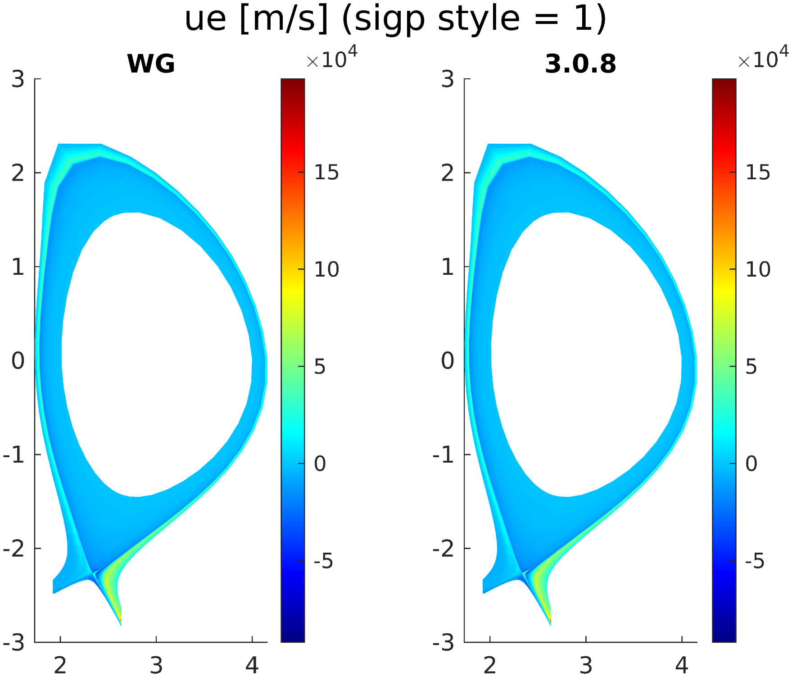

Slide 9
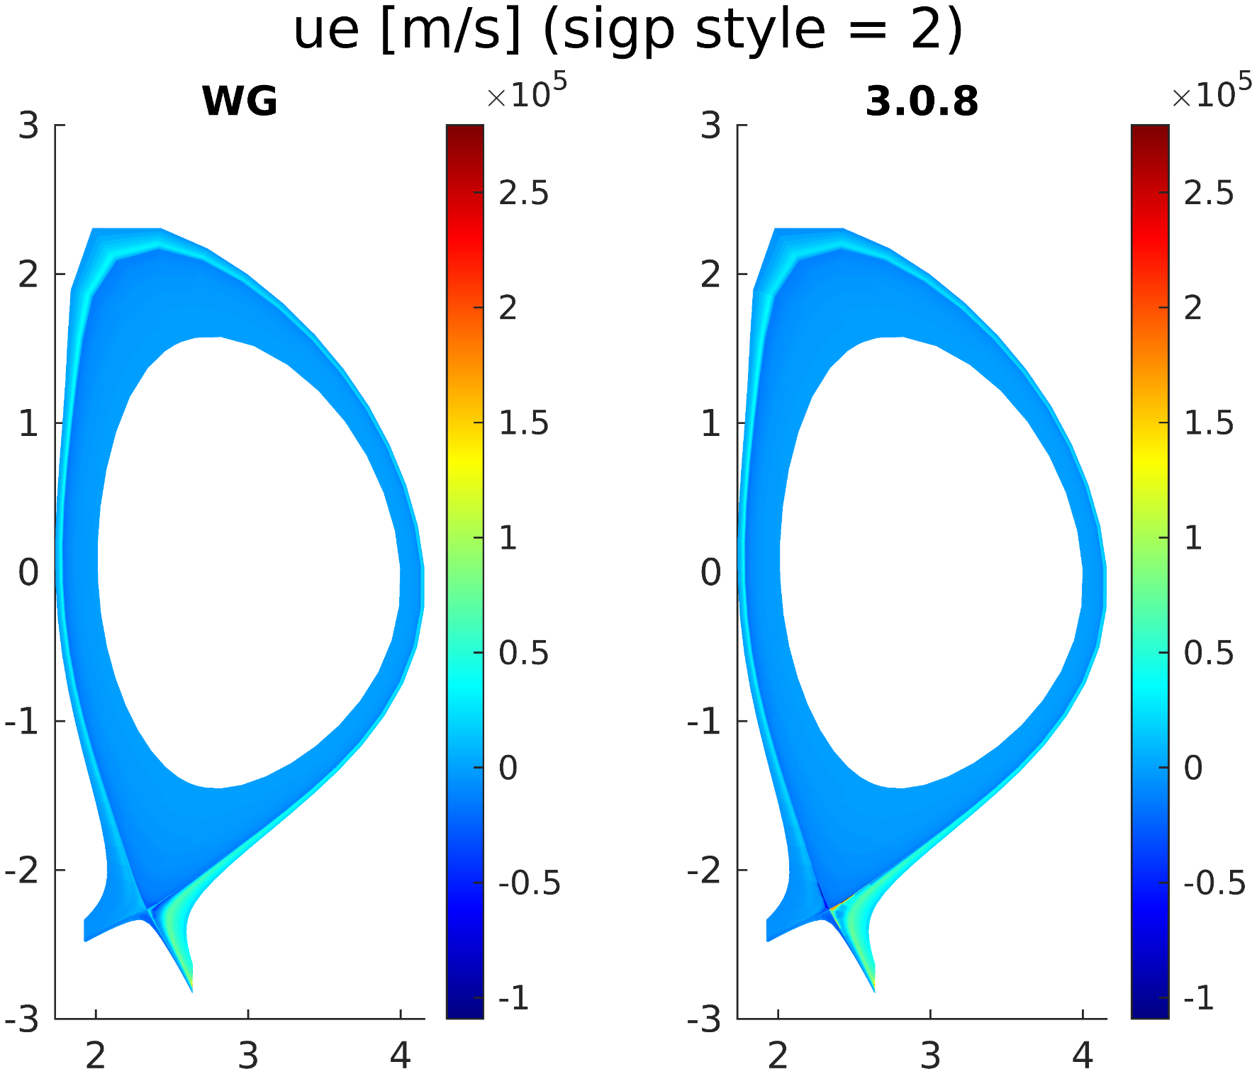

Slide 10
4. EIRENE sources on fixed BG
One timestep with 1M particles / stratum
Good agreement, but small differences due to minor updates in EIRENE and B2.5-EIRENE coupling (didn’t investiage further which changes)

Slide 11
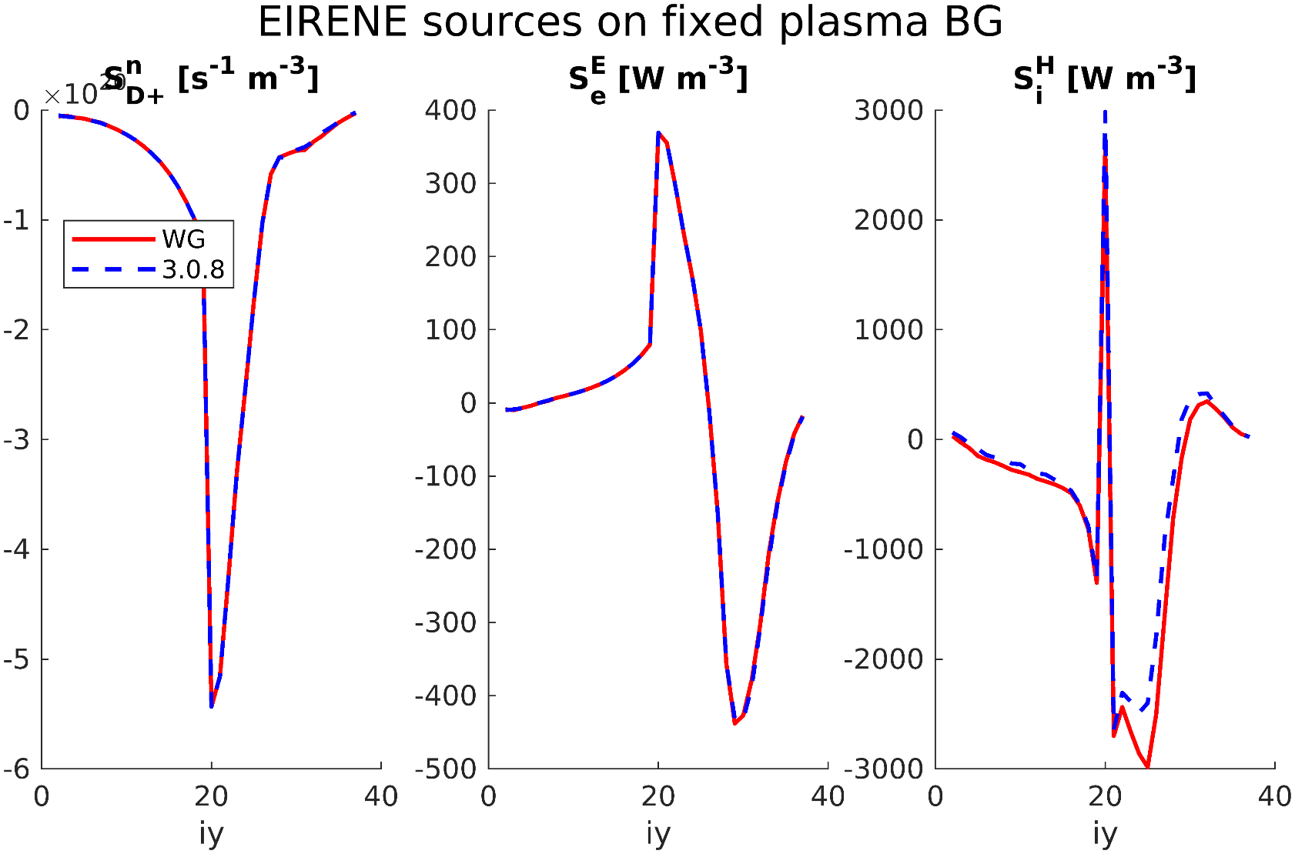
EIRENE sources: ix = 2

Slide 12
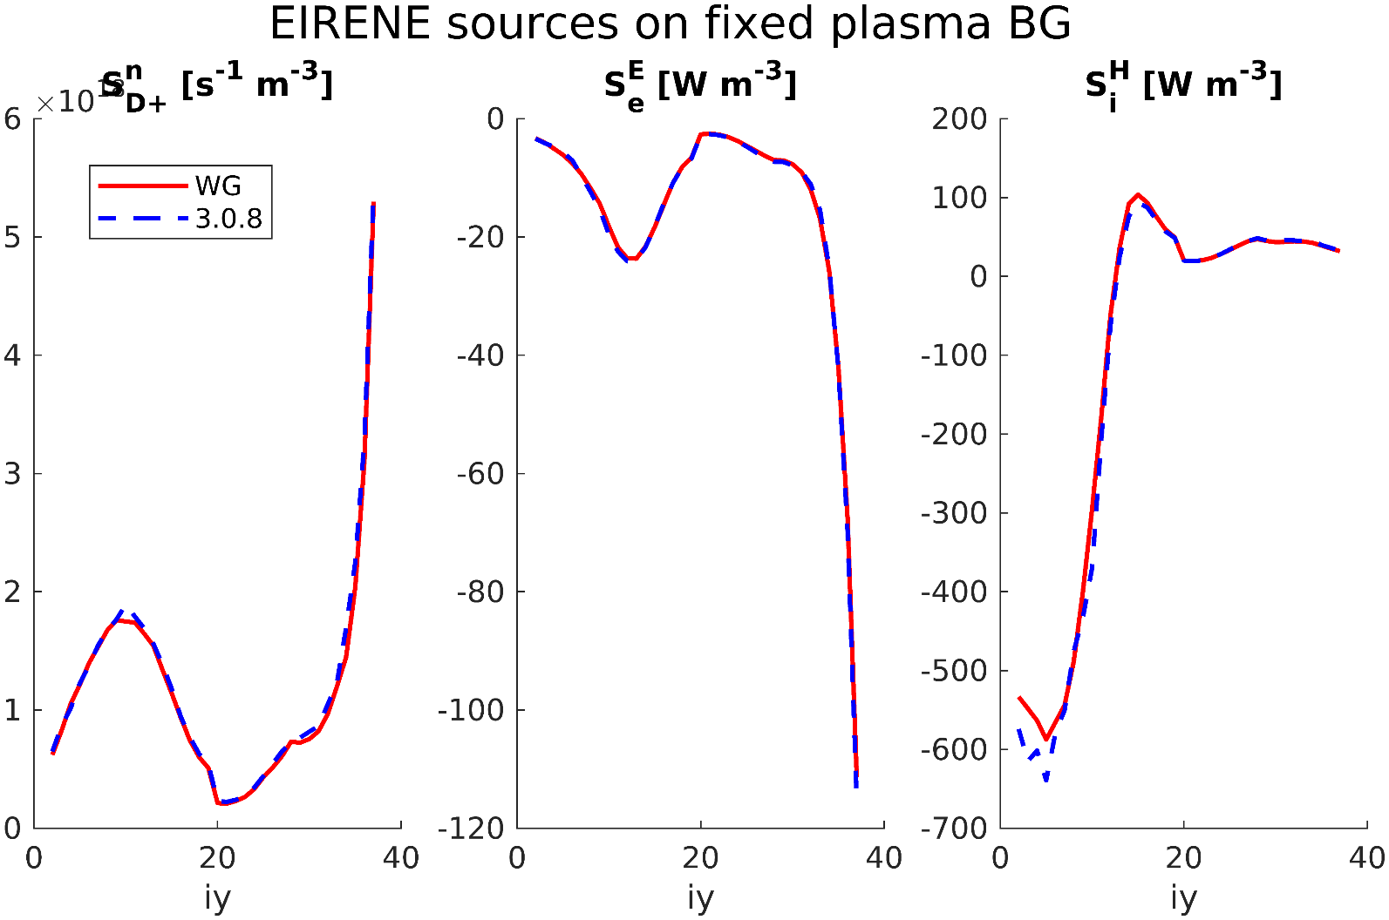
EIRENE sources: ix = 60

Slide 13
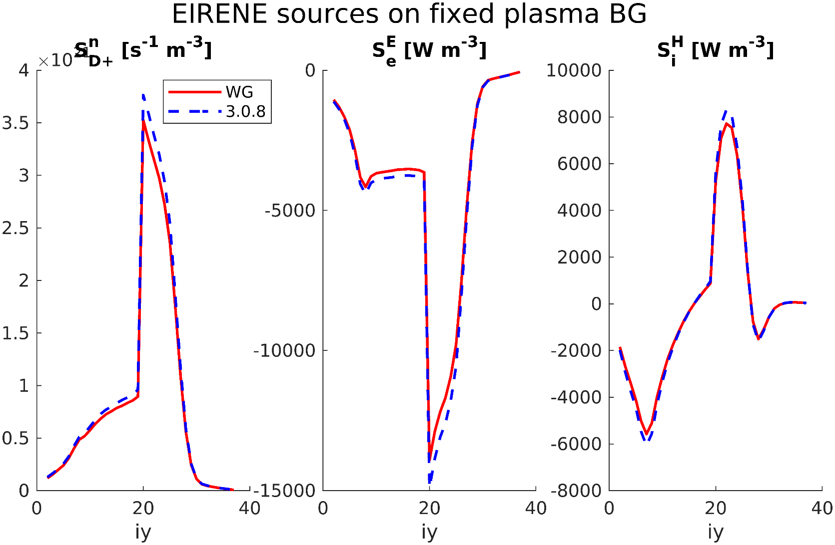
EIRENE sources: ix = 97 (nx-1)

Slide 14
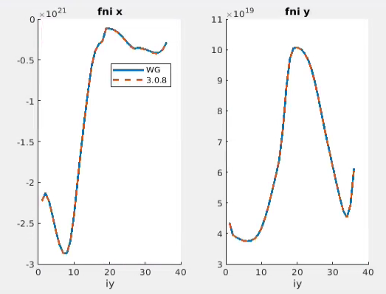
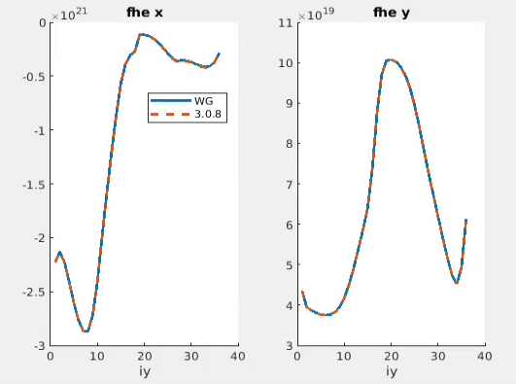
Fluxes and non-EIRENE sources on fixed BG
After adressing these issues it was possible to get perfect agreement for all fluxes and non-EIRENE sources on fixed plasma background. Some examples:
ix = 40
Total ion particle flux
Electron heat flux

Slide 15
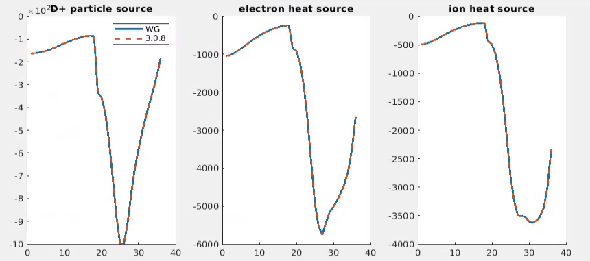
Inner target boundary conditions sources

Slide 16
Dedicated benchmark run
Re-ran an adapted benchmark case in both WG and 3.0.8
‘New’ sheath BCs also in 3.0.8 (removing difference #1)
Fixed puff instead of feedback (but I checked independently that feedback scheme works for the case in WG)
Thermo-electric flux limit turned off in both cases (removing difference #2)
Use b2sigp_style = 1 (removing difference #3)
→ Only differences in EIRENE remaining

Slide 17
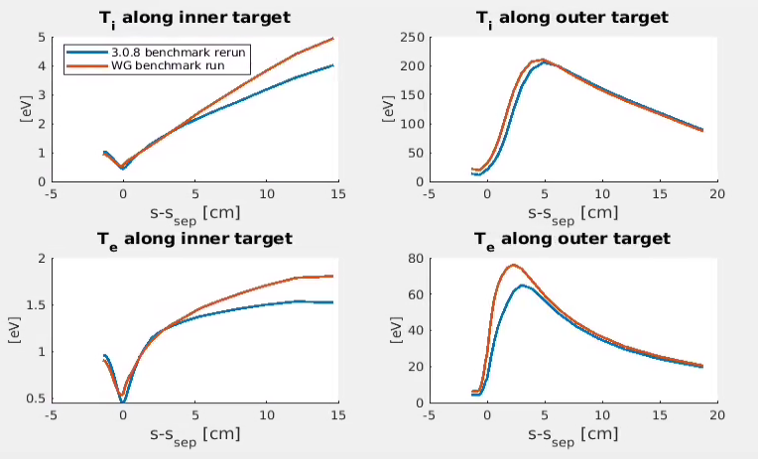
Results target temperatures dedicated benchmark runs
Differences are still not fully negligible, but small enough to conclude benchmark study

Slide 18
Content
Benchmark 3.0.8 vs WG
Narrow grid kinetic cases (with 9-point stencil)
Extended grids – SOLPS progress
Extended grids – alternative geometries

Slide 19
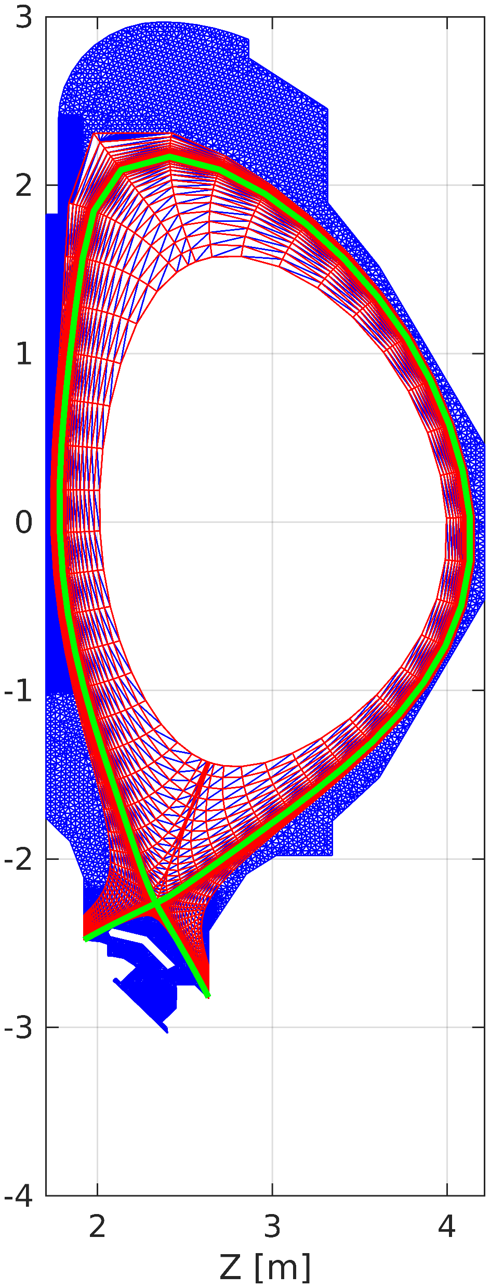
Narrow grid cases
Narrow-grid cases with kinetic neutrals run robustly in WG code version (with 9-point stencil)
Ready to be used for preliminary studies
Performed convergence scan on # EIRENE particles (see next slide)
D₂
Ne

Slide 20
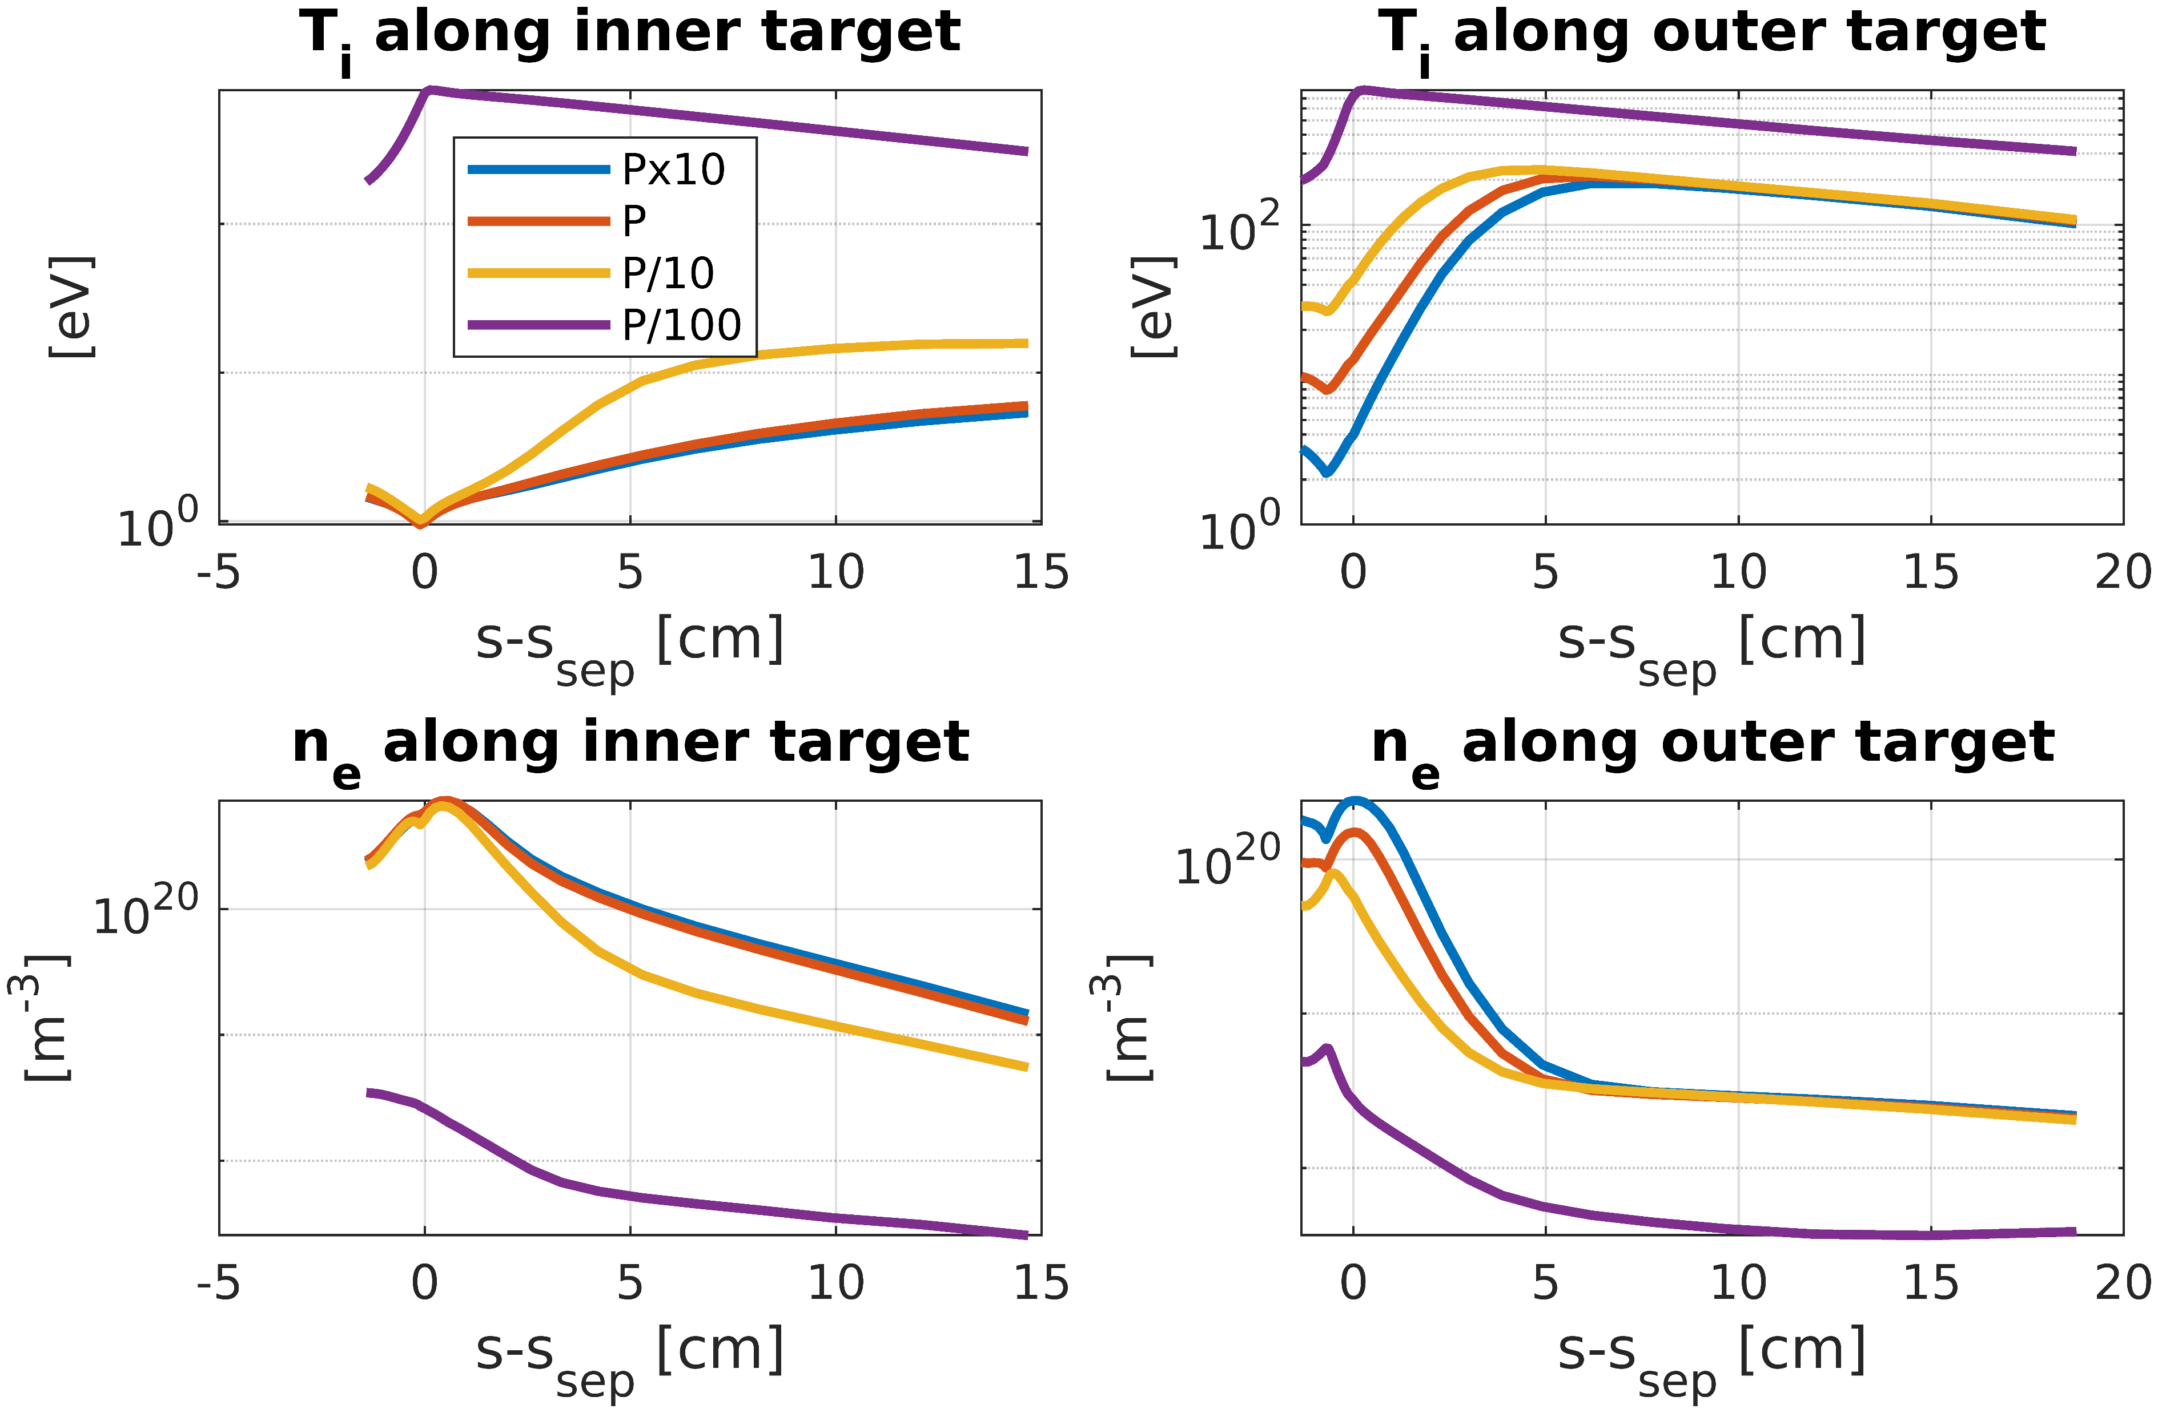
Convergence assessment on EIRENE particles
EIRENE reference particle distrubtion P
 | D | Ne
IT | 25000 | 25000
OT | 25000 | 25000
IPF | 20000 | 20000
OPF | 20000 | 20000
MCW | 20000 | 20000
Puff | 10000 | 10000
Vol. Rec. | 7000 | 7000
→ Good statistics needed on outer target

Slide 21
Narrow-grid cases with drifts
Started narrow-grid case with kinetic neutrals and drifts
For now, forced to reduce timestep to $2⋅{10}^{−7}s$ and $rxf=0.2$
100k + iterations without crash with 100% drifts, but not yet converged
No analyis of physics impact of drifts yet

Slide 22
Content
Benchmark 3.0.8 vs WG
Narrow grid kinetic cases (with 9-point stencil)
Extended grids – SOLPS progress
Extended grids – alternative geometries

Slide 23
Extended grid cases
Technically running with both kinetic neutrals and advanced fluid neutrals
Remaining issues with parallel velocities and temperatures in specific areas

Slide 24
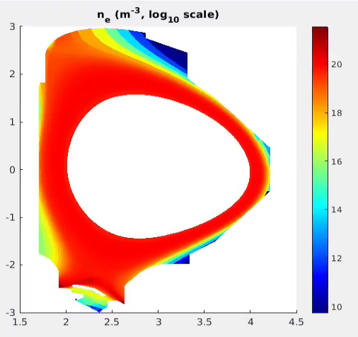
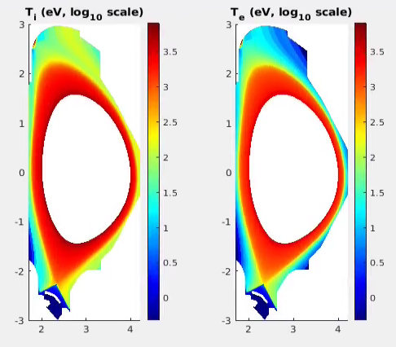
Extended grid with kinetic neutrals
Anomalous numerical viscous heating? Currently under investigation

Slide 25
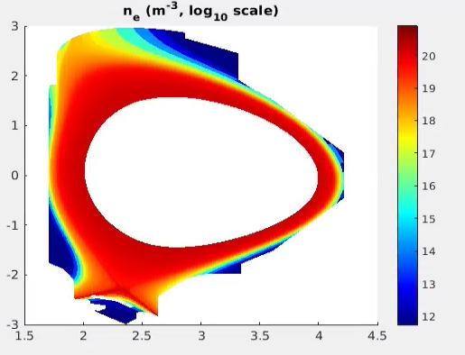
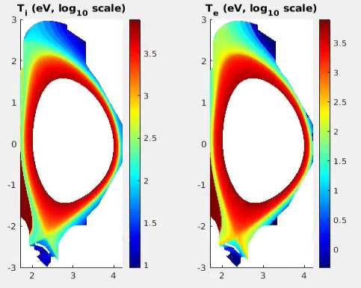
Extended grids with fluid neutrals
Anomalous numerical viscous heating and high parallel velocities at tangency points
→ These issues must be resolved before starting physics interpretation

Slide 26
Content
Benchmark 3.0.8 vs WG
Narrow grid kinetic cases (with 9-point stencil)
Extended grids – SOLPS progress
Extended grids – alternative geometries

Slide 27
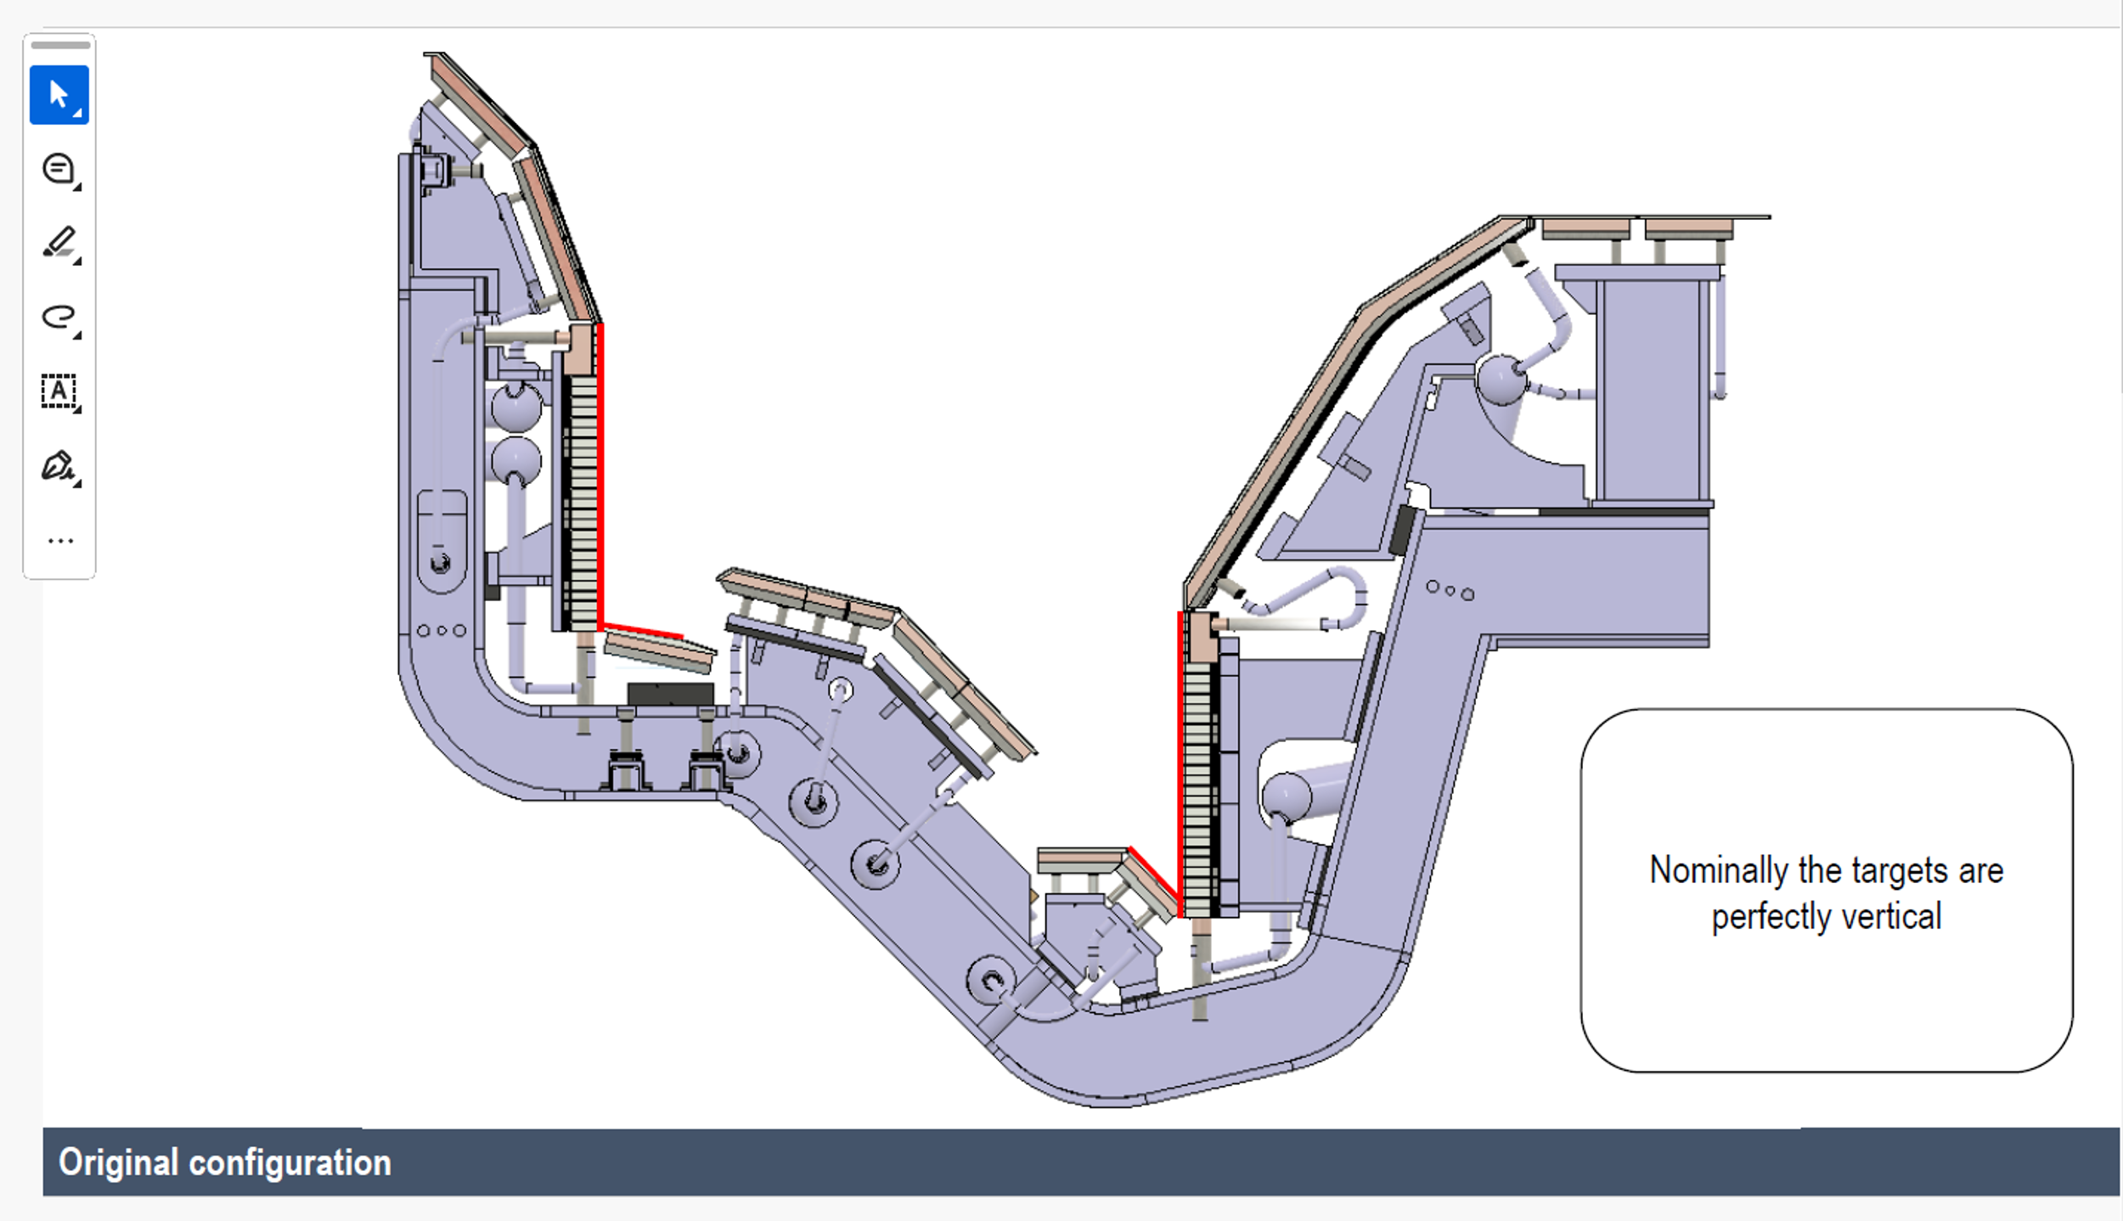
CAD geometry

Slide 28
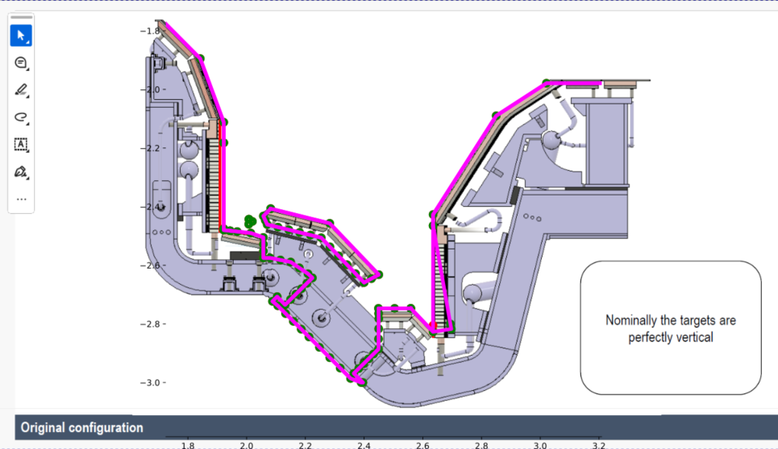
CAD geometry
These are probably the PFUs you want the strike point on (actively cooled, MB)
This is actually a gap in rotated configurations! → chose to extend reflector plate to close gap

Slide 29
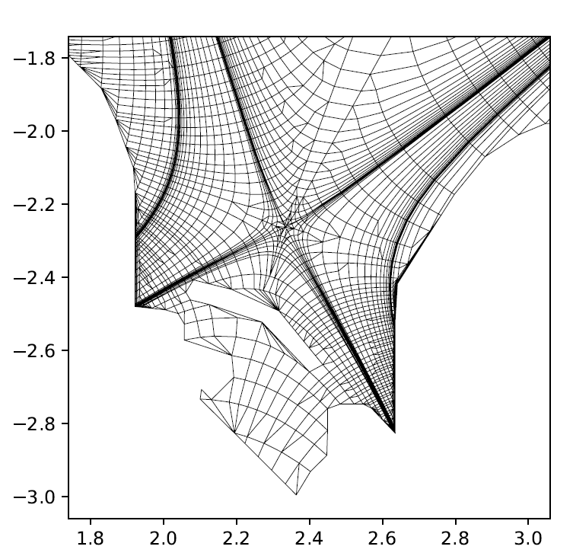
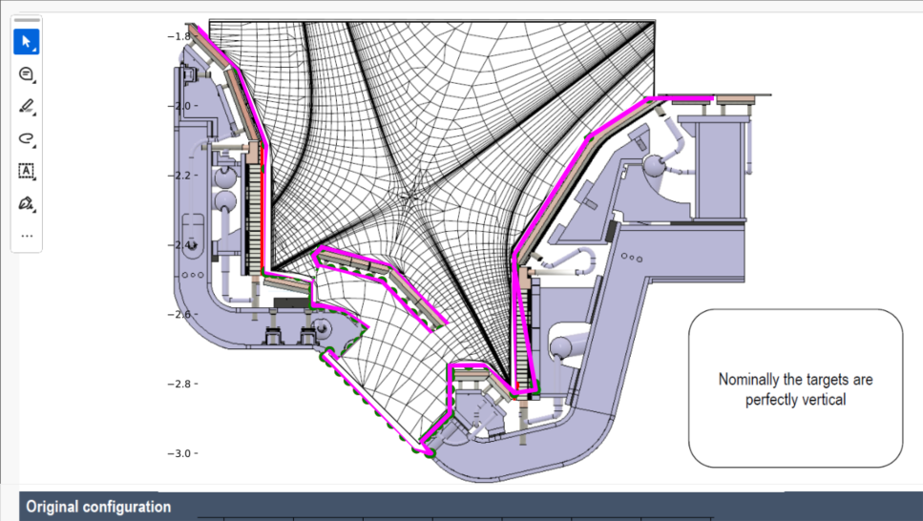
Baseline

Slide 30
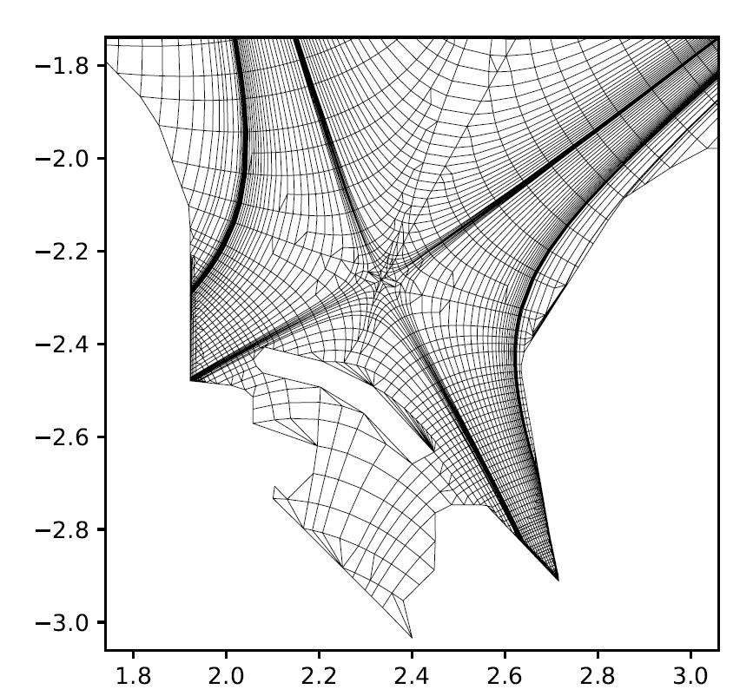
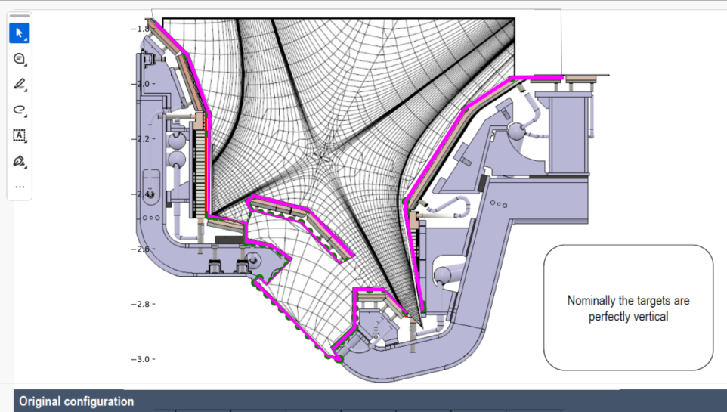
10 degrees, extended RP

Slide 31
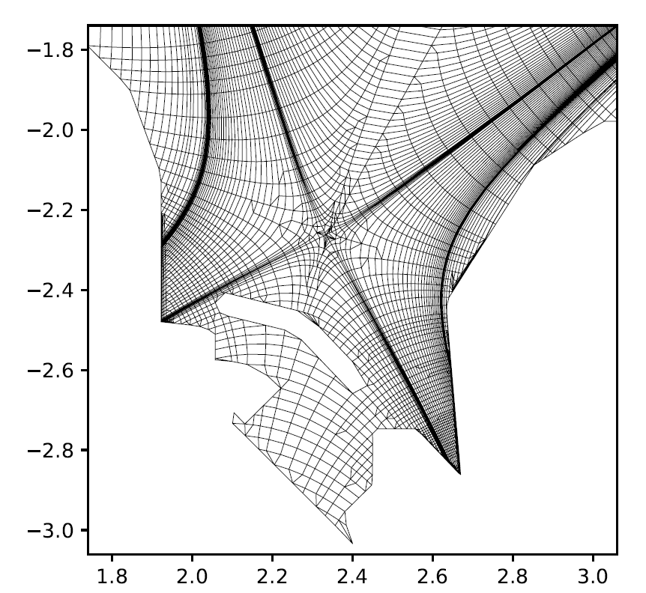
5 degree, extended RP

Slide 32
Conclusion
Technical work performed to continue JT60-SA modelling in WG SOLPS-ITER
Benchmark 3.0.8. vs WG: OK
Narrow grid runs: OK
Narrow grids + drifts: ± OK but slow
Extended grids: runs without crashing but some anomalies to be resolved
Fully extended grids can be created for alternative geometries

Slide 33
Input for next steps
Flux limiter thermo-electric conductivity
Specific reason they were activated?
Value?
Updates on what $n_{e,sep}$to aim for?
Which geometries to investigate?
Target inclination?
Dome?
What to do with gap when inclination is changed?
Cost functions?

