Slide 1
SOLPS-ITER simulations of Ne seeded scenario 2 and effect of closed geometry
G. Rubino (ISTP-CNR Bari) , L. Balbinot (Università della Tuscia)

Slide 2
Scientific objectives
Evaluate power exhaust and impurity concentration of JT-60SA high performance scenario (scenario 2, the most demanding for the divertor) with W first wall
Evaluate power density fluxes to the first wall in different plasma conditions
Evaluate detachment onset conditions
Neon seeding (SOLPS)
Evaluate the effect divertor geometry effect:
Evaluate pumping efficiency at low densities
Study the effect of V shaped corner on subdivertor neutral condition
Evaluate the effect of a change in the divertor geometry on:
Detachment achievement vs. upstream density
Neutral trapping
Pumping efficiency

Slide 3
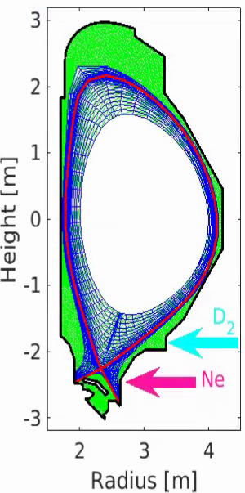
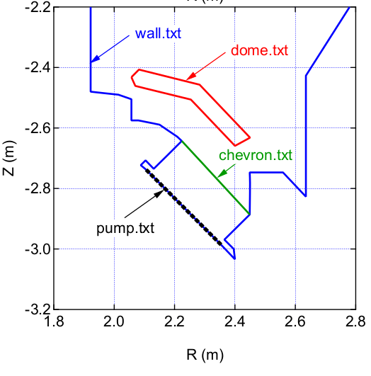
Scenario II parameters and modelling setup
Scenario #2
R [m] | 2.96
a [m] | 1.17
I_{p} [MA] | 5.5
B [T] | 2.25
P_{aux} [MW] | 41 MW
P_{in} [MW] | 20MW < P_{in} <30MW
<n_{e}>_{sep} [m⁻³] | 2.0x10¹⁹m⁻³
<n_{e}>_{ped} [m⁻³] | 5.0x10¹⁹m⁻³
<n_{e}>_{l} [m⁻³] | 6.0x10¹⁹m⁻³
D⁺ flux [s⁻¹] | 1.8x10²¹ s⁻¹
Transport parameters | Derived from experiments and scalings (λ_{q} ≈ 1.5 mm)
P_{in} ^{(@ρ=0.9)}
Realistic pumping and sub-divertor modelling
SOLPS and SOLEDGE mesh
G. Rubino & L. Balbinot | PSD meeting on the transition to W PFCs| 17 June 2025

Slide 4
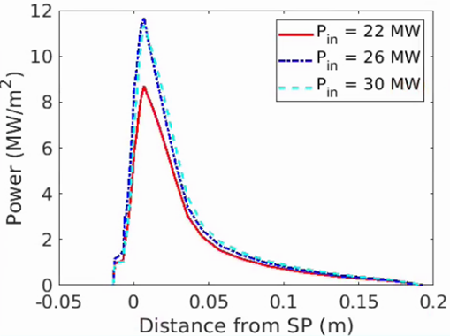
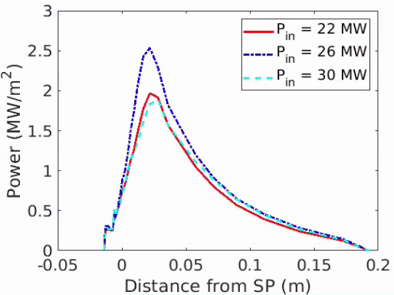
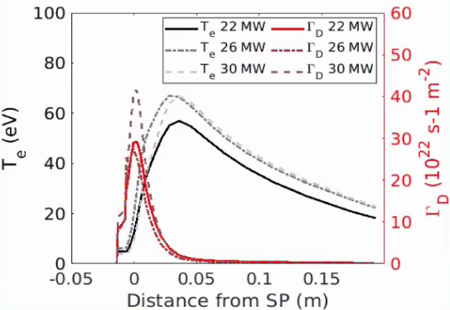
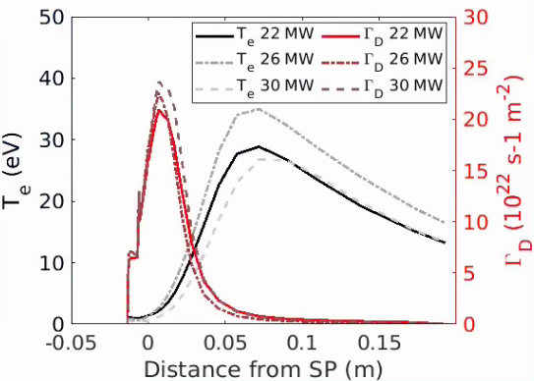
Ne seeding – main results
Input power scan (22, 26 and 30MW)
Seeding control to obtain:
power flux peak compatible with technological constraints (~10MW/m²)
detachment onset (Technological/physical constraint on W sputtering)
High power scenarios will be operated with high radiated power fraction: f_{RAD,TOT}>80%
Power flux peak is not a major concern (easiest limit to achieve)
W erosion is a major concern: detachment threshold is most stringent limit
Not feasible at low density level (n_{e,sep}~2x10¹⁹m⁻³) → Z_{eff} ≈ 6-7
SOLPS-ITER
G. Rubino & L. Balbinot | PSD meeting on the transition to W PFCs| 17 June 2025

Slide 5
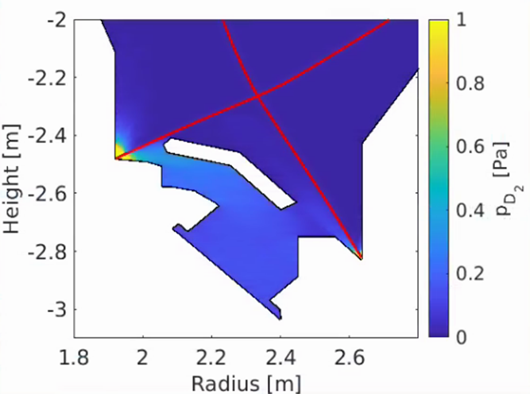
Pumping in low density cases
Both codes showed a very low pumping rate ~3x10²¹ D/s
We wanted to prove that low pumping throughput was given by neutral trapping
study divertor pumping rate in different regimes and how it could be increased
Methodology
Assess the effect of the V-shape geometry on neutral D leakage
Pure D case
Scan in P_{in} from 2 to 10 MW to cope a wide range of divertor plasma conditions at fixed upstream density n_{e,sep} = 2x10¹⁹ m⁻³ (feedback controlled)
Assess the effect of the V-shape geometry on detachment achievement and neutral trapping
Scan in n_{e,sep} to study the effect on detachment achievement
Albedo set at 0.95 (v_{pump}~100m³/s)
G. Rubino & L. Balbinot | PSD meeting on the transition to W PFCs| 17 June 2025

Slide 6
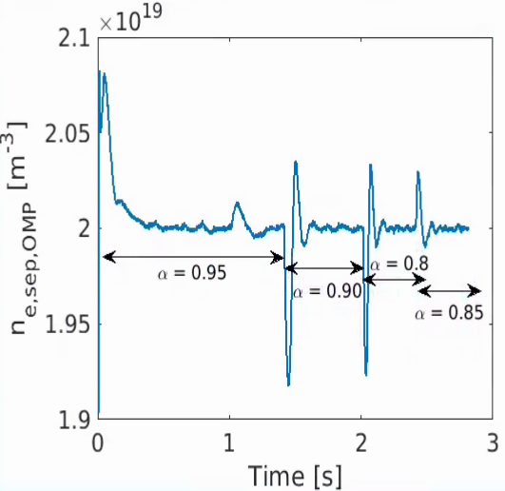
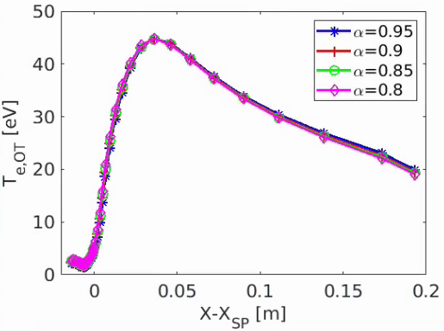
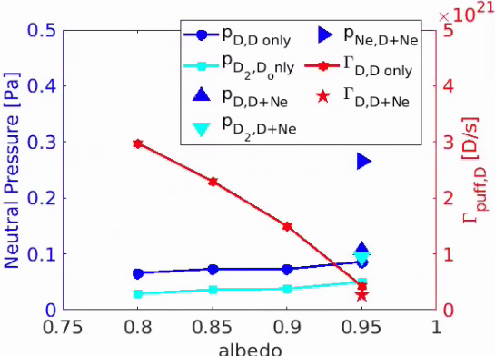
Effect of pump albedo
No power exhaust effect
Scan in D pumping albedo 0.8-0.85-0.9-0.95
Pure D plasma (for fast scan)
Attached condition on OT (P_{in} = 10 MW)
n_{esep,OMP} = 2e19 m⁻³ feedback controlled by Γ_{puff}
Same OT plasma conditions
Pressure averaged in front of the pump (both P_{D} and P_{D2})
Sub-divertor pressure doesn’t change drastically even if the albedo il changed → this is the pumping system working range in attached regime
G. Rubino & L. Balbinot | PSD meeting on the transition to W PFCs| 17 June 2025

Slide 7
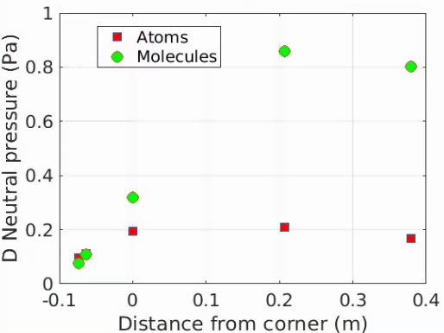
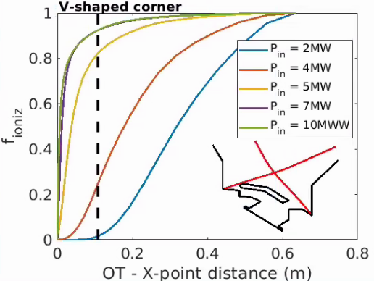
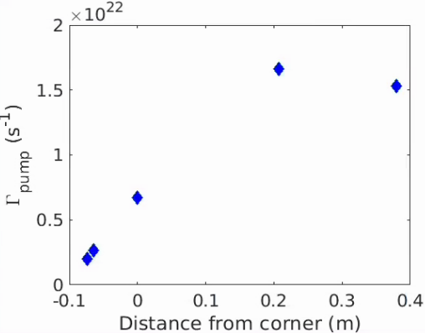
V-shape effect
Position of the ionization front where f_{ionz} > 0.8
A slight increase when detachment starts (P= 5MW)
Strong increase when the ionization front is well above the V corner​
​
Γ_{pump} ~ 1.5e22 D/s, and P_{sub-div}~1Pa in line with current experiments​
Only when ionization front is above the corner D₂ molecules are able to escape
→ p_{neut,subdivertor}≈ of 1Pa
G. Rubino & L. Balbinot | PSD meeting on the transition to W PFCs| 17 June 2025

Slide 8
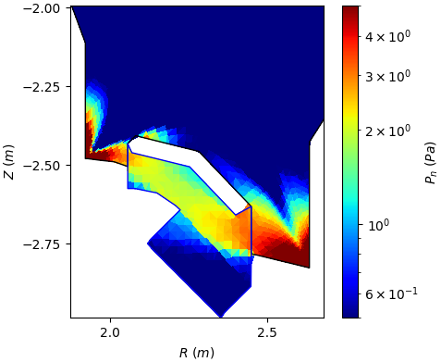
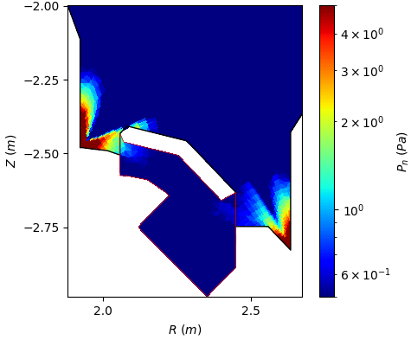
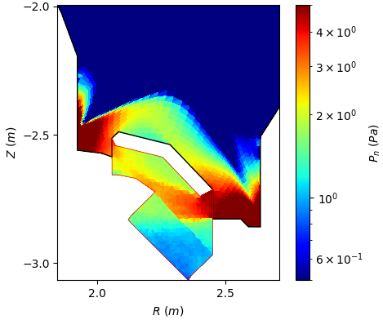
How can pumping rate be increased?
Change divertor shape
Change strike point location obtained by changing the relative position of equilibrium and first wall
Pumping thruoughput and sub-divertor pressure increases when ionization front is located above the horizontal plate.
Can we do it without deep detachment?
 | Std. case | No-corner | High strike point
Pumping rate | 4.1x10²¹ D/s | 5.62x10²¹ D/s | 9.56x10²¹ D/s
Crio press. | 0.25 Pa | 0.45 Pa | 1.0 Pa
G. Rubino & L. Balbinot | PSD meeting on the transition to W PFCs| 17 June 2025

Slide 9
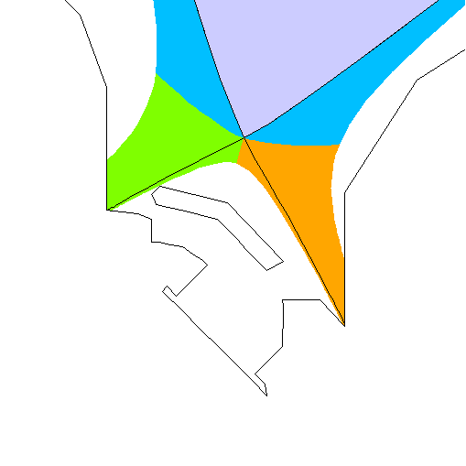
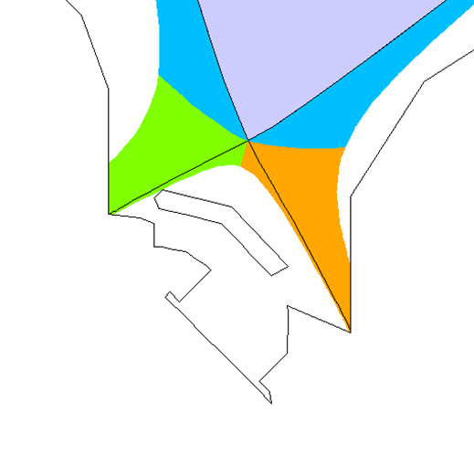
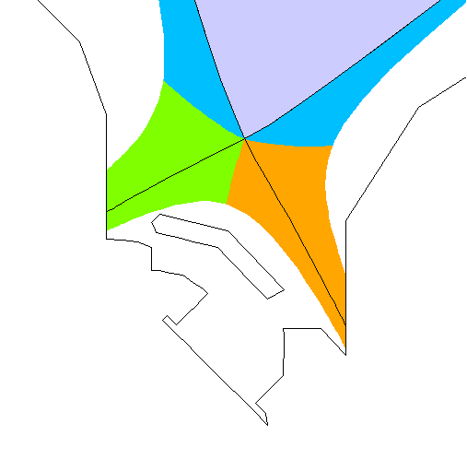
Effect of divertor geometry on detachment
3 different geometry configurations:
V-Shaped: reference
V-open: open the V-corner
High OSP: V-shaped but the strike point located above the corner
V-Shaped
V-open
High OSP
G. Rubino & L. Balbinot | PSD meeting on the transition to W PFCs| 17 June 2025

Slide 10
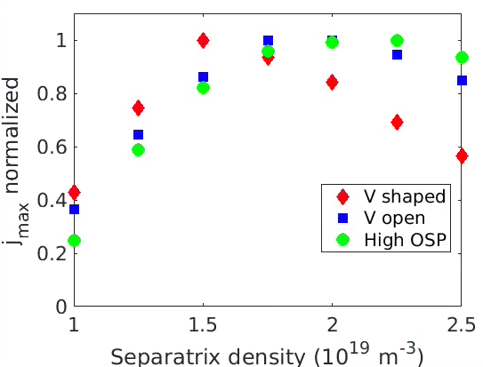
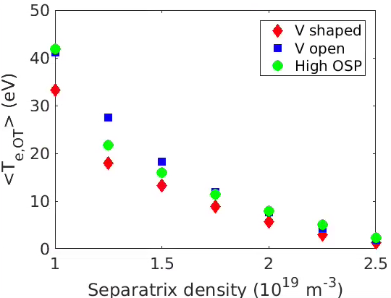
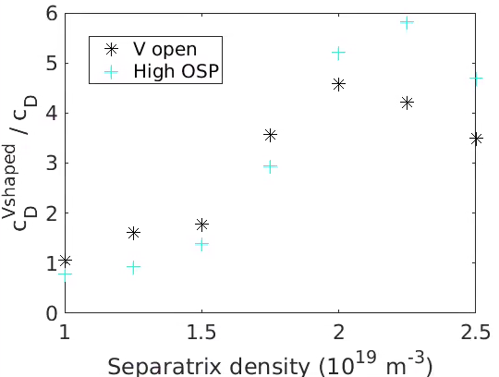
Effect on detachment achievement
Pure D scan in the different divertor geometry with fixed P_{in} = 5MW (≈ power able to dissipate in impurity seeded cases)
Evaluation of roll-over point
V-Shaped shows a considerable benefit
V-shaped detach at lower upstream density
OSP shows the worst behaviour
Effect of V closure on SP temperature
Weighted <Te,OT> decreased in V-shaped at low density thanks to the neutral trapping
Favour the detachment in the SP region
Increased neutral compression ratio c_{D} in detached OT conditions, by factor 4-5
Less effective at very low density (low neutral densities)
$$c_{D}=\frac{n_{n}^{div}}{n_{n}^{main}}, n_{n}=n_{D_{0} }+2n_{D_{2}}$$
D Galassi, Plasma Phys. Control. Fusion 2020
<T_{e,IT/OT}> = ∫ _{IT/OT} T_{e,IT/OT} Γ_{D} / ∫_{IT/OT} Γ_{D}
B. Lomanowski, Nucl. Fus. 2022
G. Rubino & L. Balbinot | PSD meeting on the transition to W PFCs| 17 June 2025

Slide 11
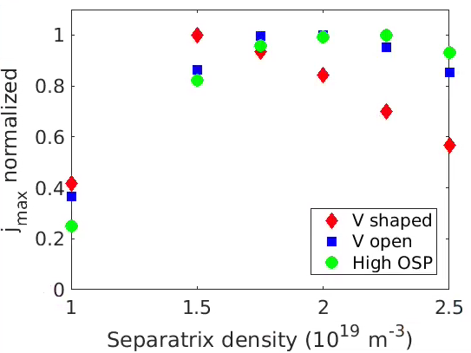
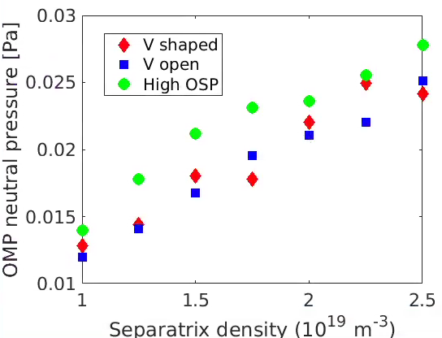
Effect on neutral leakage
Pure D scan in the different divertor geometry with fixed P_{in} = 5MW (≈ power able to dissipate in impurity seeded cases)
The neutral pressure at OMP is higher in case of an upward shift of the OSP
At the roll-over point:
(p_{neut,OMP})^{Vshaped} / (p_{neut,OMP})^{VOpen} = 0.85
(p_{neut,OMP})^{Vshaped} / (p_{neut,OMP})^{HighOSP} = 0.7
V-shaped divertor configuration decrease the neutral leakage at the roll over
G. Rubino & L. Balbinot | PSD meeting on the transition to W PFCs| 17 June 2025

Slide 12
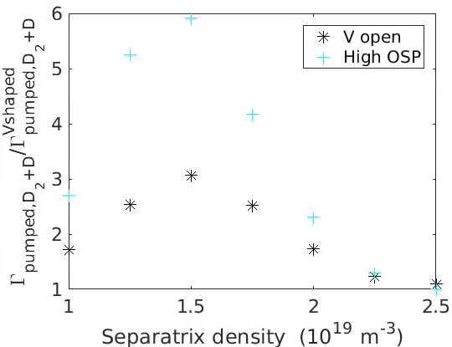
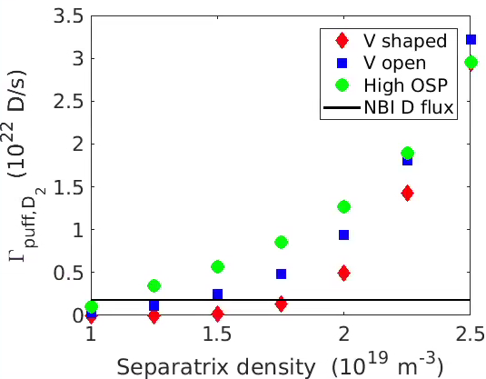
Effect geometry on pumping efficiency
Pure D scan in the different divertor geometry with fixed P_{in} = 5MW (≈ power able to dissipate in impurity seeded cases)
Evaluation of pumping efficiency
V-shape geometry tends to reduced the pumping capability at low density, OT attached or semi-detached plasma condition
The low pumping capability (subdivertor neutral pressure) related to the neutral trapping
Best solution to increase the pumping rate at low density is the shift of SP, gain up to a factor 6
Effect on puffing
In V-shaped very low Γ_{puff} at low density (same order of magnitude of NBI injected particles)
At higher density similar values due to upstream movement of the ionization front
G. Rubino & L. Balbinot | PSD meeting on the transition to W PFCs| 17 June 2025

Slide 13
Conclusions and future work
Impurity seeded simulations with Ne
the necessity to operate at high radiation fraction
Strong core contamination at low density (high Zeff) → integrated modelling is ongoing (see L. Balbinot presentation)
Low pumping rate (same order of magnitude of NBI injected particles)
Pure D simulation
the albedo negligibly affects the pumping efficiency in attached divertor plasma
V-shape geometry tends to reduce the pumping capability at low density, OT attached or semi-detached plasma condition
The low pumping capability (subdivertor neutral pressure) related to the neutral trapping
A change of the divertor geometry can increases the pumping capability of the system: Open V corner or move SP upward
In V-shaped divertor the roll over is obtained at lower density level than in a V-open divertor and higher SP
The V-shaped divertor increases the neutral compression, especially in the Strike point region thus favouring the detachment
Lower neutral leakage and OMP neutral pressure in V-shaped at detachment onset
Future work
Effect of gaps can be beneficial? (e.g. by assigning a R_{c}<1 at target)
Effect of divertor geometry (V-shaped, Open corner High SP) in Ne seeded simulation at low densities
G. Rubino & L. Balbinot | PSD meeting on the transition to W PFCs| 17 June 2025

