Slide 1
JT-60SA W divertor modeling: Status of SOLPS-ITER modelling
17/6/2025
Wouter Dekeyser
Sander Van den Kerkhof
Wim Van Uytven

Slide 2
Content
Narrow grid – density scan
Narrow grid – prelim. drift results
Extended grids
New geometries

Slide 3
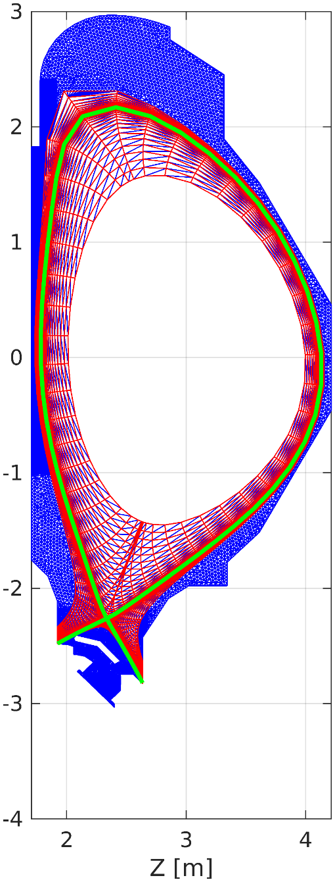
Narrow grid – density scan
Core
$Q_{e}=Q_{i}=13 MW$
$Γ_{D+}=1.88⋅{10}^{21}{ s}^{−1}$
Puff
$Γ_{Ne}=4.1⋅{10}^{20}{ s}^{−1}$
$Γ_{D_{2}}$= feedback on $n_{e,sep}$
$n_{e,sep}=\left\{2 ;2.5 ; 3 ; 3.5\right\}⋅{10}^{19}m^{−3}$
D₂
Ne

Slide 4
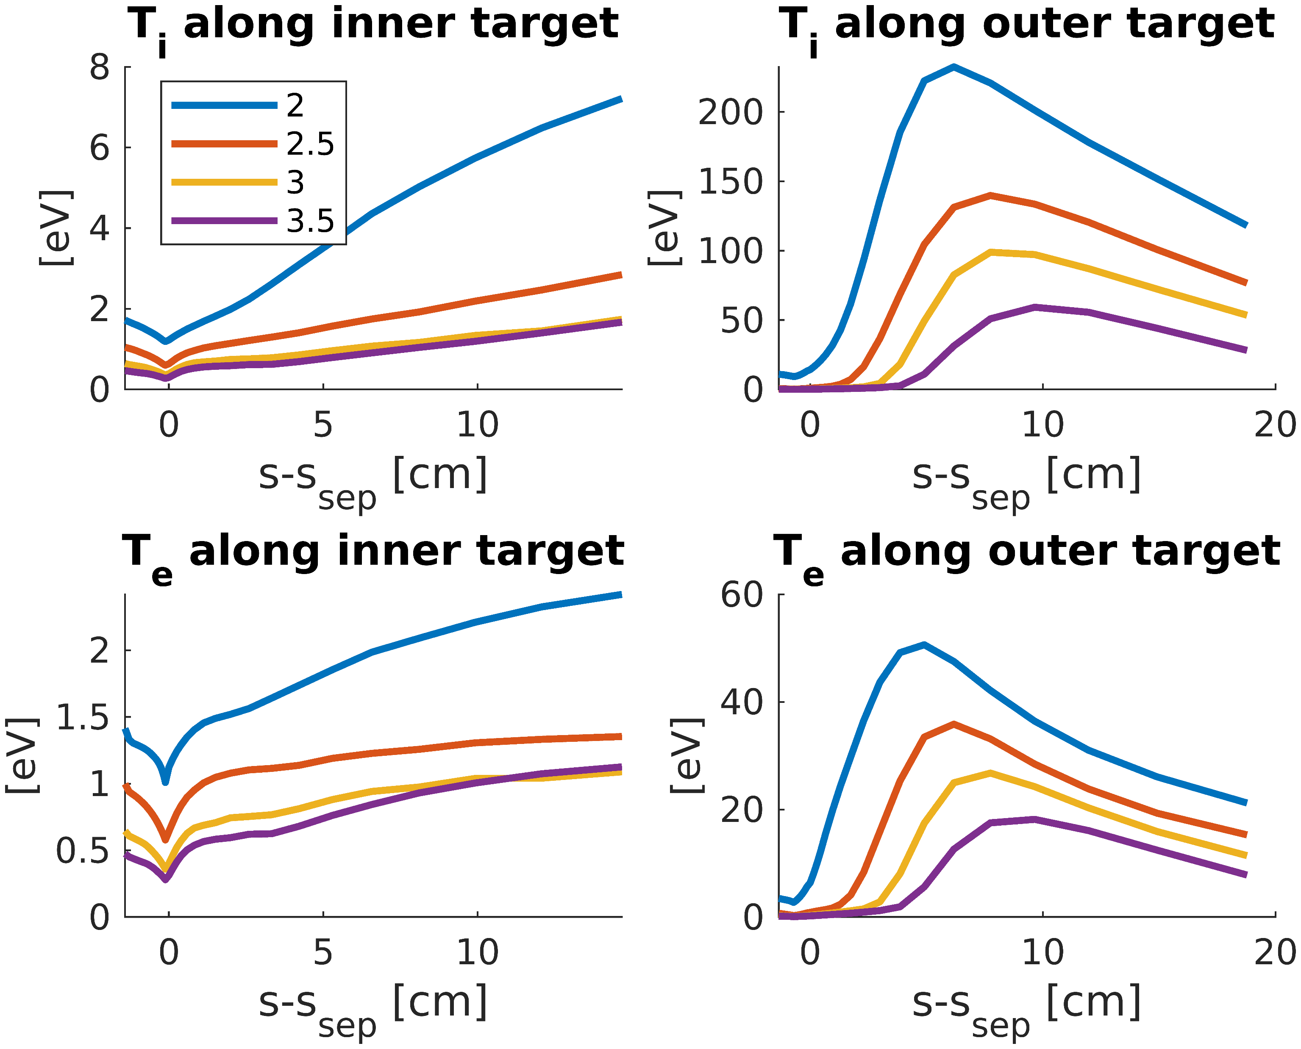
Narrow grid – density scan
Clear decrease of OT temperatues with increasing $n_{e,sep}$
Even $n_{e,sep}=3.5⋅{10}^{19}m^{−3}$ still leads to unacceptably (?) high temperatures

Slide 5
Content
Narrow grid – density scan
Narrow grid – prelim. drift results
Extended grids
New geometries

Slide 6
Preliminary nature of results
Drift cases run smoothly, 200k+ iterations without crashing
Bulk of transient phase appears completed
More simulations time needed to confirm steady-state
Slightly different BCs:
Fixed D₂ puff of $8.0⋅{10}^{20}s^{−1}$
$→$ $n_{e,sep}=2.6⋅{10}^{19}m^{−3}$ with drifts
$→$ $n_{e,sep}=2.4⋅{10}^{19}m^{−3}$ w/o drifts
Should revert to feedback on $n_{e,sep}$ for honest comparison

Slide 7
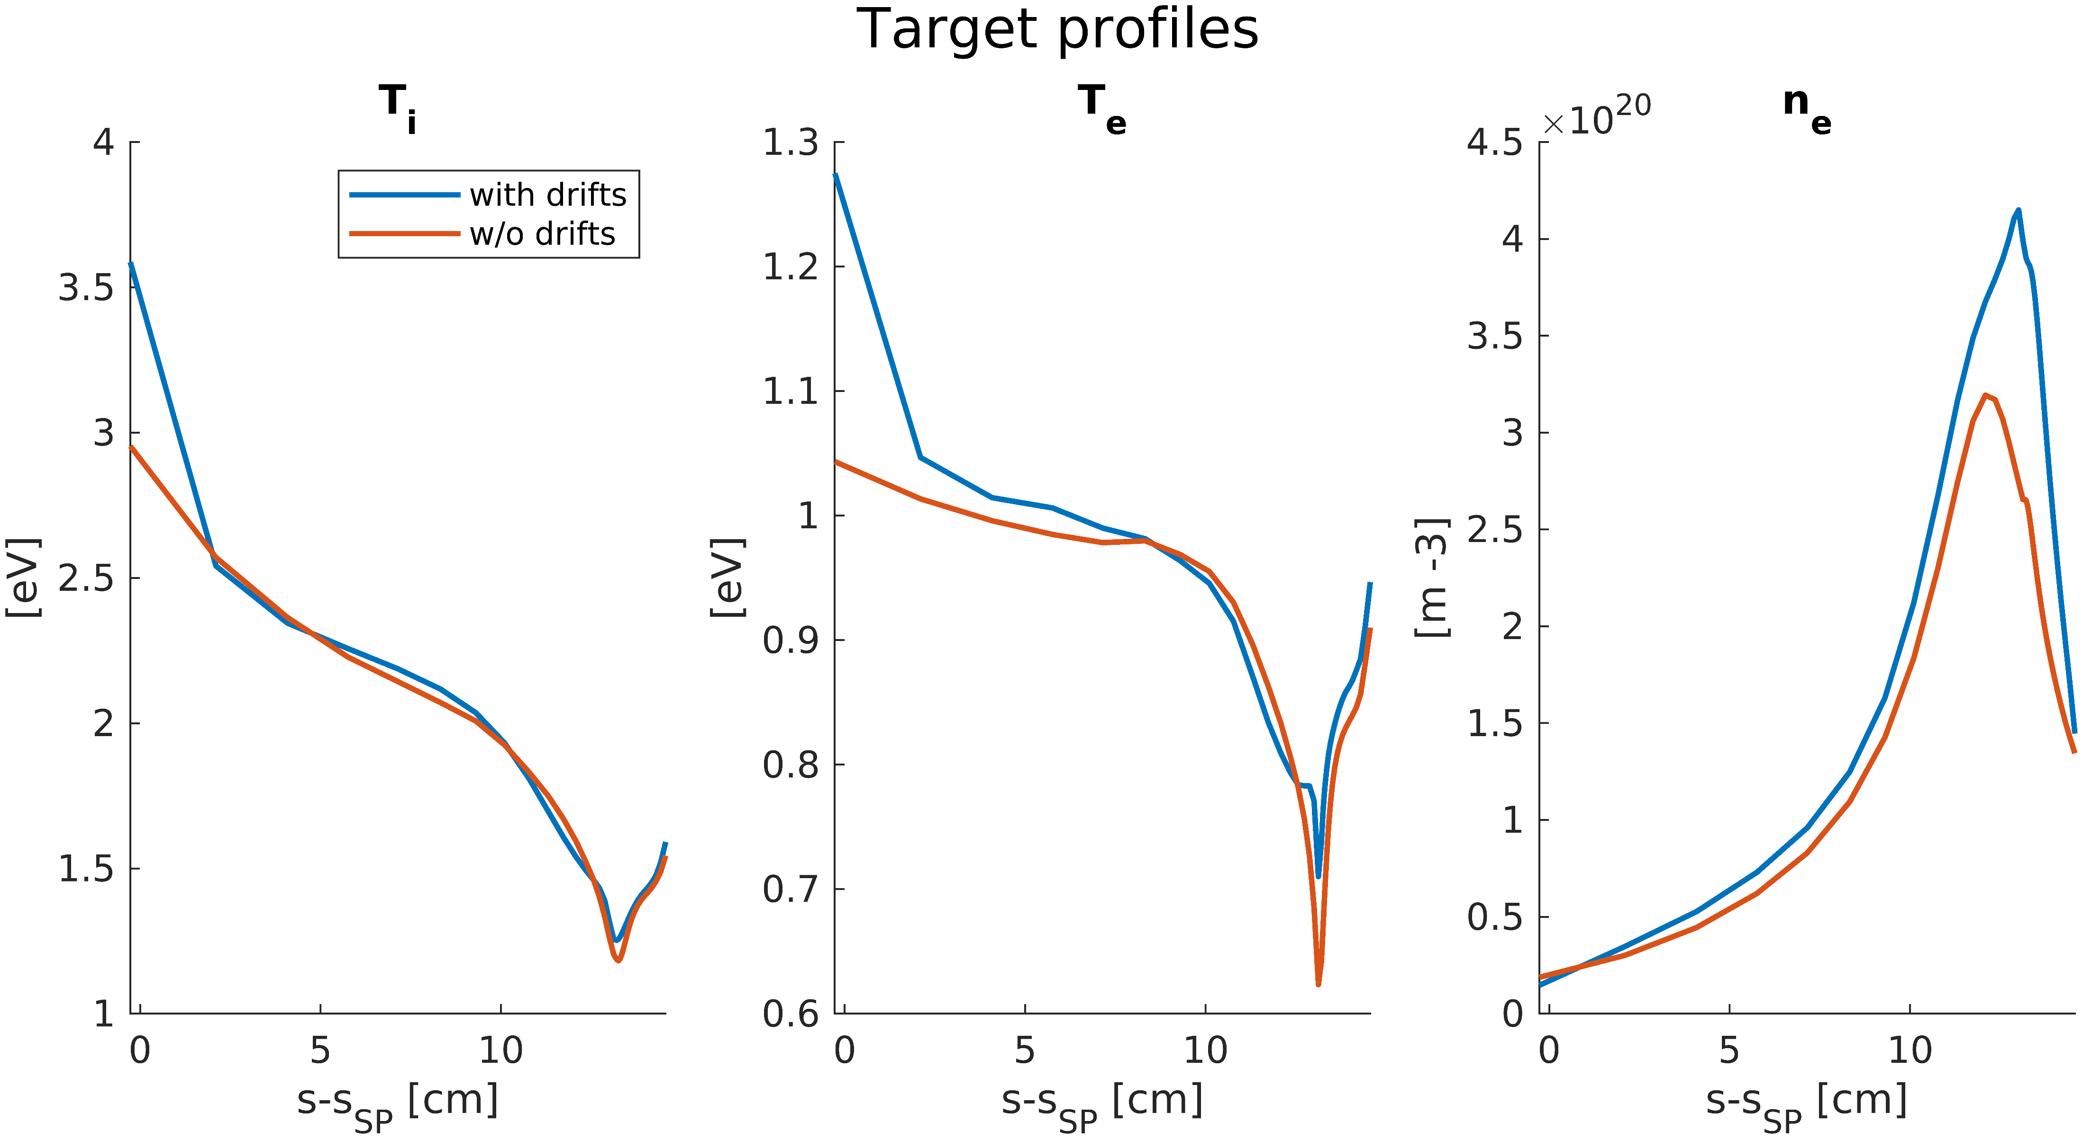
Inner target temperatures

Slide 8
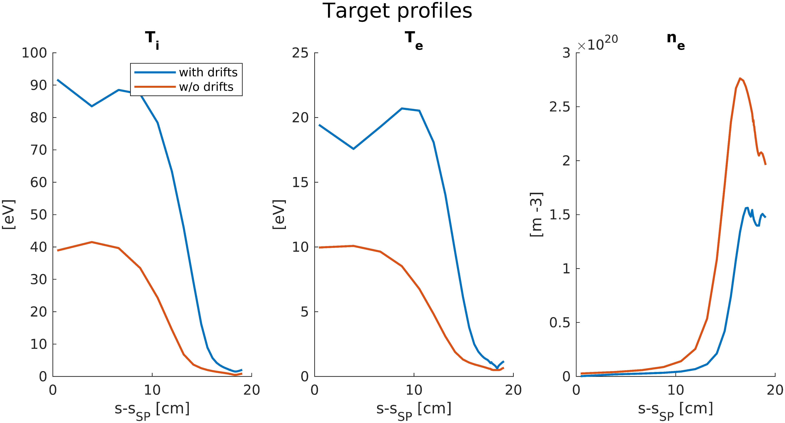
Outer target temperatures
First indication that drifts make temperature problem even worse

Slide 9
Content
Narrow grid – density scan
Narrow grid – prelim. drift results
Extended grids
New geometries

Slide 10
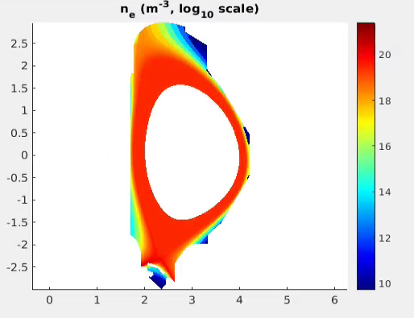
Extended grids
Convergence issues for fully extended grids are resolved thanks to latest code updates
However, quite slow due to increased number of cells
Can now evaluate heat fluxes on all PFCs

Slide 11
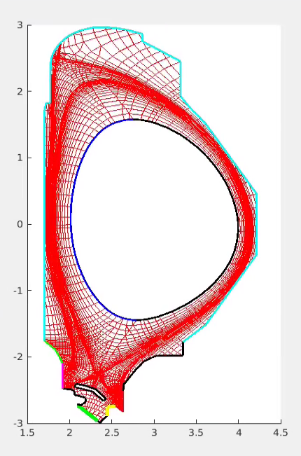
BCs
Core
$Q_{e}=Q_{i}=15 MW$ (vs 13 previously)
$Γ_{D+}=1.88⋅{10}^{21}{ s}^{−1}$
Puff
$Γ_{Ne}=4.0⋅{10}^{20}{ s}^{−1}$
$Γ_{D_{2}}$ = $7.0⋅{10}^{20}{ s}^{−1}$

Slide 12
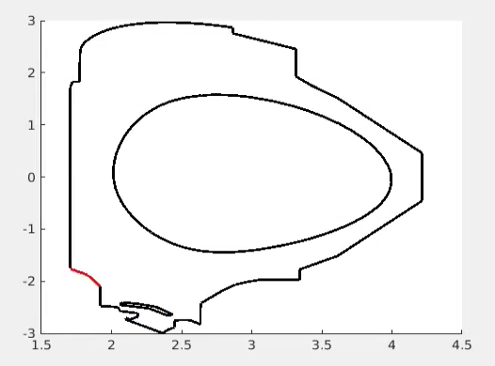
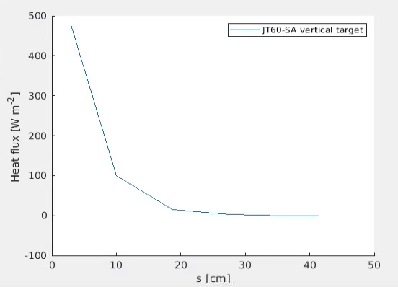
Extended grids – partially converged results
Example: (plasma-only) heat flux on IT baffle:

Slide 13
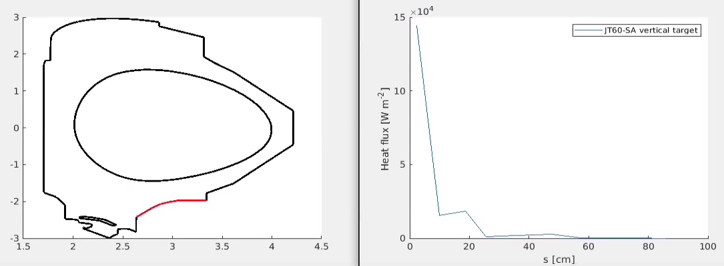
Extended grids – partially converged results
Example: (plasma-only) heat flux on OT baffle:

Slide 14
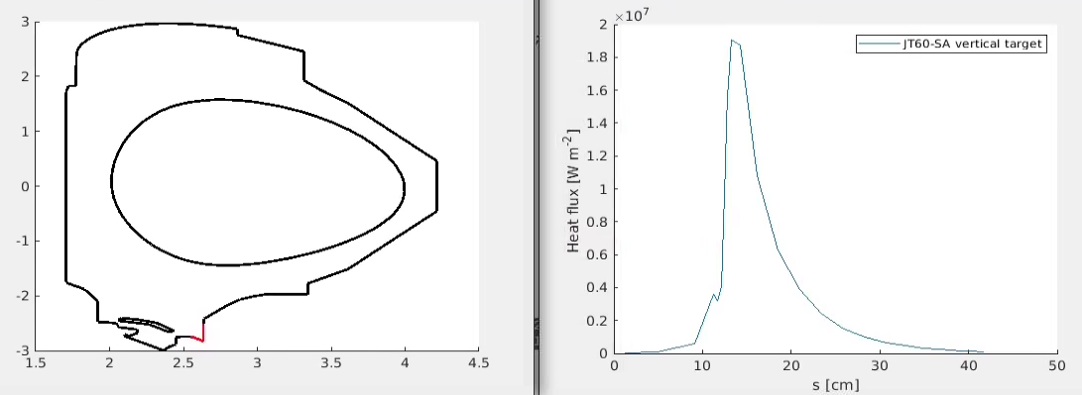
Extended grids – partially converged results
Example: (plasma-only) heat flux on OT:

Slide 15
Content
Narrow grid – density scan
Narrow grid – prelim. drift results
Extended grids
Alternative geometries

Slide 16
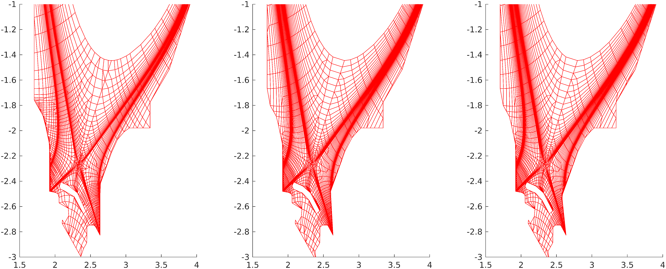
Alternative geometries
Investigate if OT inclination has any significant effect on high temperatures
Technically running but no results yet

Slide 18
