Slide 1
Integrated W modelling for JT60-SA with JINTRAC
JT-60SA T&C, ORD, DivSOL meeting
Ph.D. R. Cicioni (Consorzio RFX / University of Padova)
in collaboration with: L. Garzotti, L. Balbinot, G. Rubino, S. Gabriellini, V. K. Zotta
Funding Acknowledgement This work was carried out under the JT-60SA A&M activities in 2024 and is currently supported under the WPTE 2025 experimental campaigns.

Slide 2
Self-consistent integration of CORE and EDGE/SOL simulations with JINTRAC
Objective of the Work: assess the impact and feasibility of a W wall + W divertor in Scenario #2 of JT-60SA with integrated plasma simulations performed with JINTRAC, focusing on the Ar seeding case.
Collaboration with:
L. Balbinot & G. Rubino (SOLEDGE simulations → boundary constraints for integrated modelling)
S. Gabriellini (JETTO core simulations → starting point for integrated modelling)
Integrated simulations are performed using the COCONUT coupling of JETTO (core) + EDGE2D (SOL), through the JINTRAC suite. The core and edge are solved together, with coupling at the separatrix via plasma parameters as boundary conditions.
Outline of the presentation:
Constraints and setup for the integrated simulations → discrepancy in the radiated power between the core (JETTO) simulations and the edge/SOL (SOLEDGE) simulations.
Discussion about two possible strategies to investigate this discrepancy in radiated power.
→ This study is developed within a collaborative modelling framework, aiming to achieve consistency between core and edge simulations through coordinated constraints and cross-validation of results.
Integrated W modelling for JT60-SA with JINTRAC

Slide 3
Objective of the work
The constraints for integrated modelling are given from:
PROBLEM: discrepancy for the power crossing ρ=0.9 surface P_{ρ=0.9} :
from JETTO core simulations (by S. Gabriellini) P_{rad,ρ<0.9} ~ 6 MW → P_{ρ=0.9} = P_{aux} - P_{rad,ρ<0.9} ~ 35 MW
for SOLEDGE simulations (by L. Balbinot) P_{ρ=0.9} = 22 ÷ 30 MW
INTEGRATED MODELLING STRATEGIES:
Investigate the power losses associated with ELMs (using a discrete model).
Increase the impurity content in the core to enhance the radiated power.
Increase of main gas puffing.
Integrated simulations are still ongoing → partial results will be shown.
JT-60SA Scenario #2 [1]
Plasma current, I_{P} (MA) | 5.5 MA
Toroidal magnetic field, B_{T} (T) | 2.25 T
Major radius, R₀ (m) | 2.96 m
Minor radius, a (m) | 1.18 m
Heating power, P_{aux} (MW) | 41 MW
SOLEDGE simulation results [2]
Separatrix electron density, <n_{e}>_{sep} (m⁻³) | 3E+19 m⁻³
Separatrix electron temperature, <T_{e}>_{sep} (eV) | 150 eV
Separatrix ion temperature, <T_{i}>_{sep} (eV) | 230 eV
Power across ρ=0.9, P_{ρ=0.9} (MW) | 22 ÷ 30 MW
[1] JT-60SA Research Unit, JT-60SA Research Plan, Research Objectives and Strategy, Version 4.0 (2018)
[2] L. Balbinot, G. Rubino, et al., Assessment of SOL and divertor plasma conditions in JT-60SA with W wall in high performance scenarios, WPSA Code Management Area Progress Meeting
Integrated W modelling for JT60-SA with JINTRAC

Slide 4
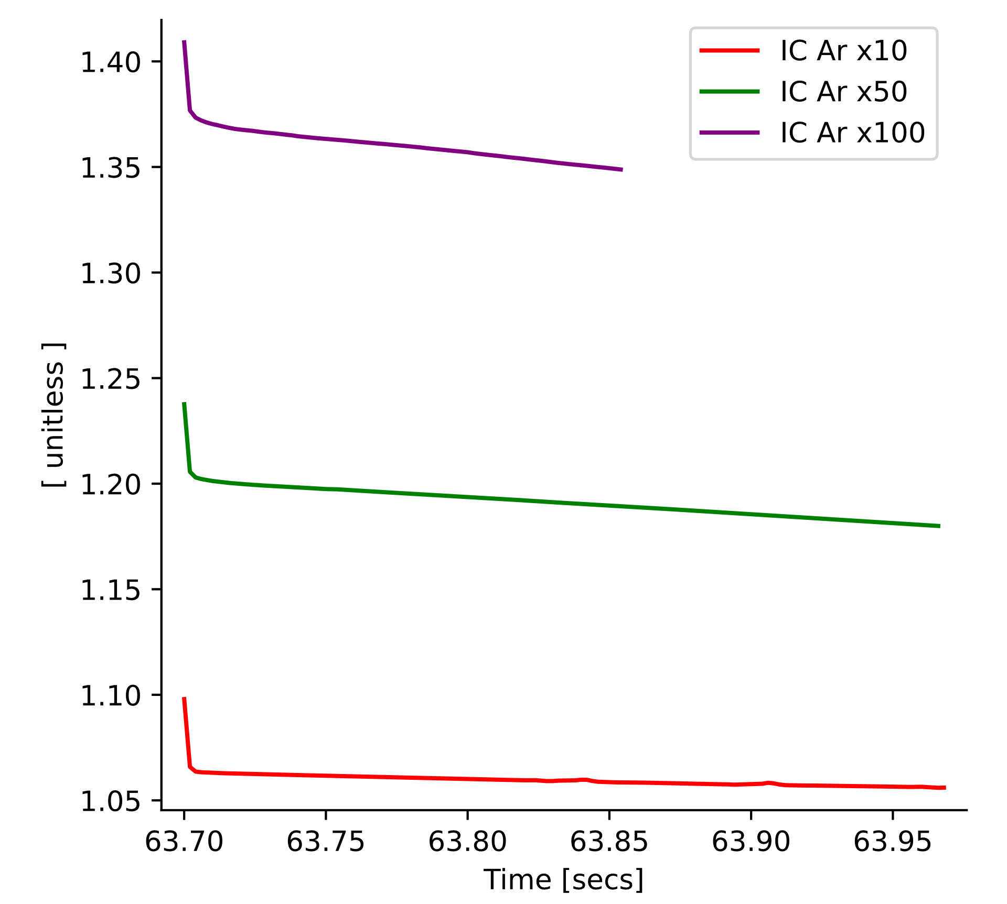
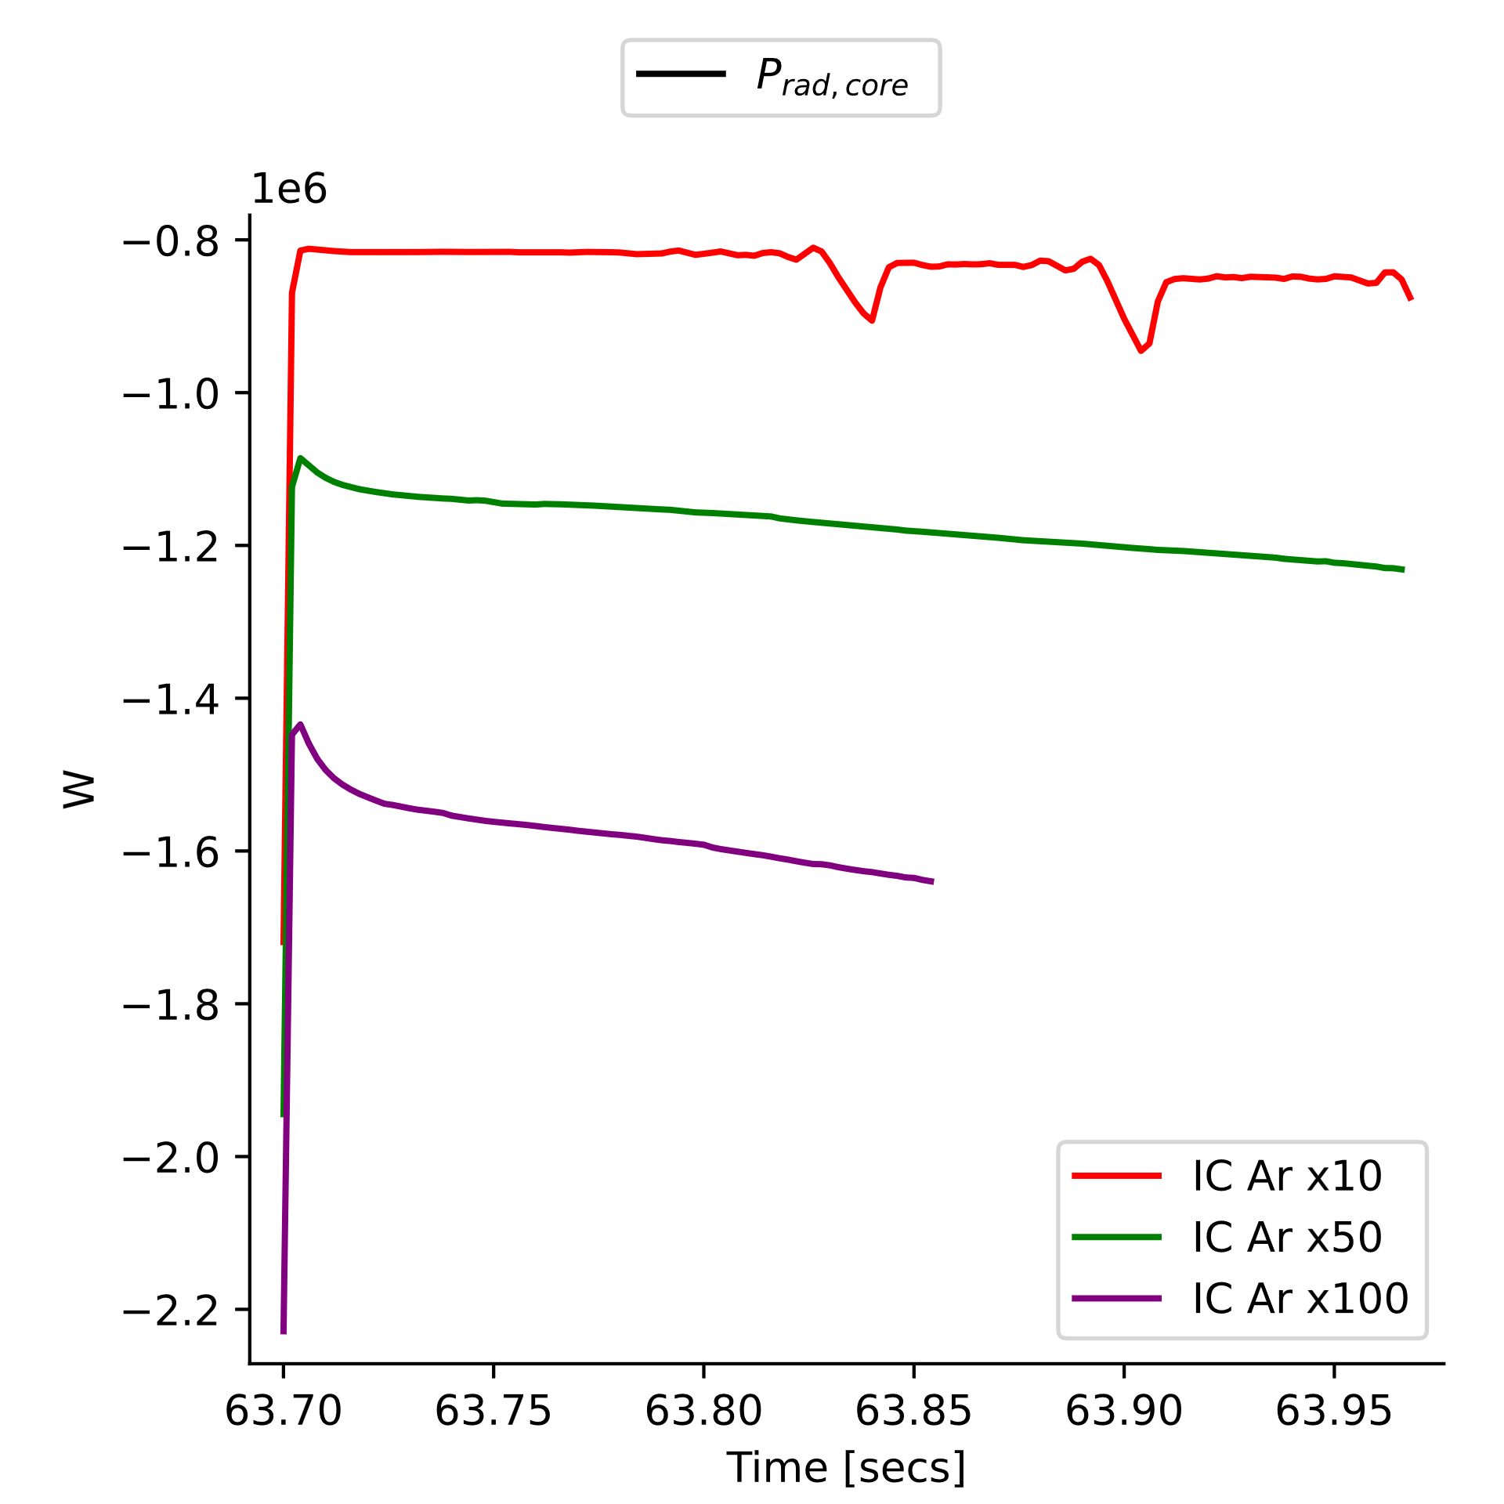
Insights from Previous Modelling*
*Previous integrated simulations [3] used different settings (no ELMs, lower impurity content). Quantitative results not reliable → used only as qualitative reference.
Qualitative results to be considered in future simulations:
A small increase in Z_{eff} via initial Ar content leads to a significant increase in core radiated power → higher Z_{eff} in the core can be an effective strategy to enhance core radiation.
P_{rad,core}
Z_{eff,core}
[3] R. Cicioni, L. Garzotti, Integrated core+SOL modelling for scenario #2 W wall and W divertor, TCM-42 Meeting, Nov. 2024
Integrated W modelling for JT60-SA with JINTRAC

Slide 5
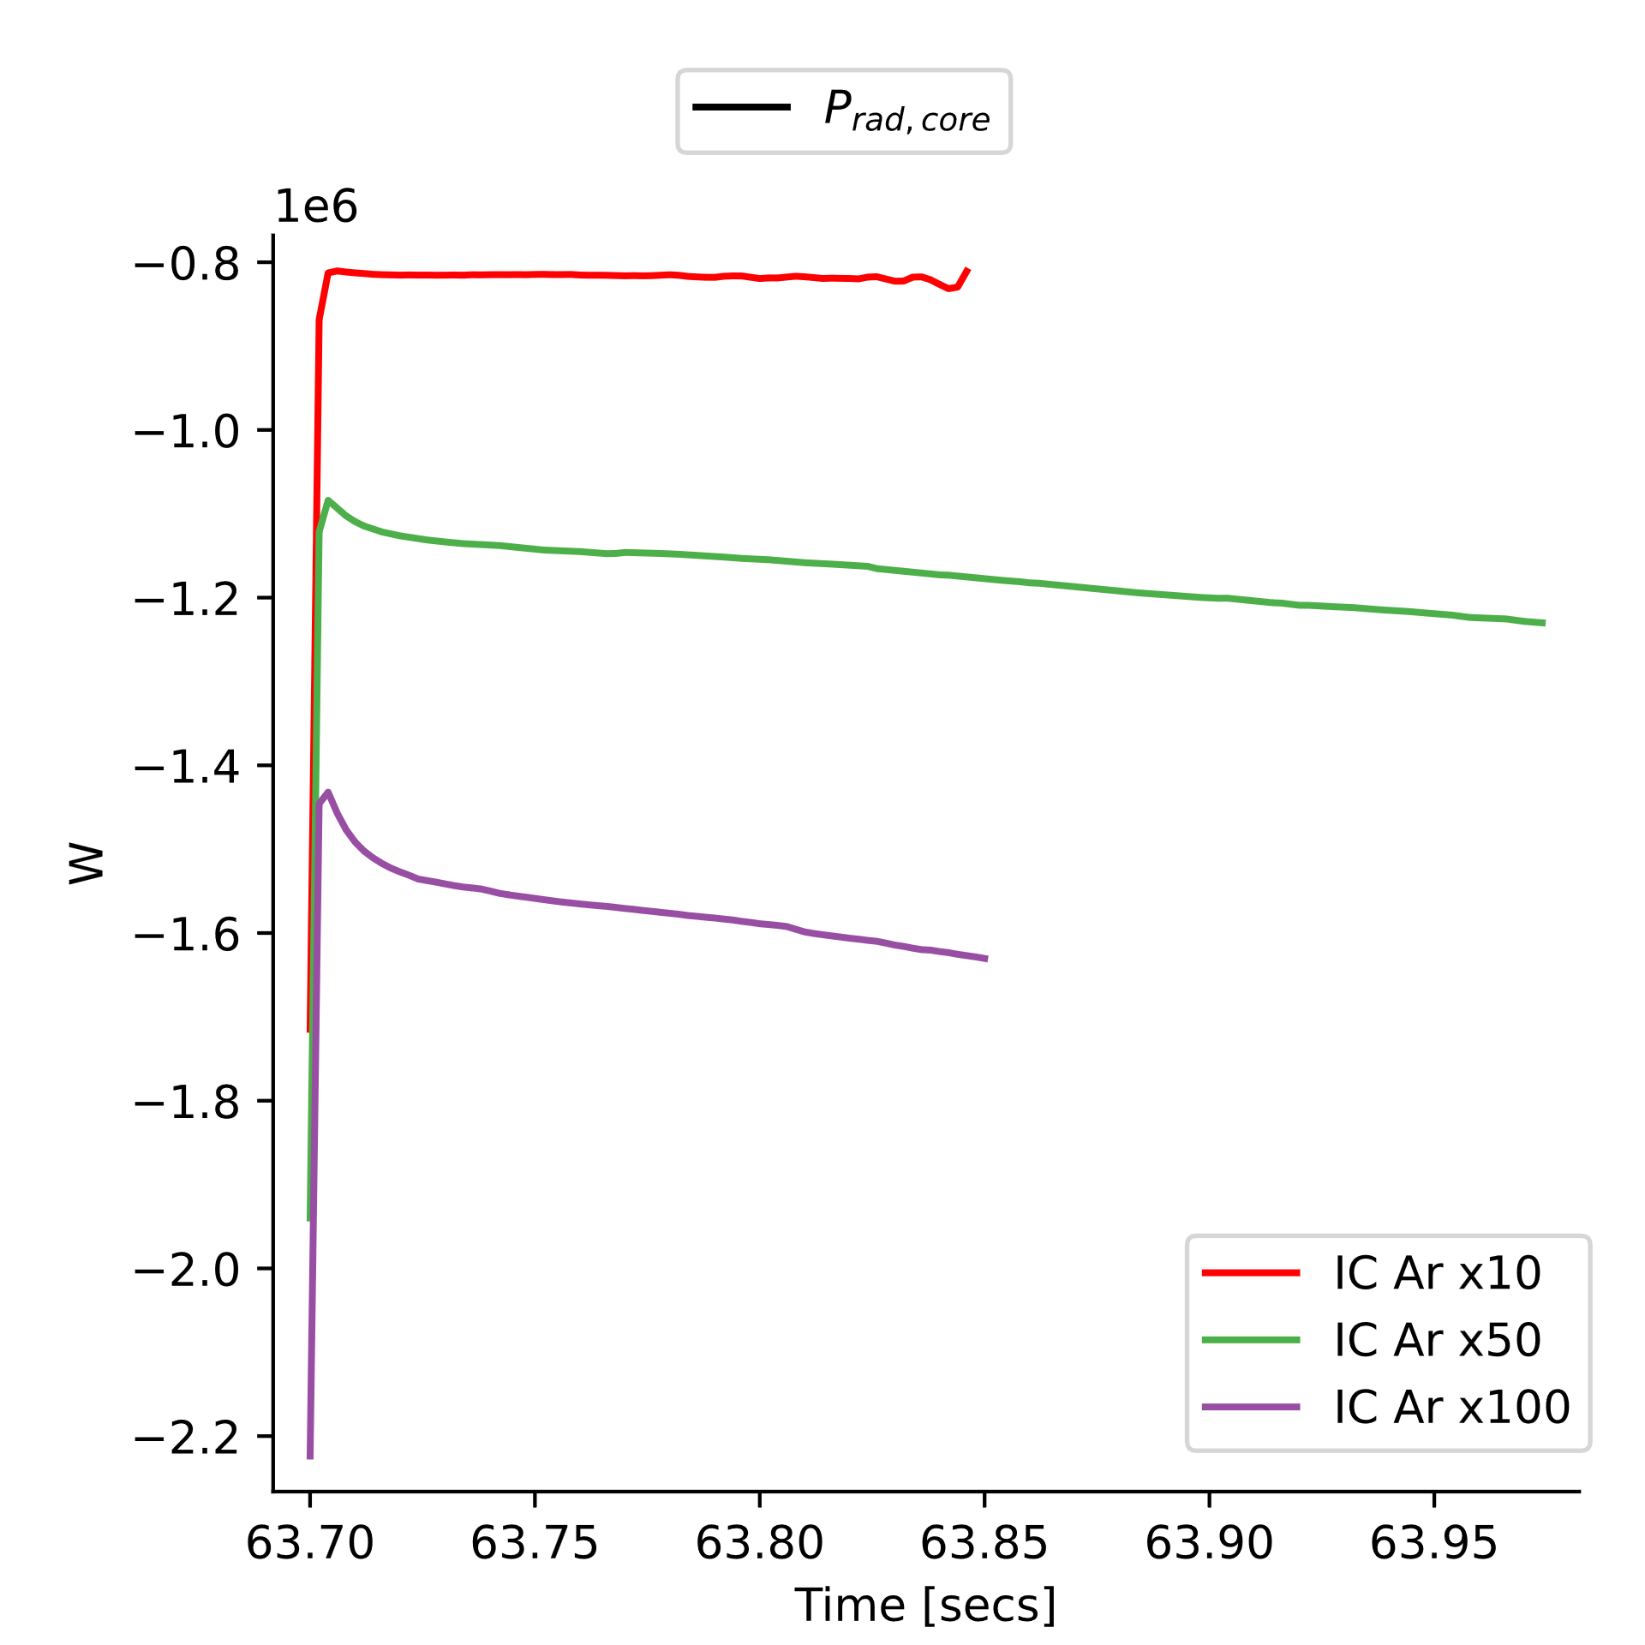
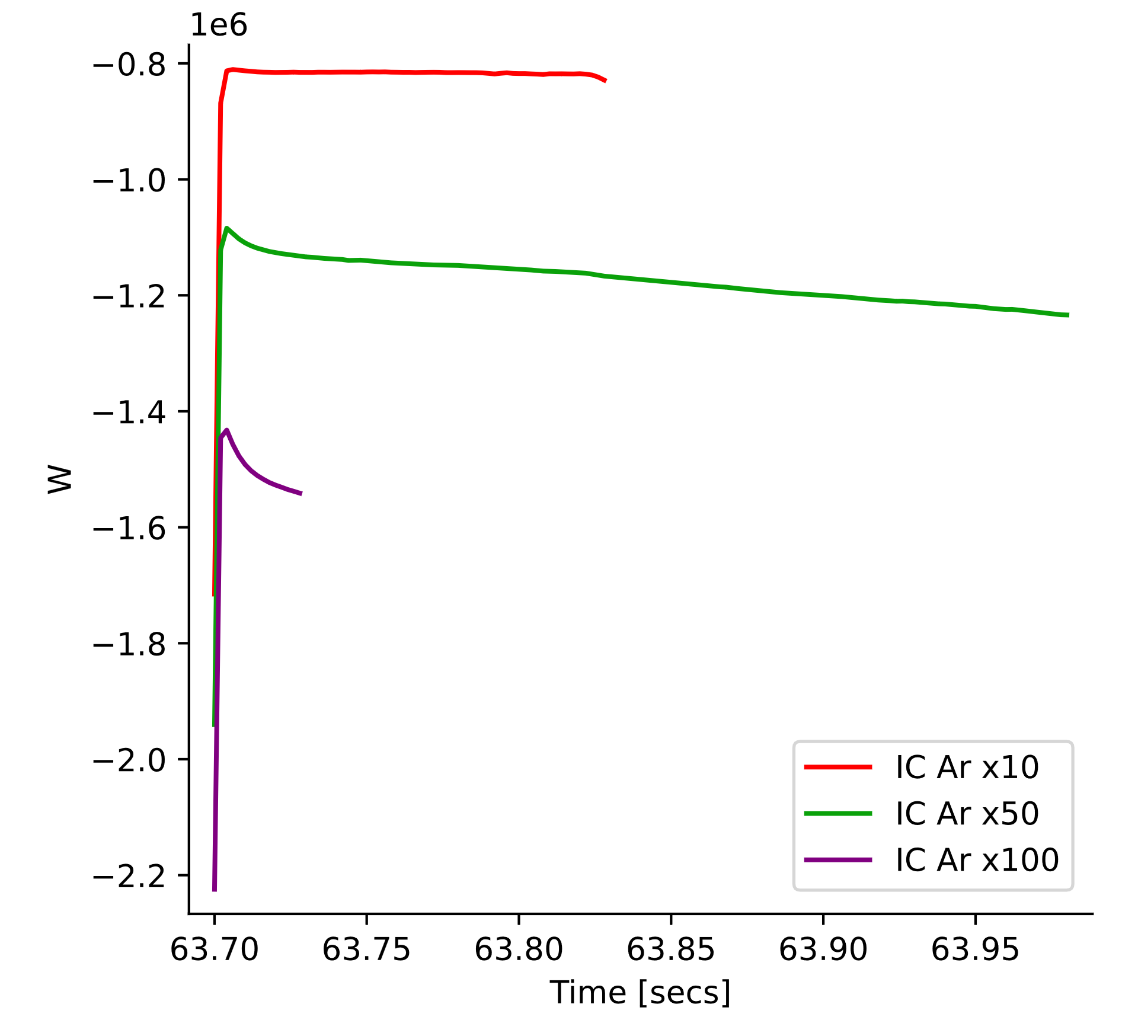
Insights from Previous Modelling*
*Previous integrated simulations used different settings (no ELMs, lower impurity content). Quantitative results not reliable → used only as qualitative reference.
Qualitative results to be considered in future simulations:
2) Varying D puffing did not significantly impact core radiation → D puffing is not an effective strategy to enhance core radiation.
P_{rad,core}
Puff rate Deuterium 5e18 s-1
Puff rate Deuterium 1e19 s-1
Puff rate Deuterium 5e19 s-1
P_{rad,core}
P_{rad,core}
[3] R. Cicioni, L. Garzotti, Integrated core+SOL modelling for scenario #2 W wall and W divertor, TCM-42 Meeting, Nov. 2024
Integrated W modelling for JT60-SA with JINTRAC

Slide 6
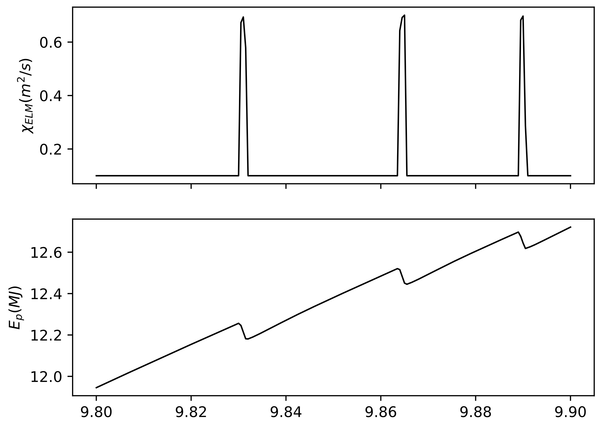
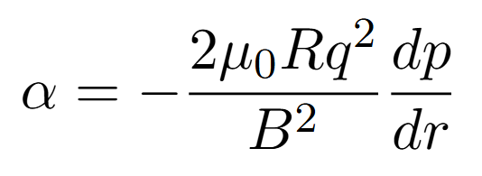
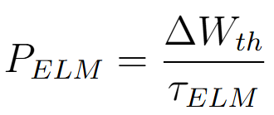
ELMs modelling (1/2)
Two approaches for ELMs modelling in COCONUT: continuous model / discrete model
In discrete model for type-I ELMs (pressure driven) two key parameters:
The power losses with ELMs P_{ELM} depend on both parameters
→ What is the best strategy to set these two parameters (α_{C} and χ_{ELM} ) to then evaluate P_{ELM}?
ΔW_{th}
τ_{ELM}
[4] R. Cicioni. et al, Integrated core-SOL modelling of JET baseline plasmas: the role of ELMs on Tungsten sputtering, Poster presented at the 66th APS DPP Conference, October 2024.
Integrated W modelling for JT60-SA with JINTRAC

Slide 7
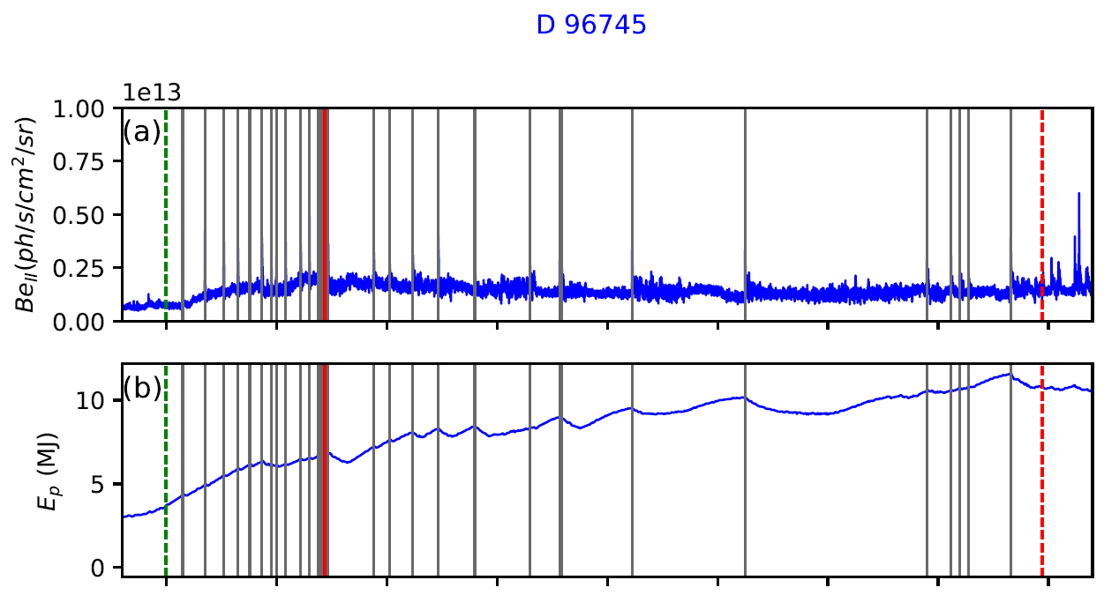
ELMs modelling (2/2)
To set the two parameters → two possible approaches:
Predictive modelling: use the results from other transport codes to set α_{C} and χ_{ELM}. If anyone has suggestions for how to predict these values, please let me know.
Parametric scan: if no predictive method is available, we scan the parameters to match the desired power loss.
Used previous expertise obtained in other machines and in similar scenario (e.g. JET [4]) to set the ELMs modelling.
→ Increasing the α threshold not only changes the ELM period, it also increases the edge temperature. This may impact impurity transport in the core → this effect still needs further investigation.
JET baseline scenario DTE2 #96745
Plasma current, I_{P} (MA) | 3.5 MA
Toroidal magnetic field, B_{T} (T) | 3.3 T
Heating power, P_{aux} (MW) | 35 MW
Main gas | D
COCONUT ELMs #96745
ΔW_{th} (J) | 76729 J
τ_{ELM} (ms) | 30 ms
P_{ELM} ~2.6 MW
[4] R. Cicioni. et al, Integrated core-SOL modelling of JET baseline plasmas: the role of ELMs on Tungsten sputtering, Poster presented at the 66th APS DPP Conference, October 2024.
Integrated W modelling for JT60-SA with JINTRAC

Slide 8
Enhancement of Z_{eff} in the core
Another strategy to increase the radiated power → increse Z_{eff} in the core by increasing initial impurity content (e.g., Argon).
Simulations show a clear trend → small increase in Z_{eff} leads to notable increasing of core radiated power.
→ Open Question: what is the maximum sustainable Z_{eff} in this scenario?
Z_{eff,core}
Integrated W modelling for JT60-SA with JINTRAC

Slide 9
Conclusions & Next Steps
The main goal of this integrated modelling activity is to combine core and edge/SOL simulations in a self-consistent way, for Scenario 2 with a full W wall and W divertor.
Actually, the main challenge is that the radiated power in the core is too low to ensure sustainable conditions at the divertor targets:
evaluate the contribution of ELMs to the radiated power.
increase the impurity content in the plasma core.
These two approaches are not independent → it might be necessary to explore both directions in parallel.
Third options (if the first two don't work) → evaluating the effect of Ar puffing rate.
EDGE2D allows the implementation of a feedback control on the Ar puffing.
Extend the study to Ne seeding once Ar seeding results are consistent.
Thank you for your attention.
Integrated W modelling for JT60-SA with JINTRAC

Slide 10
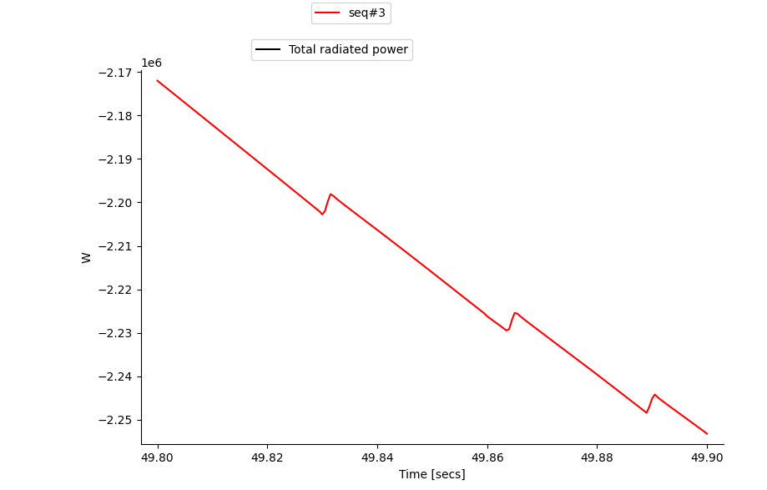
Background slide
Integrated W modelling for JT60-SA with JINTRAC

Slide 11
Status of W Integrated simulation with JINTRAC
Ph.D. Rachele Cicioni (Consorzio RFX, University of Padova) Work carried out in collaboration with: L. Garzotti, L. Balbinot, G. Rubino, S. Gabriellini, V. Zotta
Objectives of the work
Assess the plasma performance for scenario 2 with W wall and W divertor with integrated plasma simulations. Simulation planning and input parameters are selected based on results from previous studies and coordinated activities (see the collaboration). The simulations are performed with COCONUT.
Ongoing work
Extension of JETTO core simulations (by S. Gabriellini) to COCONUT (JETTO+EDGE2D) considering:
integration of dicrete model for the ELMs into the simulations (replacing the previous continuous model).
Adding the Ar puffing according to the edge simulations, with control on radiated power.
Parameter scans including: Ar puffing rate, core impurity content, D puffing rate.
Planned work
Assess the plasma performance and compare with parameters of scenario 2.
Extension of the same simulations to the Ne seeding case, once Ar seeding results are consistent.
Funding Acknowledgement This work was carried out under the JT-60SA A&M activities (Task RT06) in 2024 and is currently supported under the WPTE 2025 experimental campaign (Task RT14).

