Slide 1
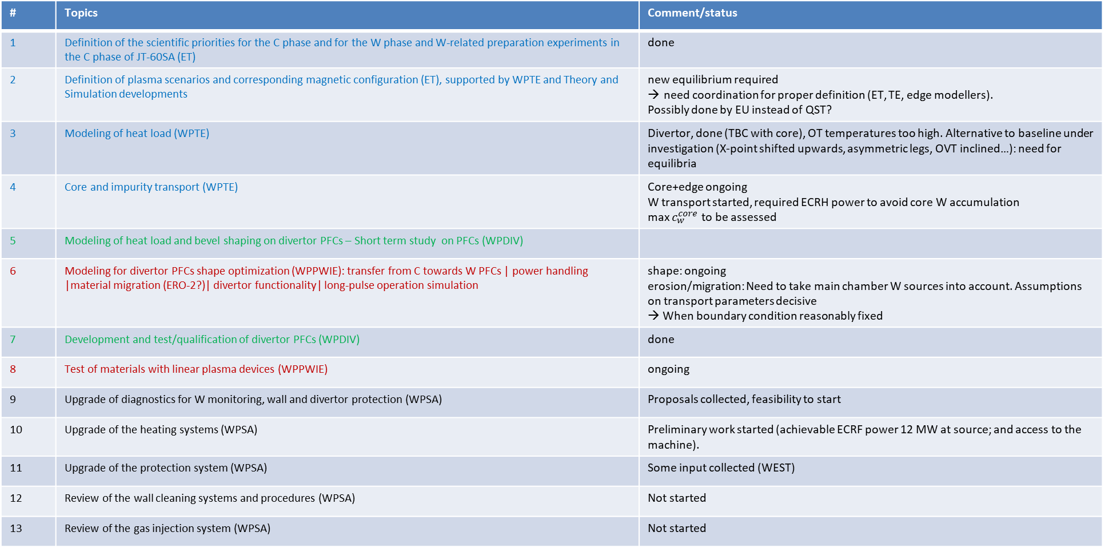
Planning for W transition
# | Topics | Comment/status
1 | Definition of the scientific priorities for the C phase and for the W phase and W-related preparation experiments in the C phase of JT-60SA (ET) | done
2 | Definition of plasma scenarios and corresponding magnetic configuration (ET), supported by WPTE and Theory and Simulation developments | new equilibrium required need coordination for proper definition (ET, TE, edge modellers). Possibly done by EU instead of QST?
3 | Modeling of heat load (WPTE) | Divertor, done (TBC with core), OT temperatures too high. Alternative to baseline under investigation (X-point shifted upwards, asymmetric legs, OVT inclined…): need for equilibria
4 | Core and impurity transport (WPTE) | Core+edge ongoing W transport started, required ECRH power to avoid core W accumulation max $c_{w}^{core}$ to be assessed
5 | Modeling of heat load and bevel shaping on divertor PFCs – Short term study on PFCs (WPDIV)
6 | Modeling for divertor PFCs shape optimization (WPPWIE): transfer from C towards W PFCs | power handling |material migration (ERO-2?)| divertor functionality| long-pulse operation simulation | shape: ongoing erosion/migration: Need to take main chamber W sources into account. Assumptions on transport parameters decisive → When boundary condition reasonably fixed
7 | Development and test/qualification of divertor PFCs (WPDIV) | done
8 | Test of materials with linear plasma devices (WPPWIE) | ongoing
9 | Upgrade of diagnostics for W monitoring, wall and divertor protection (WPSA) | Proposals collected, feasibility to start
10 | Upgrade of the heating systems (WPSA) | Preliminary work started (achievable ECRF power 12 MW at source; and access to the machine).
11 | Upgrade of the protection system (WPSA) | Some input collected (WEST)
12 | Review of the wall cleaning systems and procedures (WPSA) | Not started
13 | Review of the gas injection system (WPSA) | Not started

