Slide 1
Technological developments for JT-60SA metallic actively cooled divertor
PSD Meeting on the transition of JT60-SA to W - 17th of June 2025, remote
M. Richou¹, M. Firdaouss¹, T. Baffie¹, A. Thomas¹, P.Y. Frayssines¹, D. Dias¹, V. Tomarchio², J.H. You³
CEA, France
F4E, Germany
MPG, Germany

Slide 2
CONTENT
HHF target available concepts
Main activities in support to F4E (Monoblock concept)
Developed HHF target concepts within EUROfusion (Enhanced concept)
Support to NIFS

Slide 3
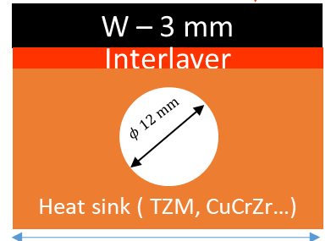
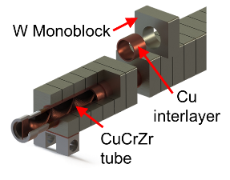
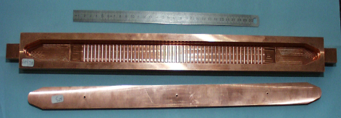
HHF target available concepts (Summary - Today)
 | Thermo-mechanical analysis | Electromagnetic analysis | Manufacturing feasibility
Conventional flat tile Massive tungsten | 2023 | 2023 | 2023 (feedback from fusion devices series manufacturing)
Monoblock Massive tungsten | 2024 (10 MW/m²) 2025 (15 MW/m²) | 2024 (Done) | 2022 (feedback from fusion devices series manufacturing)
Enhanced flat tile Massive tungsten | 2024 – (Done) | 2024 (Done) | 2024 (CuCrZr Done) 2025 (Joining to W)
OP5
2024 (CuCrZr Done)
After OP5
6
6
6

Slide 4
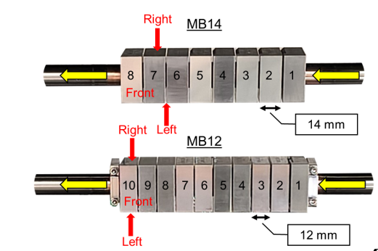
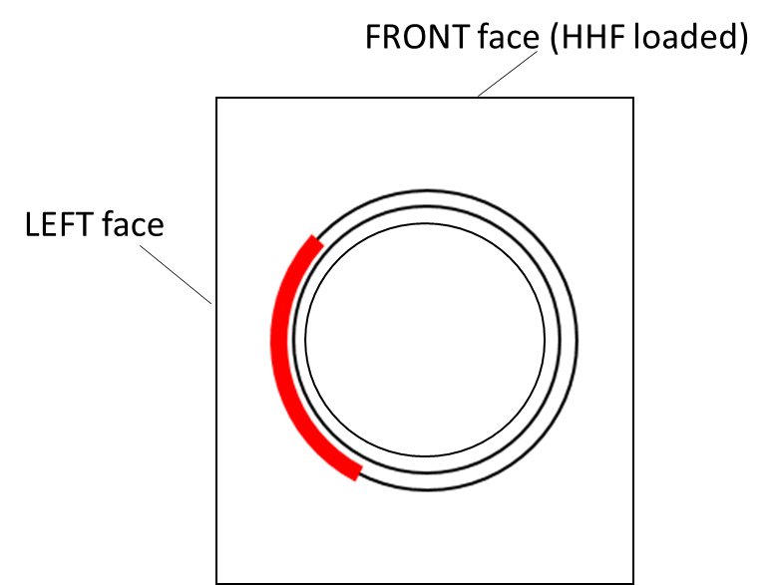
3. Main activities in support to F4E– Qualification of W monoblock (technology planned to be used for OP5) (1/3)
➔ Presence of thermal imperfection detected by infrared thermography
W thickness 8.5 mm
Inlet diameter 12 mm
Width 32 mm

Slide 5
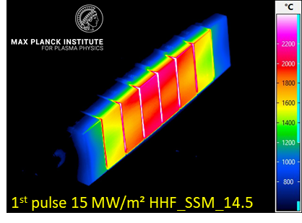
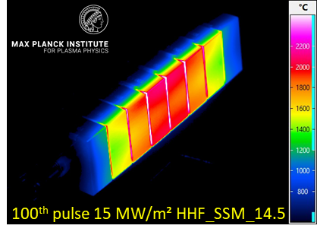
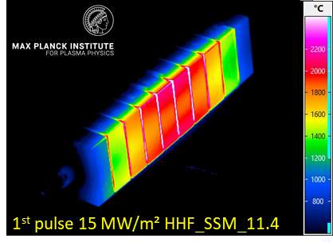
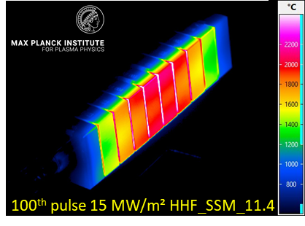
3. Main activities in support to F4E– Qualification of W monoblock (technology planned to be used for OP5) (2/3)
screening: 6 – 10 MW/m², up to 15 sec., followed by 15 MW/m², 5sec.
cyclic loading: 100 x 10 MW/m², 10 sec.
screening of pulse duration: 15 MW/m², 5…12 sec.
cyclic loading: 100 x 15 MW/m², 10 sec
high power transient loading: 3 x 20 MW/m², 2 sec.
~60 mm
Beam center
50% of power density
50% of power density
Gaussian heat flux distribution-> Gaussian temperature distribution
Prelaminar results on block n°5 : Stable surface temperature during high heat flux loading -> No damage
Temperature of M1 and M10 should be equivalent but “The surface temperature measured of block 10 in the center is much higher than for block 1 in the center (about 200 °C @ 15 MW/m²).”

Slide 6
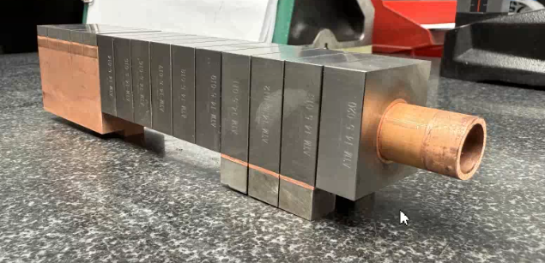
3. Main activities in support to F4E– Qualification of W monoblock (technology planned to be used for OP5) (3/3)
➔Imperfection still present after HHF tests
Prospects for WPDIV in 2025
Continue to support F4E for non-destructive testing and HHF tests
6

Slide 7
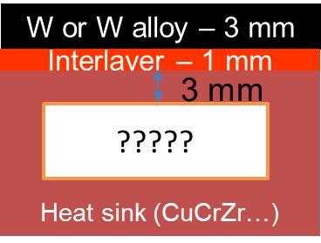
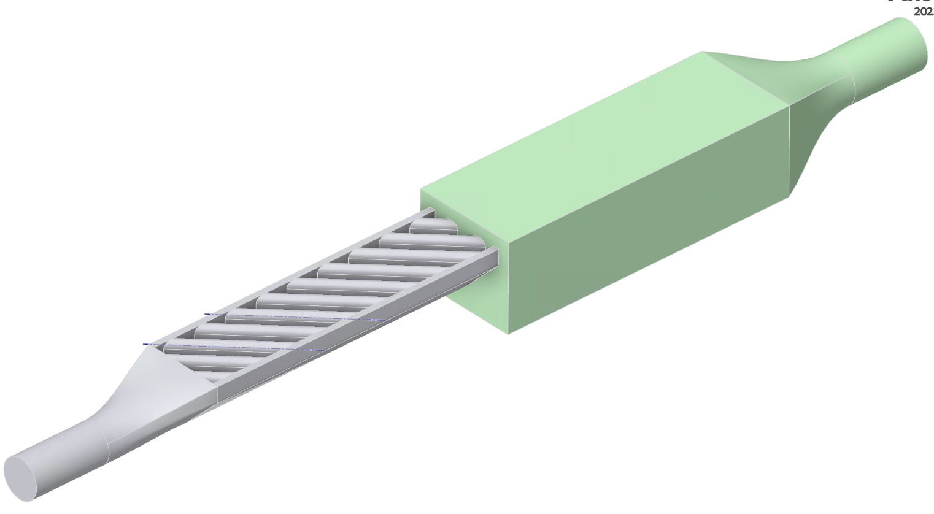
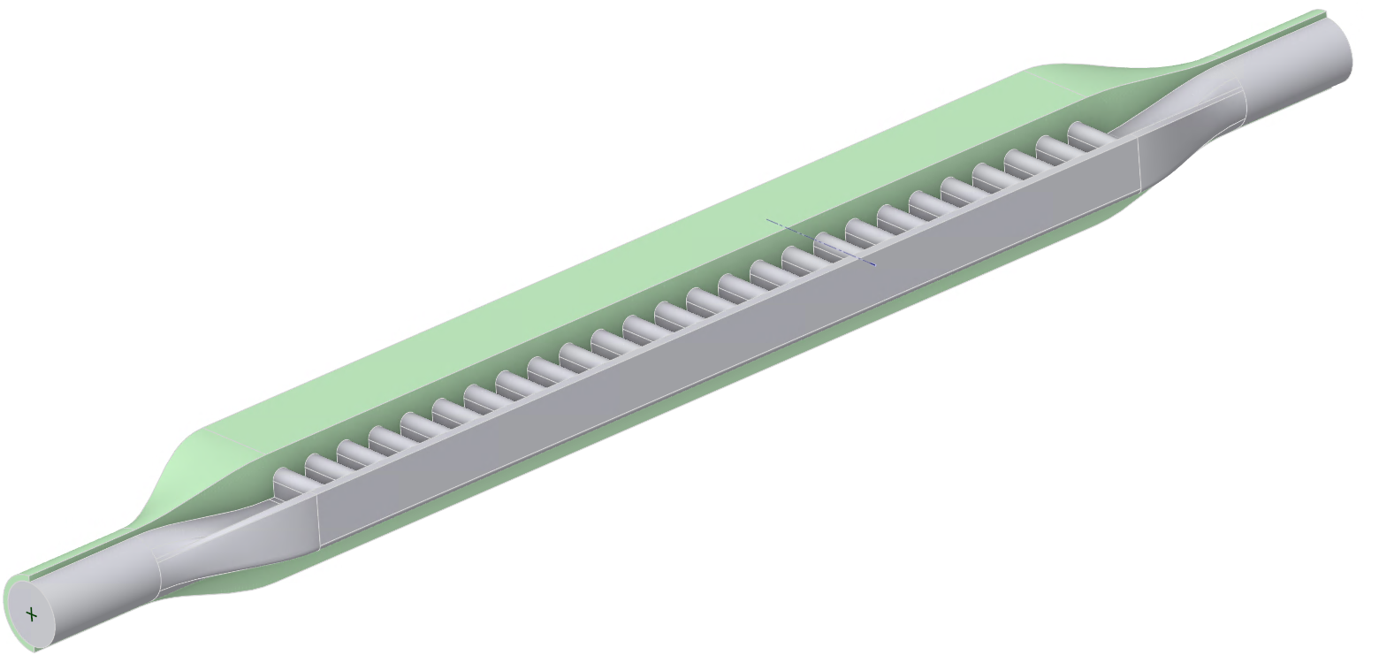
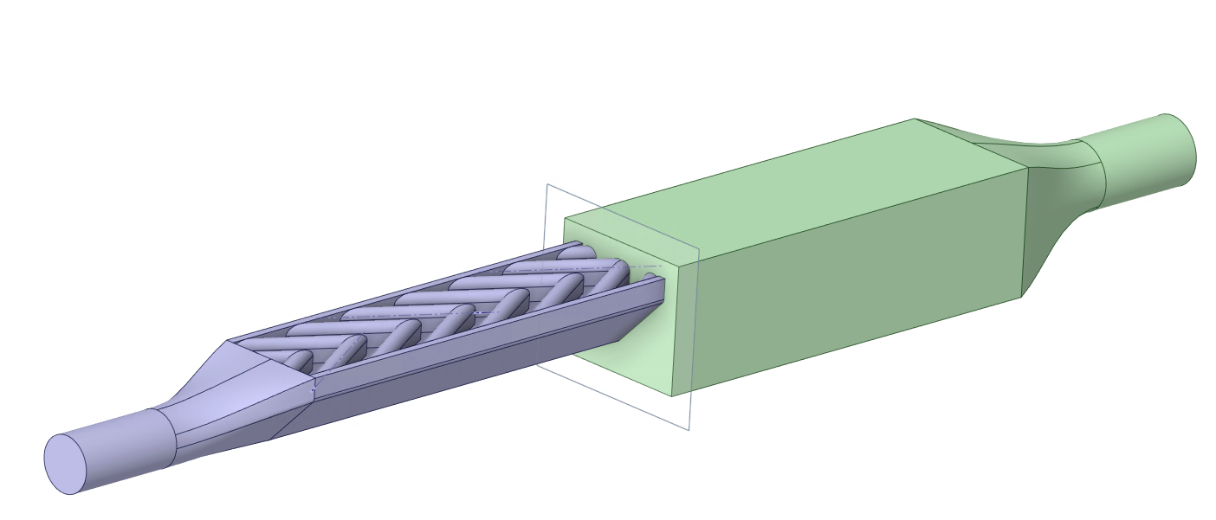
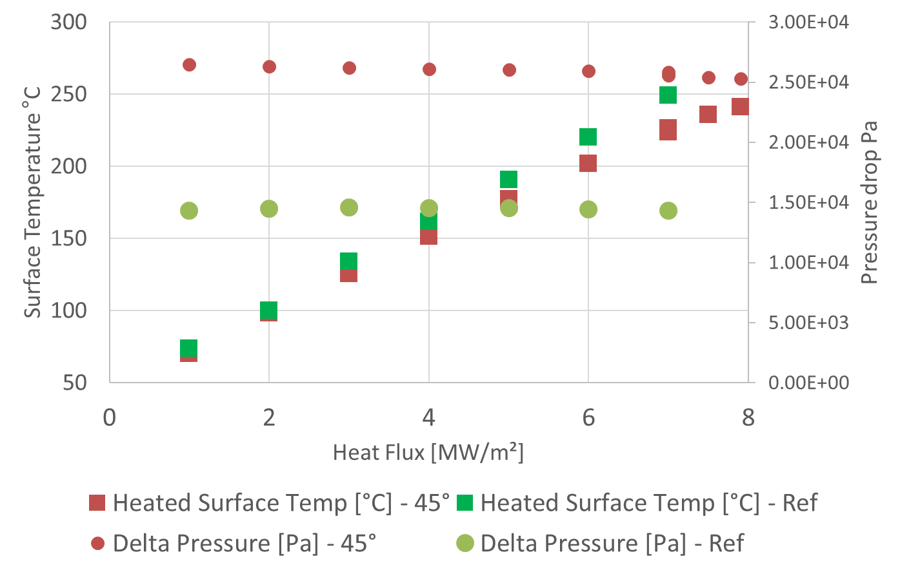
4. Developed HHF target concepts within EUROfusion
Reference geometry
Diagonal (45°)
W or W alloy – 3 mm
Q=1..20 MW/m²
Interlayer – 1 mm
3 mm
CuCrZr
Heat sink (CuCrZr…)
?????
250 mm
Modeling to estimate
surface temperature (CFD)
Chevron
V=7m/s, P=20bars, T=40°C

Slide 8
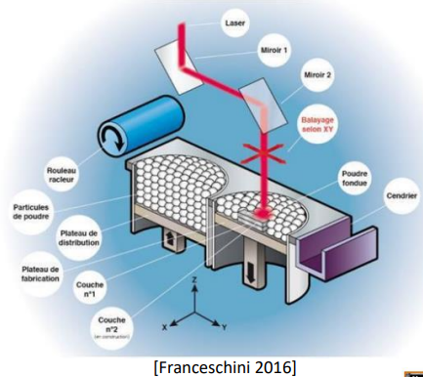
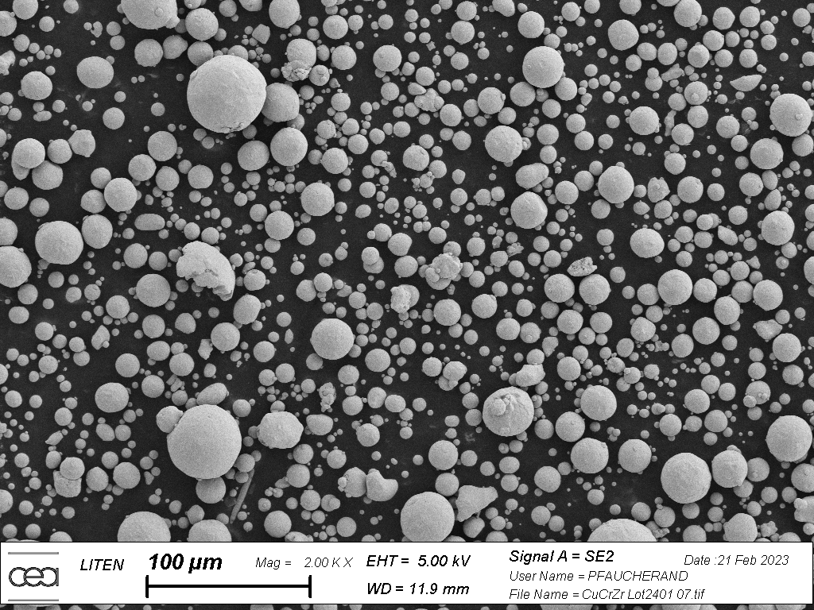
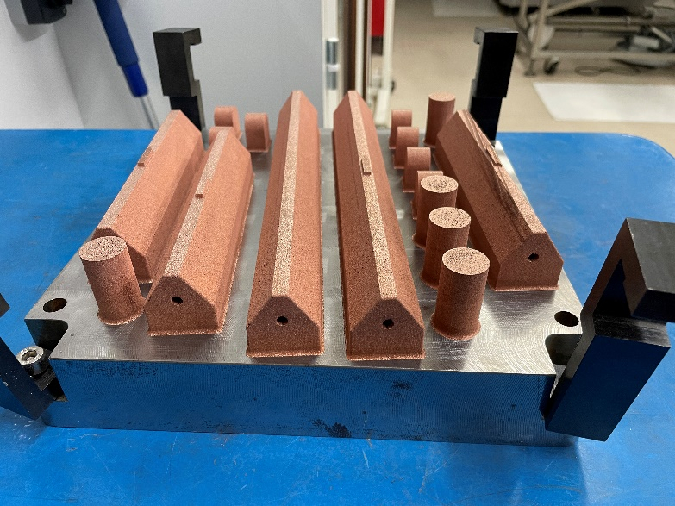
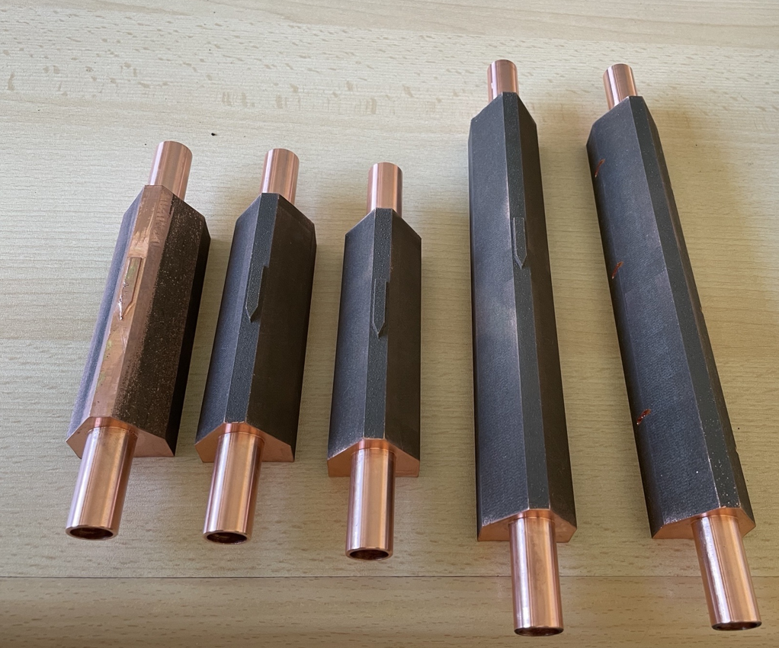
4. Developed HHF target concepts within EUROfusion
Diagonal
Internal geometries
Chevron
Job 6 (11/24) - Successfull
260 mm
160 mm
Internal diameter 12 mm
External diameter 15 mm

Slide 9
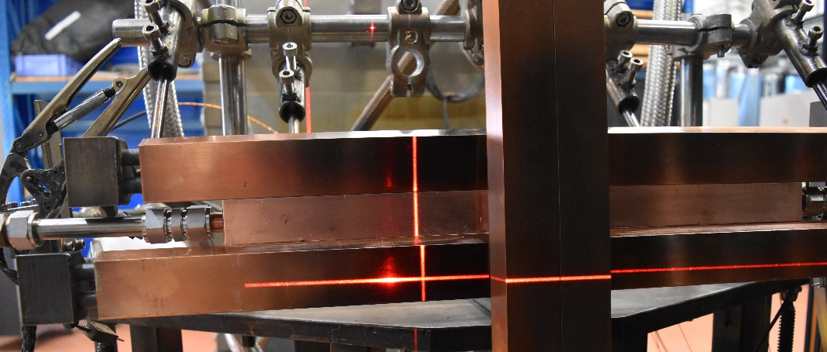
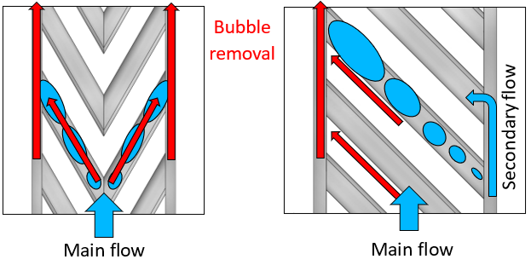
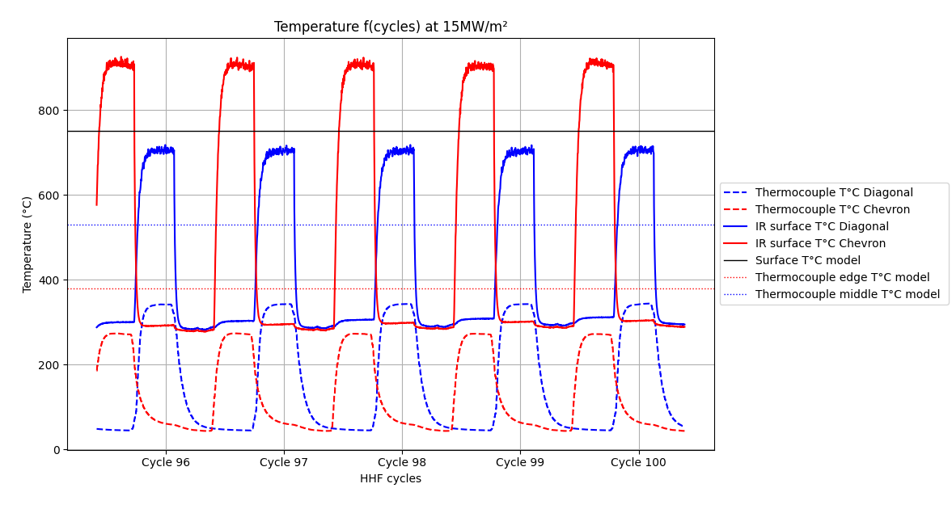
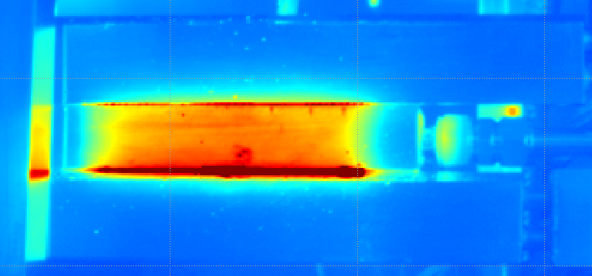
4. Developed HHF target concepts within EUROfusion
2
TC locations
Mock-ups dimensions :
Length: 260x32mm
channel thickness : 9mm
Diagonal
1
Chevron
Mock-ups successfully passed 100 cycles at 10MW/m² and 15MW/m² steady-state, and few at 20MW/m²
Tested up to 24 MW/m² without failure
Prospects: Hydraulic simulation
Chevron

Slide 10
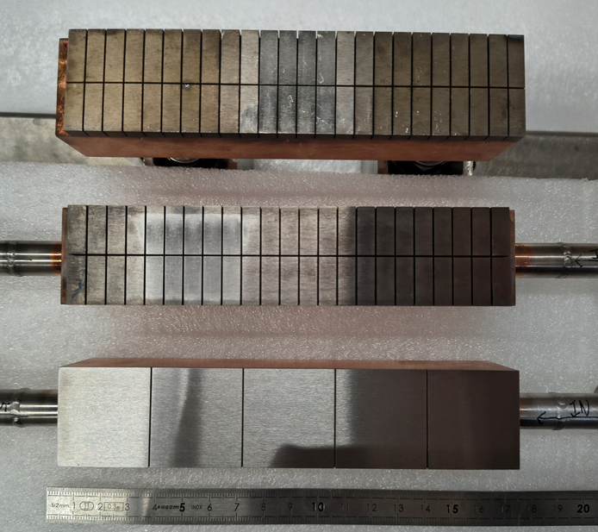
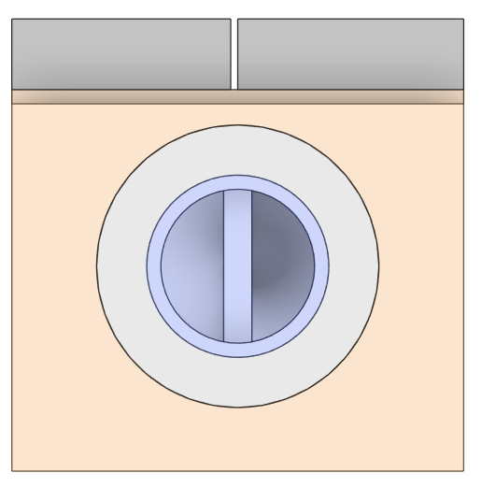
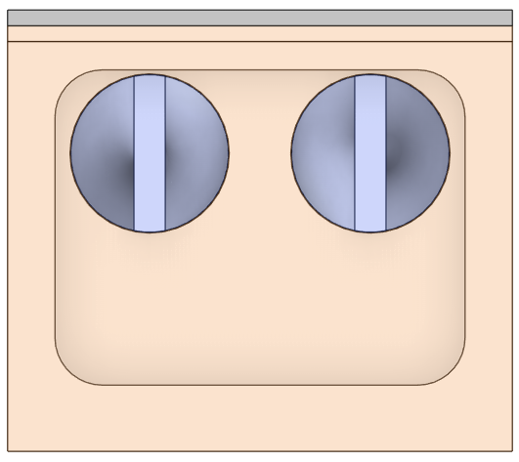
5. Support to NIFS
Mock-ups manufactured by NIFS
Tested at CEA (SATIR, HHF tests underway 1/3 done)
5mmW_DSc
5 mm
1 mm
5mmW_SSw
1mmW_DSw
5mmW_DSc
5mmW_SSw
1mmW_DSw
Dual Screw cooling
Swirl cooling
Dual swirl cooling

Slide 11
Conclusions and short term Plans
Monoblock concept (F4E provider) : Support F4E for the qualification of W monoblock mock-up needed for installation of these components for OP5 (within budgetary constrains, OK for 2025)
High heat flux testing in GLADIS (2 mock-ups) + SATIR pre and post HHF (Ultrasonic test if possible, technical constrain)
High heat flux testing in testing in HADES (Full sacale 3000c@10MW/m²) + SATIR pre and post HHF (Ultrasonic test if possible, technical constrain)
After OP5, enhanced concept may be foreseen to sustain heat loads > 20 MW/m²
Enhanced concept (EUROfusion)
HHF tests results need to be studied to conclude on performance of tested mock-ups (2025)
However does this concept bring an added value (performance vs cost) ? (Answer in S1 2025)
W joining on CuCrZr cooling structure (2025)
Test in 2026
Enhanced concept (NIFS) : non-destructive tests and high heat flux tests in HADES (2025)
Does this concept bring an added value (performance) ? (Answer in S1 2025)

Slide 12
Plans
2026 Activities (DIV-JT-60SA)
Manufacture of mock-ups/prototypes (Enhanced concepts)
Technology verification tests (mechanical tests, UT, SATIR, HHF tests, etc.) (Enhanced concepts)
Qualification of materials & joining technology (Enhanced concepts)
Preparation for PPP to bid expertise and testing facilities for the series production of ITER-like target components for JT-60SA (non-destructive testing, reception tests, etc.
Innovative R&D for design and technology of first wall & divertor target via tokamak in-situ testing
2027 Activities (DIV-JT-60SA)
Design optimisation based on the results of the target technology qualification (Enhanced concepts)
Fabrication and testing of alternative cooling structure (Enhanced concepts)
Preparation for PPP to bid expertise and testing facilities for the series production of ITER-like target components for JT-60SA (non-destructive testing, reception tests, etc.
Preliminary R&D for design and technology of first wall & divertor target via tokamak in-situ testing to prepare for installation and testing of target prototypes in JT60SA.

