Slide 1


Electromagnetic suppression of drift-wave turbulence and the L–H transition
B. De Lucca, P. Ricci, L. Stenger, Z. Tecchiolli, D. Mancini
École Polytechnique Fédérale de Lausanne (EPFL), Swiss Plasma Center
1

Slide 2
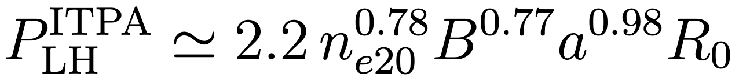
The L-H transition: some empirical facts
Power crossing separatrix exceeds threshold value: spontaneous pedestal and energy confinement time doubles
Universal mechanism: observed in wide range of tokamaks and even stellarators [Erckmann et al. PRL 1993]
Localised to the edge: Turbulent transport suppressed near the separatrix
Threshold power scales according to empirical ITPA scaling law [Martin et al. J. Phys.: Conf. Ser. 2008]
Threshold power is lower when ion grad-B drift is towards X-point (Favourable/Unfavourable)
ITPA scaling law for LH power
2

Slide 3
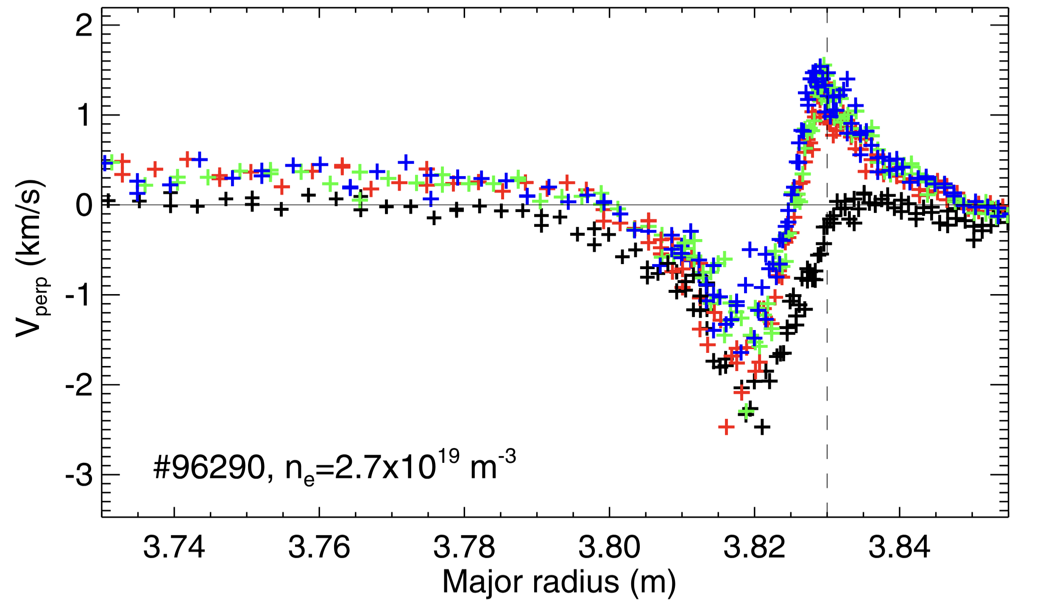

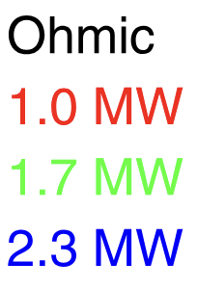
The L-H transition: some competing theories
Standard picture: turbulence suppressed by E✕B shear [Biglari et al. 1990]
Electric field shear and zonal flows at the edge suppresses turbulence, increasing electric field further via
Experiments in JET however: no significant change in electric field shear prior to transition [Silva et al. NF 2021]
Alternative: electromagnetic suppression of drift-wave turbulence [Guzdar PRL 2001, Connor & Pogutse PPCF 2001, Rogers et al. PRL 1998]
Global, flux-driven simulations of the tokamak edge now possible
Electric field across power ramp in JET [Silva et al. NF 2021]
3

Slide 4
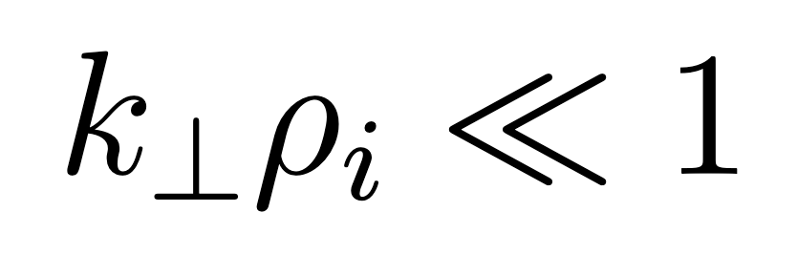
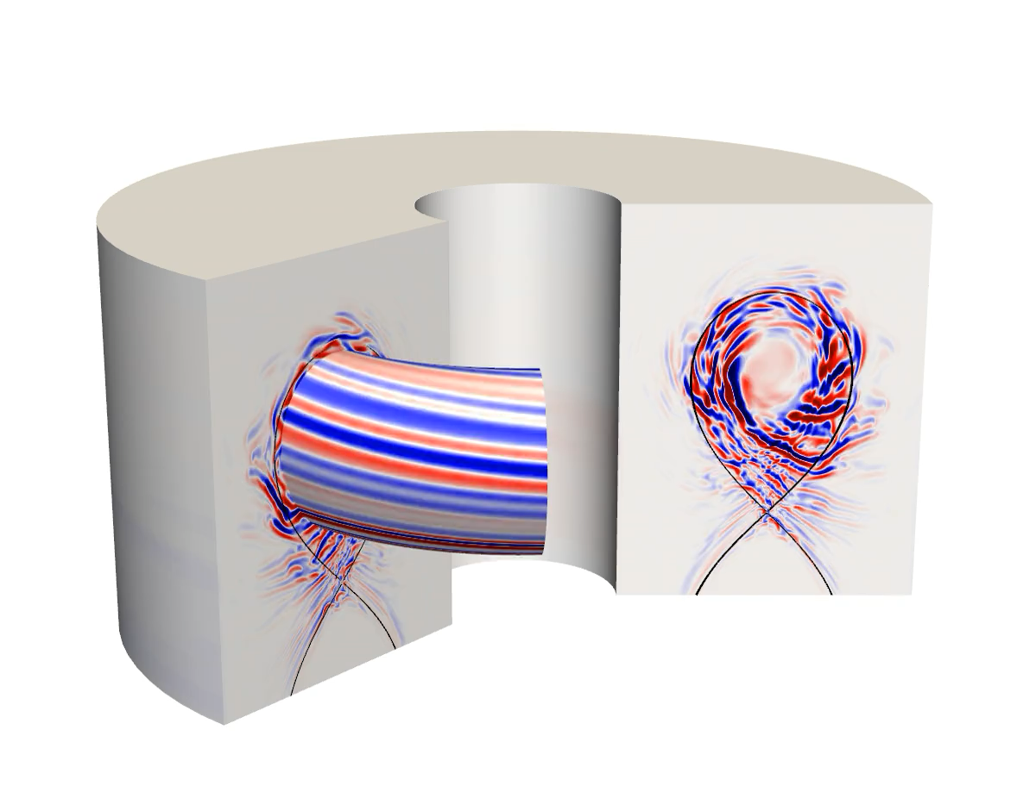
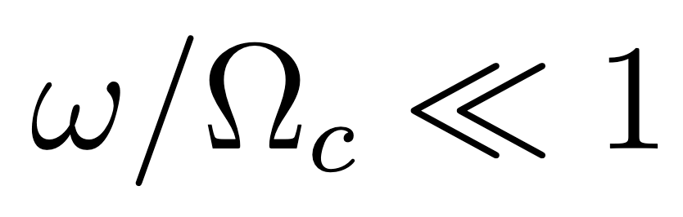
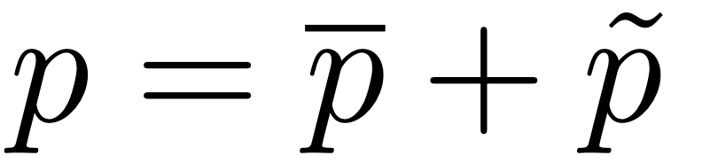
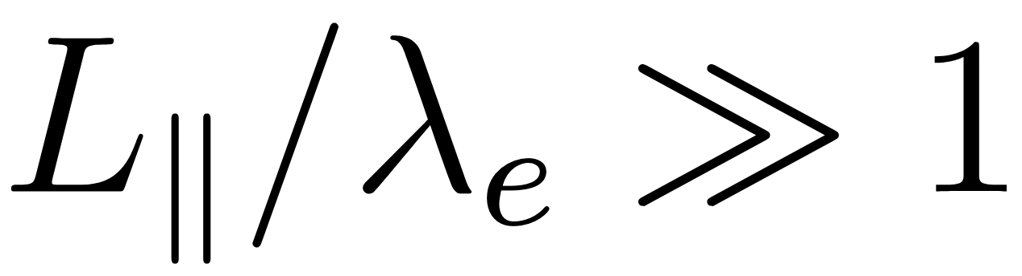
Edge turbulence simulated with GBS code
Edge and scrape-off-layer: turbulent fluctuations are O(1), large-scale and low-frequency:
Evolve background and fluctuations together
Collisionality: generally large enough for fluid description
GBS solves 2-fluid electromagnetic drift-reduced Braginskii equations [Ricci et al. PPCF 2012, Giacomin et al. JCP 2022]
Flux-driven: specify particle/heat sources and evolve global profiles
GBS
4

Slide 5
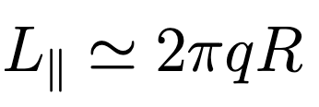
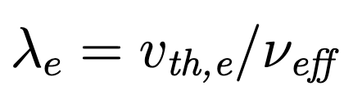
A digression on fluid validity: ASDEX H-mode edge
Collisionality in ASDEX H-mode edge: parameters from [Zholobenko et al. NF 2024]
Fluid approx. breaks down at T ∼ 1 keV
Even pedestal top at T ∼ 600 eV, collisionality is not small
Normalised
collisionality
vs temperature
5

Slide 6
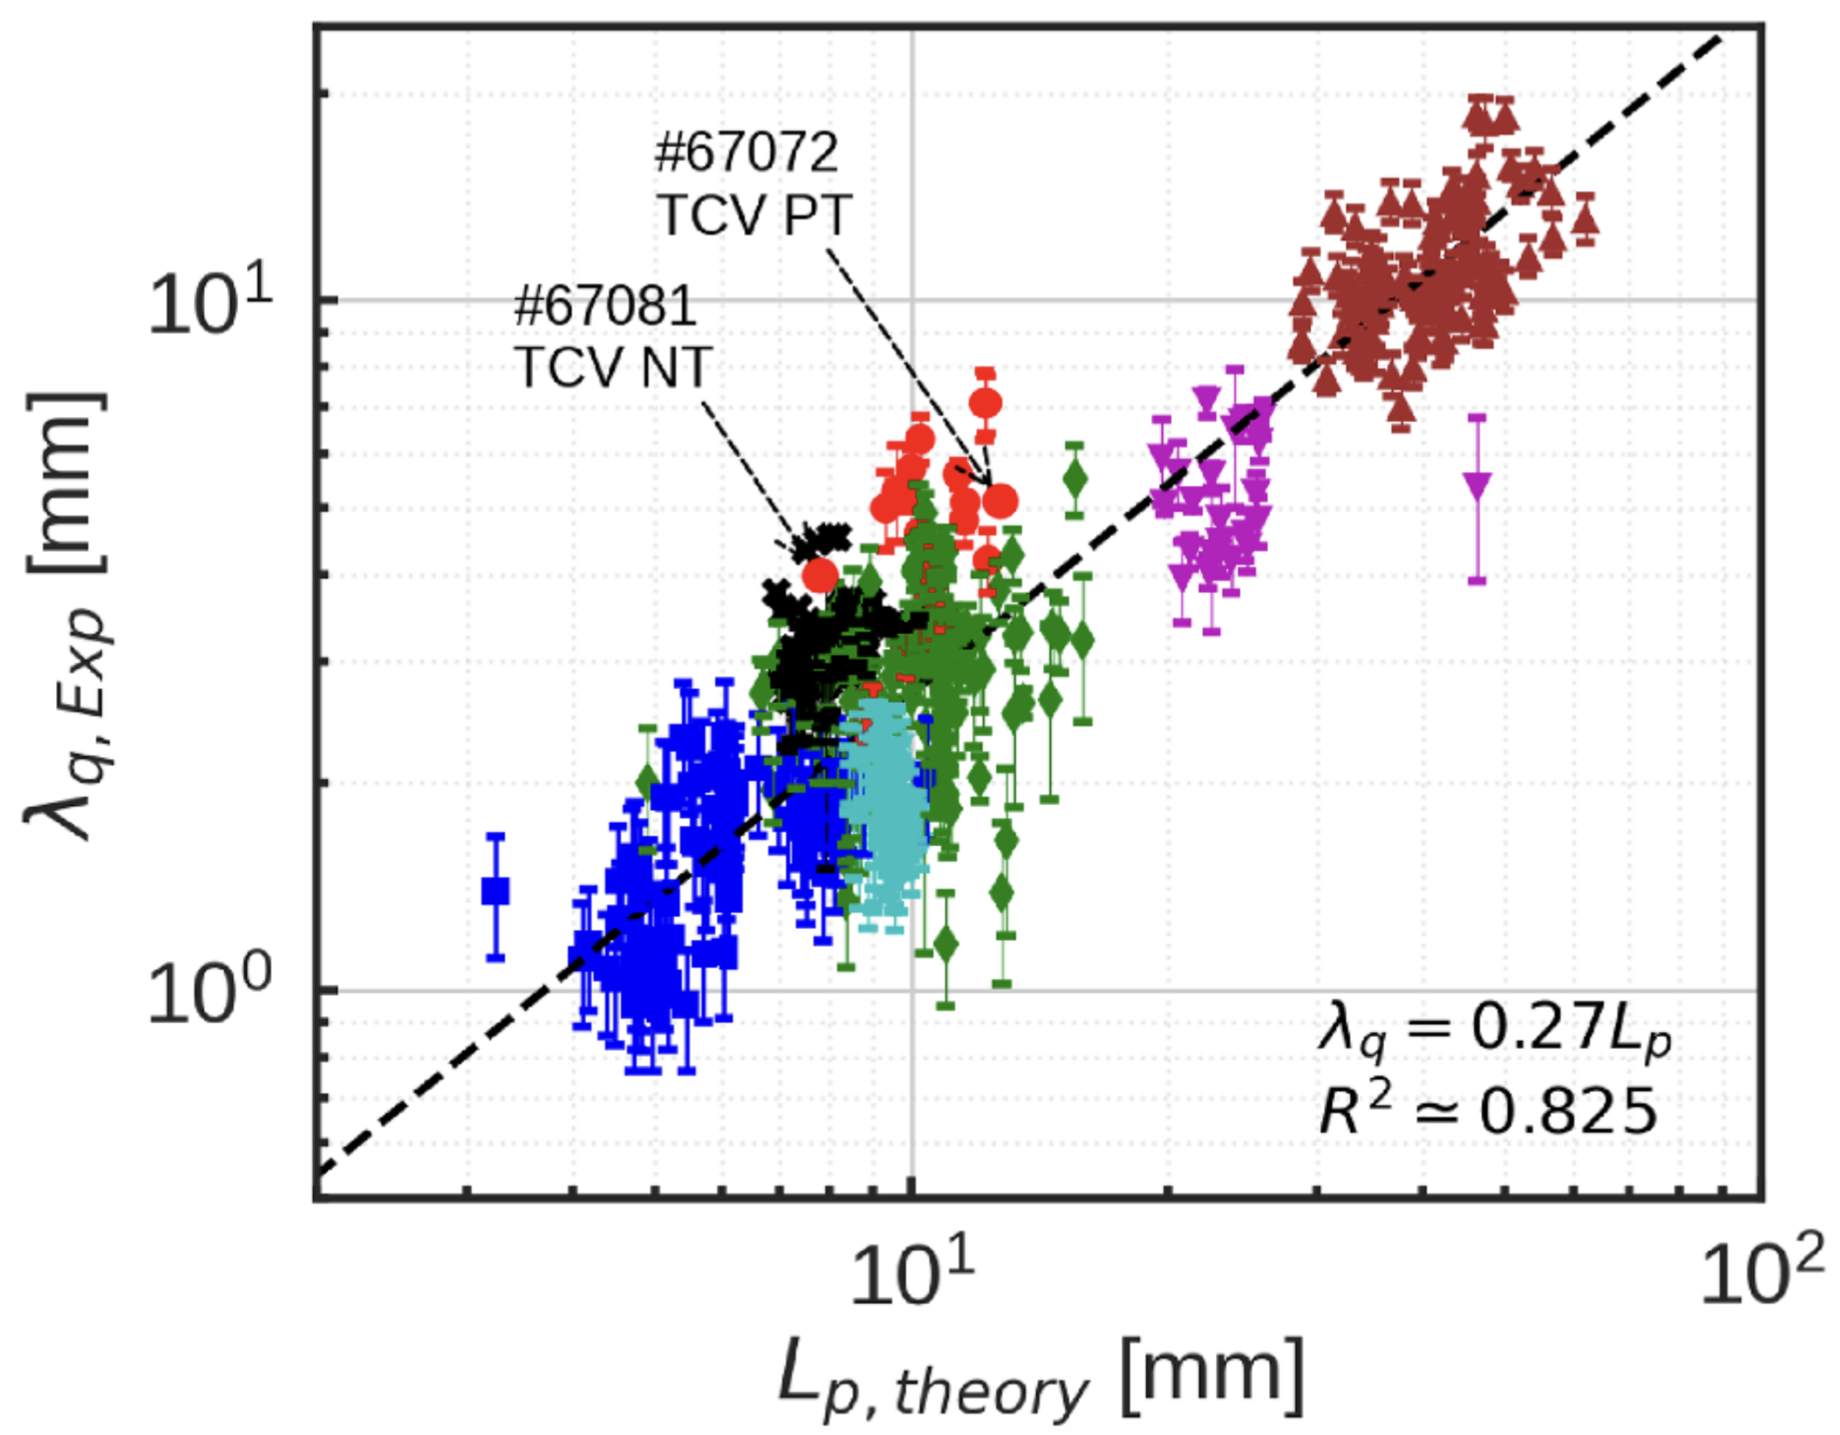

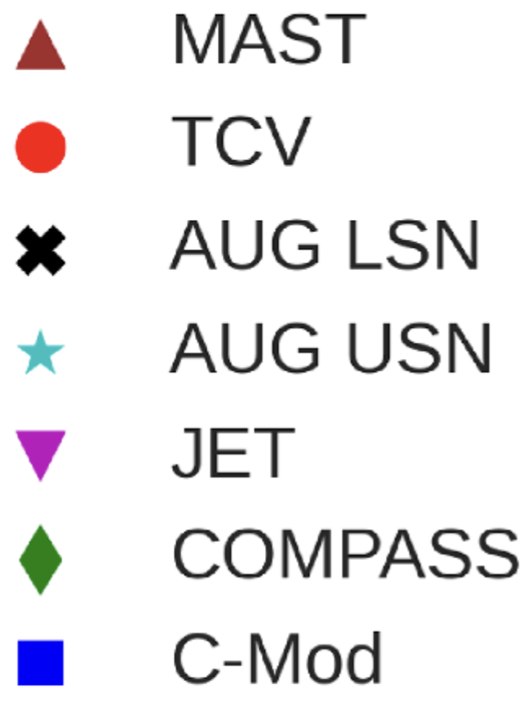
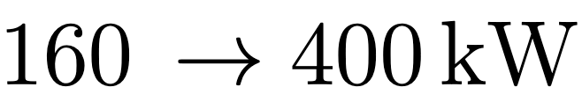
L–mode edge turbulence is resistive ballooning driven
Ballooning modes (BM): driven unstable by bad curvature
L-mode edge turbulence believed mainly driven by resistive branch (RBM) [Rogers et al. PRL 1998, Giacomin & Ricci PoP 2022]
Theoretical scaling law for in RBM dominated turbulence
Excellent agreement with experimental dataset [Lim et al. PPCF 2023]
Study L-H transition: From L-mode in analytical diverted equilibrium, we ramp up power
Simulations in both Favourable and Unfavourable configurations
Offset cost of parameter scan: reduced size (half-size TCV)
Scaling law vs multimachine L-mode heat-decay length [Lim et al. PPCF 2023]
6

Slide 7
Edge transport barriers due to turbulence transitions
Various suppressed transport regimes observed in global turbulence codes (GBS, XGC, Grillix, Soledge3X, …) [Giacomin & Ricci JPP 2020, Ku et al. PoP 2018, Zholobenko et al. submitted PRL 2025]
Increasing electron temperature (decreasing collisionality) in GBS: transition from resistive-ballooning driven to electron drift-wave turbulence
Resistive ballooning
Electron drift-wave
Vorticity
Increase power
7

Slide 8
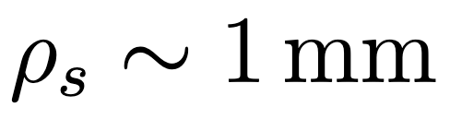
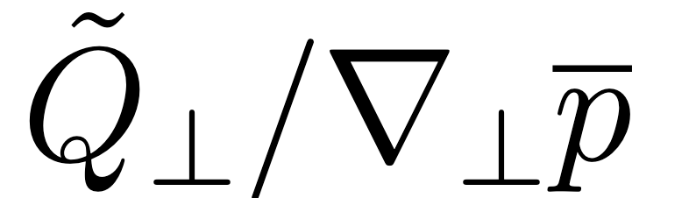
Favourable case: higher power leads to transition
Transition in Favourable case: pressure profiles steepen and turbulence suppressed
Distance from separatrix order of the sound larmor radius
Quantity to discern transport barriers: turbulent heat diffusivity
L-mode, no steep edge-gradient: we expect turbulent diffusivity to increase as we approach separatrix
Clear transition: turbulent diffusivity profile flattens and ∼ 2–3 ✕ reduction
Pressure profiles
Turbulent diffusivity profile
Increase power:
Pressure steepens
Increase power:
reduce turbulence
8

Slide 9
Unfavourable: no transition at same power
No clear transition in Unfavourable case, for same input power
Pressure profile increase slightly but much below Favourable level
Turbulent diffusivity profile: Unfavourable case remains close to L-mode transport level
To best of our knowledge, first global and flux-driven results of this kind
Difference between F/UF does not require kinetic effects (e.g. ion-orbit-losses)
We now focus on Favourable case
Pressure profiles: F/UF comparison
Turbulent diffusivity: F/UF comparison
9

Slide 10
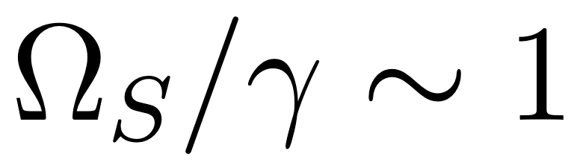
Favourable: E ✕ B shear alone cannot explain transition
E✕ B shear suppresses turbulence when shear rate Ω_{S} approaches nonlinear decorrelation time (∼ growth rate) [Terry, Rev. Mod. Phys, 2000]
Most common explanation given for L-H transition [Kim & Diamond PRL, 2003]
Simulation results: Electric-field well deepens but small difference in normalized shear rate
Need to look further: E✕ B shear alone cannot explain transition in Favourable
Drift-wave turbulence is suppressed by finite plasma β (electromagnetic effects)
Favourable: electric field
Favourable: normalised ExB shear
10

Slide 11
Electromagnetic suppression of drift-wave turbulence
Going to H-mode like conditions, edge turbulence changes to drift-wave dominated (DW)
Removing electromagnetic (EM) effects weakens the transition in Favourable case
In fact drift-wave instability suppressed by EM effects [Rogers & Dorland PoP 2005, Mosetto et al. PoP 2012]
EM suppression factor increases with pressure gradient (spontaneous pedestal formation)
EM fluctuations suppress transport
Linear theory: EM suppression of DW
Electrostatic
Electromagnetic
11

Slide 12
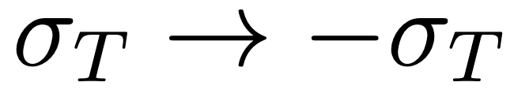
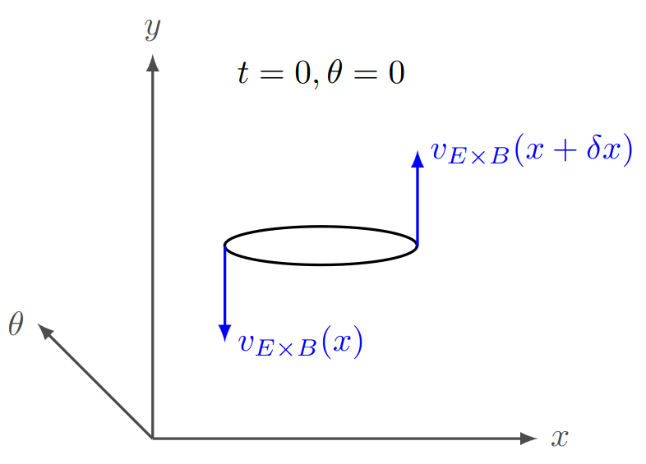
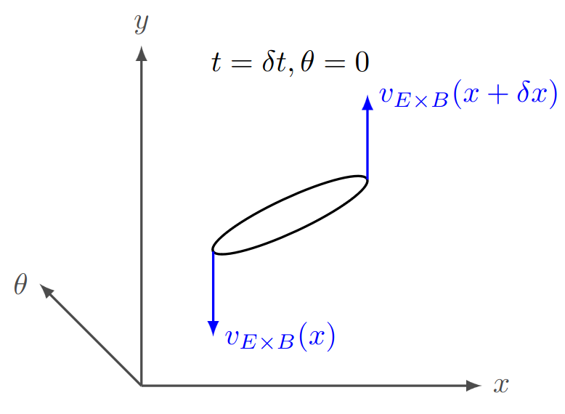
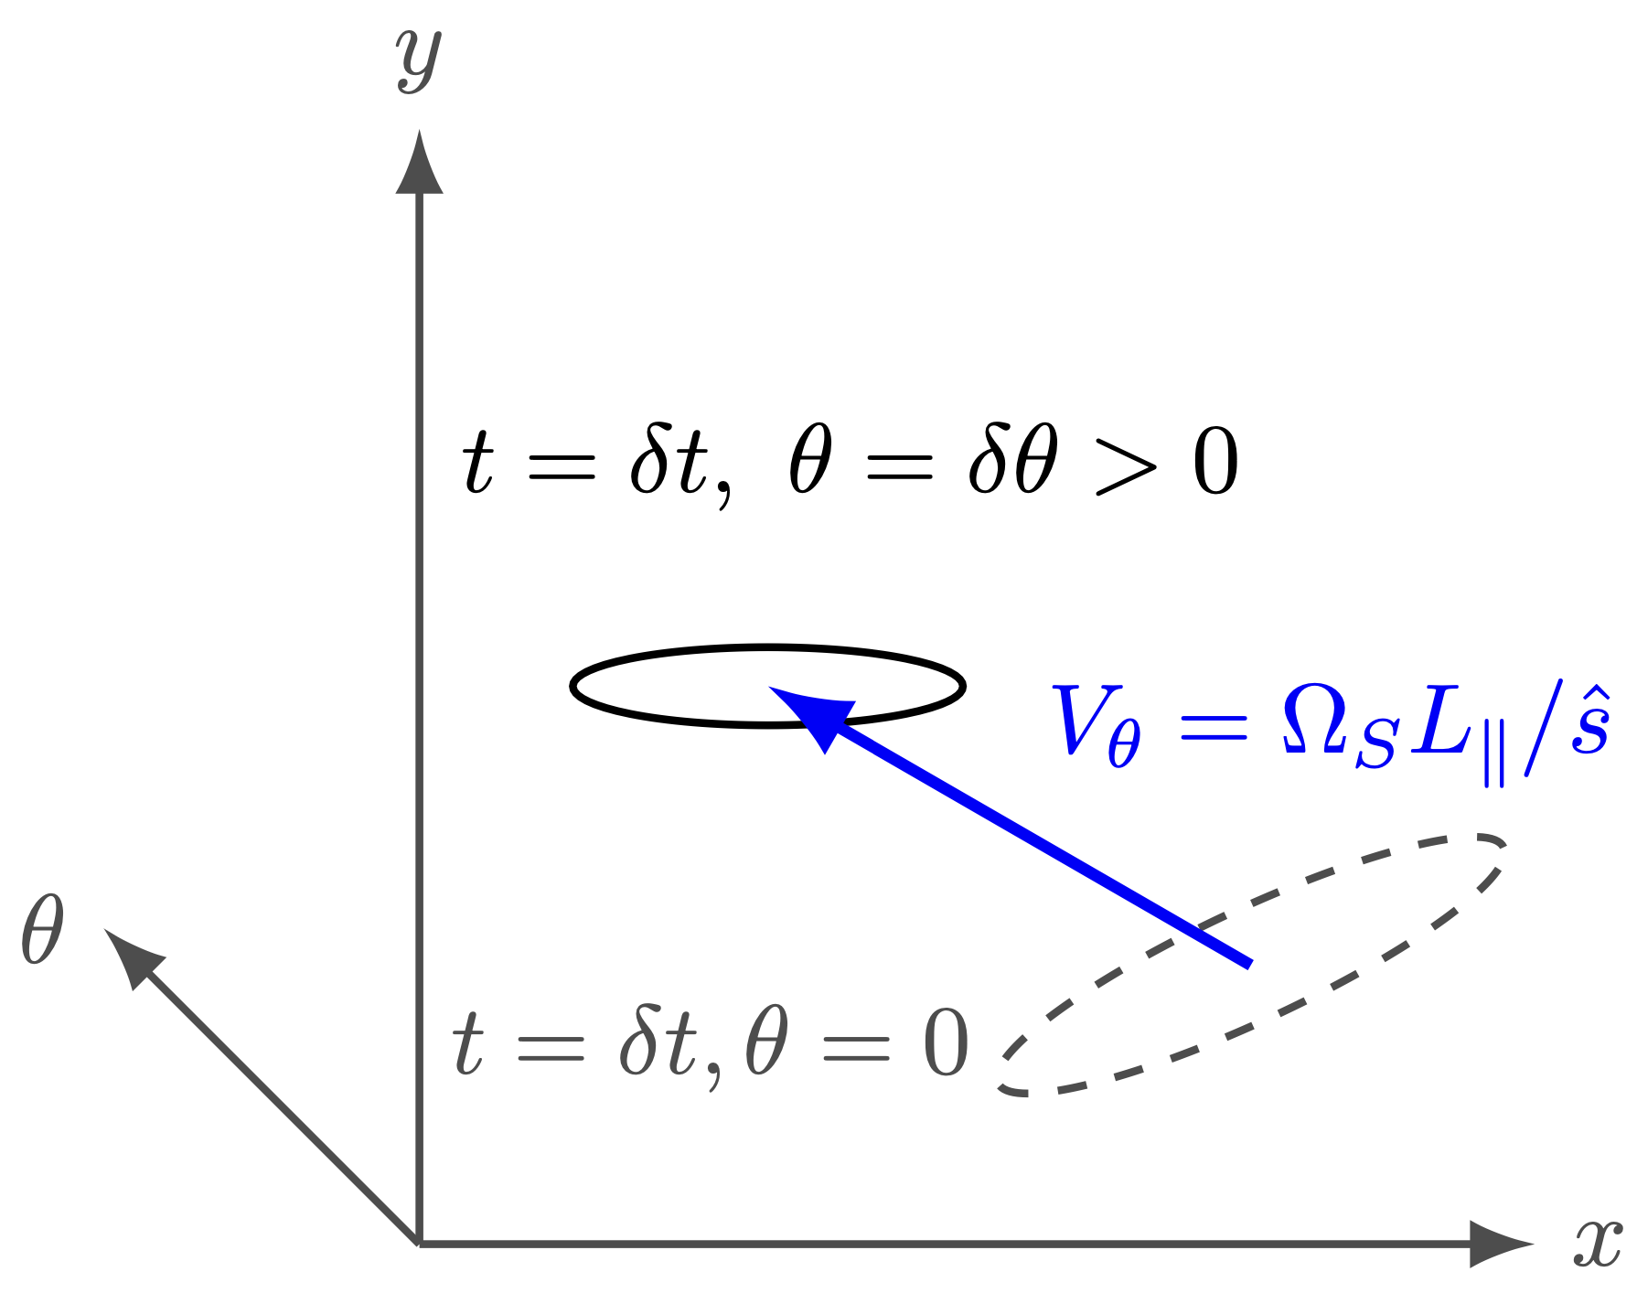
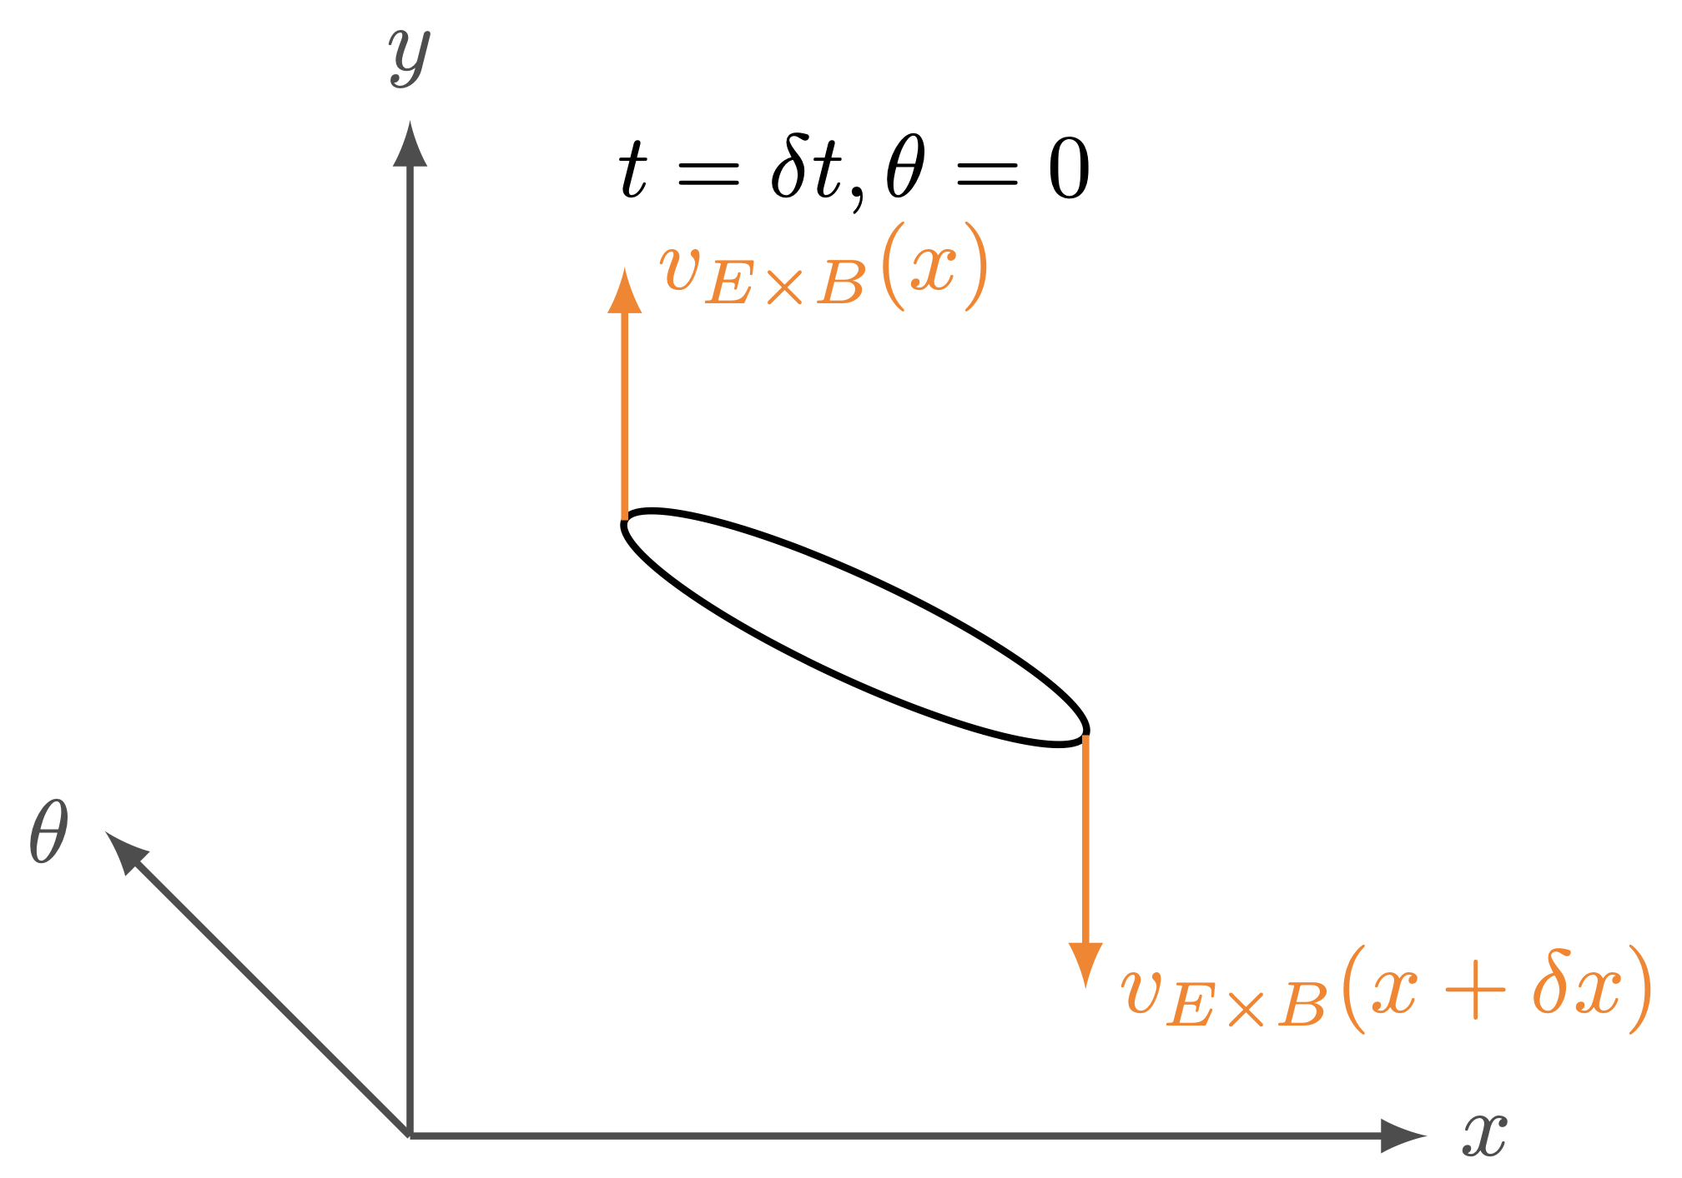
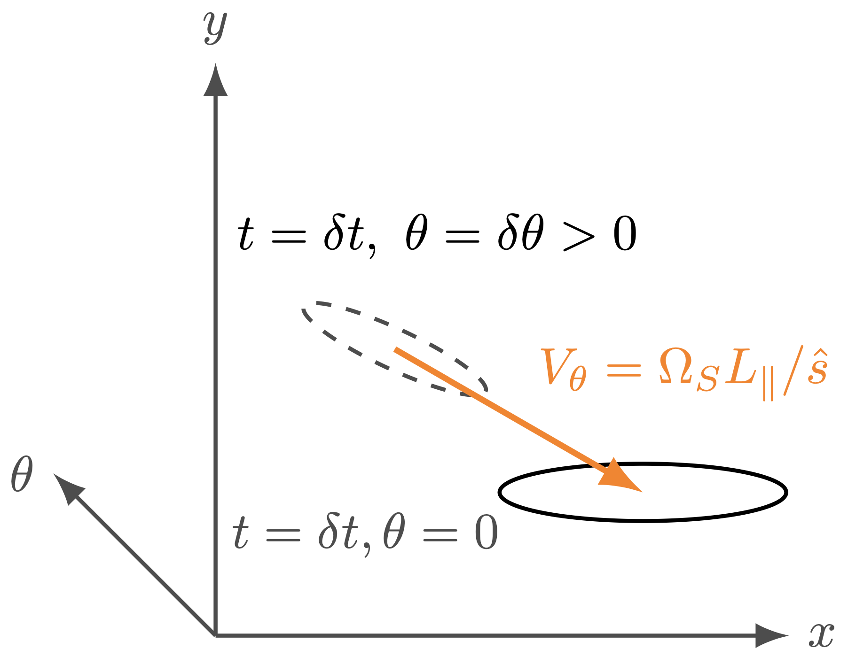
Favourable vs Unfavourable: Broken symmetry by E ✕ B shear
Favourable to Unfavourable is equivalent to flipping sign of toroidal field:
Drift velocities change direction: E✕ B flow shear at the outer-midplane (OMP) flips sign
In presence of flow & magnetic shear: unstable modes “move” along field-line in time [Newton et al. PPCF 2010]
Unfavourable mode moves forwards
Favourable mode moves backwards
12

Slide 13
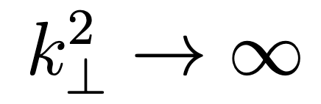
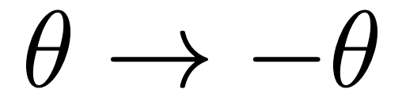
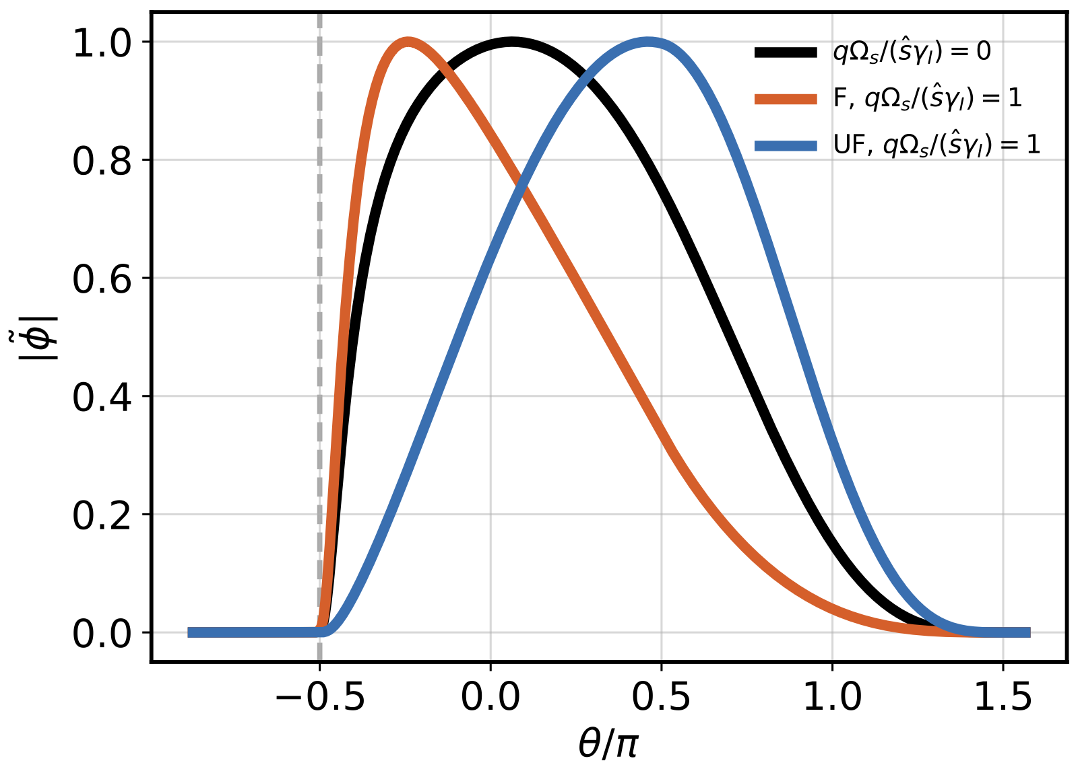
Unfavourable more ballooning unstable close to LH boundary
        Mode localised more towards X-point (Favourable), region of weakest ballooning drive and
        Mode localised more towards OMP (Unfavourable), region of strongest ballooning drive
        Symmetry-breaking effect scales with E✕ B shear and up-down asymmetry of equilibrium
        Close to the separatrix, this asymmetry is large
        Linear analysis: Unfavourable more unstable to ballooning modes
Turbulent diffusivity: UF extends farther poloidally
Unfavourable Low Power
Favourable Low Power
Unstable BM modes localisation
Growth rates:
BM with ExB shear
X-pt
13

Slide 14
Unfavourable: Transition at higher power
Increasing input power even further (∼ 2 ✕ again) in Unfavourable case leads to transition
Turbulent diffusivity profile collapses towards Favourable case
Transition occurs at ∼ 2 ✕ Favourable power level (in line with experiments)
Higher power: the drift-wave instability can at last compete with ballooning-mode turbulence
Pressure profiles: UF higher power
Turbulent diffusivities: UF higher power
14

Slide 15
L-H transition mechanism
Increase in power → increase electron temperature → ballooning to drift-wave turbulence
Electromagnetic suppression proportional to edge pressure gradient: spontaneous pedestal
Flow-shear symmetry-breaking: unfavourable configuration more unstable to ballooning modes
Transition impeded, occurs at higher power
Mechanistic explanation of L-H transition consistent with GBS results
But ultimately, is it consistent with reality/experiments
15

Slide 16
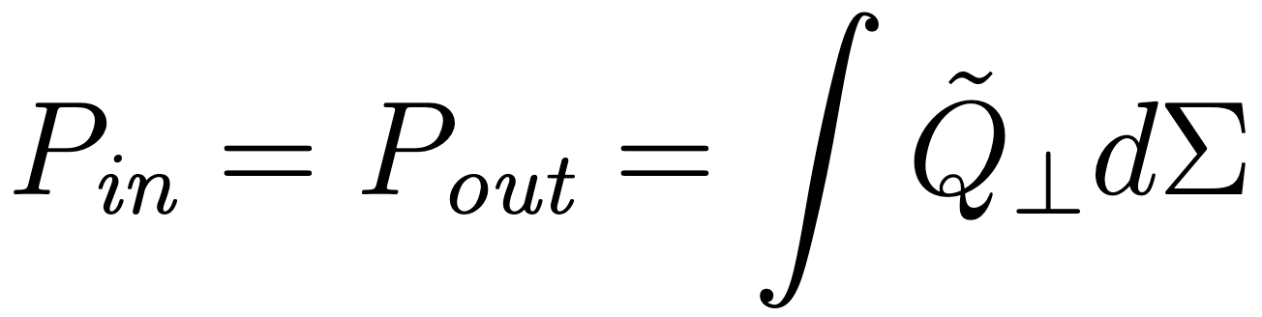
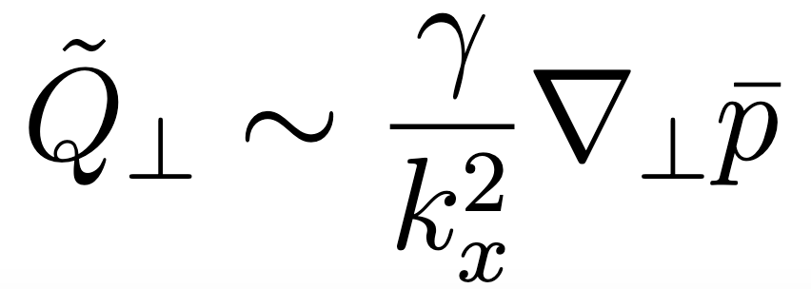
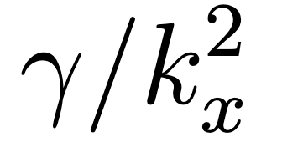
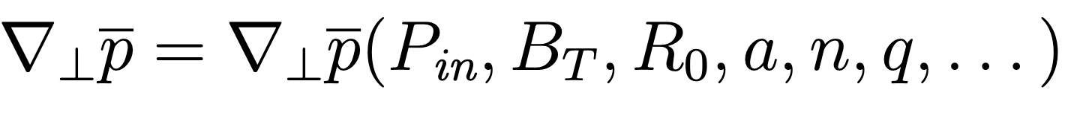
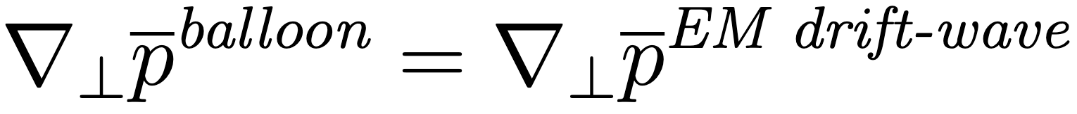

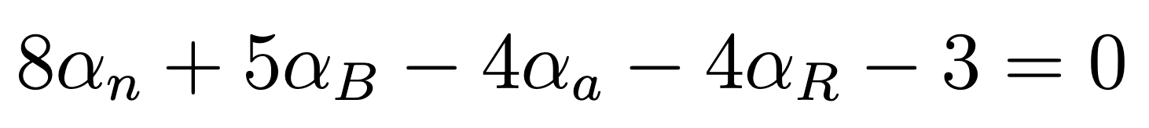
Analytical scaling law for favourable L-H power threshold
Following procedure in [Giacomin JPP 2020], can we derive analytical form for L-H power consistent with experiments?
Energy conservation
Assume turbulent transport is a random-walk (mixing-length estimate):
From linear theory in slab geometry (neglect ExB flow/magnetic shear), obtain analytical
Inverting the energy conservation equation we find
Transition criterium: turbulence can sustain the mean profiles
Transition power: 1 free parameter, K∼ O(1) overall scale
Analytical result: satisfies
Kadomtsev constraint
16

Slide 17
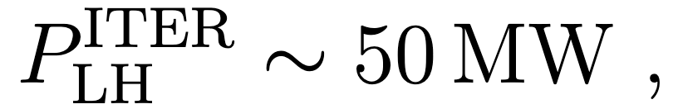
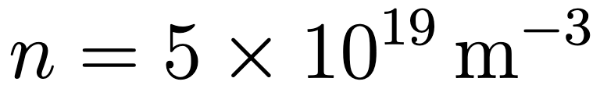
Comparison with L-H experimental data
L-H transition power threshold: theoretical scaling law
(No fitted exponents) vs experimental data (favourable only)
TCV data newly added to ITPA database [Labit et al. PPCF 2025]
Parameter to fit K = 0.48 ∼ n_{edge} / n_{line}
Theoretical scaling law L-H
Empirical scaling law [Martin et al. 2008]
17

Slide 18
Including isotope effects and effective charge
TCV data contains isotopes (H, D, He). We can account for this effect as well as Zeff
Missing Zeff data from ASDEX, set to constant 1.2 (does not affect R² setting to 1,1.5,2)
Theoretical scaling law L-H
Empirical scaling law (Martin, Isotope modified 1/A)
18

Slide 19
Conclusion: L-H transition model
GBS results: Increase in power → increase electron temperature → ballooning to drift-wave turbulence
Drift-wave dominance at high power: consistent with flux-driven results from GBS, Grillix and Soledge [Giacomin & Ricci PoP 2022, Zholobenko et al. NF 2024]
Electromagnetic suppression of DW proportional to edge pressure gradient: spontaneous pedestal
Flow-shear symmetry-breaking: unfavourable configuration more unstable to ballooning modes close to L-H boundary
Theoretical scaling law derived from quasi-linear theory and power balance
Correct scale, zero fitted exponents, outperforms Martin scaling while satisfying Kadomtsev constraint exactly
19

Slide 20
BACKUP SLIDES

Slide 21
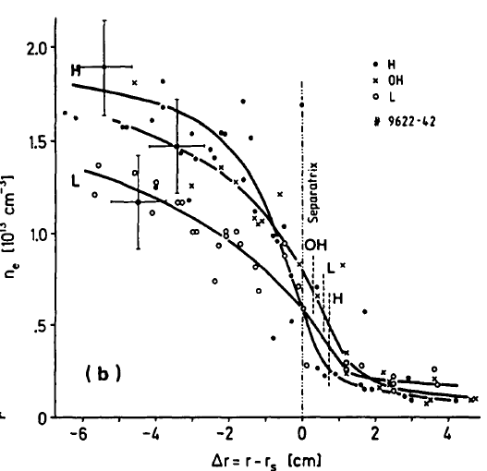
The LH transition in tokamaks
Usually: increase heating in fusion devices, increase turbulent transport (profiles are stiff)
But above a certain power, profile gradients increase spontaneously and confinement time roughly doubles
This is the Low-to-High (LH) confinement transition [ASDEX 1982]
Since its discovery, replicated across many different tokamaks and is baseline scenario for ITER [Loarte et al. PPCF 2025]
But more than 40 years on, we are still not sure what is happening
The H-mode of ASDEX [ASDEX team 1989]
21

