Slide 1
DIONE: Automating the analysis of W7-X Doppler Reflectometry data with neural networks
González Ganzábal, E. Maragkoudakis, D. Carralero, T. Estrada, T. Windisch, G.A. Rattá and the W7-X Team
National Fusion Laboratory – Division of Experimental Physics

Slide 2
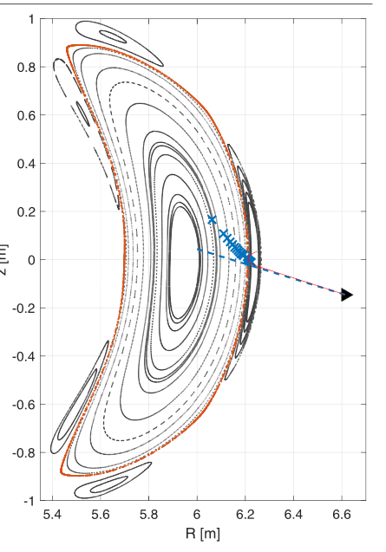
Doppler Reflectometry in W7-X
Doppler Reflectometry can be used to study density fluctuations and the perpendicular plasma flow
Both radial profiles are obtained by changing the incident beam frequency
This cycles takes on the order of hundreds of ms
The V-band incident beams range from 50 to 75GHz, cyclically matching the plasma frequencies ($ω_{p}=\sqrt{\left(\frac{n_{e}(ρ)e^{2}}{m_{e}ε_{0}}\right)}$)
The V-band incident beams range from 50 to 75GHz, cyclically matching the plasma frequencies (𝜔_𝑝=√(((𝑛_𝑒 (𝜌)𝑒^2)/(𝑚_𝑒 𝜀_0 )) ))
Figure taken from D. Carralero et al, Nuclear Fusion 2021

Slide 3
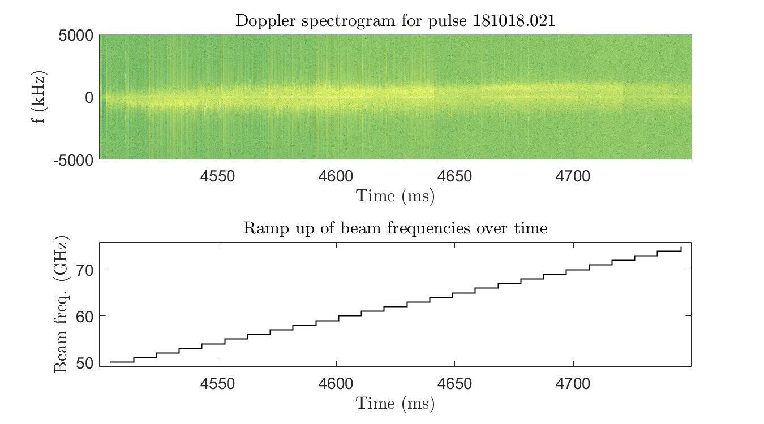
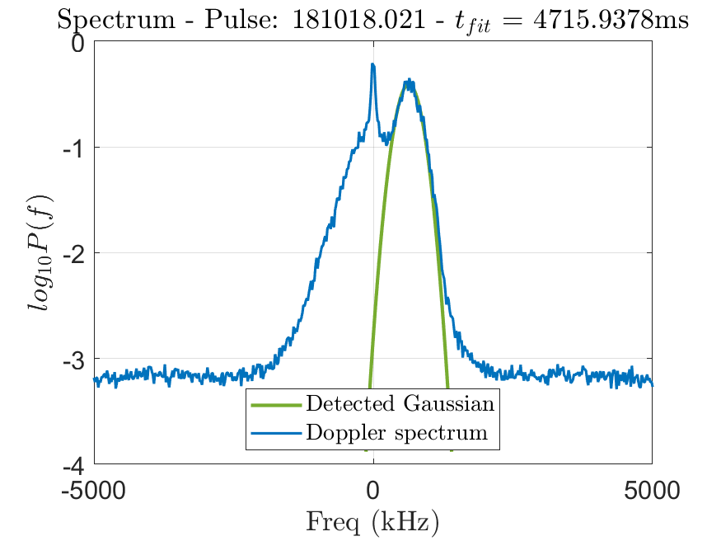
Doppler Reflectometry in W7-X
Doppler spectra are obtained by averaging over the central time: $Δt=t_{c}±2.5$ms
Doppler spectra are obtained by averaging over the central time: Δ𝑡=𝑡_𝑐±2.5ms
$$Δt$$

Slide 4
Characterising a Doppler peak
$$A_{D}$$
$$G_{D}\left(f\right)=A_{D}\exp\left(\frac{−{\left(f−μ_{D}\right)}^{2}}{2σ_{D}^{2}}\right)$$
The parameters obtained from the DR can be used to measure the amplitude of the fluctuations and the perpendicular plasma flow
$$S=10⋅ \log_{10}{(A_{D}σ_{D})}$$
$$V_{⊥}=2π \frac{μ_{D}}{k_{⊥}}$$
$$σ_{D}$$
$$μ_{D}$$

Slide 6
Doppler peak IdentificatiOn with Neural networks (DIONE)
DIONE is a Neural Network based prediction model focusing on:
Automating the data analysis
No need for a dedicated manual analysis; can run in the background
Improved speed
Comparable accuracy

Slide 7
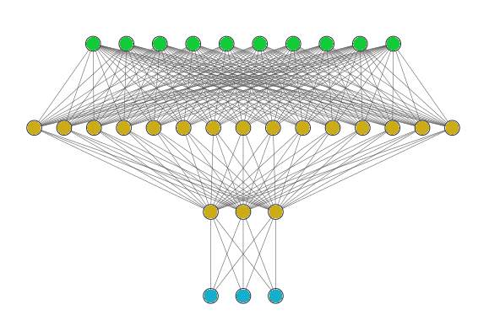
DIONE’s training dataset
Starting point: a dataset with 6710 characterised Doppler spectra
2000 of them were used to train a Feed Forward Neural Network
The FFNN only takes the frequencies of interest ($|f|$ ⪅ 3000 kHz), avoiding extra noise
The FFNN only takes the frequencies of interest (|𝑓| ⪅ 3000 kHz), avoiding extra noise
All data was manually analysed from the 2018 campaign
A common split (70%/15%/15%) was used for training, validation and testing
The output are the three parameters $μ_{D}, σ_{D}, A_{D}.$
The output are the three parameters 𝜇_𝐷, 𝜎_𝐷, 𝐴_𝐷.
…

Slide 8
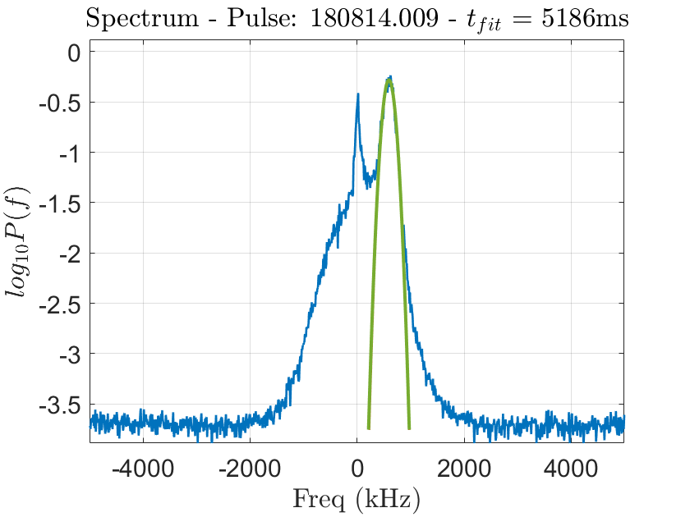
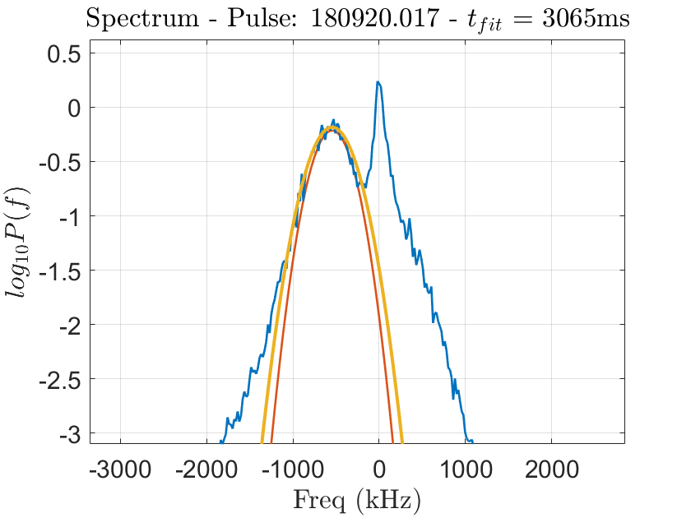
Fitting examples

Slide 9
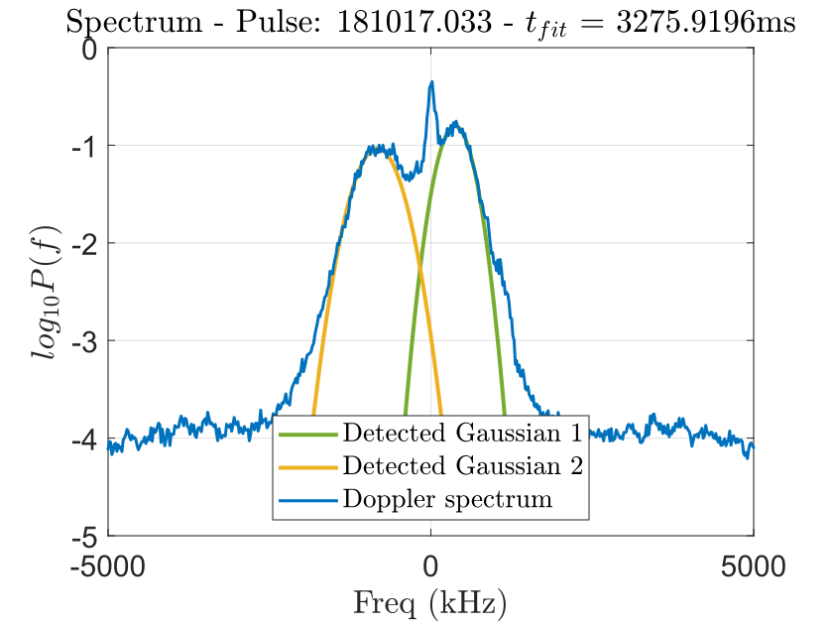
Exclusion rules and double peaks
Certain rules are used to prevent outliers:
$\left|μ_{p}\right|>85$kHZ
|𝜇_𝑝 |>85kHZ
$σ_{p}<1000$kHz
𝜎_𝑝<1000kHz
$A_{p}>1.1⋅NL$
𝐴_𝑝>1.1⋅𝑁𝐿
In some cases, two Doppler peaks might appear in opposition ($μ_{D1}>0, μ_{D2}<0$)
In some cases, two Doppler peaks might appear in opposition (𝜇_𝐷1>0, 𝜇_𝐷2<0)
The model can process both, but only the one with higher A is considered
This occurs when two regions with different velocities are too close radially (LCFS)

Slide 10
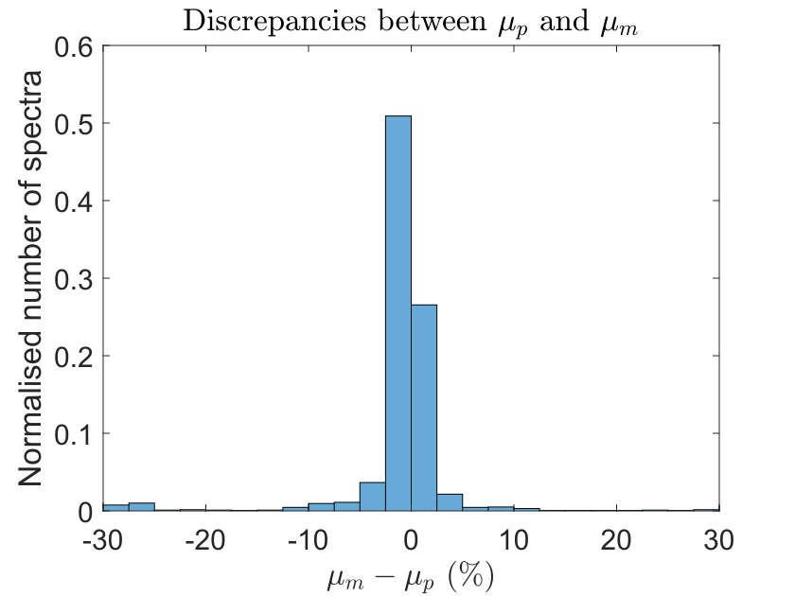
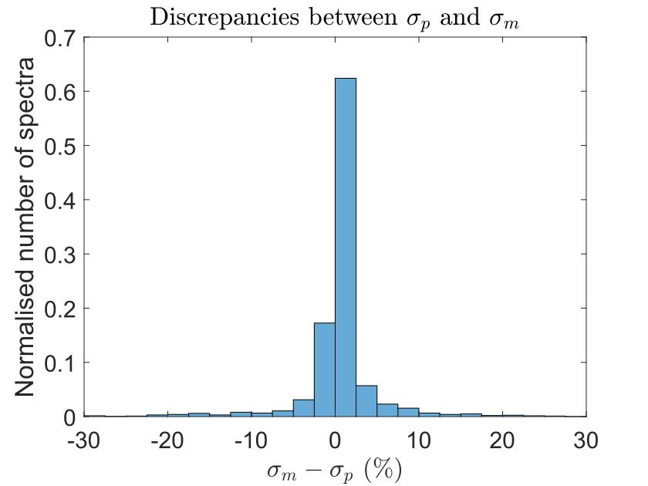
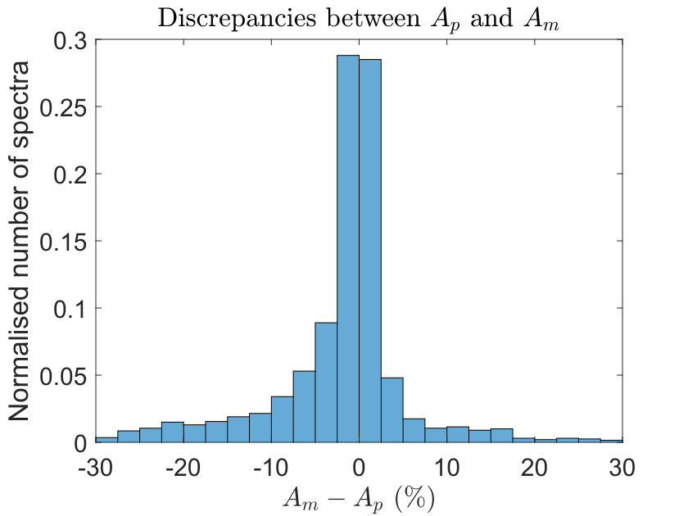
Comparing manual analysis with DIONE
M: manual analysis; P: predicted by DIONE
$$Δμ<5\%$$ | $$Δσ<5\%$$ | $$ΔA<5\%$$
87,5% | 90,1% | 82,5%

Slide 11
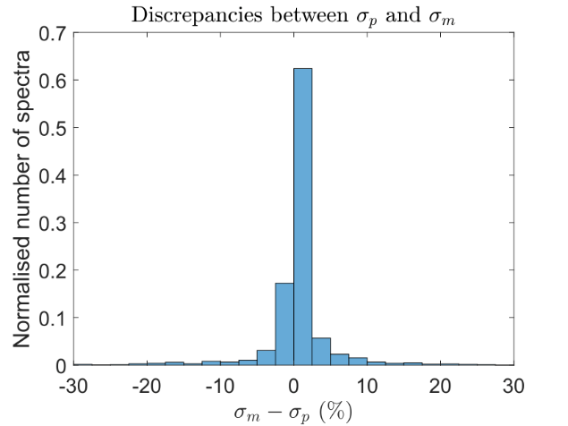
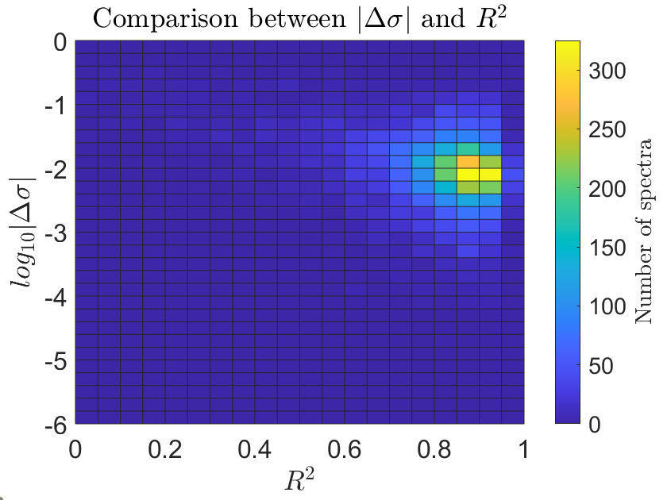
Using an independent quality measure
$R^{2}$ can be used as an additional coefficient to measure the quality of a given spectra
𝑅^2 can be used as an additional coefficient to measure the quality of a given spectra
$$R^{2}=1−\frac{{\sum_{i}{\left(y_{i}−f_{i}\right)}}^{2}}{\sum_{i}{{\left(y_{i}−\hat{y}\right)}^{2} }}$$

Slide 12
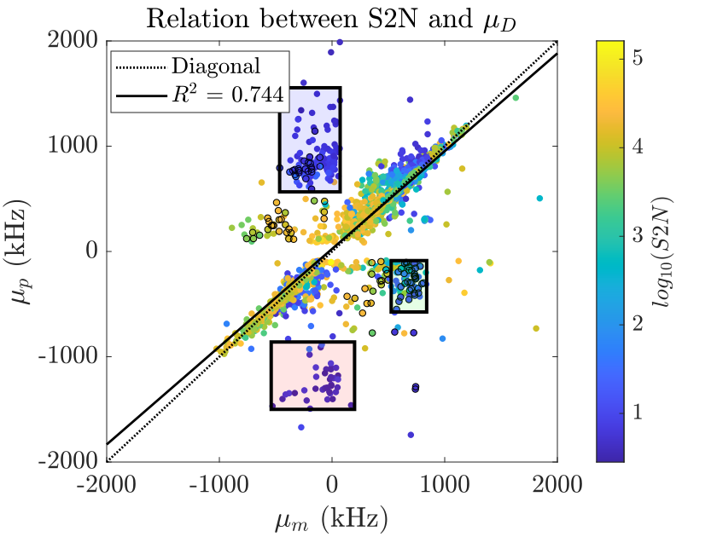
Effects of Signal to Noise (S2N) ratio
S2N is calculated in each spectrum
$$S2N=\frac{\max\left(P\left(f\right)\right)}{\frac{1}{25}\sum_{i≤25}{ P(i)}}$$
𝑆2𝑁=max⁡(𝑃(𝑓))/(1/25 ∑_(𝑖≤25)▒〖 𝑃(𝑖)〗)
Model may pick up opposite Doppler peak (see points with black edges)
The one with larger amplitude is considered the proper Doppler peak
At lower S2N, model and human are affected alike
$$1.8\%$$
$$1.2\%$$
$$0.5\%$$

Slide 13
Performance: comparing DIONE with manual analysis
Reading the data
Not much can be done
Processing raw data
Obtaining the parameters
O$btaining μ_{D}, σ_{D}, A_{D}$
Obtaining 𝜇_𝐷, 𝜎_𝐷, 𝐴_𝐷
The GUI takes at least five seconds to process and plot the spectrogram plus each spectrum
Both DIONE and the manual analysis start here
This is negligible using the model
A fully autonomous DIONE can outperform the manual analysis by a factor 66 - 196
Barely 0.2s for DIONE; can take up to 30s-1m to manually analyse

Slide 14
(Long run; assuming 30s per fit for the manual analysis)

Slide 15
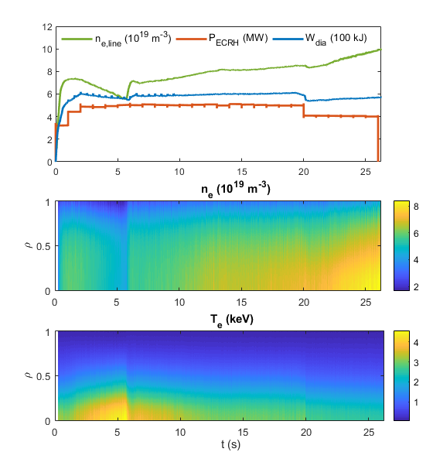
Case example: discharge 230215.061
Excelent example of why such a model is needed:
Presents a slow, progressive density increase
Very long discharge: 25 seconds of plasma
It’d take almost 14-20 hours of work to manually analyse (20-30s per fit; extremely generous)
From the 2018 campaign: two different turbulence regimes were seen
Discharges like this delve into both regimes*
With DIONE, the analysis took 18 minutes
*D. Carralero et al, Nuclear Fusion 2021

Slide 16
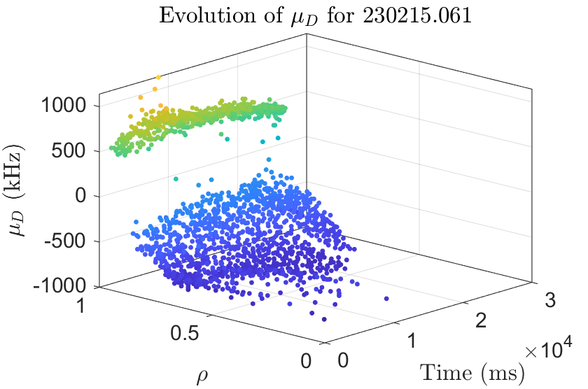
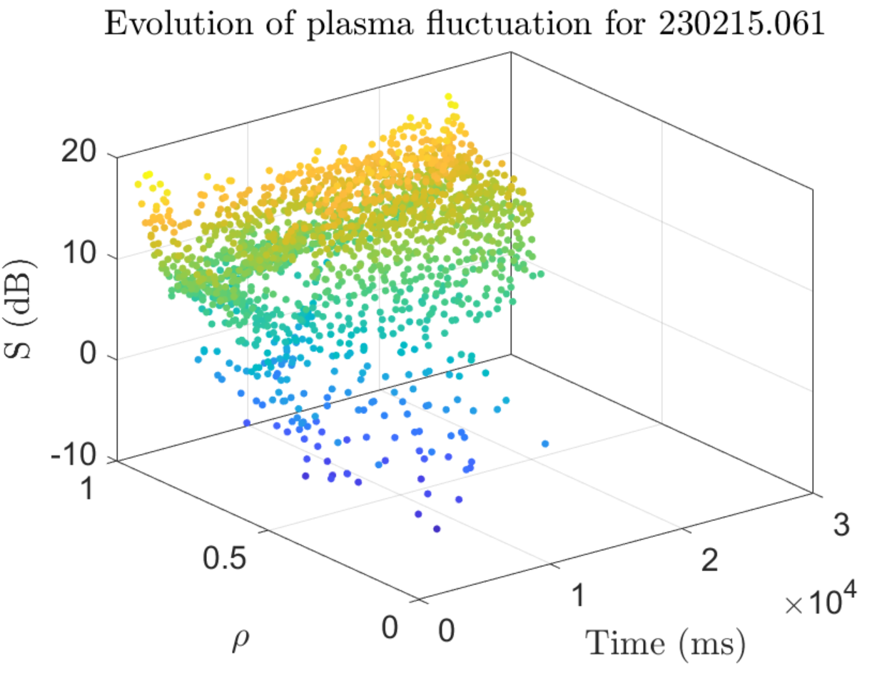
Measuring $μ_{D}$ and S
Measurements of $μ_{D}$ and S have been plotted over time and $ρ$
Measurements of 𝜇_𝐷 and S have been plotted over time and 𝜌
Some expected results can already be seen:
The change of sign in $μ_{D}$ circa $ρ>0.95$
The change of sign in 𝜇_𝐷 circa 𝜌>0.95
The amplitude of the fluctuations follows a continuum, instead of being separated in different regimes

Slide 17
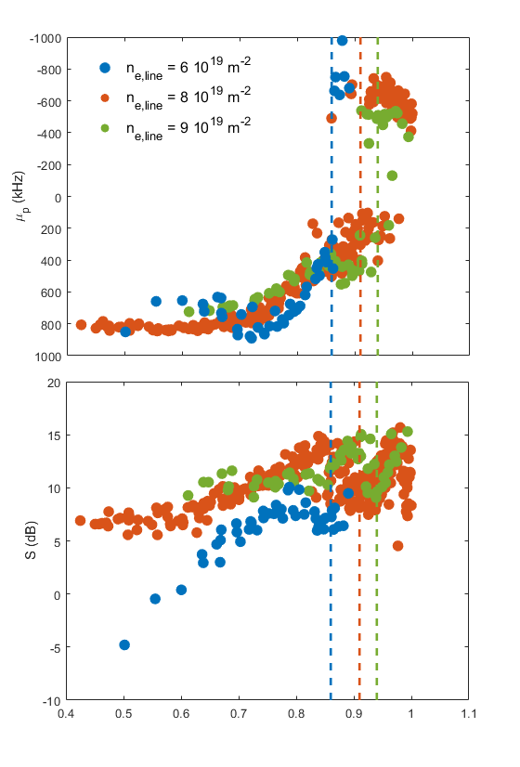
Radial profiles for $μ_{D}$ and S
Radial profiels of both $μ_{D}$ and S have been plotted
Radial profiels of both 𝜇_𝐷 and S have been plotted
The discontinous lines indicate the shear layer around the LCFS
A change in sign for $μ_{D}$ can be seen close to the shear layer
A change in sign for 𝜇_𝐷 can be seen close to the shear layer
The amplitude of the fluctuation tends to decay towards the plasma core
All in agreement with previous works

Slide 18
Conclusions
DR is a powerful diagnostic, but the data analysis should be automated
DIONE, a model based on Neural Networks, is presented
It overlaps the results obtained manually at nearly 85% of the time
The model succesfully evaluated a long discharge, one of the main objectives of the OP2.1 campaign
In terms of speed, DIONE massively outperforms the manual analysis
Quality of signal affects the model in a similar way it affects the manual analysis

Slide 19
Future work
Massive data analysis of previous discharges can now be performed in the background
Data from the three reflectometers can be analysed automatically
DIONE can be used in future campaigns as well
While the original data came from QMRV1, DIONE has already been successfully tested with data from V2 and E1
Albeit some fine tuning, bug fixing, etc, is expected

Slide 20
Back up slides

Slide 21
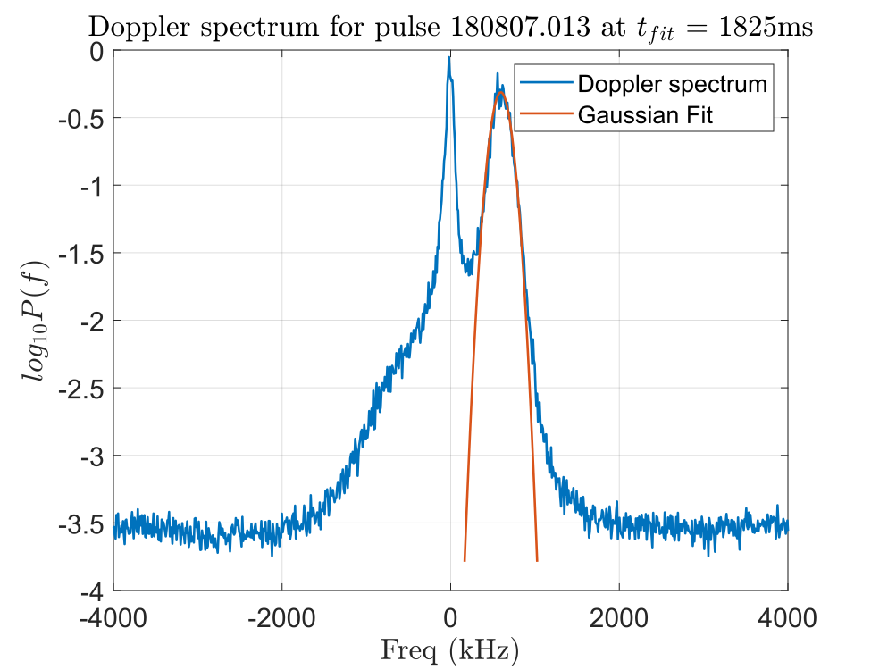
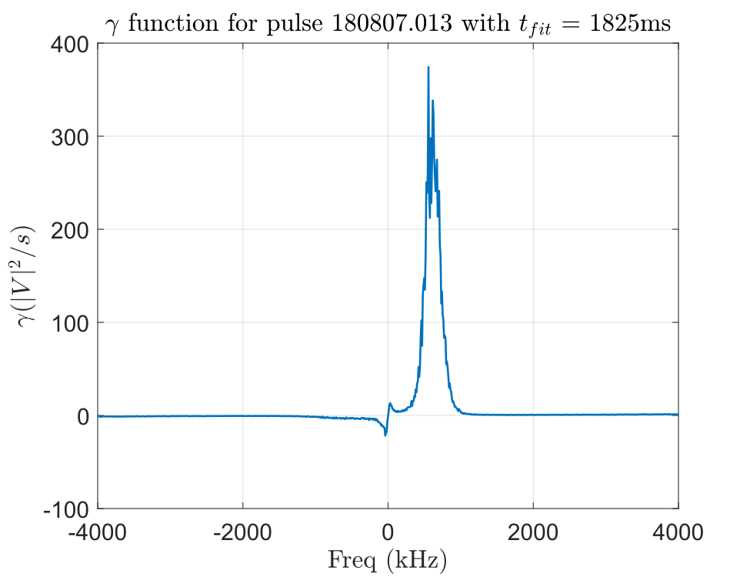
The model
Auxiliary function: $γ\left(f\right)=P\left(f\right) ⋅f$
Auxiliary function: 𝛾(𝑓)=𝑃(𝑓) ⋅𝑓
$γ\left(f\right)$ will have a maximum or minimum in $μ_{γ}$
𝛾(𝑓) will have a maximum or minimum in 𝜇_𝛾
Assuming $μ_{D}≈μ_{γ},$ then $A_{D}≈A_{γ}=P(μ_{γ})$
Assuming 𝜇_𝐷≈𝜇_𝛾, then 𝐴_𝐷≈𝐴_𝛾=𝑃(𝜇_𝛾)
Frequency limits: $μ_{γ}±FWHM$
Frequency limits: 𝜇_𝛾±𝐹𝑊𝐻𝑀
Power limit: $A_{γ}±0,2\left|V^{2}\right|$
Power limit: 𝐴_𝛾±0,2|𝑉^2 |
For a Gaussian: $FWHM=2\sqrt{2ln2}σ_{NN}$
For a Gaussian: 𝐹𝑊𝐻𝑀=2√2𝑙𝑛2 𝜎_𝑁𝑁

Slide 22
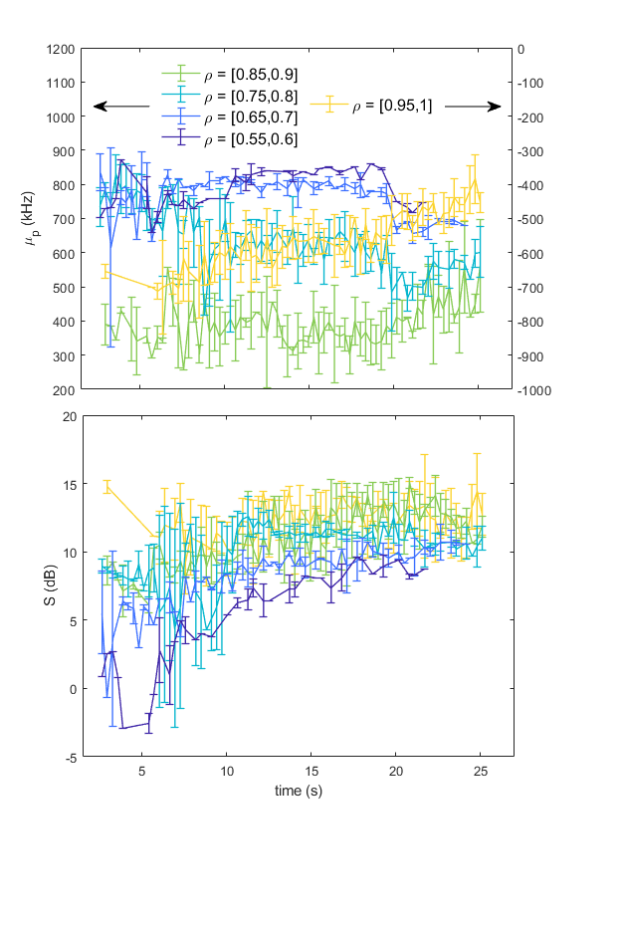
Measuring $μ_{D}$ and S
Measurements of $μ_{D}$ and S have been averaged over different plasma radius
Measurements of 𝜇_𝐷 and S have been averaged over different plasma radius
Some expected results can already be seen:
The change of sign in $μ_{D}$ circa $ρ>0.95$
The change of sign in 𝜇_𝐷 circa 𝜌>0.95
The amplitude of the fluctuations follows a continuum, instead of being separated in different regimes
An overall decrease of ${|E}_{r}\left(μ_{D}\right)|$ can be seen near the LCFS
An overall decrease of 〖|𝐸〗_𝑟 (𝜇_𝐷 )| can be seen near the LCFS

Slide 23
Analysis over $n_{eline}$

Slide 24
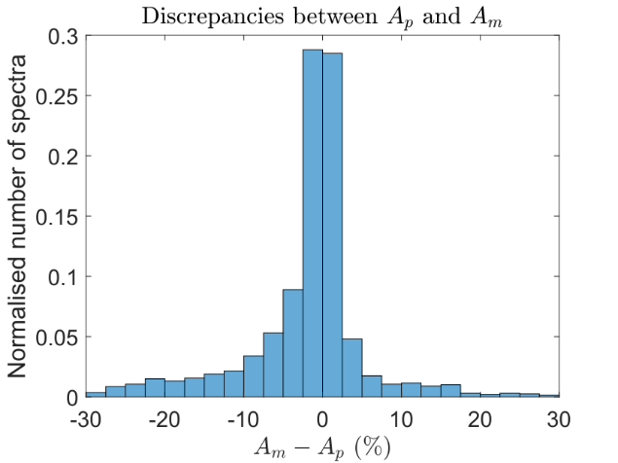
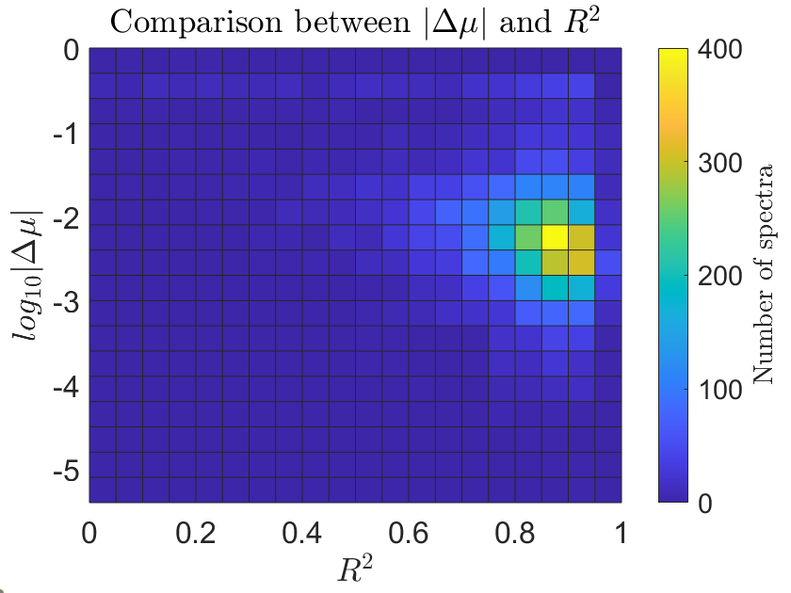
Independent quality measure
$R^{2}$ can be used as an additional coefficient in case a human operator has not processed a given spectra
𝑅^2 can be used as an additional coefficient in case a human operator has not processed a given spectra
$$R^{2}=1−\frac{{\sum_{i}{\left(y_{i}−f_{i}\right)}}^{2}}{\sum_{i}{{\left(y_{i}−\hat{y}\right)}^{2} }}$$

Slide 25
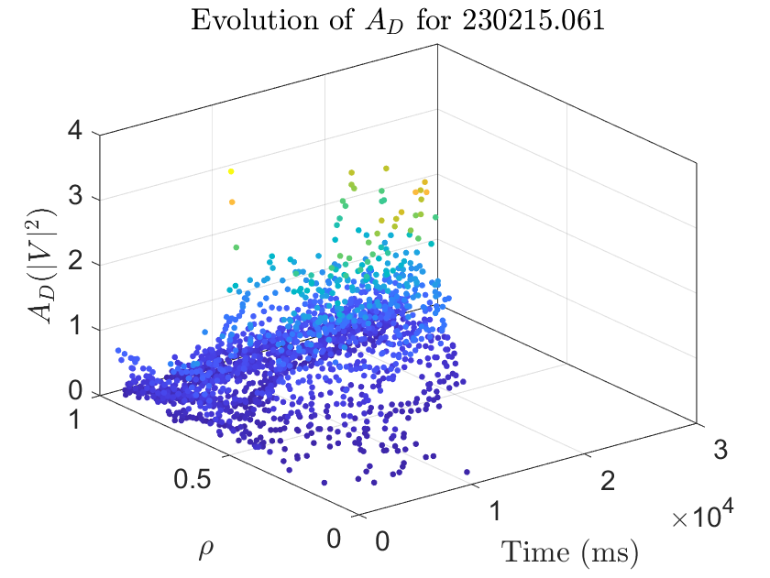
$μ_{D}, σ_{D}, A_{D}$ for 230215.061

