Slide 1
Breeding Blanket testing strategy and role of VNS on the path to commercial fusion
IEA FPCC – Paris, 16-17 February 2026
Giacomo Aiello
EUROfusion

Slide 2
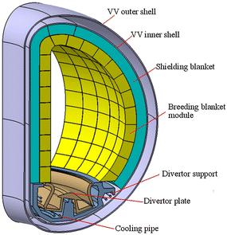
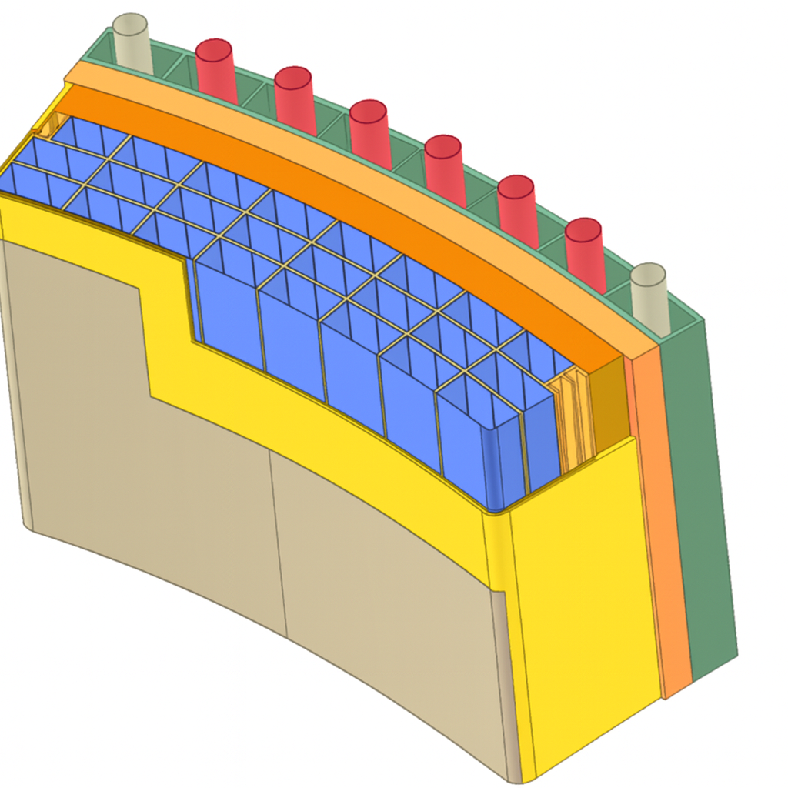
What is a Breeder Blanket ?
In a Fusion Power Plant, the Breeding Blanket is the first structure exposed to the plasma
  It has to withstand the most intense heat, EM and nuclear loads
BB functions are essential to an FPP:
  Recover nuclear heat to produce electricity
  Breed tritium to fuel the reactor
  Ensure nuclear shielding and protection of other components (Vacuum Vessel, Magnets…)
A BB is made of:
  Structural materials
  Provide mechanical strength, while forming the pressure boundary and channels for coolants and breeding materials.
  Breeders
  Generate tritium by nuclear reactions with Li-containing compounds in the Breeding Zone
  Neutron multipliers
  Increase the effective neutron yield via (n,2n) reactions to boost tritium breeding in the BZ
  Coolants
  Remove and transfer the heat it to power conversion keeping temperatures within limits.
Coolant distribution system
Breeding zone
The BB can be considered the equivalent of the “core” in fission plants
Structural box

Slide 3
A limited number of materials, but several different concepts
The list of materials that can fulfill all BB requirements is relatively limited:
Function | Requirements | Short term | Medium Term | Long term
Structural | Low Activation Irradiation resistance (50-150 dpa) | RAFM steels Casted Nanostructured Alloys | ODS steels Vanadium alloys | SiC_{f}/SiC composites
Breeders/Multipliers | Low chemical reactivity and toxicity Limited cost and sustainable supply | Ceramic pebbles (Li₂TiO₃, Li₄SiO₄..) Pure Be, Be₁₂Ti Pure Pb, Pb₁₇Li | Pure Li | Pure Li FLiBe
Coolants | Operate in appropriate T window Keep T inventory and permeation low | H₂O, He, CO₂ | Pb₁₇Li | Pure Li FLiBe
But a number of BB concepts can arise from their different combinations:
A.R. Raffray et al. Journal of Nuclear Materials
2002
How to test, screen, select and finally qualify the “best” materials and Breeding Blanket
concept(s) ?
And more have emerged in the last 20 years!

Slide 4
BB technology is critical, but its current maturity is very low
H. Zohm, A. Von Mueller, Technology Readiness Level Assessment Of Magnetic Confinement Fusion Based On The Tokamak Principle
Presented at 29th IAEA Fusion Energy Conference, London, 2023
To date, no fully functional BB system has ever been built and operated. Work so far has focused on subsystem prototypes, with integrated testing planned in ITER TBMs.
Unlike other (magnetic confinement) fusion subsystems, the breeding blanket’s key functions are directly driven by the fusion neutron flux.
ITER programme delays, and x100 reduction in fluence for DT-1, significantly undermine the TBMs ability to deliver meaningful and timely results.
The BB TRL cannot be raised without a consistent, staged testing approach in (fusion) nuclear facilities!
The delay in the development of the Breeding Blanket is also hindering the development of related technologies

Slide 5
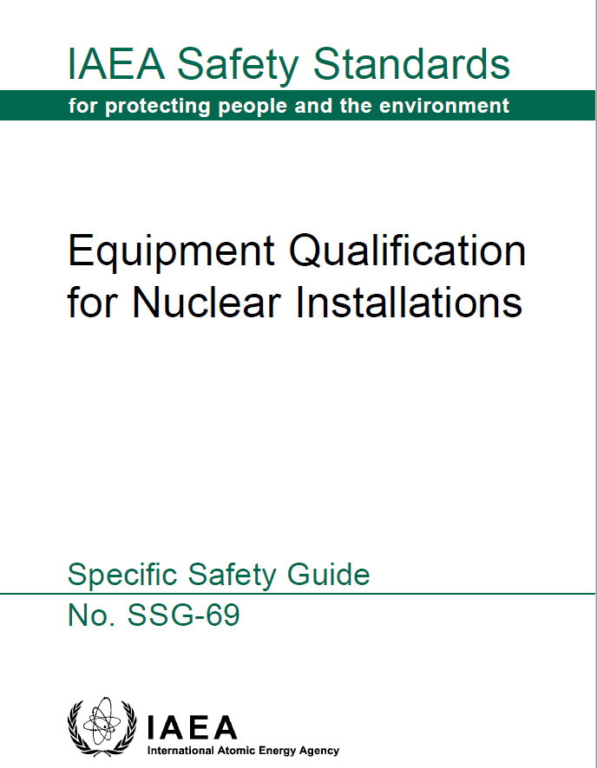
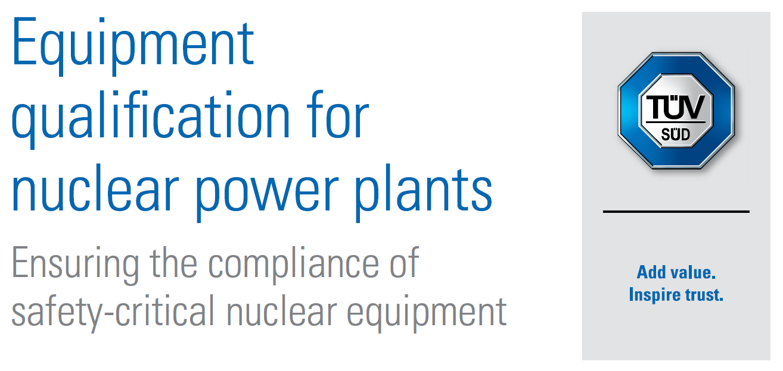
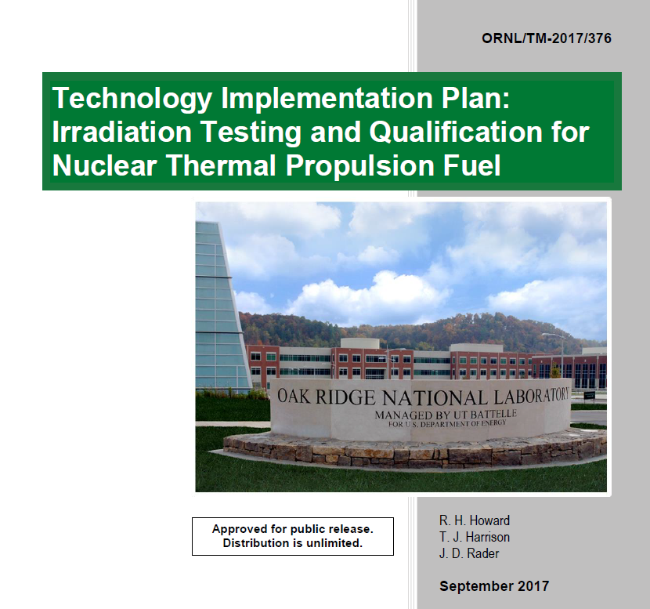
What does it mean to qualify the Breeding Blanket ?
Component qualification is an established and codified process in the fission industry:
it involves proving that it performs safely and reliably under all expected conditions.
When this process is applied to the BB, it implies proving:
Tritium Breeding Performance
Demonstrate TBR ≥ 1 through realistic testing of tritium production, extraction,
inventory, and control systems.
Irradiation Tolerance
Ensure structural and functional materials withstand high-energy neutron exposure
without unacceptable degradation (e.g. dpa, swelling, transmutation effects).
Thermal & Mechanical Stability
Prove heat removal efficiency and structural integrity under thermal cycling, gradients
and MHD/electromagnetic loads.
System Integration
Validate supporting systems: coolant loops, tritium handling, control, diagnostics
and related safety functions.
Lifetime Performance
Demonstrate long-term reliability, supported by failure statistics, ISI and
maintenance strategy validation.
Safety & Licensing Compliance
Ensure safe operation under normal and off-normal conditions;
Meet all regulatory standards for activation, shielding, and tritium containment.
WE KNOW WHAT TO DO, BUT HOW TO DO IT ?

Slide 6
Following the TRL scale for BB (nuclear) qualification
The Technology Readiness Level methodology defines a structured approach which is the most appropriate for FOAK technologies since it allows to:
  Incrementally detect unexpected phenomena that do not manifest at smaller or partially integrated scales.
  Validate hypotheses and models under increasingly realistic conditions.
  Collect data, refine models, and feed lessons learned back into design before scaling up.
  Gain confidence of regulators (but also investors and stakeholders) by systematically demonstrating the reliability and safety of the technology before full-scale deployment
The TRL scale defines increasing levels of system integration and environmental relevance, but these terms must be defined for each specific technology.
Present BB TRL level
In the following we will use the the denomination “Nuclear TRL” (NTRL) to underscore that we are looking at readiness to operate in a (fusion) nuclear environment.

Slide 7
NTRL dose ranges for a staged nuclear testing approach
NTRL | 14 MeV dose (dpa) | Description | Irradiation effects | Qualification targets
4 | 0.1 – 1 | Incubation effects | Initial neutron exposure phase. After a short incubation phase, material properties start to degrade very rapidly | Understanding of basic physical phenomena
5 | 1 - 3 | Onset of hardening and microstructural evolution | Early irradiation effects affect mechanical and physical behavior of structural and functional materials. Change in material properties start to stabilize. | Material properties
6 | 3 - 5 | Damage accumulation and coupling | Accumulated damage starts interacting with operational loads. Some material responses saturate or accelerate. | Materials compatibility and performance
7 | 5 - 10 | Onset of Advanced Degradation | Intermediate phase where irradiation and operational stresses synergize, further reducing safety and operational margins. | System functions
8 | 10 - 50 | Lifetime Extrapolation Effects | Late-stage damage accumulation; effects critical for long-term performance and reliability prediction. | System performances
9 | 50-150 | End-of-life fluence target | Damage saturation. | System qualified and in operation
Irradiation dose intervals have been defined as NTRL thresholds where different degradation mechanisms dominate.
These ranges capture irradiation phenomena from onset to saturation, ensuring understanding of material degradation and providing a framework to progressively develop and validate predictive models.
(M. A. Abdou, et al, (1984) FINESSE: A Study of the Issues, Experiments and Facilities for Fusion Nuclear Technology Research and Development, UCLAENG--84-30-Vol. No. 2, https://doi.org/10.2172/5507921)
5 dpa is identified as the boundary covering BOL effects. It is a lower target to identify and overcome early material degradation and failure modes.
10 dpa is identified as the lower target for system validation. It corresponds to a regime where degradation phenomena start to stabilize and system performance can be assessed reliably.
50 dpa is identified as the upper target for full blanket qualification, corresponding to the dose that allow full identification of degradation phenomena and extrapolation to “lifetime effects”.
150 dpa is identified as the upper target for a FOAK, corresponding to a blanket replacement time of 5 FPY assuming a neutron wall load of up to 3 MW/m². This was an “end user requirement” in the PPCS study.

Slide 8


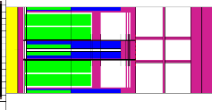


TRL 4-6: early-stage phenomenological and functional validation
REQUIREMENTS
GOALS
BOUNDARIES
TRL 4 – single effects experiment
➔Lab scale experiments
➔Pieces or sub-components
➔Simulated environment
(14 MeV-n optional)
Determine tritium production rates and nuclear cross sections for fusion-relevant degradation phenomena
Very low fluences to study materials compatibility
(0.1-1 dpa)
Integration of auxiliary systems not mandatory
MATERIAL PROPERTIES
(10-100 cm³)
TRL 5 – multi effects experiment
➔Lab scale/test-bench experiments
➔Elementary mock-ups
➔Relevant environment
(14MeV-n mandatory)
Study tritium extraction processes and efficiency
Assess compatibility of materials and degradation phenomena under neutron irradiation
Low fluences to study BoL effects (1-3 dpa)
Limited integration of auxiliary systems to reproduce gradients
MATERIAL PERFORMANCES
(1-10 dm³)
TRL 6 – technology demonstration
➔Engineering scale
➔Fully functional mock-ups
➔Relevant environment
(limited environmental factors and loads)
Validate integrated functions under combined loads
Identify early failure modes based on environmentally coupled interactions
Low fluence to overcome rapid changes in material properties
(3-5 dpa)
Integration of specific auxiliary systems mandatory
SYSTEM FUNCTIONS
(0.1-1 m³)
This is the so-called “valley of death” in the TRL scale

Slide 9
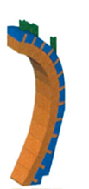
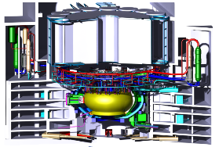
TRL 6-7: system integration, optimization and lifetime performance
REQUIREMENTS
GOALS
BOUNDARIES
TRL 7 – system validation
➔Prototype scale
➔Fully integrated system
➔Operational environment
(all environmental factors and loads)
Validate the performance of the selected BB concept
Compare different design variants in terms of statistical variability and failure probabilities
Moderate fluence to confirm reliability of operation
(5-10 dpa)
All auxiliary systems connected and in operation
SYSTEM PERFORMANCES
(1-10 m³)
TRL 8 – system complete and qualified
➔Fully representative system
➔Fully integrated system
➔Operational environment
(all environmental factors and loads)
Determine the full In-service behavior of materials and systems in an operational FPP environment
Demonstrate long-term reliability
ISI and maintenance strategy.
High fluence to extrapolate to lifetime effects
(10-50 dpa)
All auxiliary systems connected and in operation
SYSTEM LIFECYCLE
Qualification of C&S in irradiated conditions (irradiation creep, creep-fatigue interaction, fatigue crack growth, swelling…).
Qualification of representative manufacturing and assembly techniques.
Qualification of performances of auxiliary systems (T extraction).
Collection of statistical data on failure modes/frequencies for reliability analyses.
Qualification of I&C systems, diagnostics, maintenance tools and procedures.
Check for long-term corrosion effects (IA-SCC, corrosion fatigue, thinning).
Validation of ACP codes, activation of materials, tritium inventories and radioactive source terms for waste management.

Slide 10
Screening of Nuclear Fusion Facilities
The capabilities of existing and planned and proposed Nuclear Fusion Facilities (DONES, ITER, VNS, DEMO) were collected and matched to each TRL testing requirements.
Neutron fluence is not the only factor
FACILITY |  | PARAMETER OF INTEREST
 |  | Max. n-flux @FW (n.cm⁻².s⁻¹) | Avg. n-flux @FW (n.cm⁻².s⁻¹) | Max. NWL @FW (MW/m²) | Max. Availability | Max. Fluence | Test area (X x Y cm²) | Test Volume m³ (x test objs.) | Heat flux @FW (MW/m²) | Magnetic field (Tesla) | Integration of aux. systems | Integration of Instrumentation & Control
DONES MFTM 1-Beam | (w/ HFTM) | 8.30E+13 | 3.48E+13 | 0.3 | 70% | ~3 dpa/fpy | 40x40 | 0.096 (x1) | No/TBC | No/TBC | Specific to testing objectives (not fusion relevant) | Specific to testing objectives
DONES MFTM 2-Beams | (w/ HFTM) | 1.66E+14 | 6.96E+13 | 0.6 | 70% | ~6 dpa/fpy | 40x40 | 0.096 (x1) | No/TBC | No/TBC | Possible (to be explored) | Possible (to be explored)
ITER DT1 |  | 3.21E+14 | N/A | 0.75 | N/A | 0.02-0.03 (@EOL) | 46x167 | 0.53 (x2) | 0.32 | ~3.8 | Included (not full performance) | Tailored to TBM testing goals
ITER DT2 |  | 3.21E+14 | N/A | 0.75 | N/A | 2-3 (@ EOL) | 46x167 | 0.53 (x2) | 0.32 | ~3.8 | Included (not full performance) | Tailored to TBM testing goals
EU Pilot Plant (VNS) TBM |  | 1.10E+14 | 9.80E+13 | 0.5 | 40% | ~5 dpa/fpy | 106x111 | 0.7 (x4) | ~0.03 | ~4.5 | Mandatory | Tailored to TBM testing goals
EU Pilot Plant (VNS) Segment |  | 1.10E+14 | 9.80E+13 | 0.5 | 40% | Max ~5 dpa/fpy Avg. ~3 dpa/fpy | 178x49 | 0.52 (x12) | ~0.03 | ~4.5 | Mandatory | Operational
EU-DEMO Segment |  | 6.10E+14 | 5.37E+14 | 1.1 | 30% | Max. 10.6 dpa/fpy Avg. 8.8 dpa/fpy | 1245x160 | 173 (x80) | ~0.3 | ~3.7 | Mandatory | Operational
-) For DONES, we considered operation of the Middle Flux Test Module, with one or two deuteron beams.
-) For the ITER-TBM, we considered separately the DT-1 and DT-2 ITER phases.
-) For the proposed EU Pilot Plant, we considered the present VNS design as developed in EUROfusion.

Slide 11
The Role of Facilities
Facility | NTRL 4 | NTRL 5 | NTRL 6 |  | NTRL 7 | NTRL8 | NTRL 9
MTRs
ITER-TBM / DT-1
DONES |  |  |  | A
ITER-TBM / DT-2
VNS^{(*)}-TBM
VNS^{(*)}-Segment
FOAK |  |  |  |  |  | ● | ●
The contribution of the different nuclear facilities for the qualification of the BB has been reassessed considering a FOAK commercial reactor at level 8 and 9 of the (N)TRL scale.
(*) Or equivalent CTF/Pilot Plant based on a 14MeV VNS-like plasma neutron source.
 | Facility has technical capability to address the full NTRL objective
 | The facility can achieve only together with other facilities indicated the NTRL objective
 | The facility can contribute but cannot achieve alone the NTRL objective
 | The facility lacks the capability to address the NTRL objectives
● | The facility must have the technical capability to reach the objective, which is still unproven
A
NTRL 4 can be achieved today through MTRs and spallation sources, providing early material and tritium production data but cannot properly address the fusion-specific degradation modes.
NTRL 5 can be achieved in DONES (or equivalent 14MeV n-sources), enabling validation of material performance and functions. ITER TBM / DT-1 fluence is insufficient.
NTRL 6 requires both ITER TBM/ DT-2 and DONES to test both at relevant fluences and required integration. TBM testing in a Pilot Plant (or an equivalent CTF/VNS) could achieve the same goals faster.
There is currently no existing or planned facility to achieve NTRL 7 (and NTRL 8).
A Pilot Plant (or an equivalent VNS/CTF) is required al NTRL 7 and, if able to reach “reactor relevant” fluences, could also contribute to TRL8.

Slide 12
What are the potential consequences of “skipping” TRLs ?
Increased costs and delays: failure at full-scale tests is vastly more expensive and time-consuming to redesign or modify components than if the issues were detected at smaller scales.
“Catastrophic” failures: large-scale or integrated prototypes are more likely to suffer catastrophic failures because of the many interdependencies between different sub-systems.
Regulatory and licensing challenges: regulators require stepwise evidence of reliability, safety, and performance. Gaps in TRLs make it difficult to provide the necessary supporting documentation.
Missed “lessons learned” opportunities: each TRL stage provides structured feedback and lessons learned. Missing stages means losing critical insights that could inform design improvements and risk mitigation strategies.
Exponential increase of risk: risk is usually expressed as the product between the probability (P) and the impact (I) of failure (R=P x I). Skipping TRL increases P and the impact at high TRLs is much greater. The overall risk increases therefore non-linearly.
The TRL approach is not only a technical framework to increase the likelihood of success but also a
critical risk-management strategy, ensuring that "unknown unknowns" are identified and addressed
at stages when the costs and consequences of corrections remain manageable.

Slide 13
(Optimal) Facility requirements to achieve NTRLs 7-8
Provide an “operational environment”, i.e. all the relevant loads, boundary conditions and operational states of a Fusion Power Plant.
Allow for testing of “fully representative” Blanket segments, integration and testing of I&C systems, ISI and remote maintenance and repair procedures.
To provide minimal load values to allow for meaningful engineering extrapolation (factor of x2-x3 on loads)
 | TRL 7 | TRL 8 | TRL 9 (FOAK targets)
NWL | 0-3-0.5 MW/m² | 0.5-1.5 MW/m² | 1-3 MW/m²
EOL fluence | 10-20 dpa (to overcome BOL effects and allow for sequential testing) | 50 dpa (to allow for extrapolation to EOL effects) | 100-150 dpa
Pulse length | >30 min (to reach thermal steady state) | 2-4h (to allow demonstration of net electricity production) | 4h-steady state
Tritium fueling | External (to allow for failure or underperformance of BB) | External / Self-sufficiency (self-sufficiency must be proved) | Self-sufficiency
Nota:
-) TRL 8 requirements are derived from EU DEMO studies
-) TRL 9 requirements are derived from the EU PPCS study
D. Maisonnier, et al.DEMO and fusion power plant conceptual studies in Europe, Fus. Eng&Des, 2006.

Slide 14
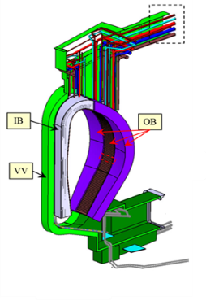
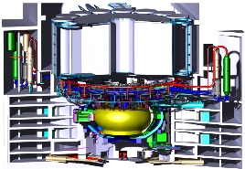
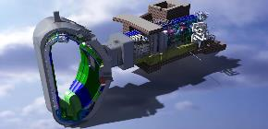

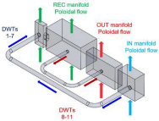
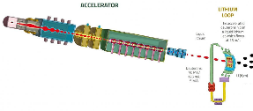

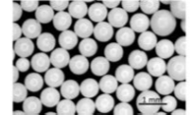


Conclusions: Nuclear Facilities for the Qualification of the BB
8 | Actual system completed and qualified through test and demonstration
Pilot Plant/
DEMO/CTF/ VNS
7 | System prototype demonstration in an operational environment
ITER/BEST
6 | System/subsystem prototype demonstration in relevant environment
5 | Component and/or breadboard validation in relevant environment
IFMIF-DONES
14MeV
n-sources
4 | Component and/or breadboard validation in laboratory environment
Fission MTRs,
spallation sources
1 -3 | Proof of concept (lab studies)

