Slide 1
Briefing
PSD Management Meeting
M. Wischmeier
Plasma Science for ITER, DEMO and stellarators department → PSD
30th of September 2025

Slide 2
Topics for discussion today
Need to re-confirm JT-60SA scientific exploitation budget requirements for 2026/2027
  Aim to provide PM with input for GA and receive a timeline when this budget will be available
  Internally at EUROfusion clarification required on funding of possible control room roles for JT-60SA <-> TRED
  Grey area is funding to participation of integrated commissioning – to be clarified also with F4E
  Hand over of diagnostics/enhancement projects from SA to TE and associated funding at which point (if any) of the becoming operational → need some clarification / document by WP SA and WP TE – funding of diagnostics in next 2 years under SA until commissioning → need of assessment of – topic is connected to discussion on working group activities.
JET data access – currently at EC awaiting feedback and news on progress
Call for deputy PWIE WP leader extended to October 20th
Call for WP TE DTFL extended to October 20th
WG on Fusion Pilot Plant for EUROfusion with 3 sub groups:
1) Fusion Pilot Plant(H. Zohm/F.Villone) 2) Physics Gaps to DEMO including Pilot Plant and Stellarator (M. Wischmeier / M. de Baar + D. Borba, A. Loarte, M. Jakubowski) 3) Nuclear Qualification and Tritium Availability (K. Hesch, J. Elbaz-Uzan):
  Physics: ITER likely to reach SRL 7 with largest uncertainty in impurity transport and alpha particle physics
  Under investigation now 3 phases of ITER – by when will ITER reach SRL 7 and how does the uncertainty change in time
  Assessment of Stellarator line in progress and need for device between W7-X and Stellarator DEMO likely (physics group to identify 4-5 areas were uncertainty is largest and a device would need to address to complement W7-X)
Meeting on uncertainty qualification in PSD² on Oct 1st → define how best to proceed

Slide 3
Project Board
PB lunch to lunch 27-28/10/2025 for Physics; engineering/DEMO is 28-29/10/2025
21/10/2025: PSD Management Meeting as Preparatory Meeting for Project Board
“Rumors”about PMP/PEP…
Not heard a definite request of how the project board shall unfold
PSD position:
  day 1 as summary of 2025 activities and status update on deliverables
  Day 2 outlook overall selection presentation to the PB from call & information on specific activities for 2026
  We need to be able in the course of 2026 to identify possible areas of underspending and need for financial resources across work packages
Project Change requests:
  Additional budget for WP PWIE DPL ( so that it is not taken from the general budget)
  ~ 6 PM for assessment of DTT Research Plan alignment with future EUROfusion needs also following the EU strategy (to be published end of 2025) and the outcome of the pilot plant working group

Slide 4
Status of news items
WP | News item expected | PL/TFL reminded | Draft received | Sent to COM | Published by COM | Title of news item
TE | 10/07/2025 |  | 09/07/2025 | 10/07/2025 | 17/07/2025 | ADC
SA | 25/07/2025 | 22/06/2025 | 25/07/2025 | 25/07/2025 | 19/08/2025 | diagnostic installation (TS)
TE | 10/08/2025
W7X | 25/09/2025 |  |  |  |  | cancel
TE | 10/09/2025 |  |  |  |  | Cancel → maybe on Rt-04
BEST | 25/09/2025 |  |  |  |  | Yevgen to prepare on the BEST RP
PWIE | 17/10/2025 |  |  |  |  | Delay to november
W7X | 25/10/2025 |  |  |  |  | cancel
TE | 10/11/2025 |  |  |  |  | This could be news on the Programme Meeting
SA | 25/11/2025
TE | 10/12/2025
W7X | 25/12/2025
2 news items from W7X happened in summer → BM to label them in the table

Slide 5
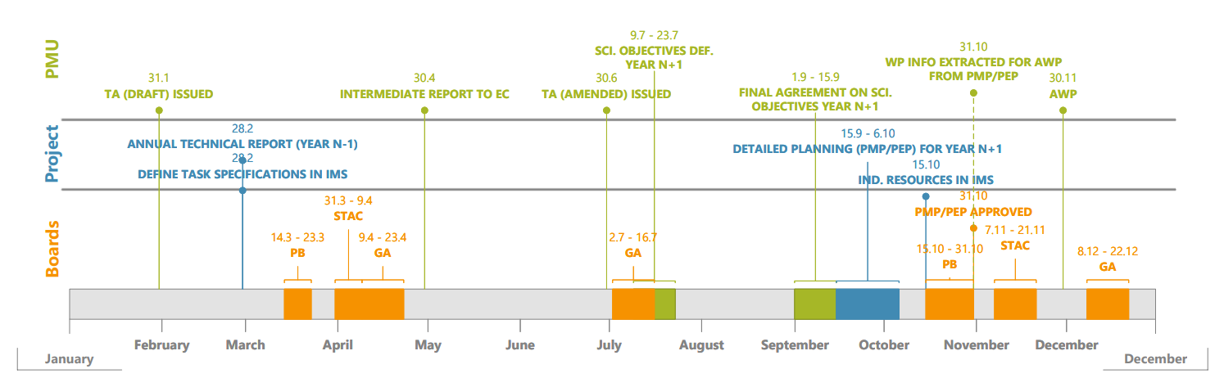
3.1 - Planning of events - EUROfusion calendar
Upcoming events
52nd Bureau meeting | 22 September 2025 | Prague, Czech Republic
52nd General Assembly meeting | 7-8 October 2025 | Remote
53rd Bureau meeting | 14 November 2025 | Remote
53rd General Assembly meeting | 16-17 December 2025 | Saariselkä, Finland

