Slide 1


WPSA report 2025-11-25
EUROfusion PSD Management Meeting
Carlo Sozzi

Slide 2
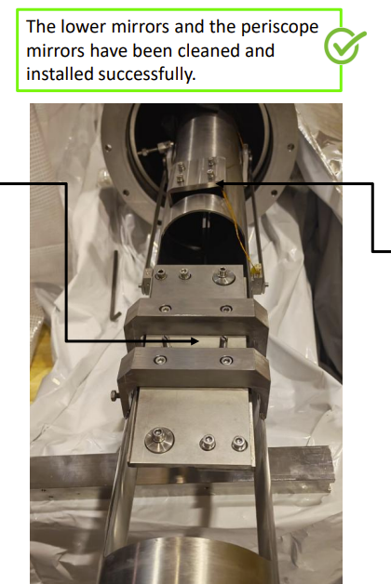
WPSA news
Systems under installation:
Divertor VUV spectrometer: in ENEA Frascati, date for final acceptance 15-18 Dec. System being assembled using one CCD camera instead of two. Second one will be installed when the system is in Naka.
MGI did still not passed He leak test. (critical line for installation in ME1 according to the present plan). New tests planned with new seals (annealed copper and rubber seals). Final acceptance planned for February 2026.
Edge TS port plug installation planned for March 2026. Synthetic diagnostics for polychromator set-up (gains) completed. Details for spatial and absolute calibration being finalized.
Others
EDICAM: software upgrade planned for 15-30 November 2025 ongoing. One of the two PCs needs replacement (CPU failure). Substitution (and team visit to complete the upgrade being organized)
Training event for the Pulse Design Tool being organized
Divertor VUV
Edge TS optics arm

Slide 3
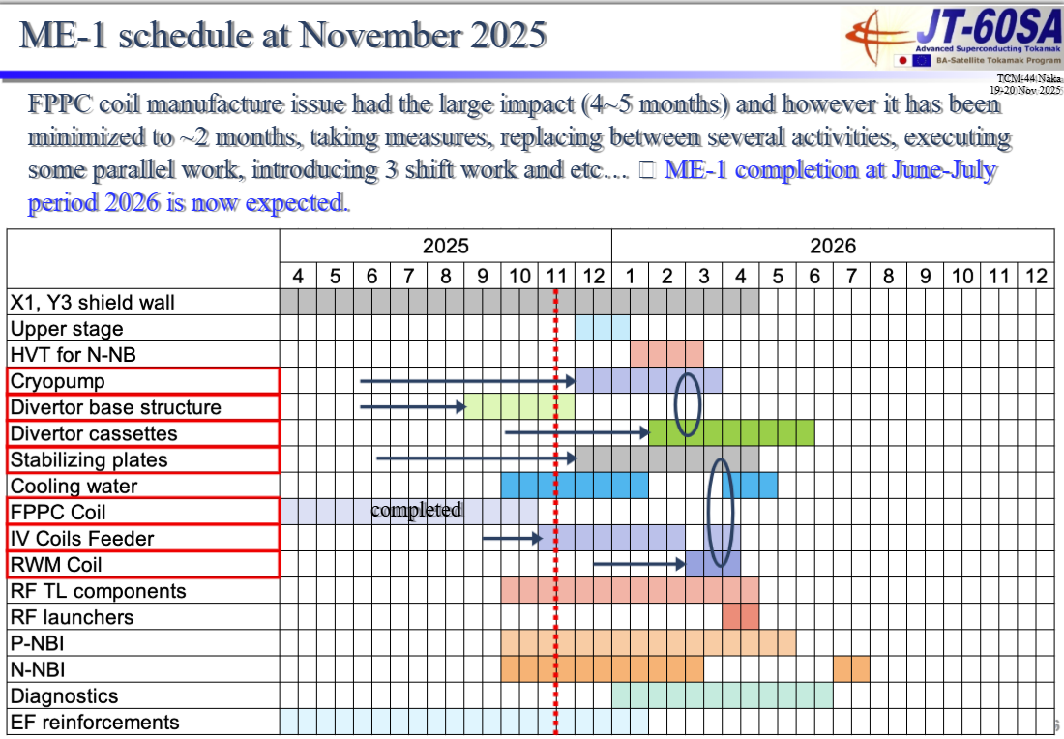
JT-60SA: ME-1 updated schedule

Slide 4
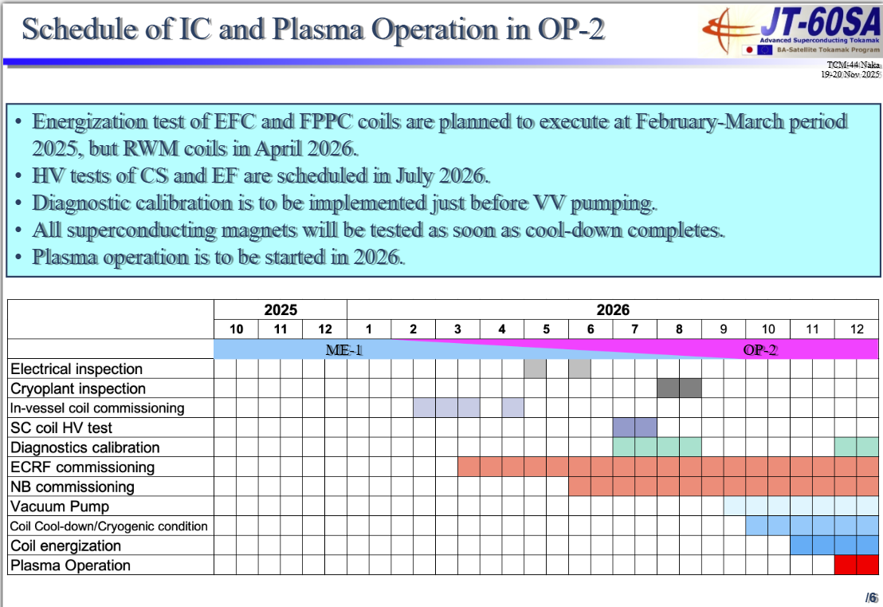
2026 commissioning time line (still provisional)

