Slide 1


Compact Neutron Spectrometer
2025 WPSA Progress Meeting
D. Rigamonti on behalf of the WPSA Enhancement neutron team
Institute for Plasma Science and Technology, National Research Council of Italy, Milan, Italy

Slide 2
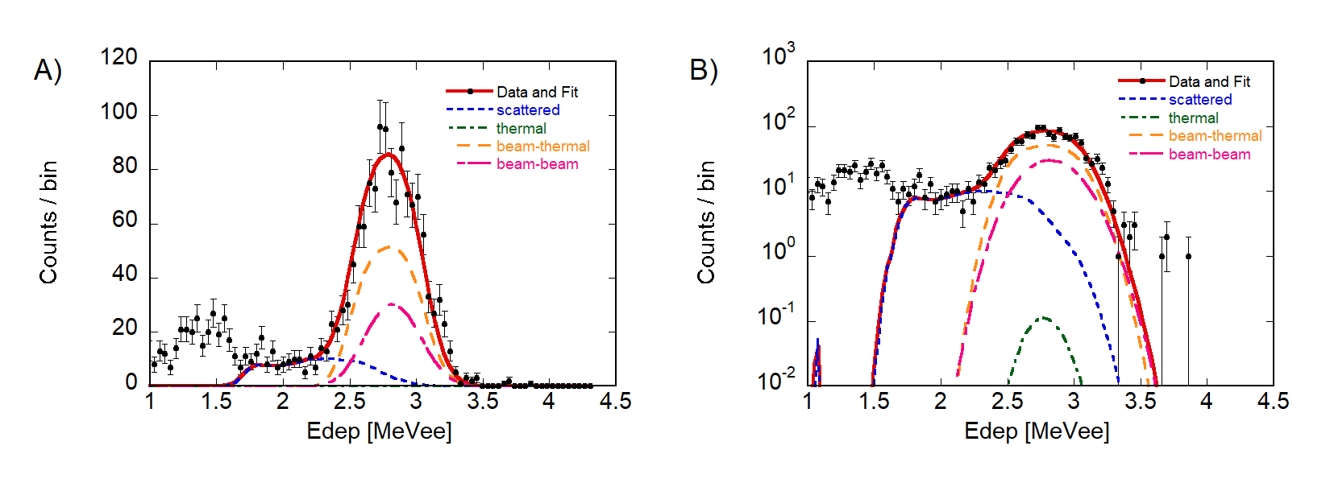
Motivation and scientific background
Feasibility and conceptual design of compact 2.5 MeV neutron spectrometer.
Motivation and scientific background
Time-of-Flight detector is the state of the art 2.5 MeV neutron spectrometers but -> it cannot be installed at JT-60SA due to space limitations.
Standard organic scintillators are not an option for spectroscopy.
Chlorine-based scintillators open up to compact and easy solutions.
Chlorine based scintillators
Detection of DD neutrons mainly based on ³⁵Cl(n,p)³⁵S nuclear reactions.
Neutron/gamma discrimination via pulse shape discrimination (PSD)
CLYC has better PSD but slower signal (a few us)
LaCl₃ has better energy res. faster signal (150 ns) but more challenging PSD
The use of CLYC already demonstrated on EAST and ASDEXu
Measured neutron spectrum at EAST with CLYC detector.
D. Rigamonti et al.2019 JINST 14 C09025

Slide 3
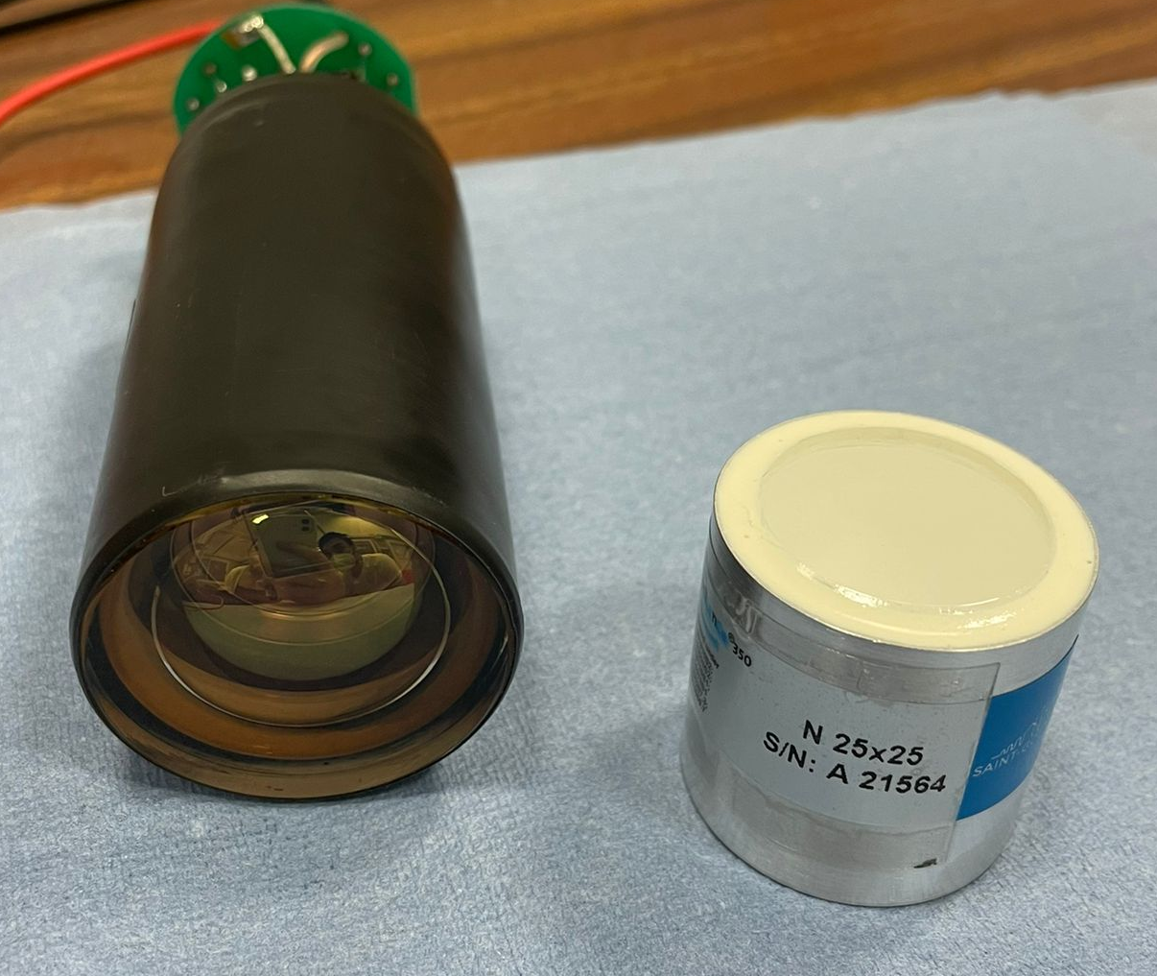
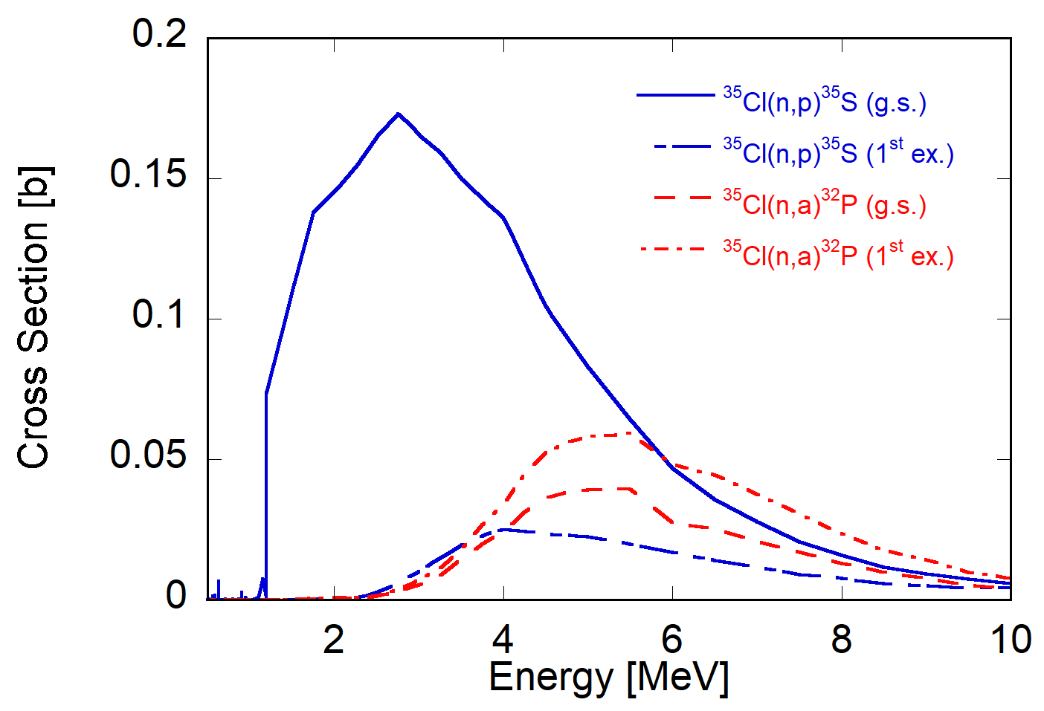
Compact Neutron Spectrometer for JT-60SA
LaCl₃ scintillator coupled to a photomultiplier tube (PMT) in then shared collimator proposed by Dr. S. Sumida in P12.
LaCl₃ exploits n-p reactions with ³⁵Cl (as for the CLYC scintillator)
High energy resolution (49000 ph/MeV)
Fast scintillation (28 ns) -> higher count rates
n/γ discrimination with enhanced algorithm
Picture of a PMT and a LaCl₃ scintillator.
n-³⁵Cl cross sections.

Slide 4
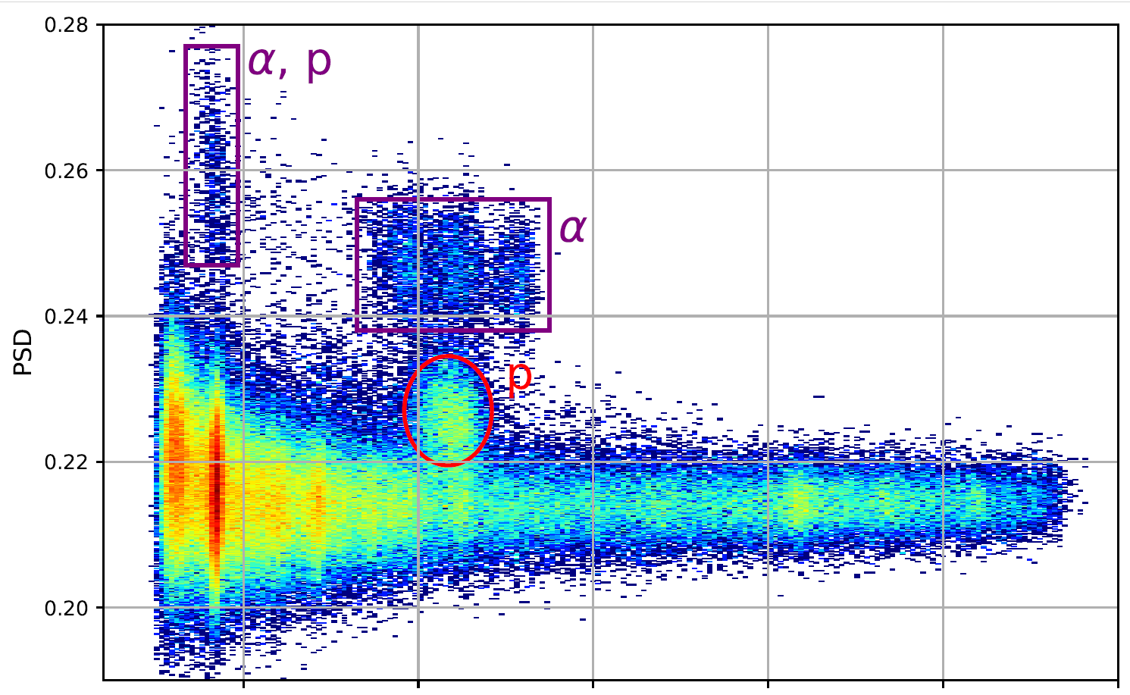
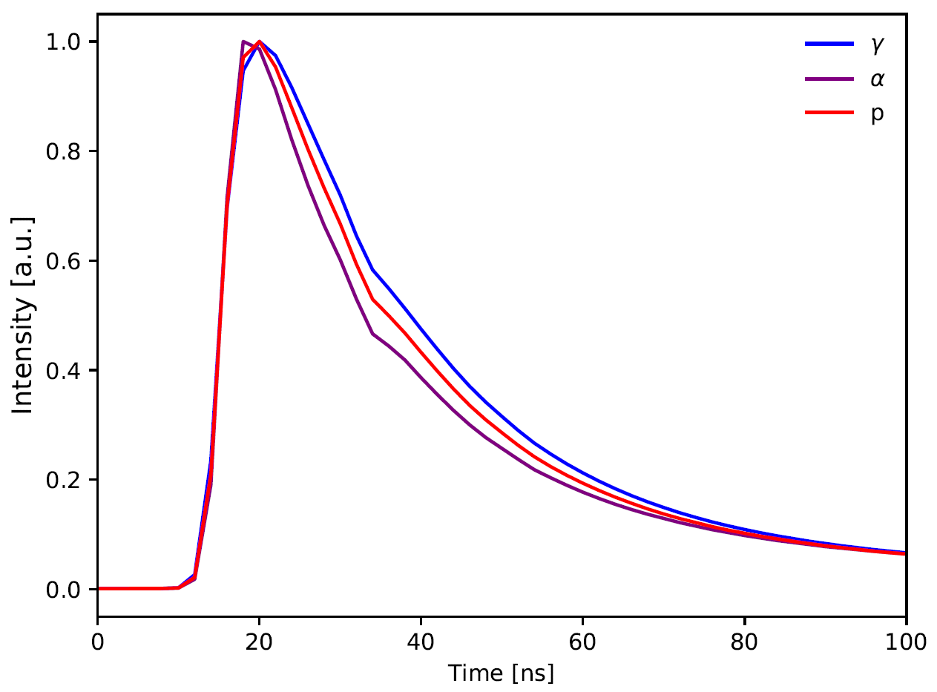
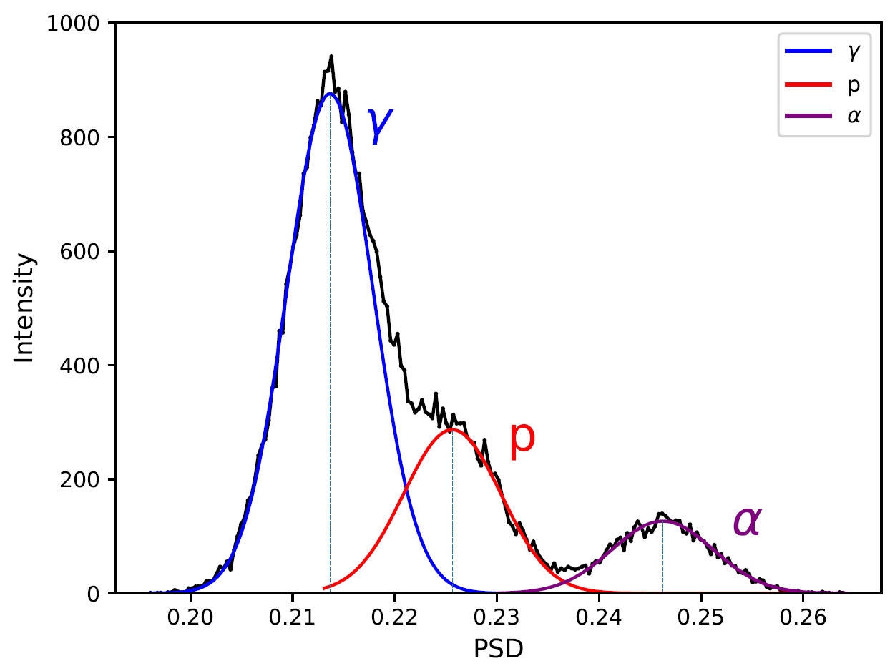
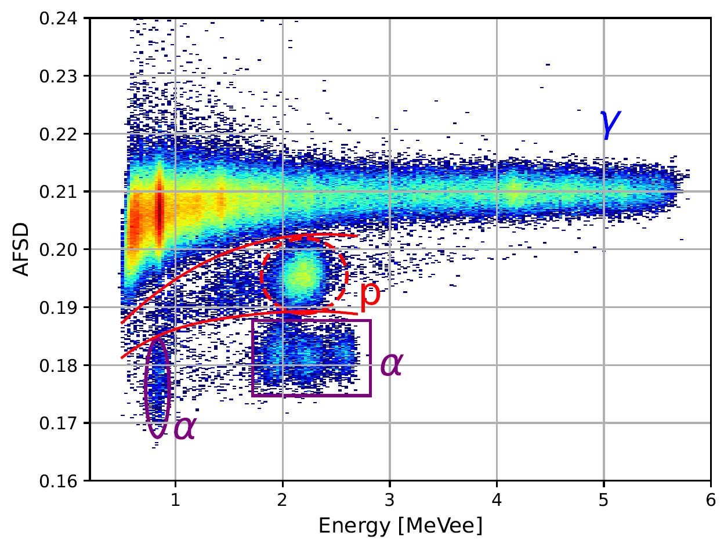
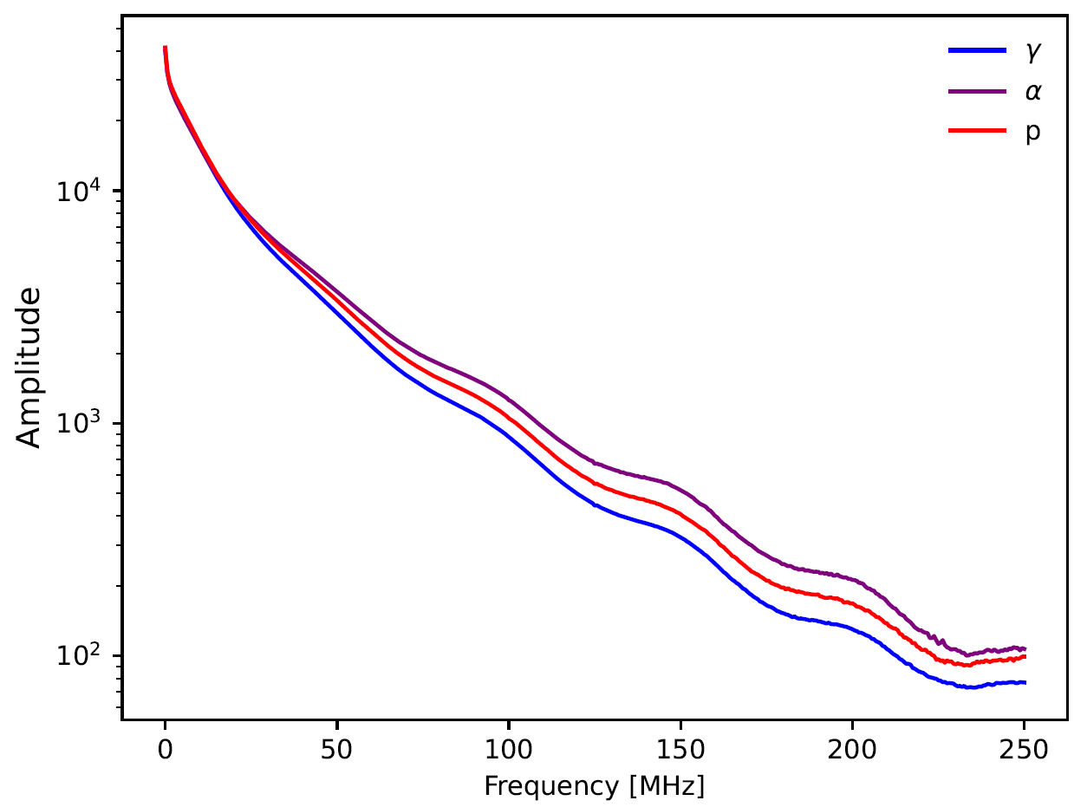
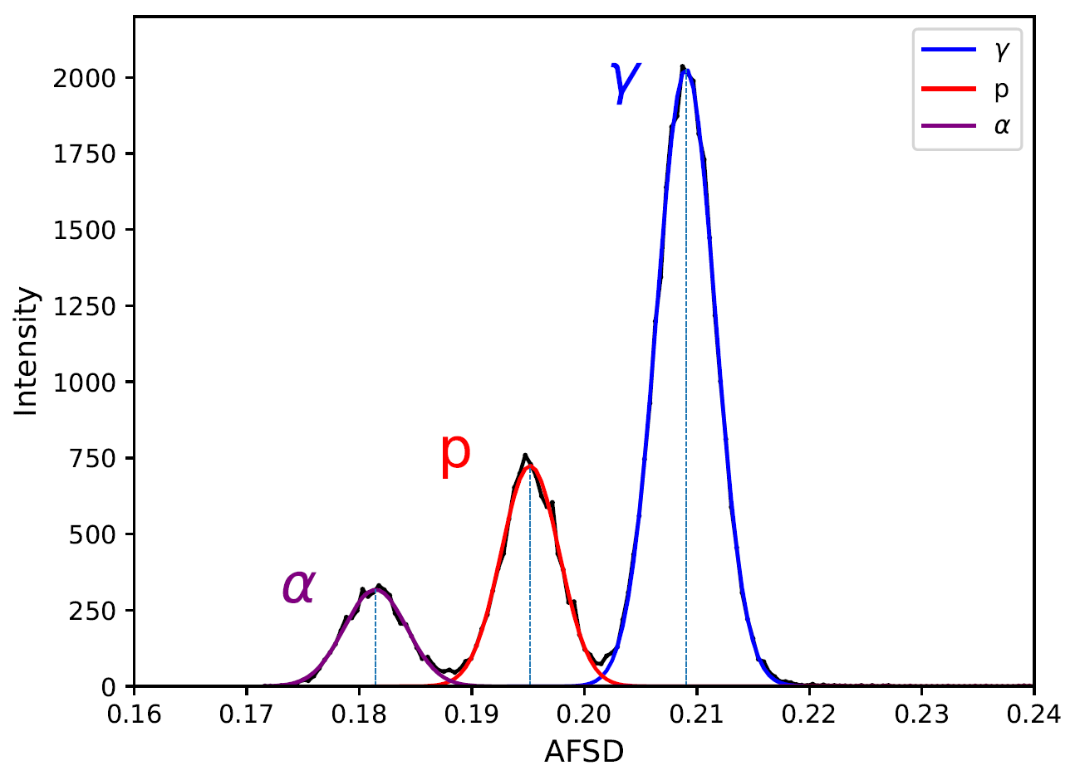
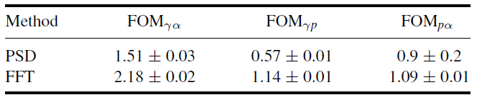
Enhanced algorithm for particle discrimination
Standard PSD
Enhanced algorithm based on FFT
Short gate
Long gate
waveforms
FOM
Very promising!
FFT of the waveforms
FOM
Table: Summary of the Figures-Of-Merit obtained with standard PSD and FFT methods.
D. Rigamonti et al.,Meas. Sci. Technol. 36 (2025) 015907 (8pp) https://doi.org/10.1088/1361-6501/ad8f4e
(+ neural network)

Slide 5
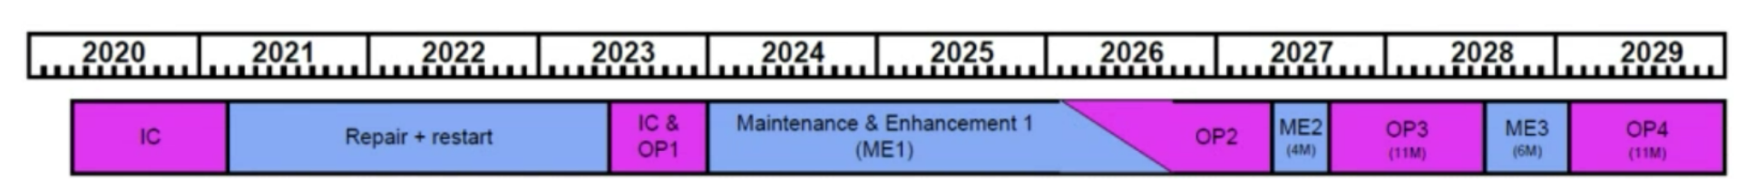
Compact Neutron Spectrometer for JT-60SA
The proposed solution is to install a LaCl₃ scintillator coupled to a photomultiplier tube (PMT) in then shared collimator proposed by Dr. S. Sumida in P12.
Diagnostics | Neutron energy spectrometer (NES) | Gamma-ray spectrometer (GRS) | Neutron energy spectrometer (NES)
Target | N-NBI fast D ion | D-³He fusion α particle | N-NBI fast D ion
JA or EU | JA | EU | EU
Detector | CLYC-7 One option : delivery from LHD | LaBr₃(Ce) | LaCl₃(Ce)
Characteristics | Well established Long time resolution of ~1 s |  | First try (AUG and MASTu) in 2025 Fast detector
Desirable installation timing | M/E2 | M/E2 | ≧M/E3
NES (JA)
GRS (EU)
NES (EU)
From Dr. Sumida

Slide 6
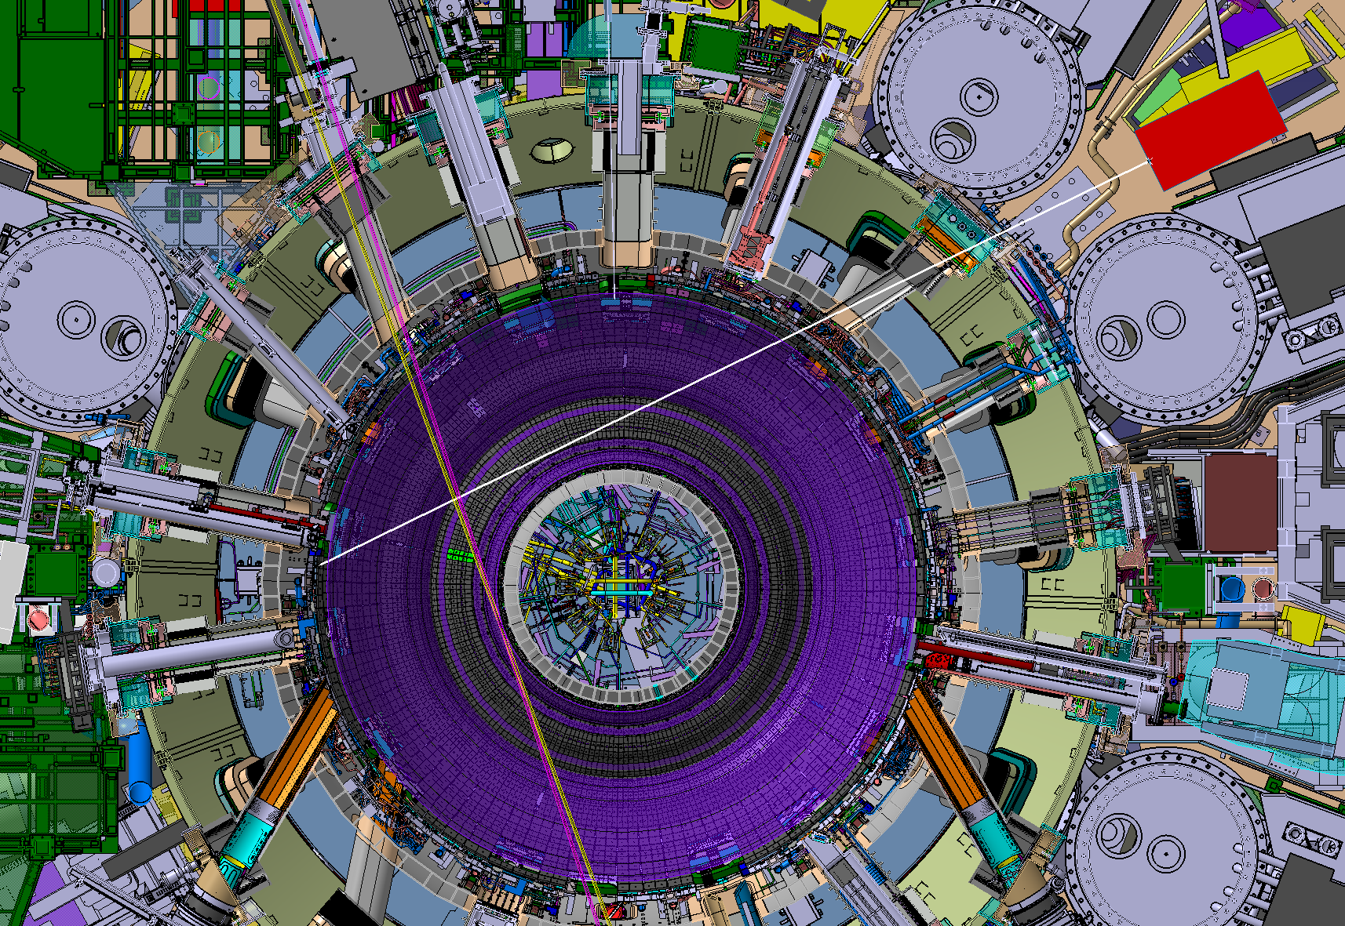
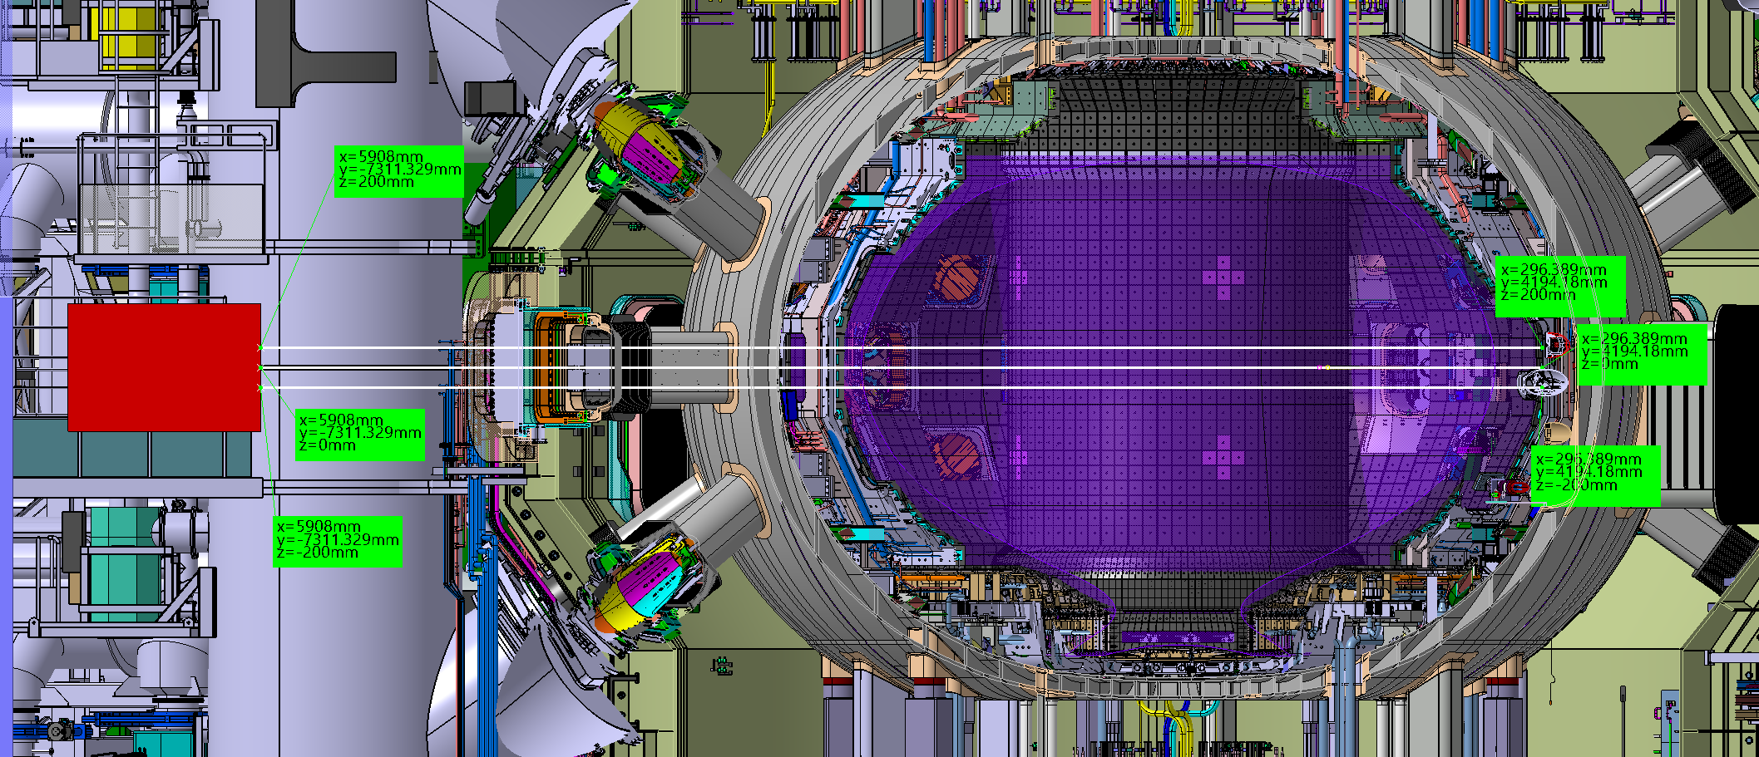
Compact Neutron Spectrometer for JT-60SA
Collimator
P-12
Collimator
P-12
Line of sight
Lines of sight
R = 9.4 m
Side view
R_{tan} = 2.105 m
N-NBI
Top view
Possible interferences between NES LoS and EDICAM need to be assessed.
Collimator inside the Torus Hall -> long cable, e.m. noise to be studied.
From Dr. Sumida

Slide 7
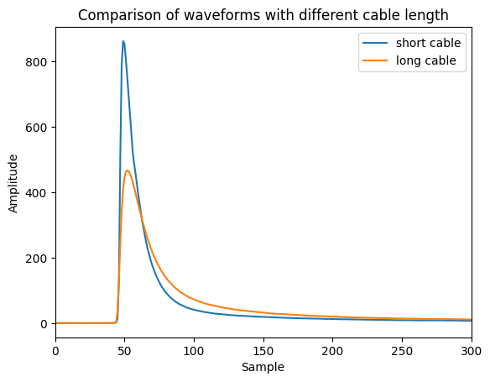
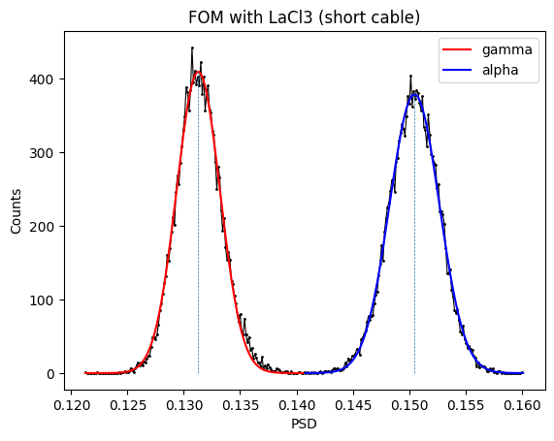
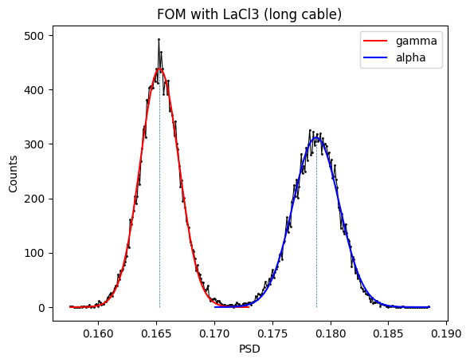
Effect of long cable on particle discrimination
Long cables smooth the signals, potentially compromising the particle discrimination.
Tests with 100 m long cable has been performed.
No significant degradation has been found in terms of FOM.
FOM≈2
FOM≈1.8
Example of waveforms recorded with short and long cables.
Figure of Merit with short cable.
Figure of Merit with 100 m long cable.

Slide 8
Effects of e.m. noise on particle discrimination
Measurements done with 2.5 MV neutrons at neutron facility.
Poissonian noise added offline to the recorded waveforms.
Example of waveforms with and without poissonian noise.
e. m. noise can definitely affect the particle discrimination!

Slide 9
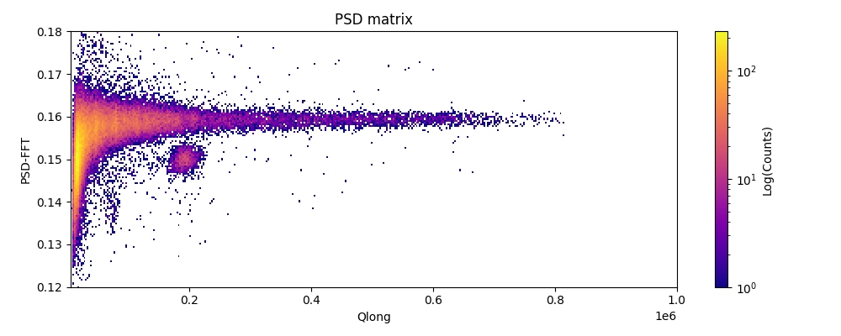
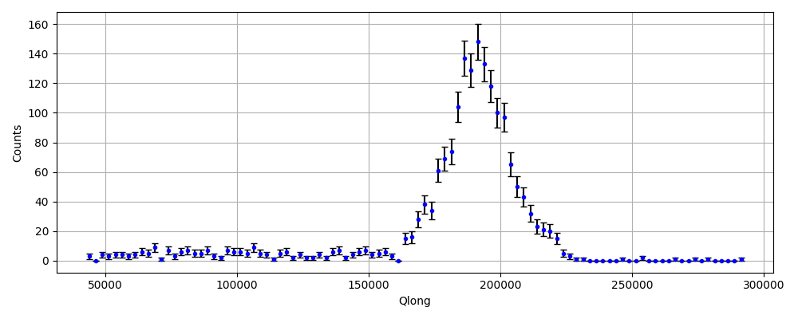
Relevant consideration in view of JT-60SA
Two LaCl₃ detectors have been recently installed on ASDEXu and MAST-U within the WPTE-Enhancement project.
The detectors have been successfully tested and used in plasma experiments.
Preliminary analysis shows that the detector performances are not compromised when used on a tokamak!
PSD-FFT
Counts
Neutron peak
Energy [a.u.]
Energy [a.u.]
PSD matrix measured with the LaCl₃ at MAST-U
Neutron peak measured with the LaCl₃ at MAST-U

Slide 10
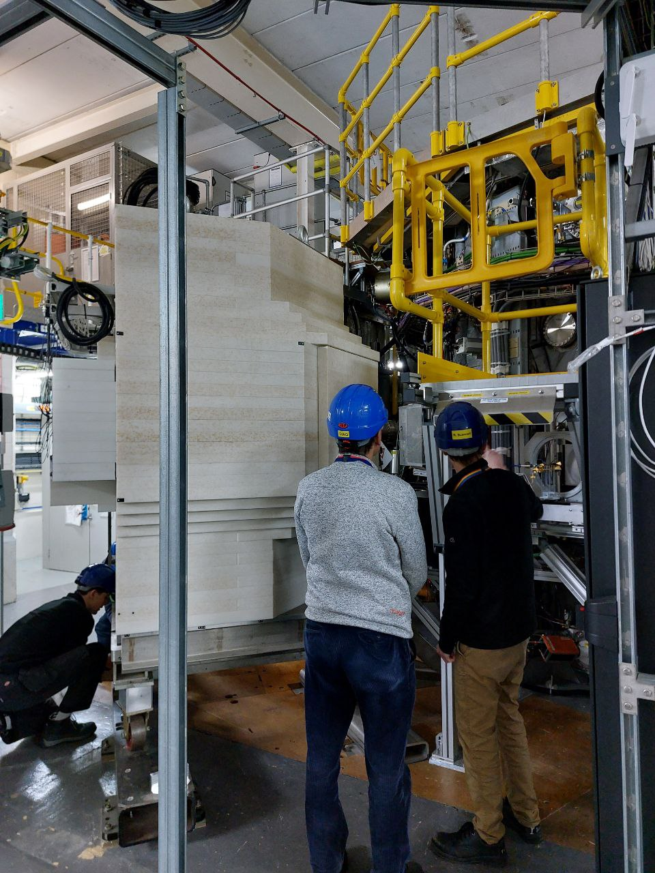
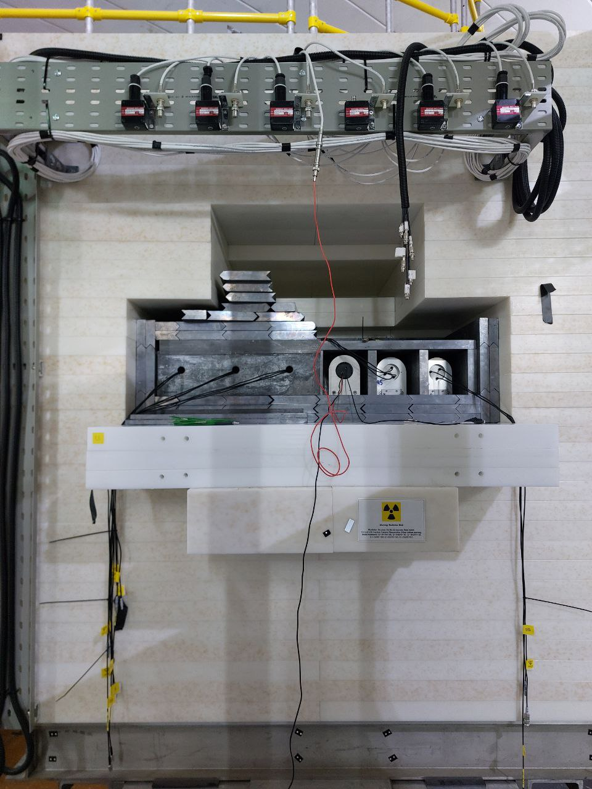
Relevant consideration in view of JT-60SA
The MAST-U enhancement is particularly relevant for JT-60SA since the detector has been installed in a shared neutron collimator inside the Torus Hall - similar to the one under design for JT-60SA - with 30 m long cable.

Slide 11
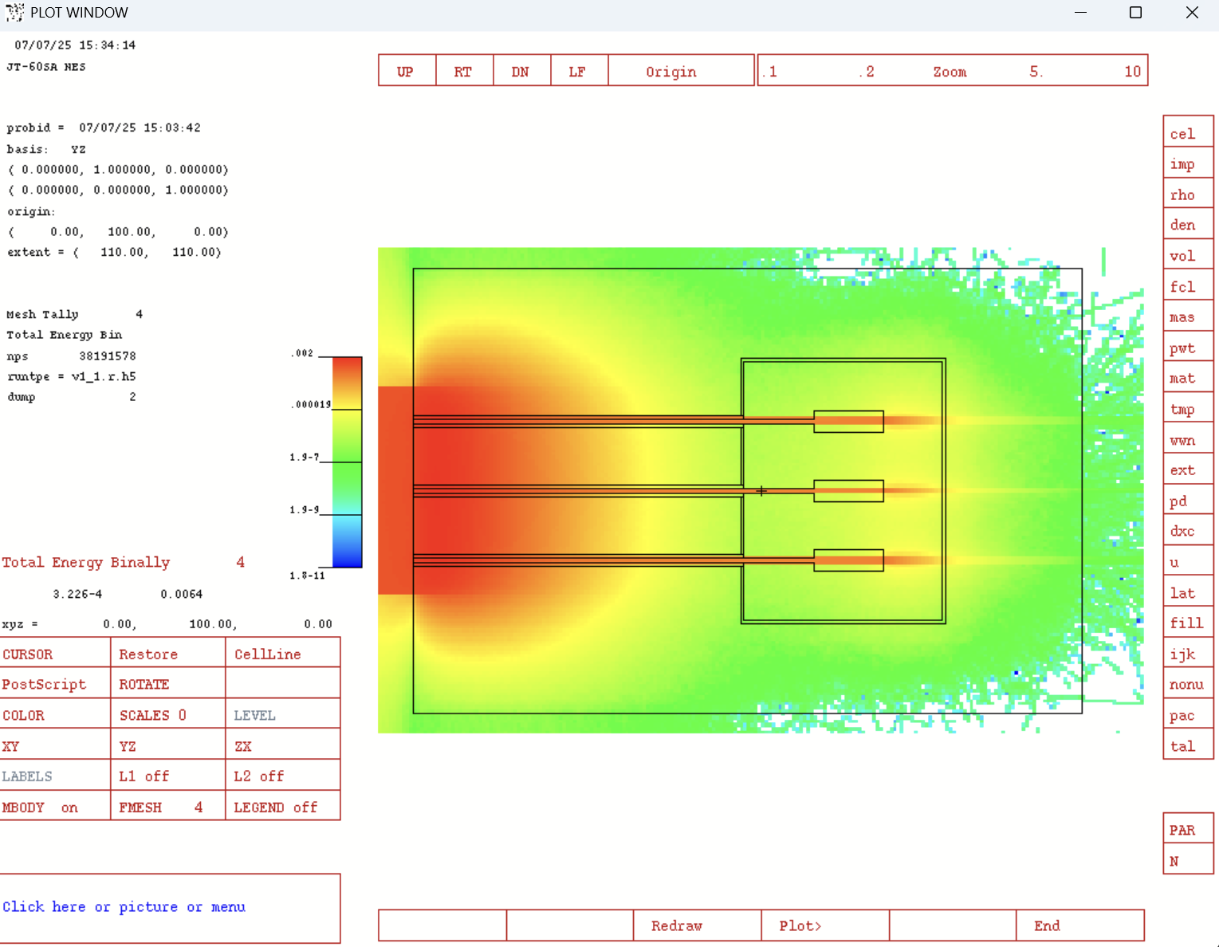
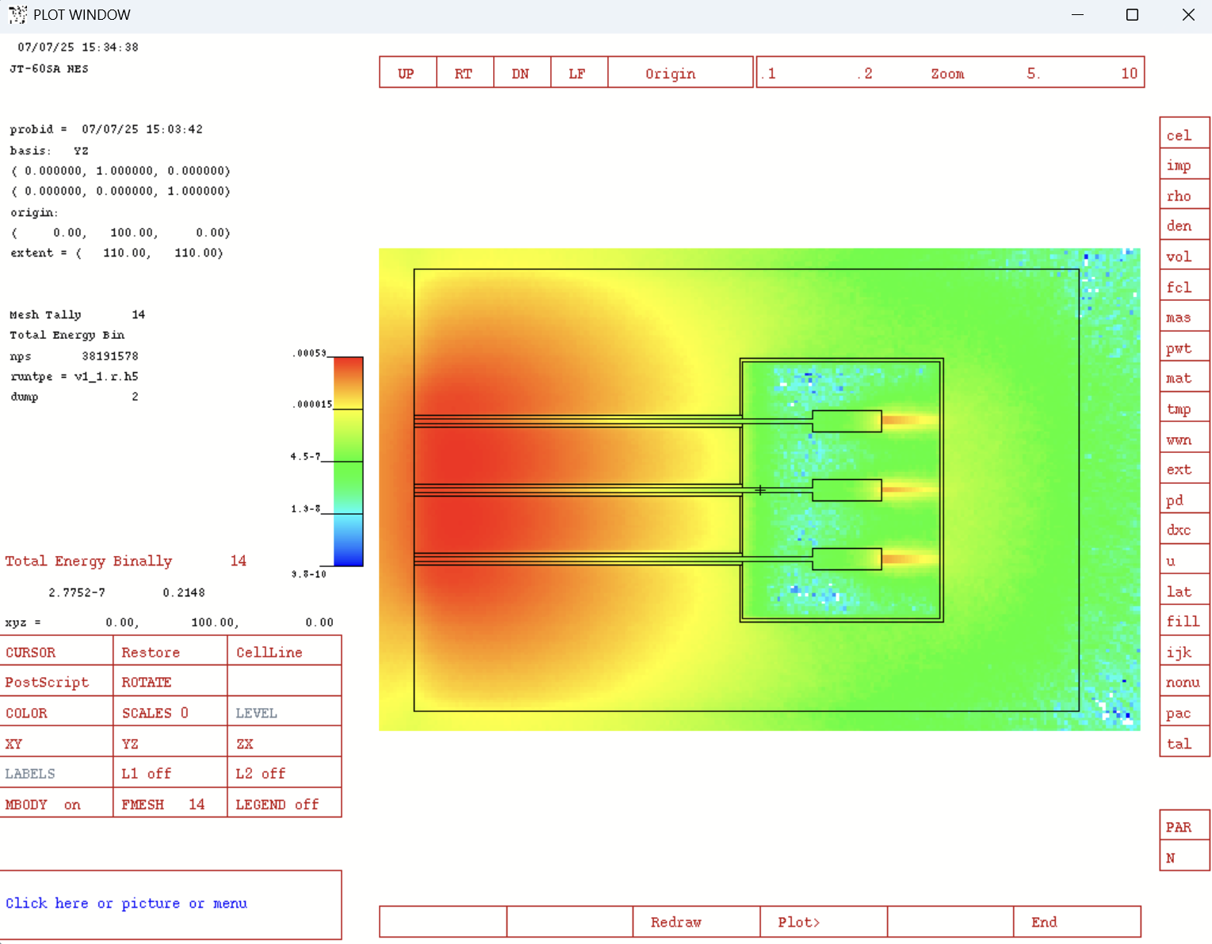
Shared collimator
A preliminary design of the collimator has been done by the Japanese colleagues.
In Milano we modelled in MCNP the collimator to check the performances.
The activity is still on going. The aim is to check performances, define the collimator size and detector box size.
Preliminary analysis!
Thanks to S. Colombi

Slide 12
Open questions and future plans
Open questions
Magnetic field at the detector position.
Confirm the coordinates of the collimator (and MCNP model of JT-60SA)
The activity is still on going. The aim is to check performances, define the collimator size and detector box size.
DAQ and LED system.
Future plans
Perform the first calculations of the expected DD neutron fluxes at the position of the NES(EU) in P12 and the expected energy spectra.
Complete the design of the line of sight.
Assess the interferences with EDICAM and try to solve them.

Slide 13
Thank you

