Slide 1
Reducing turbulent transport in tokamaks by combining up-dwn asymmetry and the low momentum diffusivity regime
Haomin Sun^{1*}, Justin Ball¹, Stephan Brunner¹, Anthony Field², Bhavin Patel², Alessandro Balestri¹, Daniel Kennedy² and Colin Roach², Eleonora Viezzer³, Manuel Munoz³, Diego Zabala³
¹Swiss Plasma Center, EPFL
²CCFE, Culham Science Centre, Abingdon, Oxon, UK
³University of Seville, Seville, Spain
TSVV2 annual meeting, 16 October 2025
October 2025

Slide 2
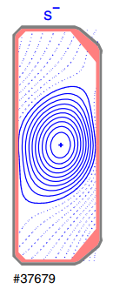
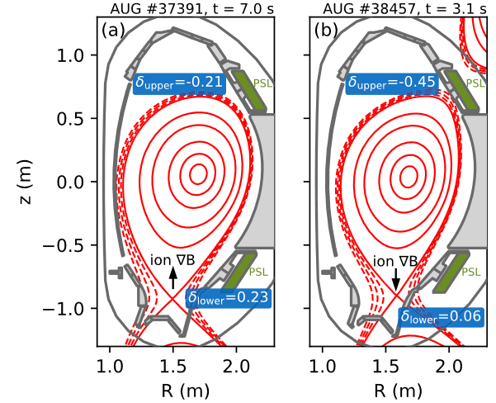
Obtaining up-down asymmetry by changing upper and lower triangularity
[Happel et al. 2023]
[Camenen et al. 2010]

Slide 3
Outline
Introduction
Suppression of turbulence by flow shear
Generating flow shear using up-down asymmetry
Results
The Low Momentum Diffusivity (LMD) regime
Turbulence stabilization using LMD and up-down asymmetry
Practical applicability study using up-down asymmetric experimental geometries
Recent progress on Prandtl number in electromagnetic turbulence
Conclusions

Slide 4
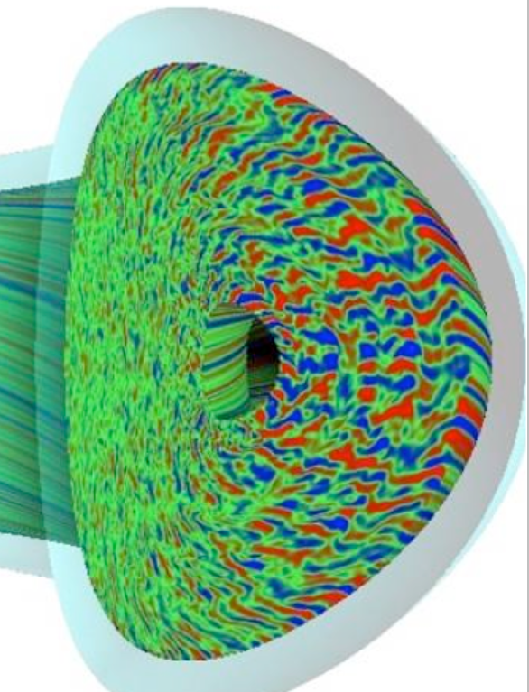
Introduction

Slide 5
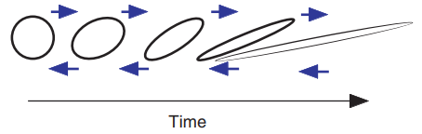
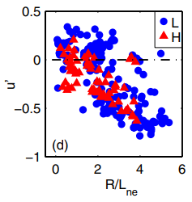
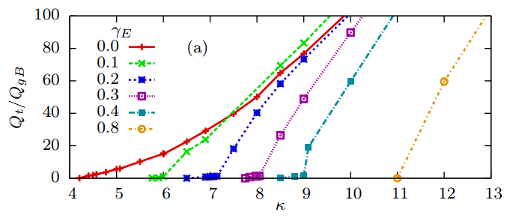


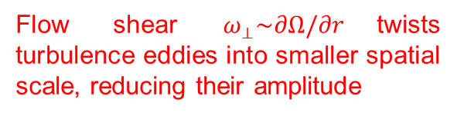
Suppression of turbulence by flow shear
Flow shear $ω_{⊥}\sim ∂Ω/∂r$twists turbulence eddies into smaller spatial scale, reducing their amplitude
ASDEX-U Experiments
Gyrokinetic Simulations
$$ω_{⊥}$$
$$ω_{⊥}$$
Increasing flow shear
$$ω_{⊥}$$
Heat Flux
Heat Flux
Pressure gradient
Pressure gradient
Pressure gradient
[Angioni et al., PRL, 2011]
[Highcock et al., PRL, 2010]
Experiments and simulations have shown that flow shear can stabilize turbulence, improving tokamak performance
Notes:
Blue arrows are velocity (mention during the talk!)

Slide 6
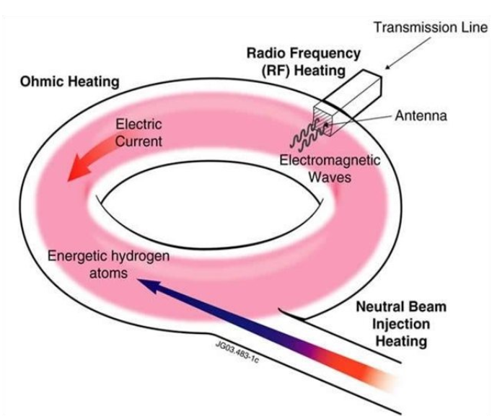

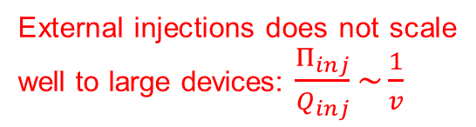
Generating flow shear using neutral beam/radio frequency waves
[Liu et al., Nuclear Fusion, 2004]
Flow shear is usually generated from external momentum sources such as NBI or RF waves.
External injections does not scale well to large devices: $\frac{Π_{inj}}{Q_{inj}}\sim \frac{1}{v}$
ITER: $ω_{⊥}<0.02v_{A}/R_{0}$
Alternatives?
Notes:
The best scenario is that we don’t have to do anything and we let the plasma itself generate a strong flow shear for us.

Slide 7
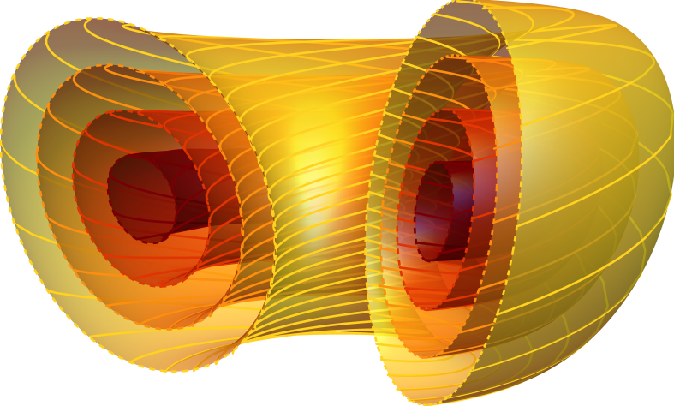




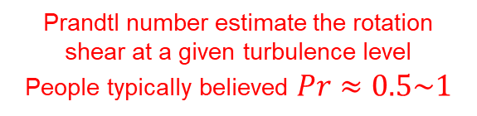
Generate flow shear using up-down asymmetry
Typical expression for momentum flux
$$Π_{i}=Π_{i,intrinsic}−D_{Π_{i}}\frac{dΩ_{i}}{dr}−P_{Π_{i}}Ω_{i}$$
Most important source of intrinsic rotation in the core: up/down asymmetry of magnetic equilibrium.
Intrinsic momentum flux
Turbulent diffusion
Pinch term
In steady state: $Π_{i}=0$, assuming $P_{Π_{i}}Ω_{i}$ is small, we have
$$Π_{i,intrinsic}=D_{Π_{i}}\frac{dΩ_{i}}{dr}$$
$$Q_{i}=−D_{Q_{i}}\frac{dT_{i}}{dr}$$
Define Prandtl number: $Pr_{i}{=}\frac{D_{Π_{i}}}{D_{Q_{i}}}$
Prandtl number estimate the rotation shear at a given turbulence level
People typically believed $Pr≈0.5\sim 1$
[Parra et al., 2011, Camenen et al. 2011, Happel et al. 2023, Ball et al., 2018]
Notes:
Three things that I want to emphasize:
In the following parts of the talk, I’ll be mostly focusing on spherical tokamaks.
We will be focusing on momentum flux driven by turbulence, not neoclassical effects.
3. In ASDEX or other tokamaks, one can achieve this shape by making a negative top triangularity and a positive bottom triangularity
Flow: 1. strong intrinsic drive, already done
2. Need low momentum diffusivity: done by us
3. To find flow shear being generated is too expensive: QL model
4. Final answer and results of flow shear reduction of heat flux.
5. Mention how you find out $Π_{i}=0$ in simulations

Slide 8
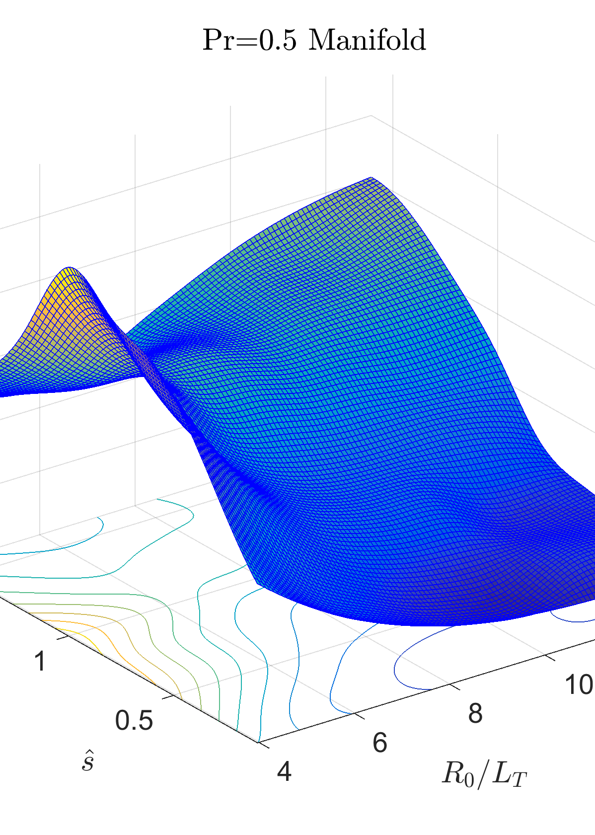
Results1: The Low Momentum Diffusivity (LMD) regime

Slide 9
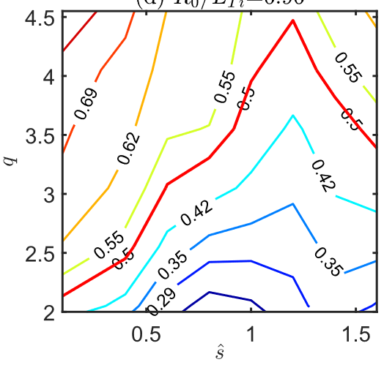
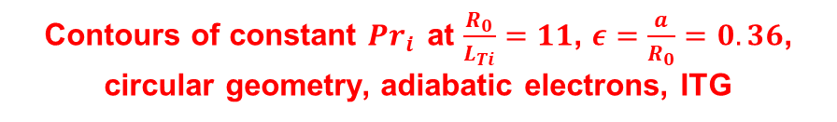
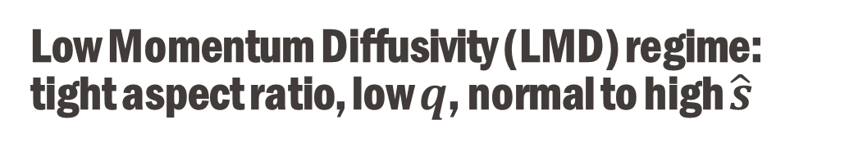
Low Momentum Diffusivity (LMD) regime: tight aspect ratio, low $q$, normal to high $\hat{s}$
Contours of constant $Pr_{i}{ }$at $\frac{R_{0}}{L_{Ti}}=11$, $ε=\frac{a}{R_{0}}=0.36$, circular geometry, adiabatic electrons, ITG
Our simulation results are not only consistent with previous works [Casson et al. 2009, McMillan et al. 2019], but going beyond them:
1. Flow shear in toroidal direction
2. Full toroidal angular momentum flux
Notes:
All of these are nonlinear simulations
We choose to define the Pr<0.5 as the low momentum diffusivity regime!!!

Slide 10
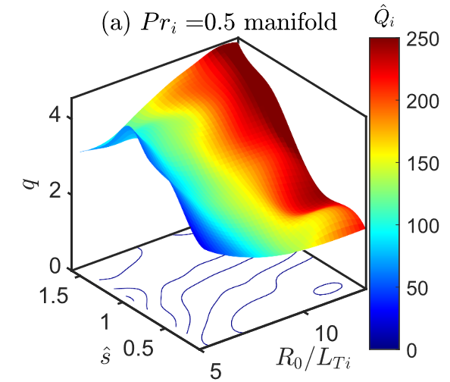
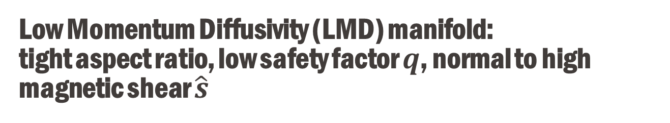

Low Momentum Diffusivity (LMD) manifold: tight aspect ratio, low safety factor $q$, normal to high magnetic shear $\hat{s}$
$ε=\frac{a}{R_{0}}=0.36$, circular geometry
Low momentum diffusivity manifold for adiabatic electrons: more than 500 nonlinear GENE simulations.
Notes:
The hat on the heat flux Q denotes that the heat flux is in the local gyroBohm unit.

Slide 11
Results2: Turbulence stabilization using LMD and up-down asymmetry
Notes:
Now we are moving on to the flux surface denoted by the red

Slide 12
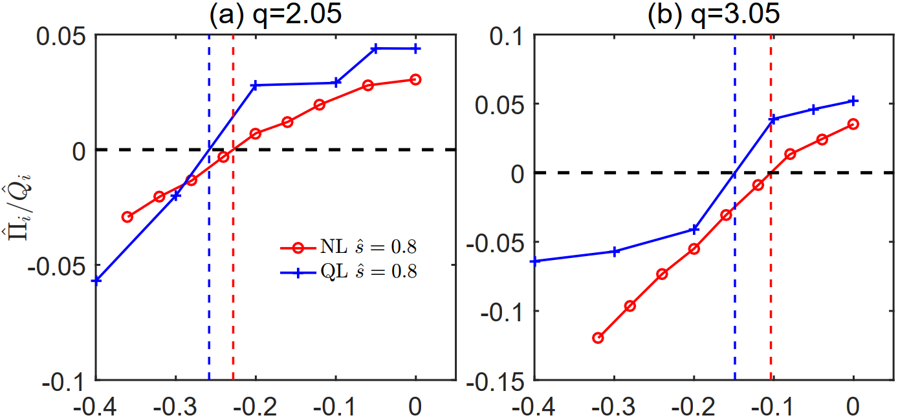
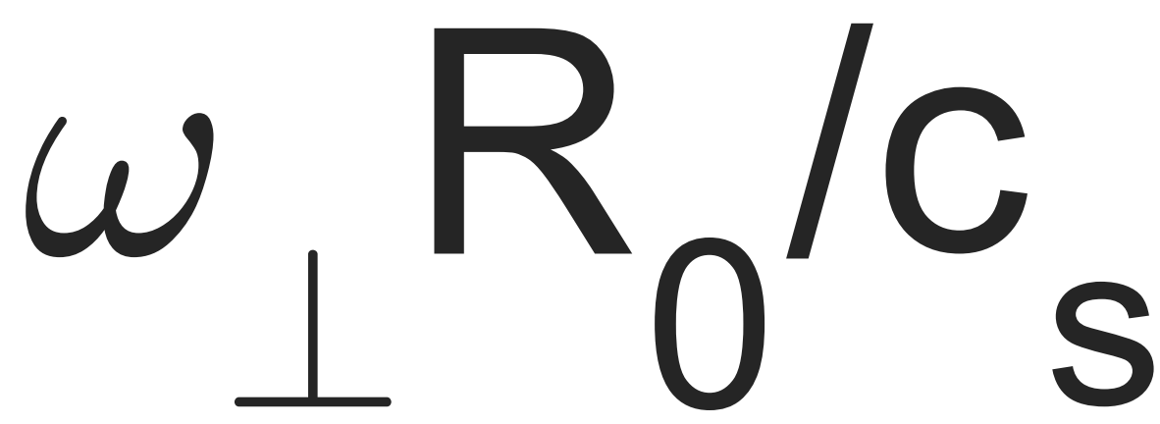

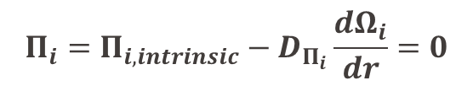
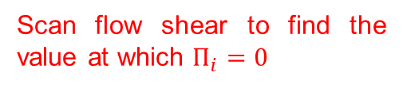
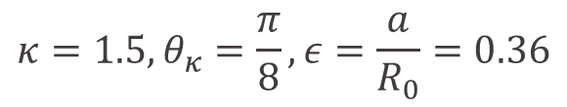

Using QL model to estimate flow shear at equilibrium
$$κ=1.5, θ_{κ}=\frac{π}{8}, ε=\frac{a}{R_{0}}=0.36$$
$$Π_{i}=Π_{i,intrinsic}−D_{Π_{i}}\frac{dΩ_{i}}{dr}=0$$
$${\hat{Q}}_{i}^{ω_{⊥}=0}$$
$${\hat{Q}}_{i}^{Π=0}$$
Scan flow shear to find the value at which $Π_{i}=0$
Using our QL model to predict the steady-state flow shear, which shows good agreements
QL model: [Sun et al., NF, 2024]
Notes:
Transition between the different subsection needs to be added!
Elongation 1.5 add
Please note that the negative value of flow shear denotes only the direction of the flow!
Please note that the QL model is only used to predict the zero crossing point.

Slide 13
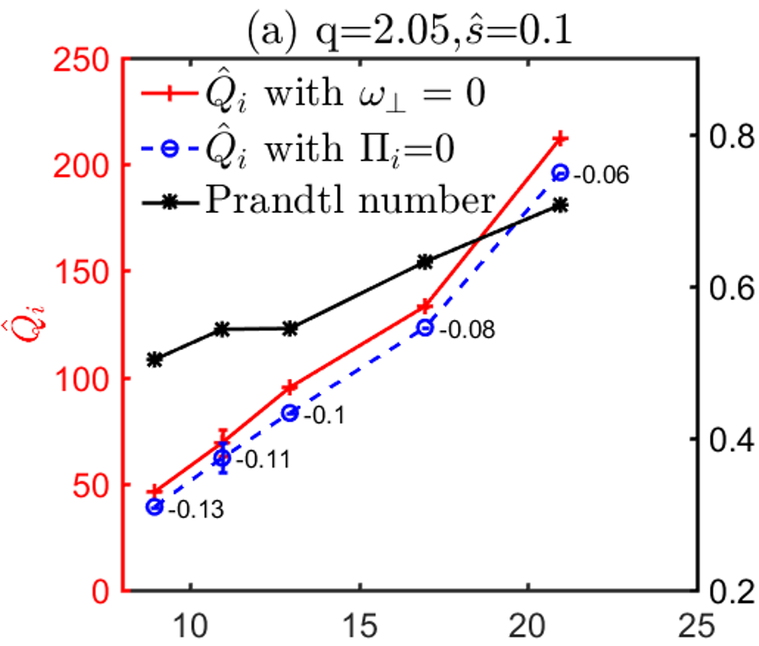
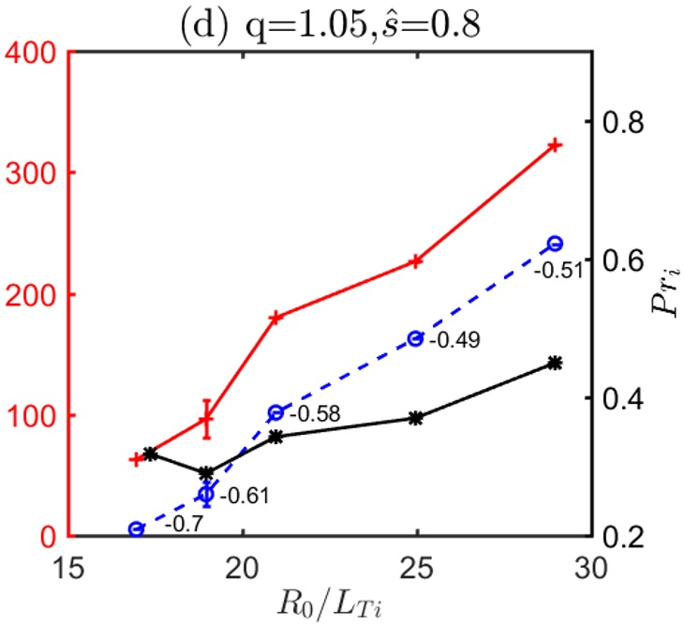

Strong flow shear in LMD regime with up-down asymmetry
Out of the LMD regime
In the LMD regime
Out of the LMD: weak flow shear, nearly no effect on heat transport
In the LMD: strong flow shear, significant suppression of turbulence especially near marginal stability
Notes:
3D plot should be flipped left-right

Slide 14
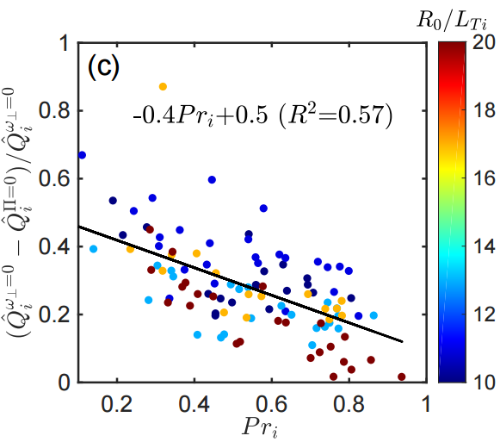
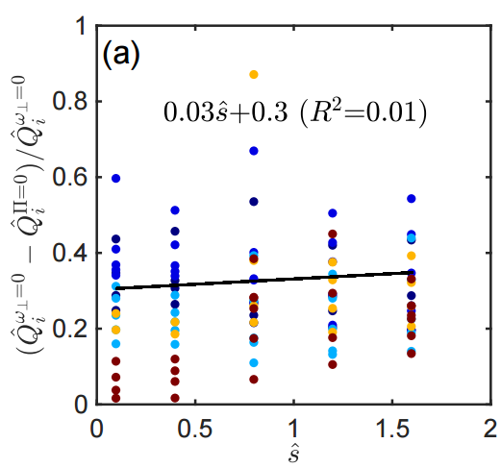
One question remains: what is the main effective parameter in determining the heat flux reduction?
Heat flux reduction
Heat flux reduction
LMD regime
Prandtl number is the main effective parameter in determining the flow shear stabilization

Slide 15
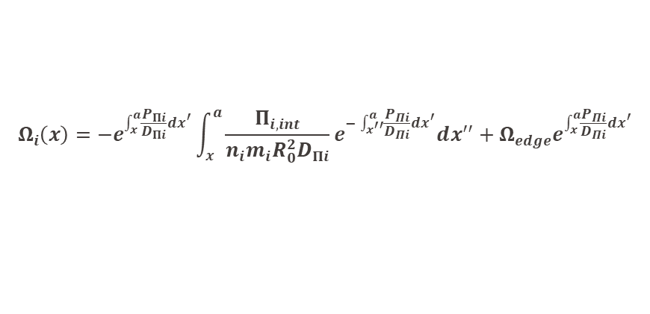


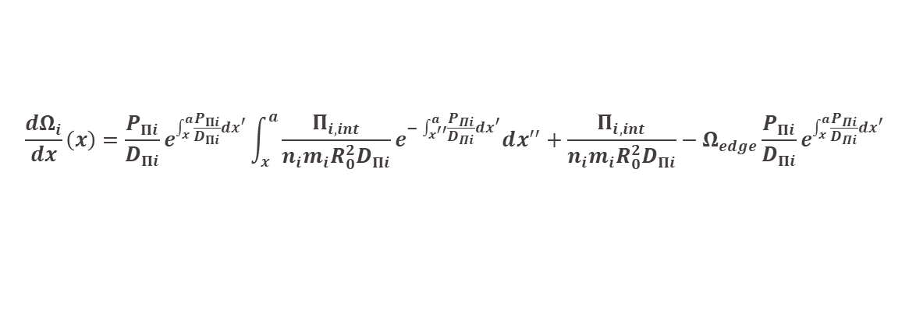
Effect of pinch term on intrinsic rotation
$$Π_{i}=Π_{i,int}−n_{i}m_{i}R_{0}^{2}D_{Π_{i}}\frac{dΩ_{i}}{dx}−n_{i}m_{i}R_{0}^{2}P_{Π_{i}}Ω_{i}=0$$
We therefore have
$$Π_{i,int}=n_{i}m_{i}R_{0}^{2}D_{Π_{i}}\frac{dΩ_{i}}{dx}+n_{i}m_{i}R_{0}^{2}P_{Π_{i}}Ω_{i}$$
Important to note that both $D_{Π_{i}}$ and $P_{Π_{i}}$ are positive [Peeters et al., PRL, 2007]
$$Ω_{i}\left(x\right)=−e^{\int_{x}^{a}{\frac{P_{Πi}}{D_{Πi}}dx^{′}}}\int_{x}^{a}{\frac{Π_{i,int}}{n_{i}m_{i}R_{0}^{2}D_{Πi}}e^{−\int_{x^{′′}}^{a}{\frac{P_{Πi}}{D_{Πi}}dx^{′}}}dx^{′′}}+Ω_{edge}e^{\int_{x}^{a}{\frac{P_{Πi}}{D_{Πi}}dx^{′}}}$$
Flip up-down symmetry changes its sign
$$\frac{dΩ_{i}}{dx}\left(x\right)=\frac{P_{Πi}}{D_{Πi}}e^{\int_{x}^{a}{\frac{P_{Πi}}{D_{Πi}}dx^{′}}}\int_{x}^{a}{\frac{Π_{i,int}}{n_{i}m_{i}R_{0}^{2}D_{Πi}}e^{−\int_{x^{′′}}^{a}{\frac{P_{Πi}}{D_{Πi}}dx^{′}}}dx^{′′}}+\frac{Π_{i,int}}{n_{i}m_{i}R_{0}^{2}D_{Πi}}−Ω_{edge}\frac{P_{Πi}}{D_{Πi}}e^{\int_{x}^{a}{\frac{P_{Πi}}{D_{Πi}}dx^{′}}}$$
Considering pinch term will only make the intrinsic rotation stronger
Notes:
Say flipping the sign of intrinsic by flipping the up-down symmetry of flux surface!

Slide 16
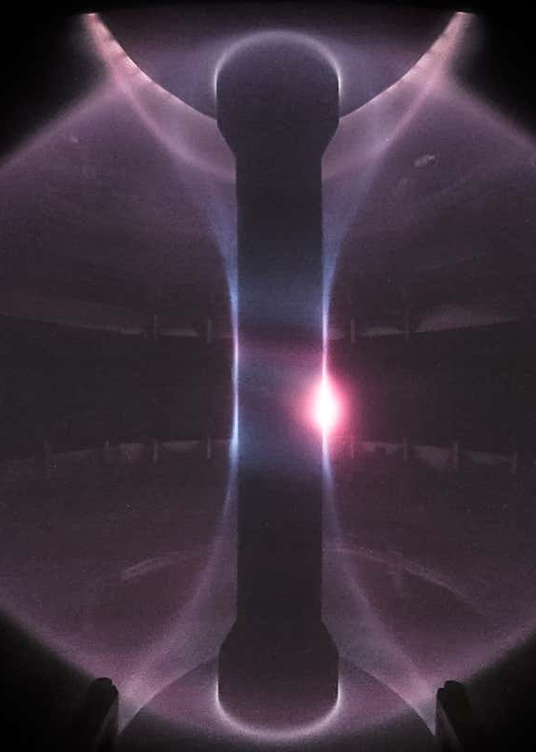
Results3: Practical applicability study using experimental geometries

Slide 17
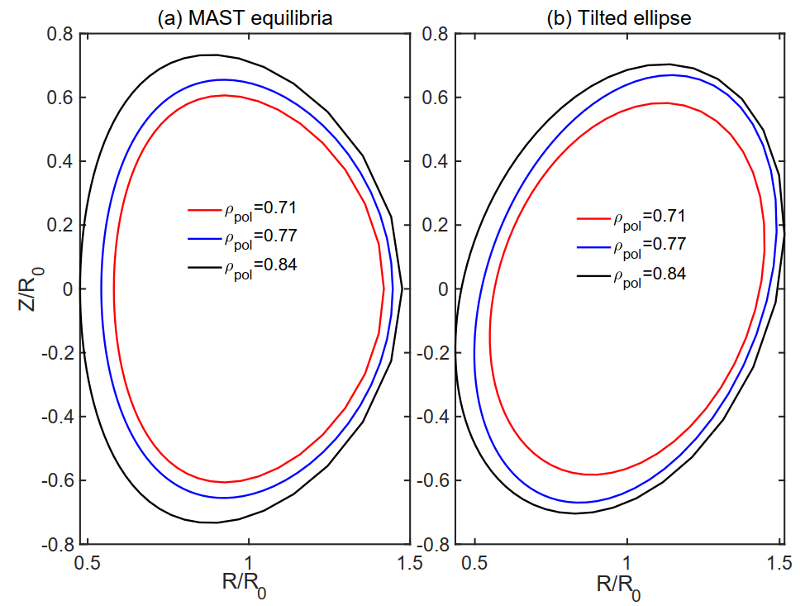
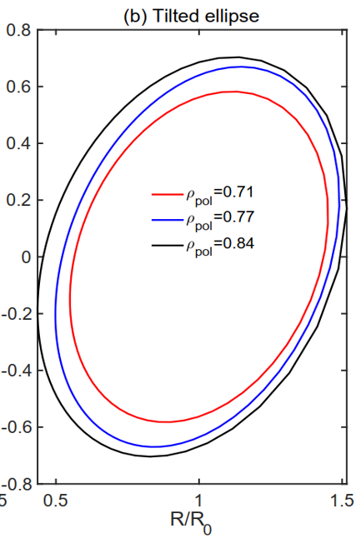


Artificially tilt MAST geometry to study intrinsic flow shear
MAST #24600 $t=0.28s$
No triangularity
$$θ=π/8$$

Slide 18
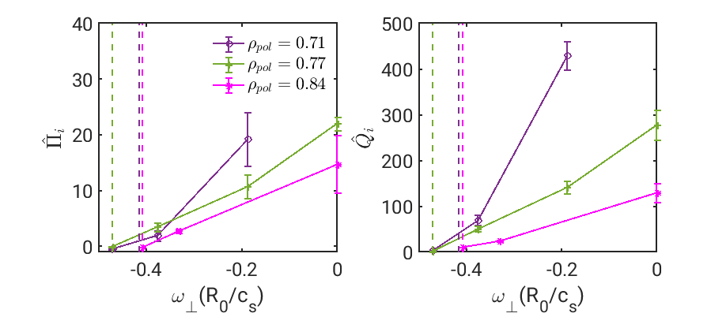
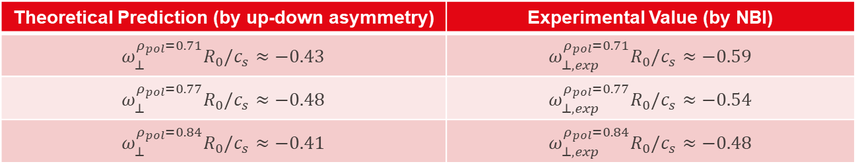
Predicting flow shear generated by up-down asymmetry
Errorbars come from rolling average
Theoretical Prediction (by up-down asymmetry) | Experimental Value (by NBI)
$$ω_{⊥}^{ρ_{pol}=0.71}R_{0}/c_{s}≈−0.43$$ | $$ω_{⊥,exp }^{ρ_{pol}=0.71}R_{0}/c_{s}≈−0.59$$
$$ω_{⊥}^{ρ_{pol}=0.77}R_{0}/c_{s}≈−0.48$$ | $$ω_{⊥,exp}^{ρ_{pol}=0.77}R_{0}/c_{s}≈−0.54$$
$$ω_{⊥}^{ρ_{pol}=0.84}R_{0}/c_{s}≈−0.41$$ | $$ω_{⊥,exp}^{ρ_{pol}=0.84}R_{0}/c_{s}≈−0.48$$
Notes:
Flip the two figures, remove the left, add a momentum flux one.
Two implications of this figure: 1. If a spherical tokamak like MAST-U could tilt its flux surface, then the intrinsic rotation could potentially stabilize turbulence
2. This strategy can be combined with the external momentum injection, meaning that it could potentially drive flow shear that is twice as large.

Slide 19
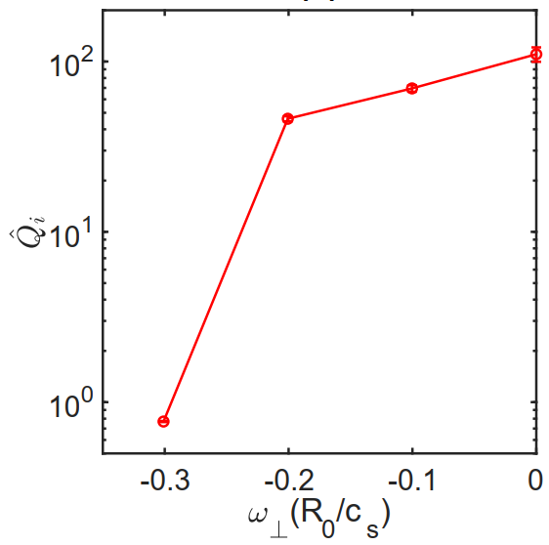
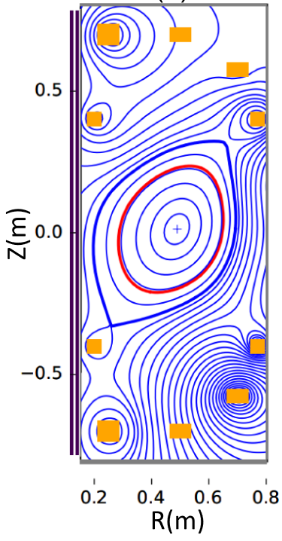


Preliminary simulation for SMART shows strong heat flux reduction with our strategy
Heat flux reduction
$$ω_{⊥}^{{\hat{Π}}_{i}=0}=−0.23c_{s}/R_{0}$$
[Doyle S. et al. 2021 Fusion Eng. Des. 171 112706]
Notes:
SMART is a new tokamak being built in Spain

Slide 20
Results4: Recent progress on electromagnetic component of toroidal angular momentum flux

Slide 21

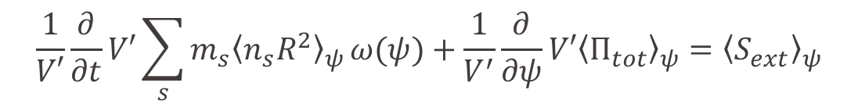

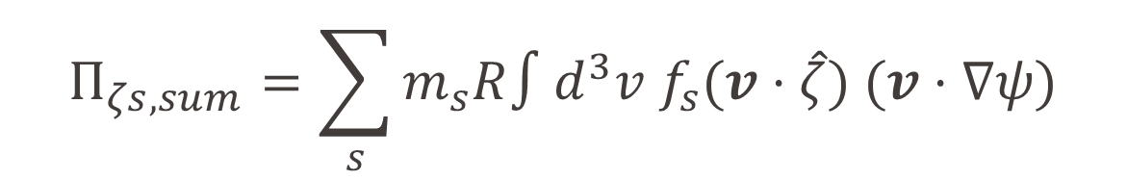
Full expression of electromagnetic toroidal angular momentum flux driven by turbulence
$$\frac{1}{V′}\frac{∂}{∂t}V′\sum_{s}{m_{s}{\left\langle n_{s}R^{2}\right\rangle }_{ψ}}ω(ψ)+\frac{1}{V^{′}}\frac{∂}{∂ψ}V′{\left\langle Π_{tot}\right\rangle }_{ψ}={\left\langle S_{ext}\right\rangle }_{ψ}$$
$$Π_{tot}=Π_{ζs,sum}+Π_{ζB}$$
$$Π_{ζs,sum}=\sum_{s}{m_{s}R∫d^{3}v f_{s}(v⋅\hat{ζ}) (v⋅∇ψ)}$$
$$Π_{ζB}=−R∇ψ⋅(δBδB)⋅\hat{ζ}$$
[Sugama & Horton 1998, Parra et al. 2011, Abel et al. 2013, Ball 2016]

Slide 22
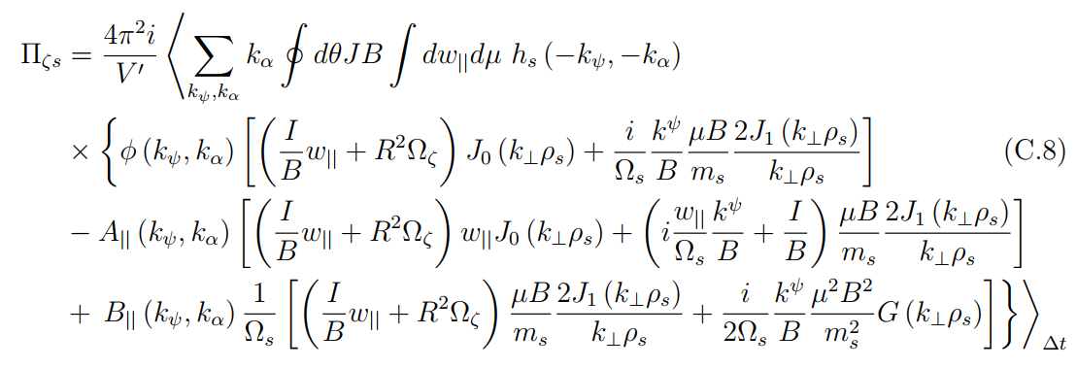
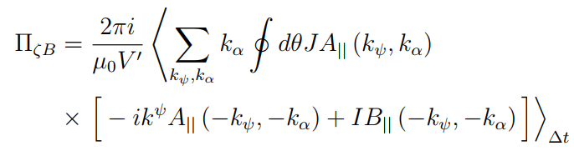







Full expression of electromagnetic toroidal angular momentum flux driven by turbulence (continue)
$$Π_{es,||}$$
$$Π_{es,⊥}$$
$$Π_{A_{||},||}$$
$$Π_{A_{||},⊥}$$
$$Π_{B_{||},||}$$
$$Π_{B_{||},⊥}$$
$$Π_{field}$$
[Ball 2016]

Slide 23
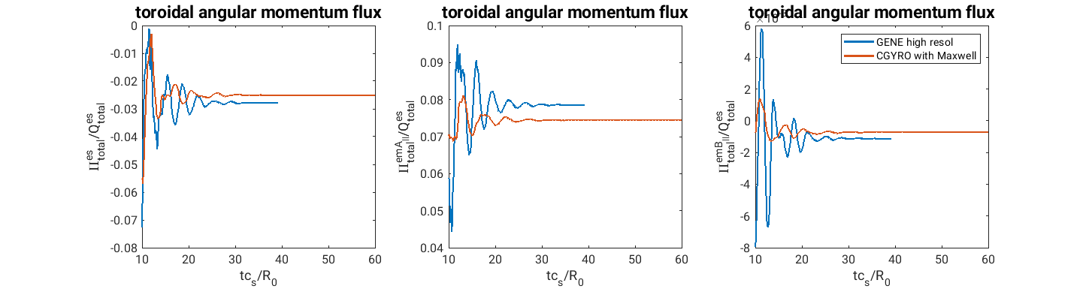
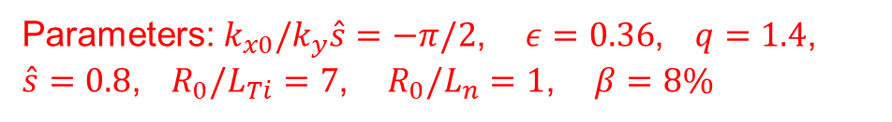
Linear benchmark between GENE and CGYRO
Parameters: $k_{x0}/k_{y}\hat{s}=−π/2$, $ε=0.36$, $q=1.4$,
$\hat{s}=0.8$, $R_{0}/L_{Ti}=7$, $R_{0}/L_{n}=1$, $β=8\%$

Slide 24
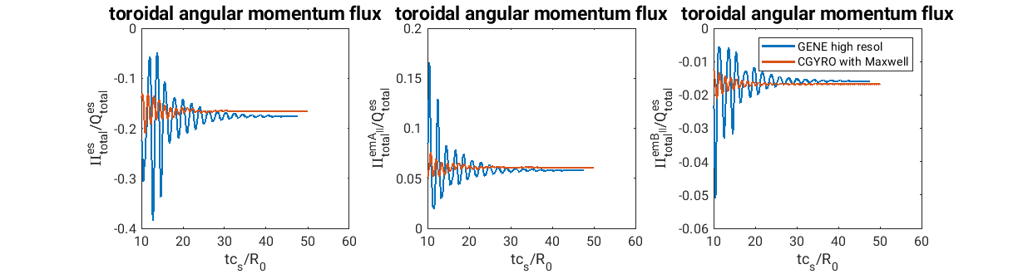

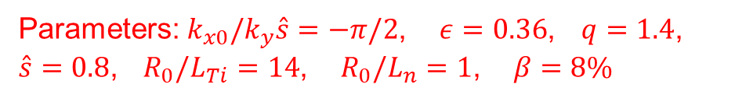
Doubled $R_{0}/L_{Ti}=14$
Parameters: $k_{x0}/k_{y}\hat{s}=−π/2$, $ε=0.36$, $q=1.4$,
$\hat{s}=0.8$, $R_{0}/L_{Ti}=14$, $R_{0}/L_{n}=1$, $β=8\%$

Slide 25
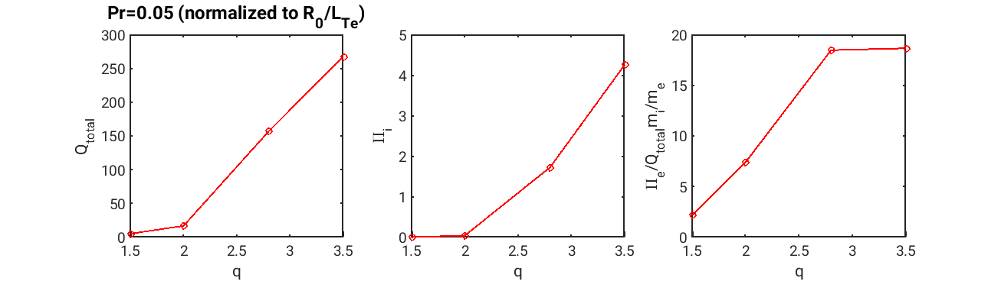
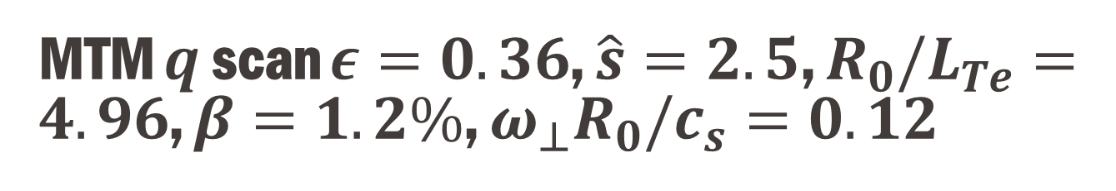
MTM $q$ scan $ε=0.36$, $\hat{s}=2.5$, $R_{0}/L_{Te}=4.96$, $β=1.2\%$, $ω_{⊥}R_{0}/c_{s}=0.12$
MTM dominated
Prandtl number is tiny and negligible for MTM
Notes:
Plot Prandtl number versus q

Slide 26
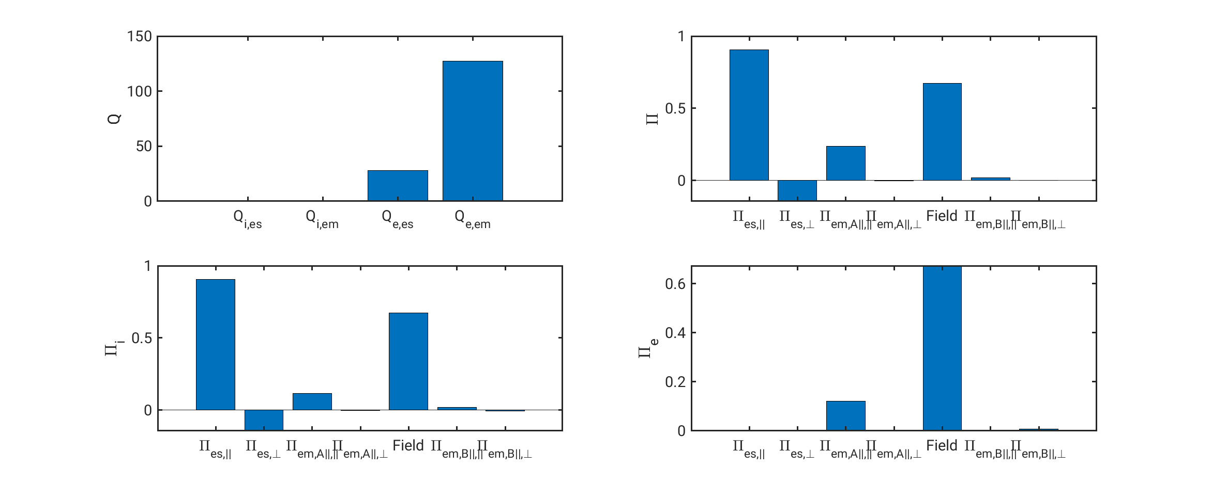
Magnitude of different terms: MTM
Maxwell stress term cannot be neglected for MTM!
Notes:
Current transport?

Slide 27
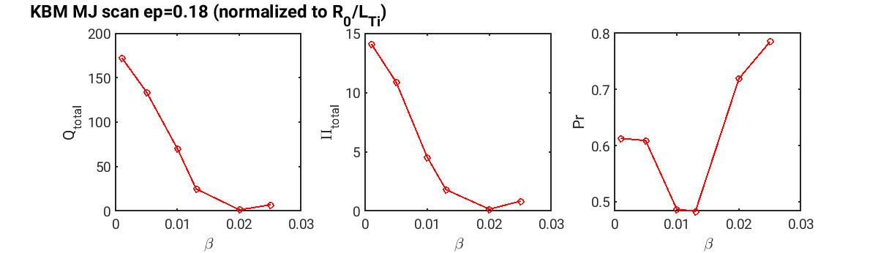
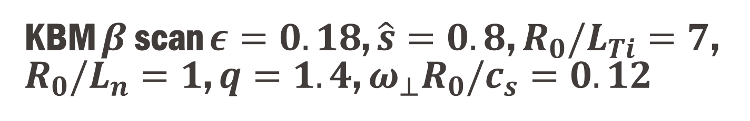
KBM $β$ scan $ε=0.18$, $\hat{s}=0.8$, $R_{0}/L_{Ti}=7$, $R_{0}/L_{n}=1$, $q=1.4$, $ω_{⊥}R_{0}/c_{s}=0.12$
KBM dominated
Prandtl number is relatively large for KBM

Slide 28
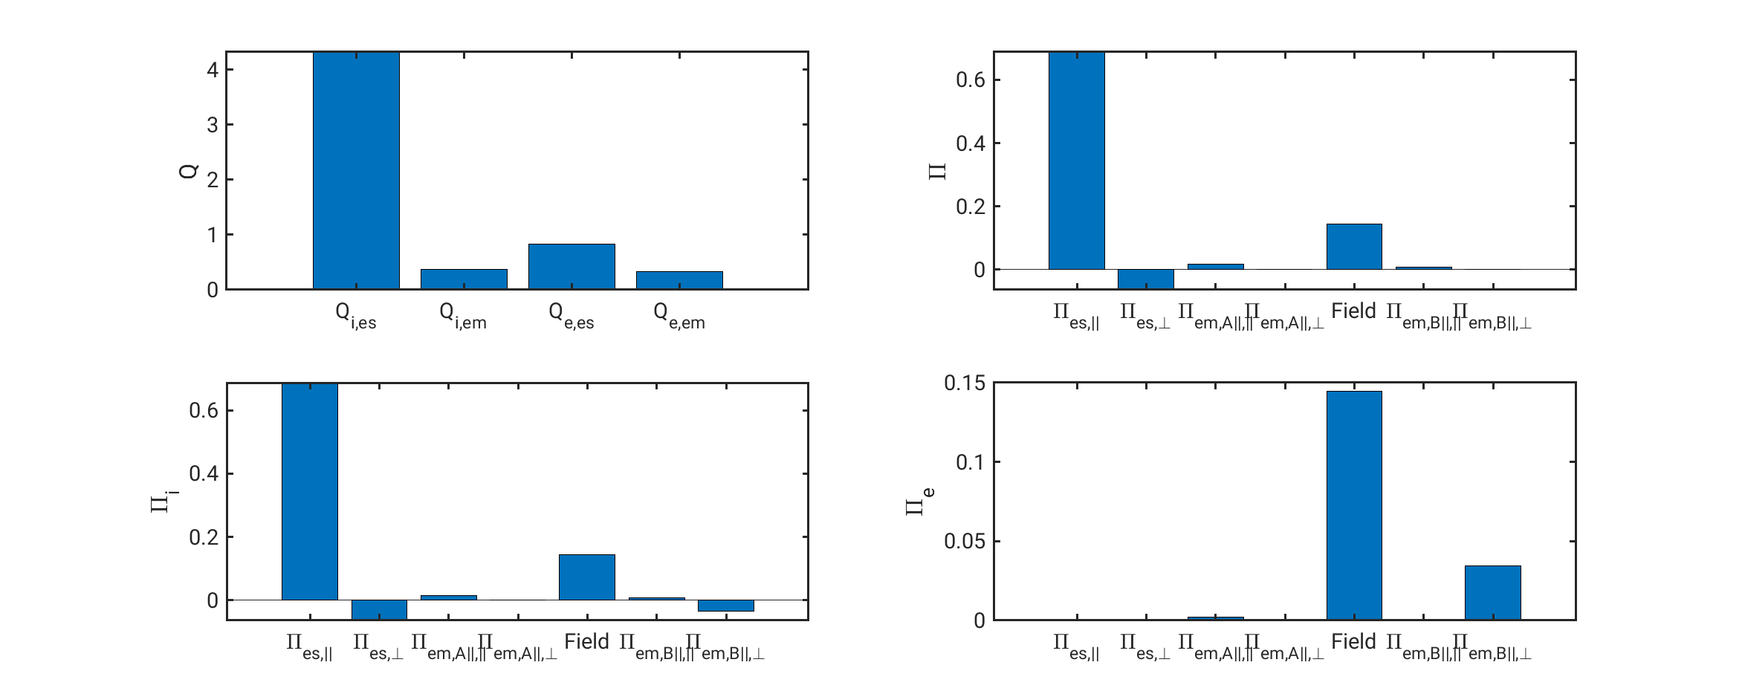

Magnitude of different terms: KBM $β=0.025$
Electromagnetic components are negligible for KBM with low $β$

Slide 29
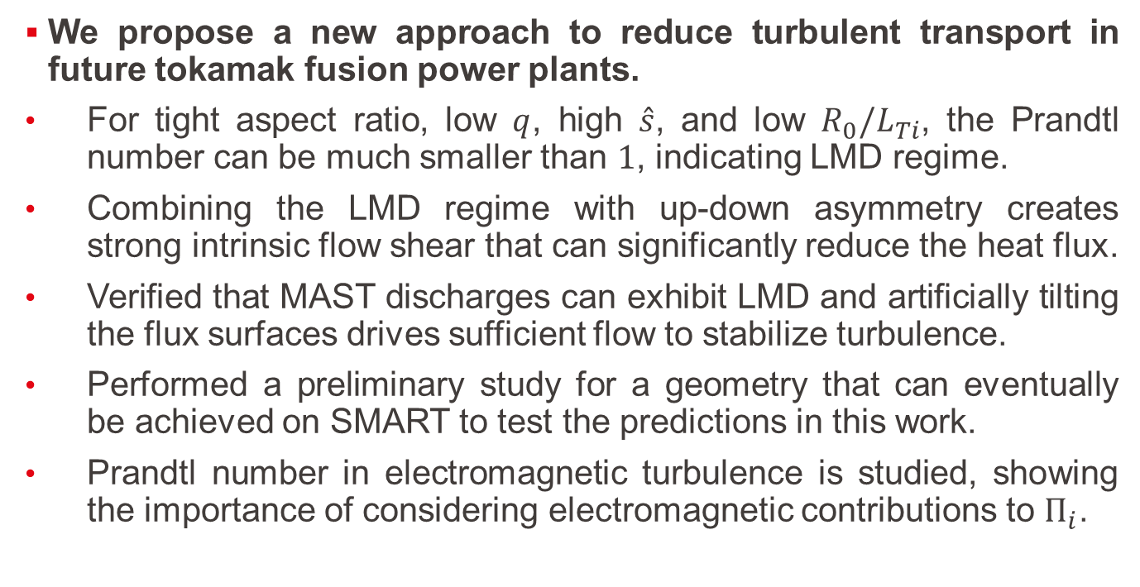
Conclusions of results
We propose a new approach to reduce turbulent transport in future tokamak fusion power plants.
For tight aspect ratio, low $q$, high $\hat{s}$, and low $R_{0}/L_{Ti}$, the Prandtl number can be much smaller than $1$, indicating LMD regime.
Combining the LMD regime with up-down asymmetry creates strong intrinsic flow shear that can significantly reduce the heat flux.
Verified that MAST discharges can exhibit LMD and artificially tilting the flux surfaces drives sufficient flow to stabilize turbulence.
Performed a preliminary study for a geometry that can eventually be achieved on SMART to test the predictions in this work.
Prandtl number in electromagnetic turbulence is studied, showing the importance of considering electromagnetic contributions to $Π_{i}$.
[H. Sun et al., Nucl. Fusion 64 (2024), 036026]
[H. Sun et al., Nucl. Fusion. 65 (2025), 076026]
Notes:
Mention SUNIST-2 & HL-3

Slide 30
References
[1] C. Angioni et al. “Intrinsic Toroidal Rotation, Density Peaking, and Turbulence Regimes in the Core of Tokamak Plasmas.” Phys. Rev. Lett. 107 (2011), 215003.
[2] E. G. Highcock et al. “Transport Bifurcation in a Rotating Tokamak Plasma.” Phys. Rev. Lett. 105.21 (2010), 215003.
[3] Y. Liu et al. “Stabilization of resistive wall modes in ITER by active feedback and toroidal rotation.” Nuclear Fusion 44.2 (2004), 232.
[4] J. Ball et al. “Optimized up–down asymmetry to drive fast intrinsic rotation in tokamaks.” Nucl. Fusion 58 (2018), 026003.
[5] H. Sun et al. “A new quasilinear model for turbulent momentum transport in tokamaks with flow shear and plasma shaping.” Nucl. Fusion 64 (2024) 036026.
[6] H. Sun et al. “Reducing turbulent transport in tokamaks by combining intrinsic rotation and the low momentum diffusivity regime.” Nucl. Fusion. 65 (2025), 076026.
[7] B. F. McMillan and J. Dominski. “Tokamak parameter regimes with low toroidal momentum diffusivity.” In: Journal of Plasma Physics 85.3 (2019), p. 175850301.

Slide 31





Why LMD regime is beneficial (simple physics explanation)?
$Π_{ζs}^{φ,||}∼φJ_{0}\frac{I}{B}w_{||}∼\frac{B_{ζ}}{\sqrt{B_{ζ}^{2}+B_{p}^{2}}}$ : Diffusive component
$Π_{ζs}^{φ,⊥}∼iφJ_{1}μw_{⊥}$ : Anti-diffusive component
With the increase of $ε/q$, the field line pitch angle is larger, meaning $B_{p}$ is becoming larger. This results in a larger $Π_{ζs}^{φ,⊥}$ and smaller $Π_{ζs}^{φ,||}$
$$Pr_{i}=\frac{{\hat{Π}}_{i}}{{\hat{Q}}_{i}}\frac{R}{L_{Ti}}\frac{ε}{qω_{⊥}}\frac{c_{s}}{R}$$
For ITG: $Q_{i}$ maximizes at around $\hat{s}∼1$

Slide 32
Benchmark between GENE and CGYRO

Slide 33


Microturbulence in tokamaks
Ion scale turbulence
1. Turbulence is highly anisotropic
2. Electromagnetic turbulence
3. Weakly collisional
4. Gyrokinetic simulation is needed to simulate such turbulence
[GYRO official website]
Microturbulence causes most of the energy loss in tokamaks
[Ball et al., J. Plasma Phys., 2020]
Notes:
Kinetic modelling is necessary.
Turbulence is highly anisotropic (on the scale of ion gyroradius)
EM turbulence
Only consider turbulent diffusivity but neglecting the neoclassical diffusivity

Slide 34





Magnetic confined fusion
[Giacomin et al., Computer Phys. Comm.,2021]
Energy transport
$$nTτ_{E}≥3×{10}^{21}keV⋅s/m^{3}$$
$τ_{E}$: energy confinement time
Producing Confinement
Improve $n,T,τ_{E}$ as much as possible
Notes:
Explain the figure
The plasma tends to escape from the confinement of the magnetic field.
Equilibrium->microinstability->turbulence being generated->turbulent transport
To achieve fusion energy: plasma: why tokamak: (get the attention of president for the first 5 minutes)

Slide 35
Procedure of getting input parameters for GENE gyrokinetic simulations
Kinetic parameters
Fit experimental TS/CXRS data
Obtain density, temperature input for GENE
GENE needs
Geometry parameters
Obtain EQDSK file from experimentalists
Convert to Miller general input parameters in GENE

Slide 36












Gyrokinetics and its coordinate system
For a $(ψ,χ,φ)$ coordinate, define
$$x−x_{0}=C_{x}(ψ)$$
$$y=C_{y}(q\left(ψ\right)χ−φ)$$
$$z=χ$$
$χ$: straight field line poloidal angle
Gyro-average:
$$φ$$
[Abel et al., Rep. Prog. Phys., 2013]
[Ball et al., J. Plasma Phys., 2020]
Notes:
This figure is an illustration of this coordinate, a plot with respect to straight field line poloidal angle and toroidal angle. The red arrows are the direction of the magnetic field. It is an unorthogonal coordinate.

Slide 37


MAST #24600 $t=0.28s, ψ_{n}=0.5$ important parameters
parameter | value | parameter | value
q | 1.2824 | Omt_i | 4.5641
$$\hat{s}$$ | 1.1722 | Omn_i | 2.5803
amhd | 1.0637 | Omt_e | 4.0157
$$κ$$ | 1.4474 | Omn_e | 2.5803
$$δ$$ | 0.1814 | Lx | 157.364
$$ε$$ | 0.4188 | Ly | 125.664
$$s_{δ}$$ | 0.1586 | nexc | 16
$$s_{κ}$$ | -0.0194 | $$k_{ymin}$$ | 0.05
$$β$$ | 1.63% | Nakata collision | 0.0008428

Slide 38



$ψ_{n}=0.5$ Linear Simulations
Exp value: $\frac{Q_{i}}{Q_{gB}}=37.5591$

Slide 39



Add flow shear, compare with experiments
Exp value: $\frac{Q_{i}}{Q_{gB}}=3.2554$
Exp value: $\frac{Π_{i}}{Π_{gB}}=0.7885$

Slide 40




$ψ_{n}=0.5$ Nonlinear Simulations, realistic geometry, no flow shear
Converge grid: $192×64×64×32×16$
Exp value: $\frac{Q_{i}}{Q_{gB}}=37.5591$
Exp value: $\frac{Π_{i}}{Π_{gB}}=−6.9684$
Exp value: $\frac{Q_{i}}{Q_{gB}}=37.5591$
Exp value: $\frac{Π_{i}}{Π_{gB}}=−6.9684$

Slide 41


MAST #24600 $t=0.28s, ψ_{n}=0.6$ important parameters
parameter | value | parameter | value
q | 1.4843 | Omt_i | 3.6615
$$\hat{s}$$ | 2.0902 | Omn_i | 2.3267
amhd | 1.0138 | Omt_e | 3.7291
$$κ$$ | 1.4525 | Omn_e | 2.3267
$$δ$$ | 0.1893 | Lx | 168.288
$$ε$$ | 0.4642 | Ly | 125.664
$$s_{δ}$$ | 0.2439 | nexc | 24
$$s_{κ}$$ | 0.0272 | $$k_{ymin}$$ | 0.05
$$β$$ | 1.09% | Nakata collision | 0.0009874

Slide 42


$ψ_{n}=0.6$ Linear Simulations

Slide 43



$ψ_{n}=0.6$ Nonlinear Simulations
Converge grid: $192×64×96×32×16$

Slide 44


Slide 45


MAST #24600 $t=0.28s, ψ_{n}=0.7$ important parameters
parameter | value | parameter | value
q | 1.8560 | Omt_i | 3.5438
$$\hat{s}$$ | 3.2020 | Omn_i | 1.5932
amhd | 0.9969 | Omt_e | 5.1947
$$κ$$ | 1.4678 | Omn_e | 1.5932
$$δ$$ | 0.1922 | Lx | 146.4
$$ε$$ | 0.5119 | Ly | 125.664
$$s_{δ}$$ | 0.3730 | nexc | 48
$$s_{κ}$$ | 0.0899 | $$k_{ymin}$$ | 0.05
$$β$$ | 0.69% | Nakata collision | 0.001948

Slide 46


$ψ_{n}=0.7$ Linear Simulations

Slide 47




$ψ_{n}=0.7$ Linear Simulations: including electron scale
$${\left(\frac{γ}{k_{y}}\right)}_{ITG}=0.995$$
$${\left(\frac{γ}{k_{y}}\right)}_{ETG}=0.556$$

Slide 48


$ψ_{n}=0.7$ Nonlinear Simulations
Converge grid: $192×64×64×32×16$

Slide 49


Parameters
$κ≈1.39$
$θ_{κ}≈0.51={29}^{o}$
At $ρ_{tor}=0.7$, we have $ε=0.393, q=1.33,\hat{s}=1.25$ (LMD regime)
Use miller general geometry for GENE simulations

