Slide 1
Fast-ion confinement in NT plasma on TCV: experiments and modelling
J. Poley-Sanjuán, Anton Jansen van Vuuren, A. N. Karpushov, , M. Podestà, S. Mazzi, B. P. Duval, M. Dreval, A. Fasoli and the TCV and WPTE RT09 EUROfusionTeams
Date: 17/10/2025

Slide 2
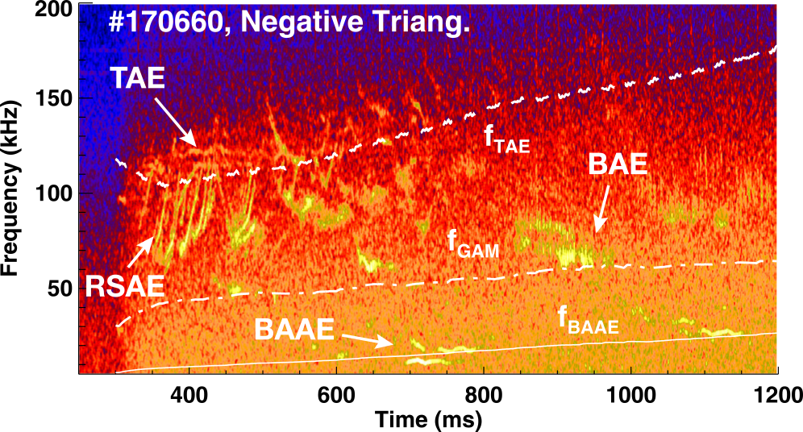
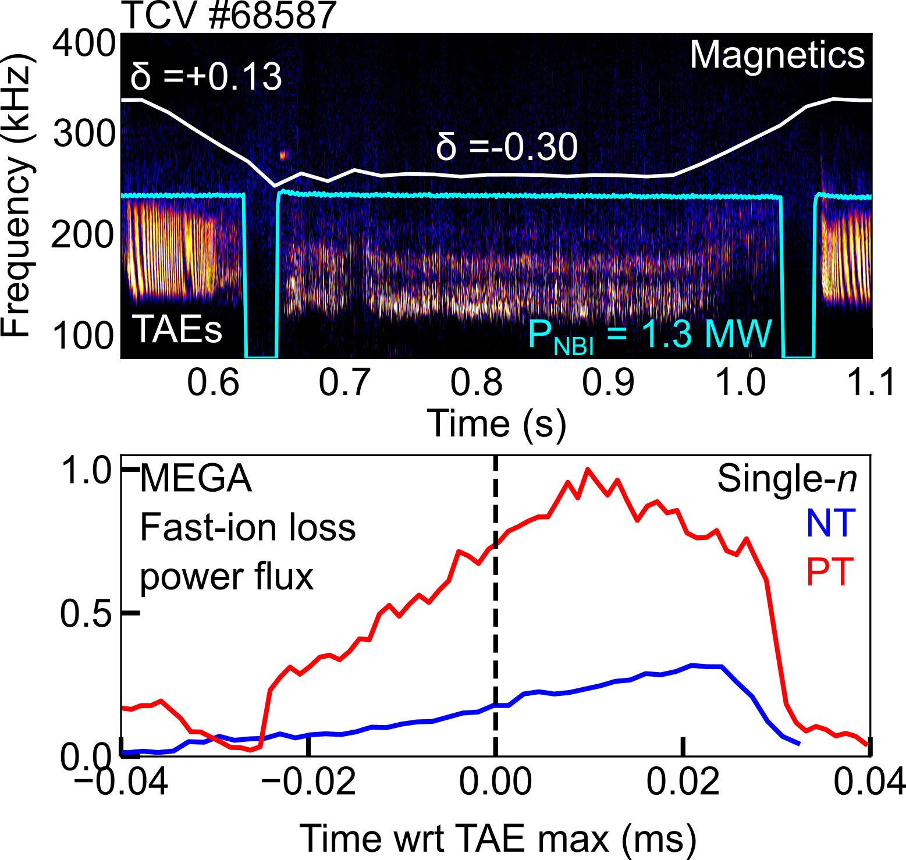
Introduction
DIII-D
NT plasmas exhibit improved thermal plasma confinement w.r.t PT.
But there are few experimental studies on fast-ion confinement in NT plasmas (see [1]).
There are no experimental studies with MHD-quiescent, flattop conditions*.
Numerical studies [2, 3] have found that for the same plasma input, TAE grow rates are slower in NT.
[1] M.A. Van Zeeland et al 2019 Nucl. Fusion 59 (top figure)
[2] Y. Ghai et al 2021 Nucl. Fusion 61
[3] P. Oyola et al 2023 IAEA FEC (bottom figure)
*up to my knowledge

Slide 3
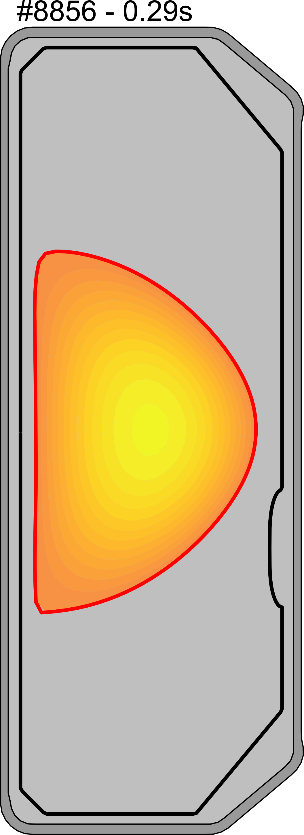
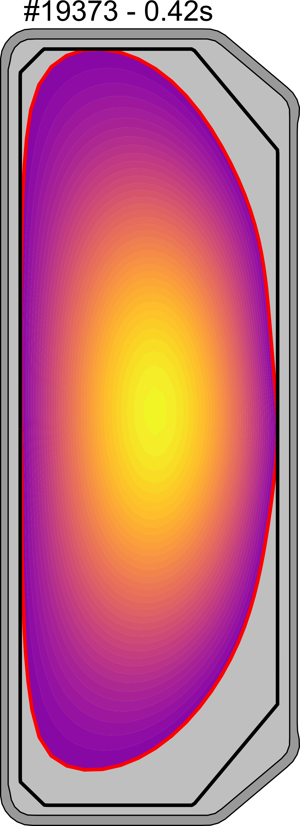
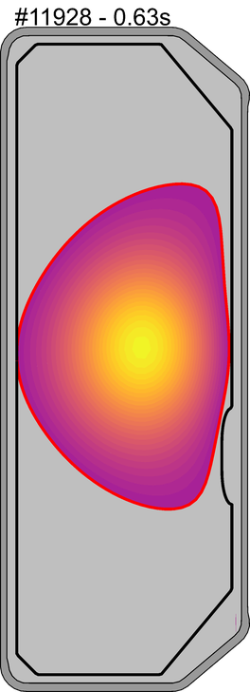
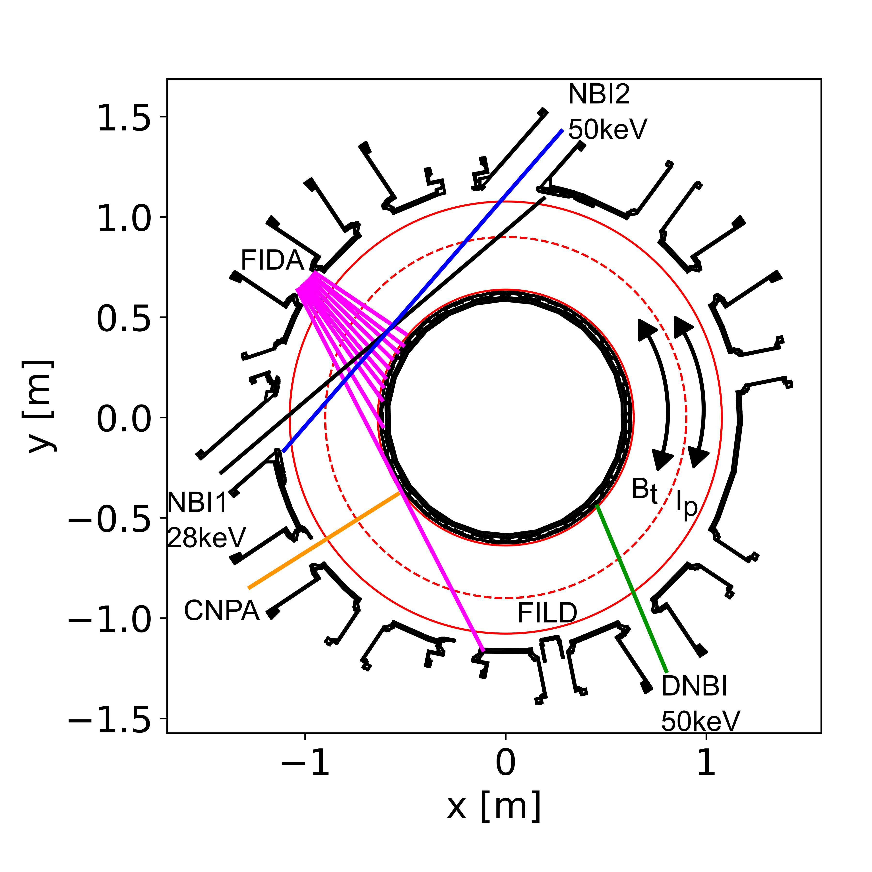
Introduction
TCV is ideal for studying NT plasmas due to its flexible shaping capabilities.
Additionally, TCV has two (1MW) NBI heating beams to produce fast-ion populations, as well as up to 2MW ECRH.
TCV has several diagnostics to infer fast-ion confinement including FIDA, FILD, NPA and Neutron detectors

Slide 4
Outline
MHD-quiescent plasma
  Experimental measurements
  Modelling
  Conclusions
TAEs on PT vs NT
  Experimental measurements
  Modelling

Slide 5
Outline
MHD-quiescent plasma
  Experimental measurements
  Modelling
  Conclusions
TAEs on PT vs NT
  Experimental measurements
  Modelling
O

Slide 6
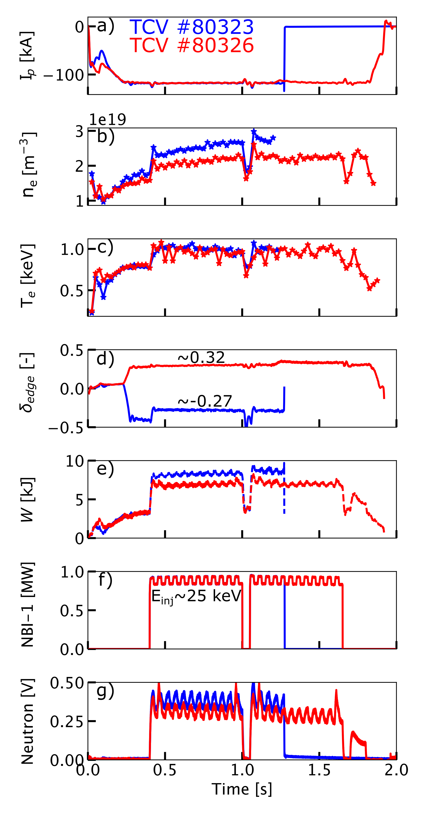
Similar temperature, higher density in NT
Experiments were carried out with limited NT/PT plasma shapes and 1MW of co-NBI-1 heating.
The goal was to obtain an MHD-quiescent scenario with a flattop current to compare against neoclassical modelling.
The main difference in the kinetic profiles arise from the density (higher in NT), leading to higher stored energy.

Slide 7
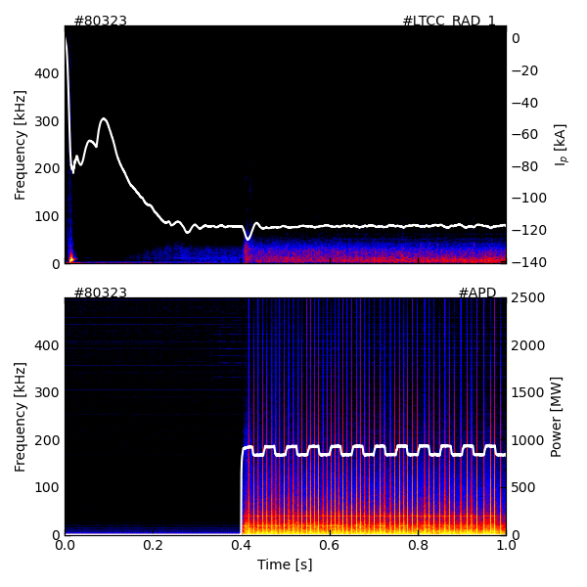
No MHD activity reported on the magnetics
Magnetics
Placing the plasma at Z = 5 cm and using the co-NBI-1 injection were the key ingredients to develop an MHD-quiescent plasma.
FILD

Slide 8
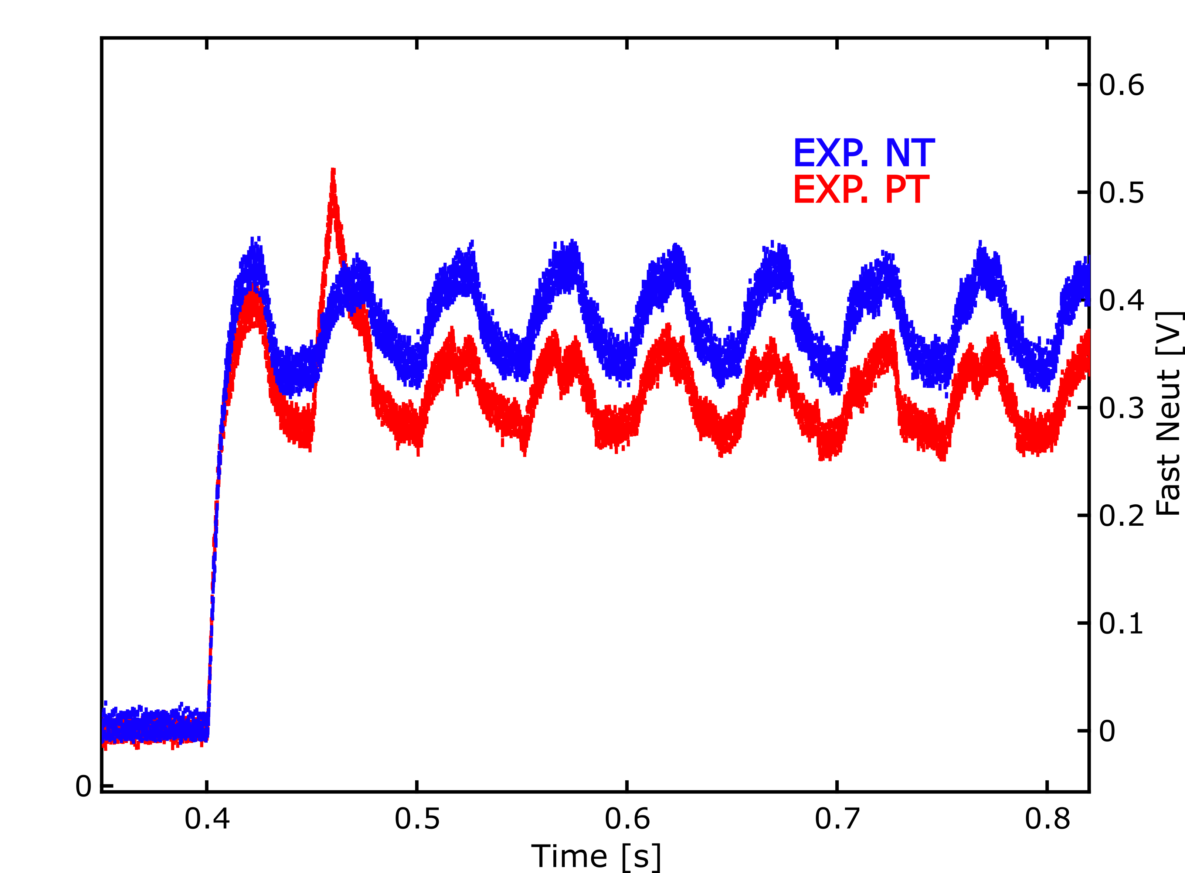
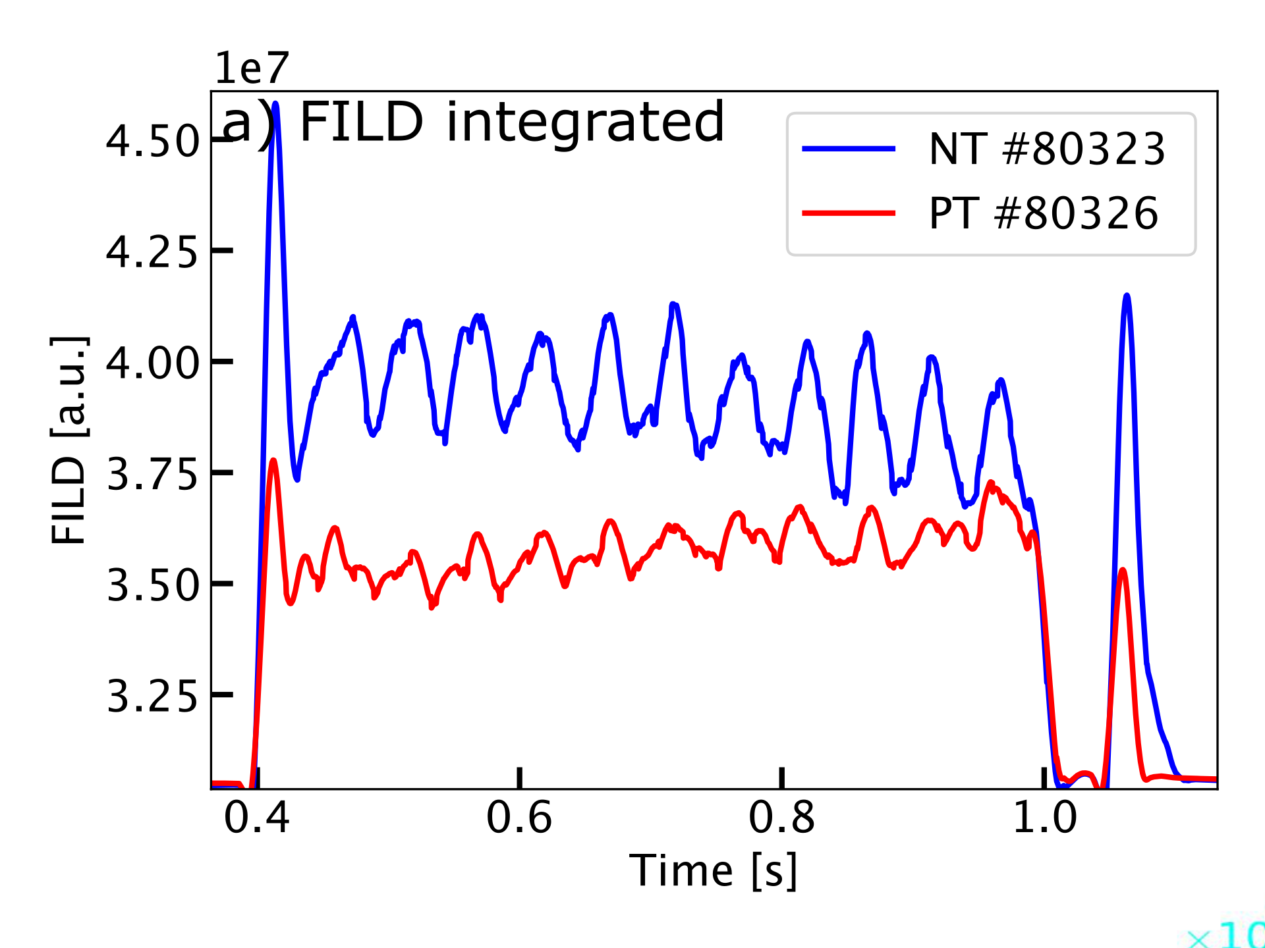
Both the neutron levels and the Fast-Ion losses are higher in NT
Neutron rate
The measured neutrons are higher in NT than in PT. This can be due to higher plasma density (beam-target reactions are the main neutron source) and to a higher fast-ion content.
The fast-ion losses are, however, also higher in NT than PT.
The FILD signal indicates higher prompt losses in NT than in PT. This is seen in the higher increment during the high-NBI modulations.

Slide 9
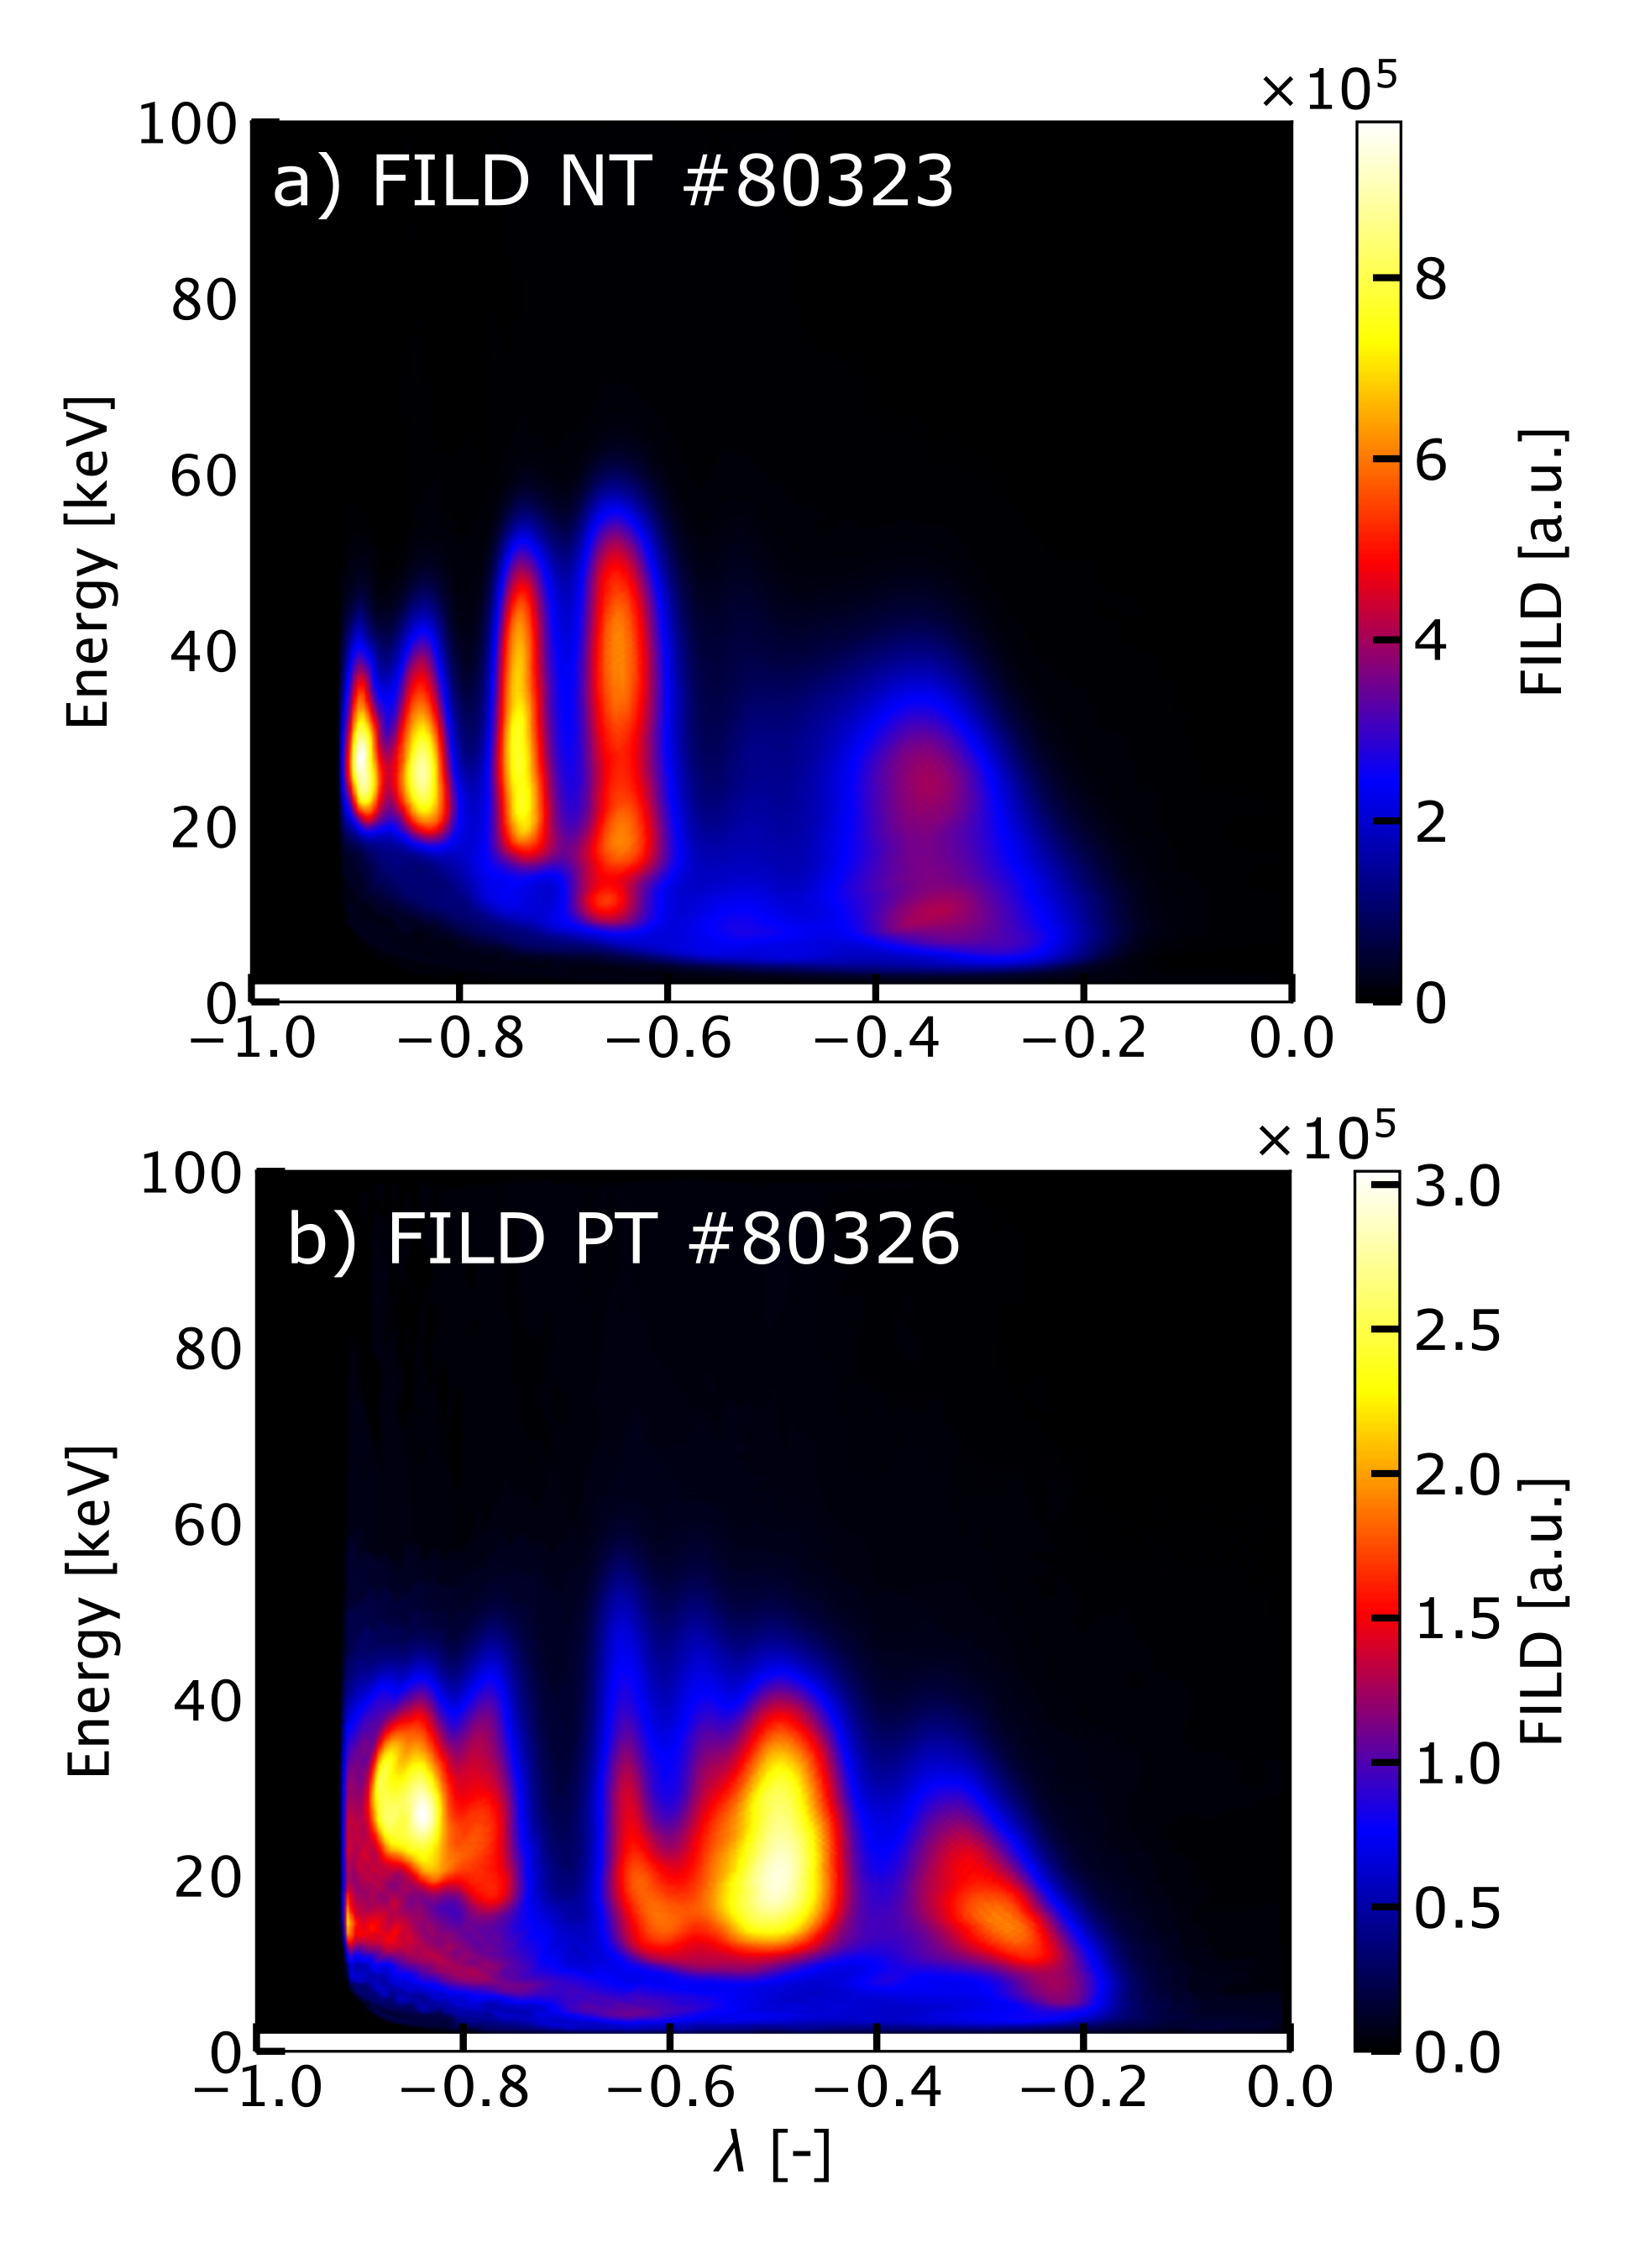
Passing, full-energy, fast ions in NT
t = 0.545 s
The FILD signal shows that the NT fast-ion losses are mainly at the primary NBI-1 injection energy (~25 keV).
In PT, there is a spread towards lower energies, indicating that the fast-ion losses have already partially slowed down before arriving at FILD.
The NT geometry has a higher fast-ion loss fraction due to prompt losses that also retain a pitch close to the NBI injection value (λ_{inj} ∼ −0.7).

Slide 10
Outline
MHD-quiescent plasma
  Experimental measurements
  Modelling
  Conclusions
TAEs on PT vs NT
  Experimental measurements
  Modelling
O
O

Slide 11
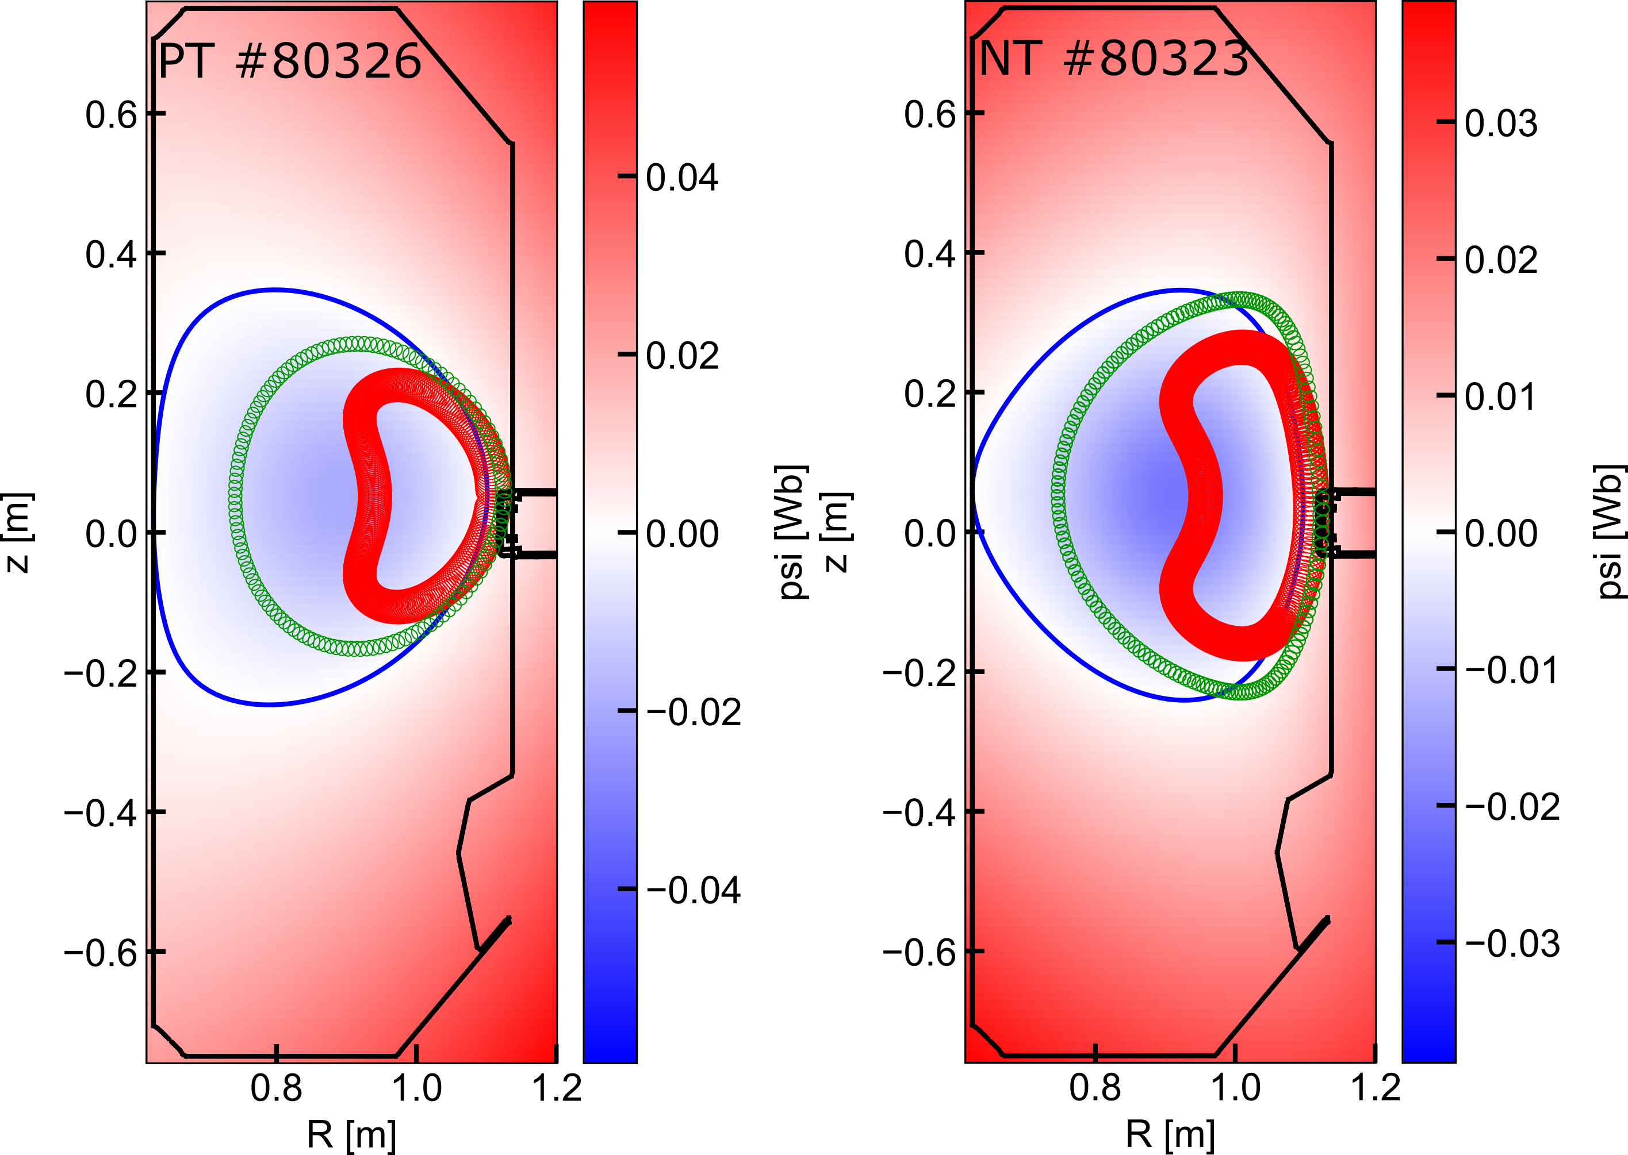
ASCOT orbits: larger path outside of the separatrix for NT
Modelling with ASCOT shows that the NT orbits, both trapped and passing, go through a larger path outside of the separatrix.
This will affect the number of prompt losses and Charge eXchange (CX) reactions outside of the separatrix.

Slide 12
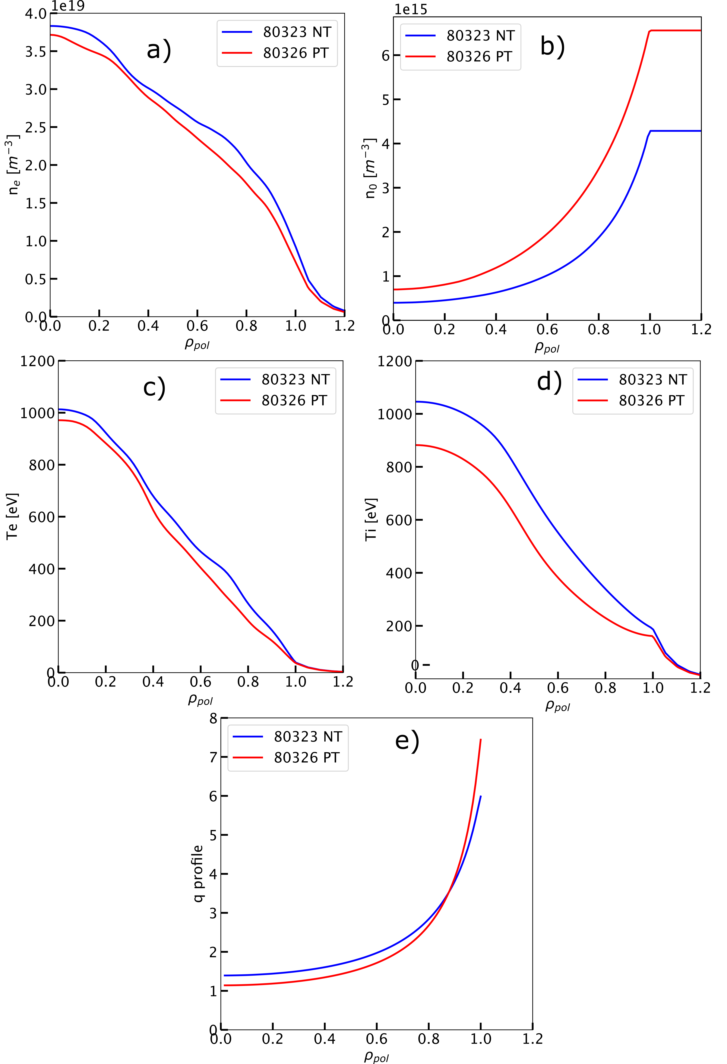
TRANSP and ASCOT modelling inputs
The main difference in the kinetic profiles comes from Ti (higher in NT) and the neutrals (bigger in PT).
The reconstructed q-profile is equivalent between both cases.
The inputs are shown at 0.545 s, for which the ASCOT simulation was performed.

Slide 13
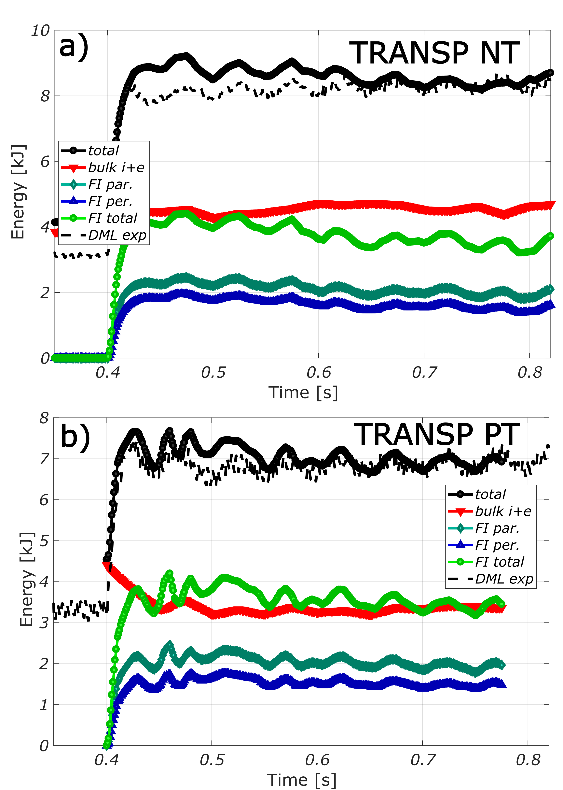
TRANSP modelling validation (part I)
To validate the TRANSP runs, we compared the total energy with the W_{MHD} from LIUQE.
Note the change in the energy contents following the changes in the NBI input power.
A good match is achieved in both cases.

Slide 14
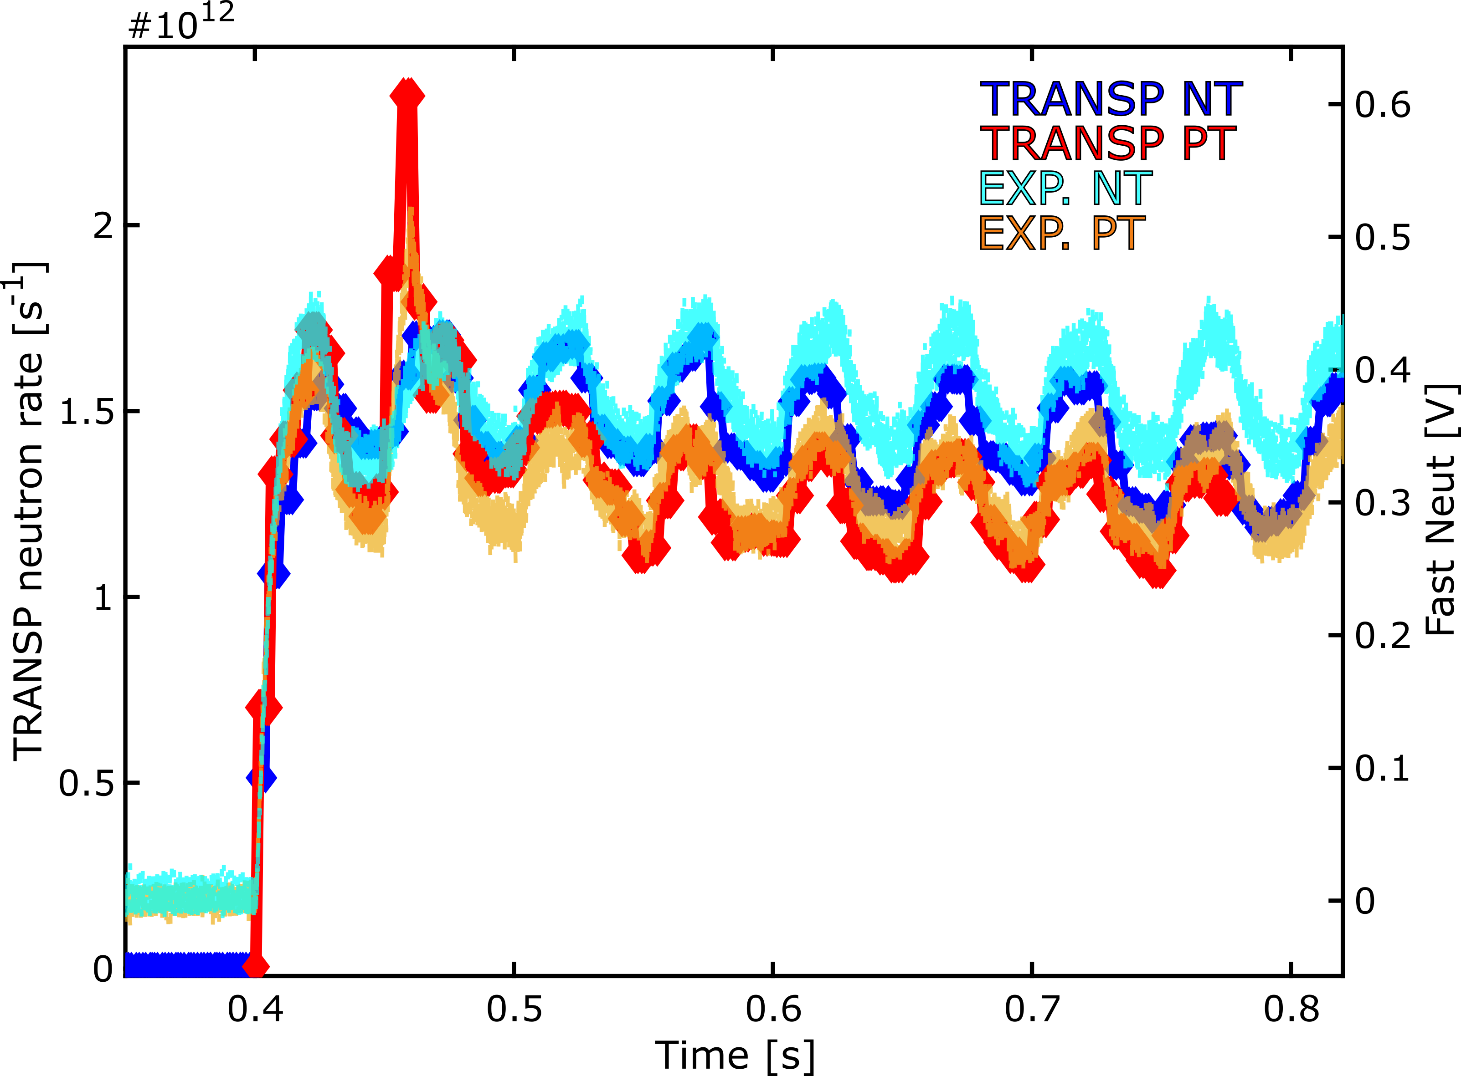
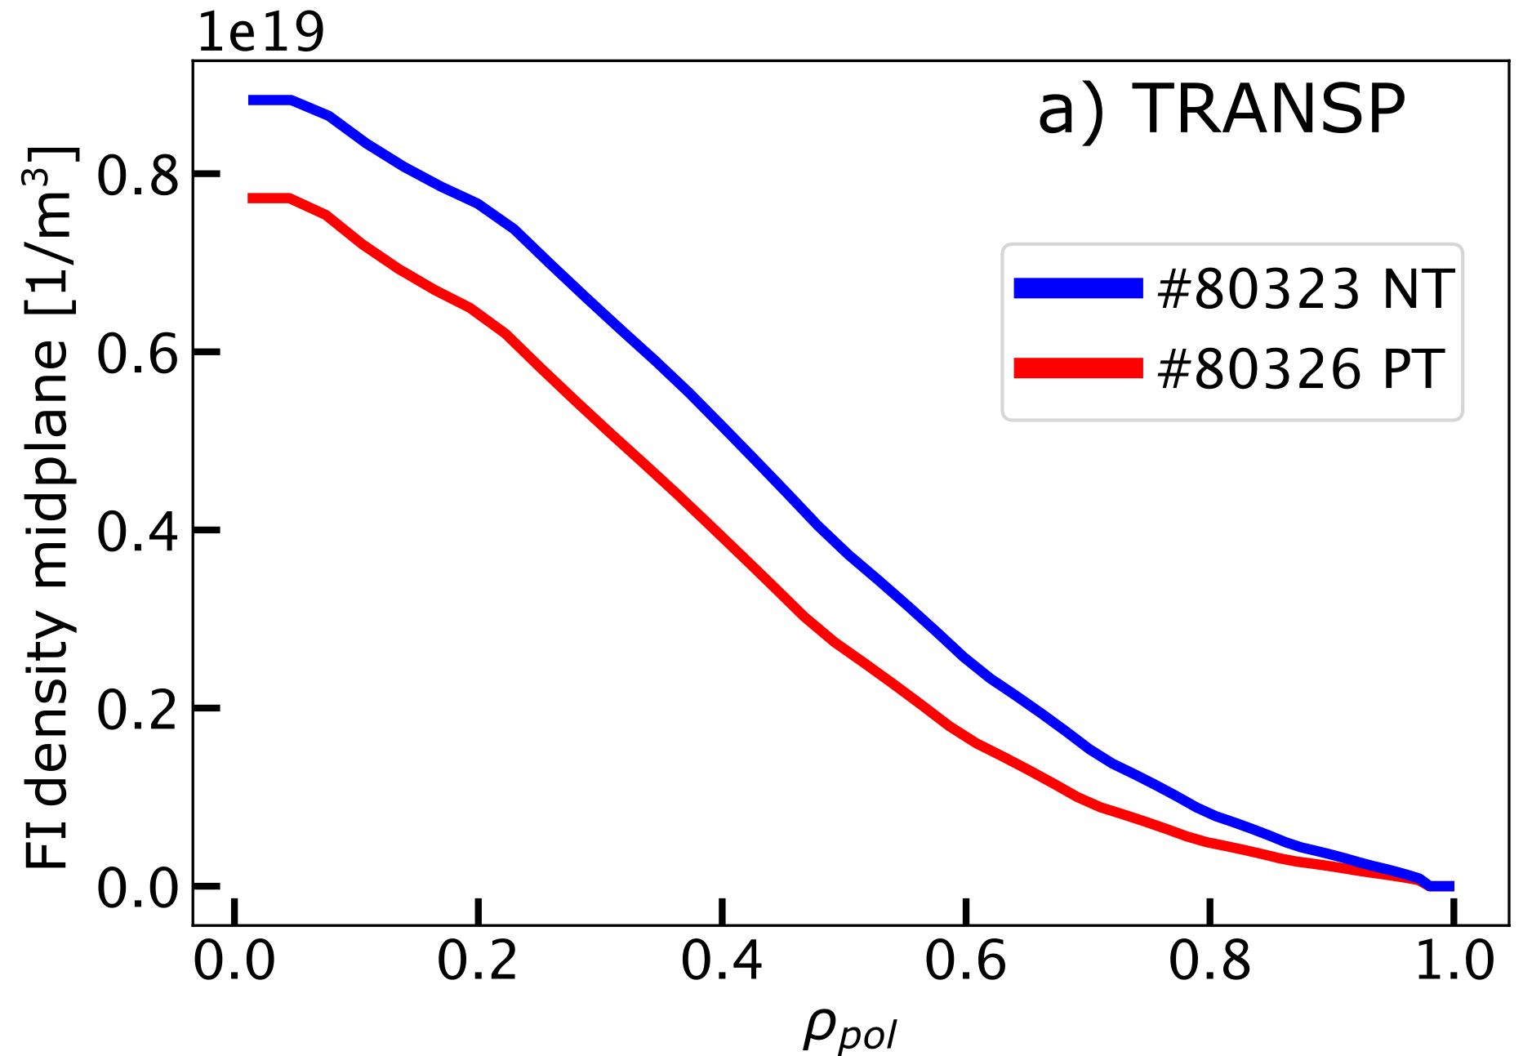
TRANSP modelling validation (part II)
To validate the TRANSP runs, we also check the rise/decay times and the saturation of the neutron rate.
This is well reproduced for both cases, showing a higher neutron rate in NT, as in the experiment.
The Fast-Ion content is also higher at NT.
This agreement indicates that the Fast-Ion transport is well described neoclassically.
t = 0.545 s

Slide 15
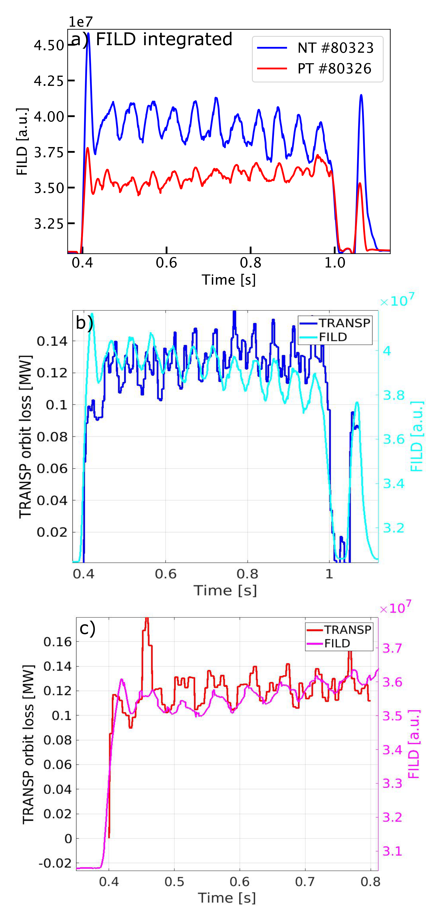
Fast-ion losses are also well modelled
The TRANSP-computed orbit losses match the rise/decay time of the FILD following the NBI-1 power modulations.
The relative amplitude of the fast-ion losses modulations is also well reproduced.
This further indicates that the fast-ion transport is well-reproduced in these simulations.

Slide 16
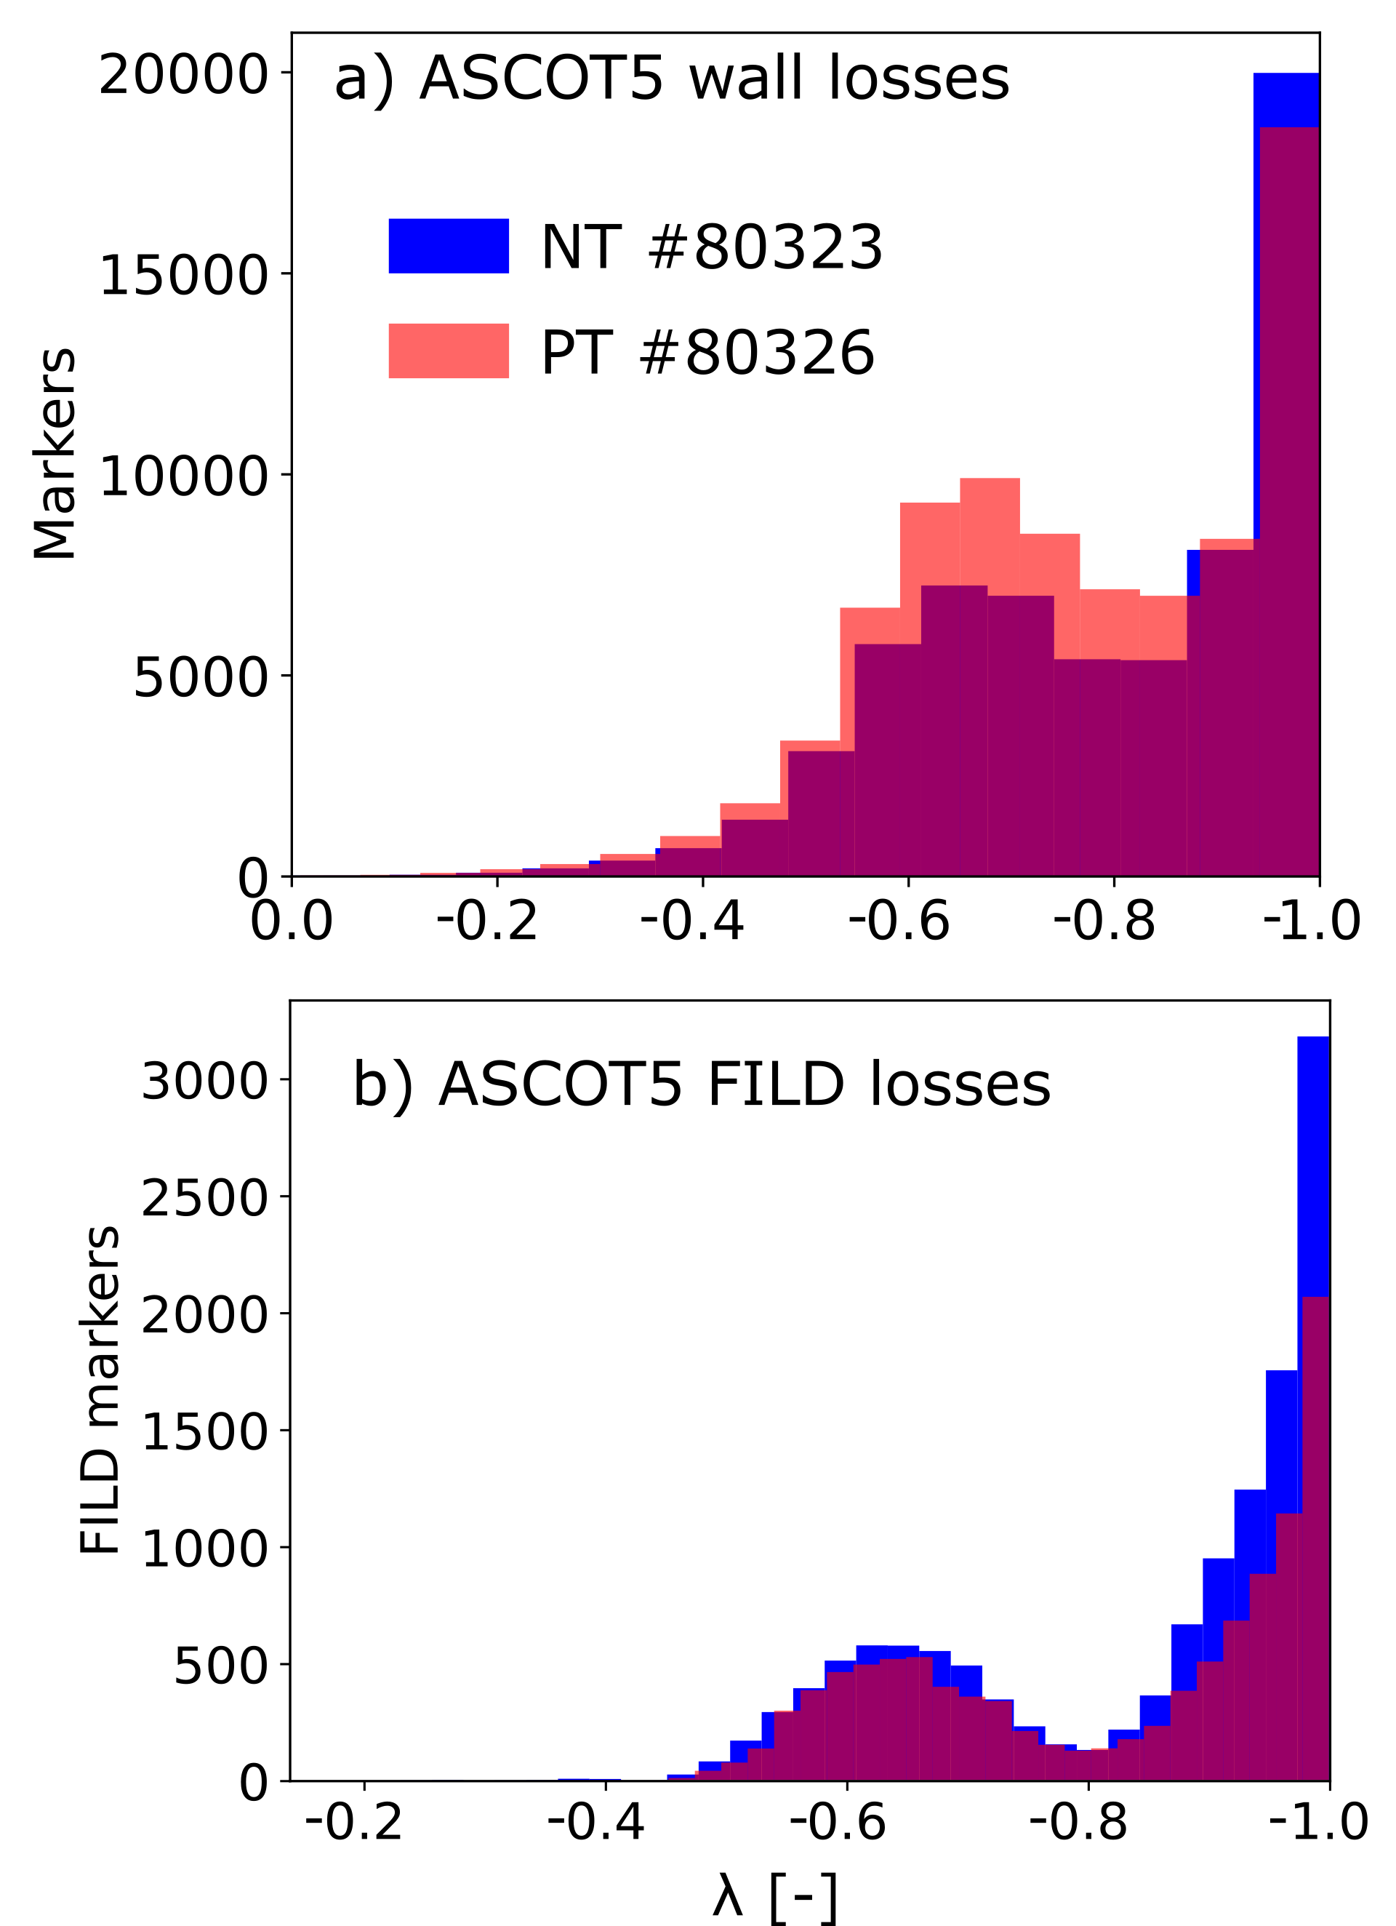
ASCOT modelling shows comparable losses in NT/PT
The ASCOT modelling indicates higher losses in NT only for the FILD.
When accounting for the total wall losses, an equivalent loss fraction is found.
The pitch of the NT losses is largely dominated by passing particles (as observed in the FILD measurements).

Slide 17
Outline
MHD-quiescent plasma
  Experimental measurements
  Modelling
  Conclusions
TAEs on PT vs NT
  Experimental measurements
  Modelling
O
O
O

Slide 18
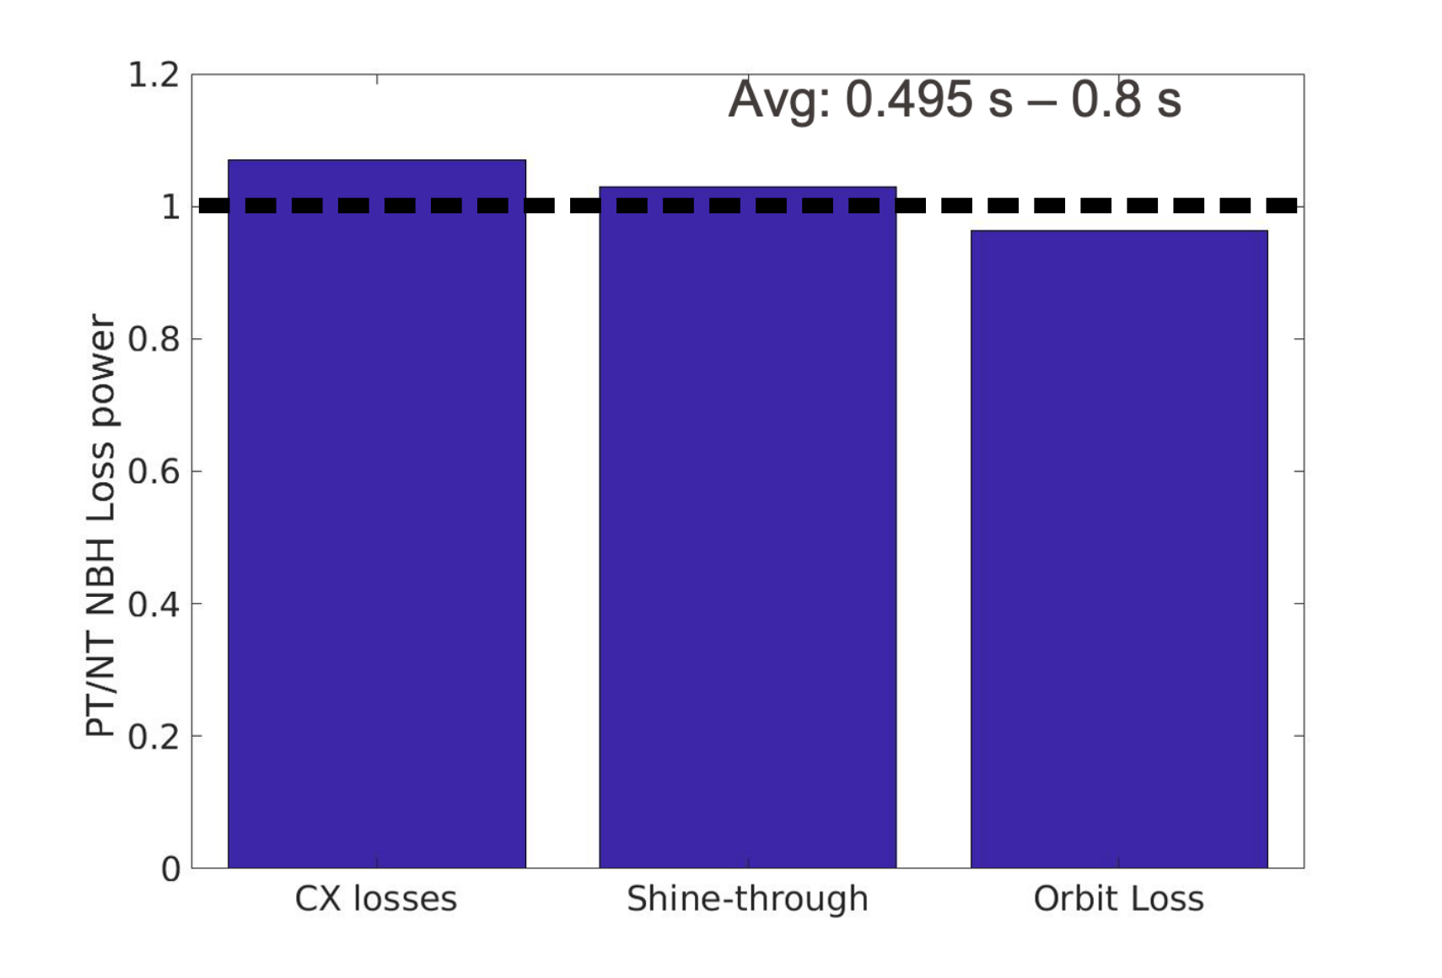
Equivalent fast-ion confinement in NT
The beam shine-through and the orbit losses are similar, indicating that the plasma geometry was not detrimental to the NBI injection. The major difference arises from the CX losses.
Due to the different orbit trajectories inside/outside the confined plasma region, CX losses outside the separatrix are ∼45% higher in NT than in PT. In contrast, within the separatrix, these values are ∼ 20% higher in PT.
Possible to expect that fusion-born fast ions will slow down within the plasma independently of the configuration’s triangularity.
NT-shaped plasmas are reinforced as a promising candidate for high-performance ELM-free operation.
TRANSP
1.11
1.05
0.98
Paper submitted to Nuclear Fusion.

Slide 19
Outline
MHD-quiescent plasma
  Experimental measurements
  Modelling
  Conclusions
TAEs on PT vs NT
  Experimental measurements
  Modelling
O
O
O
O

Slide 20
Investigation of AEs in NT vs PT plasmas in TCV
[1] P. Oyola et al 2023 IAEA FEC
Alfven Eigenmodes are a serious concern for fast-ion confinement in future machines.
Modelling [1] has suggested that TAE amplitudes are lower in TCV-like plasmas, thus a systematic experimental investigation
Studies of TAEs in PT found that counter injection is necessary (often highly off-axis, z~12cm).
Developed a scenario with on-axis heating, at low plasma current, using ECRH for longer fast-ion slowing down times.

Slide 21
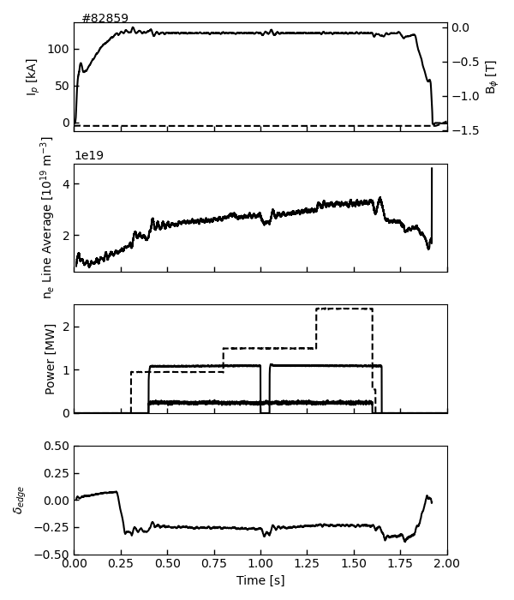
AEs in NT plasmas on TCV using counter NBI
NBI1 in counter injection was used, with NBI2 at low power to probe AE modes with FILD (co-injection is needed for the FILD).

Slide 22
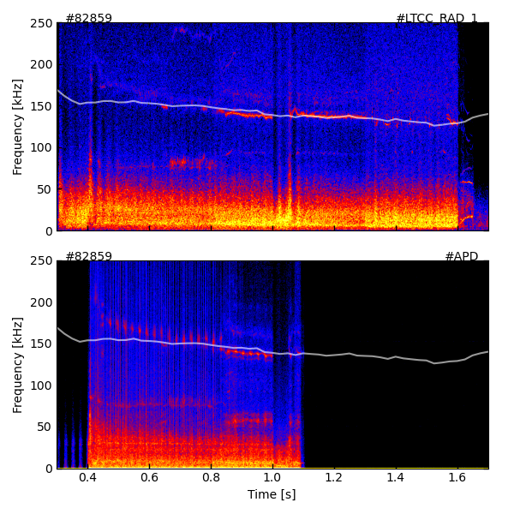
TAE clearly observable in FILD, freq. used to localize mode
NT
NBI1 in counter injection was used, with NBI2 at low power to probe AE modes with FILD.
Typically observe that an EGAM-like mode below 100kHz dominates the MHD spectrum in NT.
Weak TAE-like modes observed.
By using localised ECRH heating (ρ ~ 0.4), we’re able to suppress the GAM and observe TAE clearly.
TAE calculated* to be around ρ ~ 0.85, and losses were seen in FILD.
Magnetics
TAE
ρ ~ 0.85
FILD
TAE
ρ ~ 0.85
FILD retracts
(overheating)
*Based on formula in W.W. Heidbrink PRL 71 (1993)

Slide 23
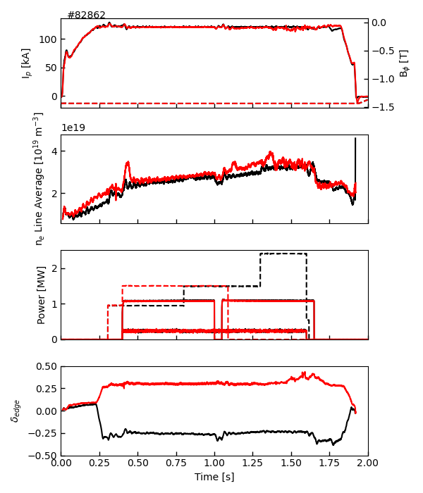
Mirrored PT discharge carried out to compare NT vs PT
Mirrored PT plasma experiments were performed to compare with NT discharges.
Good match in plasma conditions and mirrored absolute triangularity value.
NT: 82859
PT: 82862

Slide 24
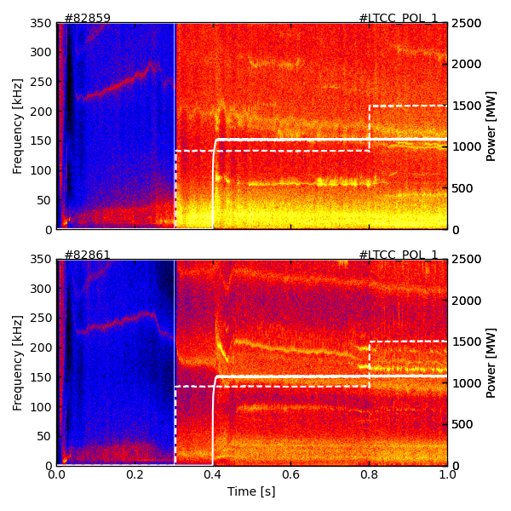
TAEs in PT easy to reproduce and larger amplitude on
NT
Mirrored PT plasma was compared to NT discharges.
Good match in plasma density and mirrored absolute triangularity value.
Low-frequency GAM is seen to have a lower amplitude in the PT scenario, with TAE amplitude larger.
Further analyses to be done on comparison of TAEs in NT vs PT, lots of data available!
NT: 82859
PT
PT: 82862
TAE

Slide 25
Outline
MHD-quiescent plasma
  Experimental measurements
  Modelling
  Conclusions
TAEs on PT vs NT
  Experimental measurements
  Modelling
O
O
O
O
O

Slide 26
FAR3D modelling preliminary results
Work is ongoing:
Modelling still needed!
Results summary:
The simulated mode frequencies from FAR3d match well with what you observed experimentally in TCV.
Negative triangularity plasmas tend to stabilise AEs with toroidal mode numbers n = 4–6.
However, for lower mode numbers (n = 1–3), positive triangularity gives slightly better stabilisation, though the difference is small.
Simulated modes are localised mostly inside ρ < 0.5, i.e., in the plasma core region where triangularity doesn’t strongly differ between NT and PT, so the shaping effect is naturally weaker there.

Slide 27
Thank you for your attention!

