Slide 1
Addressing turbulence questions in the Wendelstein 7-X stellarator device
- a combined experimental and theoretical approach
Josefine H.E. Proll, Paul Mulholland, MJ Pueschel,
Maikel C.L. Morren, Paul Costello, Gavin Weir, Ksenia Aleynikova,
Charlotte Büschel, Markus Wappl, Adrian von Stechow, Sebastian Bannmann, Linda Podavini, Jan-Peter Bähner, Pavlos Xanthopoulos,
Gabriel Plunk, Nico Guth, Emil Overduin and the W7-X Team

Slide 2
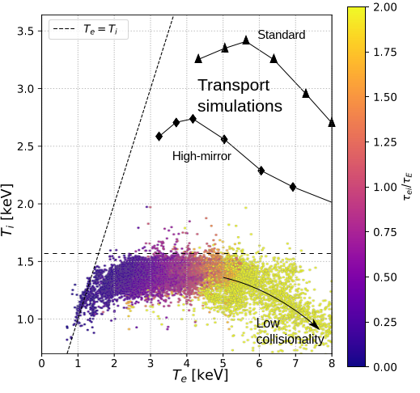
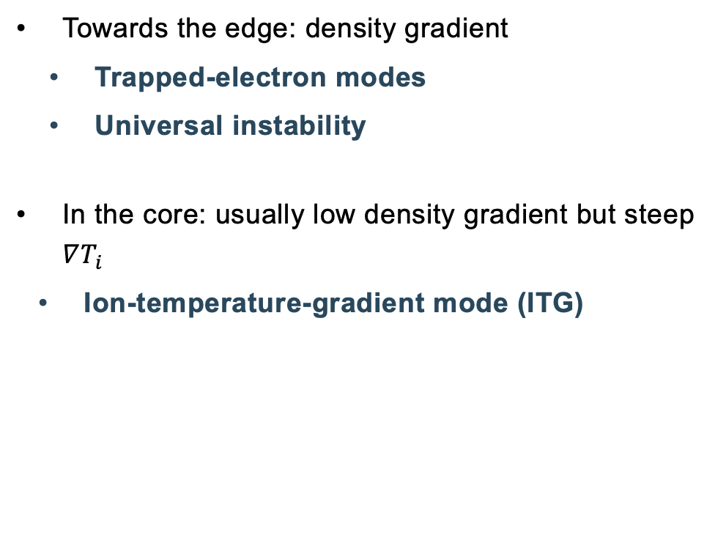
What about realistic scenarios, not only with $∇n$ but also $∇T_{i}$
ITG
TEM
Towards the edge: density gradient
    Trapped-electron modes
    Universal instability
In the core: usually low density gradient but steep $∇T_{i}$
    Ion-temperature-gradient mode (ITG)

Slide 3
Ion-temperature clamping cause by strong ITG turbulence
(just discussed by Linda Podavini)

Slide 4
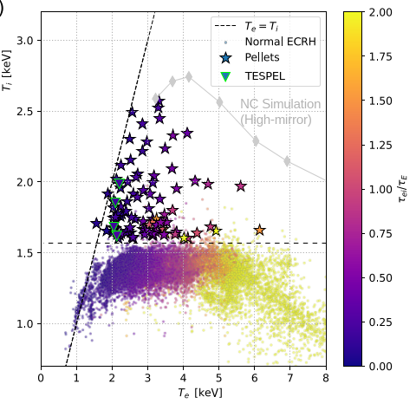
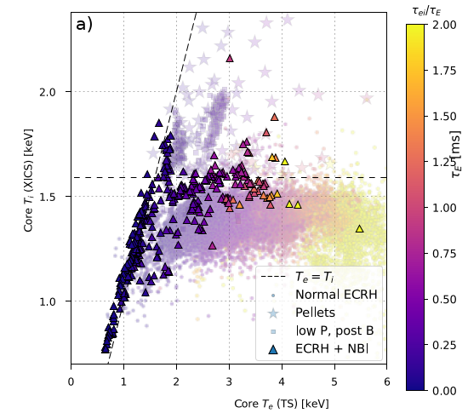
Performance can be improved by adding pellets or neutral beam injection (both: increasing the density gradient!)

Slide 5
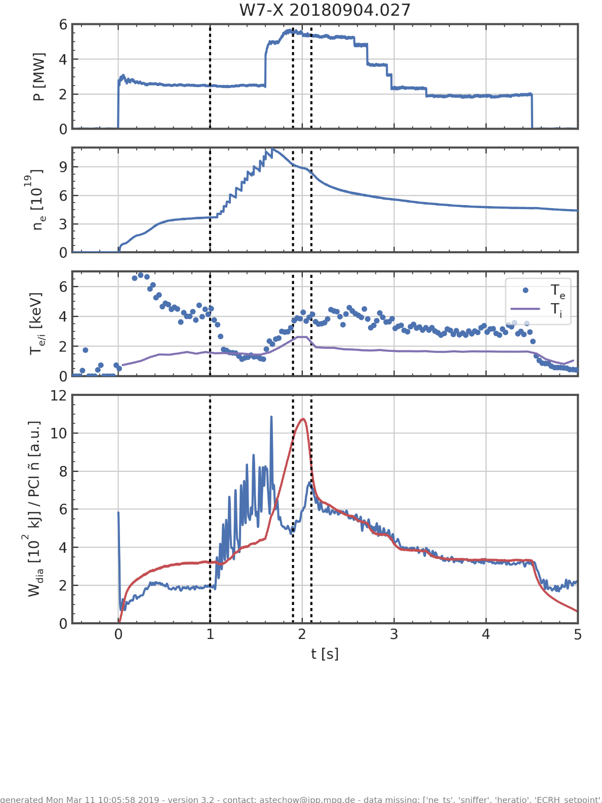
ITGs can be suppressed by $∇n$ (e.g. after pellets) in W7-X
Simulations
[Proll et al, JPP 2022]
Experimental observations
[Bozhenkov et al, NF 2020]
line-integrated density
fluctuation amplitude
diamagnetic energy
Both simulations and experiments show reduction in turbulence after increase of the density gradient (here through pellet injection)
[Xanthopoulos et al, PRL 2020]

Slide 6
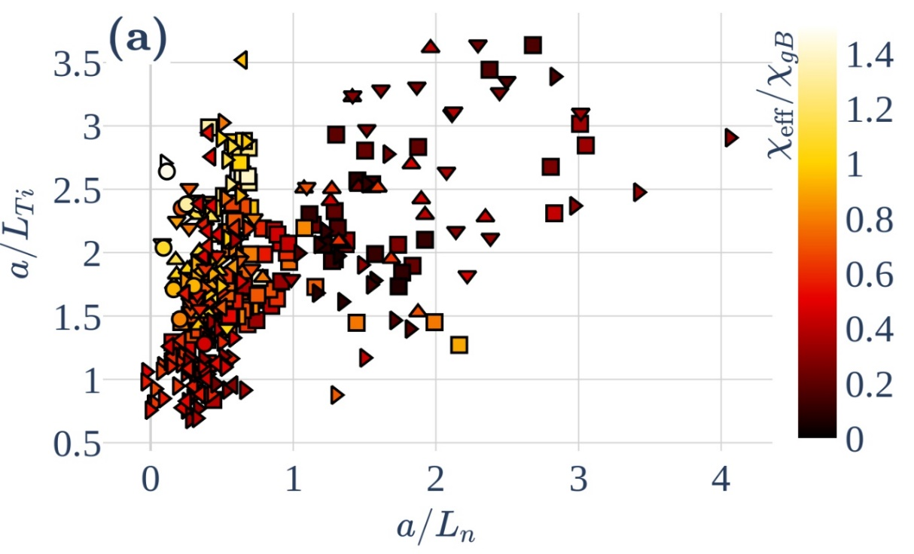
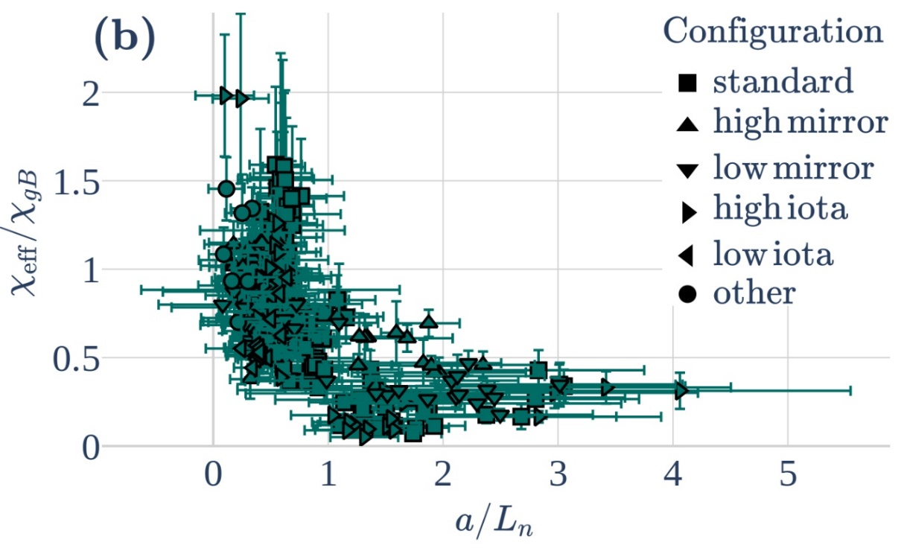
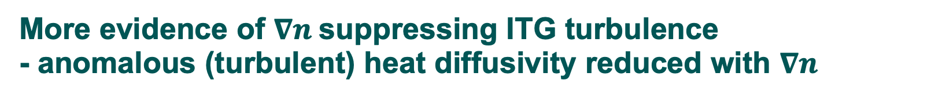
More evidence of $∇n$suppressing ITG turbulence
- anomalous (turbulent) heat diffusivity reduced with $∇n$
Anomalous heat diffusivity found to reduce strongly with increasing density gradient
[M. Wappl]

Slide 7
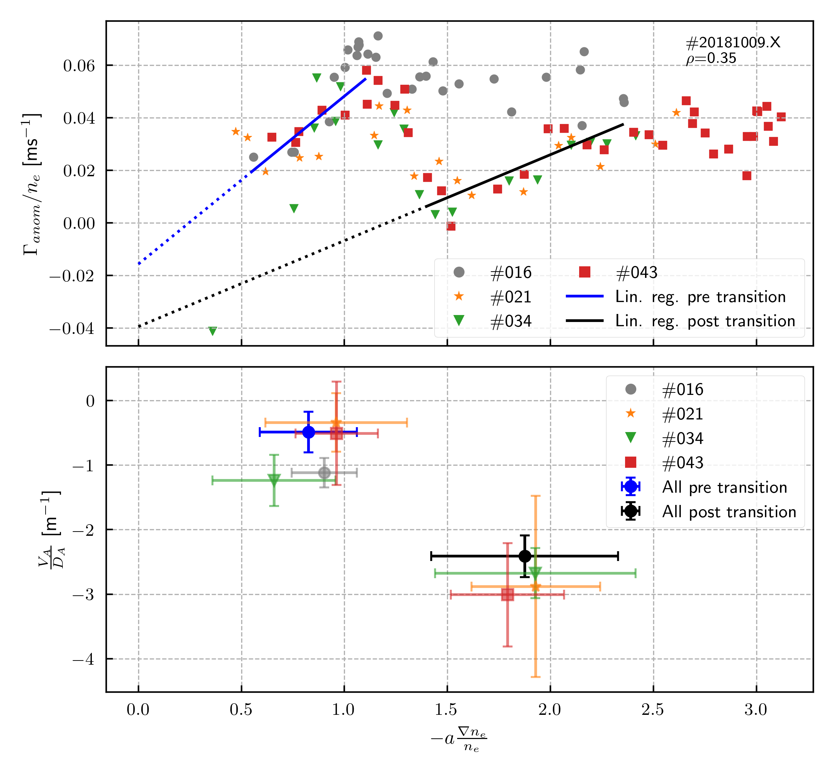

More evidence of $∇n$suppressing ITG turbulence
- anomalous (turbulent) particle transport reduced with $∇n$
Anomalous particle flux found to change strongly with increasing density gradient
[Bannmann et al, Nucl. Fusion 2024]

Slide 8
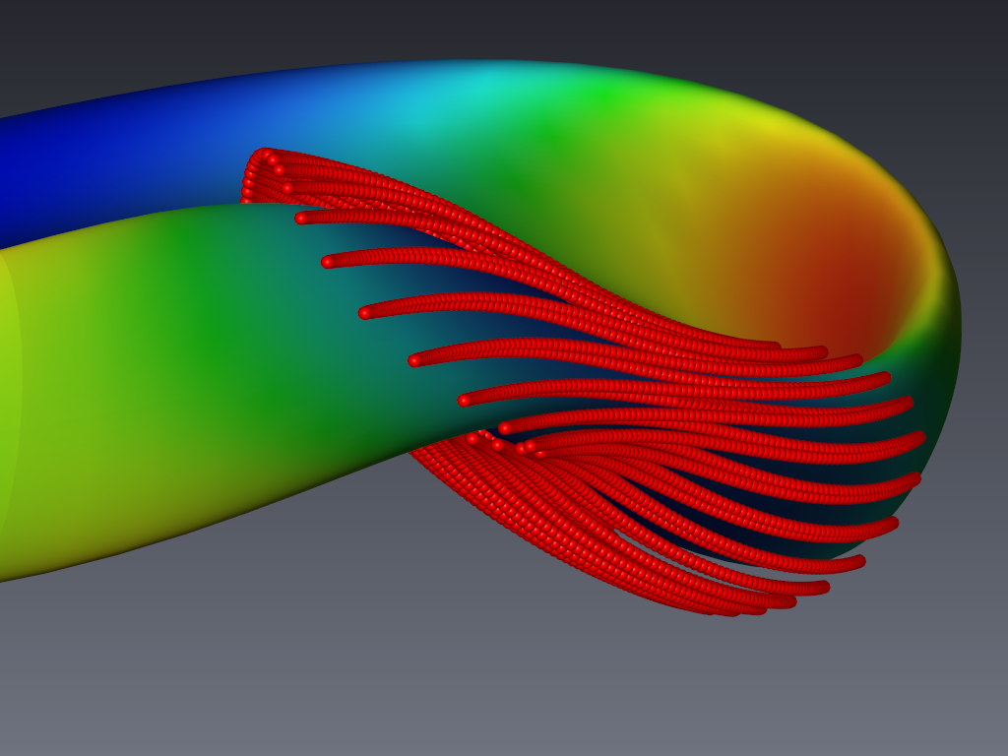
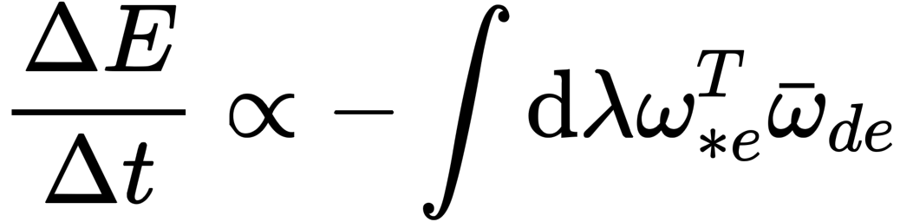
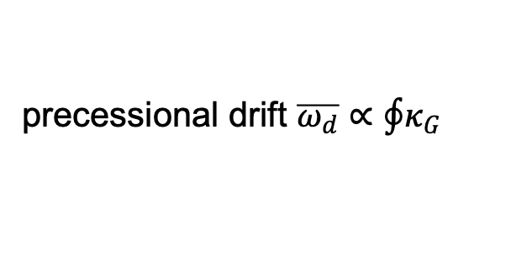
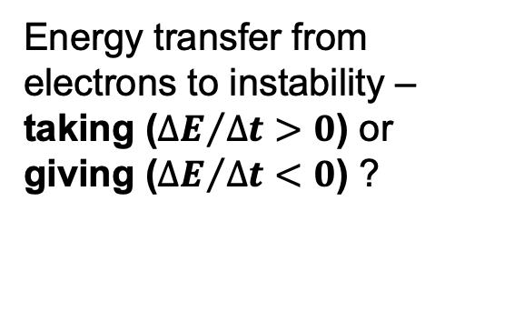
Mechanism of the trapped-electron mode (TEM)
Drift waves due to density gradient
Particles trapped in B region: precessional movement
diamagnetic drift $ω_{∗}^{T}∝∇n$
precessional drift $\overline{ω_{d}}∝\oint{κ_{G}}$
Energy transfer from
electrons to instability – taking (${∆E}/{∆t}>0$) or
giving (${∆E}/{∆t}<0$) ?
Energy to the instability
only for resonance of frequencies!

Slide 9
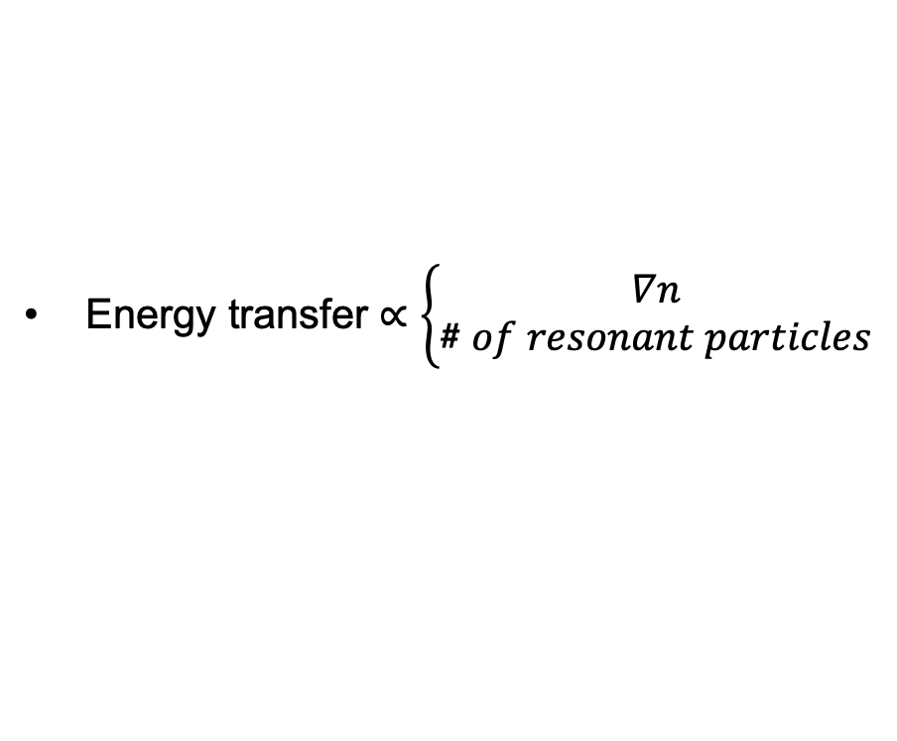
Mechanism of the trapped-electron mode (TEM)
Drift waves due to density gradient
Particles trapped in B region: precessional movement
depends heavily on the geometry and on the path the particles take!
diamagnetic drift $ω_{∗}^{T}∝∇n$
precessional drift $\overline{ω_{d}}∝\oint{κ_{G}}$
Energy transfer $∝\left\{\begin{aligned}∇n \\ \#\#\#\#\#\#\#\text{\#} of resonant particles\end{aligned}\right.$

Slide 10
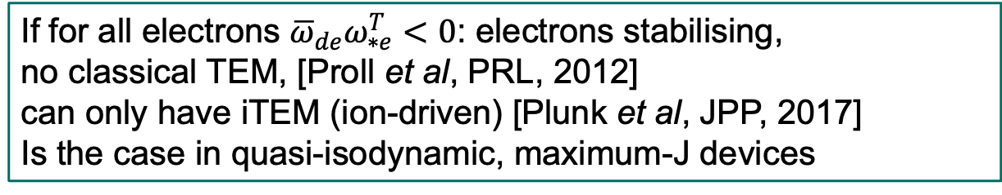
Mechanism of the trapped-electron mode (TEM)
Drift waves due to density gradient
Particles trapped in B region: precessional movement
diamagnetic drift $ω_{∗}^{T}∝∇n$
precessional drift $\overline{ω_{d}}∝\oint{κ_{G}}$
If for all electrons ${\overline{ω}}_{de}ω_{∗e}^{T}<0$: electrons stabilising,
no classical TEM, [Proll et al, PRL, 2012]
can only have iTEM (ion-driven) [Plunk et al, JPP, 2017]
Is the case in quasi-isodynamic, maximum-J devices

Slide 11
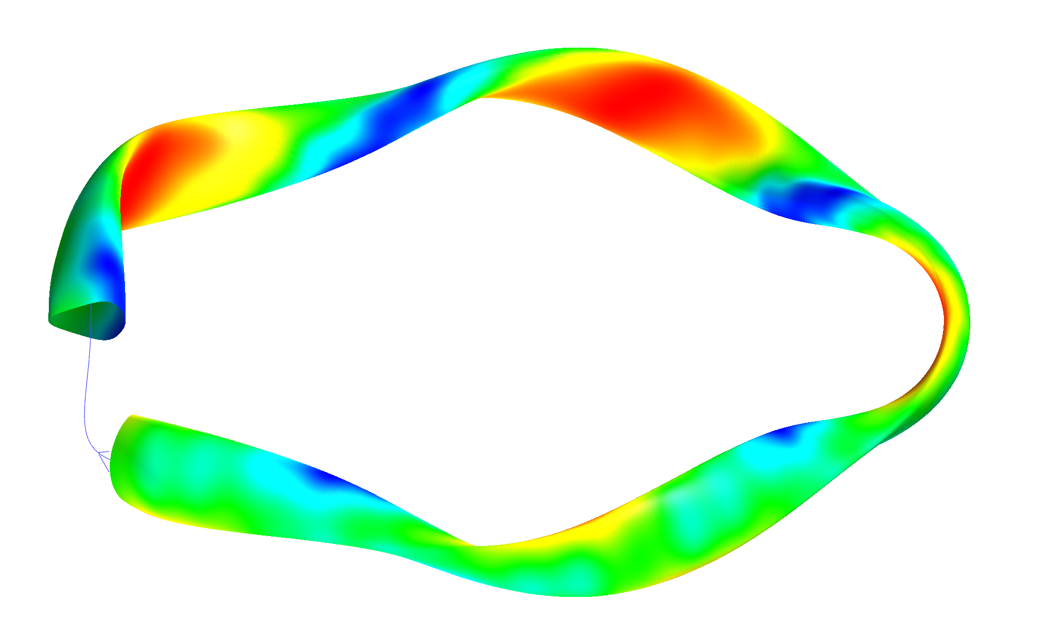
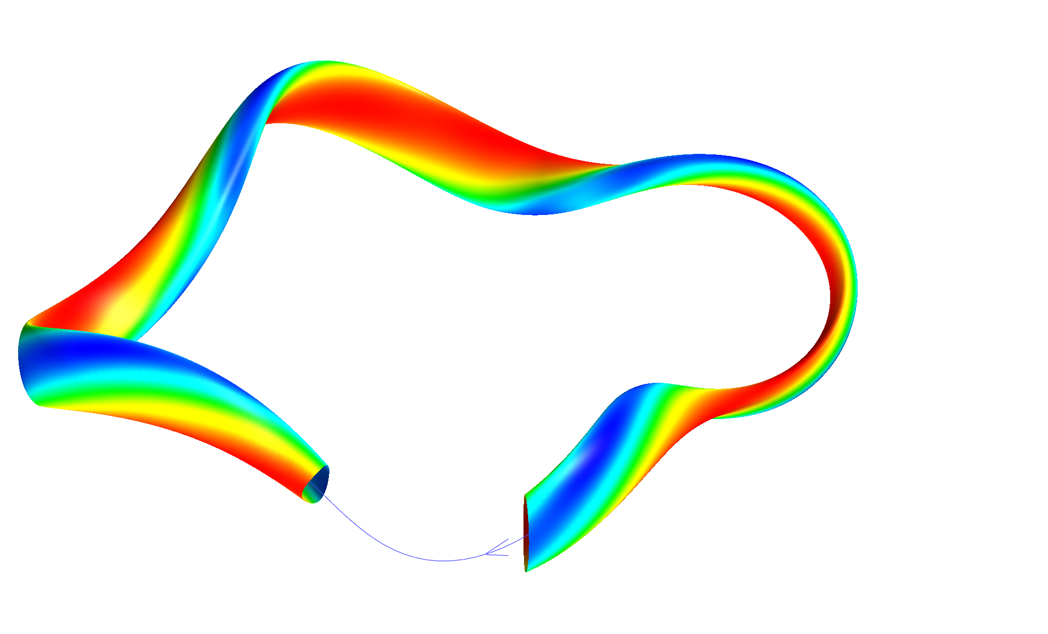
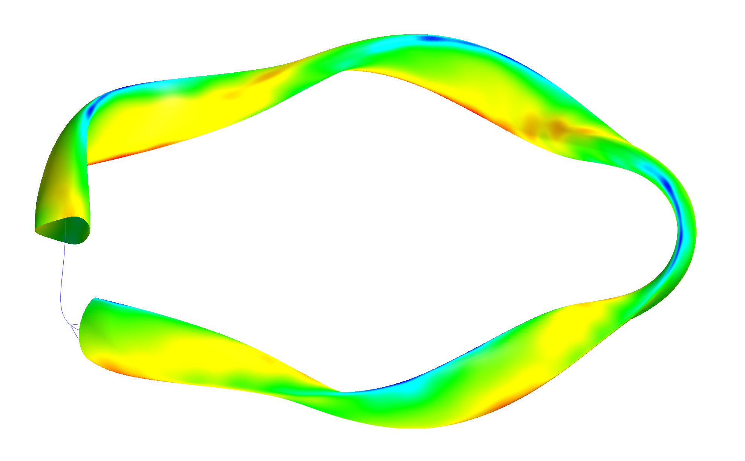
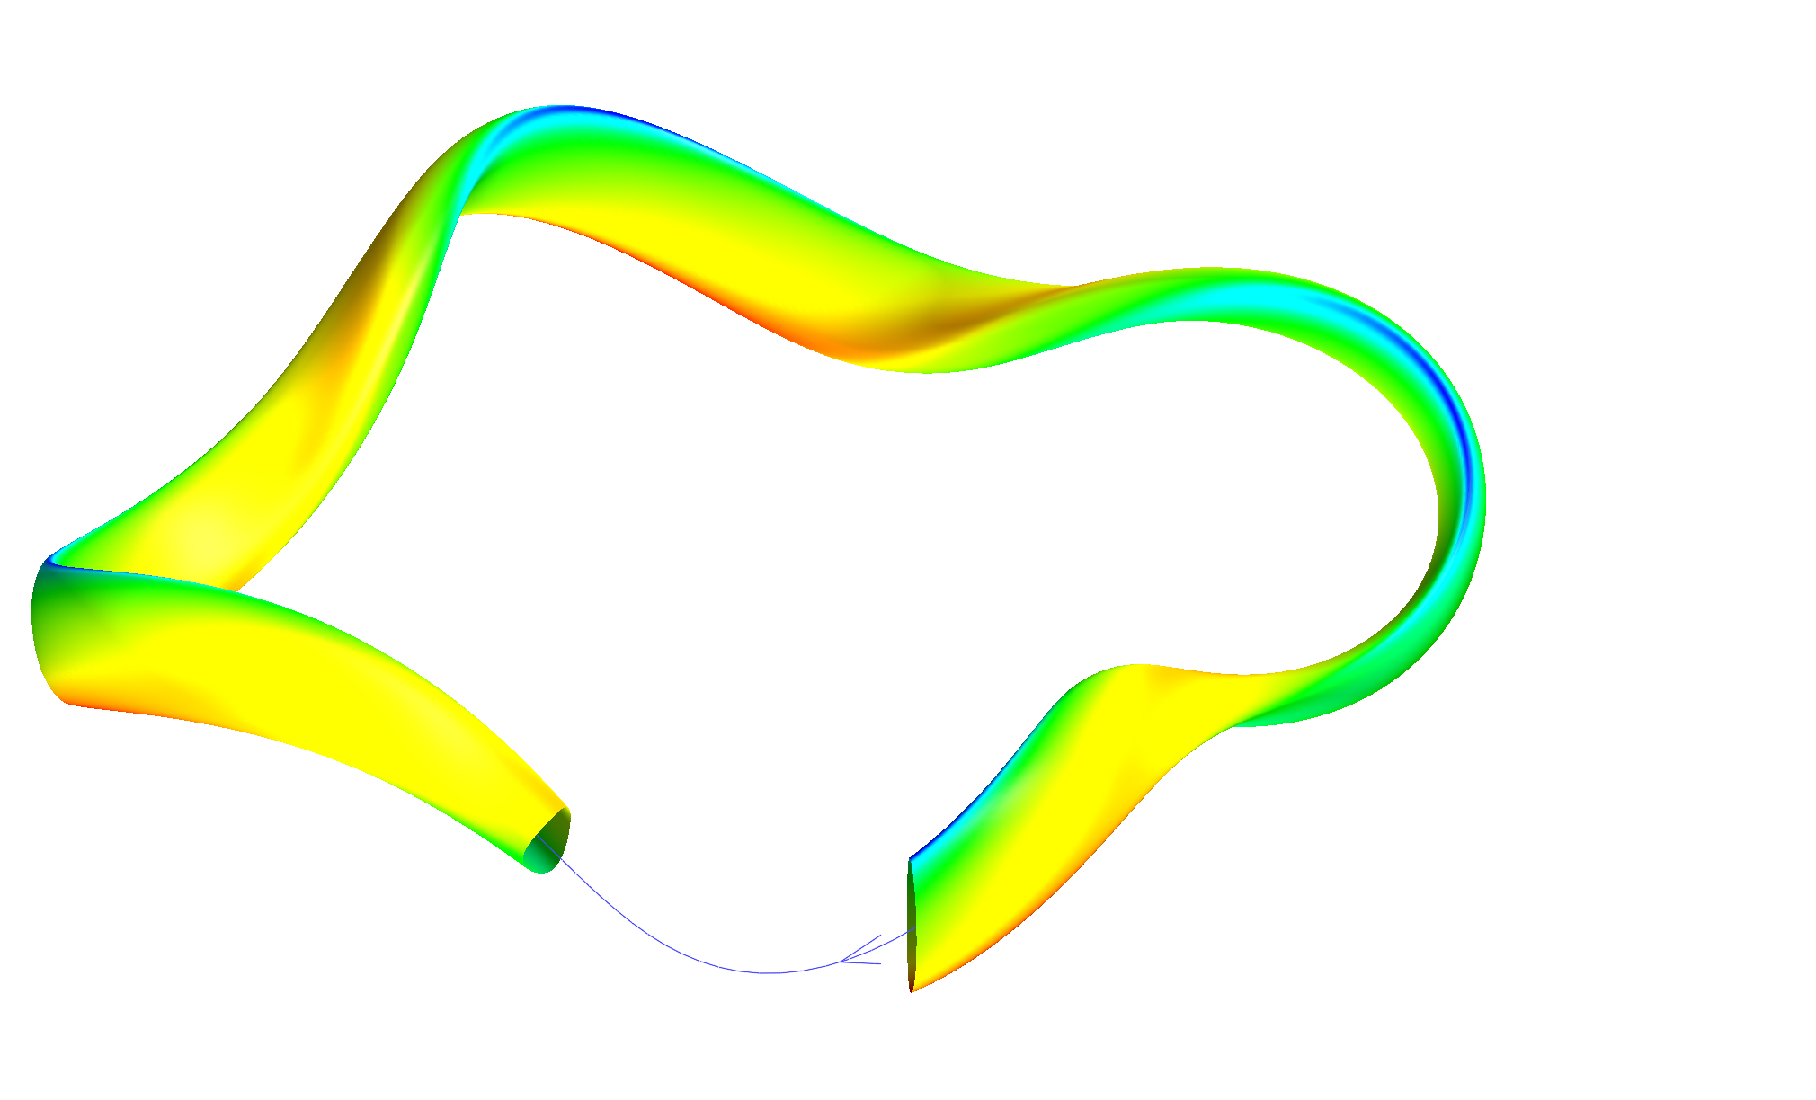
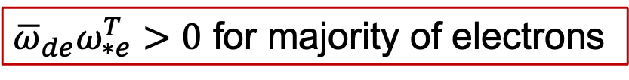
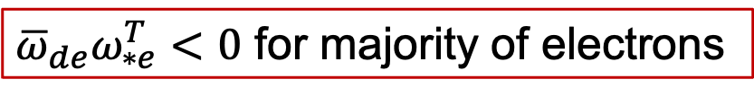

Trapped particles experience different curvature
Wendelstein 7-X
HSX
Magnetic field strength B
Location of trapped particles
Curvature $κ$
Location of strong curvature
${\overline{ω}}_{de}ω_{∗e}^{T}<0$ for majority of electrons
${\overline{ω}}_{de}ω_{∗e}^{T}>0$ for majority of electrons

Slide 12
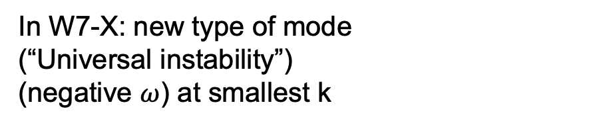
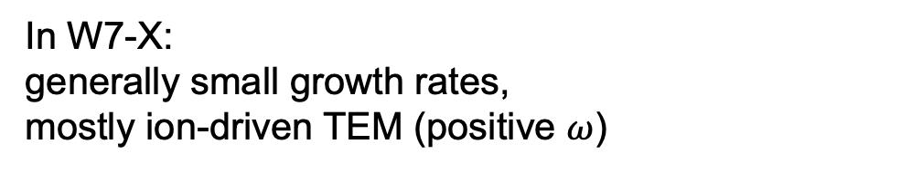
Trapped-electron modes ($∇n−$driven) - linear
Linear simulations with GENE with a/L_{n}=3
In W7-X:
generally small growth rates,
mostly ion-driven TEM (positive $ω$)
In W7-X: new type of mode
(“Universal instability”)
(negative $ω$) at smallest k
Electron-driven TEM indeed weak in W7-X
[J. Proll et al. JPP 2022]

Slide 13
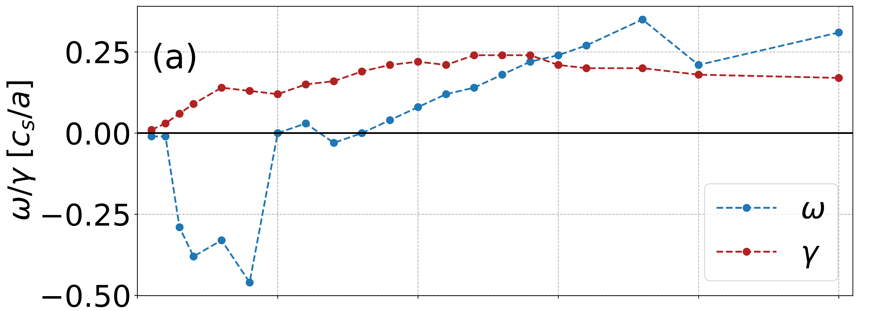
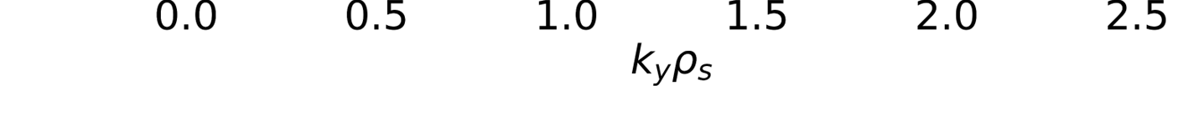
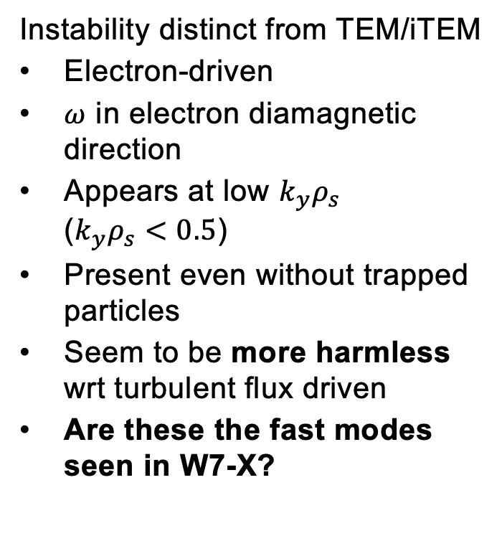
The Universal Instability shows up when TEMs are stabilised
Instability distinct from TEM/iTEM
Electron-driven
$ω$ in electron diamagnetic direction
Appears at low $k_{y}ρ_{s}$
($k_{y}ρ_{s}<0.5$)
Present even without trapped particles
Seem to be more harmless wrt turbulent flux driven
Are these the fast modes seen in W7-X?
[Costello, Proll et al, JPP 2023]

Slide 14
Lower heat flux thanks to the universal instability
Nonlinear
quasi-linear
UI kicks in

Slide 15
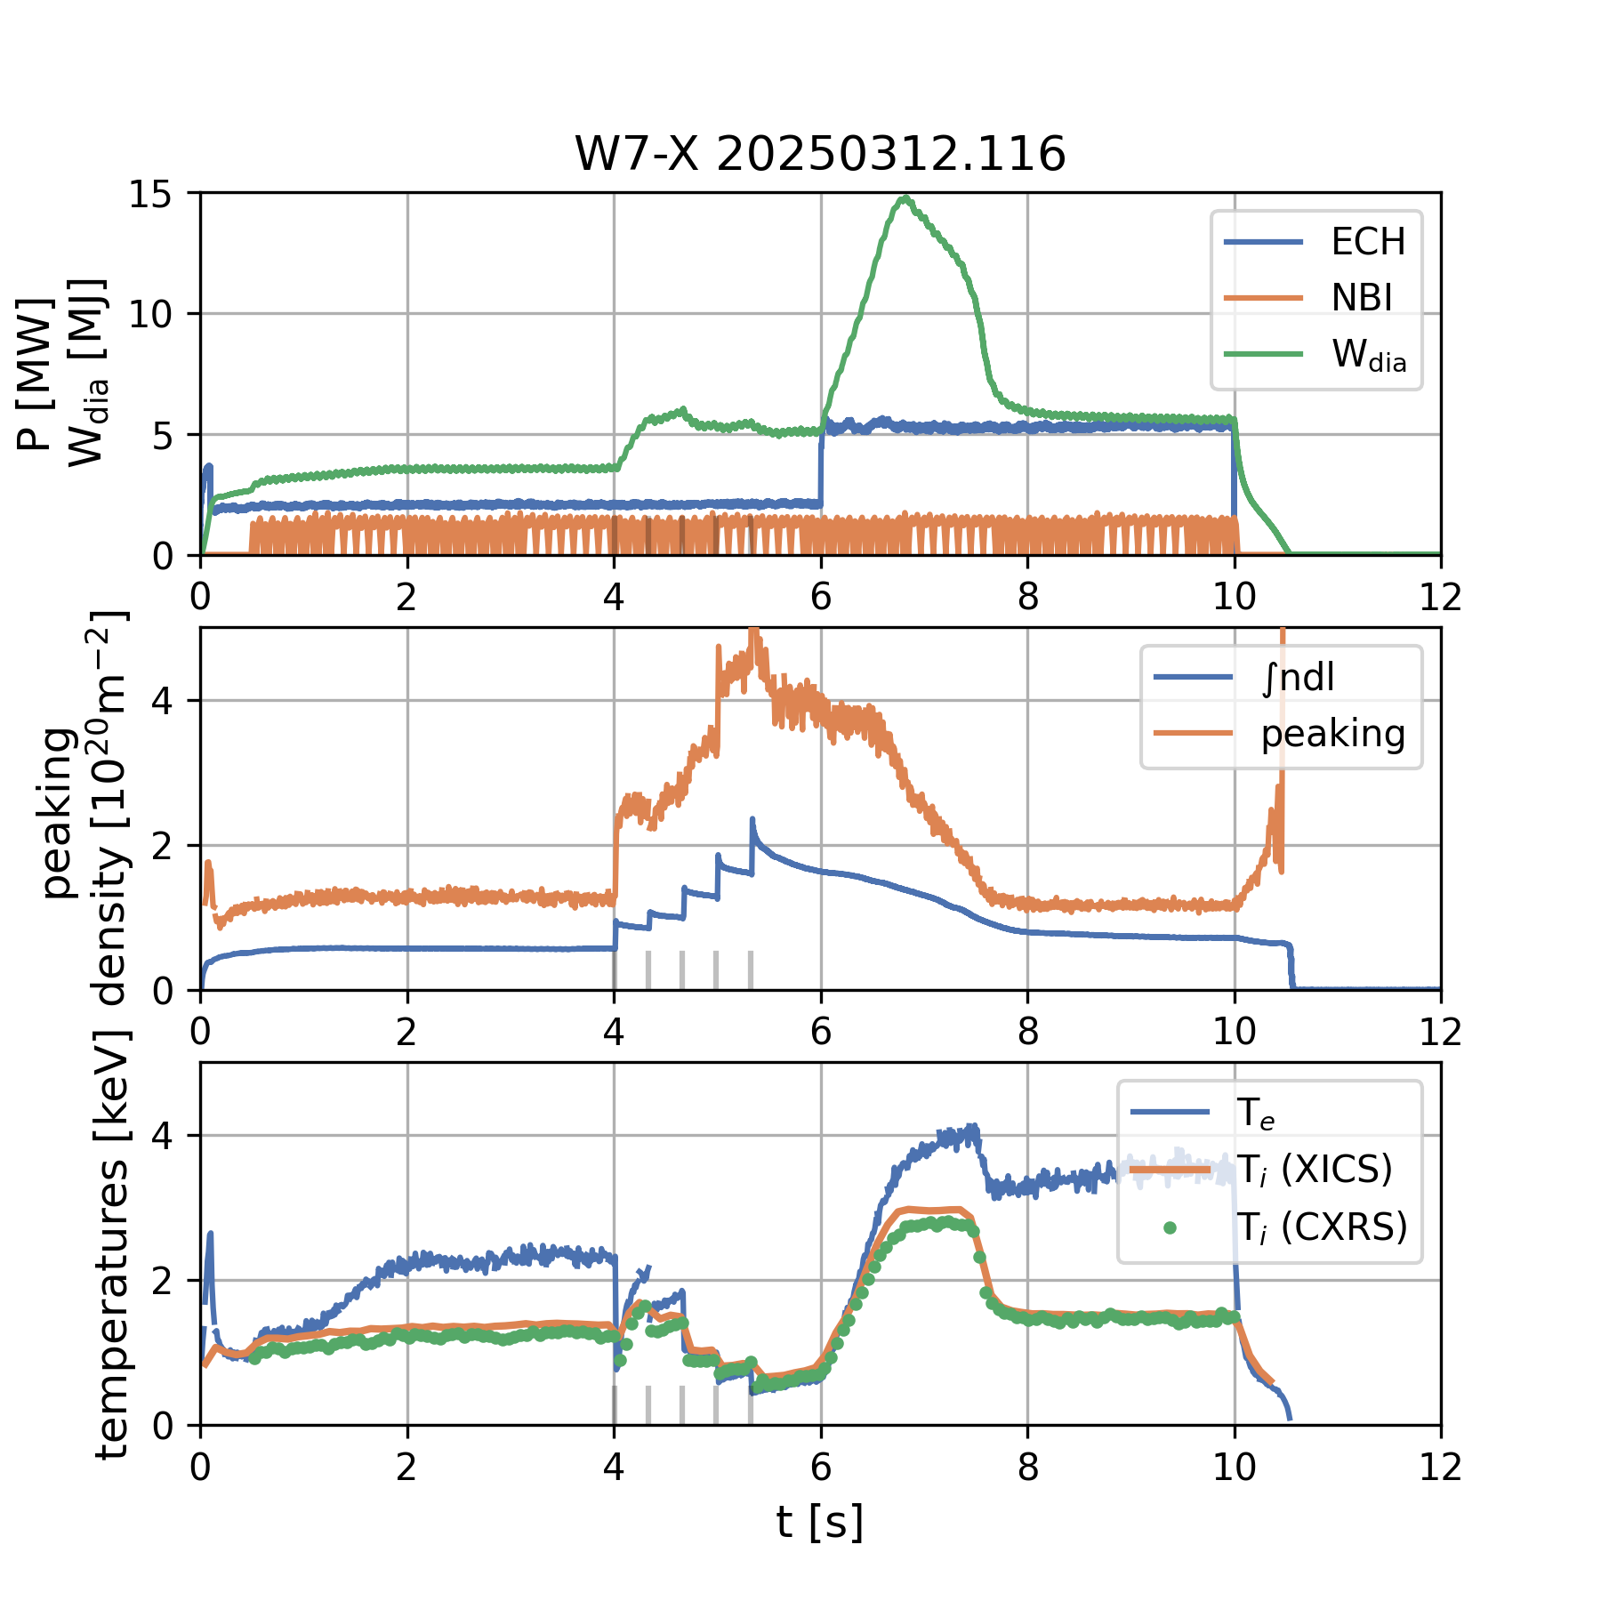
High performance scenario A: pellet injection series + ECH power step
[A. v. Stechow, in prep.]
pellet series injection at low ECH power: high density peaking [n_{e}(ρ=0)/n_{e}(ρ=0.8)] > 4
large P_{ECH} step up after pellet injection series
high (but transient) resulting W_{dia} (1.5MJ) and
T_{i} (~3 keV)
peaking sustained for 0.6s after power step
decay to flat profile in 1s
peaking < 1.5: rapid T_{i}, W_{dia} collapse
  trade-off due to ECH effect on peaking:
  low P_{ECH} + longer peaking duration vs.
  high P_{ECH} + higher T_{i}

Slide 16
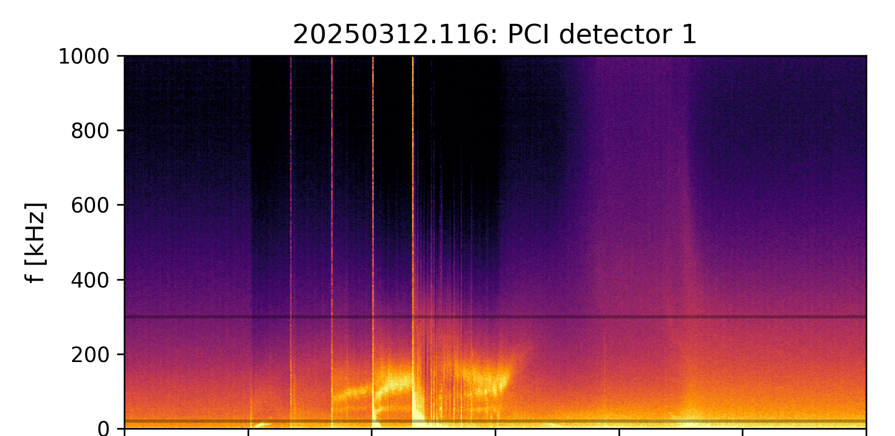
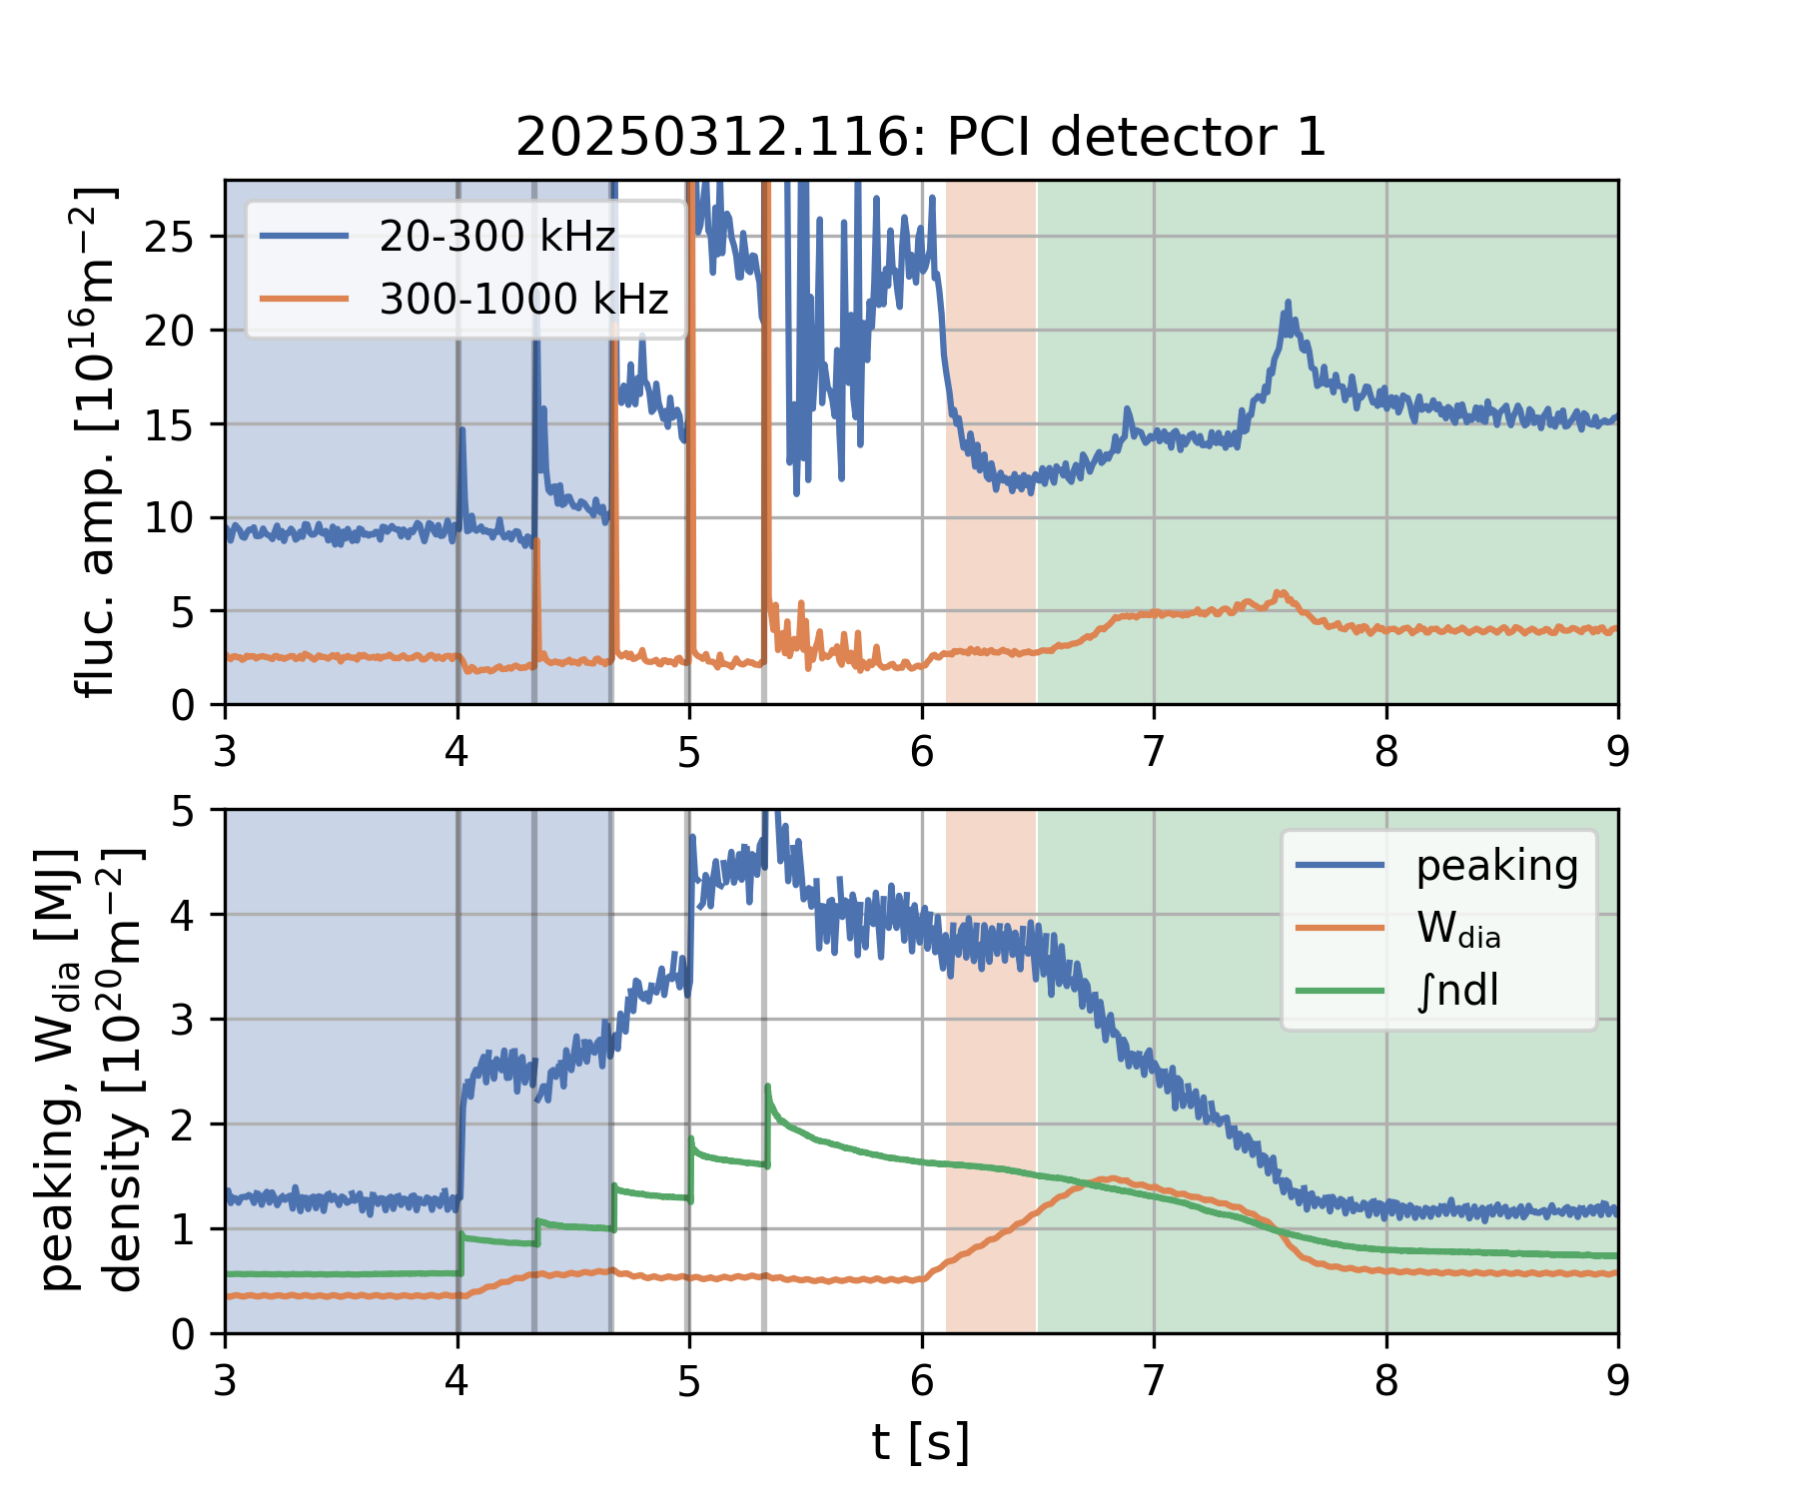
High performance scenario A: density turbulence response [A. v. Stechow, in prep.]
low broadband turbulence during high peaking
low frequency (<500kHz) amplitude scales:
    linearly with density [1,2]
    inversely with peaking
    positively with P_{ECH} [1,2]
HF signal (>300kHz) during peaking decay
descending mode + broadband spike on final T_{i} drop
  W_{dia} maximum correlates with start of peaking decay and increase of HF fluctuations
[1] J-P Bähner et al., J. Plasma Phys. 87 (2021) 905870314
[2] J-P Bähner, L Podavini et al., subm. to Nucl. Fusion

Slide 17
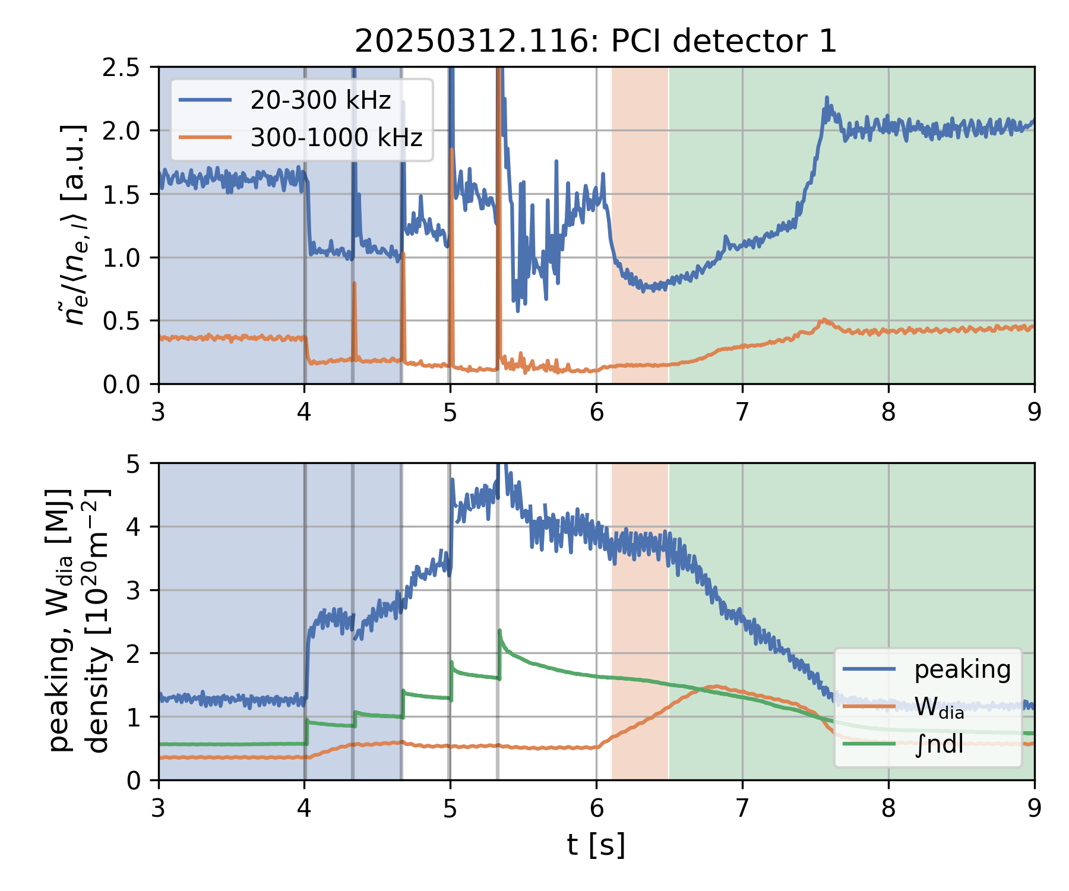
High performance scenario A: density turbulence response (normalized fluctuations)
low broadband turbulence during high peaking
low frequency (<500kHz) amplitude scales:
    linearly with density [1,2]
    inversely with peaking
    positively with P_{ECH} [1,2]
HF signal (>300kHz) during peaking decay
descending mode + broadband spike on final T_{i} drop
  W_{dia} maximum correlates with start of peaking decay and increase of HF fluctuations
[1] J-P Bähner et al., J. Plasma Phys. 87 (2021) 905870314
[2] J-P Bähner, L Podavini et al., subm. to Nucl. Fusion

Slide 18
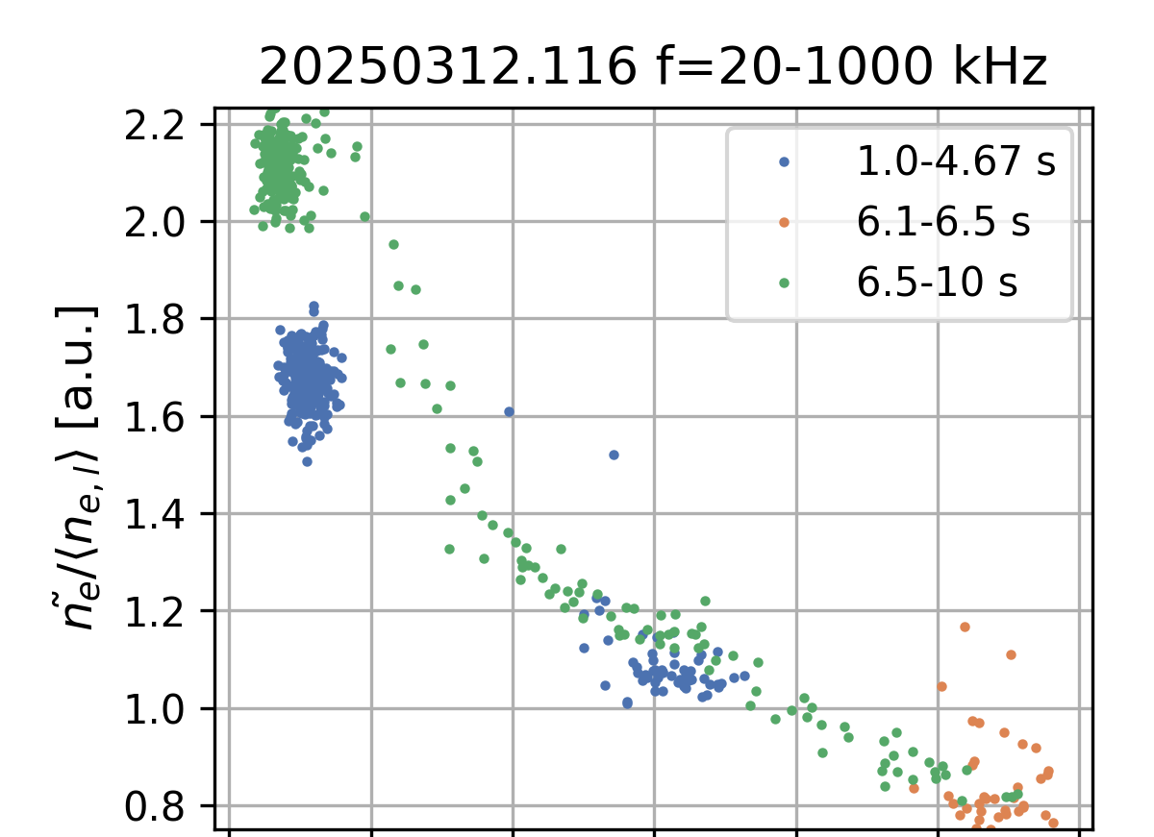
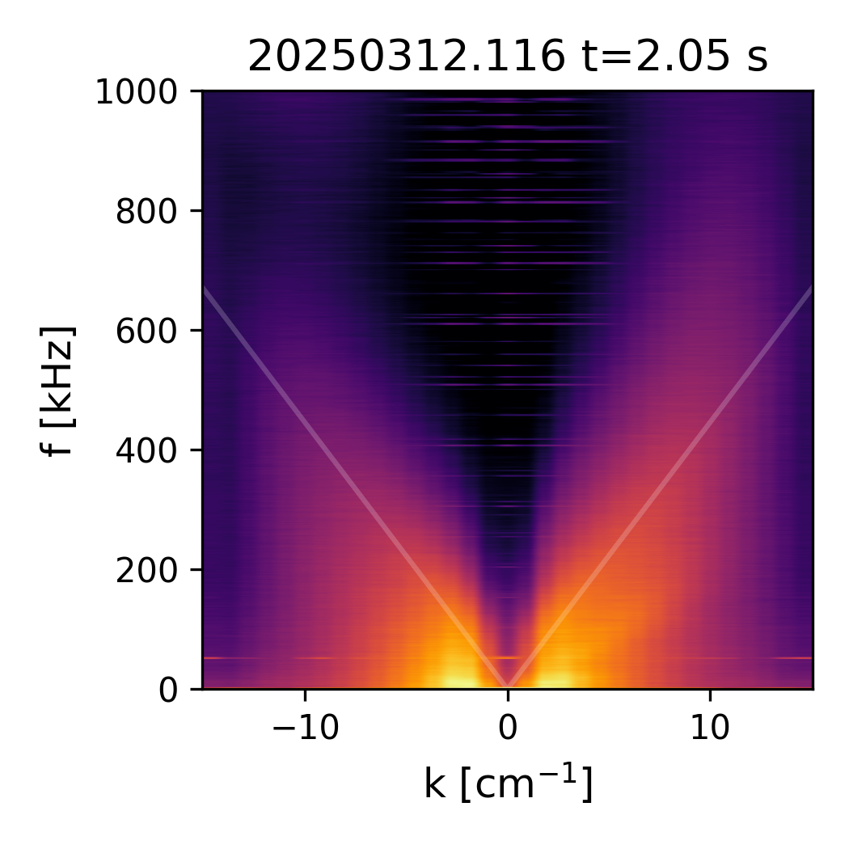
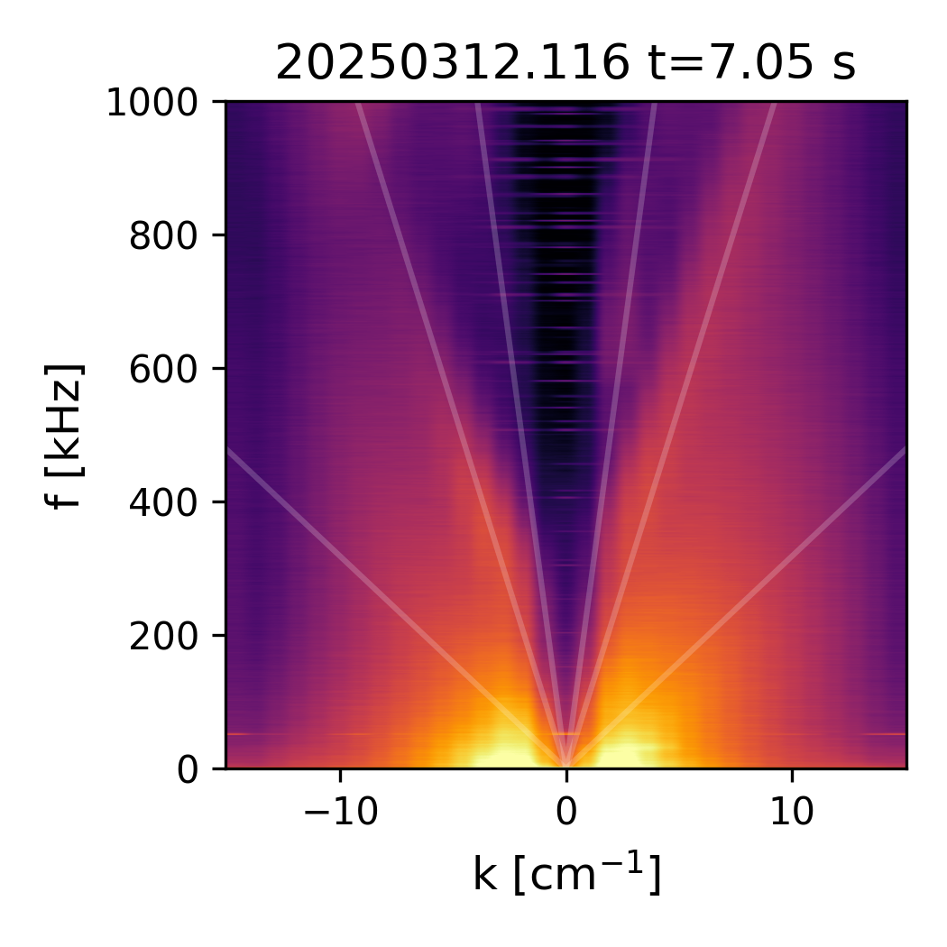
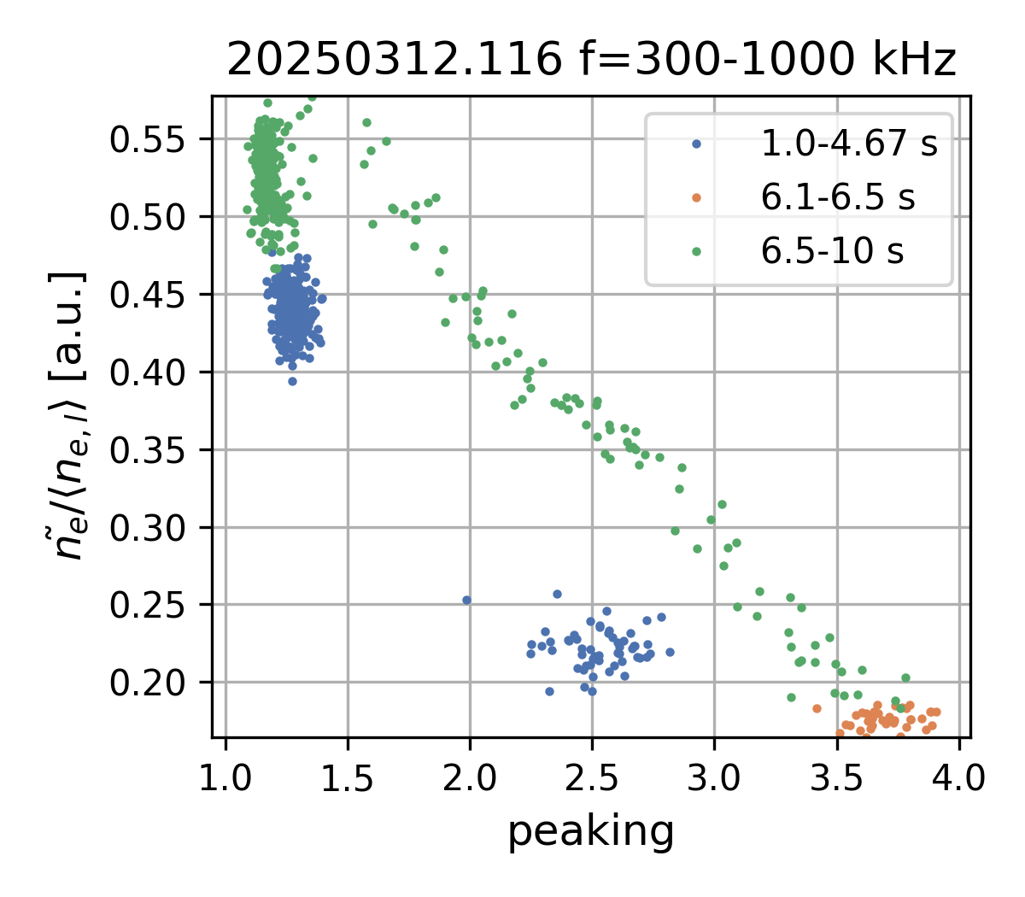
High performance scenario A: correlation of turbulence with global parameters
density-normalized low frequency fluctuations:
density peaking is a strong ordering parameter
HF fluctuations: asymmetric on rise + fall of peaking:
possible instability responsible for decay?
frequency-wavenumber spectra: increase in HF signal are additional, high velocity (6-18km/s) modes
pre-peaking
peaking decay
16 km/s
6.8 km/s
2.8 km/s
2.0 km/s

Slide 19
New results: ITG-suppresion maybe not the only mechanism, but MicroTearingModes (MTMs) leading to small transport instead?

Slide 20
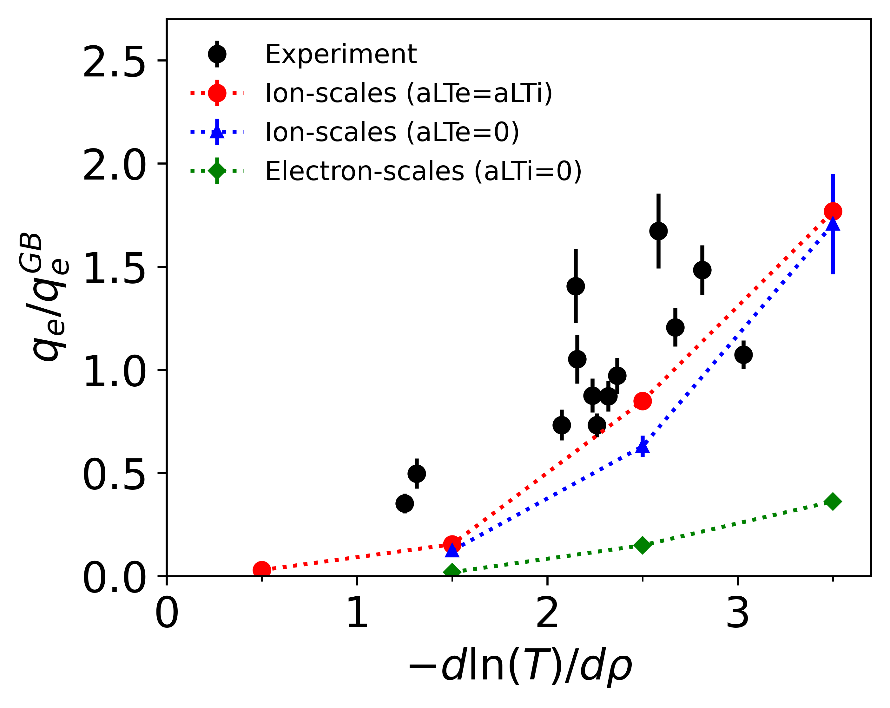
Also confirmed in theory, simulations and experiment: electron-scale turbulence is relatively weak
Heat fluxes in experiment from heat pulse propagation experiments
Simulations without electron scales sufficient to explain observations
Electron scale turbulence rather small, as also predicted by theory
[G.G. Plunk et al PRL 2019]
Valid at least for cases with comparable ion/electron drive (similar gradients)
[G.M. Weir et al, in prep]

Slide 21
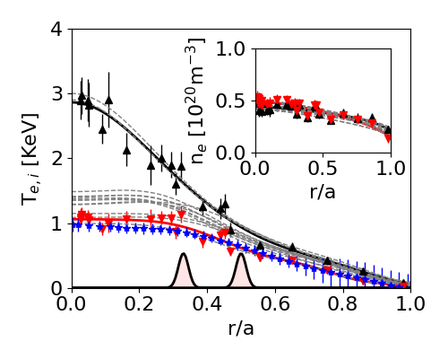
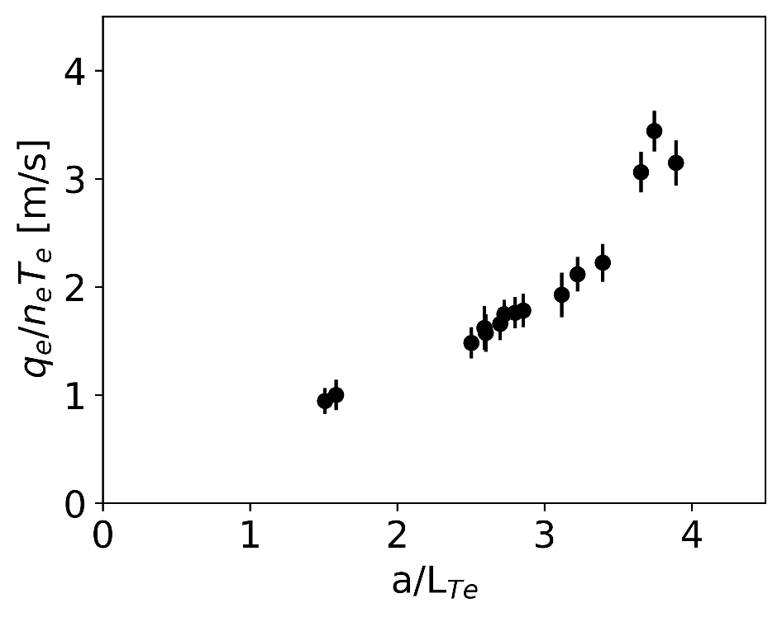
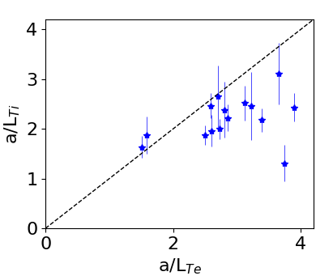

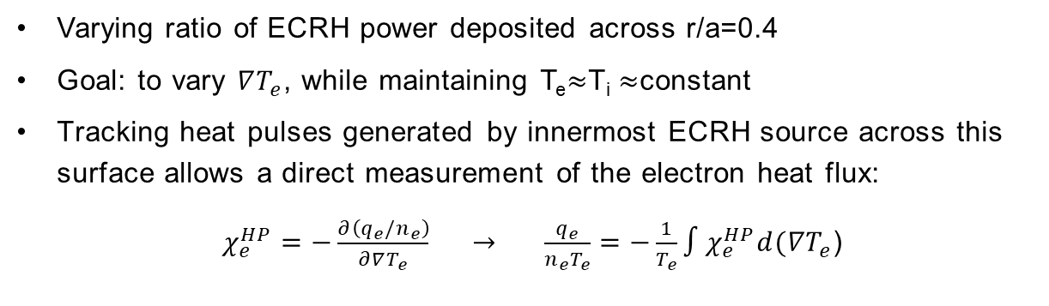

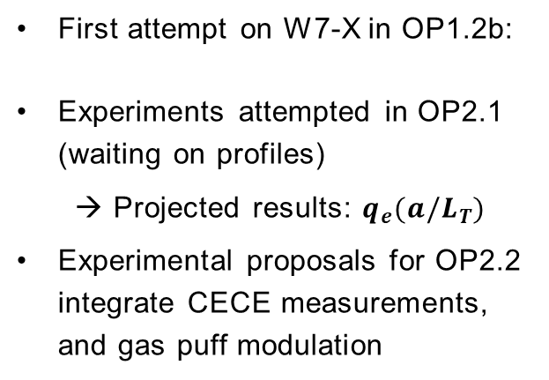


Temperature gradient control experiments:
Direct measurements of the core electron heat flux – ADD NEW FIGURES
Varying ratio of ECRH power deposited across r/a=0.4
Goal: to vary $∇T_{e}$, while maintaining T_{e}$≈$T_{i} $≈$constant
Tracking heat pulses generated by innermost ECRH source across this surface allows a direct measurement of the electron heat flux:
$χ_{e}^{HP}=−\frac{∂\left(q_{e}/n_{e}\right)}{∂∇T_{e}}$ $→$ $\frac{q_{e}}{n_{e}T_{e}}=−\frac{1}{T_{e}}∫χ_{e}^{HP}d(∇T_{e}$)
$$T_{i}$$
First attempt on W7-X in OP1.2b:
Experiments attempted in OP2.1 (waiting on profiles)
    → Projected results: $q_{e}(a/L_{T})$
Experimental proposals for OP2.2 integrate CECE measurements, and gas puff modulation
$$\frac{a}{L_{Te}}≈\frac{a}{L_{Ti}}$$
$$T_{e}=T_{i}$$
$$T_{e}>T_{i}$$
G.M. Weir, P. Xanthopolous, A. Zocco, J.H.E. Proll, O. Grulke, et. al., in preparation

Slide 22
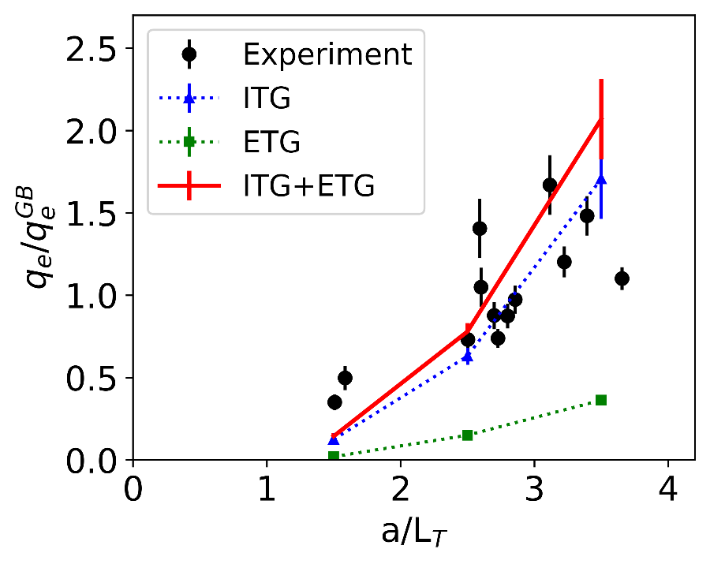

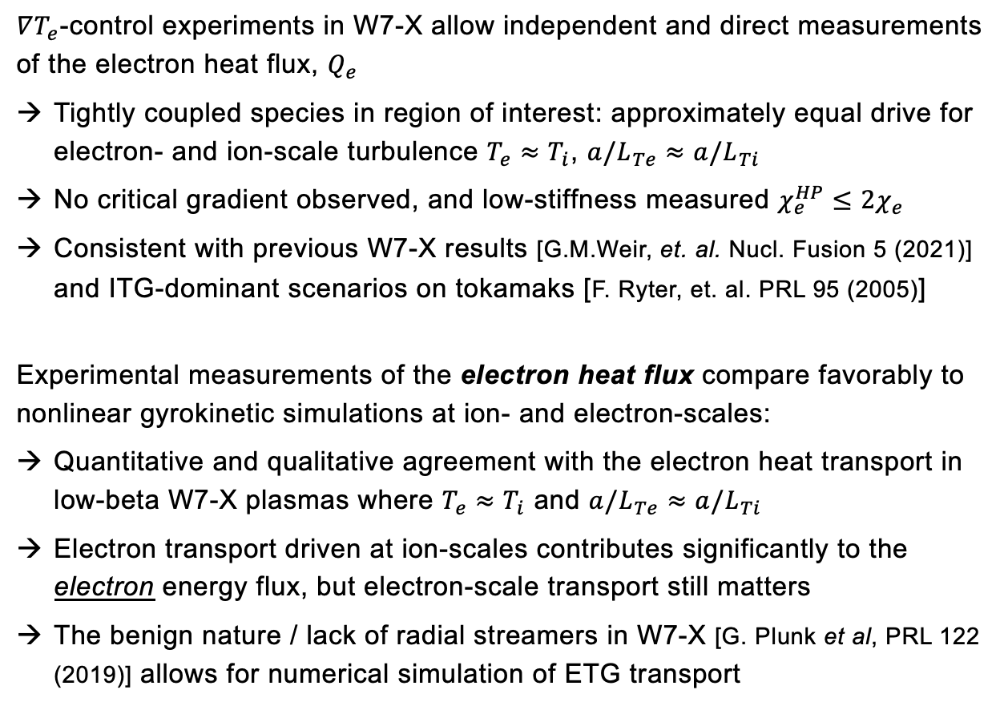
Status of results – ADD NEW FIGURES
$∇T_{e}$-control experiments in W7-X allow independent and direct measurements of the electron heat flux, $Q_{e}$
Tightly coupled species in region of interest: approximately equal drive for electron- and ion-scale turbulence $T_{e}≈T_{i}$, $a/L_{Te}≈a/L_{Ti}$
No critical gradient observed, and low-stiffness measured $χ_{e}^{HP}≤2χ_{e}$
    Consistent with previous W7-X results [G.M.Weir, et. al. Nucl. Fusion 5 (2021)] and ITG-dominant scenarios on tokamaks [F. Ryter, et. al. PRL 95 (2005)]
Experimental measurements of the electron heat flux compare favorably to nonlinear gyrokinetic simulations at ion- and electron-scales:
Quantitative and qualitative agreement with the electron heat transport in low-beta W7-X plasmas where $T_{e}≈T_{i}$ and $a/L_{Te}≈a/L_{Ti}$
Electron transport driven at ion-scales contributes significantly to the electron energy flux, but electron-scale transport still matters
The benign nature / lack of radial streamers in W7-X [G. Plunk et al, PRL 122 (2019)] allows for numerical simulation of ETG transport
$$T_{i}$$
G.M. Weir, P. Xanthopolous, A. Zocco, J.H.E. Proll, O. Grulke, et. al., in preparation

Slide 23
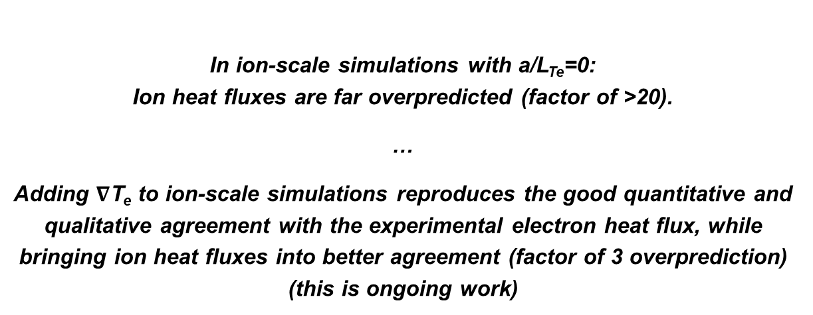
Status of results – ADD NEW FIGURES
$∇T_{e}$-control experiments in W7-X allow independent and direct measurements of the electron heat flux, $Q_{e}$
Tightly coupled species in region of interest: approximately equal drive for electron- and ion-scale turbulence $T_{e}≈T_{i}$, $a/L_{Te}≈a/L_{Ti}$
No critical gradient observed, and low-stiffness measured $χ_{e}^{HP}≤2χ_{e}$
    Consistent with previous W7-X results [G.M.Weir, et. al. Nucl. Fusion 5 (2021)] and ITG-dominant scenarios on tokamaks [F. Ryter, et. al. PRL 95 (2005)]
Experimental measurements of the electron heat flux compare favorably to nonlinear gyrokinetic simulations at ion- and electron-scales:
Quantitative and qualitative agreement with the electron heat transport in low-beta W7-X plasmas where $T_{e}≈T_{i}$ and $a/L_{Te}≈a/L_{Ti}$
Electron transport driven at ion-scales contributes significantly to the electron energy flux, but electron-scale transport still matters
The benign nature / lack of radial streamers in W7-X [G. Plunk et al, PRL 122 (2019)] allows for numerical simulation of ETG transport
$$T_{i}$$
In ion-scale simulations with a/L_{Te}=0:
Ion heat fluxes are far overpredicted (factor of >20).
…
Adding $∇$T_{e} to ion-scale simulations reproduces the good quantitative and qualitative agreement with the experimental electron heat flux, while bringing ion heat fluxes into better agreement (factor of 3 overprediction)
(this is ongoing work)
G.M. Weir, P. Xanthopolous, A. Zocco, J.H.E. Proll, O. Grulke, et. al., in preparation

Slide 24

Electron-scale turbulence is benign, and ITG turbulence can be reduced with $∇n$ – all is well?
Not quite… especially when we go to finite plasma pressure
(as needed for successful fusion)

Slide 25
Instability
growth rate
Dominant-linear ITG and KBM
ITG: ion temperature gradient mode
KBM: kinetic ballooning mode
[P. Mulholland et al, PRL 2023]
Normalized plasma pressure

Slide 26

Instability
growth rate
Dominant-linear ITG and KBM
First impression:
reactor should achieve pressures up to here
Expectation for
turbulent heat flux:
$$∝γ$$
ITG: ion temperature gradient mode
KBM: kinetic ballooning mode
[P. Mulholland et al, PRL 2023]
Normalized plasma pressure

Slide 27
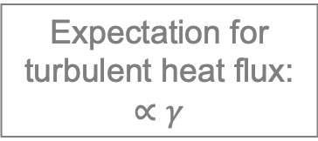
Instability
growth rate
Dominant-linear ITG and KBM
Turbulent heat fluxes
Expectation for
turbulent heat flux:
$$∝γ$$
ITG: ion temperature gradient mode
KBM: kinetic ballooning mode
[P. Mulholland et al, PRL 2023]
Normalized plasma pressure

Slide 28
Instability
growth rate
Dominant-linear ITG and KBM
Turbulent heat fluxes
Dominant instabilities…
What about subdominant?
ITG: ion temperature gradient mode
KBM: kinetic ballooning mode
[P. Mulholland et al, PRL 2023]
Normalized plasma pressure

Slide 29
Instability
growth rate
Dominant-linear ITG and KBM
Subdominant scans: stKBM
Turbulent heat fluxes
Maximum-achievable pressure actually here
Subdominant
ITG: ion temperature gradient mode
KBM: kinetic ballooning mode
stKBM: sub-threshold KBM
[P. Mulholland et al, PRL 2023]
Normalized plasma pressure

Slide 30
Modifying the geometry, e.g. going to higher shear, can aid in shifting the onset of stKBM to higher pressures

Slide 31
Experimental findings of KBMs in W7-X

Slide 32
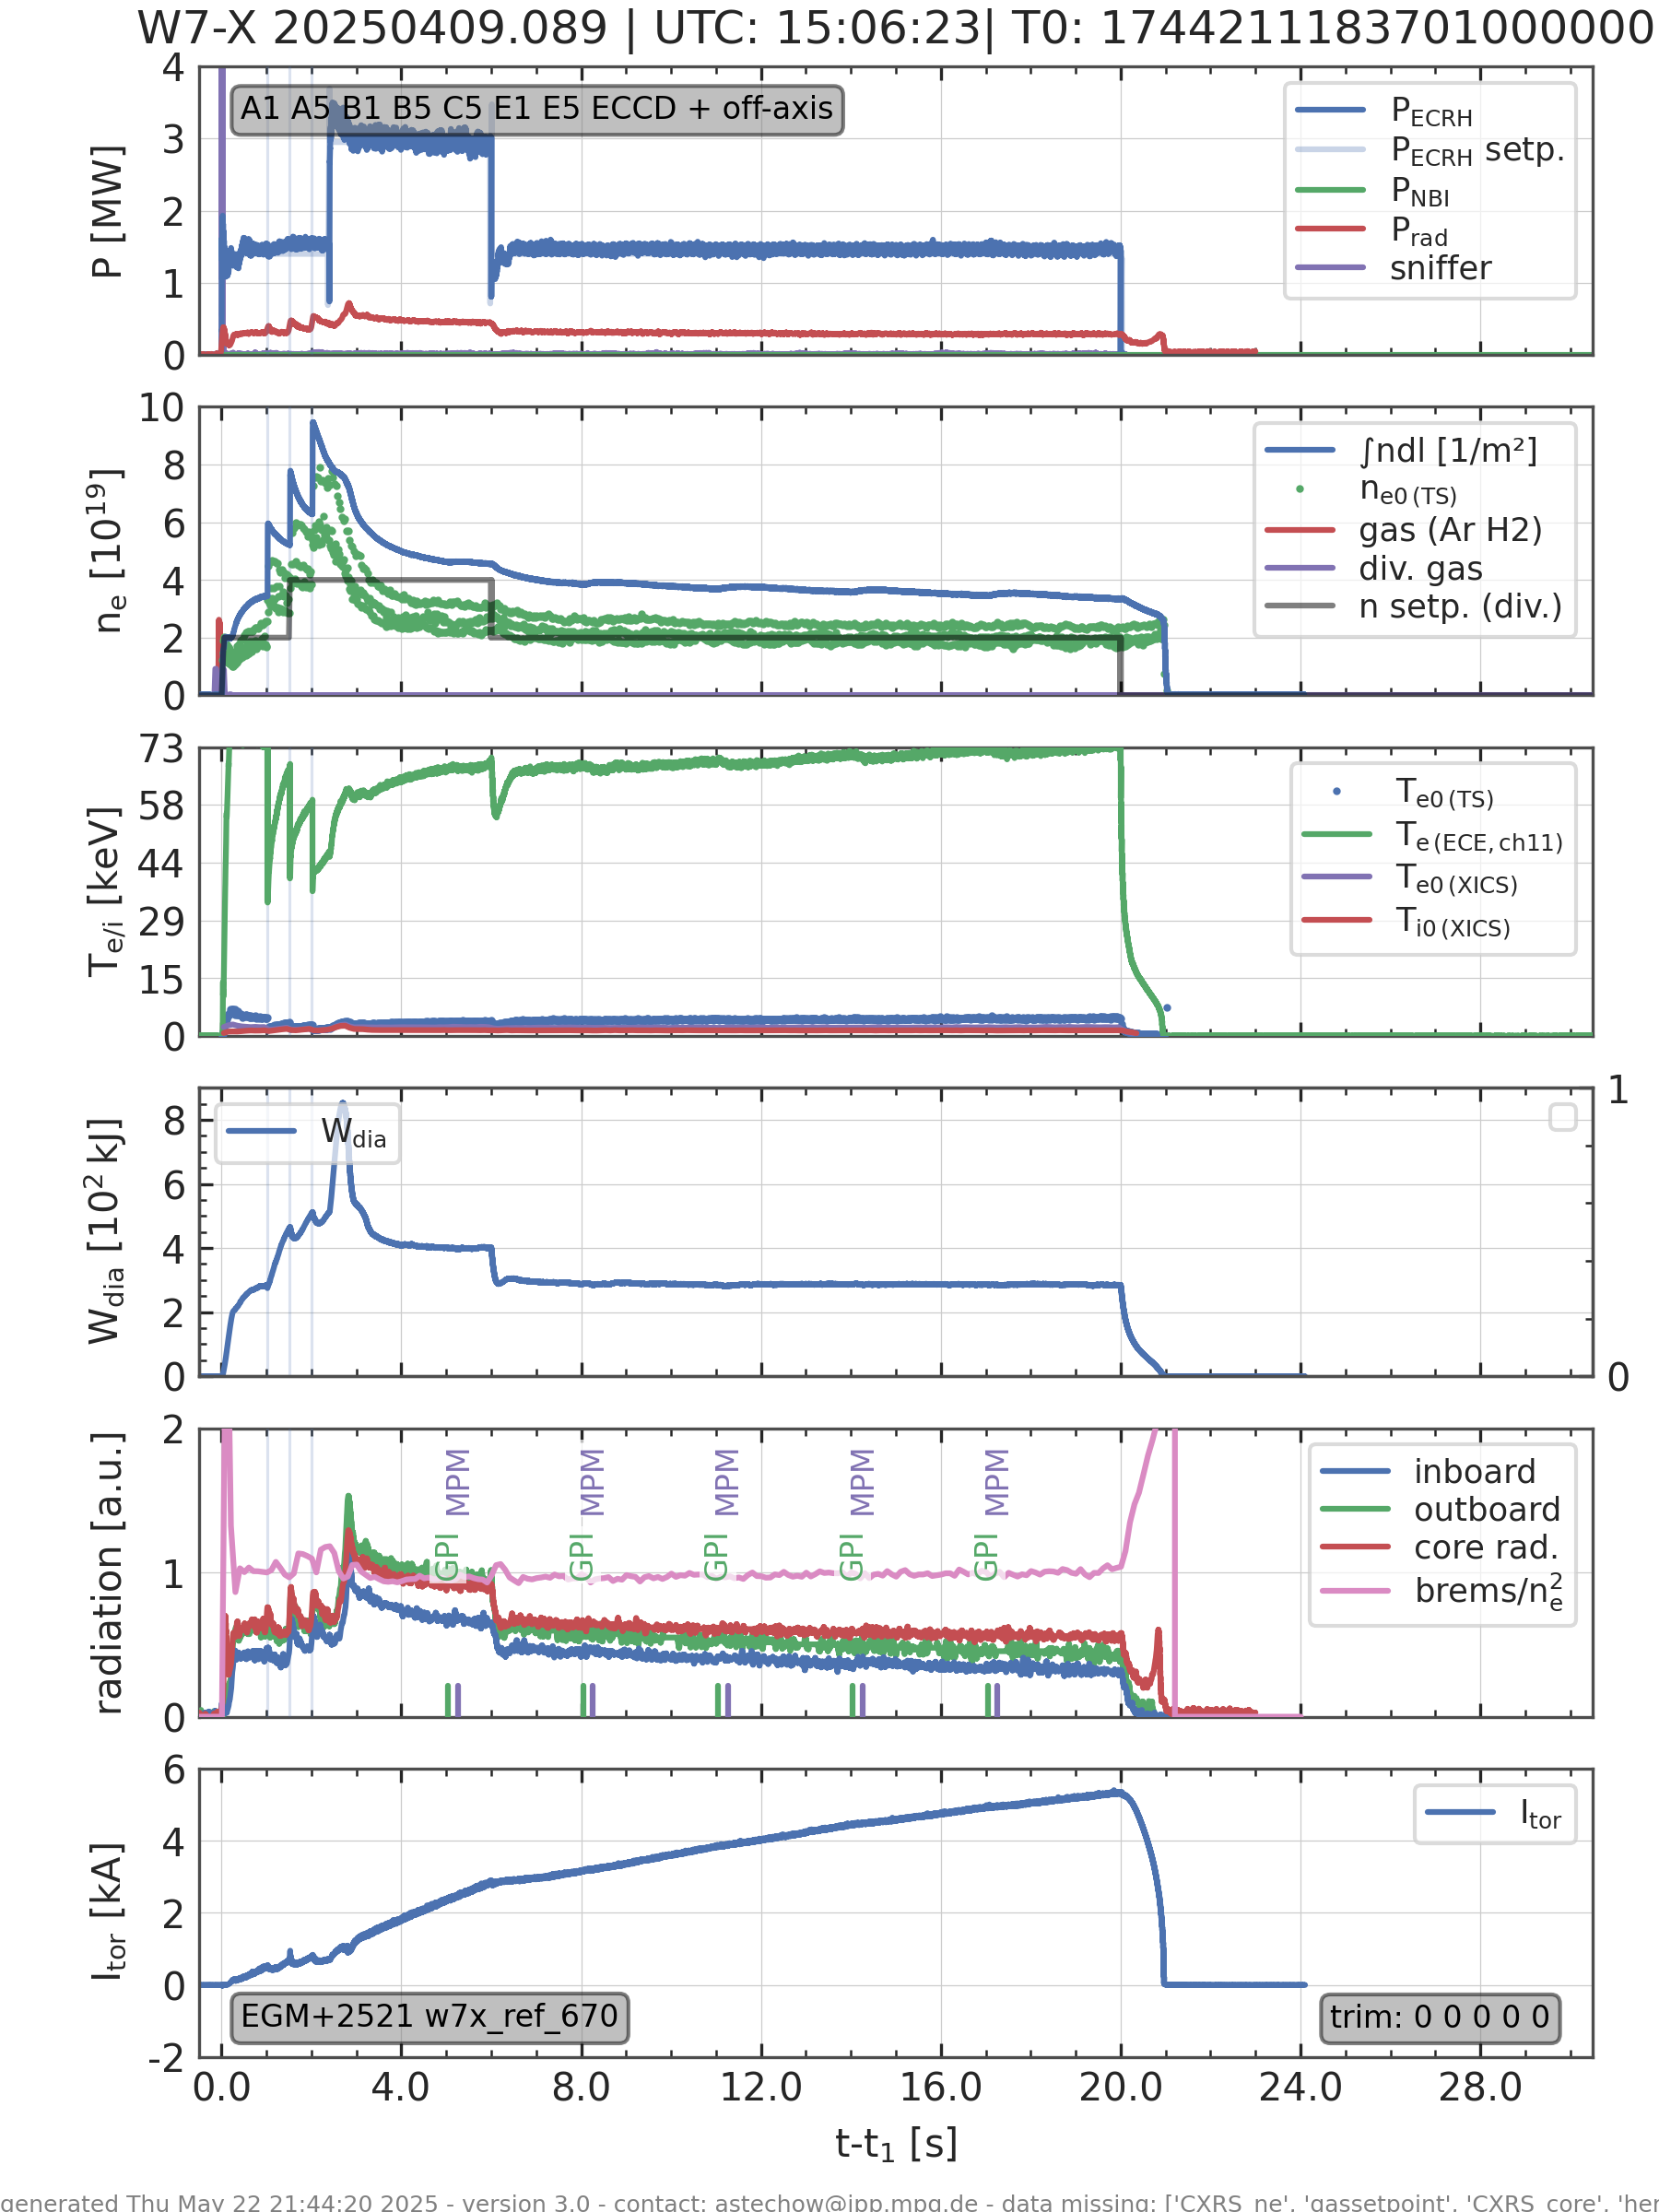
Studies of KBM Activity in W7-X, OP2.2/2.3 [*]
Theoretical background:
KBMs are β′-driven instabilities (sensitive to pressure gradient)
Predicted to be more stable in configurations with higher iota and higher mirror ratio (a new configuration, KTM, was proposed to test the threshold):
Dedicated experiments during OP2.2/3:
  Iota scan
  Session in KTM configuration
  Shear scan
  Low-field sessions to access high-beta regimes
In all sessions (except low-field), a X2 heating + 3 pellets “high-performance” recipe was used (in addition to more advanced ones):
  Produces steep pressure gradients
  Chosen for simplicity, reproducibility, and consistency across configurations
[*] K. Aleynikova et al., in preparation.
32
Max-Planck-Institut für Plasmaphysik | K. Aleynikova | 04.07.25

Slide 33
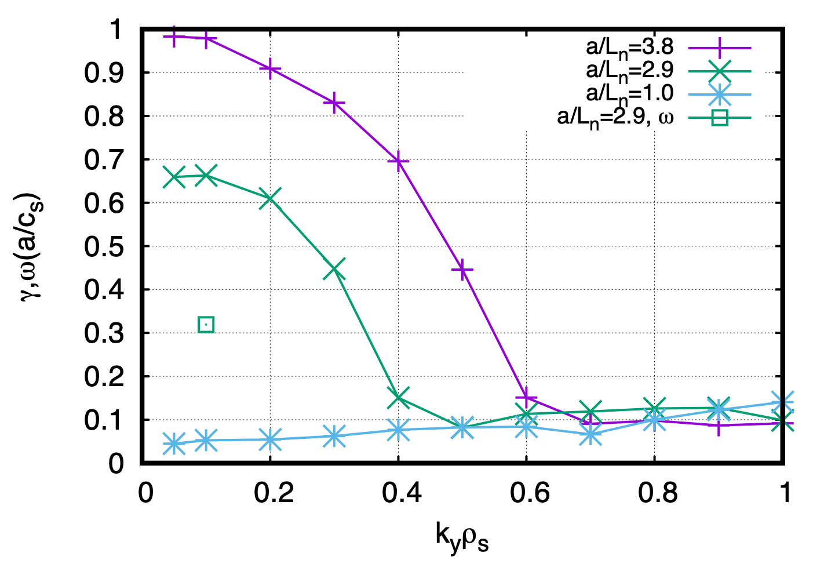
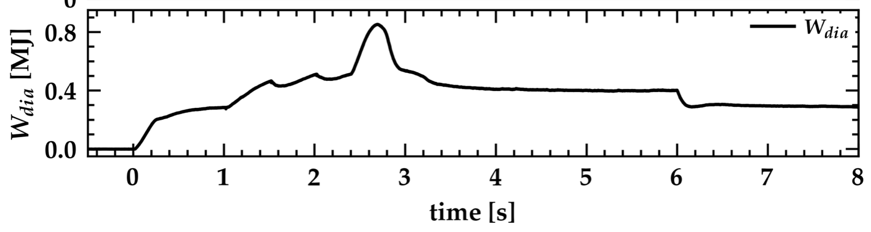
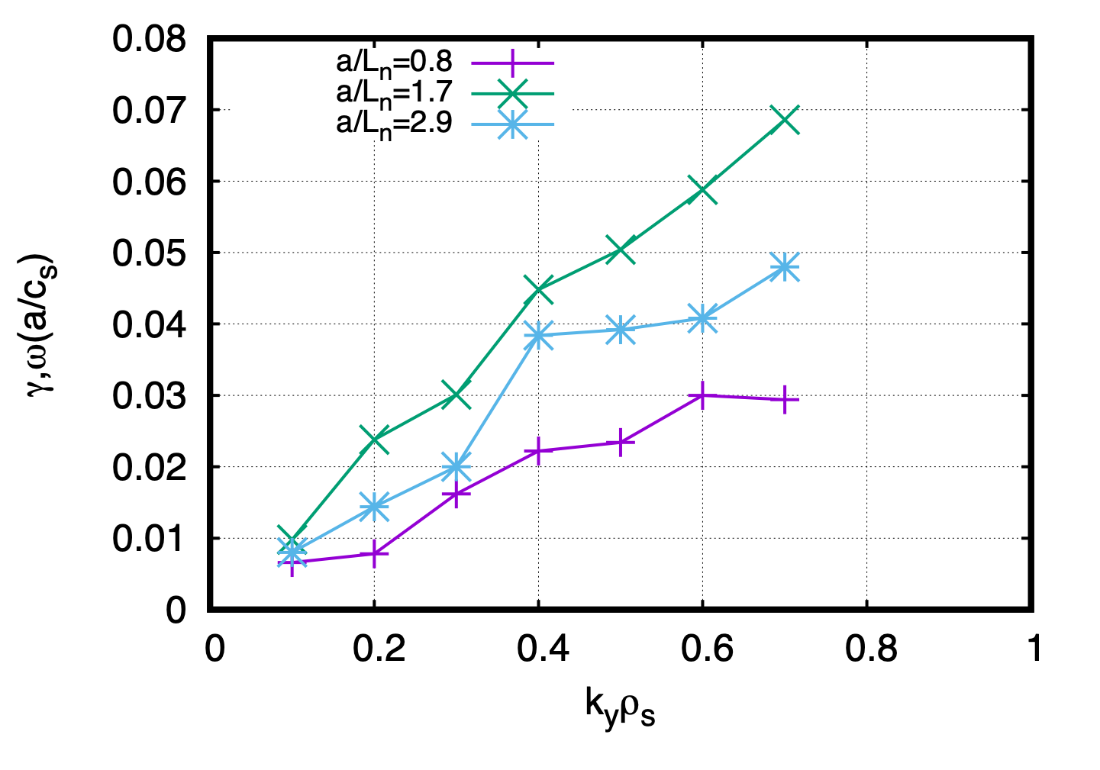
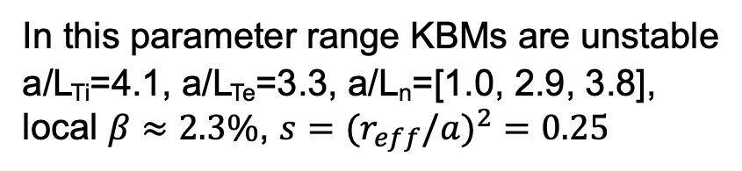
Studies of KBM Activity in W7-X, OP2.2/2.3 [*]
KBM
TEM
In this parameter range KBMs are unstable
a/L_{Ti}=4.1, a/L_{Te}=3.3, a/L_{n}=[1.0, 2.9, 3.8],
local $β≈2.3\%$, $s=(r_{eff}/a)^{2}=0.25$
stable
a/L_{Ti}=3.0, a/L_{Te}=2.1, a/L_{n}=[0.8, 1.7, 2.9], local $β≈1.0\%$
Max-Planck-Institut für Plasmaphysik | K. Aleynikova | 04.07.25
[*] K. Aleynikova et al., in preparation.

Slide 34


Mode structure derived from SXR tomography (XMCTS) using parametric forward modeling [**]
Soft X-ray data is fitted using a poloidal model with adjustable amplitude, phase, and ballooning shape.
The model is mapped to VMEC flux surfaces and compared to signals from 360 detector lines of sight.
Best fits are found by scanning mode numbers and radial positions, using fit quality and phase checks.
48 kHz mode
Courtesy of S. Bozhenkov
Courtesy of C. Büschel
[**] C. Büschel et al., in preparation.
34
Max-Planck-Institut für Plasmaphysik | K. Aleynikova | 04.07.25

Slide 35

Summary
Turbulence determines efficiency of future reactors and needs to be understood and mitigated
Electrostatic instabilities: quite ok in Wendelstein 7-X
        Electron-driven trapped-electron mode (TEM) stable
        Universal instability (UI) shows up instead of TEM, but seems more harmless in terms of transport. Has maybe been observed in experiment?
        Ion-temperature-gradient modes (ITGs) stabilised with $∇n$, plenty of evidence experimentally
Electromagnetic instabilities:
        Kinetic ballooning modes switch on sooner than anticipated and enhance ITG transport
          But this might be mitigated, e.g. by slightly higher shear
          Experimental evidence still outstanding

Slide 36
OTHER SLIDES/BACKUP

Slide 37

Linear physics not sufficient to predict turbulent fluxes
Linear growth rates – understood ✓
Nonlinear heat fluxes – not understood ✗
DIII-D Tokamak
DIII-D Tokamak
HSX stellarator
Growth rate (normalised)
W7-X stellarator
HSX stellarator
Heat flux (normalised)
W7-X stellarator
Density gradient (normalised)
Density gradient (normalised)
Nonlinear physics changing with geometry as well!
E.g. saturation mechanism through subdominant eigenmodes in HSX?
[Hegna et al., PoP 2018, McKinney et al., JPP 2019]
37
Notes:
Now we have seen that we understand why the linear growth rates behave the way they do – because W7-X benefits from a particularly advantageous geometry, the growth rates of these trapped-electron modes are low. Now typically one would expect that with the instabilities being the drivers of turbulence, lower growth rates would also mean lower turbulent fluxes.
However, I showed that this is not necessarily the case. So, the nonlinear interactions between the linear modes, and the saturation mechanisms that come from it, need to be understood as well to predict the turbulence.

Slide 38
One branch of instabilities and turbulence driven by it absent in certain geometries
Drift waves due to density gradient
Trapped particles precessing around torus
Trapped-electron modes (TEM) unstable if there is resonance
No resonant particles in certain magnetic field geometries
Wendelstein 7-X comes fairly close!
→ TEM and turbulence driven by it absent [Proll et al, PRL 2012], [Helander, Proll et al, PoP 2013]
Notes:
One of the most prominent drivers of turbulence, both in tokamaks and stellarators, is the so-called trapped-electron mode. It relies on a resonance between drift waves in the plasma and the precessional movement of particles trapped in regions of low magnetic field. Whether or not this resonance occurs depends on the geometry of the magnetic field that the particles are in.
I found that in stellarators with a certain magnetic geometry, this resonance is completely absent. This means that if we could build a device with such a magnetic field, an entire branch of instabilities, and the turbulence driven by it, is absent, and our device should be much more efficient.
Now, this was based on analytical theory, and the magnetic field geometry was very idealised. Wendelstein 7-X, almost by coincidence, is a good approximation of it, however, and the question was how it would perform even if it only approaches this ideal geometry.

Slide 39


Wendelstein 7-X only approaches ideal geometry
Ideal geometry
Wendelstein 7-X
HSX stellarator
DIII-D tokamak

Slide 40
TEM being stable in W7-X uncovers new instability
Linear simulations with GENE
In W7-X: generally small growth rates
TEM indeed weak in W7-X
– theory also valid in approximate geometry
[Proll et al, PoP 2013], [Proll et al, JPP 2022]
Because TEM is stable: uncovers the “Universal instability”
– found in W7-X for the first time in stellarators! [Costello, Proll et al, JPP 2023]
Notes:
Now, because the trapped-electron mode is stable, this gives the chance for another instability to be visibile which is usually lurking underneath, at a lower growth rate and thus invisible: the so0-called universal instability.
(and here, in DIII-D and HSX we observe the classical TEM, in the same wave number range we now uncover the UI )
Strengthening the theory predictions

Slide 41

Universal instability maybe observed in Wendelstein 7-X?
Density fluctuation measurements with Phase Contrast Imaging
[courtesy of A. v. Stechow]
Spikes from pellets → this is where we have high 𝛁𝒏
Higher-frequency fluctuations show up in addition to other fluctuations

Slide 42

High performance scenario B: density gradient stabilization by continuous injection
balance peaking loss with pellet fueling at const. P_{ECH} (power loss at 35.5s)
peaking oscillates with injections, less after 35s
density increases continuously
T_{i} elevated (1.5-2.2keV), oscillating with injections
  balance of pellet pacing and ECH pump-out crucial for steady-state operation

Slide 43



High performance scenario B: density turbulence response
transient suppression of fluctuations after injections
t < 35s: rise of fluctuations with peaking decay after every pellet - P_{ECH} too high for steady-state
t > 35s : peaking remains high until next pellet, pump-out acceptable but total density rises

Slide 44


High performance scenario B: density turbulence response (normalized fluctuations)
transient suppression of fluctuations after injections
t < 35s: rise of fluctuations with peaking decay after every pellet - P_{ECH} too high for steady-state
t > 35s : peaking remains high until next pellet, pump-out acceptable but total density rises

Slide 45



High performance scenario B: correlation of turbulence with global parameters
scaling with peaking and asymmetry in HF fluctuations holds
variety of discharges characterized by ñ ~ f(n^{ɑ}, [peaking-1]^{β}) with similar ɑ~1, β~-0.3
fueling strategy: how to choose injection rate and P_{ECH} for sustained peaking without density run-away?

Slide 46

High performance scenario C: neutral beam injection + ECH
balance peaking loss with NBI fueling
high sustainted W_{dia}
brief peaking decay to constant ~2.5 @ 6.1s
high, constant T_{i} during NBI
  NBI fueling rate and ECH pump-out balance crucial for steady-state

Slide 47



High performance scenario C: density turbulence response
broadband increase during NBI+ECH phase
k-f-spectra: additional modes during NBI phase
HF fluctuations elevated during peaking decay, settle at elevated level
    indication of constant-amplitude pump-out instability in balance between fueling source + pumpout?

Slide 48

High performance scenario C: density turbulence response (normalized fluctuations)
broadband increase during NBI+ECH phase
k-f-spectra: additional modes during NBI phase
HF fluctuations elevated during peaking decay, settle at elevated level
    indication of constant-amplitude pump-out instability in balance between fueling source + pumpout?

