Slide 1
RT-05: Physics of divertor detachment and its control for ITER, DEMO and HELIAS operation
WPTE GPM 05th November 2025
N. Vianello
On behalf of WPTE TFLs
E. Tsitrone, N. Vianello, M. Baruzzo, V. Igochine, D. Keeling, A. Hakola, B. Labit
Research Topic Coordinators
P. David, S. Henderson, H. Reimerdes, N. Rivals

Slide 2
Introduction
RT05 is investigating the detachment physics and possible scenarios at high-radiation fraction which are of potential interest for ITER and next step

Slide 3
Prioritization scheme and criteria
ITER Research Plan, including Rebaselining and ITPA
Proposal Evaluated according to the criteria:
01
Adherence to the Scientific Objectives
02
DEMO Physics Gaps
Team effort
Size and feasibility
RT Scientific Objectives
P1-2026-DEV: experimental priority for 2026: machine time granted but pulse budget might need reduction
P1-2027-DEV: experimental priority for 2027: machine time granted but pulse budget might need reduction
P2-DEV: will be done if time allows after *all* P1 proposals are completed
P3: low priority programme/out of scope
PB: piggy-back experiment/pure analysis proposal
03
PEX exploitation
04
Preparatory work for future JT-60SA exploitation

Slide 4
Scientific Objectives and Machine Time
# | Scientific Objectives for 2026-2027 | SSRL (to be re-evaluated at the end of 2025)
D1 | Characterize detachment access and core plasma performance in scenarios using different fuelling schemes, different impurity mixtures | Mature (needs underpinning)
D2 | Develop reduced physics model which can be included in radiative detachment control schemes or extrapolations to DEMO/ITER | Mature (needs underpinning)
D3 | Quantify edge-SOL particle, impurity, and heat transport, above and below the X-point under detached conditions | Judgemental
D4 | Assess the compatibility and stability in terms of overall confinement of X-point radiator regimes | Judgemental
D5 | Quantify the degree of ELM heat load mitigation achievable by impurity seeding, investigating the dependences on relevant machine parameters | Judgmental
D6 | Assess the evolution of detachment under slow transients (L-H transitions, sawtooth, loss of impurity seeding) | Mature (needs underpinning)
Proposals received (Scientific/Scenario Dev.)
 | AUG | MAST-U | TCV | WEST
RT05 | 100 / 33 | 57 / 12 | 150 / 58 | 174 / 15

Slide 5
Summary of proposals (24)
No | Proposal name | Proposer
88 | Impulsive detachment experiments for SOLPS-ITER and JOREK time-dependent validation | F. Cursi
89 | Helium transport, source localization and wall recycling in single-null divertor plasmas | A. Perek
90 | Characterization of the ion temperature turbulence at x-point and midplane locations for different regimes | J. Adamek
91 | Exploration of the XPR regime in open and closed geometry | S. Henderson
92 | How far inwards can the XPR be pushed while staying in QCE? | M. Faitsch
94 | Interplay between core and edge radiation for detachment | P. David
95 | ELM buffering in conventional divertor configuration including real-time control | M Komm
96 | Relation between n_sep and impurity throughput, p0div and impurity concentration for reduced SOL models | D. Silvagni
97 | Nitrogen distribution, compression and core contamination: investigation of seeding location, L/H-mode, dynamic behavior | R. Morgan
98 | XPR: Extension of operational space and increase of performance | M. Bernert
99 | Flow characterization in the Scrape-Off Layer | R. Ducker
100 | Characterization of the X-point radiator with horizontal and vertical equilibrium sweeps in H-mode | M. Szucs
101 | Edge turbulence characterization with the MEM and the XPM for the XPR regime at low heating at AUG | Yu-Chih Liang
102 | X-machine exploration of pellet fueling compatibility with X-Point Radiation (XPR) regimes | E. Geulin
103 | Integral XPR scenario from X-Point formation to ramp-down at WEST | N. Rivals
104 | H-mode Density Limit (HDL) with impurity seeding | C. Perez von Thun
105 | Cross-machine-scaling for far-SOL density decay with metallic walls (unseeded) | C. Perez von Thun
106 | Seeding effect on scrape-off layer profiles and fluctuations | A. Stagni
107 | Physics of plasma-neutral interactions for ITER and beyond | K. Verhaegh
108 | Detachment control in EDA H-mode | L. gil
110 | Evaluation and Comparative Study of Fluctuation-Induced Transport in the SOL and First-Wall Interaction in Different Plasma Conditions in TCV | K. Singh
111 | First-principles investigations of WEST L-mode detached plasmas at reduced Btor by validation of turbulence simulations | D Sales de Oliveira
112 | First-principles investigation of boundary turbulence in seeded detached plasmas in the TCV-X21 scenario | D Sales de Oliveira
113 | Divertor Ti profile in XPR | M. Dimitrova

Slide 6
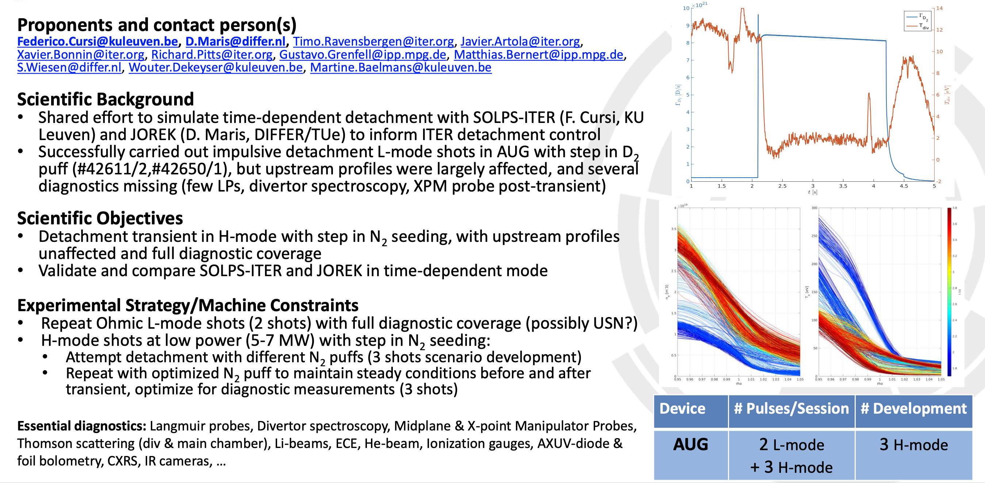
#88 Impulsive detachment experiments for SOLPS-ITER and JOREK time-dependent validation
Continuation of an effort initiated in 2025 to validate detachment dynamic models (SOLPS-ITER time dependent/JOREK with kinetic neutral)
Address D1 and D2.
Suggested to:
1. Complete L-mode first
Discuss if transient can be properly embedded into discharges for general detachment studies/XPR exploitation
P1-AUG-2026

Slide 7
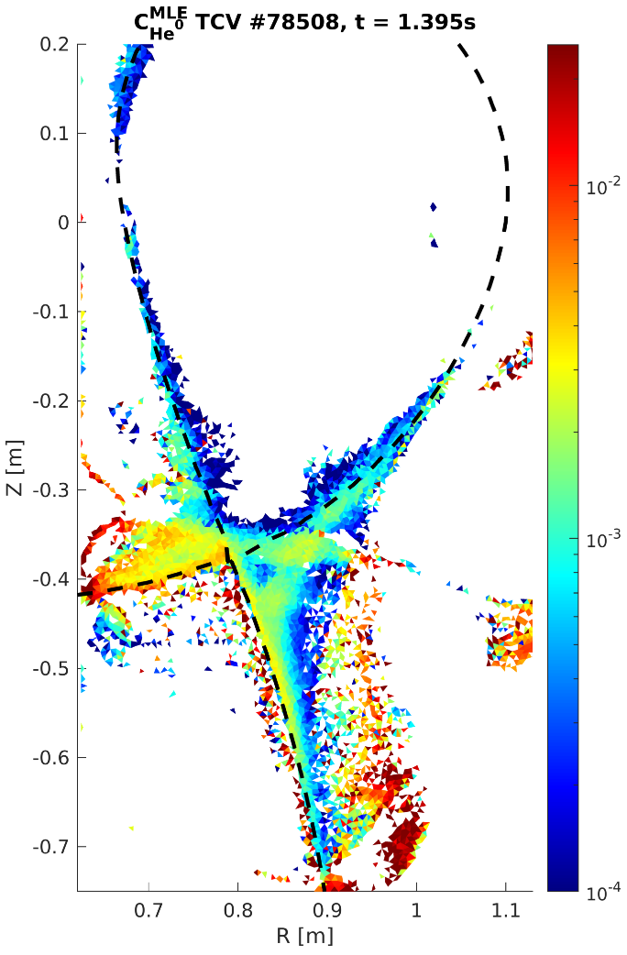
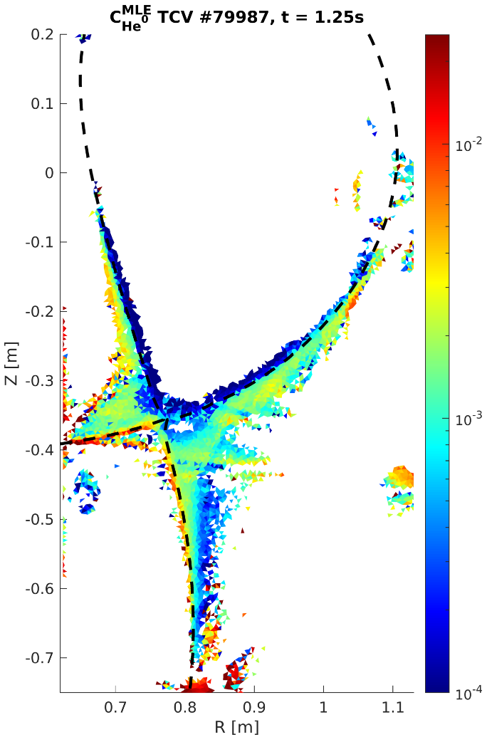

#89 - Helium transport, source localization and wall recycling in single-null divertor plasmas
2D neutral helium concentration inferences
1. Interesting multi-machine comparison on a topic which deserve attention
2. Not the higher priorities for MAST-U given the machine time available
3. On WEST should be done once and if the MANTIS system will be installed in 2027
P1-2026-TCV
P2-2026-MAST-U
P2-2027-WEST
Proponents and contact person:
artur.perek@epfl.ch , ryoko.osawa@ukaea.uk , david.MOIRAF@cea.fr et al.,
Scientific Background & Objectives
Helium exhaust at the edge and divertor remains inefficient compared to the core.
2D spectral imaging can provide poloidally resolved maps of neutral and ionised helium to measure source localisation.
By varying helium puff rate and location, the study will identify the poloidal helium transport, validate SOLPS-ITER modelling, and quantify helium transport and poloidal gradients approaching detachment.
Experimental Strategy/Machine Constraints and essential diagnostic
Unseeded L-mode discharges with varying helium gas puff location and rate | requires absolutely calibrated gas valves.
H-mode controlled XPR discharges with additional heating.
2D spectral imaging, spectroscopy, and residual gas analysers are essential. Coherence imaging spectroscopy is highly desirable.
baffled
unbaffled
Proposed pulses
Device | # Pulses/Session | # Development
AUG | - | -
MAST-U | 20 | 2
TCV | 32 | 3
WEST | 24 | 3

Slide 8
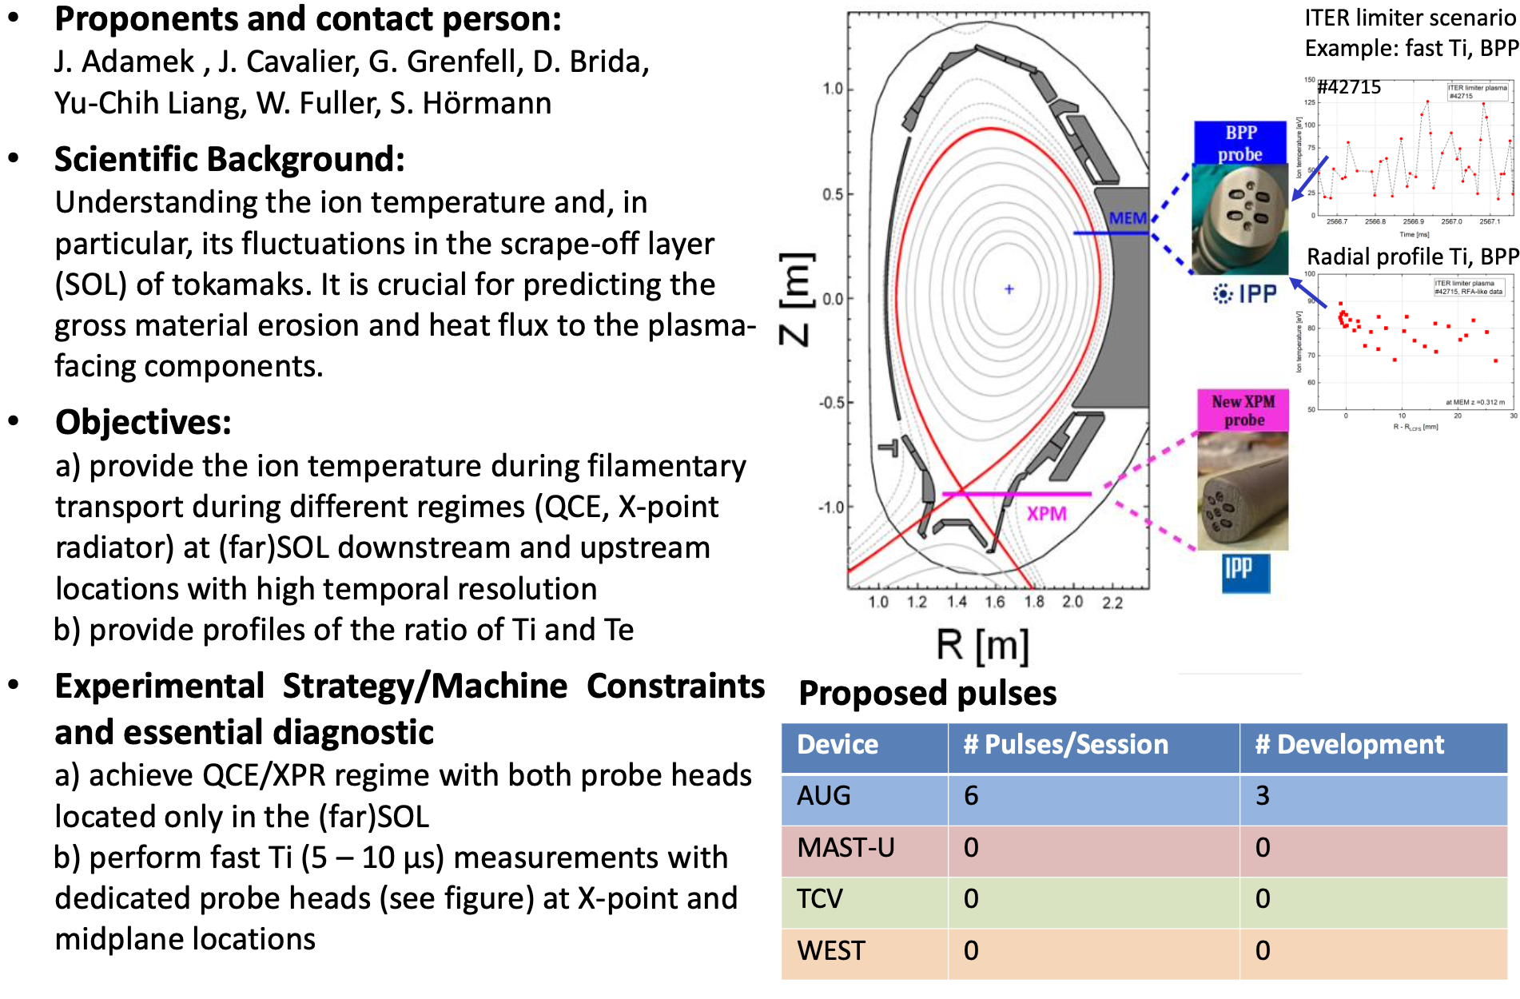
#90 Characterization of the ion temperature turbulence at x-point and midplane locations for different regimes.
To be checked how much perturbative would be the XP probe plunges for the scenarios proposed (XPR and QCE). In case prioritize the acquisition of far SOL from the MEM
P1-2026-AUG-PB

Slide 9
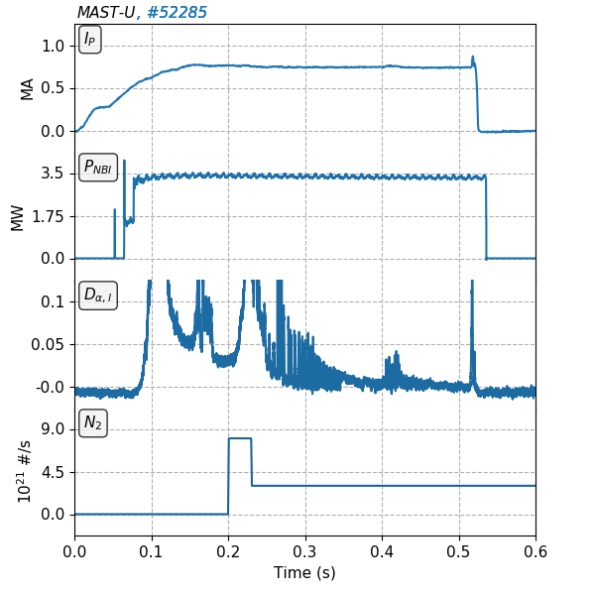
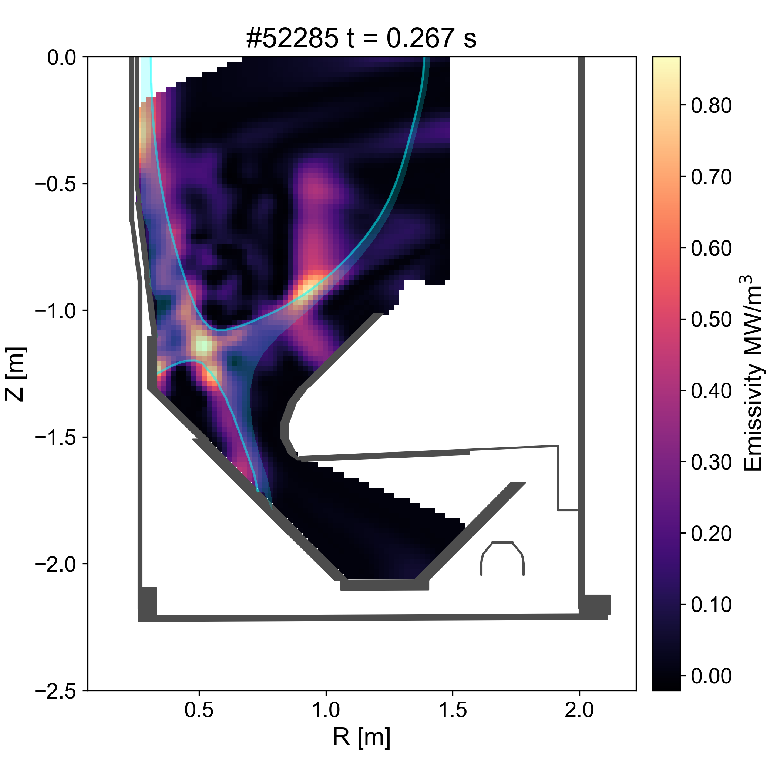
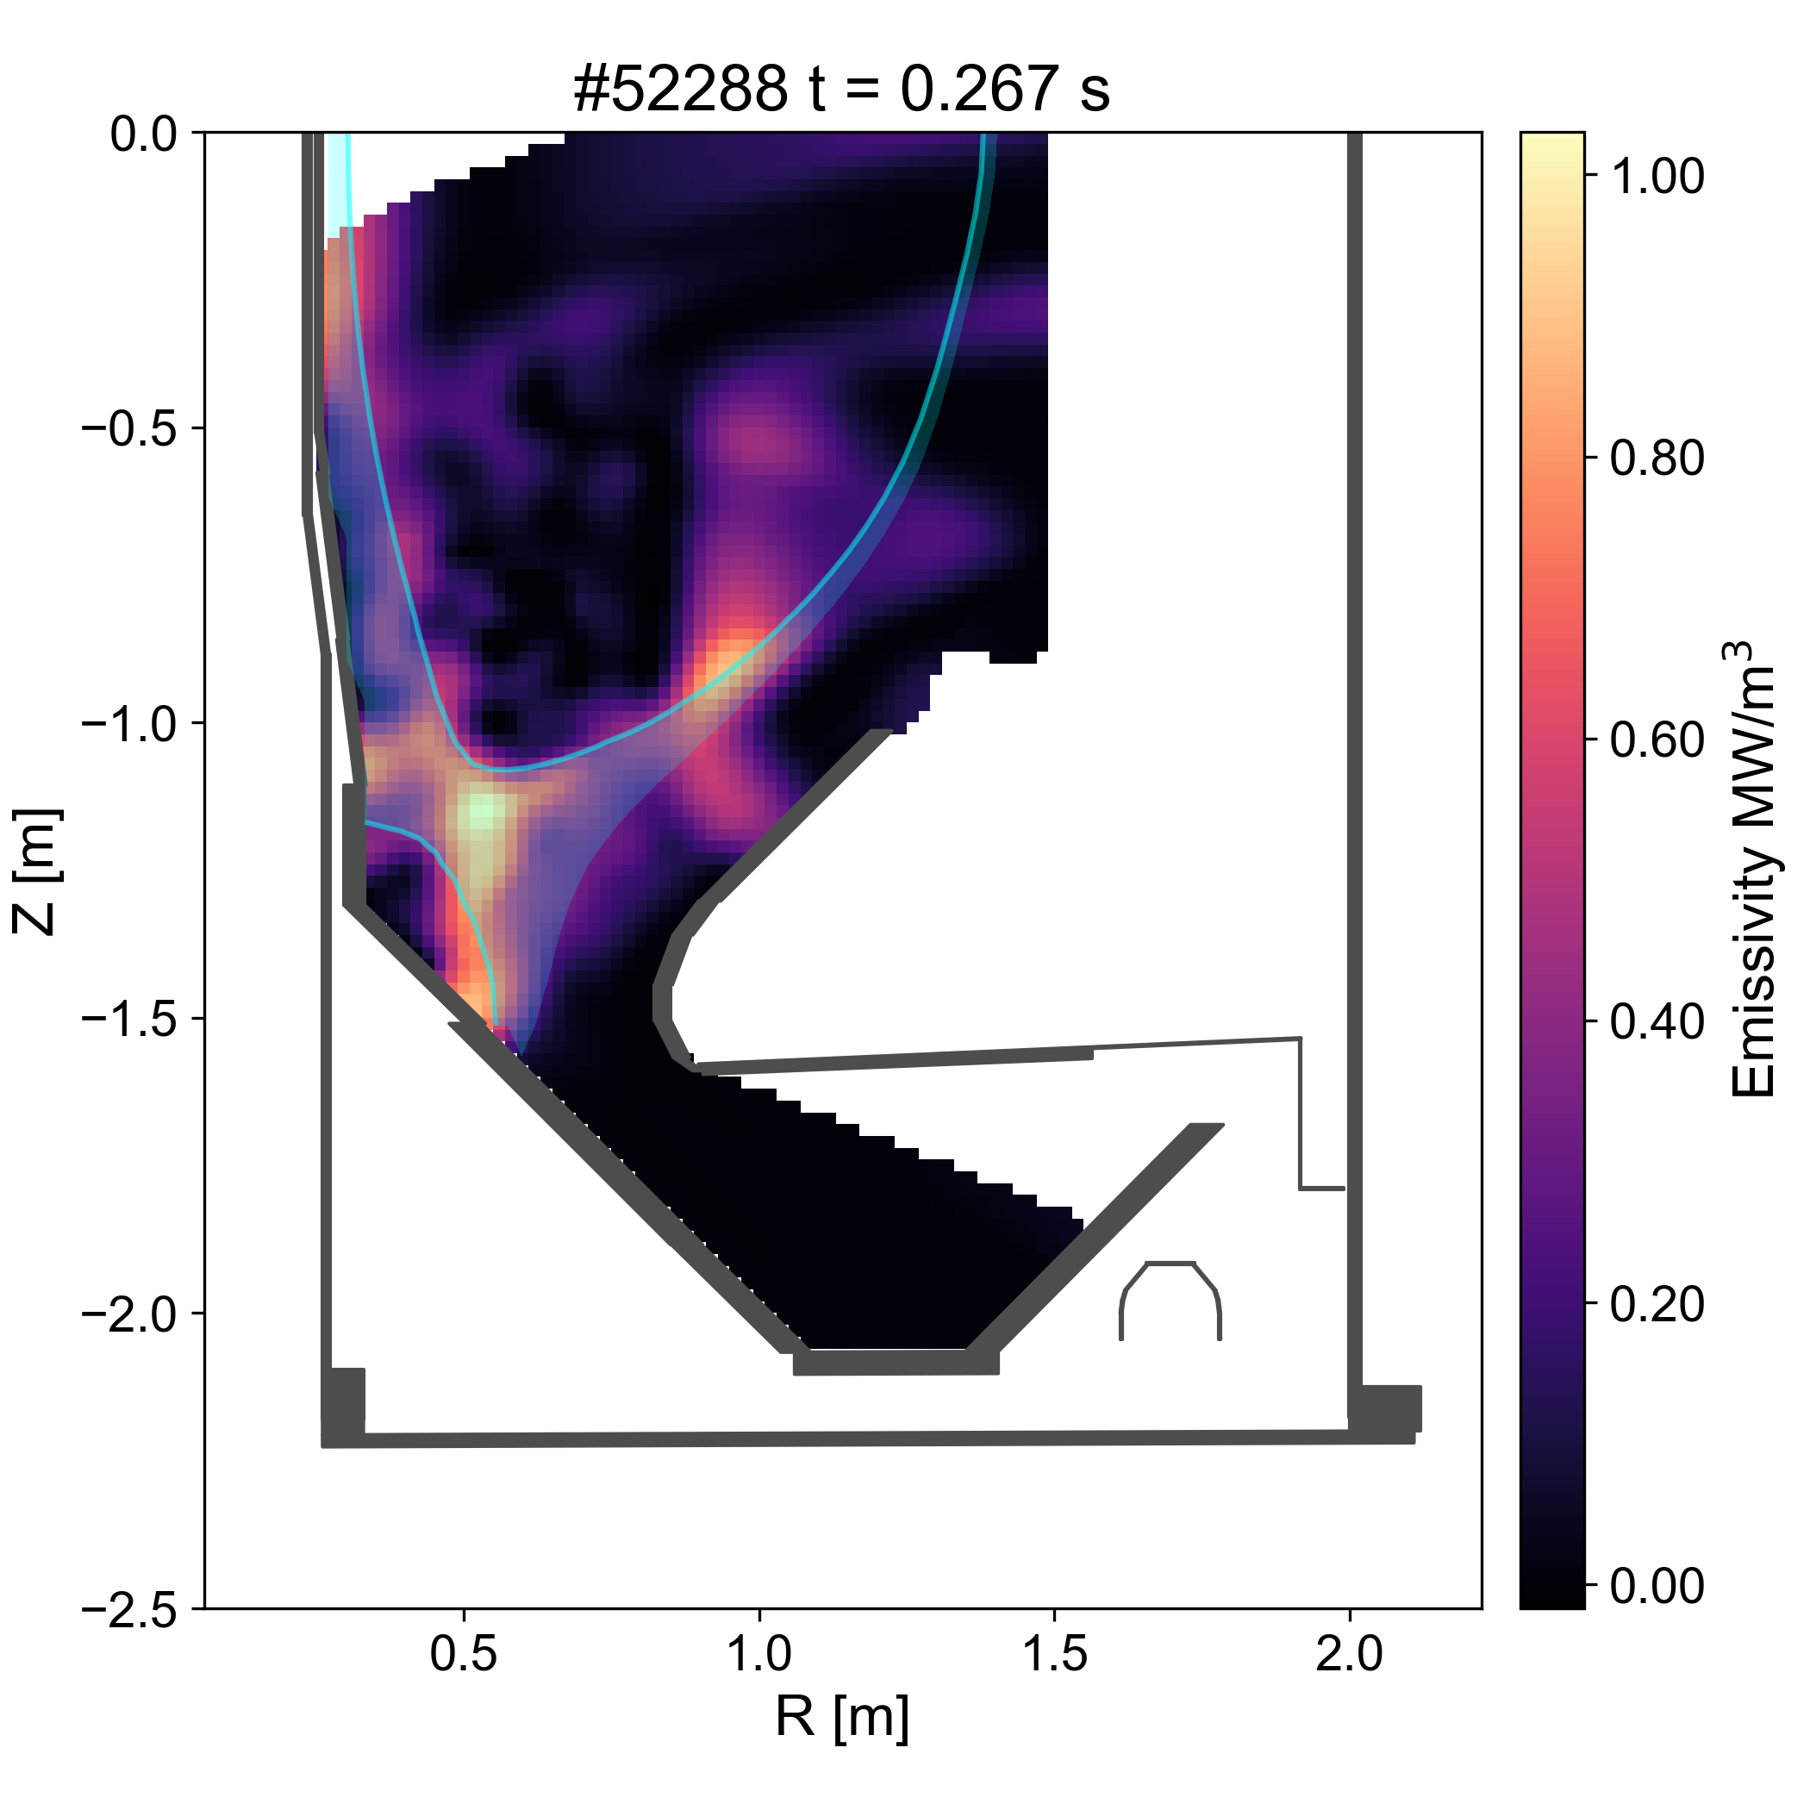
#91 - Exploration of XPR access and stability in baffled and unbaffled geometry
Complete the exploration of XPR on MAST-U, providing path for a more stable scenario
P1-MAST-U-2026
Proponents and contact person:
S. Henderson, H. Sun, P. Ryan, D. Morbey, Q. Xia
Scientific Background
Analytical XPR model shows dependency on neutral gas density at X-PT
HL transitions frequently disrupt XPR scenarios on MAST-U, putting emphasis on finding an operational window avoiding back-transitions
Objectives
Compare XPR access in scenarios with different neutral densities X-PT
Assess SOL broadening in strongly seeded scenarios
Determine XPR operational window in which HL transitions are avoided
Deliverables
D1 (Characterize detachment access); D3 (Edge/SOL particle transport); D6 (Evolution under slow transients)
Experimental Strategy
N-seeded H-mode at max. power (3.5 MW)
Stabilize two baffled and unbaffled divertor scenarios with an XPR
Vary the elongation to change the distance between the X-point and target
Compare two sets of seeding/fuelling rates for XPR access in each geometry
Apply gas cuts to understand reattachment time in strongly detached conditions
Baffled
H-L L-H
Unbaffled
Proposed pulses
Device | # Pulses/Session | # Development
AUG
MAST-U | 8
TCV
WEST

Slide 10
#92 - How far inwards can the XPR be pushed while staying in QCE?
Smooth transition?
Type-I ELMs?
…
QCE operational space/shape might be explored on the path towards high-confinement XPR scenario explored in proposal #96
P1-AUG-2027
Proponents and contact person:
Michael.Faitsch@ipp.mpg.de, Matthias.Bernert@ipp.mpg.de, Mike.Dunne@ipp.mpg.de
Scientific Background & Objectives
Demonstrate the relation between QCE and XPR
Quantify if there is a threshold at which QCE is lost once the radiator is moving further inside
Study if there is a smooth transition from QCE to XPR ELM suppression or what happens in between the two states.
Experimental Strategy/Machine Constraints and essential diagnostic
execute feed-forward and feed-back seeding ramps/steps from a QCE reference and adjust the deuterium fuelling in order to stay in QCE as fas inside with the XPR as possible.
QCE
XPR ELM suppression
XPR height
Is there a limit?
Proposed pulses
Device | # Pulses/Session | # Development
AUG | 6 | -
MAST-U | - | -
TCV | - | -
WEST | - | -

Slide 11
#94 - Interplay between core and edge radiation for detachment
Proposal trying to disentangle core/SOL radiation by means of heavy impurities radiating in the pedestal region (Kr). Due to budget constraints priorities given to qualification of XPR in view of potential ITER interest (rather than next step)
P2-AUG
Proponents and contact person:
Pierre.David@ipp.mpg.de, Matthias.Bernert@ipp.mpg.de, Michael.Faitsch@ipp.mpg.de, Dominik.Brida@ipp.mpg.de
Scientific Background & Objectives
Optimize impurity mixes for detachment, in Feedforward and/or feedback
Assess interplay between core and edge radiation for detachment
Experimental Strategy/Machine Constraints and essential diagnostic
Reproduce existing detachment scan (light impurity seeding), but with various Paux yet constant Psep (heavy impurity seeding)
Add impurity seeding to existing partially detached scenarios without an XPR (typ. QCE) to try to achieve full detachment
Proposed pulses
Device | # Pulses/Session | # Development
AUG | 10+8 | 8
MAST-U | - | -
TCV | - | -
WEST | - | -

Slide 12
#95 ELM buffering in conventional divertor configuration including real-time control
Proponents and contact persons:
M. Komm (komm@ipp.cas.cz), R. Scannell (rory.scannell@ukaea.uk), M. Zurita (martim.zurita@epfl.ch), Jack Flanagan, S. Henderson, M. Faitsch, D. Silvagni, M. Bernert, O. Kudlacek, M. Astrain, H. Reimerdes
Scientific Background & Objectives
Directly linked to RT05-22: D5
Objectives at AUG
Simultaneous observation ELM impact on both divertor targets by IR camera (at the top divertor)
Measurements of Te in ELM filaments by recipr. manipulators
Effect of divertor closure - comparison between ELM buffering in the bottom closed divertor and open upper divertor
Optimisation of the impurity mixture for simultaneous high ELM buffering and good confinement
Development of a real-time controller for the ELM impacting energy/fluence using shunt current measurements
Effect of seeding termination on the duration of ELM buffering Objectives at MAST-U
Develop an ELM buffering scenario both for the conventional and long divertor leg Objectives at TCV
Assess the effect of seeding location & baffling on ELM buffering
Experimental Strategy/Machine Constraints and essential diagnostic
Type I ELMy plasma with the AUG lower and upper divertor
Divertor IR thermography
Stable H-mode scenario with impurity seeding at MAST-U
Nice multi-machine proposal, also aiming to exploit one of the TE-Enhancement program. Well defined strategy for all devices
P1-AUG-2026
P1-TCV-2026
P2-MAST-U
[Komm NF 2023]
Proposed pulses
Device | # Pulses/Session | # Development
AUG | 13 pulses | 9 pulses
MAST-U | 5 pulses | 10 pulses
TCV | 11 pulses | 21 pulses
WEST

Slide 13
#96 Relation between nsep and impurity throughput, p0div and impurity concentration for reduced SOL models
Proposal aiming to disentangle role of fuelling of main gas and seeding of impurities on ne,sep, p0,div, and cZ to further expand reduced model prediction capabilities of ne,sep. Overall matrix of Gas/seeding to be reduced to cope with lower shot budget. Synergies should be found with proposals #104 and #106 on the overall effort on impurities effects on separatrix (including transport)
P1-AUG-2026
P1-MAST-U-2026
Proponents and contact person:
D. Silvagni, S. Henderson, D. Brida, B. Lomanowski (full list in wiki)
Scientific Background & Objectives
Nsep prediction key for confinement, detachment, ELM avoidance, disruption
Impact of combination of ΓD and ΓZ on nsep (and on cZ and p0div) nontrivial from simulations: if ΓD and ΓZ increase accordingly to keep cZ constant, nsep does not change, despite increase in p0div [Pitts NME 2019, Lore NF 2022]
Goals:
Determine the relationship between nsep and ΓD and ΓZ
Determine how cZ and p0div depend on ΓD and ΓZ
Develop reduced models able to recover experimental findings (D2)
Experimental Strategy/Machine Constraints and essential diagnostic
Similar for AUG and MAST-U:
1 unseeded reference with 5 ΓD levels
5 discharges with same ΓZ staircase and different background ΓD levels (N seeding)
5 discharges with same ΓZ staircase and different background ΓD levels (Ar seeding)
1 discharge where ΓD and ΓZ increase linearly at different rates to keep cZ constant --> experimental proof that nsep does not change
Good edge profile data, spectroscopy, Langmuir probes
For MAST-U, focus only on two levels of N and D
Particle injection rate
ΓD
ΓZ
time
Proposed pulses
Device | # Pulses/Session | # Development
AUG | 11 | 1
MAST-U | 4
TCV
WEST

Slide 14
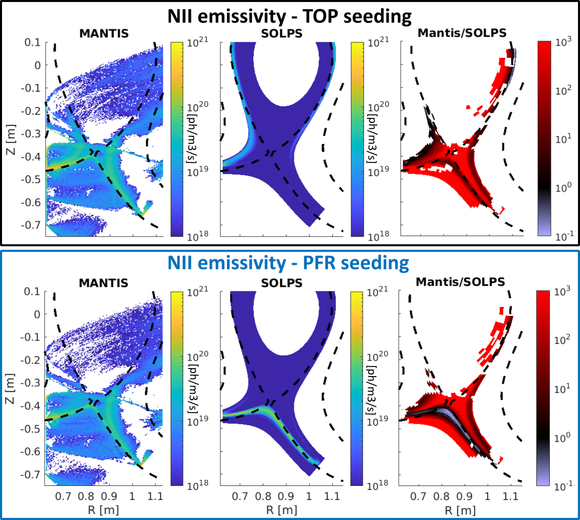
#97 Nitrogen distribution, compression and core contamination: investigation of seeding location, L/H-mode, dynamic behavior
Proponents and contact person:
Riccardo.morgan@epfl.ch , ryoko.osawa@ukaea.uk et al.
Scientific Background & Objectives
SOLPS simulations predicting very different behavior in impurity distribution for different poloidal seeding locations
Experimental indications of toroidal asymmetries caused by non axisymmetric (localized) impurity seeding
Uncertainty on impurity transport timescales and recycling coefficient
Investigate the role of seeding location on impurity distribution/compression, access to detachment and core contamination in H-mode
Compare experimental measurements, including the 2D emission distribution, to SOLPS predictions
Obtain estimates of impurity transport timescales and recycling coefficient
Assess different behaviour of heavier impurities
Experimental Strategy/Machine Constraints and essential diagnostic
Repeat same LSN, H-mode shot while changing poloidal location of seeding valve: PFR (v8), TOP(v2), LFS(v6), HFS(v4).
- Compare nitrogen emission with MANTIS, bolometry, DSS
- Compare effects on heat fluxes with LPs, IR camera
Repeat same LSN, L-mode shot while changing toroidal location of seeding valve: toroidal angles 48, 111, 214, 310 (4 shots + 1 for reproducibility)
- Compare fixed diagnostics signal with changing seeding location
Compare the shots with new and/or existing SOLPS-ITER simulations
Repeat 3-4 selected discharges while changing the seeding time trace
Repeat poloidal fuelling location scan with Ar seeding
Effort initiated in 2025 to understand the difference observed between main gas and impurities whenever injected from different poloidal location. Proposed investigation of these effects in H-mode to be prioritized.
P1-TCV-2026
P2-MAST-U-2026
Proposed pulses
Device | # Pulses/Session | # Development
AUG
MAST-U | 4
TCV | 30 | 30 (including wall cleaning)
WEST

Slide 15
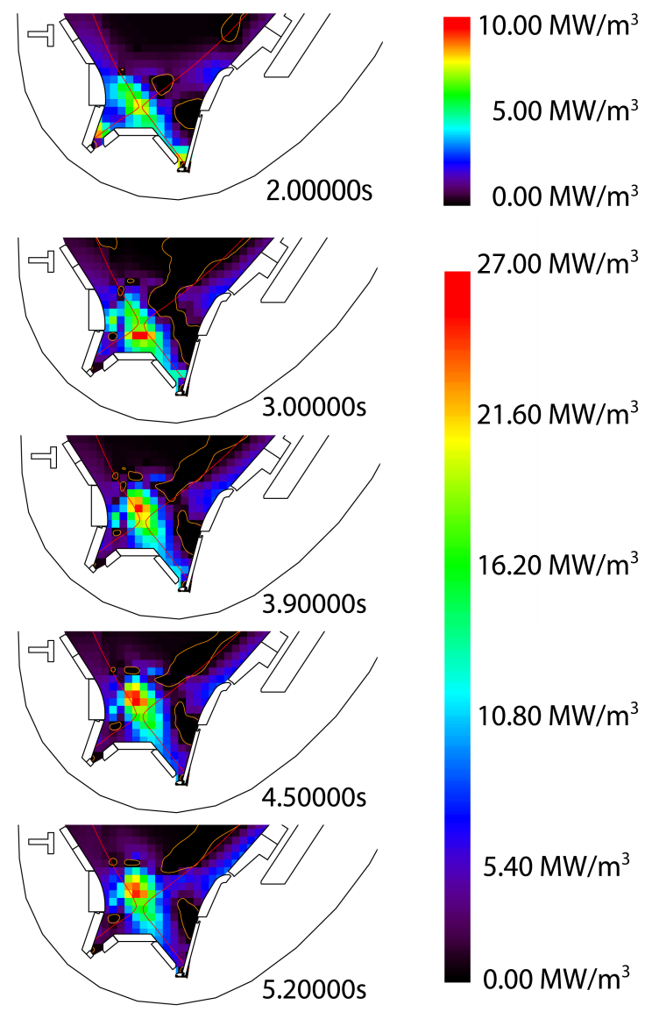
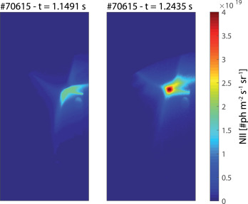
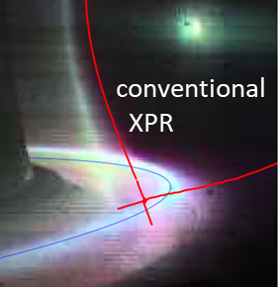
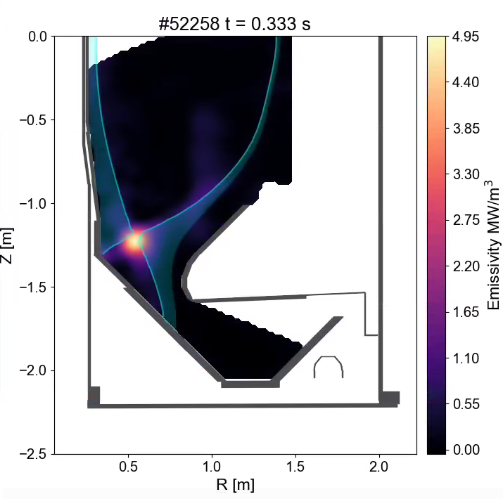
#98 - XPR: Extension of operational space and increase of performance
Workhorse proposal aiming to expand operational space in all the 4 devices, targeting better H-mode confinement or at least document confinement limits
Clear path identified in all the 4 devices.
Suggested synergies with proposal #92
P1-AUG-2026
P1-MAST-U-2026
P1-TCV-2026
P1-WEST-2026
Proponents and contact person:
Matthias Bernert, Stuart Henderson, Holger Reimerdes, Nicolas Rivals, Pierre David, Nicolas Fedorczak, Eléonore Geulin, M. Czarski, R. Mishra, K. Shingh, C. Theiler, Y. Wang
Scientific Background & Objectives
XPRs exist at AUG, TCV, WEST & MAST-U, with different access conditions among devices
The operational range in all machines should be extended, and scenarios need to be optimized for performance (AUG/TCV/MAST-U: minimize confinement time reduction in H-mode, WEST: maximize confinement increase in L-mode)
This will be tried to overcome by avoiding internal modes (AUG) and apply common tools to increase confinement (shaping, reduced gas puff, wall clearance) across machines
Operational space extension:
TCV: new control with MANTIS, higher power, Ne development
WEST: high plasma current scan, high density (+ECRH) scenarios, Argon development
Performance optimization:
Triangularity variations : AUG, TCV, MAST-U (incl. squareness), WEST
Upper divertor clearance scan (unscreened W source): WEST
Lower fueling: AUG
Experimental Strategy/Machine Constraints and essential diagnostic
Cross machine experiment, specific parameters for each device listed on wiki page
Proposed pulses
Device | # Pulses/Session | # Development
AUG | 6 | 6
MAST-U | 6
TCV | 20
WEST | 5 sessions

Slide 16
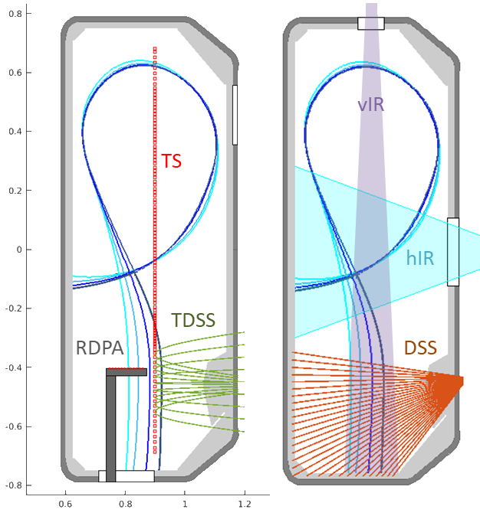
#99 - Flow characterization in the Scrape-Off Layer
Address important gap in present SOL understanding, particularly relevant for impurity transport/screening in the SOL. Potentially feasible in piggy-back for both devices. Important to ensure the indicated block-2 in strongly heated L-mode or H-mode.
P2-TCV-2026/PB
P2-MAST-U-2026/PB
Proponents and contact person:
richard.ducker@epfl.ch
massimo.carpita@epfl.ch
m.j.h.cornelissen@tue.nl
alysee.khan@epfl.ch
Scientific Background & Objectives
Perform multi-device (TCV, MAST-U) characterization of the parallel plasma flows along the SOL in L-mode and H-mode.
Evaluate the influence on parallel flows in the SOL for
divertor regime (attached / detached), closure & pumping
detachment strategy: seeded impurity and fuelling location
Experimental Strategy and essential diagnostics
L-mode for best-diagnosed scenario to develop an in-depth understanding of the physics and testbed for diagnostics:
TDSS – including new LoS arrangement
CIS – benchmark new diagnostic for 2D flows
RDPA – 2D Langmuir and Mach probe measurements
MANTIS & TS – 2D plasma quantities
FReDi – electron, ion temperature and Mach number upstream radial profiles
ECH heating to characterize divertor flows for reactor-relevant divertor conditions.
FReDi
Proposed pulses
Device | # Pulses/Session | # Development
AUG
MAST-U | 10
TCV | 20
WEST

Slide 17
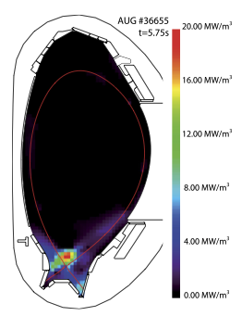
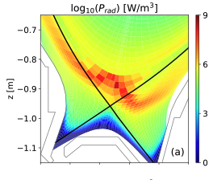
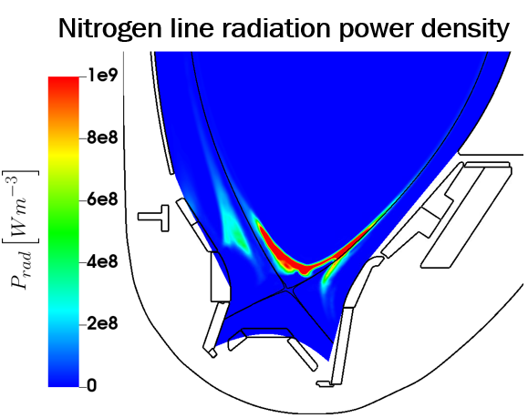
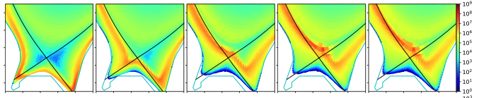
#100 Characterization of the X-point radiator with horizontal and vertical equilibrium sweeps in H-mode
Proposal aimed to increase diagnostic coverage using DTS by performing horizontal and vertical sweeps of the XPR position to further constrain the modelling.
P2-AUG/PB
To be explored if they can accommodated at the end of XPR main proposals
Y.-C. Liang private communication
M. Bernert et al 2021 Nucl. Fusion
O. Pan et al 2023 Nucl. Fusion
Proponents and contact person:
Mate Szucs mate.szuecs@ipp.mp.de
Yu-Chih Liang, Sven Korving, Matthias Bernert, Ou Pan, Matthias Hölzl, Andres Cathey
Scientific Background & Objectives
XPR simulations show different XPR core radiation shapes then bolometry
Deeper knowledge of the XPR core is beneficial for reduced models and predictive simulations Figs 1.-3.
Vertical sweeps help to get more accurate IDA profile reconstructions
Compare XPR core and pedestal profiles across different XPR heights and Bt strengths
Experimental Strategy/Machine Constraints and essential diagnostic
Using reference #38773, keep XPR at low height with control, develop and preform equilibrium sweeps
Repeat for higher XPR height and Bt
Compare to JOREK, SOLPS-ITER, JINTRAC results
Diagnostics: Vertical Thomson, Divertor Thomson, Helium beam, ECEI, ECE, Li-beam, CXRS
S. Q. Korving et al EPS 2025
Proposed pulses
Device | # Pulses/Session | # Development
AUG | 3 | 2
MAST-U
TCV
WEST

Slide 18
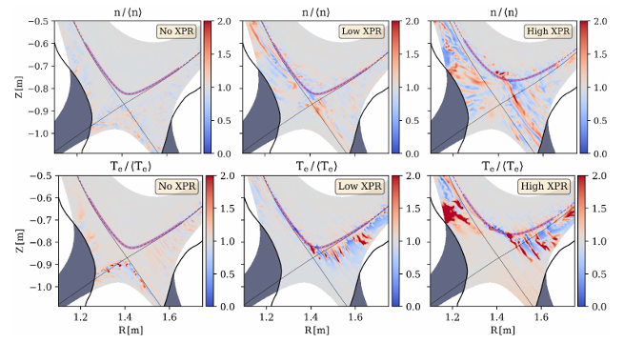
#101 Edge turbulence characterization for the XPR regime at low heating at AUG
While the low-power XPR operation might be interesting to get the entire flux profile as well as fluctuation, we suggest to consider measurements in front of the limiter, extending to higher power to infer particle and heat load in the far SOL to provide input towards first wall load (and erosion) in XPR
P1-AUG-2026 but at reduced budget
Proponents and contact person:
Y-C. Liang (Yu-Chih.Liang@ipp.mpg.de), A. Mancini, G. Grenfell, K. Eder, M. Bernert, M. Szucs, O. Pan, S. Hörmann, T. Happel, W. Fuller, W. Zholobenko
Scientific Background & Objectives
Use the high heat flux ball-pen probe heads in the midplane manipulator to characterize the edge turbulence in the XPR scenario
Use the diode bolometry to measure the fluctuations around the XPR volume
Use the X-point manipulator and the divertor thermal He beam to measure fluctuations at the (far)SOL downstream
Execute the turbulence measurements at different XPR heights (including the ELMy phase and the ELM suppressed phase)
Experimental Strategy/Machine Constraints and essential diagnostic
H-mode XPR, NBI + ECRH at low power
MEM, LFS THB, DBS, CECE: edge fluctuations measurements
AXUV: fluctuations measurements near the XPR volume
CXRS: Er measurements for comparison between low & high XPR heights
XPM, divertor THB: fluctuation measurements at (far)SOL downstream
[K. Eder et al 2025 Nucl. Fusion 65 096029]
Proposed pulses
Device | # Pulses/Session | # Development
AUG | 6 | 1
MAST-U
TCV
WEST

Slide 19
#102 - X-machine exploration of pellet fueling compatibility with X-Point Radiation (XPR) regimes
Proponents and contact person:
Scientific Background & Objectives
Operation in XPR regime is attractive for a Fusion Power Plant
Reduces thermal fluxes on the wall
Enhances plasma confinement
Operation at high density and using pellet for fueling is mandatory for powerplant
Objective - Establish whether XPR can be sustained under pellet fuelling and the impact on :
Plasma confinement
Thermal fluxes on the divertor
Core impurity levels
Assess the feasibility of achieving high density during XPR using pellets
Experimental Strategy/Machine Constraints and essential diagnostic
Reference N2 XPR (58089) for WEST and standard LSN scenario with a well established XPR at 2 different heights for ASDEX.
Fire pellets from HFS + notching 50ms (for WEST- because of LH) make a frequency scan for pellet injection
Fire pellets from LFS
Diags : Plasma density & wall temperature, (bolometry, VUV, SXR, Infrared), W sources (visible spectroscopy), Langmuir probes, ECE, reflectometry, high speed camera in front of pellet injection point
XPR compatibility with pellets (as perturbative events) shown on JET. Not for pellet fuelling discharges
Might be planned in part of the discharge if feasible
P1-WEST-2027
P2-AUG-2027
Contact: Eléonore GEULIN eleonore.geulin@cea.fr
Nicolas RIVALS nicolas.rivals@cea.fr
Nicolas FEDORCZAK nicolas.fedorczak@cea.fr
Louis FÈVRE louis.fevre@cea.fr
Hao YANG hao.YANG@univ-amu.fr
Matthias BERNERT matthias.bernert@ipp.mpg.de
Proposed pulses
Device | # Pulses/Session | # Development
AUG | 4 / 1 session
MAST-U
TCV
WEST | 15 / 1 session | (included in session)

Slide 20
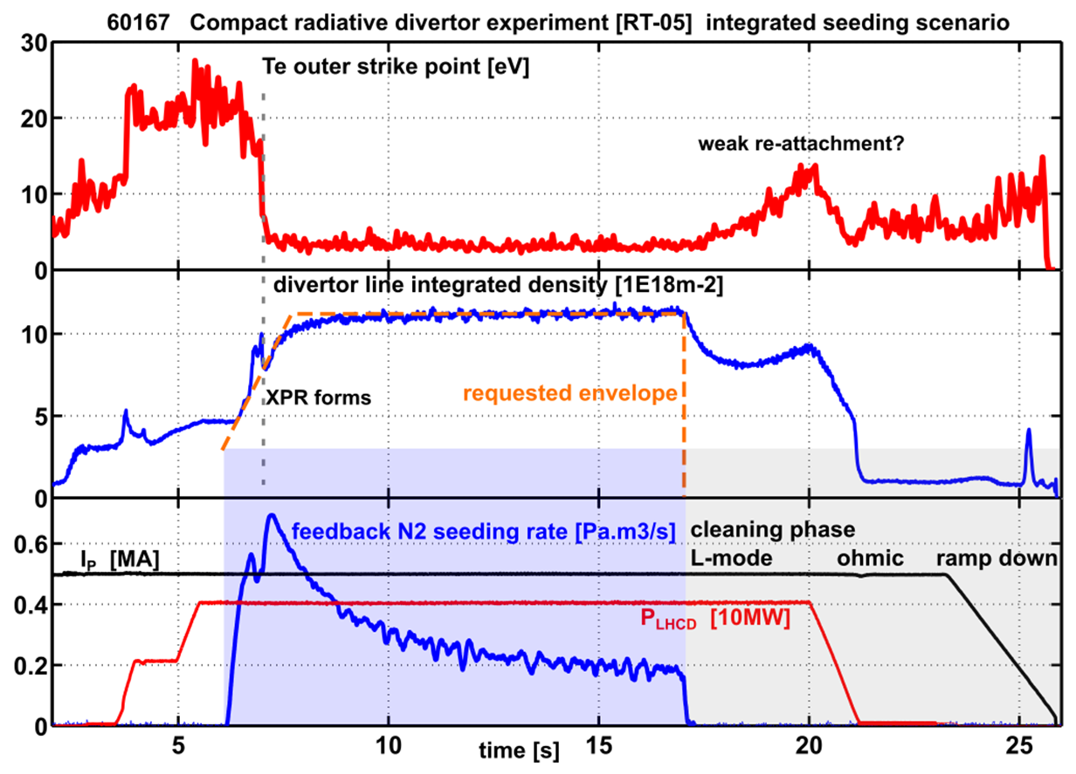
#103 - Integral XPR scenario from X-Point formation to current ramp-down at WEST – Towards “Zero divertor erosion scenarios”
Proposal aiming to extend operational space of XPR during current ramp-up. Likely to be shot consuming to fine tuning of the controller.
P1-WEST-2027
Proponents and contact person:
Nicolas RIVALS (nicolas.rivals@cea.fr), Nicolas FEDORCZAK, Eléonore GEULIN, Louis FÈVRE, Hao YANG
Scientific Background & Objectives
The XPR regime at WEST has shown to reduce divertor tungsten sources drastically (by factors up to 50)
Current XPR scenarios still involves an attached phase at the start: erosion at scenario start.
AUG showed an XPR sustained through the L-H transition.
Objective: develop scenario to maintain XPR during power ramp up in WEST without reattachement ➔ XPR state with non-eroding divertor from end-to-end.
Controller envelope shape development
Assess whether envelope is compatible with several injected power levels (2 MW, then 4 MW, LH power)
Experimental Strategy/Machine Constraints and essential diagnostic
Restart from scenario from pulse WEST #62352, with controller envelope, and scan shape. If fails, go back to feedforward forms.
Possible summary figures
Avoid attached start
Proposed pulses
Device | # Pulses/Session | # Development
AUG
MAST-U
TCV
WEST | 1 session (15 pulses) | Included in session

Slide 21
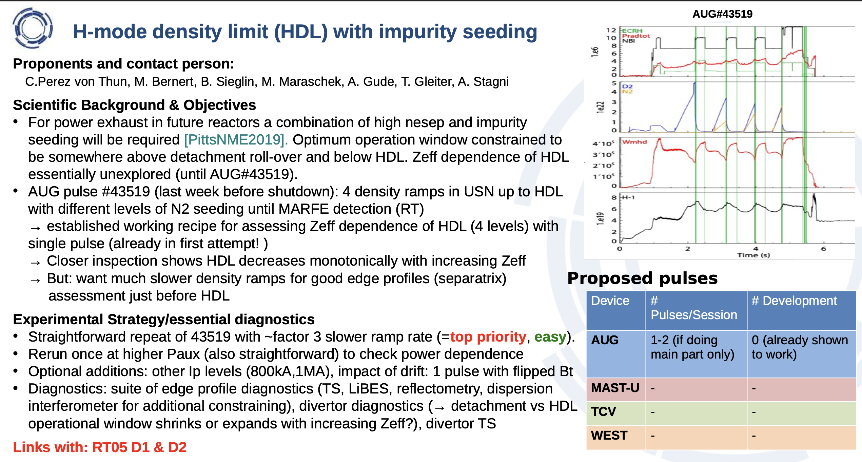
#104 - H-mode density limit with impurity seeding
To be combined with proposal #106 and partially with proposal #96. Overall effort towards establishment of Zeff effect on separatrix/near/far SOL transport (and turbulence).
P1-AUG-2026

Slide 22
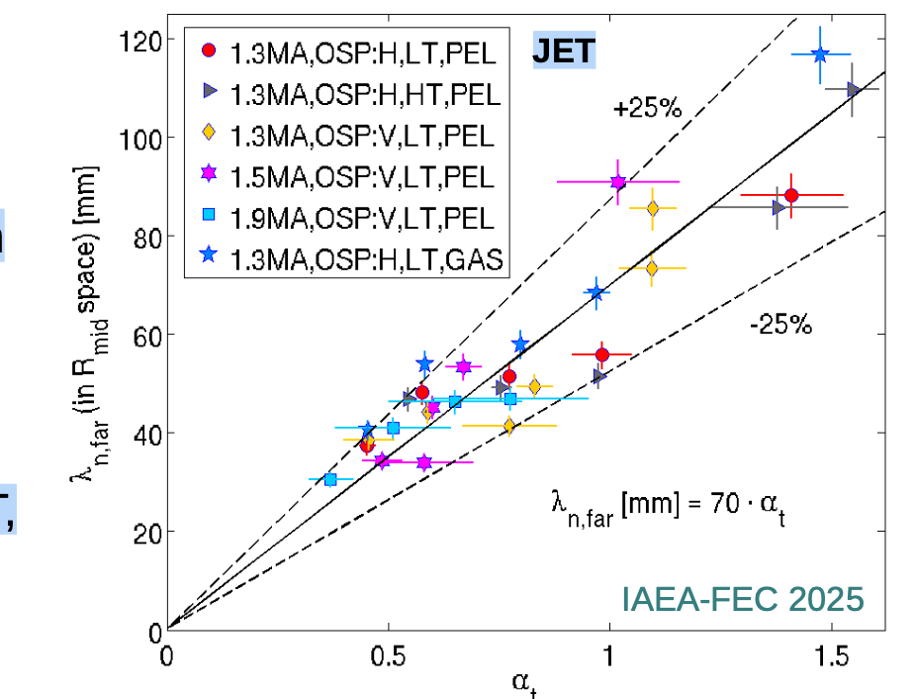
#105 - Cross-machine scaling for far-SOL density decay with metallic walls (unseeded)
Proponents and contact person:
C.Perez von Thun, A. Stagni, N. Rivals, R. Mitteau, Y. Corre
Scientific Background & Objectives
Main chamber could far outweigh other W sources in ITER but strongly depends on background plasma assumptions [PittsNME2025]
Need to find a way to extrapolate far-SOL density flattening from current devices to ITER to correctly predict main chamber W-source
Correlation between flattening and turbulence parameter αt,sep found on TCV, AUG, JET. On AUG, αt,sep unifies QCE and std H-mode wall fluxes [Redl NF2024]. On JET, diverse H-mode dataset follows unified scaling with αt,sep [von Thun IAEA 2025].
To capture machine size in unified scaling, need to combine far-SOL data from different devices.
Experimental Strategy/essential diagnostics
Use consistent profile / separatrix / α_{t} / λ_{n},far evaluation methodology for all machines
Test/expand suitability of multimachine-scaling also to L-mode (α_{t} captures implicitly?)
For AUG, JET and tentatively (non-metallic) TCV: rely on existing/new parasitic far-SOL data (Li-beam, reflectometry, TS,...)
At WEST: run "standard" LSN scenario and build far-SOL profiles and FW heat fluxmeasurements. Scan the position of the outboard mobile antenna limiter equipped with pecker Langmuir probes. Vary limiter position from far away to flush with antenna. Combine with RCP measurements and reflectometry.
Links with: RT05 D2 & D3, ITPA DSOL-34
Need first the establishment of a robust H-mode on WEST with fuelling scan capabilities. Might be considered as piggy back in 2027 once this is establishment. The cross-device database collection should be encouraged as data-mining/piggy back since beginning of 2026
P2-WEST-2027
Device | # Pulses/Session | # Development
AUG | Existing/parasitic
MAST-U
TCV | Existing/parasitic
WEST | 1 session (15 pulses) | Included in session

Slide 23
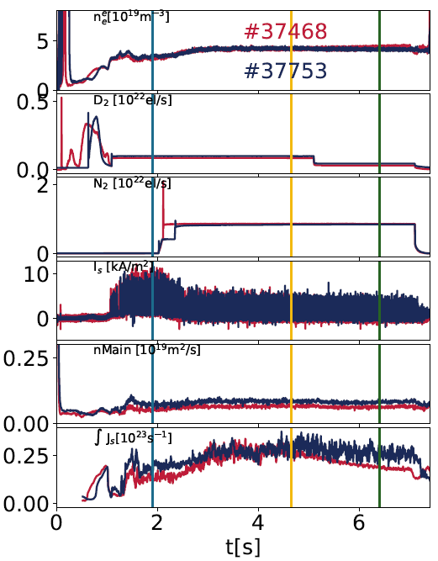
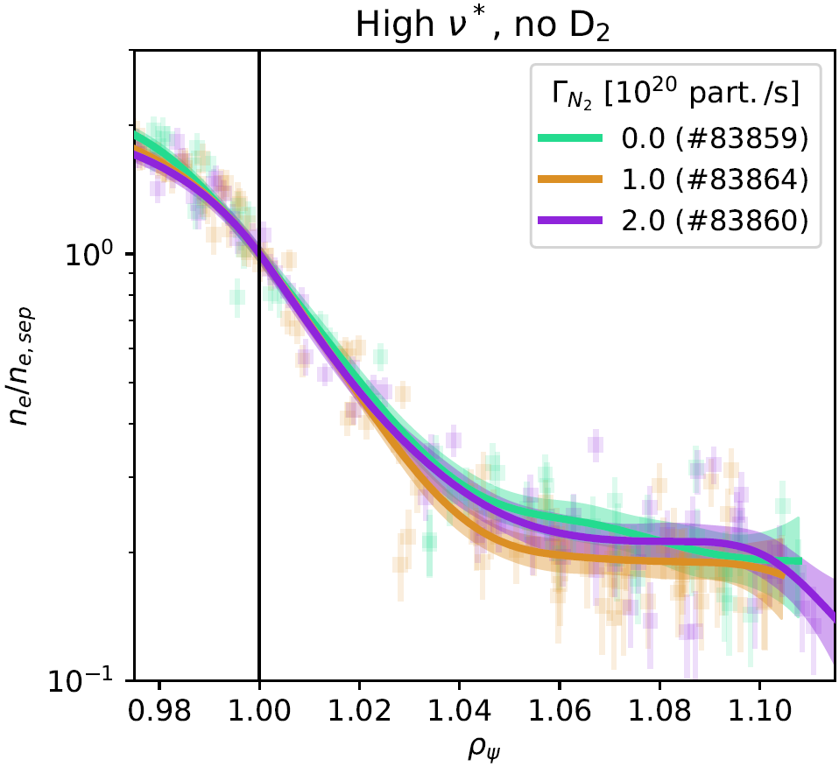
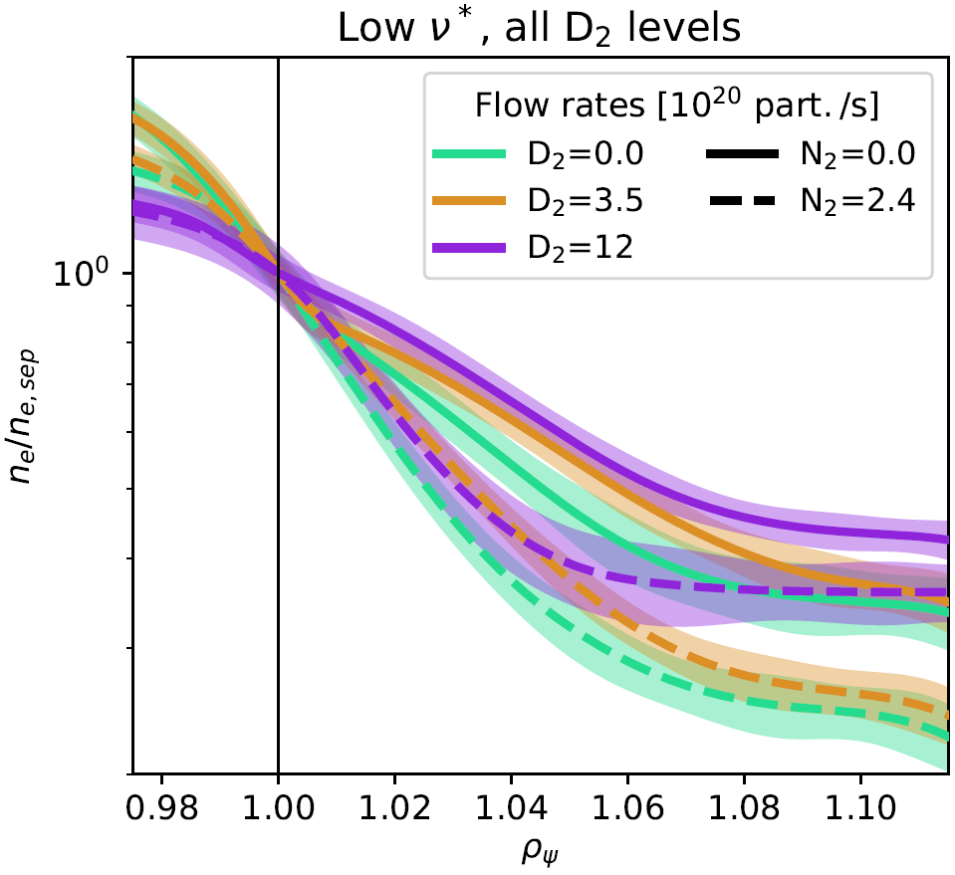
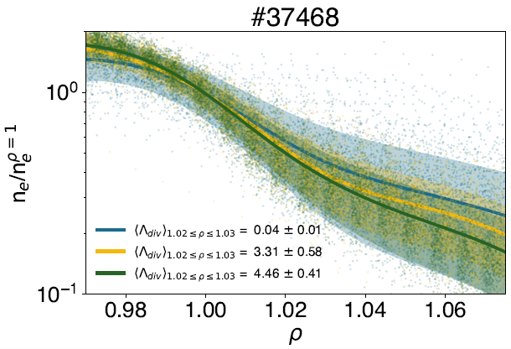
#106 - Seeding effect on scrape-off layer profiles and fluctuations
AUG
TCV
Proponents and contact person: adriano.stagni@igi.cnr.it et al
Scientific Background & objectives
Impurity seeding essential for H-mode detachment, but understanding of its effect on SOL properties is missing
In TCV observed little effect of N2 seeding on SOL density decay in high density, medium power type-I ELMy scenario whereas significant profile steepening and shoulder mitigation at low density, high power
Unclear how seeding affects upstream parameters and plasma conditions, effect of edge Z_{eff} not quantified yet
Goal: disentangle the role of main gas and impurity seeding injection rates on SOL profile and fluctuation properties, comparing LSN vs USN in AUG
Experimental Strategy/Machine Constraints and essential diagnostic
Experiments on AUG, 0.8MA/2.45T scenario: 6 shots
4 LSN discharges at fixed D2 gas + N2 injection rate in steps including initial unseeded reference phase
2 USN repeats of the previous scheme at lowest and highest D2 levels
Diagnostics: all the main edge and SOL systems for profiles and fluctuations, spectroscopic data for impurity distribution
To be combined with proposal #106. Overall effort towards establishment of Zeff effect on separatrix/near/far SOL transport (and turbulence).
P1-AUG-2026
High density, medium power
Possible summary figures
Low density, high power
Proposed pulses
Device | # Pulses/Session | # Development
AUG | 6 | 0

Slide 24
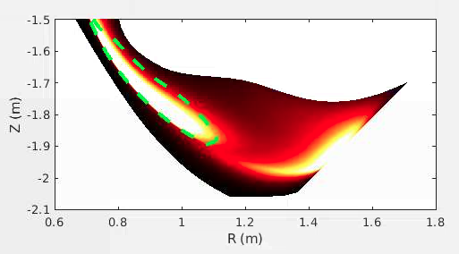
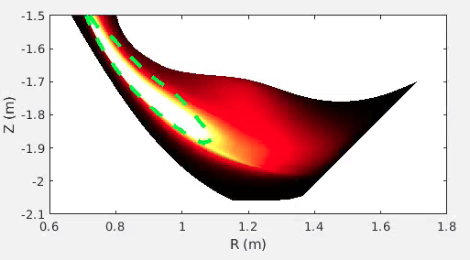
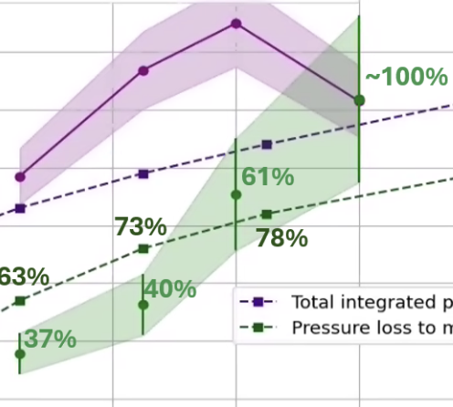
#107 Investigating the impact of plasma-neutral interactions on detachment
SOLPS-ITER simulations [D. Moulton, et al.]
D* emission -> Plasma-molecular reactions
Reproduced with improved rates [Verhaegh, et al. 2024, NF; arxiv]
New rate
Default rate
Most of the proposal is likely to be done parassitically ensuring enough diagnostic coverage, with possible repeat to complete the dataset. The only different experiment is on MAST-U with C2D4 impurity injection
P2-MAST-U-2026
Pressure
Proponents and contact person:
K. Verhaegh, E. Pawelec, et al.
Scientific Background & Objectives
Last year: both plasma-molecule collisions and reactions play a critical role on detachment and model comparisons/improvements
Errors molecular CX rate further solidified -> corrections needed for simulations ITER & beyond
Limited data on metallic machines, in higher power conditions
Experimental Strategy/Machine Constraints and essential diagnostic
CD₄ puffs in MAST-U to delineate impact carbon wall and put TCV & MAST-U results in perspective
Use molecules as a sensor for kinetic effects and validate against kinetic codes (REMKiT1D)
Long-pulse molecular transport in metallic devices on WEST using D2 Fulcher emission
Work towards porting TCV & MAST-U results to metallic machines, starting with synthetic diagnostics & data-mining
Work towards porting this sophisticated analysis to XPR regimes to investigate the roles neutrals play in XPRs
Da
Ion/molecule collisions -> power/momentum losses [Osborne, et al. NF 2025 ]
Upstream pressure Pressure loss ion-mol. collision
Core Density
Proposed pulses
Device | # Pulses/Session | # Development
AUG | ? (<4) | 0
MAST-U | 4 | 0
TCV | 0 (TBLLD RT07) | 0
WEST | 5-10 | 0

Slide 25
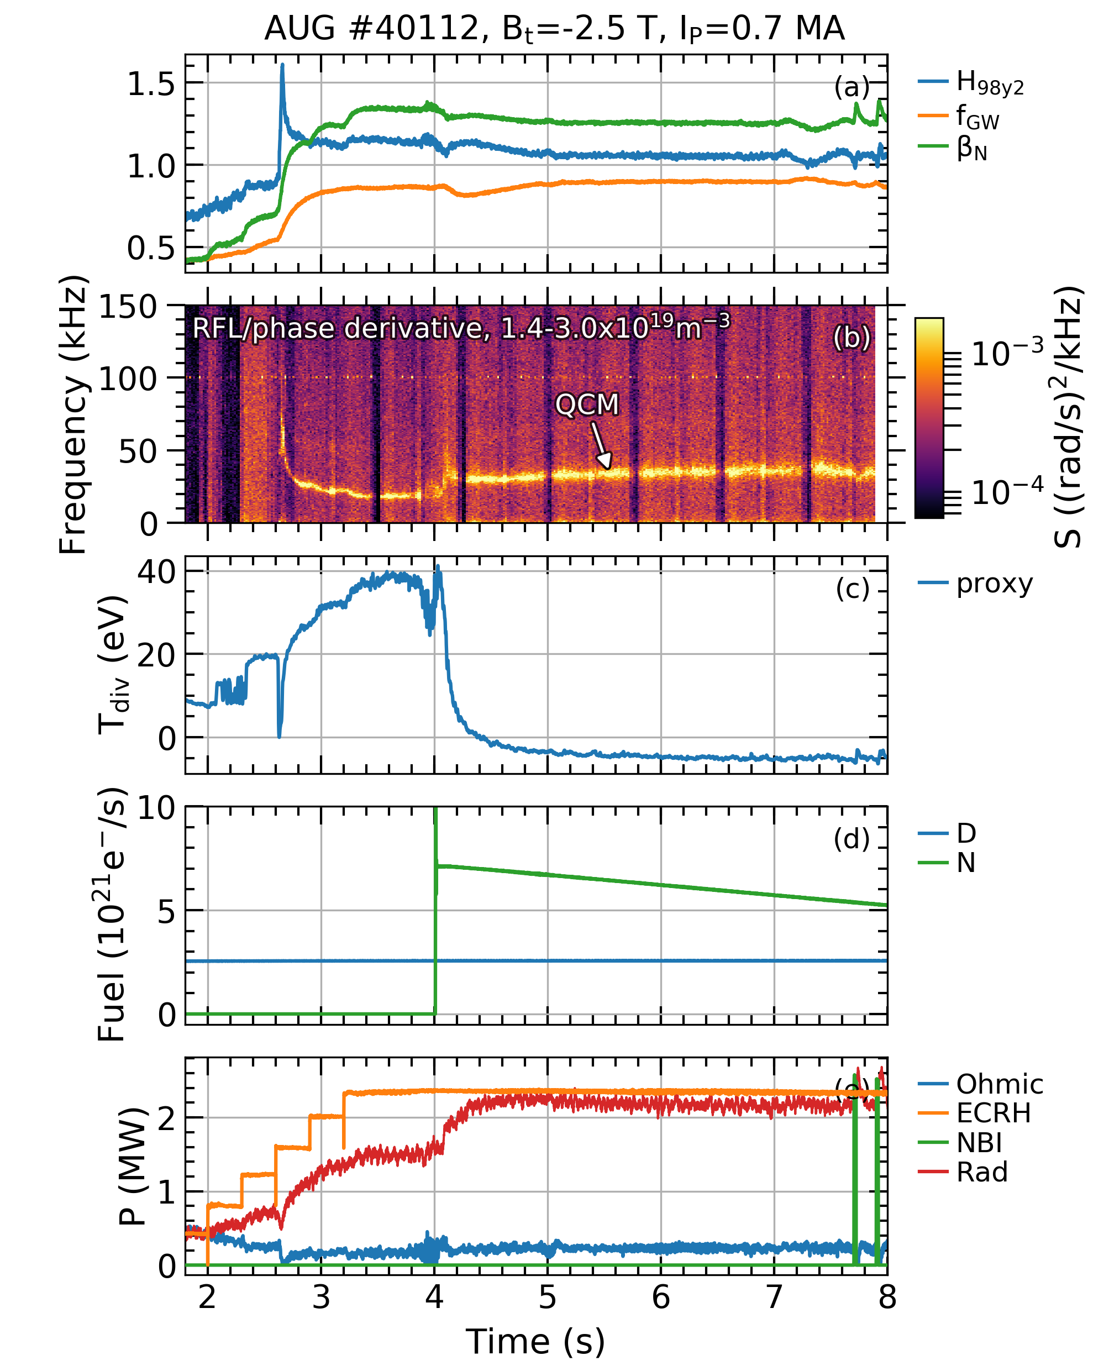
#108 Detachment control in EDA H-mode
Proponents and contact person:
L. ​‎Gil (luis.gil@tecnico.ulisboa.pt), M. Bernert, D. Brida, G.D. Conway, M. Faitsch, C. Silva, ...
Scientific Background & Objectives
EDA H-mode: promising no-ELM regime, compatible with impurity seeding
However:
Feedforward seeding for detachment not applicable to reactors
Shunt current feedback not possible with fully detached divertor
Main objectives (more on the wiki):
Demonstrate real-time, XPR-control of EDA H-mode detachment for the first time
Investigate the effect of seeding on the EDA power window and extend it to higher P_{sep}/R
Develop robust EDA scenarios with different impurity mixes for future exploitation
Experimental Strategy/Machine Constraints and essential diagnostic
High δ, dominant wave heating (mostly ECRH), N/Ar/Ne seeding:
Feedforward seeding first to adjust setup XPR controller, then real-time control
XPR height steps at constant power
Power ramps at constant XPR height
Vary D fueling levels
Try different impurity mixes
This proposal consists in demonstrating and exploiting real-time control of the detachment state in EDA H-mode with the X-point radiator controller for the first time. May be important in the qualification of different no-ELM regime but once proved the capability in feed-forward the feedback is not mandatory
P2-AUG-2026
[L. Gil et al FEC 2023]
Proposed pulses
Device | # Pulses/Session | # Development
AUG | 10

Slide 26
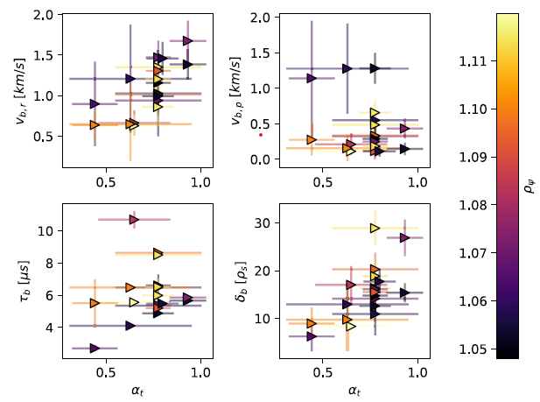
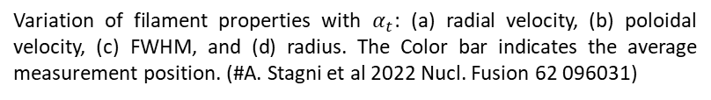
#110 - Evaluation and Comparative Study of Fluctuation-Induced Transport in the SOL and First-Wall Interaction in Different Plasma Conditions in TCV
Propose to piggy-back/data mining for not intrusive diagnostics. Might increase priorities once RP will be available. Not indicated the capabilities of RP
P2-TCV-2026
Proponents and contact person
Kaushlender Singh, Alysée Khan, Elena Tonello, Christian Theiler, Yinghan Wang, Margherita Ugoletti, Matteo Agostini, and Olivier Février
kaushlender.singh@epfl.ch
Scientific Background & Objectives
Understanding and evaluating particle and energy exhaust in the divertor and scrape-off-layer (SOL) regions of a tokamak are fundamental prerequisites for the safe and reliable operation of ITER.
We aim to evaluate fluctuation-induced radial transport in the SOL and assess its parametric dependencies in L-mode, attached, and detached plasma conditions.
We aim to extend this study to the QCE regime in both attached and detached conditions.
Experimental Strategy/Machine Constraints and essential diagnostic
Conduct gas-puff scans in L-mode plasmas, spanning the transition from attached to detached regimes, to characterize fluctuation-induced transport in the SOL.
Carry out a gas-puff scan in the QCE regime to correlate SOL parameters with the resulting particle and heat flux profiles.
Assess the extent to which first-wall interaction can be mitigated by increasing the outer wall gap, both in L-mode and in the QCE regime.
(a)
(b)
(c)
(d)
Variation of filament properties with $α_{t}$: (a) radial velocity, (b) poloidal velocity, (c) FWHM, and (d) radius. The Color bar indicates the average measurement position. (#A. Stagni et al 2022 Nucl. Fusion 62 096031)
Proposed pulses
Device | # Pulses/Session | # Development
AUG | 0 | 0
MAST-U | 0 | 0
TCV | 22 | 0
WEST | 0 | 0

Slide 27
#111 - WEST detached L-mode plasmas at reduced Btor for the validation of turbulence simulations (RT05)
To be understood what already availableas reference scenario for modelling validation on WEST. If not piggyy back on main scenarios at different recycling condition. Do we really need reduced Btor also in view of modelling optimization under TSVV-B?
P2-WEST-2027
Proponents and contact person:
Diego Sales de Oliveira (diego.salesdeoliveira@cea.fr)
Jorge Morales, Guido Ciraolo, Patrick Tamain
Scientific Background & Objectives
- Develop a stable L-mode WEST detached plasma at reduced Btor optimized edge diagnostic coverage for modeling
- Produce a dataset for the validation the first edge turbulence simulations of WEST using SOLEDGE3X
- Characterize the turbulent transport in the simulations and compare with DBS and RCP measurements
- Quantify turbulent flux arriving at first-wall PFCs and possible implications for operation
- Assess the parallel and perpendicular mechanisms underlying the power exhaust and confirm the code predicitions with experiments
Experimental Strategy/Machine Constraints and essential diagnostic
Start from the reference discharges LSN 1.9T/300kA (60208,60117+more) and change magnetic geometry parameters and current gain stability
Once stable, perform a density scan step letter to acquire data at different levels of detachment
Langmuir probes in the max and min probe locations, DBS, RCP, McPherson, TS, spectroscopy, IR
Possible summary figures
Proposed pulses
Device | # Pulses/Session | # Development
WEST | 5 | 10

Slide 28
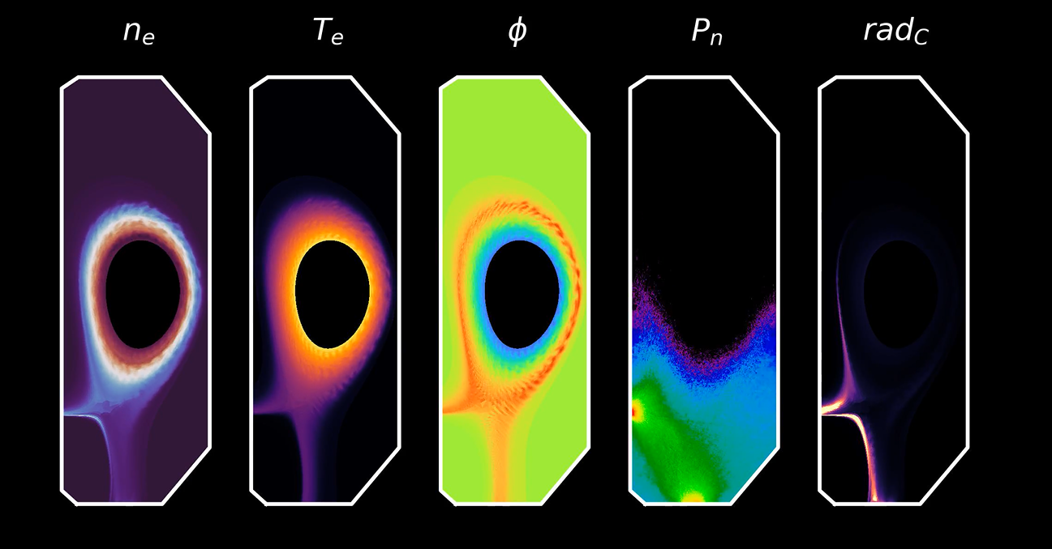
#112 - First-principles investigation of boundary turbulence in seeded detached plasmas in the TCV-X21 scenario
Full dataset collection supported. Not if the mentioned code are already capable of self-consistent treatment of impurity species. If so will be good to discuss this within RT05 team
P1-TCV-2026
Proponents and contact person:
Diego Sales de Oliveira (diego.salesdeoliveira@cea.fr)
Hugo Bufferand, Patrick Tamain, Guido Ciraolo, Christian Theiler, Paolo Ricci, Holger Reimerdes, Riccardo Morgan, Giuseppe Drago
Scientific Background & Objectives
- Achieve a seeded detached TCV-X21 scenario and produce an extensive dataset for turbulence validation
- Validate the first edge turbulence simulations to assess the predictive capabilities of the code
- Investigate the on the filament transport activity in seeded plasma
- Determine the amount of impurities transported by cross-field turbulent transport and its direct impact on detachment
- Determine if divertor-localized filaments in the X-point region represent important for core contamination
Experimental Strategy/Machine Constraints and essential diagnostic
Start from a reference shot in the TCV-X21 scenario in sheath-limited conditions and perform a N ramp to observe detachment
Take the nitrogen flow value for the detached plasma and perform an FF injection in both field directions
Discharges performed with (ideally) LILO baffles to increase divertor closure and facilitate detachment; we didn’t observe a clear roll-over in the unseeded detachment attempts in the TCV-X21 and TCV-X23 cases
Repeat the shots to have the LPs in different operational modes and to collect data for statistics
Proposed pulses
Device | # Pulses/Session | # Development
WEST | 15 | 4

Slide 29
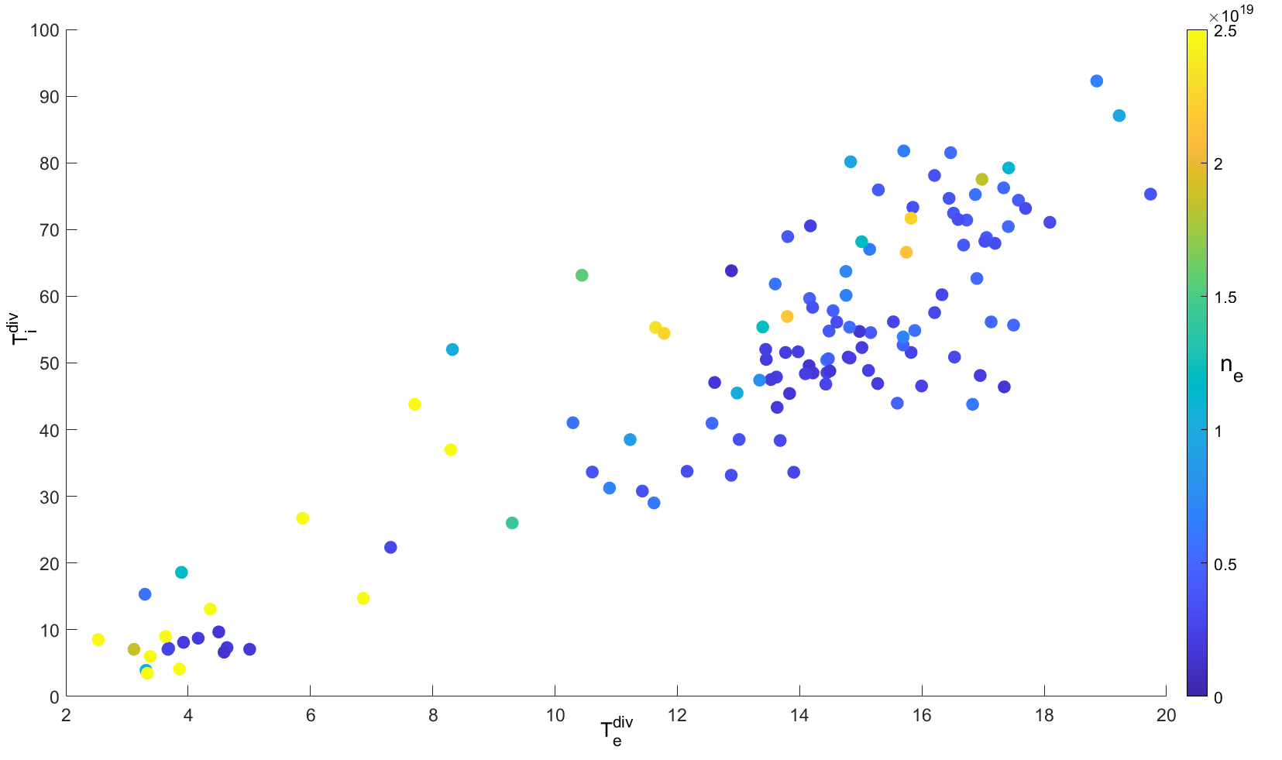
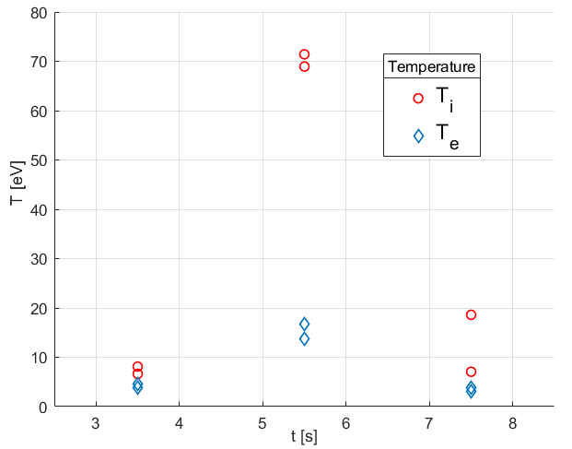
#113 - Divertor Ti profile in XPR
RT05: Physics of divertor detachment and its control for ITER, DEMO and HELIAS operation
Should not be the primary focus of the XPR session, but sweeping/SP movement to collect the profile on Ti might be envisage proposed during the session
P2-WEST-2026
Proponents and contact person:
Miglena Dimitrova (dimitrova@ipp.cas.cz ), Jernej Kovačič, Pavlina Ivanova, Bianca De Martino, Jamie Gunn, Tomaž Gyergyek
Scientific Background & Objectives
XPR reduces W sources in WEST tokamak and is suitable for long pulse operation (already several 10s of seconds).
Using divertor RFA and LPs retrieve Ti and Te profiles pre-, during and post-XPR regime at various levels of LHCD power.
Experiment addresses deliverable D3.
Experimental Strategy/Machine Constraints and essential diagnostic
LH power scan with LSN
RFA is fixed at MB#28/#29-> use fixed strike point with power ramp
Next shot move the strike point position to obtain radial profile of Ti and Te
4-5 radial points needed to define Ti decay length (profile)
Needed: RFA + LP + Pecker probes + IR
Possible summary figures
detached
Fig.: T_{i}^{div}/ T_{e}^{div} (up) database with density colorbar;
Radial profile of T_{i}^{div} and T_{e}^{div} for WEST during #61357 – XPR @7.5 s (left)
XPR
Proposed pulses
Device | # Pulses/Session | # Development
AUG | - | -
MAST-U | - | -
WEST | 15 pulses / 1 session | 2 pulses

Slide 30
Summary of P1 and budget proposal
 | AUG |  | TCV |  | MAST-U | WEST
 | 2026 | 2027 | 2026 | 2027 | 2026 | 2026 | 2027
Tentative allocation | 24 | 26 | 70 | 110 | 24 | 30 | 30
Total proposed | 137 |  | 189 |  | 74 | 213
Scientific/dev. | 101/36 |  | 135/54 |  | 62/12 | 194/19
P1 proposals | #88, #95,#96, #98,#101 #104 #106 | #92 | #89,#95, #97, #98, #112 |  | #91, #96, #98 | #98 | #102, #103

Slide 31
JET analysis plan RT-05
Focused on mixed Ar+Ne seeding:
Analysing Ar & Ne core concentrations – Ash Patel
Analysing Ar & Ne div. concentration – S.Henderson
Compression analysis – A.Patel & S. Henderson
Mixed Impurity modeling SOLPS – Ou Pan
Offset between different impurity species
Radiation distribution (Lz curves with transport)
Document (technical?) limits for Ar & Ne seeding – M.Bernert ->PSI
Start of integrated modelling – P.Manas/S.Korving
Pellets in XPR – M.Bernert/E.Geulin?
Strongest missing points:
Edge modelling of XPR and its onset
Pedestal analysis – Why does the pedestal not degrade in ELM suppression
Main chamber SOL characteristics
Integrated modelling?
TRANSP modelling
Calculation of ITG stabilization by impurities
It’s the biggest dataset of mixed impurity seeding existing (including DT discharges)!
Join us to help understanding it!

Slide 32
Full set of open points of analysis
Impurity concentrations and their comparison between species
Trade-off between Ne and Ar: optimal ratio / changes to plasma
Is there a benefit of the mixes vs single impurity
Edge modelling:
Mixed Seeding
Comparison of N, Ne, Ar
XPR vs onset
DT – isotope effects (with seeding)
Time dependent modelling (gas cut discharges)
SOL transport (notably changes with Ar), far SOL fluxes, first wall loads
Radial electric field unseeded vs seeded
He concentrations/behavior/built-up in DT
TRANSP simulations (with correct imp. conc.)
Quantify ITG effect, turbulence behavior with high Zeff
Influence of pellets
ELM analysis: Are ELMs suppressed?
Pedestal stability analysis
Highest power pulses: Performance & comparison
Impact of XPR on confinement
partially M.Bernert
partially M.Bernert
partially M.Bernert
O. Pan
partially O. Pan
partially M.Bernert

